Slide 1
2020 Spring OER Liaisons Orientation
February 2020

Slide 2
Overview
Introduction to the ASCCC OERI
Spring 2020 Liaison Expectations
Resources Developed - Resources Recently Funded
OER “Collections”
Website – coming soon!
Your needs?

Slide 3
ASCCC OERI
A 5-year project to implement OER systemwide by coordinating state level activities to increase OER availability and supporting local OER implementation.
At the end of the initial project period, the structure and accomplishments of the OERI would be evaluated and future funding needs identified.

Slide 4

OERI Structure
Notes:
We’re creating a web…

Slide 5
OERI Faculty Coordinator
Michelle Pilati
  Psychology, Rio Hondo
Notes:
We’re creating a web…

Slide 6
OERI Regional Leads
Dave Dillon
  Counseling, Grossmont
Shagun Kaur
  Communication Studies, DeAnza
Jennifer Paris
  ECE/CD, College of the Canyons
Amanda Taintor
  ECE/CD/ID, Reedley
Suzanne Wakim
  Biology, Butte

Slide 7

OERI Structure
Regional Leads
  Discipline Leads
  OER Liaisons
Communication
  List-servs
  Webinars
  Canvas space
  Surveys
  Coming soon - Website

Slide 8
OERI’s Goal?
Increase the use of open educational resources in lieu of commercial texts by all reasonable means available.
What does that mean?

Slide 9

Photo by Lukas from Pexels
Notes:
We could use force to bring faculty and colleges along...

Slide 10

Photo by Sharon McCutcheon from Pexels
Notes:
We could bribe you with donuts...

Slide 11

Photo by from Pexels
Notes:
Or candy and flattery…

Slide 12

Photo by Linda Eller-Shein from Pexels
Notes:
Or would could create conditions that make you want to join the party….

Slide 13
Increase OER Use By…
Increasing awareness.
Increasing the availability of high-quality OER.
Making the adoption of OER easier.
Supporting you to help your faculty join us…

Slide 14
Spring 2020 – New/Renewed Emphases
Academic Freedom
Accessibility
Attributions
Students
Recognizing users of OER and local efforts
Use of Canvas discussions

Slide 15
Spring 2020 OERL Expectations
Sign up for the ASCCC OER listserv by selecting “ASCCC OER Initiative” at https://www.asccc.org/signup-newsletters.
Complete – and document – your Spring 2020 OER Liaison “attendance” activities by May 15. Activities should be tracked throughout the term via the Spring 2020 Liaison Tracking Spreadsheet

Slide 16
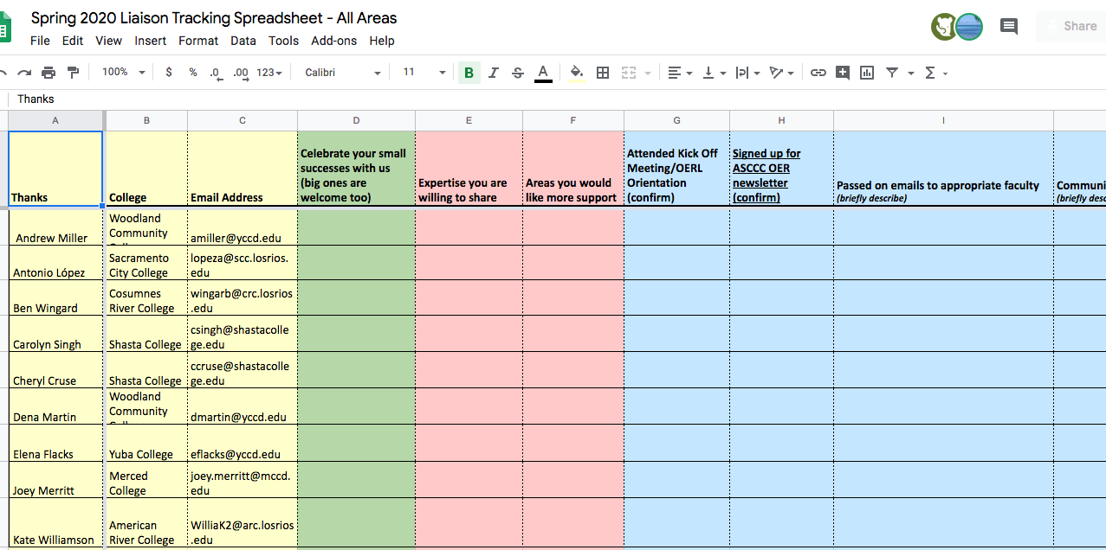
tinyurl.com/Spring2020OERL

Slide 17
Spring 2020 OERL Expectations
Attend two additional OERI Webinars or OERL Conversations during the spring term. Selected from:
  Monthly OER Liaison Webinars (varied times)
  Weekly OERI Webinars (Thursdays at 1:00), or
  “OER Liaison Conversations”
    NEW – informal conversations regarding a selected topic.
    Not archived.

Slide 18
Spring 2020 OERL Expectations
In addition to forwarding OERI’s messages to appropriate faculty, communicate with your local senate and campus faculty regarding the work of the OERI.
Check-in at least twice with an OERI representative to share local needs and issues.

Slide 19
Resources Developed - Resources Recently Funded

Slide 20
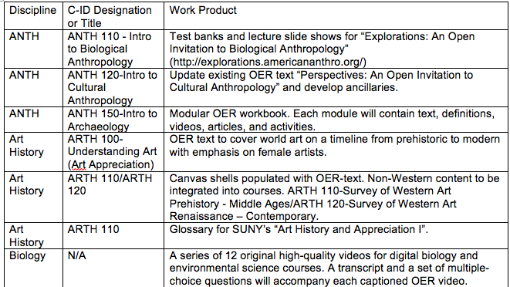
Examples of Recently Completed Projects

Slide 21
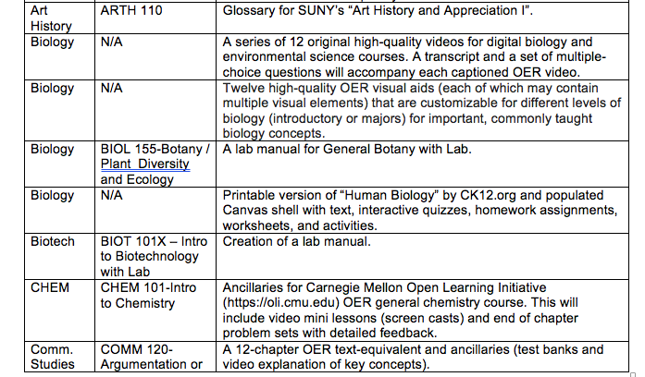
Examples of Recently Completed Projects

Slide 22
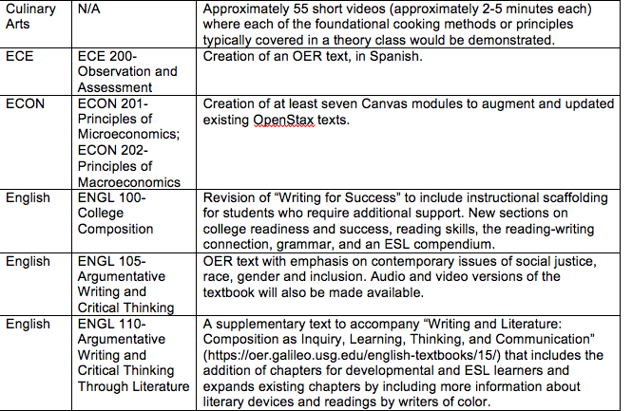
Examples of Recently Completed Projects

Slide 23
2020 RFP
Focus on resources that ultimately lead to savings for students – proposals must be tied to a specific course or courses, as opposed to general resources that support student success.
Collaboration required
Interim product required
~ Eleven months to complete
Selected projects announced last week

Slide 24
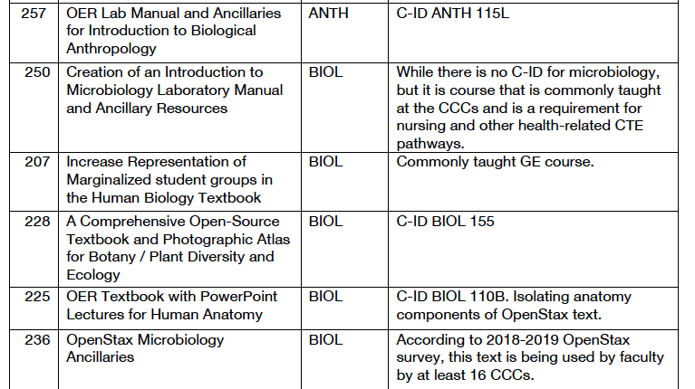
2020 RFP – Examples of Funded Projects
Funding levels separated
  Up to $10,000
  $10,001 to $20,000
  $20,001 to $30,000
  Justification for why cost is what it is must be delineated – the focus is on the cost of the work, not the impact of the product
More guidance with respect to budget
More guidance with respect to documenting impact

Slide 25
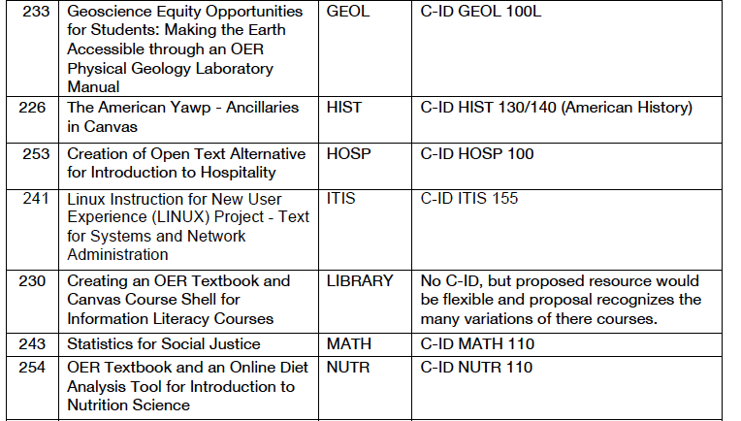
2020 RFP – Examples of Funded Projects
Training provided – possibly required – up-front:
  Creative commons licensing
  Accessibility
  Attributions
Expectations clearly communicated at the outset:
  Specifications of final product(s)
  Identified check-in points

Slide 26
2020 RFP
“Letter of Intent to Submit” – Required
Collaboration – Required
Approximately 162 unique letters received
All submitters were contacted to provide feedback and assistance
Over 60 proposals were reviewed
Approximately 24 were funded

Slide 27

OER Collections
Courses >> Degrees
Creating OER pathways that are also ZTC
Notes:
Freeing faculty and students….

Slide 28
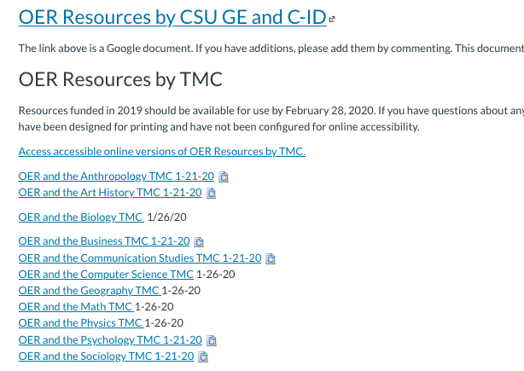
Available at tinyurl.com/OERI-TMCResources

Slide 29

OERI Website – Coming soon!

Slide 30
How can OERI help you?

Slide 31
For More Information…
Canvas Site - tinyurl.com/ASCCC-OpenEd
Notes:
Michelle

