Slide 1
CCC "Marking" of No-Cost Course Sections - An SB 1359 Update
ASCCC OER Weekly Webinar – February 13, 2020

Slide 2
Your Presenters
Michelle Pilati, ASCCC OERI Faculty Coordinator
Suzanne Wakim, ASCCC OERI Regional Lead

Slide 3
Overview
What does SB 1359 say?
How are we doing?
What can we say for certain regarding the implementation of SB 1359?
ASCCC Resolution
Topics of debate…

Slide 4
What does SB 1359 say?

Slide 5
SB 1359 (Block, 2016)
CA Education Code 66406.9.
(1) (A) Clearly highlight, by means that may include a symbol or logo in a conspicuous place on the online campus course schedule, the courses that exclusively use digital course materials that are free of charge to students (“no-cost”) and may have a low-cost option for print versions.
Notes:
(a) Each campus of the CCC and the CSU shall, and each campus of the UC is requested to, do both of the following:
(b) For purposes of this section, the following terms have the following meanings:
(1) “Course schedule” is a collection of available classes, course sections, or both, published electronically, before the start of an academic term.
(2) “Open educational resources” are high-quality teaching, learning, and research resources that reside in the public domain or have been released under an intellectual property license, such as a Creative Commons license, that permits their free use and repurposing by others, and may include other resources that are legally available and free of cost to students. “Open educational resources” include, but are not limited to, full courses, course materials, modules, textbooks, faculty-created content, streaming videos, tests, software, and any other tools, materials, or techniques used to support access to knowledge.

Slide 6
SB 1359 (continued)
(B) The course materials described in subparagraph (A) may include OER, institutionally licensed campus library materials that all students enrolled in the course have access to use, and other properly licensed and adopted materials.
(2) Clearly communicate to students that the course materials used for the courses identified pursuant to paragraph (1) are free of charge and therefore not required to be purchased.
(c) This section shall become operative on January 1, 2018.
Notes:
(a) Each campus of the CCC and the CSU shall, and each campus of the UC is requested to, do both of the following:
(b) For purposes of this section, the following terms have the following meanings:
(1) “Course schedule” is a collection of available classes, course sections, or both, published electronically, before the start of an academic term.
(2) “Open educational resources” are high-quality teaching, learning, and research resources that reside in the public domain or have been released under an intellectual property license, such as a Creative Commons license, that permits their free use and repurposing by others, and may include other resources that are legally available and free of cost to students. “Open educational resources” include, but are not limited to, full courses, course materials, modules, textbooks, faculty-created content, streaming videos, tests, software, and any other tools, materials, or techniques used to support access to knowledge.

Slide 7
Example – No-Cost Designation Below Section Number

Slide 8
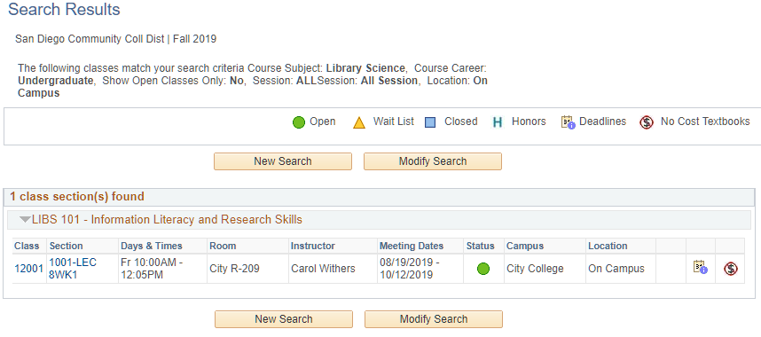
Example – No-Cost Designation – Far Right

Slide 9
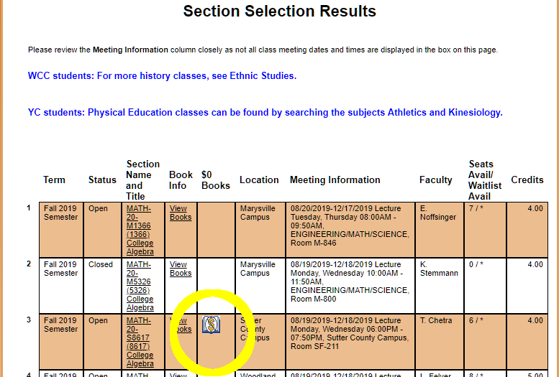
Example – No-Cost Designation – 5th Column

Slide 10
Example – No-Cost and ”Low Cost OER” Designations
Notes:
OER as “low cost”, not ZTC

Slide 11
How are we doing?

Slide 12
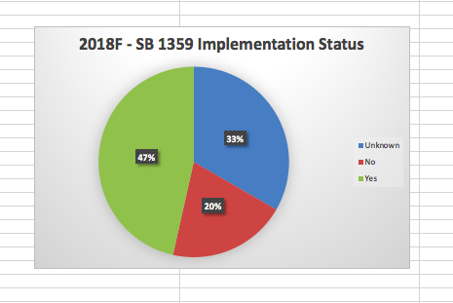
2018 Fall SB 1359 Implementation Status

Slide 13
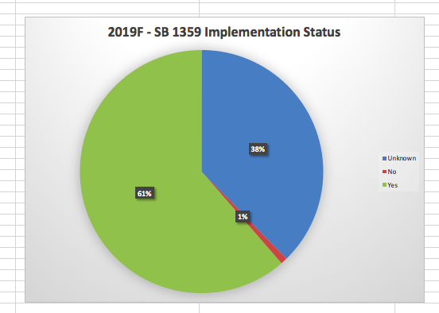
2019 Fall SB 1359 Implementation Status - Observed

Slide 14
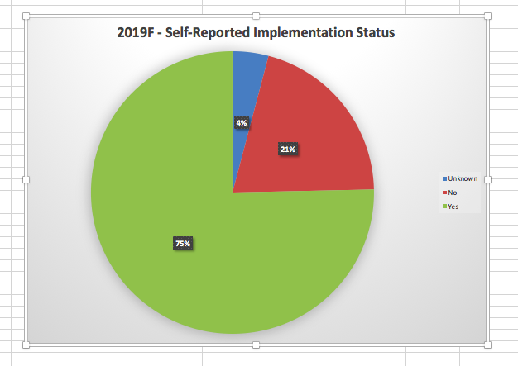
2019 Fall SB 1359 Implementation Status - Reported

Slide 15
Faculty are awesome.
Has SB 1359, the requirement that all course sections “that exclusively use digital course materials that are free of charge to students” be noted as such in your online course schedule, been fully implemented at your college?

Slide 16
“Fully” Implemented?
Photo by Suzy Hazelwood from Pexels

Slide 17
”Fully Implemented”
73 respondents
Has SB 1359, the requirement that all course sections “that exclusively use digital course materials that are free of charge to students” be noted as such in your online course schedule, been fully implemented at your college?
Yes - 42
No - 12
Yes, but… or No, but….

Slide 18
Yes – or No – but…..
Yes, we are identifying courses as ZTC (zero textbook cost) and LTC (low textbook cost) in our online schedule. However, we have had some issues this past Spring in ensuring these labels have been correctly applied. Our committee is actively working with our bookstore and course scheduler to ensure these issues are fixed.

Slide 19
Yes – or No – but are we marking all OER/ZTC sections?
Yes, we are working on it and it has been implemented. Have tracked down OER courses and updated in the catalog, and advised the department chairs of such as well as announcements at Academic Senate. But it is hard to say if ALL OER/ZTC course sections are reflected as such. Fully implemented to the extent of my knowledge.

Slide 20
Yes – or No – but I think we’re missing some.
Yes, we note this in the schedule; however, I think there are some courses that may not get reported.

Slide 21
Yes – or No – but the results are incomplete.
Procedures are in place, but rely on individual faculty reporting the status of their course, so while the process is fully implemented, the results are incomplete.

Slide 22
So….
…despite the fact that some elements of implementation are murky (or maybe because of it?), OER Liaisons are hesitant to say ”we’ve done it”.

Slide 23
“Fully implemented”
As reported:
Corrected
Yes - 42
No - 12
??? - 19
Yes - 55
No - 15
??? - 3

Slide 24
Preliminary Data - Spring 2020
Yes –
No –
??? -

Slide 25
Implementation of SB 1359
What do we know for certain?
Photo by Alexandra Novitskaya from Pexels

Slide 26
What do we know for certain?
There has to be SOMETHING in your schedule of classes consistent with the intent of the legislation.
Clearly highlight, by means that may include a symbol or logo in a conspicuous place on the online campus course schedule.
What does conspicuous mean?

Slide 27
Conspicuous
Per the Oxford dictionary:
standing out so as to be clearly visible.
attracting notice or attention.

Slide 28
What does conspicuous look like in an online schedule?
“visible”, “attracting notice or attention”
Visible when searching for classes?

Slide 29
Consistent with SB 1359?
When the student accesses the course resources, they are informed the section is no-cost?
A note in the visible comments indicating the section is no-cost?
A PDF on the website of all the no-cost sections?

Slide 30
What are OER Liaisons concerned about?
Why is there any source of uncertainty?
Photo by Marina from Pexels

Slide 31
Does ZTC = No-cost (per SB 1359)?
ZTC = Zero Textbook Cost
“ZTC” for the CCCs has been defined by the CCCCO in the context of ZTC degrees.
No associated costs for students, other than true material costs. Students may be required to purchase a calculator or supplies. ✔
Does not presume materials are digital or openly licensed. ✔
Resources may have a cost, but that cost is not passed along to students. ✔
Notes:
M
J - Consistent with SB 1359..

Slide 32
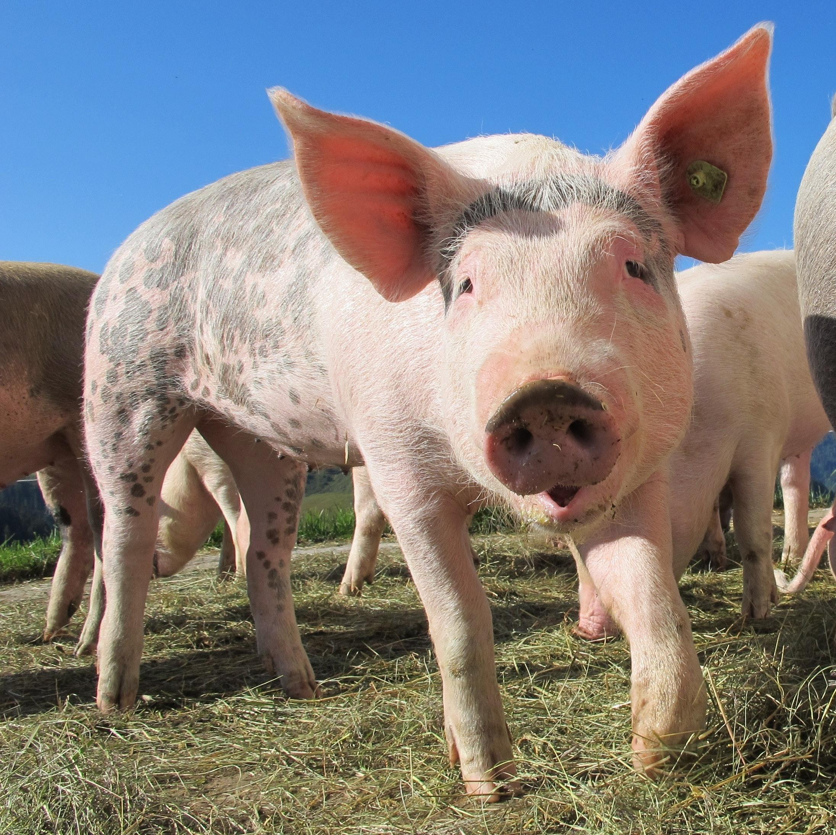
Does ZTC = No-cost (exclusively digital)?
No-cost (as defined by SB 1359) – “courses that exclusively use digital course materials that are free of charge to students and may have a low-cost option for print versions”
Notes:
M - Potential discussion – does it matter, should it matter, and/or is a strict interpretation of SB 1359 necessary? Should the CCCs be using the same definitions/interpretations?

Slide 33
Who, what, how, and when…
…. determines which could sections are marked with your no-cost designation?

Slide 34
What process is used to determine which course sections will be marked with the no-cost designation?
“Faculty determination and division/department verification of textbook replacement”
“It looks like we are still figuring this out…”
“Faculty should complete and submit course materials information to the campus bookstore. The information received from the bookstore is reviewed and used to populate the required textbooks and those that have free digital OER/ZTC materials are given the logo in the course schedule.”

Slide 35
No texts and less than $40…
“Currently, any course which has no textbooks associated with it will be labeled ZTC. Additionally, any course which has a version of the text (ie digital) available to students for free will also be labeled ZTC…”
“Any course with less than $40 on required resources.”

Slide 36
Process or criteria?
No actual process.
Self-report.
Information collected at the time of text selection (reported when textbook order is place).
Unclear what criteria, if any, are employed.

Slide 37
Are courses that do not use a text marked with the no-cost designation?
No – 19
Practices vary – 19
Yes – 22
No response - 13

Slide 38
ASCCC Resolution 13.01; Spring 2019
Develop Recommendations for the Implementation of a No-Cost Designation in Course Schedules
Resolved, That the ASCCC develop suggested guidelines, policies, and practices for implementation of SB 1359 (Block, 2016) no later than Spring of 2020.
Notes:
J

Slide 39
Should courses with no text be marked with the “no-cost” designation?
Should courses with no textbook be recognized with the no-cost designation?
Notes:
J

Slide 40
Are OER, ZTC, and no-cost being appropriately differentiated? Do they need to be?
Notes:
J

Slide 41
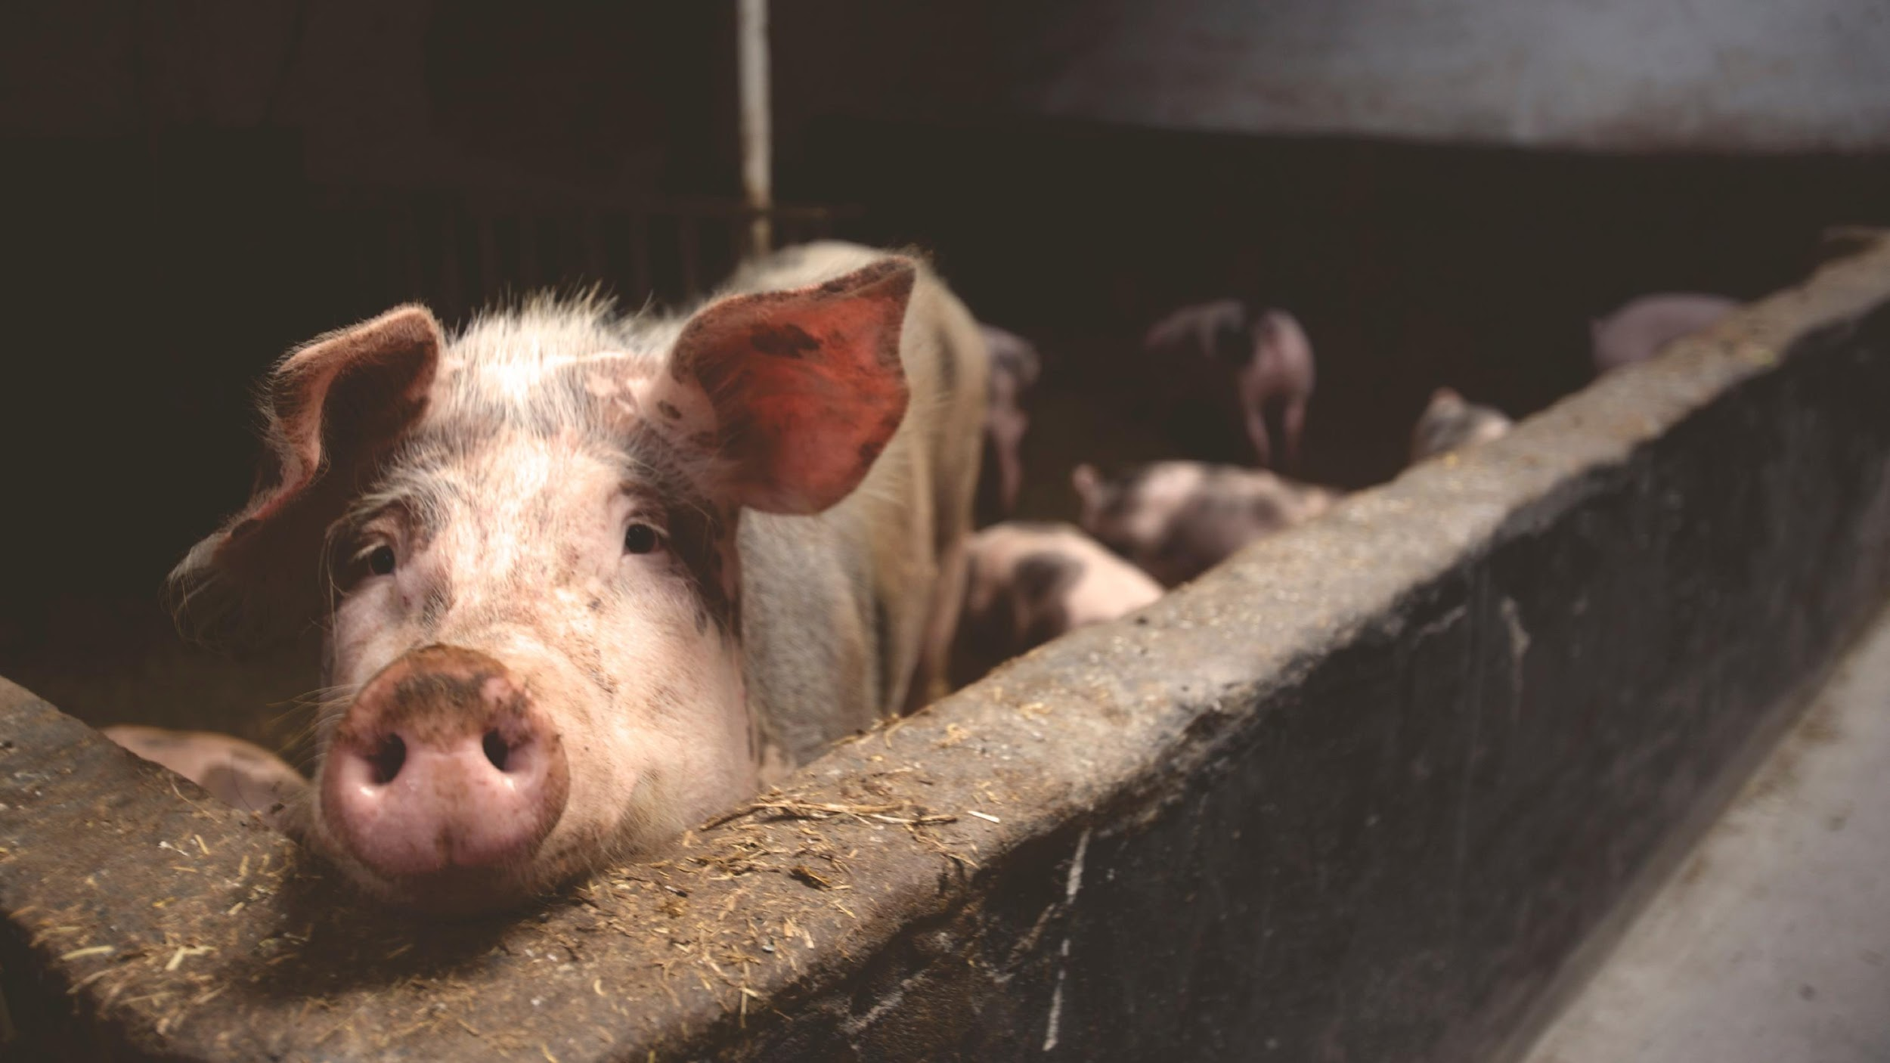
Should practices be consistent?
Notes:
Jennifer

Slide 42
Conclusions?
Notes:
J

Slide 43
Today…
Most colleges have implemented SB 1359 – but have concerns about how they are doing it.
Clear processes are needed to ensure consistency.
Notes:
J

Slide 44
Still Unclear….
What to mark…
Best process for identification…

Slide 45
For More Information…
Talk to your OER Liaison
Canvas Site - tinyurl.com/ASCCC-OpenEd
Michelle Pilati - mpilati@asccc.org
Suzanne Wakim - wakimsu@butte.edu
Notes:
Michelle

