Slide 1
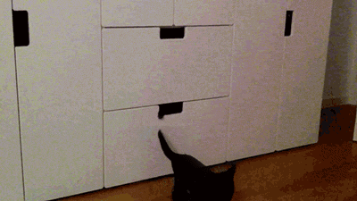
Welcome! Thank you for joining us for “Copyright, Fair Use, and Piracy: Where Does OER Fit In?”
We will begin shortly.

Slide 2
Copyright, Fair Use, and Piracy: Where Does OER Fit In?
WALTER BUTLER, LIBRARIAN, PASADENA CITY COLLEGE
DAVE DILLON, ASCCC OERI REGIONAL LEAD
This presentation is licensed CC-BY 4.0

Slide 3
We are not lawyers
(nor do we portray them on tv)

Slide 4
Notes:
Poll Title: What is NOT protected by US copyright? https://www.polleverywhere.com/multiple_choice_polls/wMryX9AnqTjQ3nvPETVTE?display_state=instructions&activity_state=opened&state=opened&flow=Instructor&onscreen=persist

Slide 5
Notes:
Poll Title: What is NOT protected by US copyright? https://www.polleverywhere.com/multiple_choice_polls/wMryX9AnqTjQ3nvPETVTE?display_state=chart&activity_state=closed&state=closed&flow=Instructor&onscreen=persist

Slide 6
Notes:
Poll Title: What is NOT protected by US copyright? https://www.polleverywhere.com/multiple_choice_polls/wMryX9AnqTjQ3nvPETVTE?display_state=chart&activity_state=closed&display=correctness&state=closed&flow=Instructor&onscreen=persist

Slide 7
What is copyright?
Basically - Copyright protects original and creative works, and it gives the copyright owner the right to (and to give permission to):
Make copies of the work
Prepare derivative works based on the original work
Distribute the work
Publicly display the work
Publicly perform the work

Slide 8
Copyright infringement in a nutshell
Whenever material is redistributed, copied, derived from, performed, displayed, without the copyright owner’s permission is copyright infringement.
**of course there are exceptions**

Slide 9
Notes:
Poll Title: Are OER protected by copyright? https://www.polleverywhere.com/multiple_choice_polls/5SemriVeifZUzBySCoXGf?flow=Default&onscreen=persist

Slide 10
Public Domain works can be OER
Works that are no longer protected by copyright = public domain
All works first published or released before January 1, 1925
Creators can release work into the public domain.
And then there’s a whole bunch of separate dates and exceptions…

Slide 11
Creative Commons Licensing
Creative Commons licenses are the most common licenses for OER.
They work with copyright – not against copyright
They make permissions transparent for reuse
Anyone can use and assign them freely to their own works

Slide 12
can I use works without knowing their copyright Permissions?

Slide 13
Pirated Works
Works that are illegally shared online
Avoid using these

Slide 14
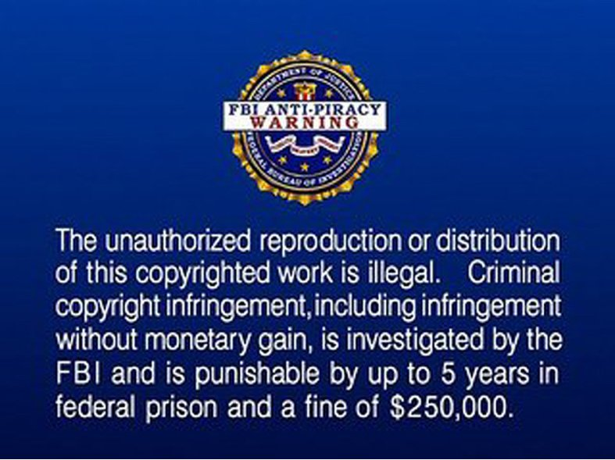

Slide 15
How do I know if It is Oer or not?

Slide 16
Look at the license
Traditional all rights reserved copyright?
Or Creative Commons license?

Slide 17
Creative commons: the six licenses
The above has been excerpted from “Creative Commons Licenses” by Creative Commons which is licensed under a Creative Commons Attribution 4.0 International license. Icons by The Noun Project.

Slide 18
Copyright Exceptions
Fair Use
TEACH Act

Slide 19
TEACH Act
Makes using copyrighted material while teaching online more “permissible”
Only applies to PERFORMANCE and DISPLAY permissions of copyright
Perform: non-dramatic literary and non-dramatic musical works in their entirety
Display works: permits just as you would in a face-to-face class.
Notes:
Technology, Education and Copyright Harmonization Act: performance and display of material in online environments (ie: performance of non-dramatic literary/musical works – poems, short stories; popular music) Other works such as musicals, operas, music videos – can be shown in limited portions. Displays of works can be used as comparable to what would be done in a face-to-face class.

Slide 20
TEACH Act Requirements
Access must be limited / controlled
Copyright policies must be in place for students/faculty
Copyright needs an informative component
Copyright notices must accompany all materials used.
Notes:
There are also requirements: confirm that they are using the right types of works; distribution of materials have limited access; must have copyright policies in place and made them available to students and faculty; and an education component to make people aware of copyright; and copyright notices with materials

Slide 21
So, is it Fair Use?
Fair Use
Fair Use is CASE BY CASE
Only a court can truly determine the final application of it.
Use your best judgment

Slide 22
Fair use – The four factors
the purpose and character of your use
the nature of the copyrighted work
the amount and substantiality of the portion taken, and
the effect of the use upon the potential market.
Notes:
March 2020, there was a court ruling on an ongoing case revolving around fair use cases and library e-reserves (Cambridge/Oxford/Sage press v Georgia State). The lawsuit is about e-reserves materials at GSU in 2009 and has been appealed twice and kicked back to the lower court both times. So, this is the third court ruling. There were 48 Fair Use cases in question, most of them upheld – and now 11 situations/titles were not considered fair use (each court ruling, the number has grown – 1st: 5 were not fair use, 2nd: 7 were not fair use; 3rd: 11 were not fair use) . I’m using this as an example because there are still a lot of gray areas even in e-reserves, and this case was based on circumstances and availability of e-resources in 2009. The current environment with publishers producing much more digitally makes the situation trickier.

Slide 23
Notes:
Poll Title: You want to provide access to an article from the New York Times as part of your class readings. Afraid that the article will disappear, you save it as a PDF on your computer and upload it in your Canvas shell. This is an example of: . https://www.polleverywhere.com/multiple_choice_polls/69KQNdbQv866zfw2DUTqM?flow=Default&onscreen=persist

Slide 24
Notes:
Poll Title: You decide that your online class needs a little music appreciation time, and you download "Here Comes the Sun" and play it for them in its entirety online. This is an example of... https://www.polleverywhere.com/multiple_choice_polls/QZWkIfTPpbEU0X5xgx4py?flow=Default&onscreen=persist

Slide 25
Questions / Discussion

