Slide 1
2021 Facilitated OER Development Overview Communication Studies: Interpersonal Communication
Welcome!

Slide 2
Overview
Background
Project
Approach
Support
Roles and Timelines
Next steps…

Slide 3
Background
OERI – Increasing OER use, availability, and awareness in the CCCs
RFP I – What do you want to do?
RFP II – Required collaboration
Today – Filling Identified Need

Slide 4
Background – Communication Studies
Communications Studies ADT Required course:
Public Speaking (COMM 110)
”List A” – Select two from:
Argumentation/Argumentation & Debate (COMM 120)
Interpersonal Communication (COMM 130)
Small Group Communication (COMM 140)

Slide 5
Communication Studies List A Courses and C-ID
Argumentation/Argumentation & Debate (COMM 120) – 108
Interpersonal Communication (COMM 130) - 103
Small Group Communication (COMM 140) - 91

Slide 6
Public Speaking OER
Many options – and lots of adoptions.
Public Speaking Project
Stand Up, Speak Out: The Practice and Ethics of Public Speaking
Exploring Public Speaking: 3rd Edition
Fundamentals of Public Speaking [Available at College of the Canyons]

Slide 7
Argumentation/Argumentation & Debate OER
Resources recently developed – supported by ASCCC OERI
Arguing Using Critical Thinking
How Arguments Work
Ancillaries under development
Other options
Logical Reasoning [Bradley Dowden, CSU Sacramento]
Logic and Critical Thinking

Slide 8
Interpersonal Communication OER
OER Textbooks
Interpersonal Communication: A Mindful Approach to Relationships by Jason S. Wrench, Narissra M. Punyanunt-Carter, and Katherine S. Thweatt
Includes a student handbook and ancillaries
Interpersonal Communication Textbook is now on Pressbooks.
Various resources offer elements of an interpersonal text.

Slide 9
Small Group Communication OER
OER Textbooks
Small-Group Communication
An Introduction to Group Communication
Problem-Solving in Teams and Groups
OER Courses
Small-Group Communication - This course is licensed under a Creative Commons Attribution 3.0 Unported License.
Influencing Stakeholders: Dealing with Power and Dynamics in Teams and Networks (Links to an external site.) - by TU Delft OpenCourseWare is licensed under a Creative Commons Attribution-NonCommercial-ShareAlike 4.0 International License. Although aimed at engineering students, it contains excellent case studies on team development and negotiation.

Slide 10
Completely Unscientific Analysis
At 6 CCCs
All had at least some faculty – if not all – using OER for Public Speaking
4/6 - Argumentation
1 - Interpersonal
4/5 Small Group
AHC, AVC, Grossmont, LAVC, RHC, SBCC

Slide 11
C-ID 130 – Interpersonal Communication
C-ID establishes the skeleton of a course – the minimum
Truly open resources allow you to modify an OER as needed
Principles of verbal and nonverbal transactions that occur in relationships. Study of theory and research findings and their application to communication in interpersonal relationships in personal and professional contexts.

Slide 12
C-ID 130 Content
Theories and principles of interpersonal communication
Verbal and nonverbal interactions
Interpersonal communication in various contexts, including personal and professional
The effects of communication on perceptions and personal identities
Ethical interpersonal communication
Conflict management in interpersonal relationships

Slide 13
C-ID 130 Objectives
Describe ways that communication creates, develops and changes personal identities including variables such as culture, gender, ethnicity, and race; explain the effect of communication on personal identities.
Describe the effects of communication on interpersonal relationships and social and cultural realities;
Demonstrate an understanding of ethical interpersonal communication founded on communication theory and research including listening and other individual skills and competencies for successful interpersonal communication; and
Diagnose conflict in interpersonal relationships and demonstrate appropriate conflict management strategies.

Slide 14
C-ID 130 Representative Texts
Adler, R. Interplay: The Process of Interpersonal Communication. (latest edition). Oxford University Press
Adler, R. & Proctor II, R. Looking Out, Looking In. (latest edition) Wadsworth Publishing
Wood, J. Interpersonal Communication: Everyday Encounters. (latest edition). Wadsworth Publishing

Slide 15
Project
Develop an OER for Interpersonal Communication
Collaboratively
Designed for our students
Emphasis on Diversity, Equity, Inclusion

Slide 16
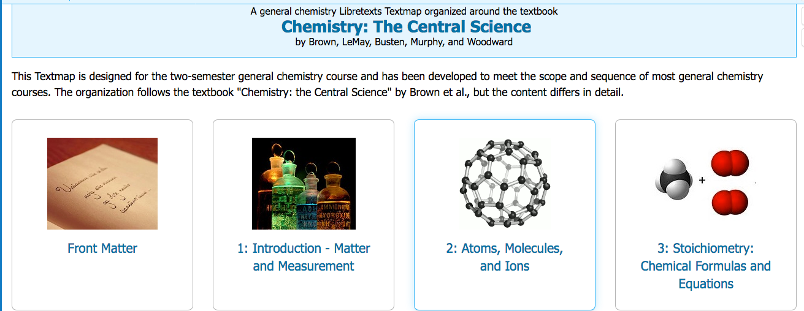
Approach
Develop a Textmap based on features of commercial texts, creating a skeleton of the text
Curate and develop content

Slide 17
Textmap – Detailed….
Adler: Interplay, 11th edition Table of Contents
Chapter 1: Interpersonal Process Why We Communicate
Physical Needs
Identity Needs
Social Needs
Practical Needs
The Communication Process
A Model of Communication
Insights from the Communication Model
Communication Principles
Communication Misconceptions
Interpersonal Communication Defined Quantitative and Qualitative Definitions Personal and Impersonal Communication: A Matter of Balance Interpersonal Communication and Technology Mediated vs. Face-to-Face Communication Challenges of Mediated Communication Choosing the Best Communication Channel Communication Competence Communication Competence Defined Characteristics of Competent Communication Summary Activities

Slide 18
Textmap – Chapter Level
Chapter 1: Interpersonal Process
Chapter 2: Culture and Communication
Chapter 3: Communication and the Self
Chapter 4: Perceiving Others
Chapter 5: Language
Chapter 6: Nonverbal Communication
Chapter 7: Listening: Understanding and Supporting Others
Chapter 8: Emotions
Chapter 9: Dynamics of Interpersonal Relationships
Chapter 10: Communication Climate
Chapter 11: Managing Conflict
Chapter 12: Communication in Families and at Work

Slide 19
Support
Development Team Members will receive training on:
Accessibility
Attributions
LibreTexts
Team can identify and request additional support as needed (e.g., illustrations)

Slide 20
Roles and Timelines
An OERI Team Member will serve as your Project Manager and will coordinate the work
One or two discipline faculty will serve as the Project Lead or Leads
Work can be divided up by section, chapter, role – the team will decide
Multiple check-ins will be established in order to ensure progress - at minimum:
Initial Product
Interim Product

Slide 21
Timeline
All interested faculty must complete the application process by December 18
Team members to be selected early in 2021
1st Team Planning Meeting in late January or early February
Schedule, compensation, deadlines – all determined at this meeting
Training for Team Members to begin in February 2021

Slide 22
Next Steps
ASCCC seeking local Academic Senate President’s recommendation of interested faculty
No formal commitment needed until after that 1st meeting
Information gathering likely to be initiated prior to the 1st meeting

Slide 23
Questions, Comments, Suggestions?
Photo by LinkedIn Sales Navigator on Unsplash

Slide 24
And then….
Find application information at: https://tinyurl.com/ASCCCOER21
Reach out to Michelle with questions at: mpilati@asccc.org
tinyurl.com/ASCCC-OpenEd >> Discipline specific resources
Have a fantastic holiday!
Notes:
Photo by Mockaroon on Unsplash

Slide 25
Interpersonal Resources
http://opencourselibrary.org/cmst-210-interpersonal-communication/
4 units from 2014

