Slide 1
2021 Facilitated OER Development Overview
Nursing

Slide 2
Overview
Background
Challenges
Project
Support
Roles and Timelines
Next steps…

Slide 3
Background
OERI – Increasing OER use, availability, and awareness in the CCCs
RFP I – What do you want to do?
RFP II – Required collaboration
Today – Identifying a need – and determining how to meet it

Slide 4
Nursing Challenges
While you all teach to the same standards, how you do it varies – curriculum is not consistent
How do we define a state-level need when we begin with diverse curriculum?

Slide 5
Priorities
OER with the greatest potential for adoption AND cost-savings
  New text-equivalent
  Tailoring of existing OER for CCCs
  Ancillaries that would increase adoption of existing OER
OER that assists students in meeting their educational goals

Slide 6
Project
Nature, scope, timeline – all TBD
We need your input to determine what should be done
The project (or projects) will be:
  Developed collaboratively
  Designed for our students
  Developed with inclusiveness, diversity and equity in mind

Slide 7

Project – Step 1?
Review existing OER?
Determine course or resource to focus on?
???
Photo by Dimitri Houtteman on Unsplash

Slide 8
Support
The nature of the support provided will be dependent upon the nature of the project
Development Team Members may receive training on:
  Accessibility
  Attributions
  LibreTexts
Team can identify and request additional support as needed (e.g., illustrations)

Slide 9
Roles and Timelines
An OERI Team Member will serve as your Project Manager and will coordinate the work
One or two discipline faculty will serve as the Project Lead or Leads
Work can be divided up by section, chapter, role – the team will decide
Multiple check-ins will be established in order to ensure progress - at minimum:
  Initial Product
  Interim Product

Slide 10
Timeline
All interested faculty must complete the application process by December 18
Team members to be selected early in 2021
1st Team Planning Meeting in late January or early February
  Schedule, compensation, deadlines – all determined at this meeting
Training for Team Members to begin in February 2021

Slide 11
Next Steps
ASCCC seeking local Academic Senate President’s recommendation of interested faculty
No formal commitment needed until after that 1st meeting
***Information gathering likely to be initiated prior to the 1st meeting***

Slide 12

Questions, Comments, Suggestions?
Photo by Gemma | That's Her Business on Unsplash

Slide 13
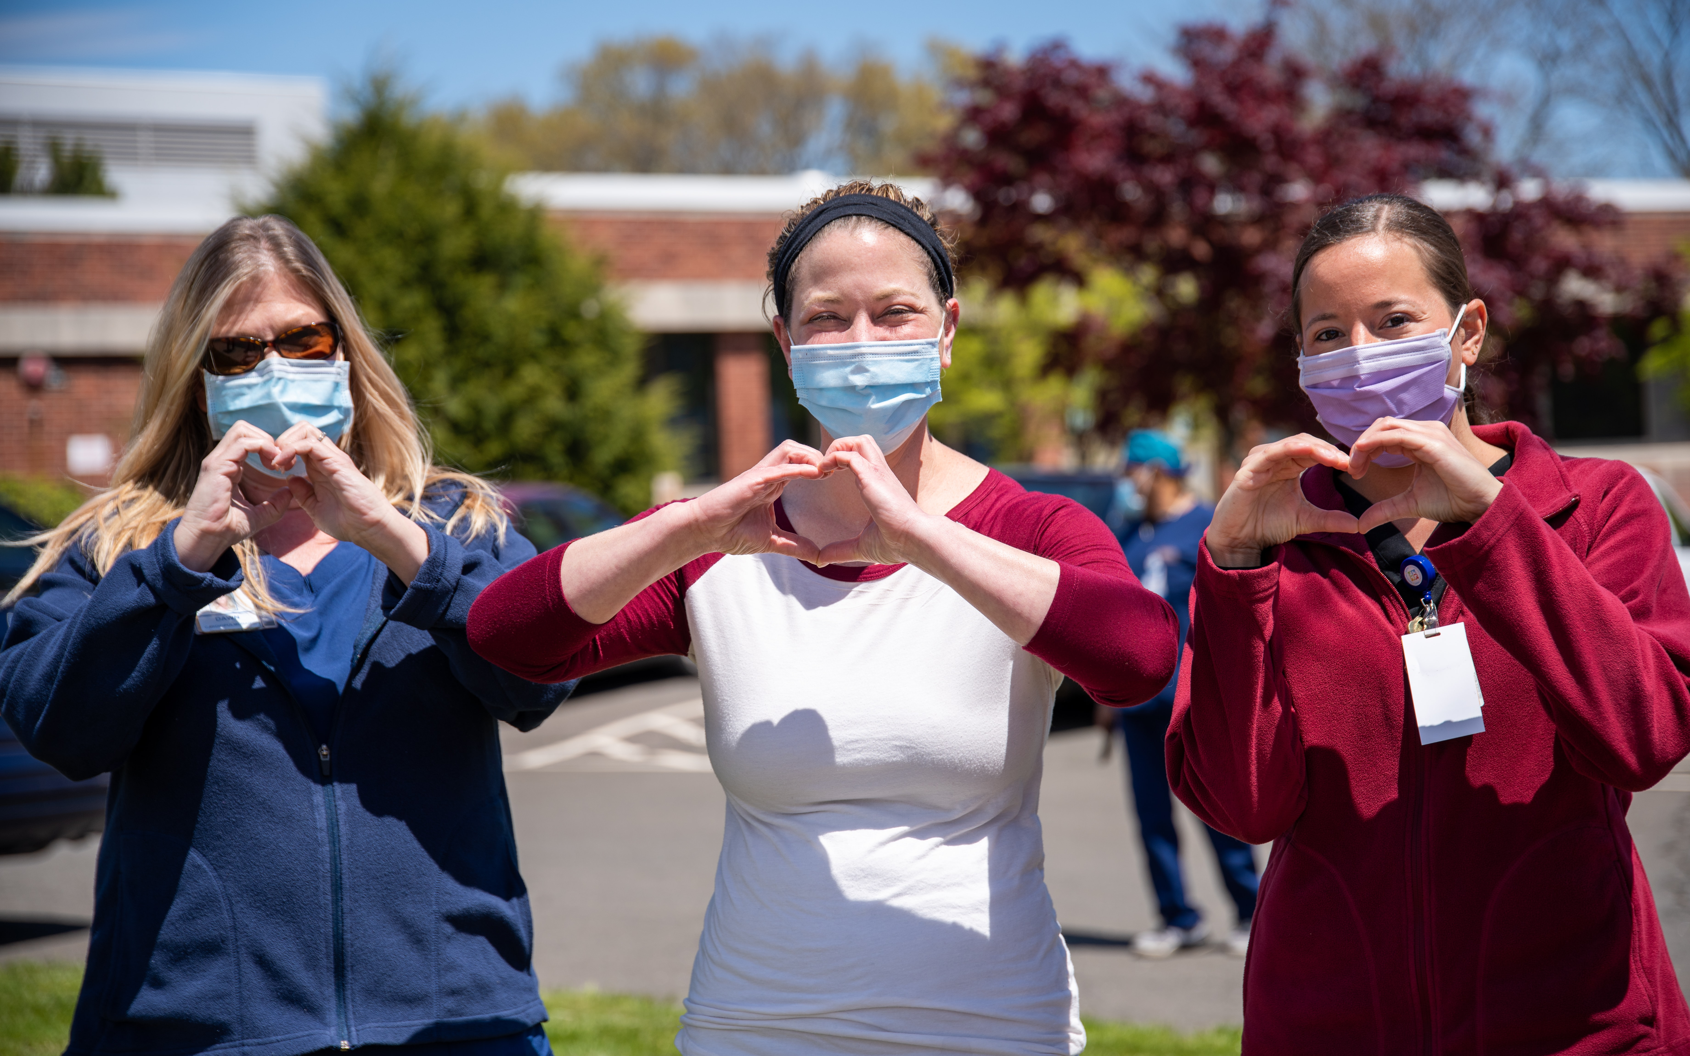
And then….
Find application information at: https://tinyurl.com/ASCCCOER21
Reach out to Michelle with questions at: mpilati@asccc.org
Have a fantastic holiday!
Photo by Rusty Watson on Unsplash

