Slide 1
2021 Facilitated OER Development Overview Psychology
Welcome!

Slide 2
Overview
Background
Project
Approach
Support
Roles and Timelines
Next steps…

Slide 3
Background
OERI – Increasing OER use, availability, and awareness in the CCCs
RFP I – What do you want to do?
RFP II – Required collaboration
Today – Filling Identified Need

Slide 4
Background - Psychology
Required courses for a psychology ADT
Introduction to Psychology
Statistic
Psychological Research Methods
“List A” – Intro to Biopsych or one of two biology courses (with articulation)

Slide 5
PSY 150 - Introduction to Biological Psychology
While currently an option, some of the CSUs that are the reason for the biology options are now wanting this course (in other words, List A may change)
No available OER
93 CCCs

Slide 6
Project
Develop an OER for Introduction to Biological Psychology
Collaboratively
Designed for our students
Emphasis on Diversity, Equity, Inclusion

Slide 7
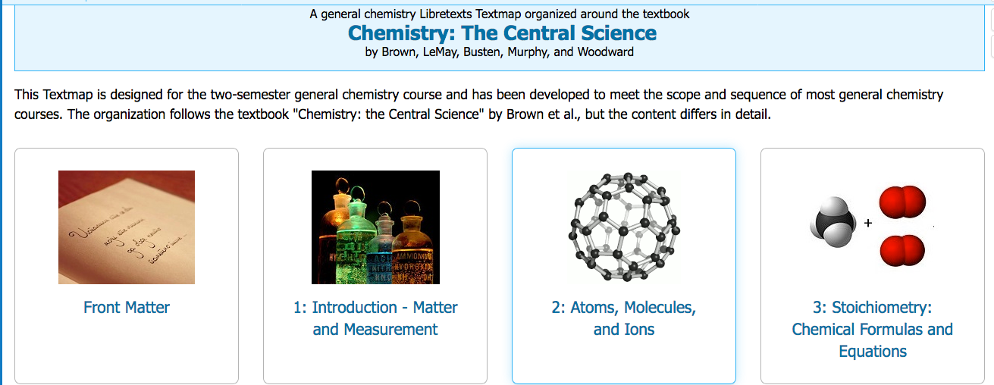
Approach
Develop a Textmap based on features of commercial texts, creating a skeleton of the text
Curate and develop content

Slide 8
Support
Development Team Members will receive training on:
Accessibility
Attributions
LibreTexts
Team can identify and request additional support as needed (e.g., illustrations)

Slide 9
Roles and Timelines
An OERI Team Member will serve as your Project Manager and will coordinate the work
One or two discipline faculty will serve as the Project Lead or Leads
Work can be divided up by section, chapter, role – the team will decide
Multiple check-ins will be established in order to ensure progress - at minimum:
Initial Product
Interim Product

Slide 10
Timeline
All interested faculty must complete the application process by December 18
Team members to be selected early in 2021
1st Team Planning Meeting in late January or early February
Schedule, compensation, deadlines – all determined at this meeting
Training for Team Members to begin in February 2021

Slide 11
Next Steps
ASCCC seeking local Academic Senate President’s recommendation of interested faculty
No formal commitment needed until after that 1st meeting
Information gathering likely to be initiated prior to the 1st meeting

Slide 12
Questions, Comments, Suggestions?
Photo by Gemma | That's Her Business on Unsplash

Slide 13
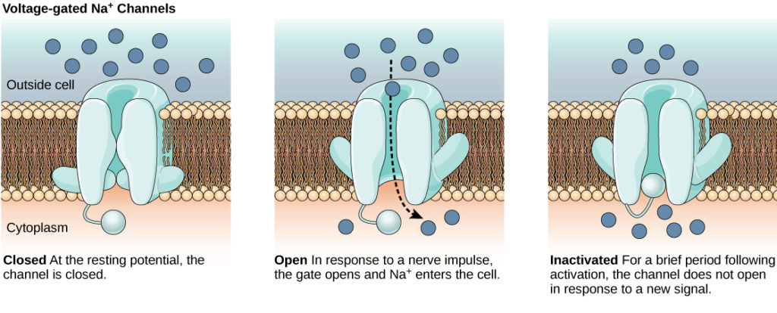
And then….
Find application information at: https://tinyurl.com/ASCCCOER21
Reach out to Michelle with questions at: mpilati@asccc.org
Have a fantastic holiday!
Notes:
Image source - https://chem.libretexts.org/Courses/Lumen_Learning/lhrli@ucdavis.edu/Book%3A_Biology_for_Majors_II_(Lumen)/18%3A_Module_14%3A_The_Nervous_System/18.9%3A_Resting_Membrane_Potential

