Slide 1
OER and Business Discipline
April 9, 2021, 10:30 am PT

Slide 2
Agenda
OER Overview
Creative Commons
Adopting an OER
Business Discipline OER resources – progress to-date
Q&A
Robots by annemazo on Pixabay

Slide 3
What are Open Educational Resources?
Creative Commons defines OER as teaching, learning, and research materials that are either (a) in the public domain or (b) licensed in a manner that provides everyone with free and perpetual permission to engage in the 5R activities– retaining, remixing, revising, reusing and redistributing the resources.
-- Creative Commons

Slide 4
The 5R Permissions of OER
The framework, freely available under a Creative Commons Attribution 4.0 license (CC BY), was designed by Lumen Learning as the 5Rs
Make and own copies
Retain
Reuse
Use in a wide range of ways
Adapt, modify, and improve
Revise
Combine two or more
Remix
Share with others
Redistribute

Slide 5
Traditional Resources
OER
Copyright owned and usage is limited
Cannot copy, scan, or share without permission
One student = one copy
Cannot change (revise or edit) material
Free ≠ Open
The resource is FREE
Freely and instantly available online
Copy, scan, share, as much as needed
Edit, revise, modify (depending on the license)

Slide 6
Traditional Textbook
OER
Ancillaries
PPT
IM
Test Banks
Case
Solutions
Etcetera
PPT and IM may not be needed given full rights to the content
Varying level of availability:
Test Banks, exercises, etc.
More adoption, more ancillaries

Slide 7
Business Discipline - Available OER
C-ID courses
BUS 110: Introduction to Business
BUS 115: Business Communication
BUS 120: Legal Environment of Business
BUS 125: Business Law
BUS 140: Business Information Systems
OER and the Business Administration Transfer Model Curriculum

Slide 8
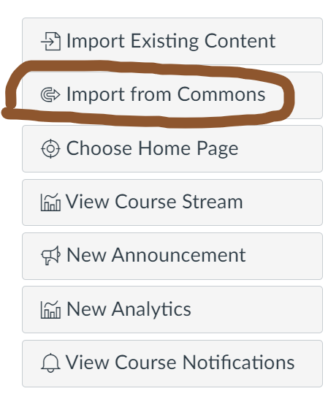
Other Business Courses
Financial Accounting
Applied Calculus
Entrepreneurship
Business Plan
Marketing
Management and others
ASCCC Business Discipline page
How to find it from Canvas Commons

Slide 9
Thank you for your attention!
When in doubt, please always ask!
Please submit any questions to: oeri@asccc.org

