Slide 1
OER and Physics
Emilie Hein, PhD
Skyline College

Slide 2
What are Open Educational Resources?
Creative Commons defines OER as teaching, learning, and research materials that are either (a) in the public domain or (b) licensed in a manner that provides everyone with free and perpetual permission to engage in the 5R activities– retaining, remixing, revising, reusing and redistributing the resources.
-- Creative Commons

Slide 3
The 5R Permissions of OER
Make and own copies
Retain
Reuse
Use in a wide range of ways
Adapt, modify, and improve
Revise
Combine two or more
Remix
Share with others
Redistribute
The framework, freely available under a Creative Commons Attribution 4.0 license (CC BY), was designed by Lumen Learning as the 5Rs

Slide 4
Traditional Textbook
OER
Publishing company owns copyright and sells book for profit
Cannot copy, scan, or share without permission
One student = one copy
Cannot change (revise or edit) material
No one making a profit
Freely and instantly available online
Copy, scan, share, as much as needed
Edit, revise, modify (depending on the license)

Slide 5
Why Use OER, Especially Now?
Free - students need extra financial help right now
Instant access- no waiting for books to arrive
Takes guessing game out of copyright and fair use
Perfect for online classes - many can be integrated into Canvas
Many have a print option

Slide 6
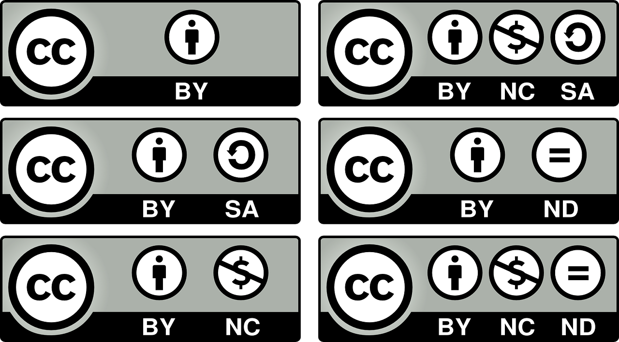
How Do You Know if Something is OER and Not Just Free?
Look for Creative Commons licenses:

Slide 7
OER and Physics: Where to start?
https://asccc-oeri.org > Resources > California Community Colleges Open Educational Resources By Discipline > Physics
https://asccc-oeri.org/open-educational-resources-and-physics/
Also Andrew Park’s webinar last year
https://asccc-oeri.org

Slide 8
Additional Resources
Cool4ED
MERLOT
OER Commons
LibreTexts
And more free resources…
ComPADRE Resources and Services for Physics Education
Simulations
PhET
Videos
OpenStax's Concept Trailers
Khan Academy Physics Library

