Slide 1
Welcome!
We’ll get started momentarily.
You will be muted. We invite you to ask questions via the chat or raise your hands, and then unmute yourself.
Today’s topic: RFP Focused Webinar III - Budget and Action Plan
This presentation will be archived and available at asccc-oeri.org

Slide 2
RFP Focused Webinar III - Budget and Action Plan
ASCCC 2021 Request for Proposals

Slide 3
Our Focus Today
In this webinar we'll discuss the level of detail needed in your budget and action plan and address common budget-related questions. What does a realistic budget and an effective plan look like? Section C of the RFP.

Slide 4
Overview
Budget Summary
How Funds are Disbursed
RFP Language
Examples
Action Plan
RFP Language
Examples
General Guidelines
Timelines and RFP Scoring Rubric

Slide 5
Fund Disbursement
December 13th – 3rd check-in product (*80% completion; overall progress check) (1st payment)
May 10th – Final product due (2nd Payment)
ASCCC will write checks at the direction of the faculty lead
Tax forms collected from all recipients
No local “overhead” – your accounting and grant office are not involved

Slide 6
Budget and Action Plan
1. Funds Requested (select one)
Standard Scale ($1,000-$10,000)
Medium Scale ($10,001-$20,000)
Large Scale ($20,001-$30,000)
Note: If an initial review of your budget suggests it was inappropriately categorized, the OERI reserves the right make adjustments to budgets and funds requested.
Notes:
Proposals for the development of ancillaries must provide
specific details regarding the final OER
connect the specific resources developed to estimated time for development.
should acknowledge any existing resources that will be integrated into the work.
If include components that rely on other websites must also provide alternative options should those websites be inaccessible or no longer available.

Slide 7
Budget and Action Plan
2. Budget Summary
Please list the types of activities which, if awarded, you would fund to achieve the product, affixing a dollar amount to each.
Funding for travel, hardware, or dissemination activities will generally not be provided. But, if such funds are deemed imperative, please provide a rationale to justify this exception.

Slide 8
Budget and Action Plan
2. Budget Summary (continued)
identifying pay for faculty or other individuals, please specify the hours of work involved and an hourly pay rate. For faculty, please use $60 as the hourly rate of pay.
If you have identified a need for professional assistance, such as a copy editor or a licensing expert, please determine the costs associated with such services and use those figures when preparing your action plan. (narrative)
Mention any additional funding available for the project.

Slide 9
Budget Summary - Example
Sept. 10 hours per week for 4 weeks.
40 hrs x $50 hr = $2,000
Oct. 10 hours per week for 4 weeks.
40 hours x $50 hr = $2,000
$4,000 Total
What’s missing? What needs modification?
Notes:
Who is getting paid – and the payrate for faculty should be $60. Hours of what?

Slide 10
Budget Summary - Example
Cost for this project is estimated at $20,000
80 hours of writing, editing, and curation by primary author at $50/hr: $9000
15 stipends of $200 for invited author submissions: $3000
80 hours of design, layout, accessibility, etc., at $35/hr. for hired staff: $6300
Associated publishing costs estimated at $1700 (??)
Notes:
The maths is wrong. The hourly rate should be $60.

Slide 11
Budget Summary - Example
Instructional Salaries ($15,000): The majority of our budget is set aside to pay instructor salaries to conduct the necessary research
Two primary instructors will complete the initial research and with help from experienced faculty and experienced investigators will adapt the text.
Employee Benefits are included at 15% of instructional salaries. ($2400)
Other Operating Expenses ($1700) for post-production design of the textbook.
Other costs are assumed at 4% of the total project ($900). Total Expense -$20,000
Notes:
What’s wrong here? We are not paying overhead costs.

Slide 12
Budget and Action Plan
3. Action Plan - Identify
timelines and
responsible parties for all activities.
Your timeline should specify three interim project deadlines and deliverables that are aligned with the project deadlines mentioned in the RFP.

Slide 13
Budget and Action Plan
August 16, 2021 - 1st check-in product (*25% completion)
October 12, 2021 - 2nd check-in product (*50% completion)
December 13, 2021 - 3rd check-in product (*80% completion)
February 14, 2022 - product distributed to reviewers
March 14th, 2022 - Reviews are due
May 10th, 2022 - Final product due
*Defined by applicant.

Slide 14
Action Plan Checklist
Timelines for all activities
Responsible parties for all activities
At least three mid-project deadlines and deliverable aligned with dates specified in the RFP.
Where, when, and how collaboration will occur specified in detail

Slide 15
Action Plan - Example
What’s missing?
For each chapter, transfer questions from PDF of existing OER to MS Word DOCX file
Format questions, corresponding answers, and validate the DOCX file
Convert DOCX file to Canvas quiz using Respondus software
Randomly select 3 chapters for operability within Canvas
Using Canvas, export all 17 Chapter Canvas Quizzes into downloadable ZIP
Validate importability of quizzes into another Canvas course
Upload ZIP file to PDQ

Slide 16
What’s Missing?
Action plan requires what, when, and who
Activities ✔ (what)
When (timelines)
Who (responsible parties)
Mid-project deadlines and deliverables.

Slide 17
Action Plan - Example
Product - seven new modules to accompany an Openstax text.
All materials will be posted in Canvas by lead faculty member.
June 2019: Module authors identified. First meeting with module authors to clarify structure of modules and authoring timeline.
July – August: Authors prepare module drafts posted on non-public Canvas course. Consultation with coordinators continues through conference calls.
September: Complete first draft of modules submitted for review by coordinators and internal peer reviewers. (mid-project deadline and deliverable?)
October – Authors respond to reviewer suggestions….

Slide 18
Action Plan - Example
July 1: Lead will determine other authors (3) and assign roles.
Aug. 15: Lead will finish coordinating the harvesting of the resource.
Sept.1: the three authors will submit their content.
Sept. 15: the designer will present an initial design of the resource and ancillaries.
Oct. 1: the three or more peer reviewers will submit their reviews.
Nov. 1: the authors will submit their final revisions.
Dec. 1: the designer will finalize the design and usability testing.
Dec.15: the final product will be submitted.

Slide 19
General Guidance
Ensure all elements of your submission are consistent – e.g., team, project description, budget, action plan
Have someone else review
Remember that readers are unlikely to be discipline faculty

Slide 20
Timelines
Monday, March 22, 2021 – Submission portal opened
Monday, April 19, 2021, 5 pm – Submission portal closed
Week of April 26 – Proposals reviewed
On or before Monday, May 10, awards announced
All information related to the RFP will be available on the ASCCC OERI website. (asccc-oeri.org)

Slide 21
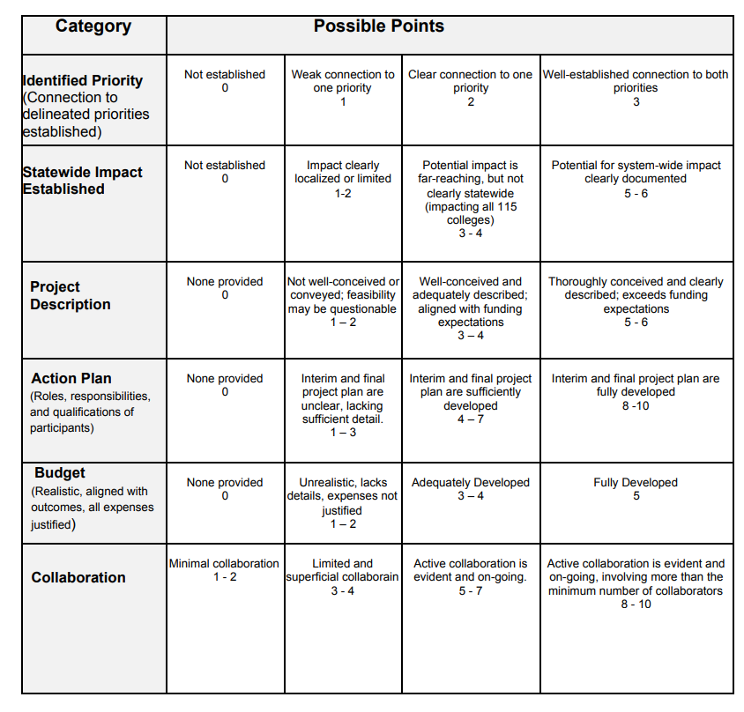

Slide 22
Questions

