Slide 1
A Conversation on OER for IR
Facilitated by Charlotte Lee, Berkeley City College, ASCCC OERI Liaison, Political Science
November 10, 2021, 12:30-1:30pm via Zoom

Slide 2
Agenda
What are OER? An overview
OER in IR
Open conversation: Your experiences, questions, reflections

Slide 3
What are Open Educational Resources?
Creative Commons defines OER as teaching, learning, and research materials that are either (a) in the public domain or (b) licensed in a manner that provides everyone with free and perpetual permission to engage in the 5R activities– retaining, remixing, revising, reusing and redistributing the resources.
-- Creative Commons

Slide 4
The 5R Permissions of OER
Make and own copies
Retain
Reuse
Use in a wide range of ways
Adapt, modify, and improve
Revise
Combine two or more
Remix
Share with others
Redistribute
The framework, freely available under a Creative Commons Attribution 4.0 license (CC BY), was designed by Lumen Learning as the 5Rs

Slide 5
Traditional Textbook
OER
Publishing company owns copyright and sells book for profit
Cannot copy, scan, or share without permission
One student = one copy
Cannot change (revise or edit) material
No one making a profit
Freely and instantly available online
Copy, scan, share, as much as needed
Edit, revise, modify (depending on the license)

Slide 6
Why Use OER, Especially Now?
Free - students need extra financial help right now
Instant access- no waiting for books to arrive
Takes guessing game out of copyright and fair use
Perfect for online classes - many can be integrated into Canvas
Many have a print option

Slide 7
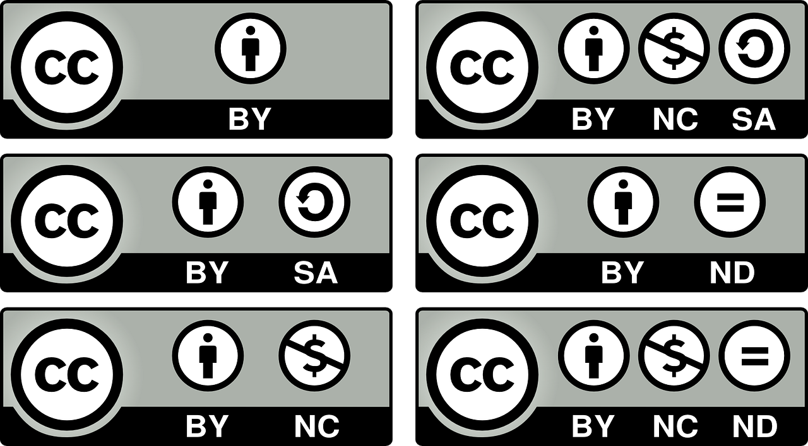
How Do You Know if Something is OER and Not Just Free?
Look for Creative Commons licenses:

Slide 8
Agenda
What are OER? An overview
OER in IR
Open conversation: Your experiences, questions, reflections

Slide 9
OER in Political Science
Discipline-specific repository of OER and OEP (Open Educational Practices): OPoliSci.com
https://www.opolisci.com
About: Created by Dr. Josh Franco at Cuyamaca College in San Diego County, this website contains open access resources such as textbooks, journal articles, and teaching materials such as question banks, assignments, and videos

Slide 10
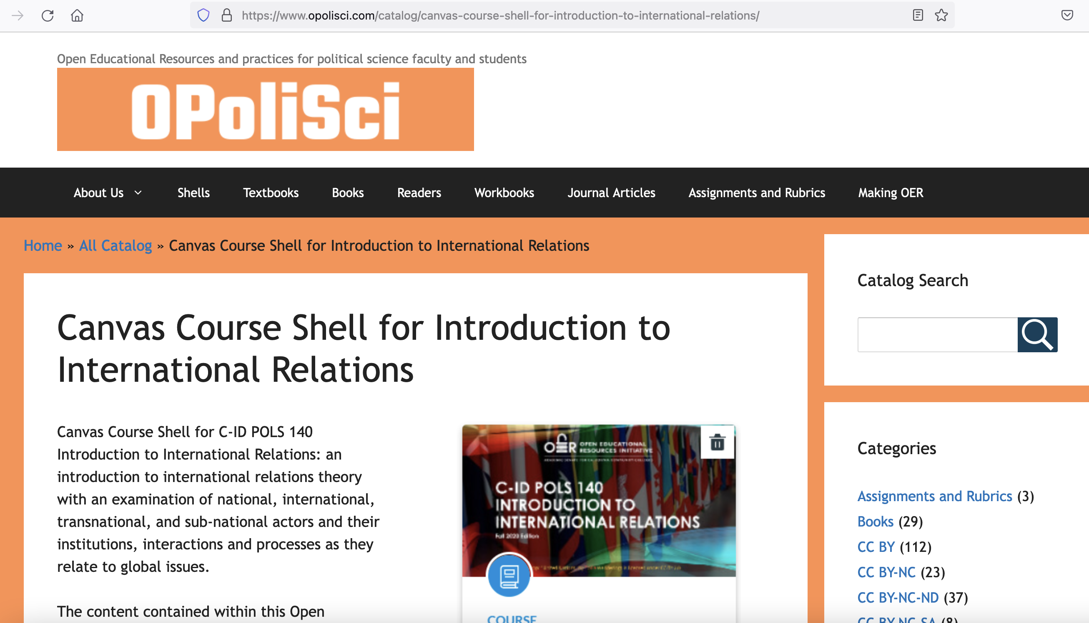
Canvas course shell for Intro to IR
Available on Canvas Commons
https://www.opolisci.com/shells/canvas-course-shell-for-introduction-to-international-relations/
About: Designed by CCC faculty with support from an ASCCC OERI grant, this course shell contains 12 modules on theories and topics in international relations. Includes a textbook-equivalent and ancillaries such as lesson plans, handouts, lecture slides, video clips, quiz banks

Slide 11
OER for IR - Texts
E-IR
https://www.e-ir.info
About: This is a repository for many materials related to international relations; most material is targeted at undergraduates (at the lower and upper division levels). Materials include textbooks, chapters, essays, and also papers by undergraduates. Materials do not appear to be peer-reviewed.

Slide 12
More repositories for OER texts – Not IR-specific, but searchable
Open Access Books on JSTOR
https://about.jstor.org/librarians/books/open-access-books-jstor/
About: JSTOR has identified and made searchable Open Access ebooks
Open Research published by Cambridge University Press
https://www.cambridge.org/core/what-we-publish/open-access
About: Cambridge University Press has a website dedicated to open research, and all products are open access. Webpage is searchable for open access journal articles and books.
BCcampus Open Education
https://open.bccampus.ca/what-is-open-education/
About: This is a provincial-level initiative in British Columbia, Canada, to make available OER for a variety of fields of study.

Slide 13
Other Courseware/Ancillary Materials
Council on Foreign Relations World 101
https://world101.cfr.org/
About: A free online course that explains the fundamentals of international relations and foreign policy. Using multimedia storytelling, World101 invites those who are new to international relations to investigate what lies at the core of the most important global topics. The program is intended for people of any age, both inside and outside of formal academic settings.
Council on Foreign Relations Model Diplomacy
https://modeldiplomacy.cfr.org/
About: Model Diplomacy offers free National Security Council (NSC) and UN Security Council (UNSC) simulations that present both historical and hypothetical scenarios based on real issues,with content informed by Council on Foreign Relations experts.

Slide 14
Agenda
What are OER? An overview
OER in IR
Open conversation: Your experiences, questions, reflections

Slide 15
Let’s talk!
Are there any additional resources to add to what we currently have on the OERI Resources page? https://asccc-oeri.org/open-educational-resources-and-political-science/
Can you share some successes with OER? What do you love about them?
What have been barriers to OER adoption that you’ve encountered?
If you've adopted OER, what are some challenges that you've faced? How did you overcome them?
Pros and cons of OER versus Zero Textbook Cost (ZTC)?

Slide 16
Action steps
Please post in the chat or share out: Identify one next step for you in your OER journey.

