Slide 1
Open Educational Resources
This Photo by Unknown Author is licensed under CC BY-SA

Slide 2
What are Open Educational Resources?
Any type of educational materials that are in the public domain & published under open licenses (Creative Commons)
They can include textbooks, lecture notes, syllabi, assignments, tests, images, maps, etc.
Can be used, modified, shared, and reused.

Slide 3
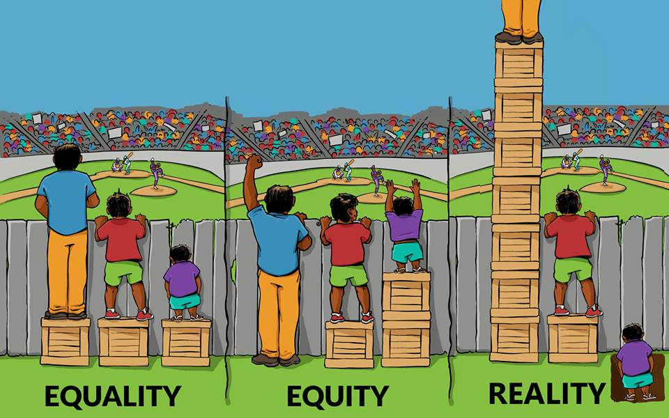
Why Use OER?
Textbooks are expensive
“Zero Textbook Cost” Courses
Gives faculty freedom to edit, delete, combine, or add content
Provide an engaging learning experience for students.
Promote diversity, equity, and inclusion
This Photo by Unknown Author is licensed under CC BY-NC

Slide 4
US History
C-ID 130, 140
World Civilizations
C-ID 150, 160
Western Civilizations
C-ID 170, 180

Slide 5
Nenagh Brown
Primary Documents: World History

Slide 6
Anti-racist narratives
How to Build a Community?
Collaborative Projects?
Resources & Support?
Email list?
Other Ideas?
African, Asian, and
Indigenous Peoples’ Histories

Slide 7
Questions Ideas/Suggestions Comments
Anu Mande
Fullerton College
amande@fullcoll.edu

