Slide 1
Creating ZTC Degrees in Chemistry
December 7, 2021

Slide 2
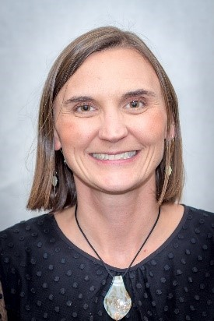
Welcome! Please introduce yourself in the chat
What is OER?
Why ZTC Degrees?
Chemistry Barriers to OER
Open Discussion
Patricia Foley, Ph.D.
Chemistry Discipline Lead
College of the Canyons

Slide 3
What are Open Educational Resources?
Creative Commons defines OER as teaching, learning, and research materials that are either (a) in the public domain or (b) licensed in a manner that provides everyone with free and perpetual permission to engage in the 5R activities– retaining, remixing, revising, reusing and redistributing the resources.
-- Creative Commons

Slide 4
The 5R Permissions of OER
Make and own copies
Retain
Reuse
Use in a wide range of ways
Adapt, modify, and improve
Revise
Combine two or more
Remix
Share with others
Redistribute
The framework, freely available under a Creative Commons Attribution 4.0 license (CC BY), was designed by Lumen Learning as the 5Rs

Slide 5
ZTC Degrees – the Motivation
Students spend $1240/year on textbooks and supplies¹
66% of students avoid buying course materials due to steep prices²
Pilot program: $5 Million for planning and implementing ZTC pathways in California Community Colleges: 37 programs created³
State allocated $115 Million investment in developing ZTC pathways⁴
College Board, Trends in College Pricing and Student Aid 2021, Figure CP-1
Hanson, Melanie. “Average Cost of College Textbooks” EducationData.org, August 12, 2021
CCC Chancellor’s Office. “ZTC Degree Grant Program 2020 Legislative Report”
AB 132
Notes:
https://www.gov.ca.gov/2021/07/27/governor-newsom-signs-legislation-to-make-college-more-affordable-and-accessible-in-california/

Slide 6
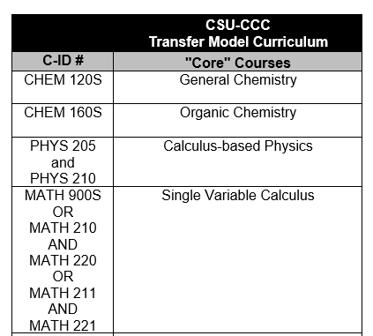
ZTC Degrees and Chemistry
What do students spend money on?
Textbooks
Online homework systems
Lab manuals
Lab goggles, gloves, notebooks, scantrons

Slide 7
ZTC Degrees and OER Course-level development
OER Compilation;
Development of
Ancillary Materials
OER usage is standard
practice
OER Discovery
ZTC Degrees
OER Development
OER Adoption
Widespread OER
Adoption

Slide 8
Other areas that require chemistry courses
Transfer Model Curriculum | Chemistry C-ID
Ag Animal Science | CHEM 110
Ag Business | CHEM 101 or CHEM 110
Ag Plant Science | CHEM 101 or CHEM 110
Biology | CHEM 120S
Chemistry | CHEM 120S, CHEM 160S
Computer Science | CHEM 110
Elementary Education | CHEM 140
Environmental Science | CHEM 110
Geology | CHEM 120S
Kinesiology | CHEM 110
Nutrition | CHEM 110
+ Pre-nursing
+ Pre-med
+ Engineering

Slide 9
What can we do?
Gaps in our Discipline
Text for Organic Chemistry (C-ID CHEM 160S)
Text for Survey of Chemistry and Physics (C-ID CHEM 140)
Text for Introduction to Chemistry (C-ID CHEM 101)
Barriers to Adoption
Online homework supplements not available
Images unavailable or difficult to find
No chemistry-specific community for OER

Slide 10
A community of OER advocates in Chemistry
Group email list
Webinar/Conversation once per semester
Newsletter/updates once per semester?
Potential collaborators for upcoming funding opportunities
If you’d like to be added to the list, please put your name and email in chat

Slide 11
ASCCC OERi RFP IV
Purpose: to support faculty in
the creation of an OER text,
improvement of an existing OER text, or
development of an ancillary resource that will increase OER adoption
Requirements:
Collaboration – must have collaborators from 3 different CCC Districts. Each collaborator must agree to use the resource in their course
Equity – must incorporate IDEA and culturally responsive elements in text design

Slide 12
ASCCC OERi RFP IV
Deadline: January 31, 2022
Overview + Submission Requirements
https://asccc-oeri.org/asccc-oeri-request-for-proposals-iv-overview/
Collaborator Recruitment Request (by Dec 10th)
https://docs.google.com/forms/d/e/1FAIpQLScpBETIb4b74Qbn3vt6yroEJm-_T2-C--9rx1Tgz2f8gniKhA/viewform

Slide 13
Thank you!

