Slide 1
Welcome!
On behalf of the ASCCC OERI, we are please to have you here with us for “RFP IV Focused Webinar II – Meaningful Collaboration”
If you are not already muted, please mute yourself upon arrival. As this is set up as a meeting, we will be able to have an actual discussion – but we need all those who are not speaking to be muted.
Please note that you are encouraged to use the Zoom “chat” feature for questions and comments.
This event will be recorded. Archives of all ASCCC OERI events are available at asccc-oeri.org > Webinars and Events
RFP IV resource pages - tinyurl.com/OERI-Events, tinyurl.com/OERI-RFP4

Slide 2
RFP IV Focused Webinar II - Meaningful Collaboration, December 8, 4:00 - 5:00 pm
Why is collaboration a required component of this RFP process? A discussion of the reasons collaboration is required and a discussion of the various approaches that can be employed to address this requirement.
The image is released under Creative Commons CC0

Slide 3
Your Presenters and Chat Managers
•Dave Dillon
•Regional Lead, ASCCC OERI
•Counseling Faculty, Grossmont College
•Shagun Kaur
•Project Facilitator, ASCCC OERI
•Communication Studies Faculty, De Anza College
•Suzanne Wakim
•Project Facilitator, ASCCC OERI
•Biology Faculty, Butte College

Slide 4
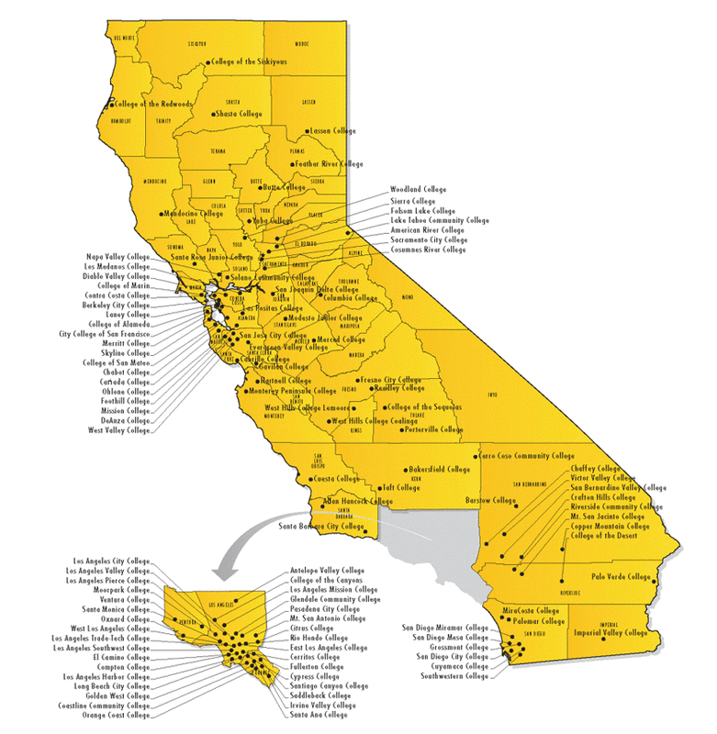
Collaboration
Increases
Adoptions and
Benefits to
Students
Notes:
We are all different - collaboration adds insight. Even better if collaboration is across the state (N/S, rural/urban, large/small, etc.)
IDEA
Additional benefit - building community. Projects built a network in addition to a resource.
This will help with continued updating of the resource

Slide 5
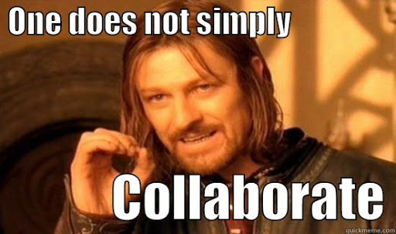
Successful collaborative projects take careful planning
Notes:
Quickmeme: http://www.quickmeme.com/p/3w0f8a
The projects that struggled didn’t have a clear plan

Slide 6
Before submitting the RFP
Planning & Organization

Slide 7
Step 1
Identify all collaborators
Outline of project
Who does what
What is needed by the project:
Creating content
Internal Reviews
Attributions & Accessibility
Identify collaborators and their scope of work
Notes:
We will help find reviewers at the end, but you should be doing internal reviews with the team
It’s OK to have someone do the cleanup - but that should be identified at the beginning (not fall on the leads).
Everyone should work on accessibility & attribution throughout
Accessibility much more difficult after the fact
Attributions may lead to incompatible licenses at the end
LEAD only organizes - they shouldn’t do all the work!

Slide 8
Step 2 - Deliverables and Work-plan
Component | Author | Due Date | Reviewer | Due Date
Chapter 1 text | Mona | Month 1 | Carol | Month 2
Chapter 1 ancillaries | Mona | Month 1 | Sue | Month 2
Chapter 1 images | Bassam | Month 1 | Mona | Month 2
Chapter 2 text | Sue | Month 1 | Carol | Month 2
Chapter 2 ancillaries | Mona | Month 2 | Bassam | Month 3
Notes:
Make sure the workload is fair
Mona is doing most of the work
Should also review others so she isn’t working in a vacuum
Carol is only doing a few review
OK but DON’T have only 1 person writing with everyone else only reviewing
Projects that did best had deep collaboration
Superficial collaboration makes it easy for people to walk away (
This needs to be granular so it’s easy to track
Track it somewhere (google sheet)

Slide 9
During the project
Organization & Communication
Notes:
SUZANNE - end
SHAGUN - start
ALWAYS about organization
Challenge was projects that didn’t have a clear plan

Slide 10
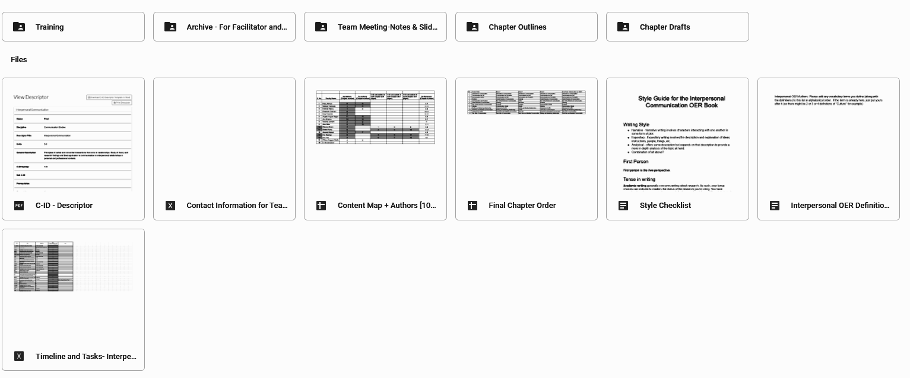
Project Planning by Shagun Kaur is licensed
CC BY 4.0
Step 3: A shared Google drive with folders for planning, resources, timelines, chapter drafts, reviews etc is generally a good place to start
Notes:
A Google folder taken from the Interpersonal COmmunication Facilitated Project

Slide 11
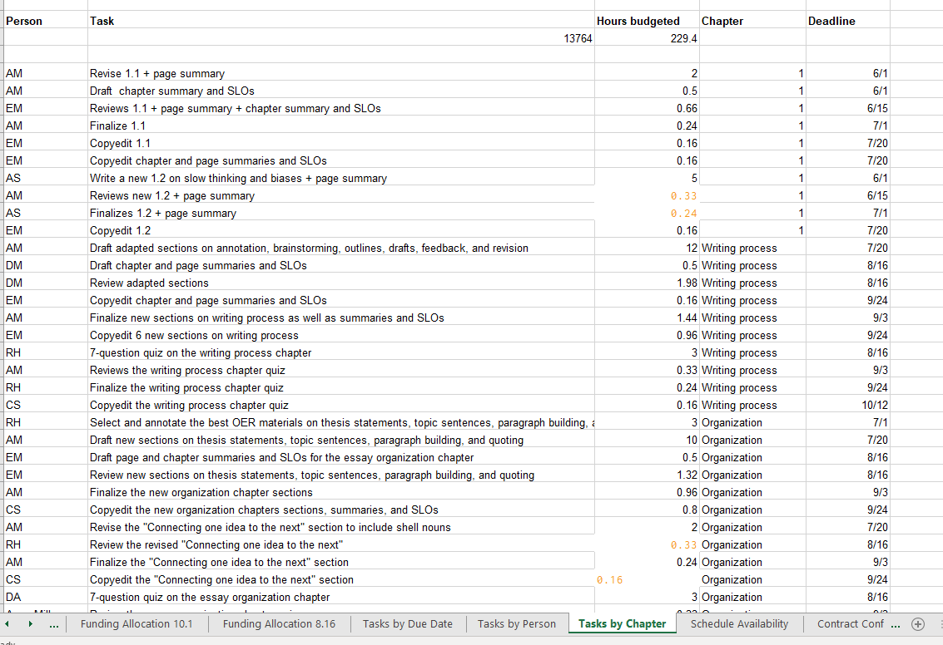
Step 4: Plan: Holistically and individually
Image: RFP3 Project 76 by Anna Mills is licensed CC BY-NC 4.0

Slide 12
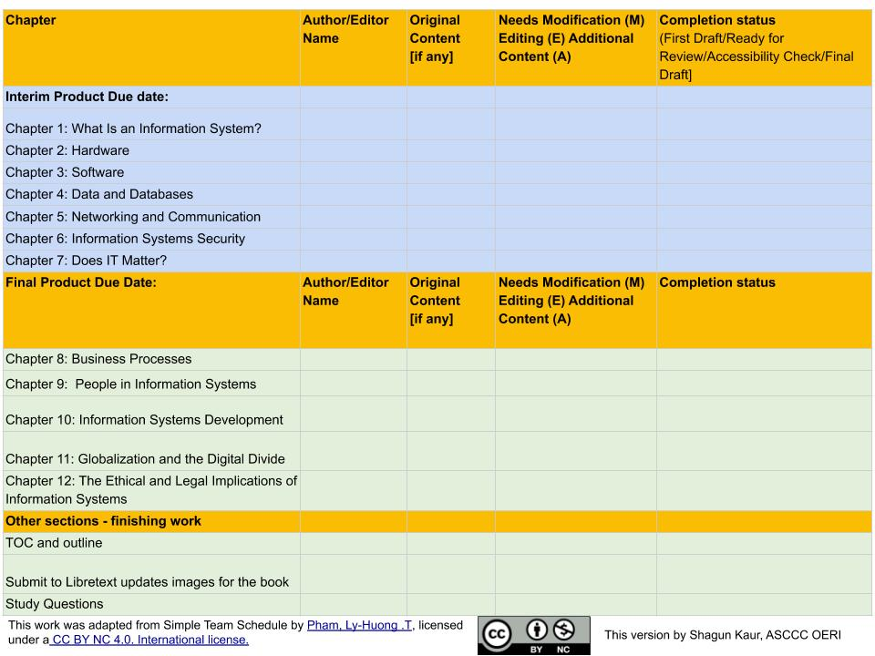
Step 5
Detailed Timeline
&
Tracking

Slide 13
Step 6 - Communication plan
Set up regular, live meetings
At least each month
First meeting in the first few weeks
Meetings with Project Facilitator
Additional communication strategies
Email
Slack, Teams, etc.
Notes:
SHAGUN - end

Slide 14
Ongoing
Content and Tools

Slide 15
Step 7 - Organize resources
Sample Tracker
Notes:
Suzanne

Slide 16
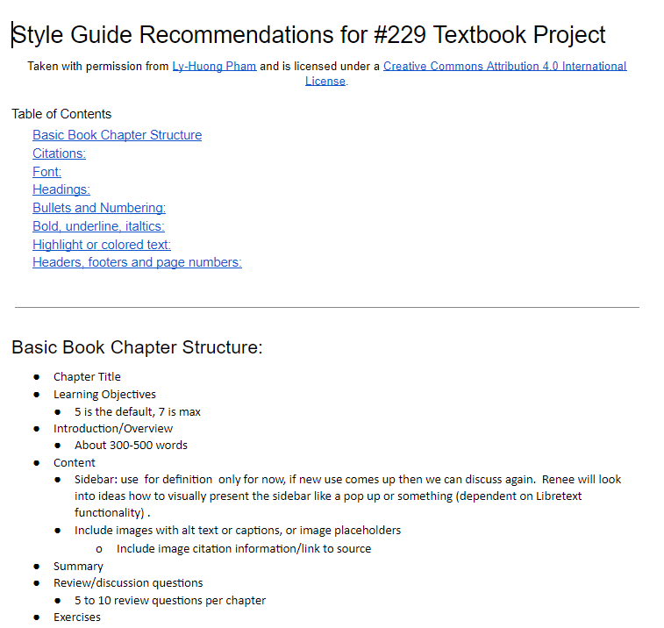
Step 8 - Building the Book
Tools
Google Docs / OneDrive
LibreTexts
Develop a style guide
Notes:
2 Workflows for textbook - depends on group skills, and level of collaboration
Fully in Libre
Start in Google → then move to Libre
Only some need to work in Libre
Ancillaries - different. More like #2

Slide 17
Summary
Identify each person’s scope of work
Develop a detailed timeline for each person
Develop a tracking strategy
Schedule regular meetings with the team
Organize and keep track of all resources used
Work as a team to create a cohesive product

Slide 18
Additional Resources
Archived webinar: RFP III Focused Webinar II – Approaches to Collaboration
ASCCC OERI Website (asccc-oeri.org)
Resources
Webinars and Events
ASCCC OER E-Mail (oeri@asccc.org)

Slide 19
Questions and Answers
Toshi the black pug by Charles Deluvio on Unsplash

Slide 20
THANK YOU
HAPPY HOLIDAYS!
Santa’s Beardie by Pierre Bamin on Unsplash

