Slide 1
How to integrate OER Physics homework sets in Canvas
Emilie Hein, PhD
Skyline College

Slide 2
What are Open Educational Resources?
Creative Commons defines OER as teaching, learning, and research materials that are either (a) in the public domain or (b) licensed in a manner that provides everyone with free and perpetual permission to engage in the 5R activities– retaining, remixing, revising, reusing and redistributing the resources.
-- Creative Commons

Slide 3
The 5R Permissions of OER
Make and own copies
Retain
Reuse
Use in a wide range of ways
Adapt, modify, and improve
Revise
Combine two or more
Remix
Share with others
Redistribute
The framework, freely available under a Creative Commons Attribution 4.0 license (CC BY), was designed by Lumen Learning as the 5Rs

Slide 4
Traditional Textbook
OER
Publishing company owns copyright and sells book for profit
Cannot copy, scan, or share without permission
One student = one copy
Cannot change (revise or edit) material
No one making a profit
Freely and instantly available online
Copy, scan, share, as much as needed
Edit, revise, modify (depending on the license)

Slide 5
Why Use OER, Especially Now?
Free - students need extra financial help right now
Instant access- no waiting for books to arrive
Takes guessing game out of copyright and fair use
Perfect for online classes - many can be integrated into Canvas
Many have a print option

Slide 6
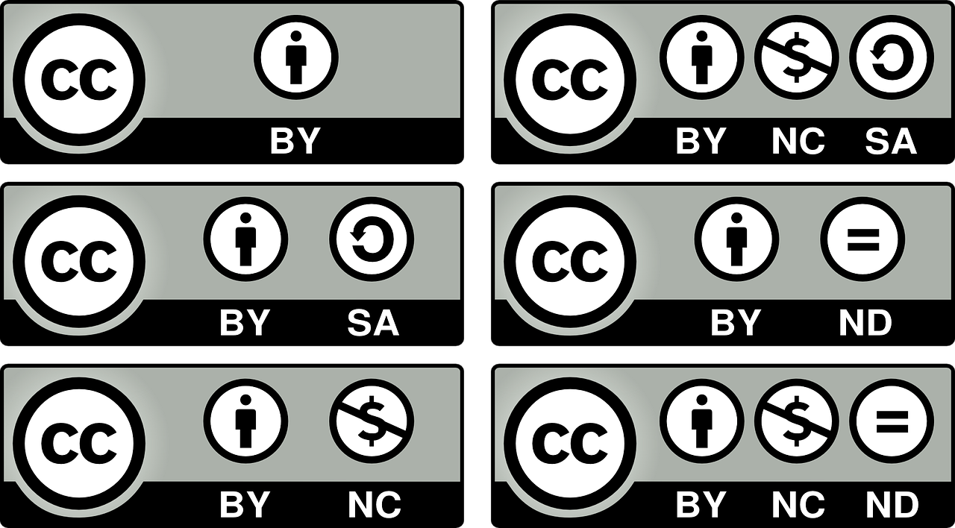
How Do You Know if Something is OER and Not Just Free?
Look for Creative Commons licenses:

Slide 7
OER and Physics: Where to start?
https://asccc-oeri.org > Resources > California Community Colleges Open Educational Resources By Discipline > Physics
https://asccc-oeri.org/open-educational-resources-and-physics/
Also Andrew Park’s webinar last year
Andrew Park: https://asccc-oeri.org/2020/04/16/webinar-oer-for-physics/
Emilie Hein: https://asccc-oeri.org/2021/04/05/oer-and-physics/

Slide 8
OpenStax Physics + MyOpenMath + Canvas
Complete problem sets are available for
OpenStax College Physics (C-ID PHYS 105 and 110)
OpenStax University Physics, Volumes 1, 2 and 3 (C-ID 205, 210 and 215)
PHYS 105 – Course ID: 77794, Enrollment Key: CollegePHYS1 **
PHYS 110 – Course ID: 86217, Enrollment Key: CollegePHYS2 **
PHYS 205 – Course ID: 93601, Enrollment Key: cid.205.template
PHYS 210 – Course ID: 93976, Enrollment Key: cid.210.template
PHYS 215 – Course ID: 75880, Enrollment Key: cid.215.template
If you are interested in using these and have questions, please reach out: Emilie Hein heine@smccd.edu
** updates coming Spring 2021

Slide 9
Getting started with your first MyOpenMath course
Start by creating a MyOpenMath account
Go to https://www.myopenmath.com and click on “request an instructor account”
Or directly to https://www.myopenmath.com/newinstructor.php
Once you can access your account, click “Add New Course”
Then select “Copy from my or a colleague’s course” and use the Course ID and Enrollment Key you want to use.
Pick a course name and an enrollment key
You can review Course Copy Options, etc…
Recommended: LMS Integration (LTI) – select “Allow the LMS to set assessment due dates”
You are ready to create your course!
The course ID
The enrollment key
Key: LTIkey_######_1
Secret: uxE9uxhF

Slide 10
Integrating MyOpenMath into your Canvas course
Go to Settings, then click the Apps tab
Click on View App Configurations, then the +App button
For Configuration type, select "By URL"
For Name, enter MyOpenMath, or whatever you'd like
For Consumer Key, enter: LTIkey_####_1, where #### is your Course ID
For Shared Secret, enter the secret shown in your MyOpenMath Course Settings
For the Config URL, enter https://www.myopenmath.com/canvas.php
Click Submit

Slide 11
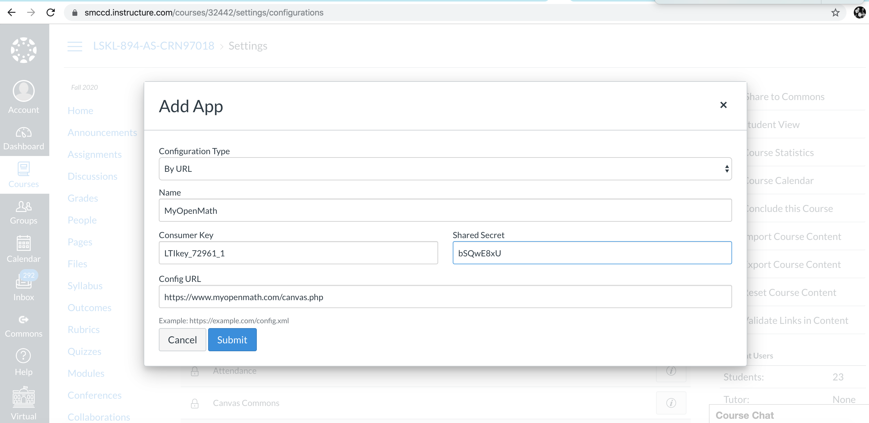

Slide 12
To create a link to an individual assessment, in Canvas
Go to the Assignments page, and click +Assignment
Under Submission Type, select "External Tool"
Click on the "Find" button, then on the MyOpenMath tool (or whatever name you used when you created the tool)
The first time using this key and secret, MyOpenMath will ask you to sign into your MyOpenMath account. This is necessary to establish a connection between your LMS account and your MyOpenMath account.
You will not need to do this step again.
Students will not be asked to sign in and will not need a MyOpenMath account.
If this is your first link from this course, MyOpenMath will ask you to select the MyOpenMath course you want to connect your LMS course with.
Select the assignment you want to link to, and click Make Placement.
Click the Select button
Finish setting up the assignment in Canvas
Assignments set up this way will receive grade return from MyOpenMath

Slide 13
Additional Resources
Cool4ED
MERLOT
OER Commons
LibreTexts
And more free resources…
ComPADRE Resources and Services for Physics Education
Simulations
PhET
Videos
OpenStax's Concept Trailers
Khan Academy Physics Library

Slide 14
Questions?

