Slide 1
OER and Math —
Sharing and Learning Session
12/3/21 Scott Hubbard (shubbard@losmedanos.edu)
🔗 Link to Slides: bit.do/mathoer2
📺 Link to Webinar Recording:

Slide 2
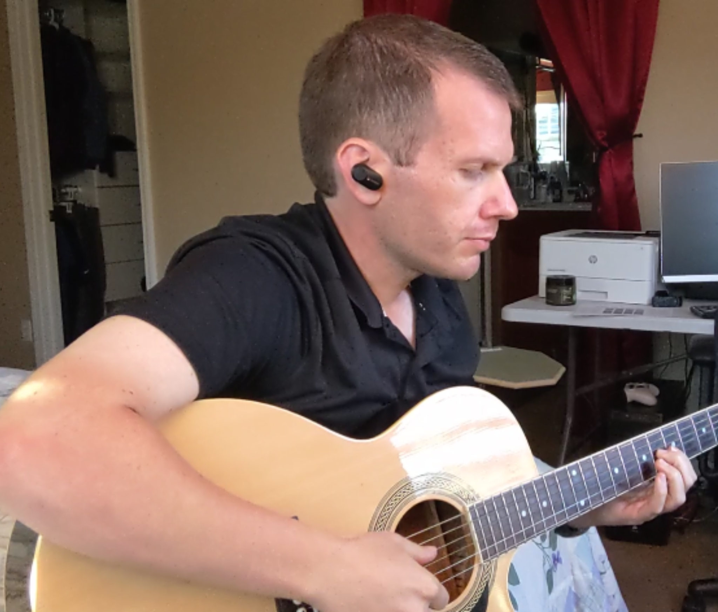
Who Am I?
Scott Hubbard, Los Medanos College
Math faculty at Los Medanos College
OER user for six years
OERI Liaison and Math Discipline Lead
Project co-lead at LMC for three years
Our OER@LMC page: https://www.losmedanos.edu/oer/

Slide 3
What are Open Educational Resources?
Creative Commons defines OER as teaching, learning, and research materials that are either (a) in the public domain or (b) licensed in a manner that provides everyone with free and perpetual permission to engage in the 5R activities– retaining, remixing, revising, reusing and redistributing the resources.
— Creative Commons

Slide 4
The 5R Permissions of OER
Make and own copies
Retain
Reuse
Use in a wide range of ways
Adapt, modify, and improve
Revise
Combine two or more
Remix
Share with others
Redistribute
The framework, freely available under a Creative Commons Attribution 4.0 license (CC BY), was designed by Lumen Learning as the 5Rs

Slide 5
Traditional Textbook
OER
Publishing company owns copyright and sells book for profit
Cannot copy, scan, or share without permission
One student = one copy
Cannot change (revise or edit) material
No one making a profit
Freely and instantly available online
Copy, scan, share, as much as needed
Edit, revise, modify (depending on the license)

Slide 6
Why Use OER, Especially Now?
Free - students need extra financial help right now
Instant access - no waiting for books to arrive
Takes guessing game out of copyright and fair use
Perfect for online classes - many can be integrated into Canvas
Many have a print option

Slide 7
How Do You Know if Something is OER and Not Just Free?
Look for Creative Commons licenses:

Slide 8
OER and ZTC Helps Students

Slide 9
Resources
https://asccc-oeri.org/resources/
https://ccconlineed.instructure.com/courses/4543/pages/discipline-page
https://ccconlineed.instructure.com/courses/4543/pages/oer-and-the-math-transfer-model-curriculum
https://cool4ed.org/course-showcase
https://www.cool4ed.org/courseshowcase-resources/36/317
https://openstax.org/subjects/math
https://www.myopenmath.com/

Slide 10
Discussion Time
What’s Good and Not So Good for Math OER
MyOpenMath
RFP: tinyurl.com/OERI-RFP4

Slide 11
OER and Math —
Sharing and Learning Session
12/3/21 Scott Hubbard (shubbard@losmedanos.edu)
🔗 Link to Slides: bit.do/mathoer2

