Slide 1
Welcome to How to OER: A Guide for Showing Discipline Faculty How to Map Their Courses and Find OER
On behalf of the ASCCC OERI, we are pleased to have you here for one of our weekly webinars.
If you are not already muted, please mute yourself upon arrival. As this is set up as a meeting, we will be able to have an actual discussion – but we need all those who are not speaking to be muted.
You are also encouraged to use the “chat” feature. Feel free to introduce yourself in the chat while we wait to get started.
This webinar will be recorded.

Slide 2
How to OER: A Guide for Showing Discipline Faculty How to Map Their Courses and Find OER
Sally Potter
Fresno City College, Dept of EMLS/Linguistics, OER Faculty Coordinator
OERI Area A Regional Lead
sally.potter@fresnocitycollege.edu

Slide 3
Agenda
Quick introductions
Course mapping “tools”
Crash course on licensing & attribution
All the places to look for OER
Discussion & questions

Slide 4
Backwards Mapping of SLOs/Objectives & Course Design
STEP 1: Start with what you want students to learn.
STEP 2: Plan your assessments.
STEP 3: Look for materials that give students the information that will make them succeed on the assessments.
STEP 4: Prepare the materials and deliver them to your students.

Slide 5
Creative Commons
Nonprofit “dedicated to building a globally-accessible public commons of knowledge and culture”
Supplies copyright licenses, including legal framework that allows creators to share work more openly
Licenses work within existing copyright law

Slide 6
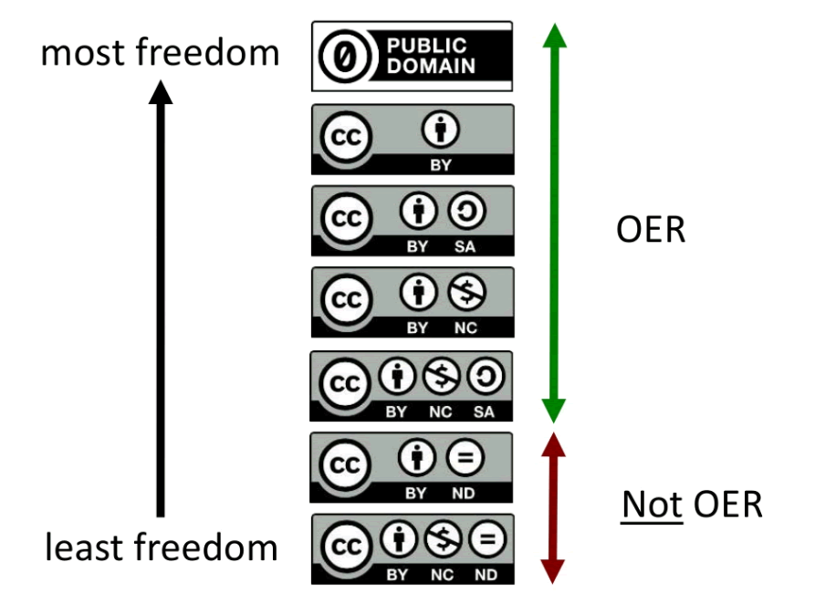
Creative Commons Licenses by D'Arcy Hutchings is licensed under a Creative Commons Attribution 4.0 International License.
All Ygraph.com content and data are available under the CCA 3.0 license.
Notes:
ASCCC OERI archived webinars:
OER Licensing and Attributions: https://asccc-oeri.org/2020/03/30/webinar-oer-licensing-and-attributions-2/
Creative Commons, Copyright, and Fair Use: Why Do We Need OER?: https://asccc-oeri.org/2019/10/24/creative-commons-copyright-and-fair-use-why-do-we-need-oer/

Slide 7
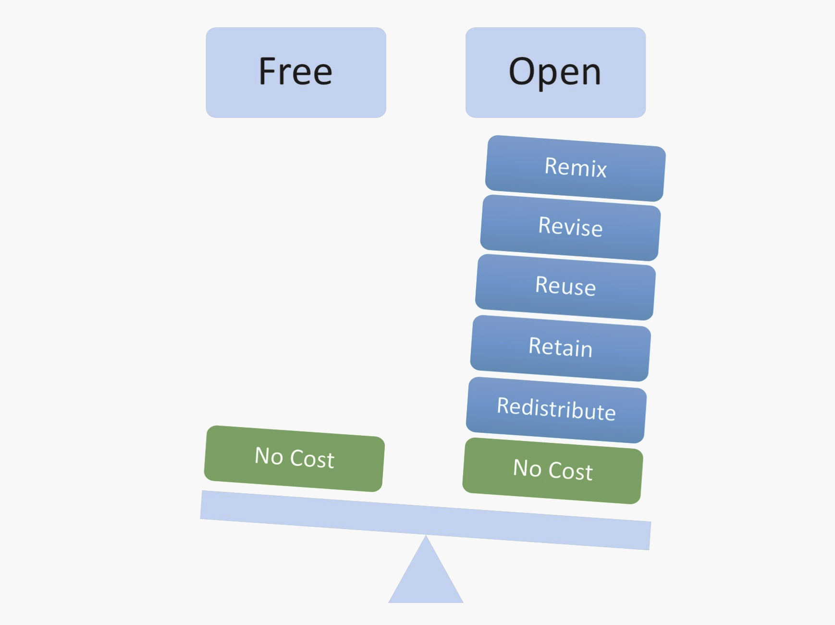
More than just free
Fair Use
ZTC
Magician by GraphicMama-team from Pixabay, CCO
Free v. Open by Designers for Learning: Gain Experience for Good, Jennifer Maddrell, Director (CC, BY, NC, SA)
Notes:
7

Slide 8
Zero Textbook Cost (ZTC)
Library resources: ebooks, journal articles, LibGuides, videos on demand, newspaper articles, etc.
Websites (be aware of Accessibility issues)

Slide 9
How to Attribute Sources: TASL
TITLE - What is the name of the material?
AUTHOR - Who owns the material?
SOURCE - Where can I find it?
LICENSE - How can I use it?

Slide 10
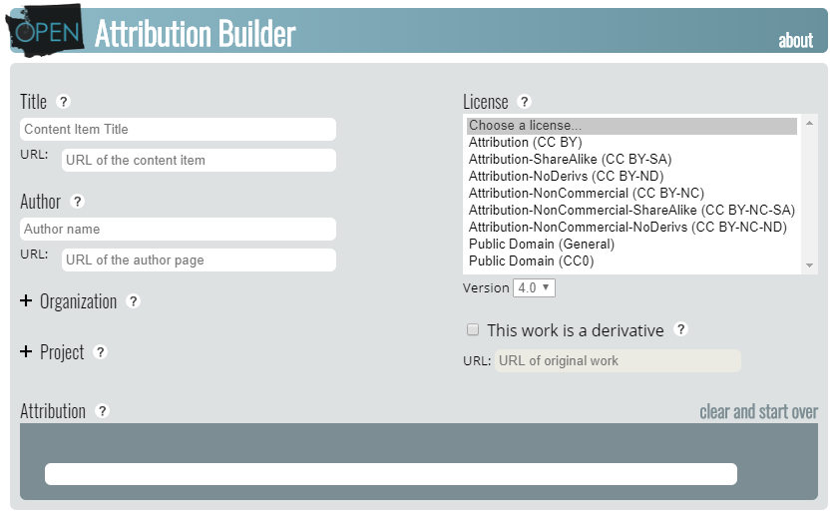
Great Resource for Attributions – Open Attribution Builder
"Open Attribution Builder" by Open Washington is licensed under CC BY 4.0
Notes:
https://www.openwa.org/attrib-builder/

Slide 11
Finding OER: Where to Look for High Quality OER

Slide 12
OERI Website
asccc-oeri.org
Webinars & Events tab → Archived Webinars
Resources tab → OER by Discipline

Slide 13
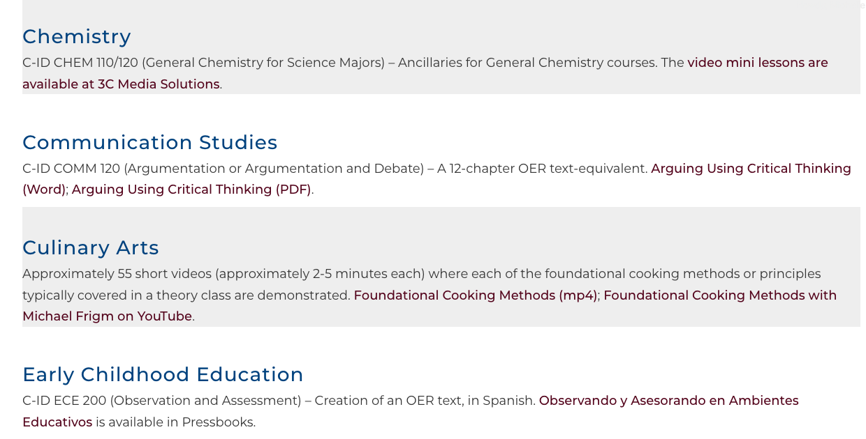
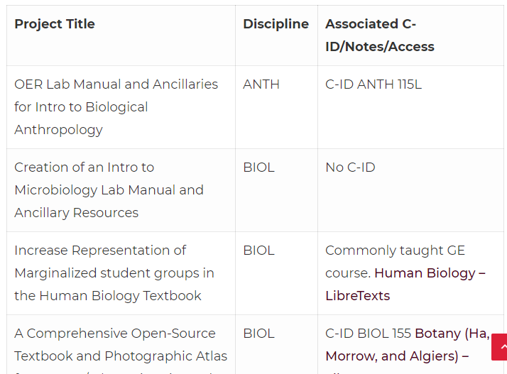
Looking at the OERI Website

Slide 14
OERI Canvas Site
http://tinyurl.com/ASCCC-OpenEd
Collections provided by
By CSU GE & TMC
By Discipline

Slide 15
Looking at the OERI Canvas Shell
→Discipline Specific Resources
Find your discipline on the Discipline Page

Slide 16
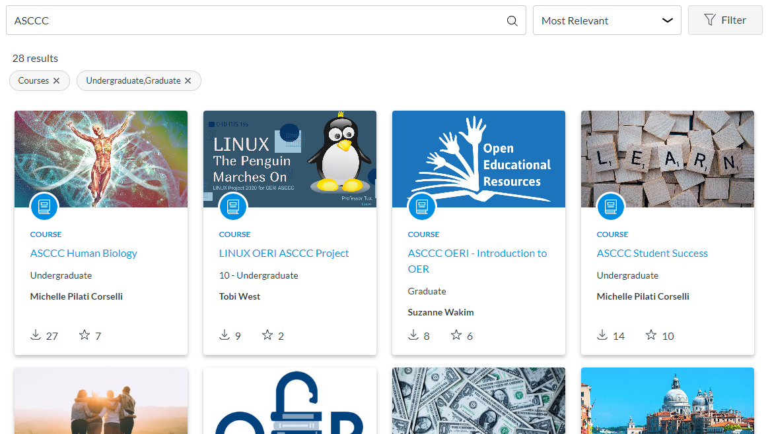
OERI on Canvas Commons
Resources are shared on Canvas Commons

Slide 17
Complete Textbook Repositories

Slide 18
Open Textbook Library
https://open.umn.edu/opentextbooks
A peer-reviewed collection of hundreds of open textbooks spanning multiple subjects
All textbooks are quality reviewed by faculty from a variety of institutions
Suggestion: Browse by subject or search subject
Notes:
Is a referatory, which means it links to materials from different authors and publishers instead of housing those materials on its platform.
Supported by the Open Education Network (lots of OER studies) and contains over 900 open textbooks - 60% of books in the Open Textbook Library have been reviewed by faculty. If you look at those reviews, they look at things like obviously the accuracy and comprehensiveness, organization/flow of the work, readability, cultural relevance and sensitivity. Book is given an overall rating averaging out separate reviews.
Business, Computer science, engineering, biology, math, law, social sciences, natural sciences, medicine, etc.

Slide 19
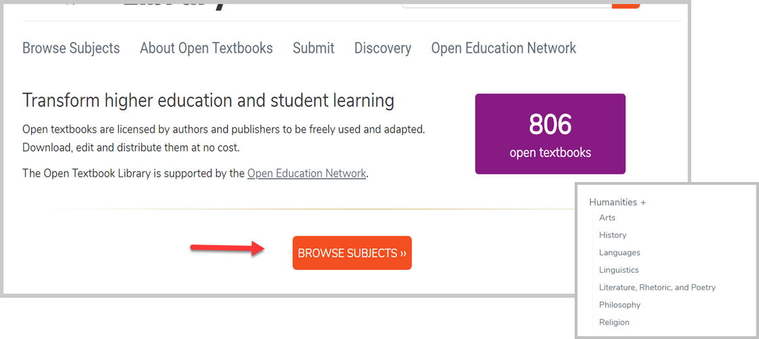
Looking at Open Textbook Library

Slide 20
OpenStax
https://openstax.org/
Professionally written and peer reviewed
Has ancillaries
Has LTIs from partners that are not “free”
Notes:
Project of Rice University
Titles are peer-reviewed by educators to ensure readability, accuracy, meet requirements for courses they're written for.
40 titles ranging in topics from Astronomy to Economics and Psychology.
Anyone can adopt titles in OpenStax. You can just link to the page for students. OpenStax partners with OER Commons so that you can find materials created to align with specific OpenStax content.
Some of the titles come with instructor and students resources. There is a cartridge that allows you to embed the book into Canvas. Some books have ancillaries.

Slide 21
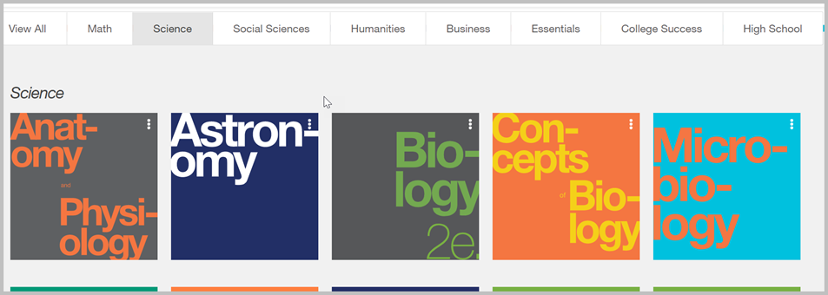
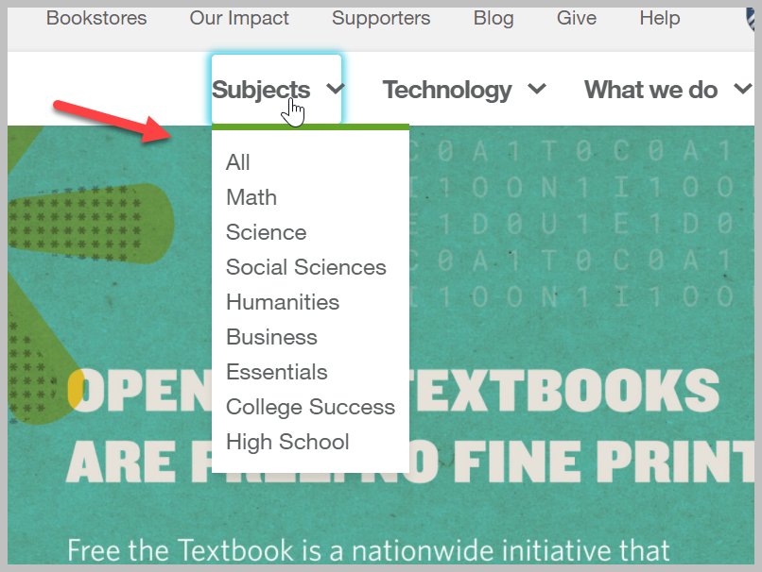
Looking at OpenStax

Slide 22
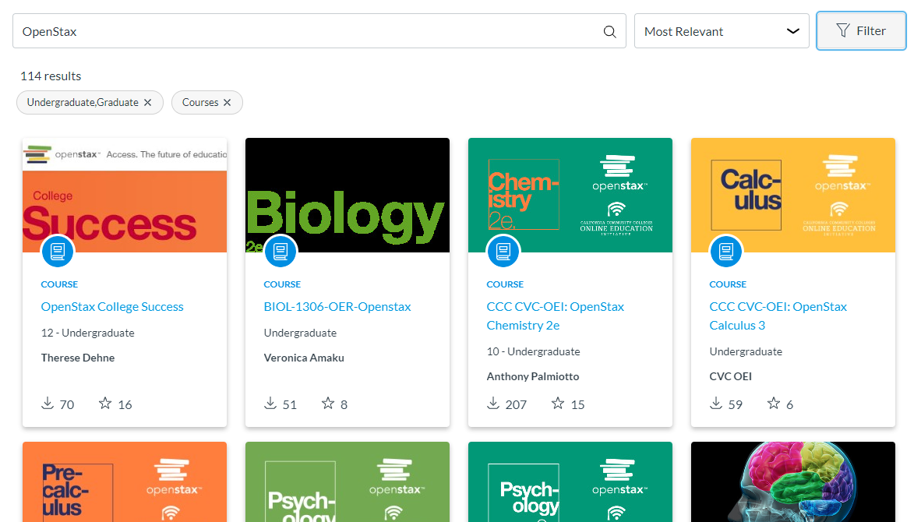
OpenStax is Now in Canvas Commons

Slide 23
Open SUNY Textbooks
https://textbooks.opensuny.org/browse-oer/
Smaller repository
Textbooks are authored and peer-reviewed by SUNY faculty and staff
Textbook tab → Browse by Subject
Publishing initiative established by State University of New York libraries and supported by SUNY Innovative Instruction Technology Grants
Notes:
Covers a large range of subjects but only about 1-4 titles in each subject
What’s interesting about SUNY Textbooks is that the titles in here are either original work, or a significant adaptation of another open work, so it is somewhat “exclusive” content

Slide 24
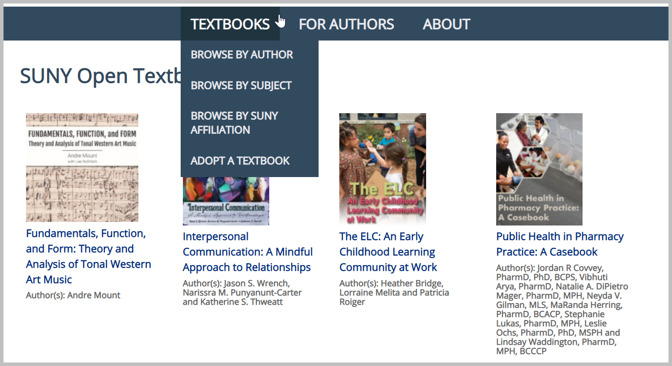
Looking At Open SUNY

Slide 25
BC Campus Open Ed
https://open.bccampus.ca/browse-our-collection/find-open-textbooks/
Reviewed by faculty
Meets BC Campus accessibility requirements

Slide 26
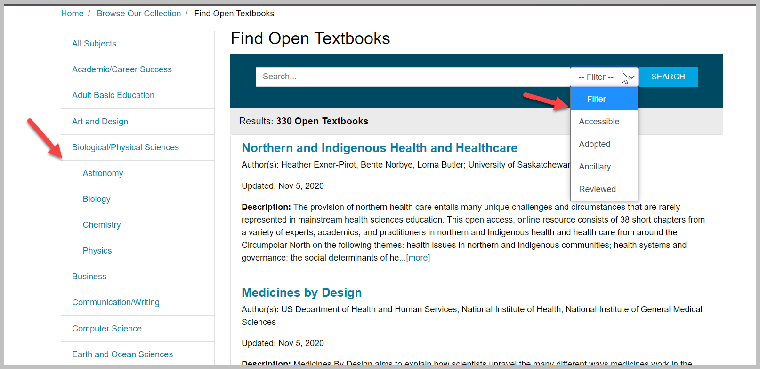
Looking at BC Campus Open Ed

Slide 27
Aggregated Repositories

Slide 28
Skills Common
https://www.skillscommons.org/
Workforce Training Materials
Expansion through Trade Adjustment Assistance for Community Colleges and Career Training (TAACCCT) grant
Browse by industry or search a topic

Slide 29
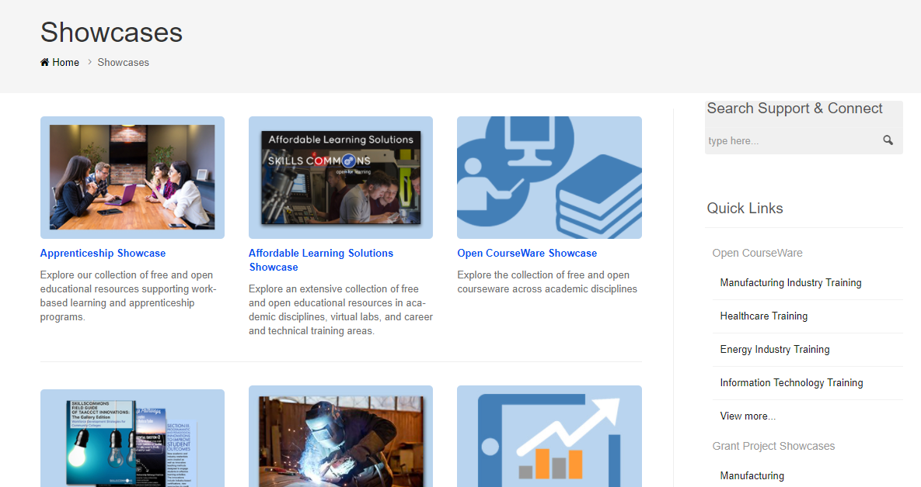
Looking at Skills Commons

Slide 30
cool4ed
http://www.cool4ed.org/
California Open Online Library for Education aggregates searches across several collections
→ Course Materials Showcase (toolbar across top)
→ Select Discipline
→ Select CID or Course
Notes:
Larger repository/referatory that has books, but also modules, assignments, full courses, and ancillaries.
Sort of an extension of MERLOT.
Created by the California Open Education Resource Council and hosted by the CSU system. You can search by course ID.

Slide 31
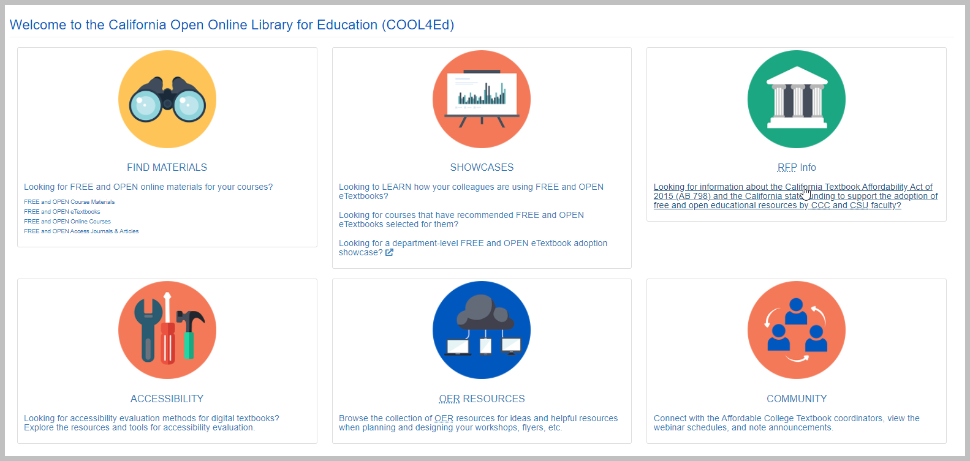
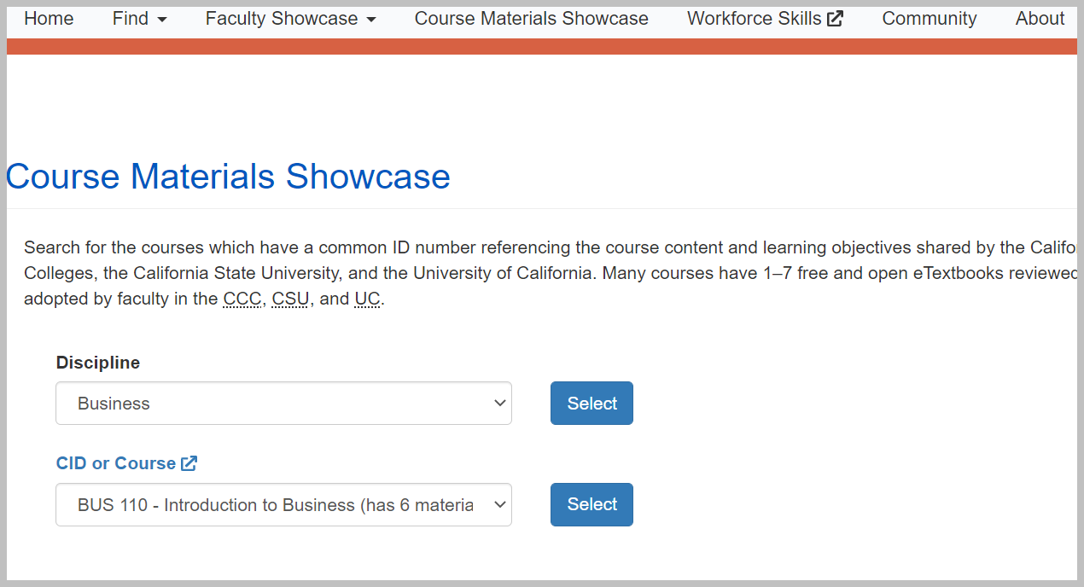
Looking at cool4ed
Notes:
Faculty showcase where faculty describe their process, challenges during development, differences in student learning, student feedback, about the course it's used in.
Materials showcase provides ratings by faculty from the CCC, CSU, and UC. Ratings are based on a standard rubric.

Slide 32
Open Oregon
http://openoregon.org/resources/
Aggregates library and openly licensed materials by:
Course name
Institution
Instructor information

Slide 33
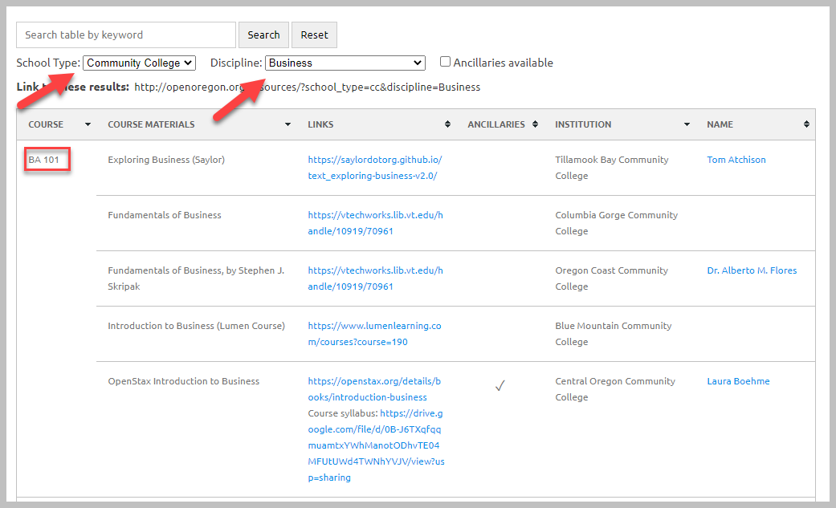
Looking at Open Oregon
Notes:
I encourage you that if the material says “available via library access” to check with our library

Slide 34
OER Commons
https://www.oercommons.org/
Suggestion: Use the drop-down menus to filter your search!
Also has a building platform

Slide 35
Looking at OER Commons
Notes:
Filter by subject, education level and whether the material aligns with some kind of state standard
I usually just filter by subject and education level, but you can just do a general search and filter as you go just as you would in a library database

Slide 36
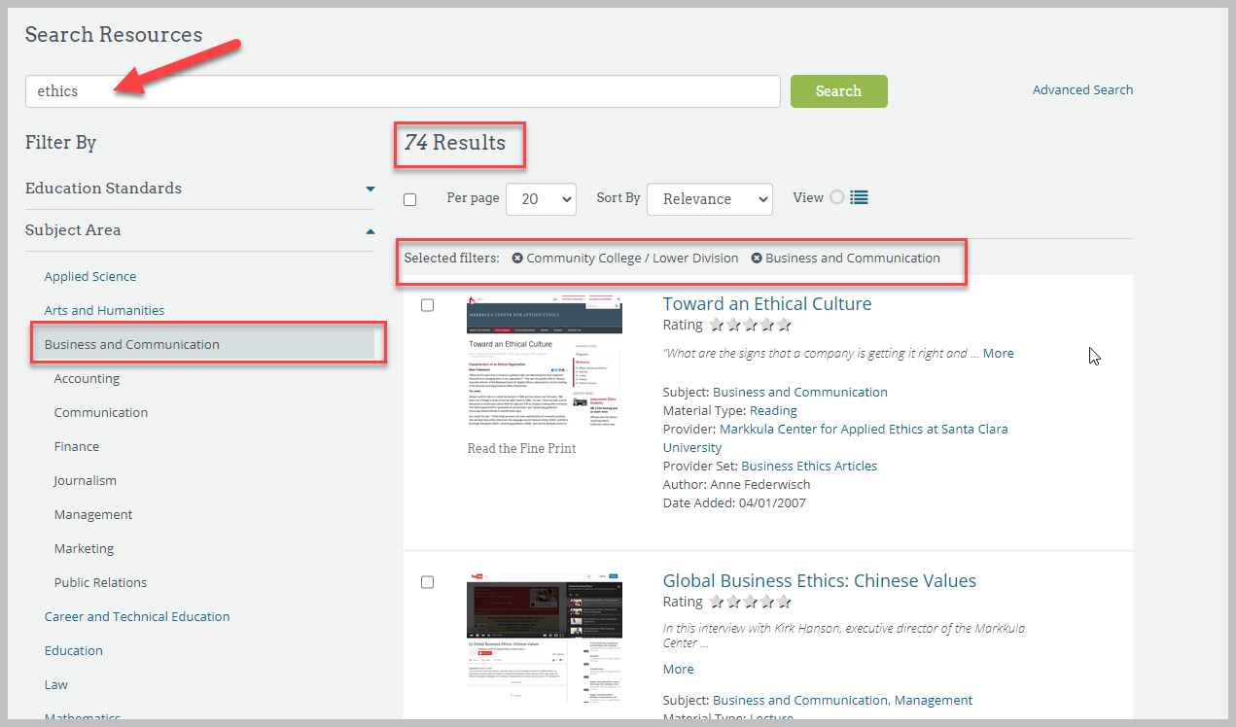
Looking at OER Commons cont.
Notes:
Broad search for anything related to Ethics, then filtered to materials in the subject area of business and communication as well as the education level to lower division or community college
You can also limit by license type, media format, and material type. It is a huge repository which is why it has so many limiters

Slide 37
LibreTexts
https://libretexts.org/
A repository of OER
Can “easily” remix various books together
Editable and importable
Notes:
Started by faculty at UC Davis and expanded under a Dept of Education grant.
A repository for OER, but what I think makes LibreText different from the other two is it allows for advanced customization and creation of OER (e.g. interactive elements) all within LibreText studio. Or you can just use what you find in there, as is.
Nearly 400 textbooks/materials and they are all in different libraries or sections of the platform.
Subjects include, biology, chemistry, engineering, humanities, math, workforce development, foreign language, etc.
A note about LibreText. It has a pretty good level of support, I think, and there is the opportunity of having on-site training for using the studio.

Slide 38
OASIS Geneseo
https://oasis.geneseo.edu/
Search tool that aims to make the discovery of open content easier
Textbooks, videos, and ready to use modules available
Identify keywords related to your course and its learning outcomes and/or objectives
114 Sources
Textbooks, modules, podcasts, video, and more
Notes:
Sources mean that it is pulling from other repositories - many universities, open publishing houses, content like TED Talks, and repositories like BCCampus and LibreTexts

Slide 39
Looking at Oasis
Limit your search by
Material type
License
Subject
Source
Notes:
Linda

Slide 40
Google Advanced Search
Advanced option is under “settings” or “tools”
Select “usage rights”
Add lots of limiters

Slide 41
Questions? Any tips or tricks you can share?
Photo by Yellow CC BY NC 2.0 on flickr.com

