Slide 1
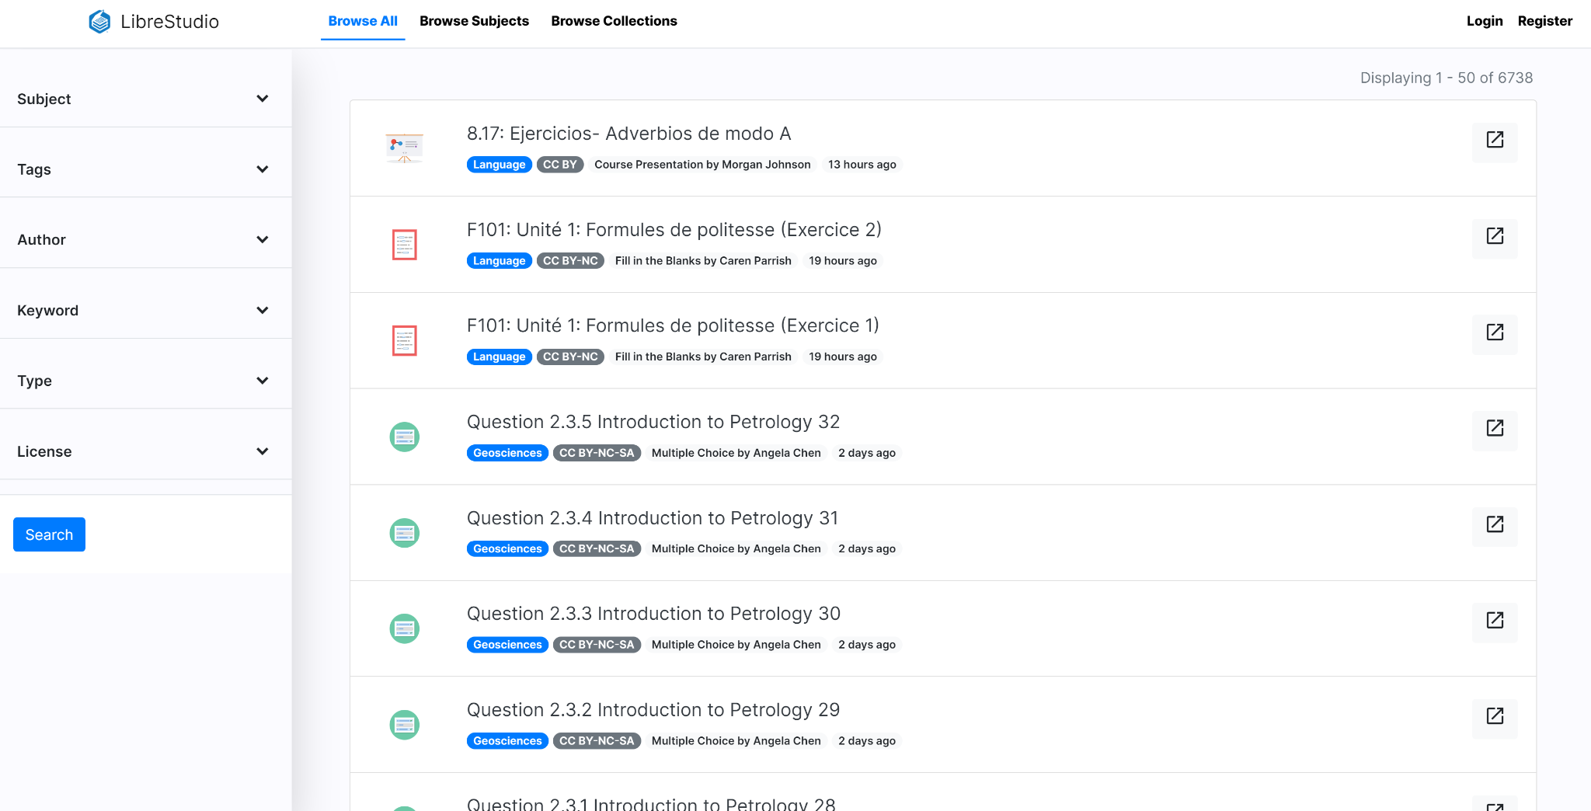
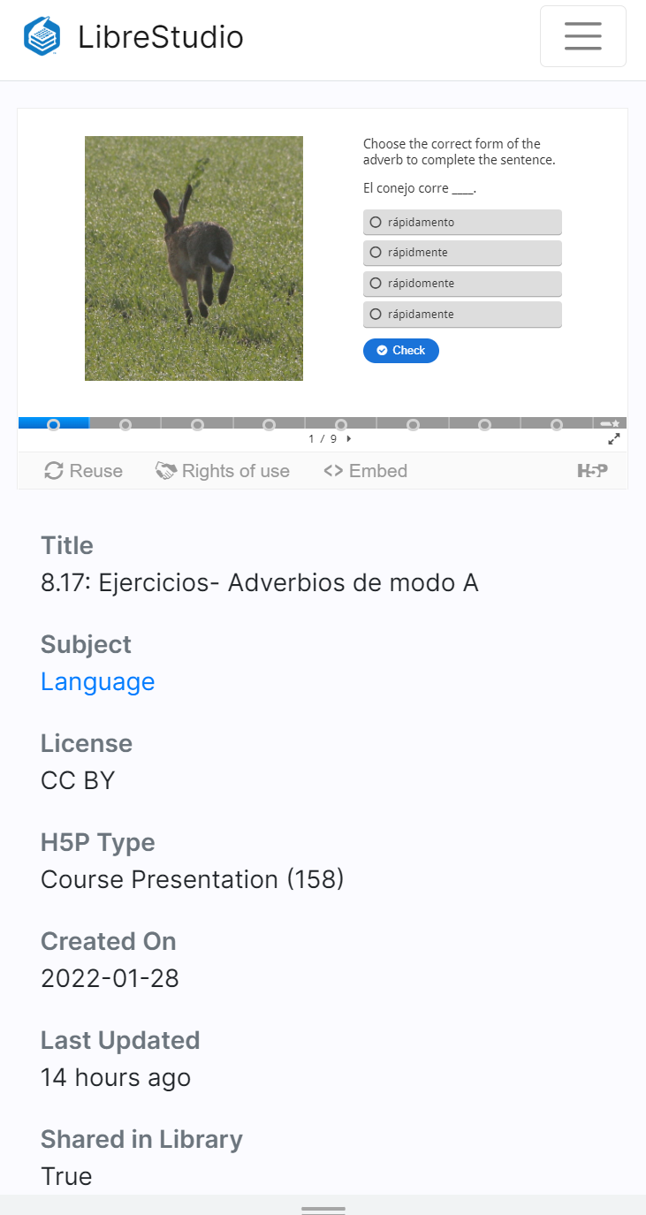
Beginner Series: Introduction to H5P
ASCCC OERI Webinars
March 25, 2022

Slide 2
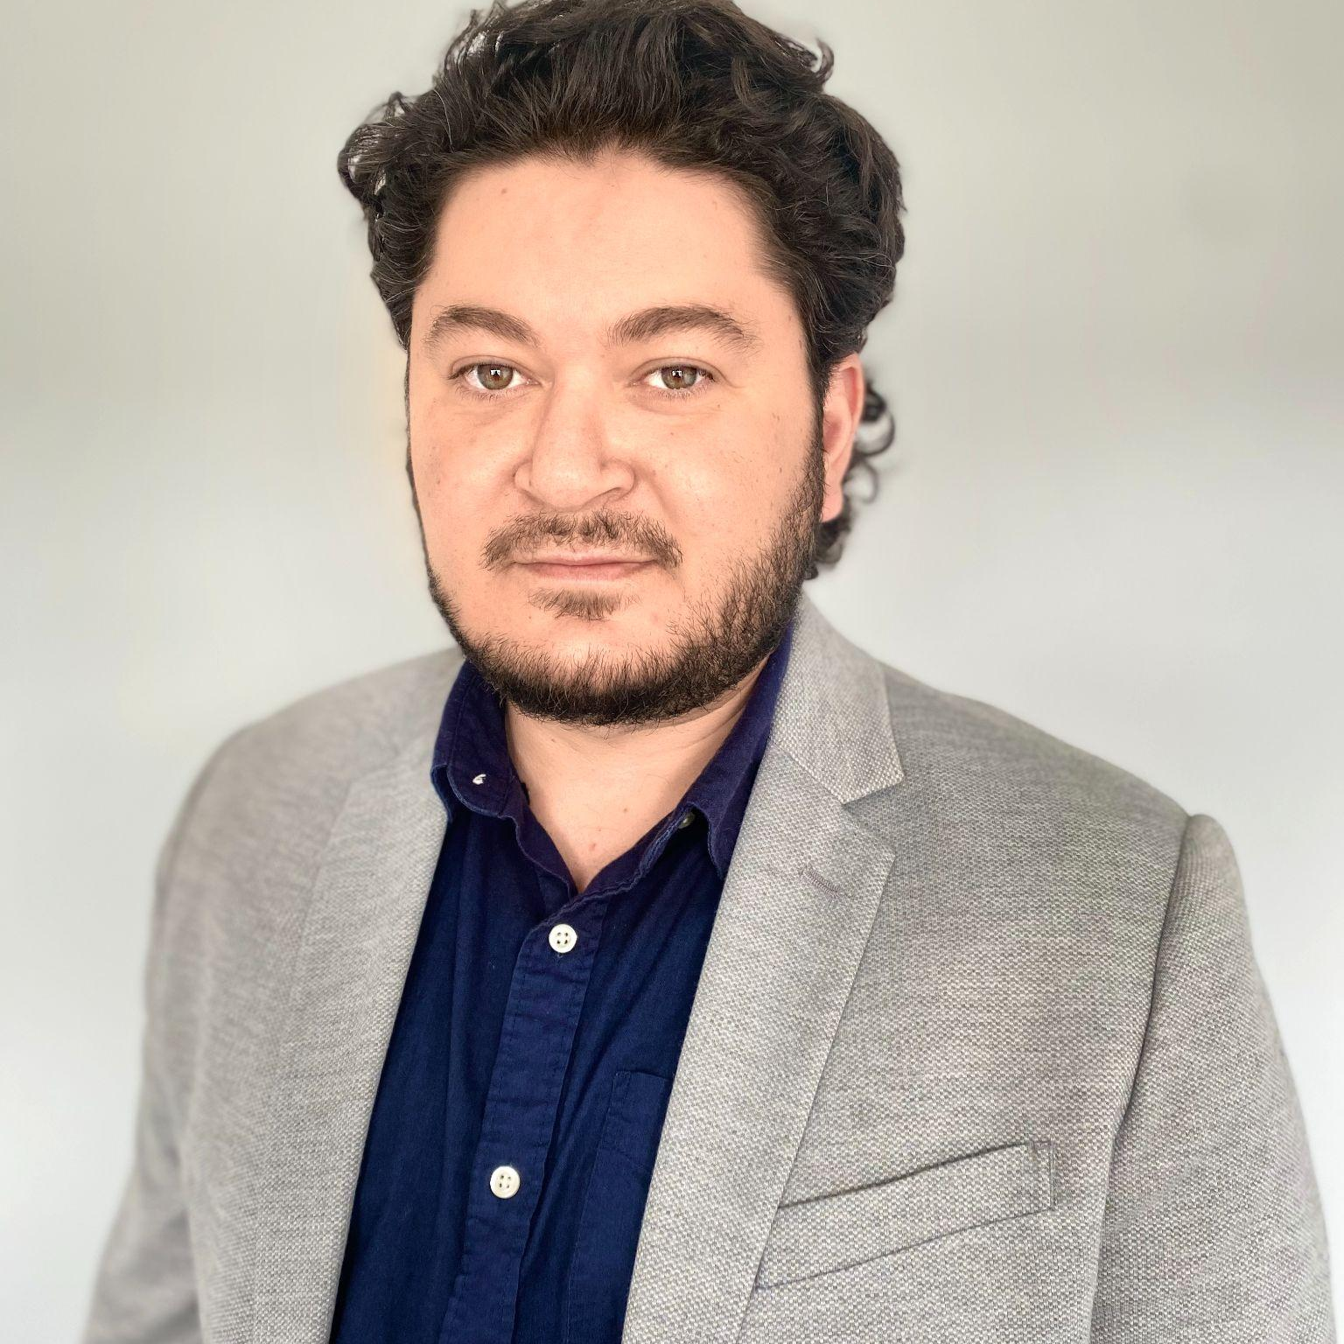
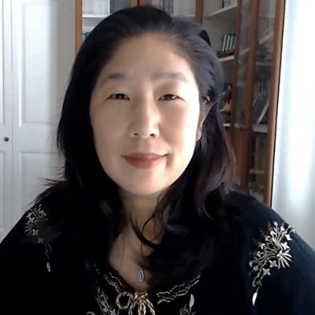
Presenters
Yasin Dahi
Cristina Moon
Sr. Product Manager
LibreTexts
Spanish Faculty
Chabot College
yasin@libretexts.org
@ymdahi
cmoon@chabotcollege.edu
Co-author of Entrada Libre

Slide 3
Agenda
1. What is H5P?
2. Introduction to LibreStudio
3. Cristina Moon: Real World Examples
4. Hands-on Exercise with H5P & LibreStudio
5. Questions and Answers

Slide 4
What is H5P?
Using H5P you can create interactive web-based educational resources that are reusable and remixable.
For more detailed information, visit:
h5p.org
h5p.com

Slide 5
What can you create with H5P?
There are 55 content types available on LibreStudio, you can learn more about each content type at h5p.org:
https://h5p.org/content-types-and-applications

Slide 6
What can you create with H5P?
Create interactive assignments and activities.
Activity: Formative Assessment Quiz
Assignment: Self-paced learning with Documentation Tool
Reading: Presentations with self-assessment
Reading: Engaging interactive videos

Slide 7
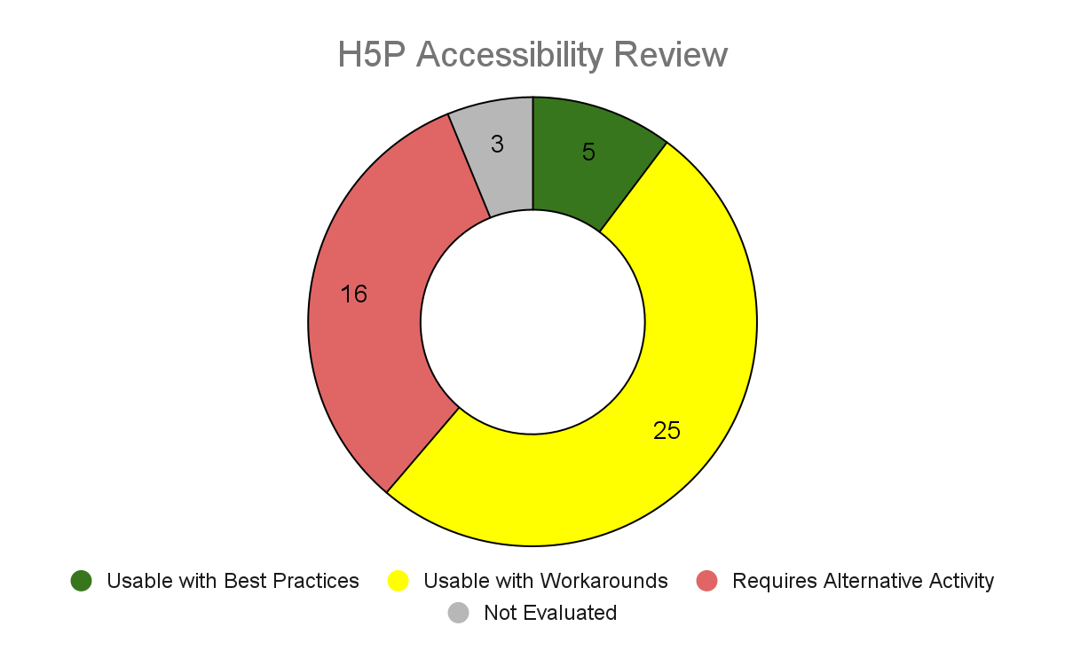
Accessibility
Link to H5P Accessibility Review
Review conducted by Nicolas Crisosto from ASCCC OERI
Contains tips for authors to guide towards better accessibility for each content type

Slide 8
What can we do with H5P?
Create interactive content
Embed our h5p where our student learn
Share our h5p with an open license
Download, Remix/adapt any h5p shared openly

Slide 9
What are some ideas for projects?
Add mini self-assessment questions to your course/book
Refresh your videos / presentations
Replace your Captivate learning modules
Collaborate with your colleagues on a interactive content bank
Create Student-authoring assignments

Slide 10
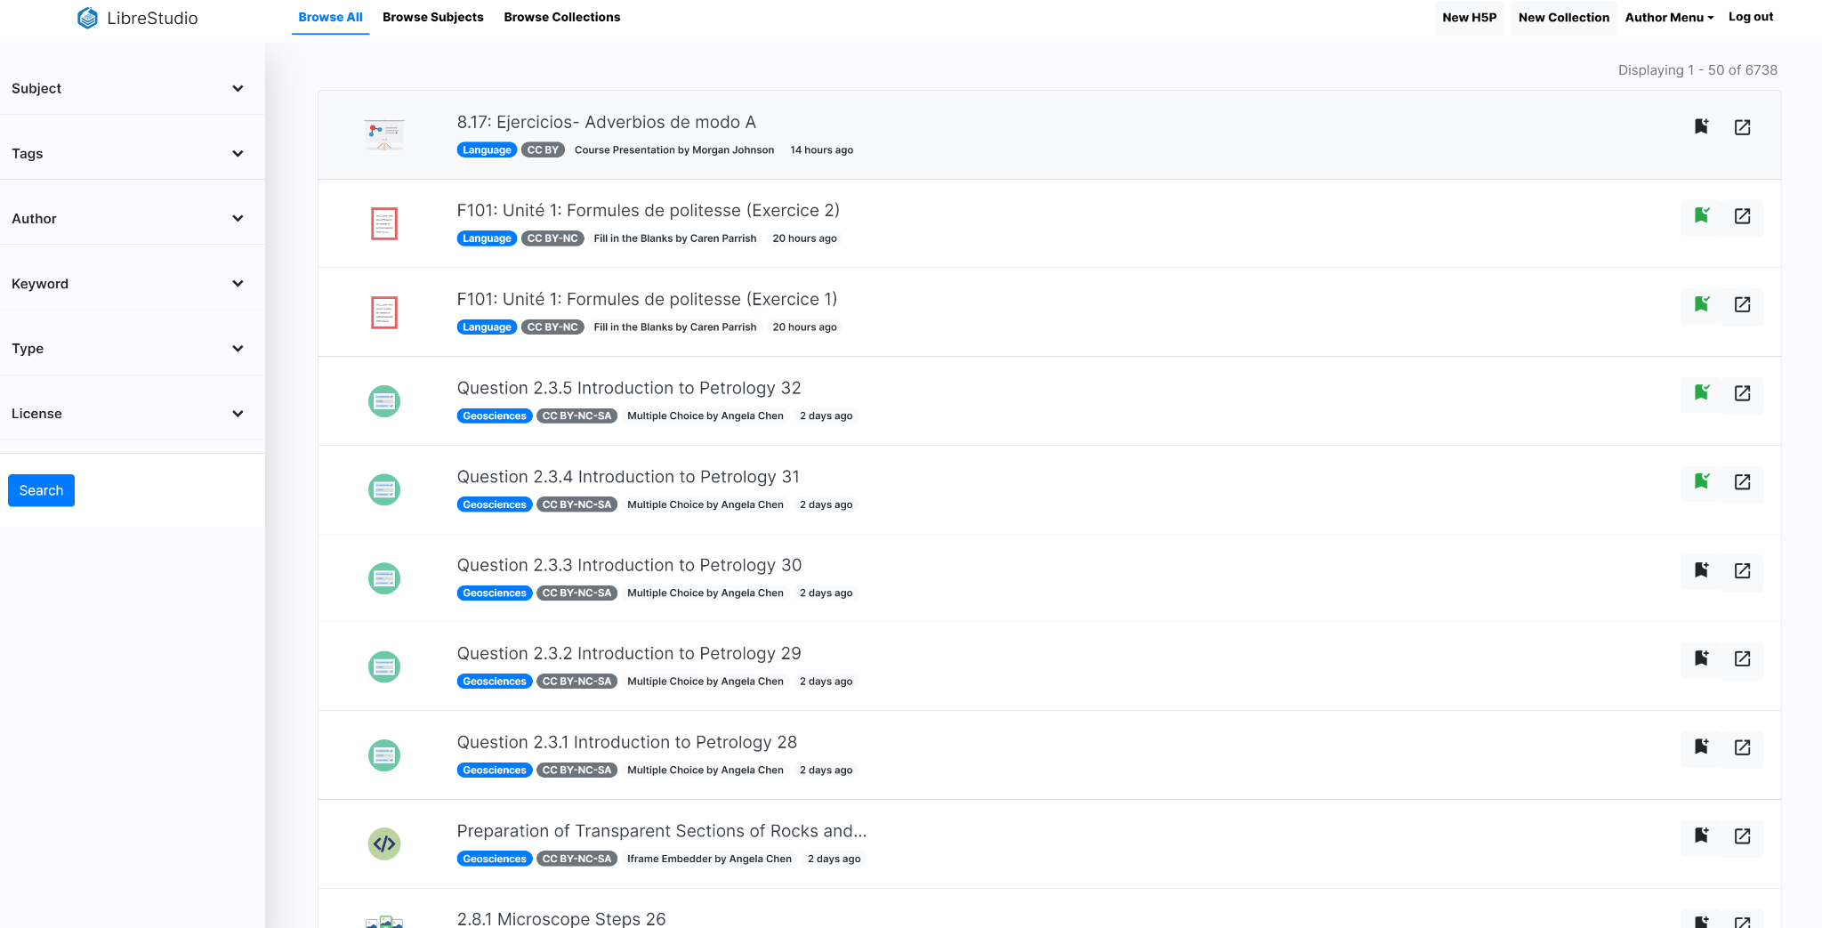
Introduction to LibreStudio

Slide 11
LibreStudio
Over 7500 openly shared h5p and 300+ educators actively creating content.
Create, remix, and share h5p
Free to all ASCCC members
Shared Catalogue and Collections
Instructor Profiles
Collaborations
studio.libretexts.org

Slide 12
LibreStudio
Register for account:
Register with the following code:
ASCCC
studio.libretexts.org

Slide 13
Real-world Examples
With Dr. Cristina Moon Spanish Faculty, Chabot College

Slide 14
Dr. Cristina Moon
Dr. Cristina Moon is Professor of Spanish at Chabot College. She joined the college in 2006. She earned a Bachelor of Arts in Spanish from UC Berkeley, and a Master of Arts and Doctorate in Hispanic Languages and Literatures from UCLA. Dr. Moon taught at UCLA, Scripps College, Western University of Health Sciences (Pomona), and San Jose State University. She has developed online courses for first and second-year Spanish and has been teaching online since 2008.
Currently, Dr. Moon is the Spanish Lead, H5P Lead, and the OER Liaison for the Academic Senate for California Community Colleges Open Educational Resources Initiative (ASCCC OERI). At Chabot College, she is the OER/ZTC Coordinator and World Languages Coordinator.
Spanish Faculty at Chabot College
cmoon@chabotcollege.edu Co-author of Entrada Libre

Slide 15
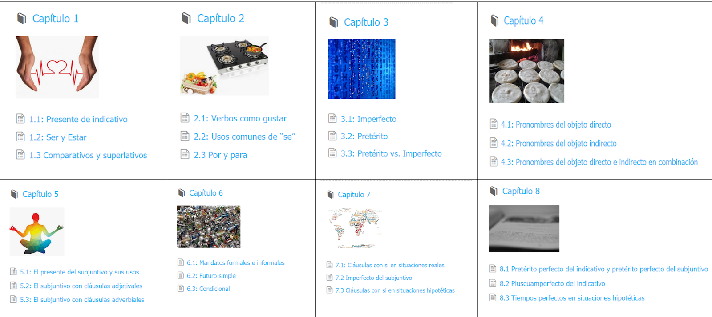
Entrada Libre: Intermediate/Advanced Spanish Grammar Manual

Slide 16
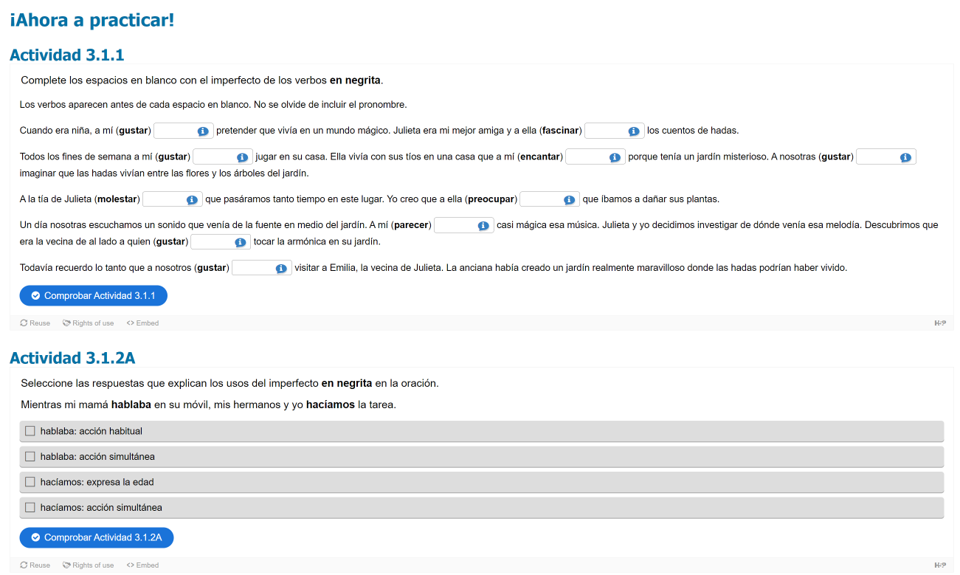
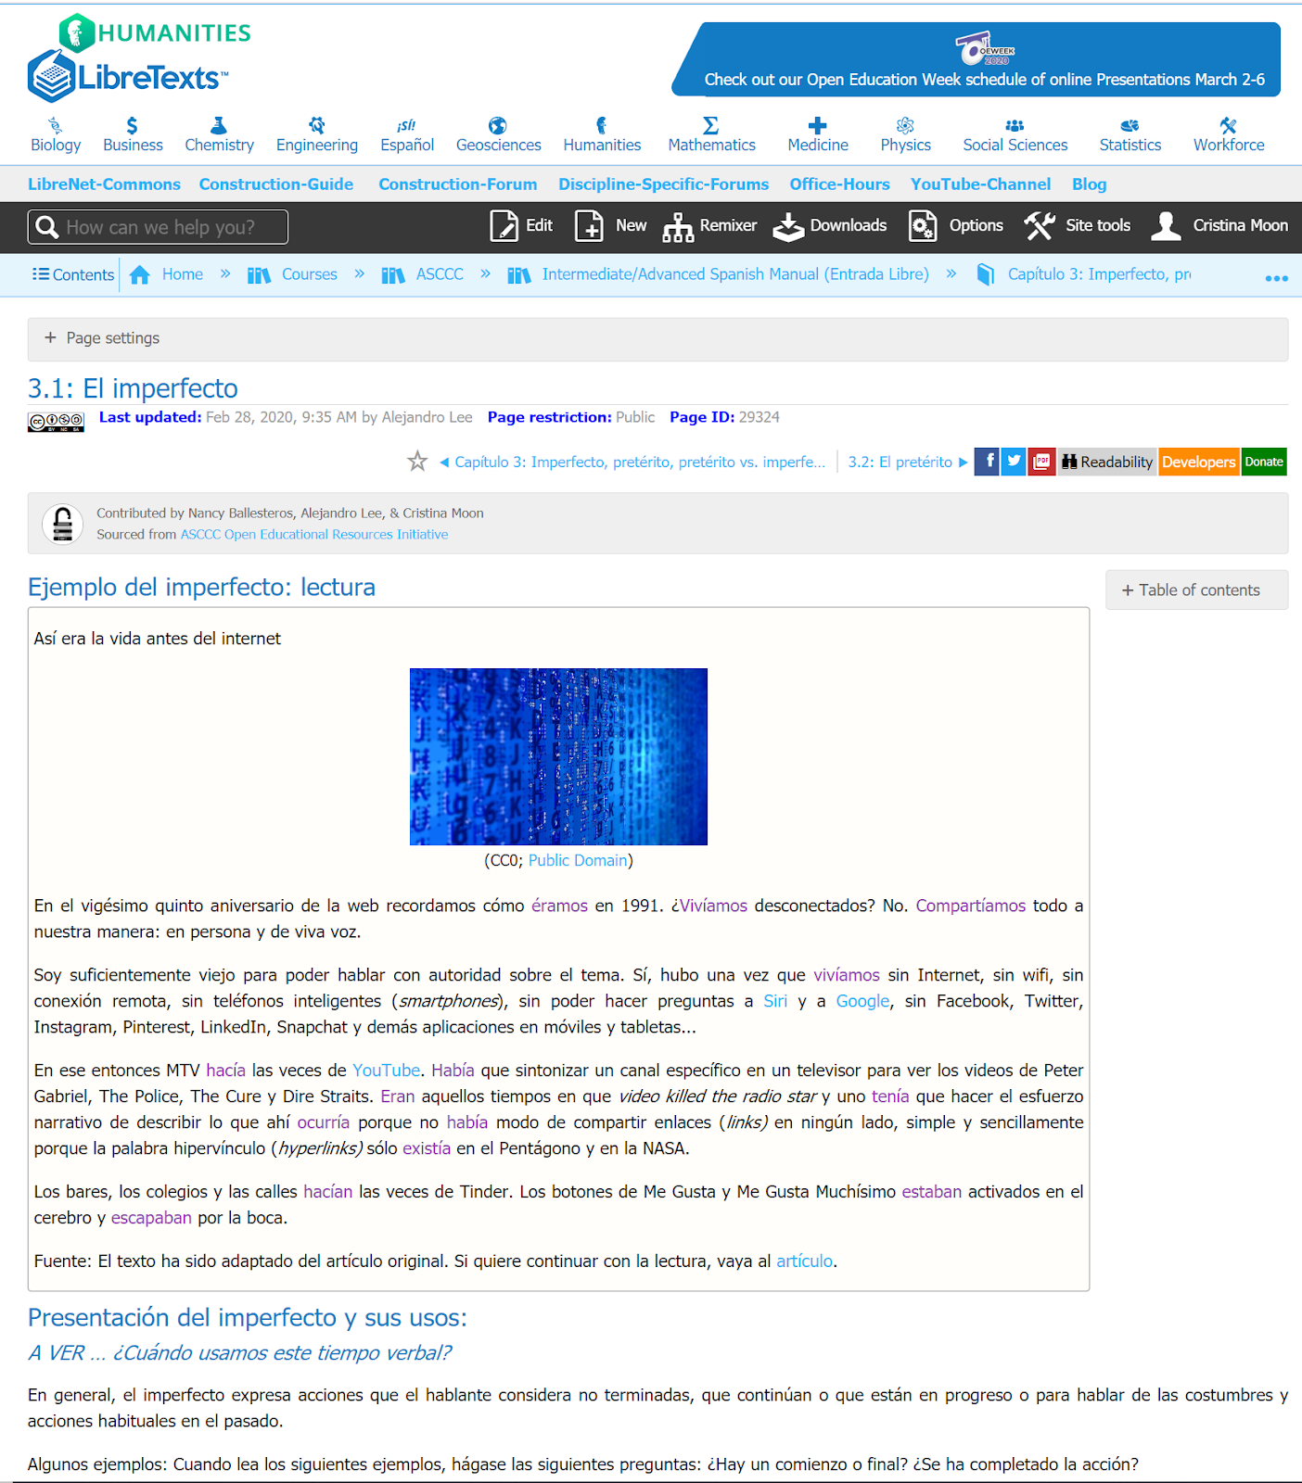
Using H5P activities in LibreTexts

Slide 17
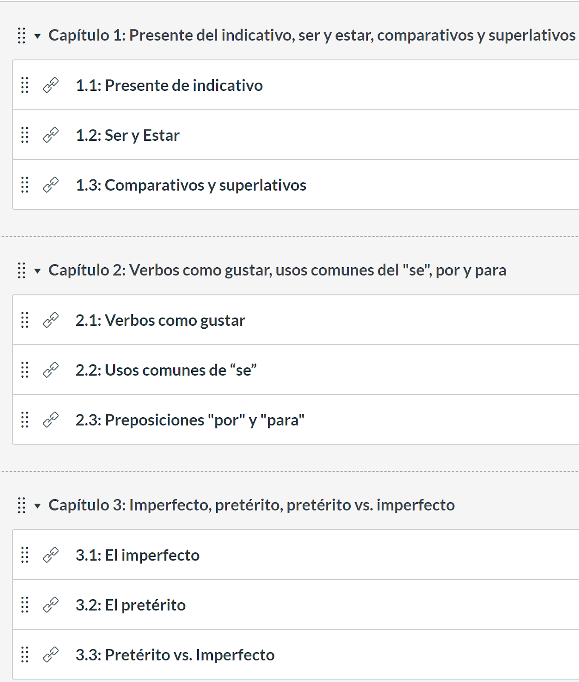
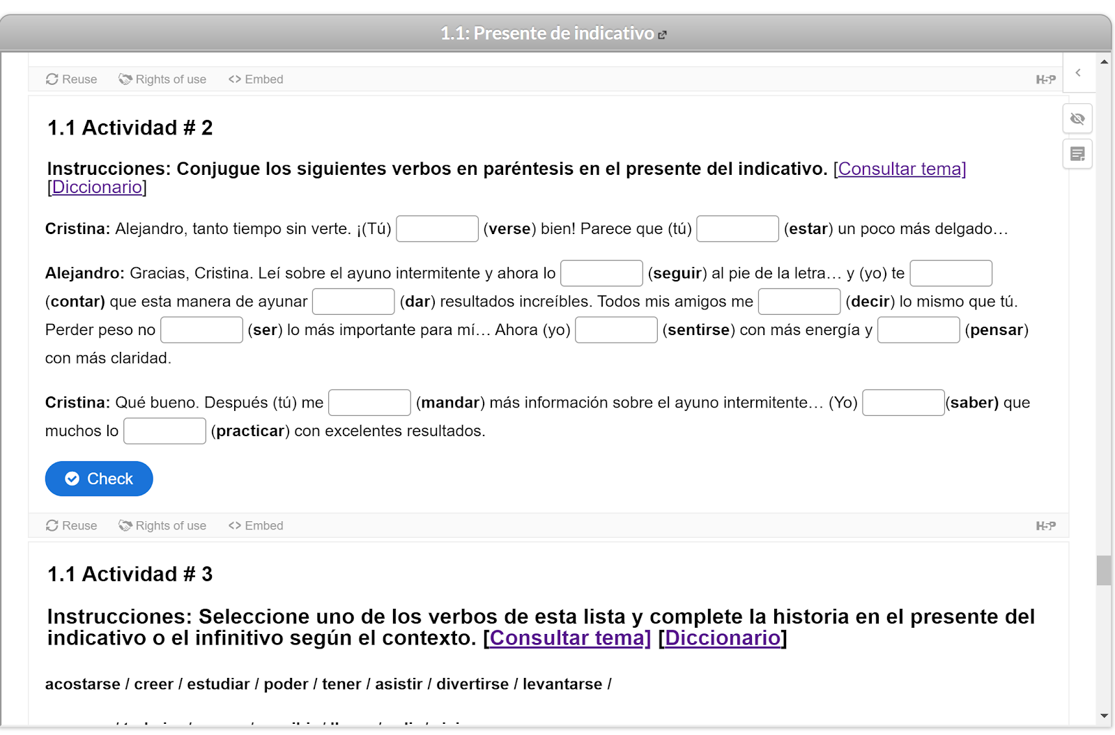
Import it as a common cartridge format to a LMS such as Canvas

Slide 18
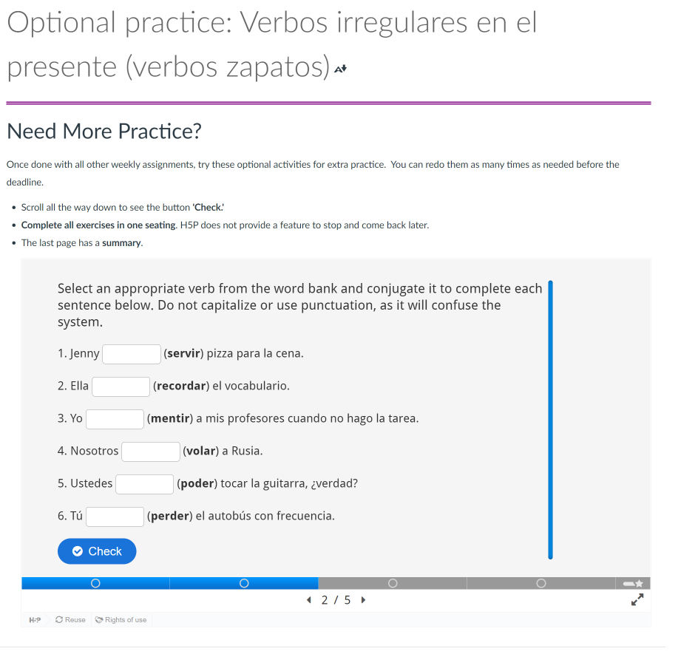
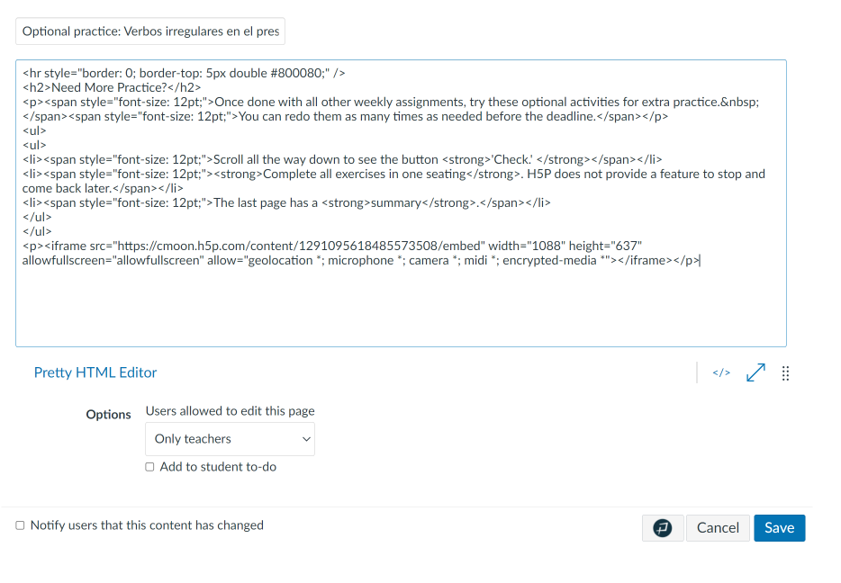
Embedding H5P activities in Canvas as formative assessments

Slide 19
Hands-on Activity: Creating H5P

Slide 20
01. Creating a simple self-assessment activity
Goals:
Create a Multiple-Choice Question
Add feedback for students
Embed it in our course (Canvas LMS)

Slide 21
What did we learn?
The H5P Editor has lots of helpful links.
I should consult the Accessibility Review to make sure I am creating compliant content.
I should familiarize myself with the different types of content that I can create.
I can embed my h5p, or any other openly shared h5p, in my course/book.
Once the H5P is embedded in my course, any updates will automatically display.

Slide 22
02. Creating an interactive reading assignment
Goals:
Create a Course Presentation.
Add text and images to the slides.
Add a quiz to the slides.
Add MetaData and Share in Library.
Embed this Presentation in our LMS

Slide 23
What did we learn?
Following the Accessibility Guide improves my content for everyone.
I should use tags organize my work.
I should add a license to make my work easier to adapt.
It’s easy to collaborate with my colleagues and split up the work.
Each content type is different and there are lots of settings to explore.

Slide 24
Questions and Comments

Slide 25
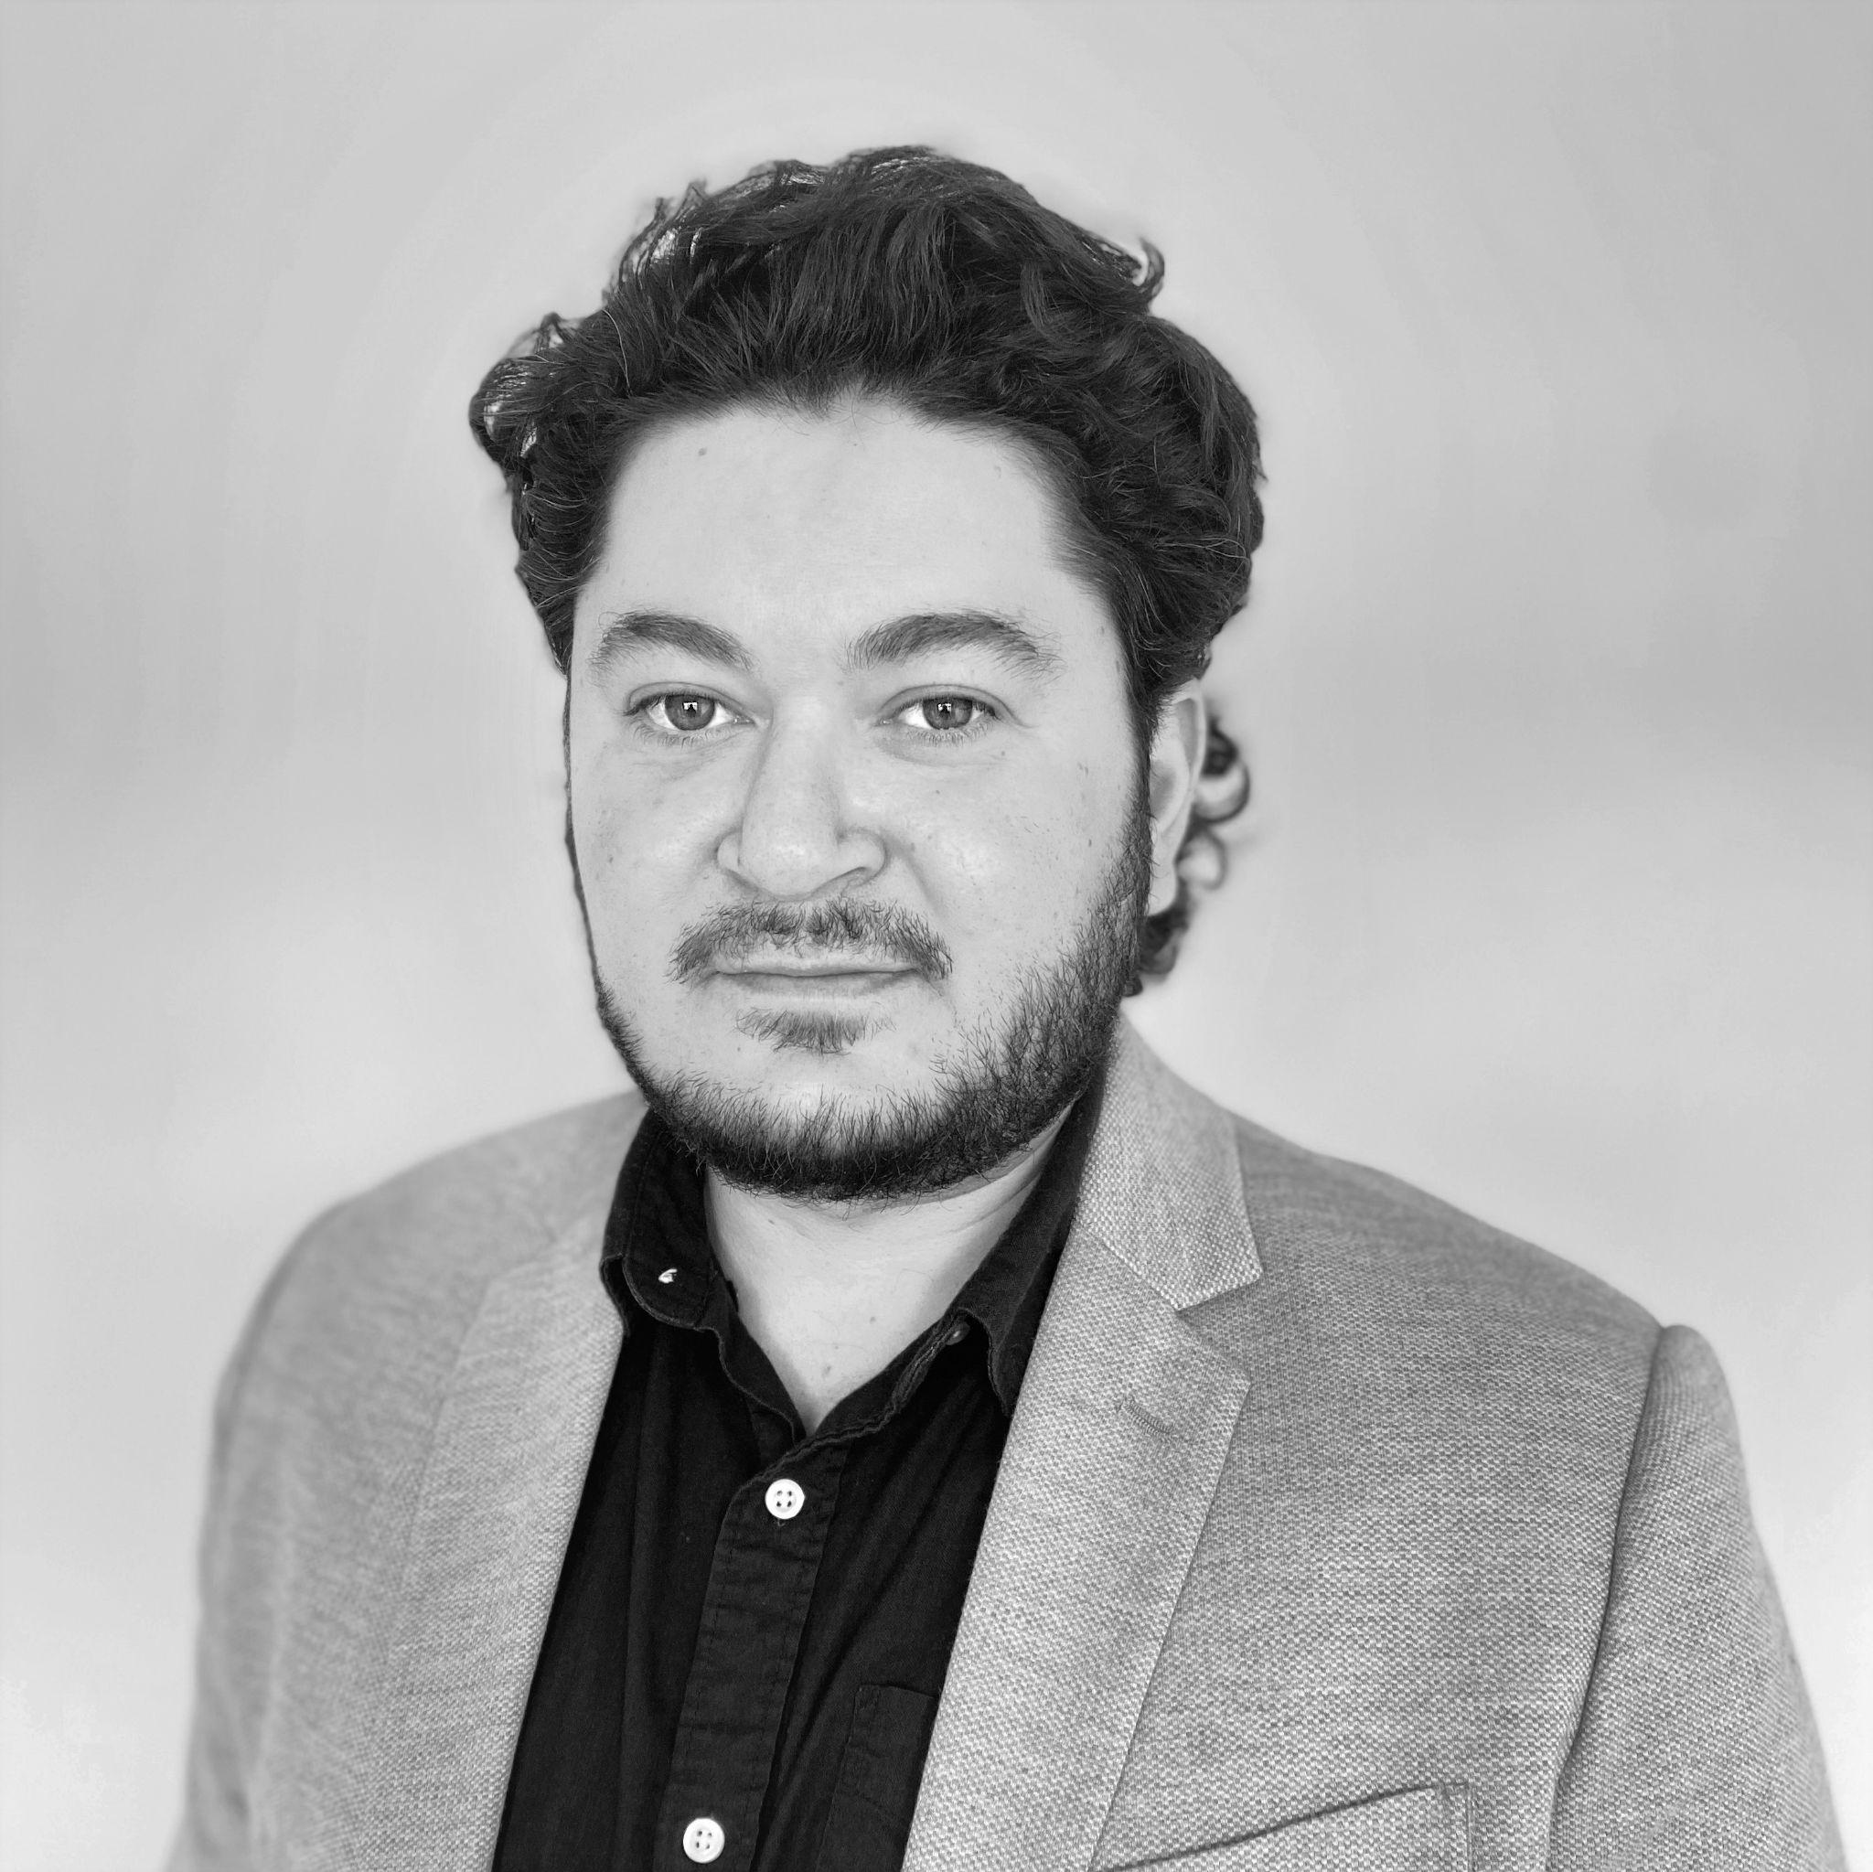
Questions?
Yasin Dahi
Sr. Product Manager, LibreTexts
Join our forum:
https://forums.libretexts.org/g/LIbreStudio
yasin@libretexts.org | @ymdahi on Twitter

