Slide 1
Welcome OER Liaisons!
On behalf of the ASCCC OERI, we are pleased to have you here with us for one of our Spring 2022 OERL Kickoffs
If you are not already muted, please mute yourself upon arrival. As this is set up as a meeting, we will be able to have an actual discussion – but we need all those who are not speaking to be muted.
Please note that you are encouraged to use the Zoom “chat” feature for questions and comments or you can use the raise your hand feature
We should also have time for Q & A at the end

Slide 2
ASCCC OERI Spring 2022 Kick-Off for OER Liaisons

Slide 3
Overview
OER Liaison Basics
ASCCC OERI Progress Report
What’s up with ZTC?
New Directions
Legislation?

Slide 4
OERI Regional Leads
OERI Regional Leads
Sally Potter (Area A)
English and ESL, Fresno City
Heather Dodge (Area B)
Library, Berkeley City
Jennifer Paris (Area C)
ECE/CD, College of the Canyons
Dave Dillon (Area D)
Counseling, Grossmont

Slide 5
Other OERI Personnel
Faculty Coordinator
Michelle Pilati – Psychology, Rio Hondo
OERI Project Facilitators
Shagun Kaur - Communication Studies, DeAnza
Suzanne Wakim - Biology, Butte
Communication Lead
Julie Bruno – Communication Studies, Sierra
Library Discipline Lead
Rachel Arteaga – Library, Butte
LibreTexts Liaison
Jennifer Rogers
Contact your Regional Lead to schedule training

Slide 6
OERI Resources
Listservs
Webinars and “Conversations”
Canvas space
Surveys
Website
Courses and modules
What do you need?
What do your faculty need?
Notes:
??? What else should we be doing to connect with you?

Slide 7
Resource Reminders
Listservs – encourage your faculty to sign up for their discipline listserv
ASCCC.org > Resources
Discipline listservs are one-way – they don’t “blow up”
OER by TMC – our collection has grown and is growing
OER by Discipline
Are your faculty using OER that we don’t know about? Let us know…

Slide 8
OERI’s Goal?
Increase the use of open educational resources in lieu of commercial texts by all reasonable means available.
Photo by Markus Winkler on Unsplash

Slide 9
Increase OER Use By…
Increasing awareness
Increasing the availability of high-quality OER
Making the adoption of OER easier
Supporting you to help your faculty join us…

Slide 10
Spring 2022 OERL Expectations
Sign up for the ASCCC OER listserv by selecting “ASCCC OER Initiative” at www.asccc.org/signup-newsletters.
Complete – and document – your Spring 2022 OER Liaison “attendance” activities (items 3 and 4) by Wednesday, May 11. Activities should be tracked throughout the term via the Spring 2022 Liaison Tracking Spreadsheet (tinyurl.com/Spring2022OERL)
Attend an OER Liaison Spring 22 Kick-Off.

Slide 11
And..
Host ONE or attend TWO OERI events during the spring term. Experienced OERLs who would like to host an event should consult with their Regional Lead to discuss this option.
Communicate with your local senate and faculty regarding the work of the OERI, forwarding the OERI Newsletter broadly and reaching out to specific faculty and departments as warranted.
Check-in at least twice with an OERI representative to share local needs and issues.
Notes:
Weekly Webinars – Fridays at 10:30

Slide 12
REALLY Important
You are our connection to the college.
If you are not able to push communications to your college community as needed, please contact your Regional Representative for assistance.
Notes:
So important, we are including the exact same slide used in the fall.

Slide 13
ASCCC OERI Progress Report

Slide 14
ASCCC OERI Report to the DOF and the Legislature
The bill would require the ASCCC to submit a report to the Legislature and the Department of Finance on or before February 1, 2022, including specified data related to the progress of supporting and expanding the use of open educational resources pursuant to the bill.
Notes:
While December and January could have been spent doing other things, a legislative deadline loomed large… Excerpt from the trailer bill language that became the OERI

Slide 15
Didn’t we just begin yesterday?
OERI formally launched February 1, 2019. We had just one complete non-pandemic year.
Funds were for 5 years. Technically, the OERI has been in existence for 3.5 years.
The OERI requested and received an extension of the time allocated to spend the funds for its work by twenty-four months to June of 2025. Those savings can now be used to fund the OERI for an additional two years. This additional time will allow the OERI to more fully realize its potential, furthering the development and adoption of OER resources, and achieving the goal of establishing a sustainable statewide commitment to OER.

Slide 16
What have WE done?
We = OERI and you…
Hosted over 135 webinars that have been attended by over 2100 faculty.
Hosted 56 webinars for OER Liaisons.
Created a website (asccc-oeri.org) to promote OER and simplify the identification of available OER by providing easy access to OER resources organized by
discipline (27 comprehensive collections),
general education area
Transfer Model Curriculum (25)

Slide 17
Also…
Established a team of over 30 Discipline Leads to curate existing OER and facilitate OER awareness and adoption.
Supported the creation of 63 new OER over three competitive funding cycles, with an emphasis on collaboration, meeting statewide needs, and sustainability.
And we are about to review the proposals for Round IV
Developed a framework for reviewing and revising OER and other course resources to ensure that they are inclusive, diverse, equitable, and anti-racist (the ASCCC OERI IDEA Framework), which will be integrated into future OERI supported projects and used to review and modify existing resources.

Slide 18
And…
Tracked and supported the implementation of California Education Code 66406.9 that requires the colleges to identify Zero Textbook Cost (ZTC) course sections in their online course schedules.
Collaborated with representatives from the CSU and the UC to host Cal OER, a free OER conference intended to highlight the state’s OER/ZTC work and attended by over 400 faculty.
Developed and piloted an OER/ZTC student impact survey to assess the impact of textbook costs and OER/ZTC materials on California community college students.

Slide 19
Reports need data…
So – more schedule sleuthing.
Data gathered for a total of 18 courses (includes the work of OERLs).
The OERI considered just 18 courses and identified 3754 ZTC sections. If each section consists of 30 students and the required text would normally cost $50, the savings would be $5,631,000.
Notes:
Of the 115 colleges in the analysis, 9 colleges were excluded including two that were purchasing all texts for students and seven others that could not be analyzed.

Slide 20
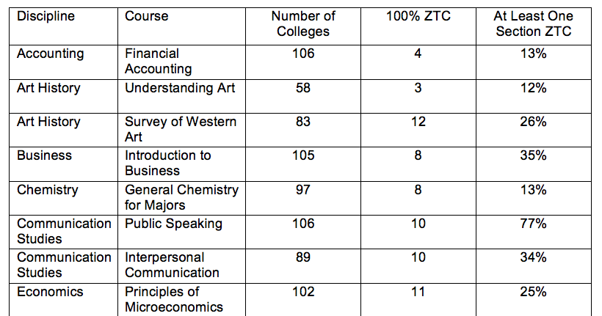
ZTC Schedule Analysis Summary Data (Accounting to Econ)
From Fall 2021 to Spring 2022 – more ZTC marks and more textbook information available. (yeah!)
Notes:
We will share all the data shortly. As you can see, courses where we expected a lot and a little were used.

Slide 21
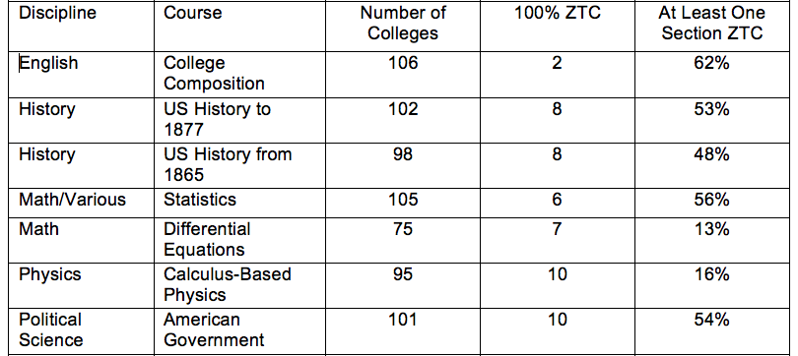
ZTC Schedule Analysis Summary Data (English to Poli Sci)

Slide 22
ZTC Schedule Analysis Summary Data (Psych to Soc)

Slide 23
Notes…
If the fall data were not available – or looked fishy – Spring was used
Public Speaking and Intro Psych – if data from fall indicated no ZTC, spring data were considered – and used if ZTC status had changed
In other words, we added a little bias – just a little…

Slide 24
What we don’t know….
Were some sections ZTC due to a district purchase?
Two colleges excluded from the analysis due to this – and this could be a new trend.
If HEERF funds are being used to cover the cost of texts, are OER efforts likely to be stalled?

Slide 25
Southwestern College to pay students’ expenses for spring semester
“Southwestern College will use $13.8 million in COVID-19 relief funds to help pay students’ college expenses for the Spring 2022 semester, the institution announced.”
“The funds can go toward childcare, rent and utilities, car repairs, cost of books, medical expenses and technology, such as buying or repairing a laptop, and internet fees, the college said.”
The San Diego Union-Tribune, January 25, 2022 https://www.sandiegouniontribune.com/communities/south-county/story/2022-01-25/southwestern-college-to-pay-students-expenses-for-spring-semester

Slide 26
What’s up with ZTC?
Photo by Wyron A on Unsplash
Photo by Wyron A on Unsplash
Notes:
We have no idea….

Slide 27
"I am committed... in addressing.. the racket that is textbooks in this country. Usurious costs associated with textbooks and so we will do more this year... because we in California have an obligation to disrupt that entire system nationwide.“ – Governor Newsom
Source: Rich Pedroncelli / Associated Press
Notes:
But we do know what Gavin wants…

Slide 28
SEC. 60. Section 78052 of the Education Code is amended to read:
(a) It is the intent of the Legislature that community college districts
develop and implement zero-textbook-cost degrees and
develop open educational resources for courses to reduce the overall cost of education for students and decrease the time it takes students to complete degree programs.
Notes:
And that OER is supposed to be a part of it.

Slide 29
We’re not sure what will happen, but….
The chancellor’s office shall award an initial round of grants no later than January 1 of a fiscal year for which the funds are appropriated.
The CCCCO missed a legislated deadline, so something should happen soon.

Slide 30
“New” Directions – Disciplines and Discipline Leads
Discipline surveys – coming soon
New Discipline Leads - initiated work over the break – biology, geography, geology, kinesiology, public health science
Highest priority for recruitment – education and social justice studies
Emphasis on community-building
tinyurl.com/DL4OERI
Notes:
Not really “new” – reinvigorated…. As we prepared the report, we looked closely at the disciplines that we have worked with – and have not – and we had plans to expand that work in spring of 2020 – when everything went sideways.

Slide 31
Supporting the ZTC Program
Ensuring all discipline collections - and related information – are current.
We need your help -
Do you have ZTC degrees that we have not identified?
Are there OER that your faculty are using that are not shared in our collections?
How can we help you?
Are there disciplines that we need to engage?

Slide 32
IDEA Audit
IDEA = inclusive, diverse, equitable, and anti-racist
Working with other ASCCC committees to expand its use.
Integrating it into new projects.
Reviewing prior work.
Piloting at colleges or in disciplines, perhaps?
Available at tinyurl.com/OERI-IDEA

Slide 33
Students…
Engaging students in OER work
Developing a statewide low-cost definition
OERI Student Impact Project
Photo by Jeswin Thomas on Unsplash
Notes:
Student Voices – what does Heather want to share?

Slide 34
OERI Student Impact Project
Nine OERLs participating
Survey pilot on textbook cost impact and OER - Fall 2021/Spring 2022
Development of a showcase of college-based student videos, highlighting how textbook costs and OER/ZTC are impacting students
First webinar on the pilot student survey is February 25th – sharing initial data
Final product will be the Fall/Spring survey results, showcase of videos, and a toolkit for running similar projects at your college

Slide 35
Legislation?
DRAFT bills have been circulating – related to textbook costs
One proposes that CSU and CCCs be required to publish textbook costs for courses in their course catalogs.
And defines a textbook as “a book that contains printed material.”
We’ll keep you posted.

Slide 36
Photo by Daniel Chicchon on Unsplash

Slide 37
More Information
ASCCC OERI Website (asccc-oeri.org)
Resources
Webinars and Events
IDEA Framework - tinyurl.com/OERI-IDEA

Slide 38
And to contact us…
General OERI E-Mail: oeri@asccc.org
Find everyone’s e-mail at: https://asccc-oeri.org/about-us/

