Slide 1
Planning a Course with OER
History

Slide 2
2021 Webinars What are OER? Reuse, revise, remix, retain, redistribute Where to find OER? Curated lists: US, Western, World History Benefits of OER Faculty and Students
2022 Webinars
Revising Pedagogy
Beyond textbook affordability
Learner-centered pedagogy
Success & graduation
Editable Content
Customize content
Sharing OER Content
Faculty and Students
MERLOT, OER Commons, OpenStax, LibreText

Slide 3
Discussion
Decision to use OER
Availability & quality of existing OER
Content modifications
Barriers to OER adoption
Perceptions of quality
Accessibility & usability

Slide 4
Panelists
Matthew Tribbe, Fullerton College
Joshua Ashenmiller, Fullerton College
Lindsay Weiler, Mt. San Jacinto College
Joe Krulder, Butte College
George Jarett, Cerritos College
Julianne Johnson, College of the Canyons

Slide 5
Hypothes.is for The American Yawp: Identifications

Slide 6
Hypothes.is for The American Yawp: Links

Slide 7
Hypothes.is for The American Yawp: Links

Slide 8
Instructor-Created Chapter Question Banks for The American Yawp

Slide 9
Assigning The American Yawp: Module

Slide 10
Assigning The American Yawp: Identification Terms

Slide 11
Assigning The American Yawp: Links

Slide 12
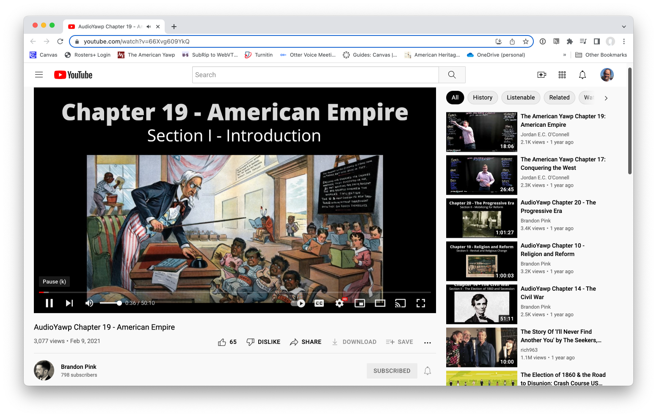
The American Yawp Audiobook Chapters
Brandon Pink, AudioYawp https://www.youtube.com/watch?v=VbjXJLPzW70&list=PLyoa39DGYPzfaZj_Ekdiu-KqtkevgpXhq

Slide 13
Decision to use OER
Availability & quality of existing OER
Content modifications
Barriers to OER adoption
Perceptions of quality
Accessibility & usability
Revising Pedagogy
Beyond textbook affordability
Learner-centered pedagogy
Success & graduation
Editable Content
Customize content
Sharing OER Content
Faculty and Students
MERLOT, OER Commons, OpenStax, LibreText
Feedback: What’s the best way to stay in touch/share resources?

Slide 14
Thank You! Have a great weekend.
Anu Mande Fullerton College Email: amande@fullcoll.edu

