Slide 1
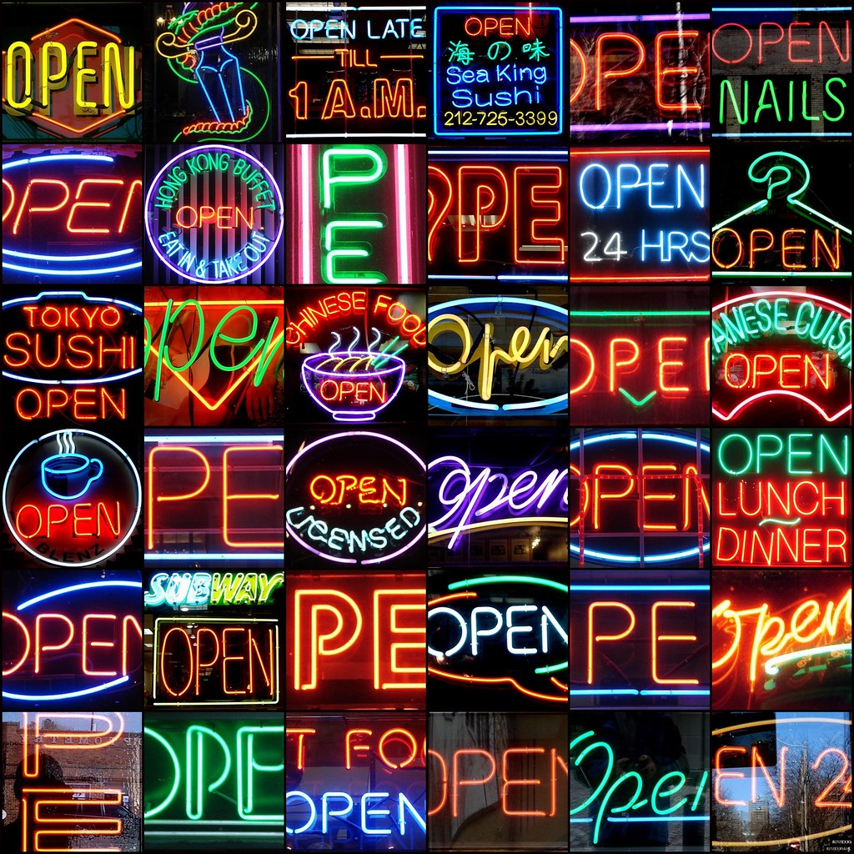
Strategic Planning for Open Education
… A brief introduction
Dr. Karen Cangialosi
"OPEN" by mag3737 [CC BY-NC-SA 2.0]

Slide 2
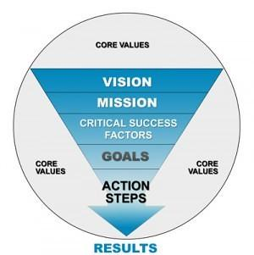
Your communication plan:
Start with the “Why”, not the “What”,
Begin with Cores Values, not specific steps
"Strategic Planning" by BetterBizIdeas [ CC BY 2.0]
Notes:
If you start with the “what”, or the action steps without setting a clear stage to inspire faculty and others - you will struggle.

Slide 3
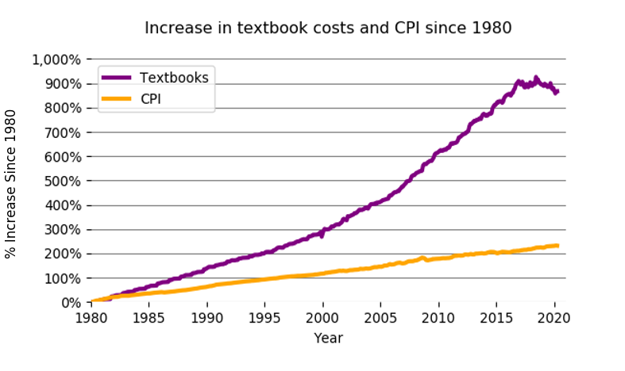
Textbook costs have risen 3X the rate of inflation
Slides by Karen Cangialosi [CC BY 4.0 SA]
Notes:
From: https://mathematikoi.net/p0/
the rate has been higher than rises in health care and housing costs
Textbook costs have risen 3X the rate of inflation. Most students pay more than $300 a semester, for many its over $1,000 – this is money that comes out of their pockets. So effects whether they can eat or get a babysitter. Students worry more about paying for textbooks than tuition.

Slide 4
2021
200,000
students
202
colleges & universities
42
states
To read the full report visit http://bit.ly/RCReport2021
Slides by Karen Cangialosi [CC BY 4.0 SA]

Slide 5
Study of 86,000 students at 123
two and four year institutions across the U.S. April 2019
Food Insecure: 45%
Housing Insecure: 56%
Homeless: 17%
Notes:
From the Hope Center. Hope4College.com

Slide 6
21,000 students in the study
Slides by Karen Cangialosi [CC BY 4.0 SA]

Slide 7
Free (for students)
Open Educational Resources by Ron Mader [CC BY 2.0]
Slides by Karen Cangialosi [CC BY 4.0 SA]
Notes:
Free for students. That doesn’t mean that they are free to make.

Slide 8
“The OER movement has saved students, parents, schools and governments at least $1 billion dollars.”
U.S. & Canada Higher Ed: $921,783,169
U.S. & Canada K-12: $45,051,066
International: $38,500,000
Total: $1,005,334,235
Data from SPARCopen.org, 2018
Slides by Karen Cangialosi [CC BY 4.0 SA]

Slide 9
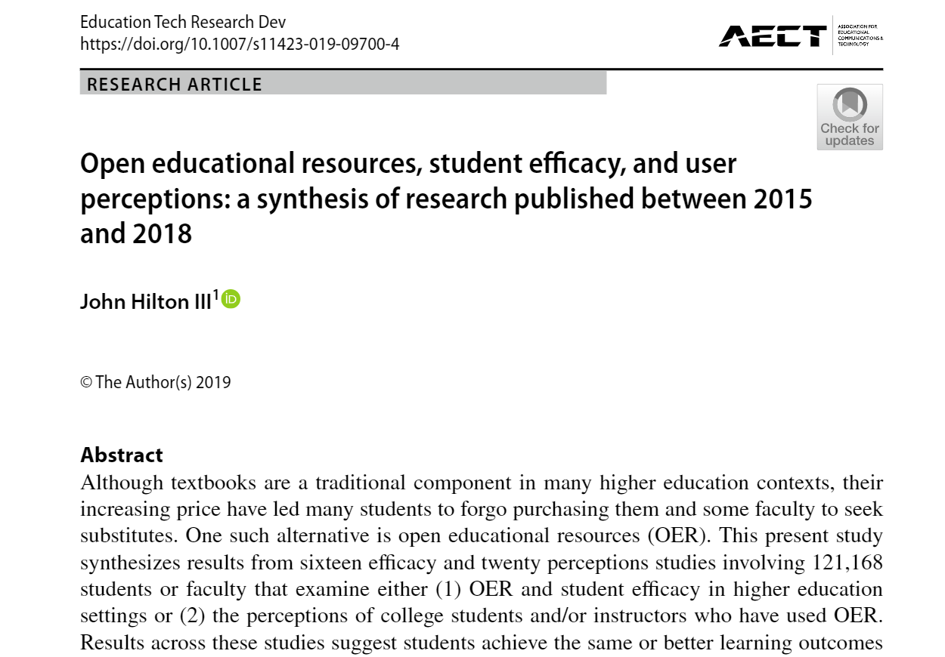
Synthesizes results from 36 studies involving 121,168 students.
Notes:
Including increased course throughput, improved grades, and reductions in DFW rates, lower course withdrawal rates

Slide 10
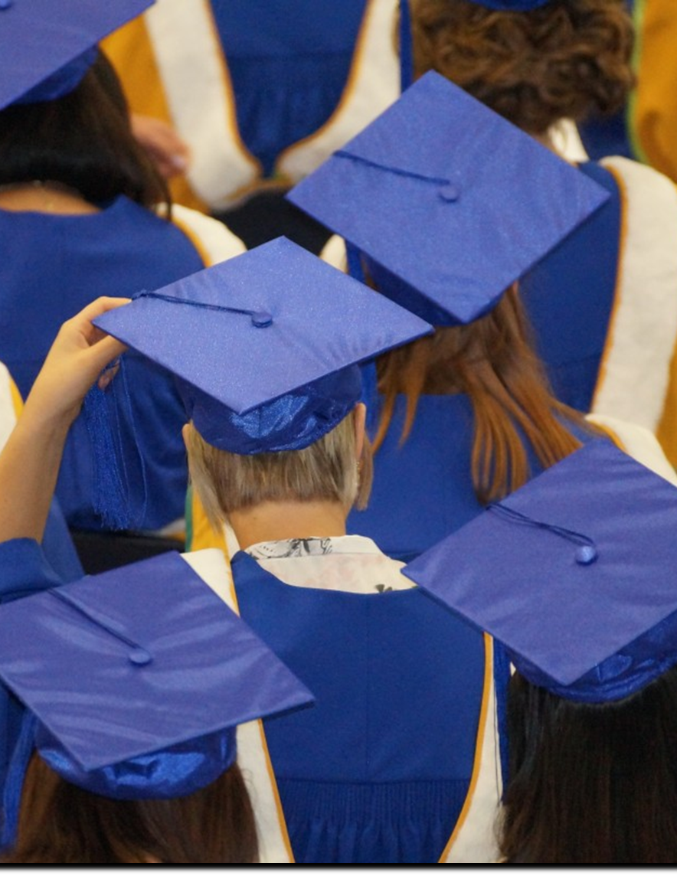
Students in Courses using OER compared to non-OER
Increase in course throughput rates
Improve end-of-course grades and decrease DFW rates for all students
Reduction in DFW rates for minority and Pell eligible students
Lower course withdrawal rates
Higher % of students completing course with a C or better
Slides by Karen Cangialosi [CC BY 4.0 SA]

Slide 11
The Impact of OER: University of Georgia Study
Population | Change in Grade | Change in DFW*
All Students | +8.6% | -2.68%
Non-Pell Eligible | +7.4% | -2%
Pell Eligible | +12.3% | -4.4%
Non-White | +13% | -5%
Part-Time | +28% | -10%
Total Students: 21,822 *DFW= Drop, Fail, Withdraw
Notes:
Study looking at change in grades (column 1) and change in the number of DFWs (column 2).
Note that ALL student groups increase the overall course grade by almost a full letter grade.
Compare Pell and non-Pell eligible students (“Federal Pell Grants usually are awarded only to undergraduate students who display exceptional financial need”
Pell eligible students had a much bigger boost
Not surprising because cost is still a factor
Non-white students also had a larger boost
So, it’s not JUST cost
Part-Time students had the largest boost
Source: AAC&U, University of Georgia The Impact of Open Educational Resources on Various Student Success Metrics, in International Journal of Teaching and Learning in Higher Education, 2018

Slide 12
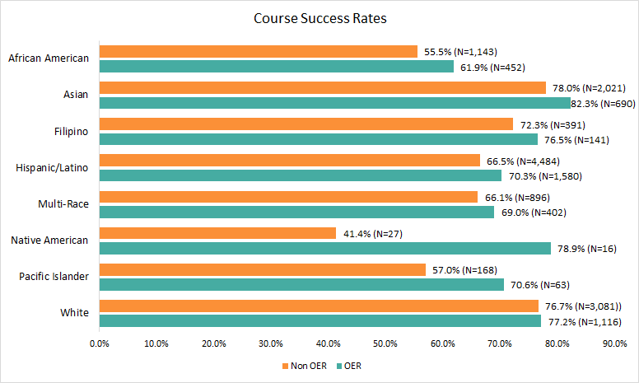
OER Success Rates
Notes:
Talking points:
Let’s delve into the “non-white” category a bit further.
Study at a California Community College that looked at ethnic groups more directly
Comparing pass rates for classes using OER to sections of the same courses that did not use OERs
Comparing same courses is important for consistency
The success rates are higher for all groups when using OER than when not using OER. (at least slightly)
But the difference in improvement is much more pronounced for certain groups
African American - 6.4% difference
Asian - 4.3%
Filipino - 4.2% difference
Hispanic/Latino - 3.8%
Pacific Islander - 13.6% (but the N is small)
Native American - 37.5% (but the N is small)
Source: Sample Course Success Rates by Ethnicity
Data
Overall success: non OER 55.5% (N=1,143), OER 61.9% (N=452)
Asian success: non OER 78% (N=2,021),OER 82.3% (N=690 )
Filipino success: non OER 72.3% (N=391),OER 76.5% (N= 141)
Hispanic/Latino success: non OER 66.5% (N=4,484 ),OER 70.3% (N=1,580 )
Multi-race success: non OER 66.1% (N=896 ),OER 69% (N=402)
Native American success: non OER 41.4% (N=27),OER 78.9% (N=16)
Pacific Islander success: non OER 57% (N=168),OER 70.6% (N=63)
White success: non OER 76.7% (N=3,081),OER 77.2% (N=1,116)

Slide 13
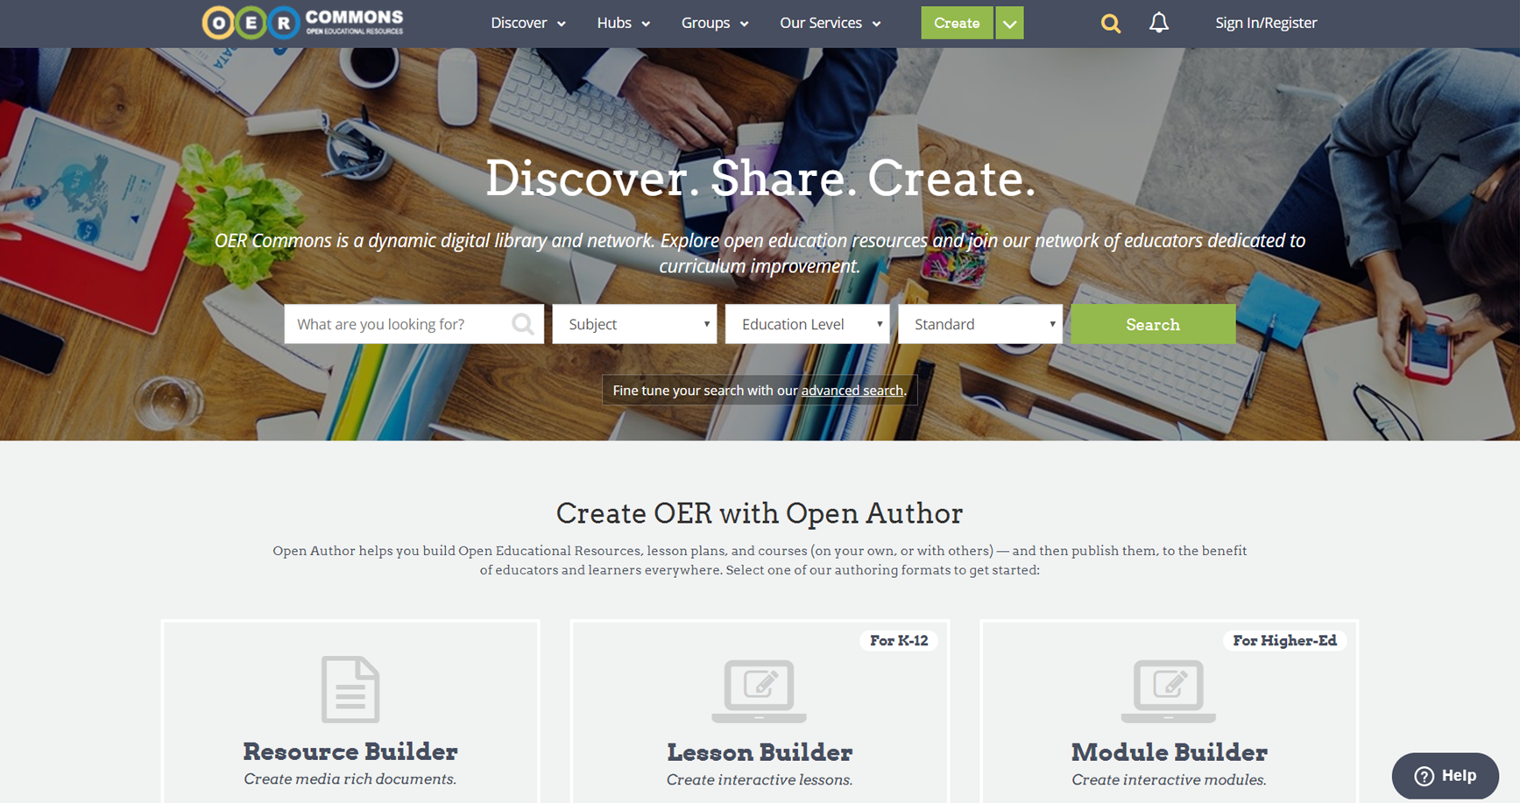
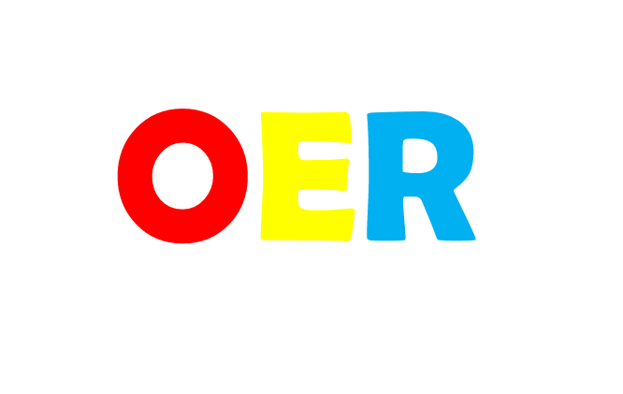
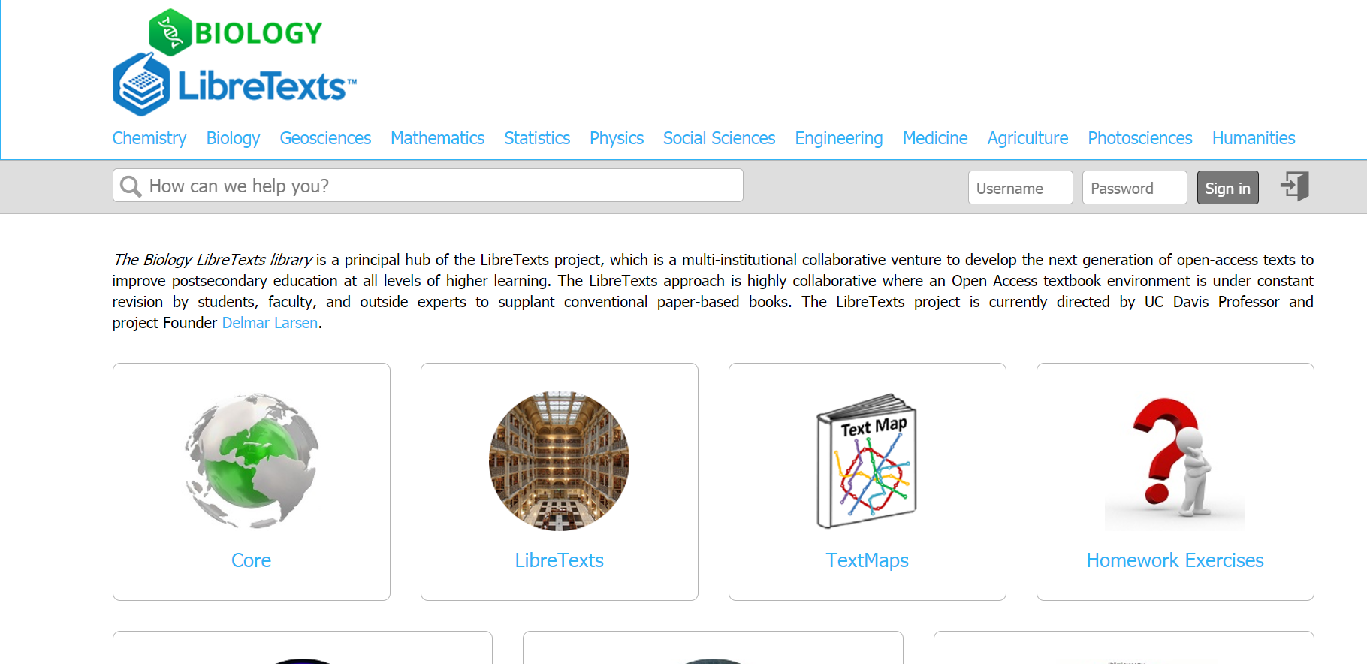
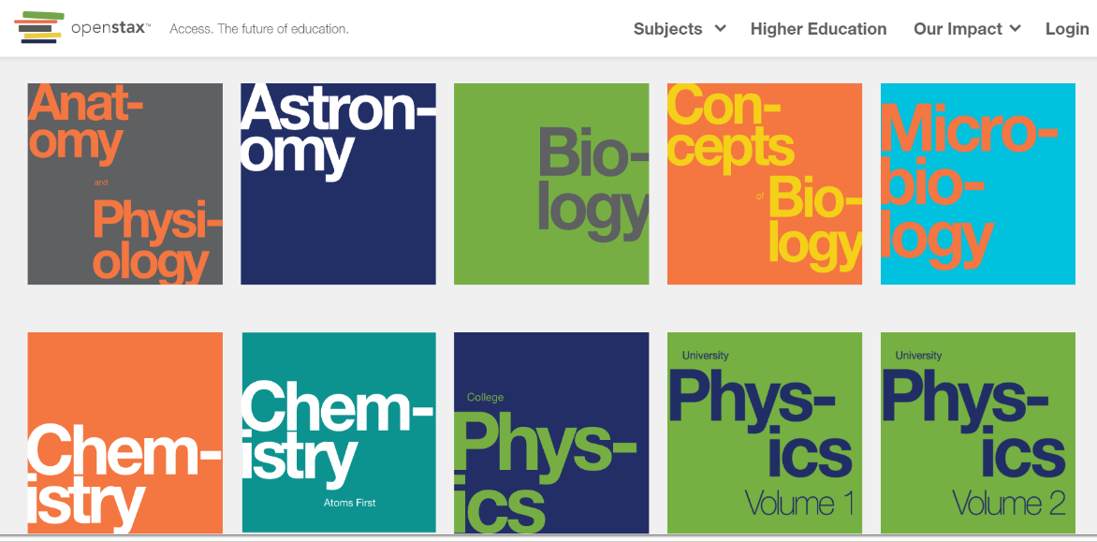
QUBEShub.org
OERcommons.org
LibreText Project
OpenStax
Slides by Karen Cangialosi [CC BY 4.0 SA]

Slide 14
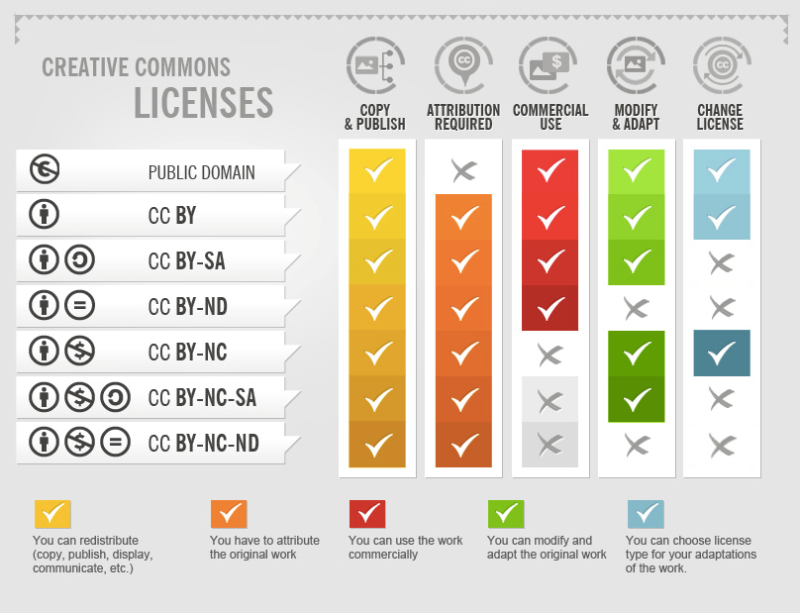
The Open License
Not just “free”, but Open.
Creative Commons licenses explained
©Foter (adapted by Jisc) via Foter blog
CC BY-SA
Slides by Karen Cangialosi [CC BY 4.0 SA]

Slide 15
FREE as in Freedom (the 5 R’s)
Reuse
Revise
Remix
Redistribute
Retain
Slides by Karen Cangialosi [CC BY 4.0 SA]
Notes:
The terms "open content" and "open educational resources" describe any copyrightable work (traditionally excluding software, which is described by other terms like "open source") that is licensed in a manner that provides users with free and perpetual permission to engage in the 5R activities
Reuse - the right to use the content in a wide range of ways (e.g., in a class, in a study group, on a website, in a video)
Revise - the right to adapt, adjust, modify, or alter the content itself (e.g., translate the content into another language)
Remix - the right to combine the original or revised content with other material to create something new (e.g., incorporate the content into a mashup)
Redistribute - the right to share copies of the original content, your revisions, or your remixes with others (e.g., give a copy of the content to a friend)
Retain - the right to make, own, and control copies of the content (e.g., download, duplicate, store, and manage)

Slide 16
OER
Digital
Multimedia
Downloadable
Adaptable
Current
Public
Openly Licensed
Free
Open Educational Resources by Ron Mader [CC BY 2.0]
Slides by Karen Cangialosi [CC BY 4.0 SA]

Slide 17
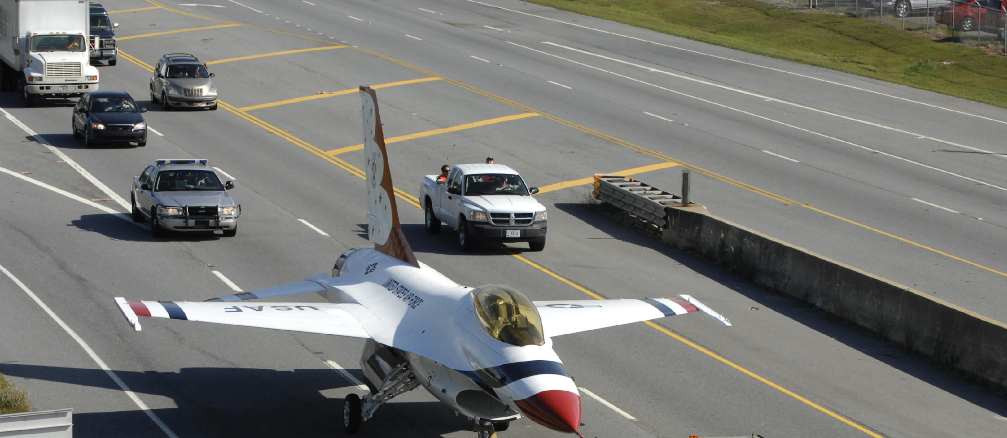
“Using OER the same way we used commercial textbooks misses the point. It’s like driving an airplane down the road.” – David Wiley
Slides by Karen Cangialosi [CC BY 4.0 SA]

Slide 18
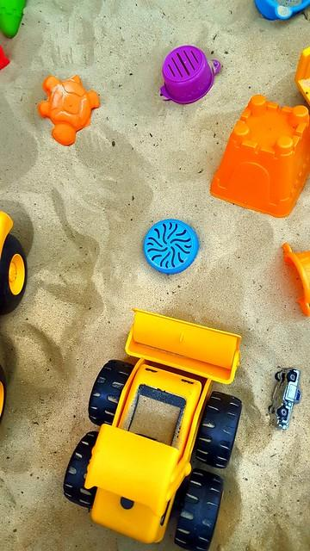
Why Revise/Remix OER?
Students can do all of this too!
Mix OER with your own material to make something richer
Adapt the material to make it more accessible for people with different disabilities
Insert culture-specific references, make more culturally representative and responsive
Translate it into another language
Correct any errors or inaccuracies
Insert more media or links to other resources
Chop it up into smaller chunks that might be easier to learn from, or could be reused elsewhere
Change the target educational level
Change the format to make it work in different learning environments
Insert a different point of view to that originally given
Adapt it for a different audience
SLIDE BY Christin Wixson [CC BY 4.0]
Notes:
Large and small changes are possible with OER that might provide a variety of benefits. All without having to wonder if the changes you make are ok from a copyright standpoint. (Is this fair use? What are those educational exceptions again?) I heard a wonderful story at this year’s OER summit about a professor who changed the names in the textbook examples to reflect the diversity of their classroom.
For some, using OER is a bridge to Open Pedagogical Practices (OEP) such as having students themselves play with the OER and make the above changes, that then get passed on to the next cohort of students. Isn’t playing how humans learn?
Content of this slide is from the P2PU course Learning to (Re)Use OER week 3 materials, which was itself adapted from Why remix an Open Educational Resource? written by Liam Green-Hughes under CC BY.
Sandbox by SurFeRGiRL20 is licensed under CC BY

Slide 19
Inclusion, Diversity, Equity, and Anti-Racism
Academic Senate, CA Community Colleges OER Initiative (ASCCC OERI)
An IDEA Framework in development
Illustrations and Photos
Example Names
Gender-Inclusive Language and use of Pronouns
Historical, Pioneering or Current Researchers and Studies in the Field
References/Bibliography and Credit to Diverse Researchers/Authors
Applications, Examples, and Problem Scenarios
Appropriate Terminology
Keyword, Glossary, and Metadata Representation
Equitable Perspectives on Issues, Events, and Concepts
Slide by Suzanne Wakim
Notes:
Framework being developed by the CA Academic Senate OER Initiative to help faculty evaluate and develop course resources
Some easy changes, some more complex

Slide 20
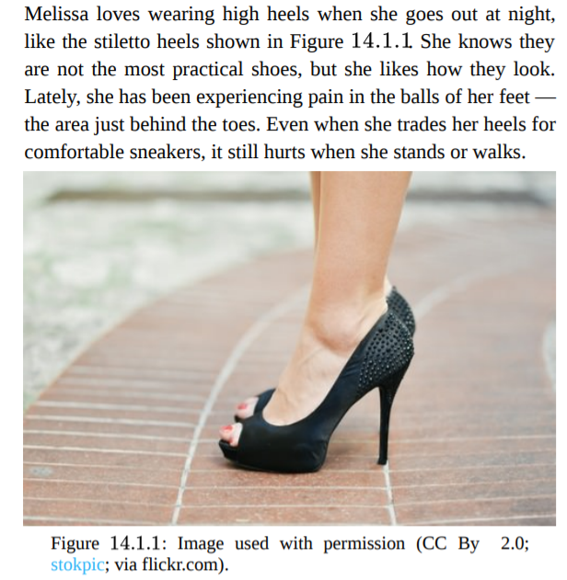
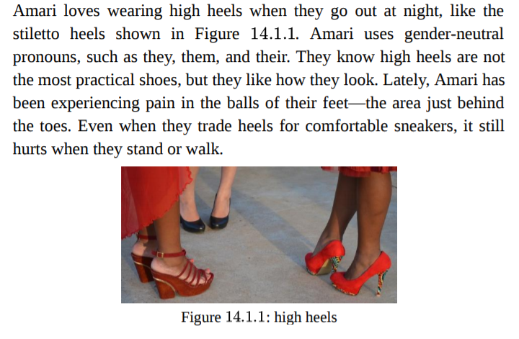
Entry Point
Notes:
Talking points:
This is the before and after of a case study for a biology book.
The point of the story is the effect heels have on bones
Changed picture to be more inclusive
Places to find diverse images
Changed names throughout the book
Source of names - wikipedia
Changed pronouns
Also explained the singular “they” because it’s still new to some people
Be careful to not perpetuate stereotypes when making these changes.
Eg - showing people with disabilities only when talking about the disability
Marie Curie effect - she has become the stand-in for women in science
Heels by Stokpic via pixabay; pixabay license
Heels by Agnali via Pixaby.com; pixabay license

Slide 21
ROTEL Grant
Notes:
https://sites.google.com/view/rotelgrant/home
The hypothesis - ….
Why this matters is on the next slide

Slide 22
Slides by Karen Cangialosi [CC BY 4.0 SA]
Notes:
From products and resources – to Practices and People

Slide 23
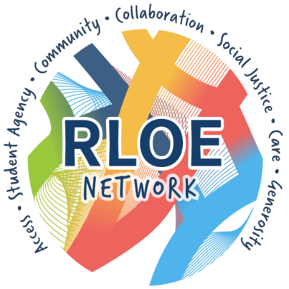
Open Pedagogy emphasizes:
Learners contributing to, not just consuming knowledge
Community and collaboration, sharing resources, ideas and power
Connection to the wider public
Student Agency, Learner-driven

Slide 24
Students as creators
Textbooks (e.g., pressbooks)
Ancillary materials: test banks, etc.
DoOO – student website creation
Open Google Docs
Open Videos
Open Case studies
Open Labs, simulations, animations
Open Datasets
Open Lab notebooks
Social media posts
Public web annotations
Wikipedia articles
Many Orbs, by Angela Hanley [CC BY-NC-SA 2.0]
Notes:
You can locate and create all of this stuff yourself – or you can get your students to be involved in researching, remixing, and creating these things themselves
students can choose how and what to learn…create…and share

Slide 25
Antología abierta de literatura hispana
Created by Julie Ward and students in her Introduction to Hispanic Literature course
Students authored critical introductions while also helping each other with editing and formatting
Others helped curate the list of authors and works undergraduates could choose from
Image from Antología abierta de literatura hispana by Julie Ward is licensed under a Creative Commons Attribution 4.0 International License
https://press.rebus.community/aalh/
Notes:
The next example is focused on Hispanic Literature and is authored entirely in Spanish. While the projects may be similar, I want to demonstrate how Open Education practices can be used to achieve different outcomes with students. Julie not only asked students to author critical introductions to texts, but also worked with a few students to edit and format these texts into Pressbooks, verify public domain licenses and other facts. Other students were introduced to this project earlier on and asked to help curate a list of authors and works for the assignment. In this case, undergraduate students not only gained confidence and important experience working on a book project, as with the last OEP, but the project also provided the opportunity for the instructor to converse with students about canon formation.
I’ve linked to Julie’s entire assignment and weekly plan in the handout. You’ll see that with her project, she’s not only trying to cultivate in students research or writing skills, but using the assignment as a window into the world of OER. She introduced her students to the concept of Creative Commons licenses and provided a primer and set of skills for them to self-determine how they would license their work. She guided them through a Memorandum of Understanding and in so doing, asked students to think about what it means to own their content and disseminate it into the world. Over the course of the project, Julie also looked at research grants and work-study opportunities for students contributing to the project after the semester was completed. All students are also credited in the final text.

Slide 26
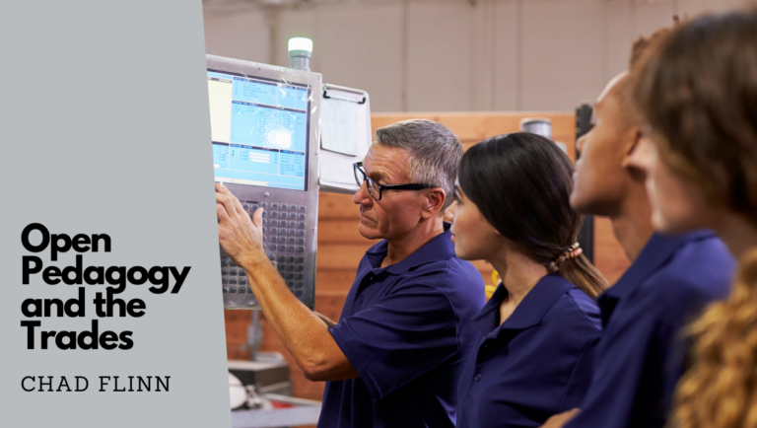
https://bccampus.ca/2021/01/18/co-creating-oer-with-students-in-the-trades/
Notes:
Creating textbooks,
Using google forms,
Reflective journaling in the trades

Slide 27
Beyond Equity
Modified from original image by Craig Froehle
OER
Open Pedagogy?
Slides by Karen Cangialosi [CC BY 4.0 SA]
Notes:
Social Justice framework is INTEGRAL to open pedagogy
Equity- giving everyone what they need to be successful.
Equality – treating everyone the same.
Does open ped allow us to remove barriers for learning?

Slide 28
Strategic Planning
Form a campus Open Education Strategic team to write & implement the plan together
Librarians
Instructional designers/technologists
UDL specialists, other staff support - maybe even your bookstore
Faculty (full time and part time)
Administrators
Plan Faculty Development Events
OER Workshops: What are open licenses?, What is OER? What are the benefits?
Identify your faculty champions: Use examples of your faculty doing this work already. Faculty OER panels, Student panels- have them tell their stories
Open Pedagogy Workshops, Faculty OEP panels
Provide support for OER adoption and OER Creation
Stipends for faculty to swap commercial textbooks with OER
Stipends for faculty to create their own OER
Staff support, librarians, instructional designers/technologists with dedicated time to assist with OER adoption & creation
Provide support for Open Pedagogy/Open Educational Practices (OEP)
Stipends for faculty to create OEP assignments

Slide 29
OER and OEP are an opportunity to make a transformational impact on student lives and their learning
RLOE Invitation to Participate in the Program and Strategic Plan Development
May 31 - June 17

Slide 30
“Open is a process, not a panacea”
-Robin DeRosa
Slides by Karen Cangialosi [CC BY 4.0 SA]
Notes:
Digital redlining and the digital divide are real and insidious (not everyone has access to broadband or can afford a laptop).
Ed tech is largely about making profits for companies.

Slide 31
“All education is a struggle over what kind of future you want for young people” –Henry Giroux
This work by Karen Cangialosi is licensed under a
Creative Commons Attribution 4.0 International License
Notes:
“All education is a struggle over what kind of future you want for young people” –Henry Giroux

