Slide 1
Welcome to Using OER to Support Ungrading and Mastery Grading in Early Childhood Education Courses!
On behalf of the ASCCC OERI, we are pleased to have you here for one of our discipline webinars
If you are not already muted, please mute yourself upon arrival. As this is set up as a meeting, we will be able to have an actual discussion – but we need all those who are not speaking to be muted.
You are also encouraged to use the “chat” feature. Feel free to introduce yourself in the chat while we wait to get started.
If you would to ask a question out loud, feel free to use the Raise Hand reaction
This webinar will be recorded

Slide 2
OER and Alternative Grading
OER and Alternative Grading

Slide 3
Why traditional grading doesn’t work
Notes:
Before going through quotes ask attendees to think through each of them and decide if they ring true for how they approach grading

Slide 4
“Teachers…are often reduced to tweaking points and outfoxing a grading program to make sure that students get the grades they deserve.”

Slide 5
“If everything about me in a class is judged and included in a grade,… my grades say not what I’ve learned in the subject so far, but who I am”

Slide 6
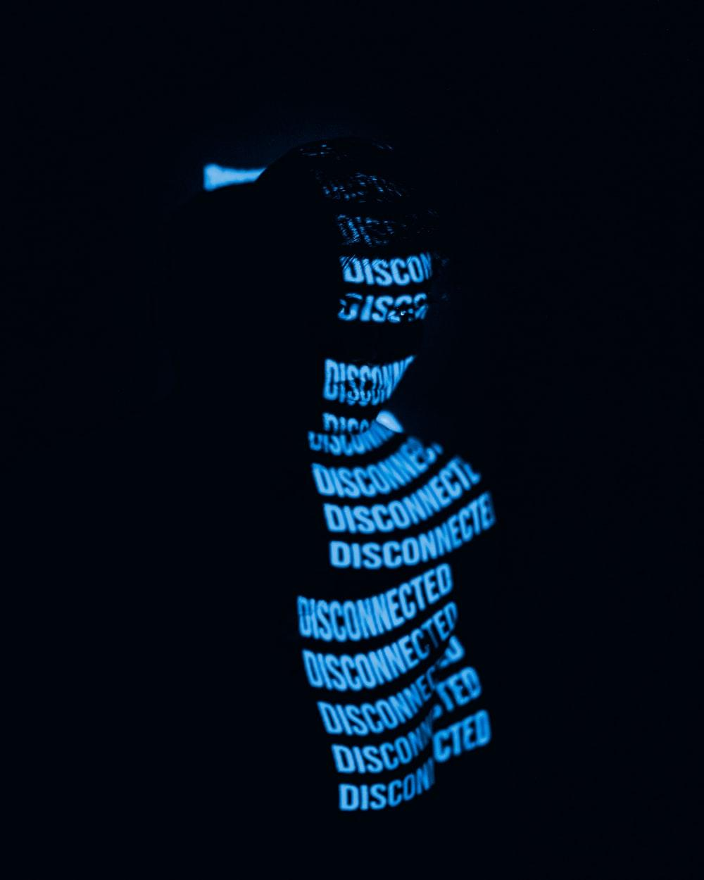
“Current models of teaching and assessment often fail. They fail to promote learning. They fail to provide useful feedback. They fail to produce joyous cooperative learning. They fail to produce positive relationships among students, or between students and teachers. They fail to meet the needs of diverse students, and they fail to promote equity.”

Slide 7
This Photo by Unknown author is licensed under CC BY-SA.
"The way we grade should increase students' confidence so that each student feels that she is equally eligible for academic success – even predestined for that success – regardless of circumstances or educational background."

Slide 8
"...a teacher's grading policies and practices reveal how she defines and envisions her relationship to students, what she predicts best prepares them for success, her beliefs about students, and her self-concept as a teacher.
That's why challenges to our grading practices don't just offend our professional judgment; they can invoke an emotional and psychological threat."
This Photo by Unknown author is licensed under CC BY.

Slide 9
Risk-Taking ​and Grading
When everything is graded, we send the message that mistakes are NEVER acceptable.​
​
Learning cannot occur WITHOUT mistakes ​
Mistakes allow growth from misconceptions and misunderstandings ​
Students must trust teachers enough to make mistakes.​
“If you make a mistake, or even are just having a bad day, it’s going to count against you. There is no room for error, no safe place to make mistakes. Death by a thousand cuts.....A thousand cuts for 12 years of academic life. “
Notes:
Students must take risks and revealing mistakes for teachers to help them BUT this only works if students trust teachers enough to make mistakes.​

Slide 10
What is mastery grading (aka standards-based grading? )
system that evaluates students’ progress towards mastering specific learning targets
If that’s it, why is it so hard?

Slide 11
The foundational work of trust
“ What you ask them to do becomes an opportunity to learn rather than another piece of paper to "complete". It's a shift in purpose and philosophy. And requires teacher and student training to shift thinking in purpose of why they're in the classroom.” - @PersidaB
Trust your students
“Allow them to surprise you. Give them freedom. Allow them to fail but allow them to learn from those failures. If you don't trust your students, they will fail. If you believe they won't do it if you don't make it worth points, then they won't do it. Trust your students.” - Jason Buell
Trust yourself
What you’re giving them will help them learn- the role of OER
Everything you do is to help them learn
“Points are a shield. When you take away that shield all you're left with is the trust you have in yourself that you're doing what's right.” - Jason Buell
Create a consistent narrative

Slide 12
Why?
The goal is learning
Changing the points game
Tracking by CONCEPT not by CHAPTER…. OER?
Notes:
Tracking by concept not by chapter
How many conversations revolve around students asking what they need to do to pass the class.

Slide 13
K.I.S.S.B.U.G
Keep it Simple Standards-Based or Un-Grading

Slide 14
Start at the end
01
02
03
Identify outcomes and align to skills/objectives
Curate and provide content to master skills
Assess
Notes:
I think this process applies to both of upgrading and standards based grading?

Slide 15
Step One: What are your course outcomes
Do you know where to find those?
Do you agree with them?

Slide 16
WHAT ARE THE SKILLS REQUIRED TO MEET EACH OUTCOME?
Notes:
Figure out what skills are needed to master each outcome. This is most likely going to be the hardest part of the journey and you will revise as you go through the semester. This is okay
Don’t get stuck on terminology. Whatever term works for you and make sense to you so you can explain to students use that term.
Explain why I us

Slide 17
Step Two: Provide Content for Mastery of Skills
How do you do this without OER? (or other free options)

Slide 18
STEP THREE: ASSESS THOSE SKILLS
Easier said then done……..

Slide 19
Creating assessments that assess
What skills map to the assessment/assignment?
Create a rubric aligned to skills/outcomes/topics not specifics of assignment
Allows for creativity 🡪 UDL
Assignment can assess multiple skills
What if the assignment doesn’t assess ANY of your skills?

Slide 20
Let’s talk evaluation of skills
Rubrics…..“attempt to deny the subjectivity of human judgment” – Alfie Kohn
Notes:
Discuss the differences in these two rubrics and the advantages and disadvantages of each potentially

Slide 21
BUT WHAT ABOUT MY GRADEBOOK…..
No perfect or right solution
“ When the how’s of assessment preoccupy us, they tend to chase the why’s back into the shadow” – Alfie Kohn

Slide 22
CREATING ASSIGNMENT GROUPS: EXAMPLE 1
Grades for Test Student: ECE-20-54786-2022SP (instructure.com)

Slide 23
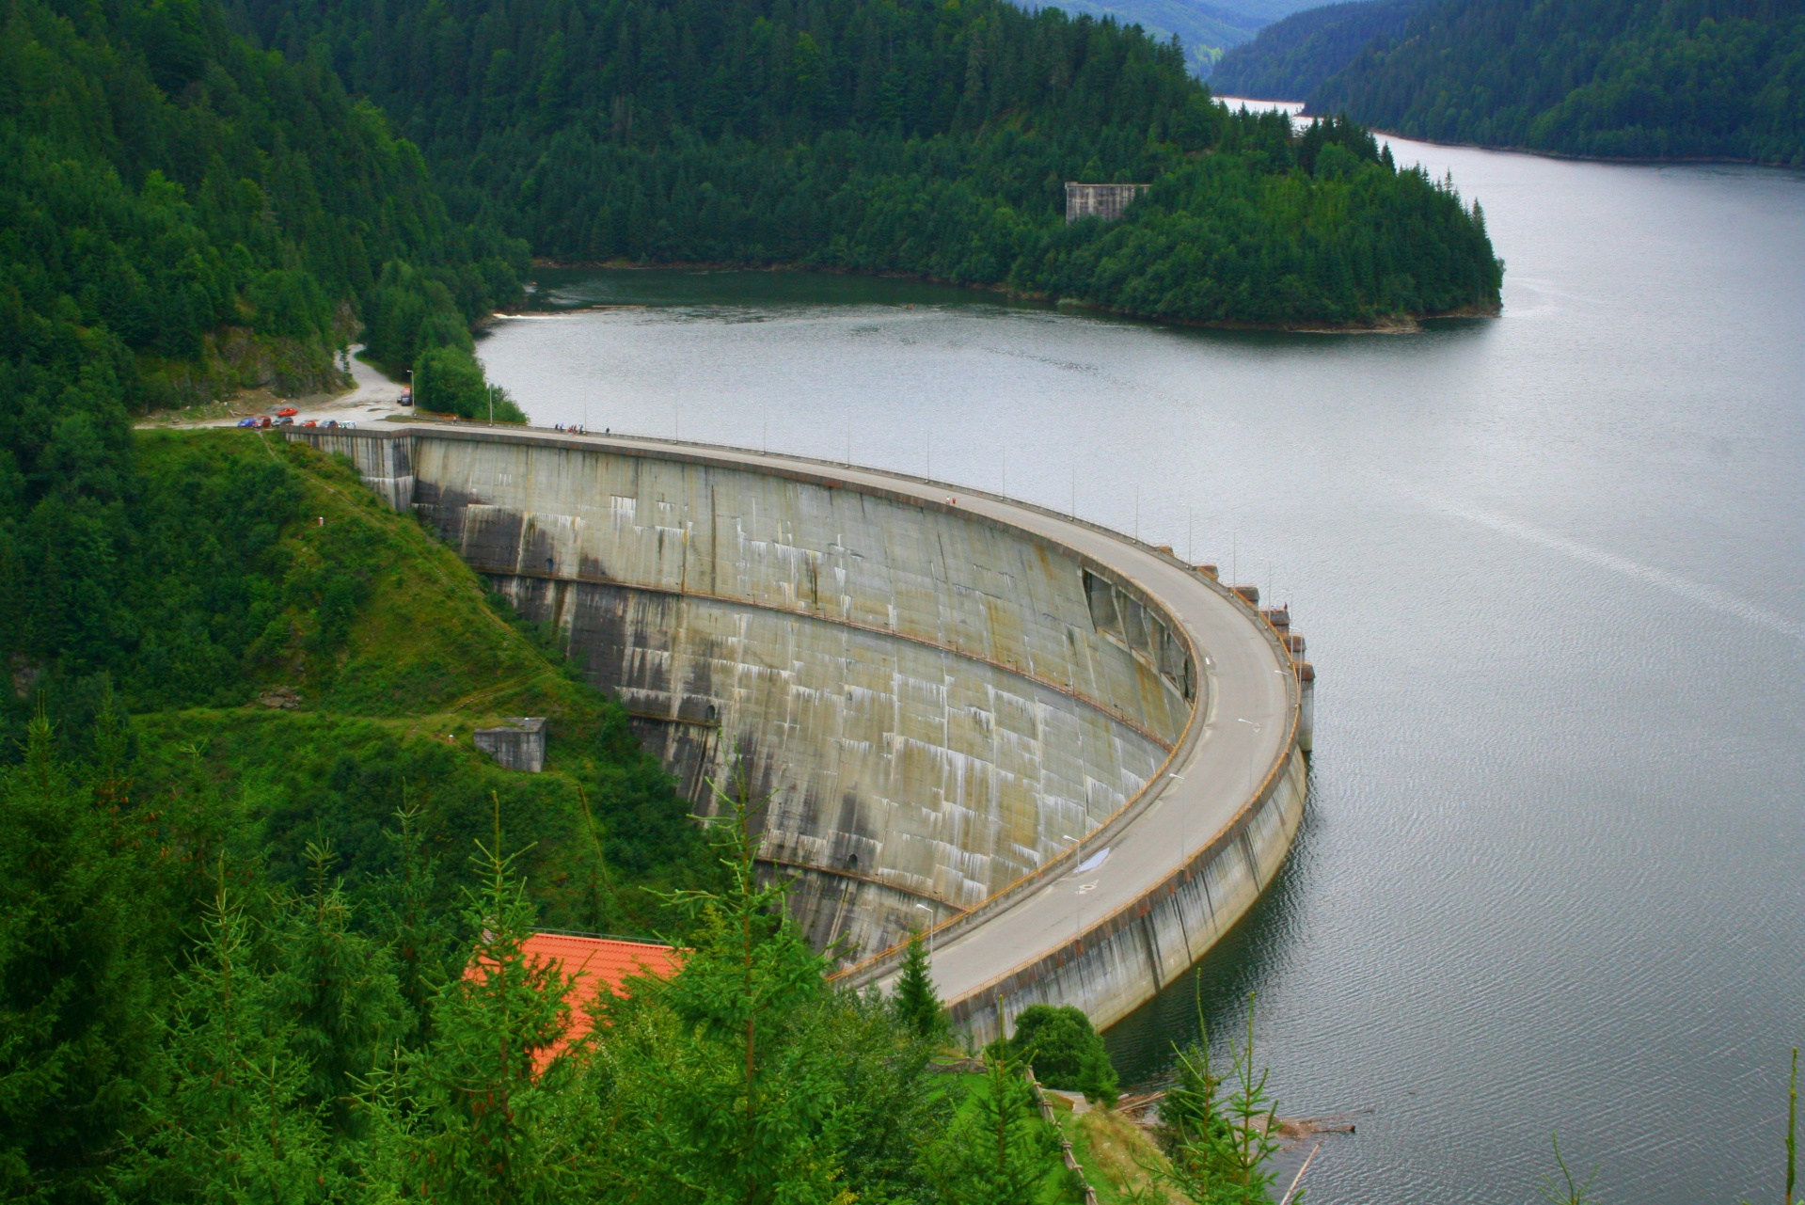
Final Thoughts
What holds you back from making a change?
Which of your grading practices best support learning? Why?
What grading practices are you most open to reconsidering?

Slide 24
Things to remember…….
Baby steps………..
Notes:
IF time allows play Baby steps video

