Slide 1
Welcome!
On behalf of the ASCCC OERI, we are please to have you here with us for “Open Pedagogy.” This event will be recorded. Archives of all ASCCC OERI events are available at asccc-oeri.org > Webinars and Events

Slide 2
Open Pedagogy Overview
Introductions
Definitions
Examples
Discussion
Resources
Q & A

Slide 3
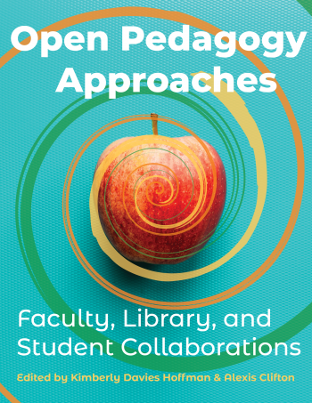
Resources
Notes:
note CCC faculty chapter author:
Informed Open Pedagogy and Information Literacy Instruction in Student-Authored Open Projects Cynthia Mari Orozco

Slide 4
Resources
Open Pedagogy Approaches
https://milnepublishing.geneseo.edu/openpedagogyapproaches/

Slide 5
Resources
University of Rochester Open Education Resources and Services

Slide 6
Definitions
Pedagogy - noun
the method and practice of teaching, especially as an academic subject or theoretical concept.
Oxford Languages

Slide 7
Definitions
Open -
adjective allowing access, passage, or a view through an empty space; not closed or blocked up.
"the pass is kept open all year by snowplows"
verb move or adjust (a door or window) so as to leave a space allowing access and view.
"she opened the door and went in"
noun a championship or competition with no restrictions on who may qualify to compete.
"the venue for the British Open"
Oxford Languages

Slide 8
Definitions
Open Education -
Open education is an educational movement founded on openness, with connections to other educational movements such as critical pedagogy, and with an educational stance which favours widening participation and inclusiveness in society.[1] Open education broadens access to the learning and training traditionally offered through formal education systems[2] and is typically (but not necessarily) offered through online and distance education. The qualifier "open" refers to the elimination of barriers that can preclude both opportunities and recognition for participation in institution-based learning. One aspect of openness or "opening up" education is the development and adoption of open educational resources in support of open educational practices.
https://en.wikipedia.org/wiki/Open_education

Slide 9
Definitions
Authentic Assessment
- Evaluates whether a student can successfully transfer the knowledge and skills gained in the classroom to various contexts, scenarios, and situations; measures not just what students know but how they can apply that knowledge.
Requires high-quality product and justification of the solutions to the problems encountered
Tied to real-world contexts; requires students to “do” the subject
Are integrated challenges in which a range of skills and knowledge must be used in coordination
Involves complex tasks for which there may be no right or wrong answer and may not be easily scored (NJIT.edu)
Notes:
Sally https://www.njit.edu/ite/authentic-assessment

Slide 10
Definitions
Renewable Assignments -
Different from a traditional disposable assignment, a renewable assignment is where students compile and openly publish so that the assignment outcome is inherently valuable to the community after the class is over (Veletsianos, 2017).
Renewable Assignment Design Framework
collaboration and exchange
opportunities for revision, creativity & modification
sharing of resources inside & outside the classroom
learning happens through cooperative critique
innovation - something novel is produced (Seraphin et al., 2018)
Notes:
Sally https://journals.sagepub.com/doi/full/10.1177/1475725718811711
https://topr.online.ucf.edu/r_1h7ucljsasbkbsd/#:~:text=Different%20from%20a%20traditional%20disposable,over%20(Veletsianos%2C%202017).

Slide 11
Open Pedagogy Examples
Student Feedback - Immediate Change Implementation
Errors Assignment
Student Artwork Project
Life in Quarantine
IDEA Framework
Notes:
Blueprint - 5 examples

Slide 12
Errors Assignment
Identify errors in the textbook.
Despite careful editing and reviewing, the Blueprint textbook contains errors (all textbooks contain them). Identification of these errors allows me to fix them which will benefit current and future students. Once an error found by a student is confirmed by a review team, a correction in the digital text will be made immediately and a correction in the downloadable and print versions will be made for the next version. The instructor will be the final authority on error submission eligibility and completion credit. E-mail the identified error(s), your suggestion for the correction, and the pertaining chapter to the instructor.

Slide 13
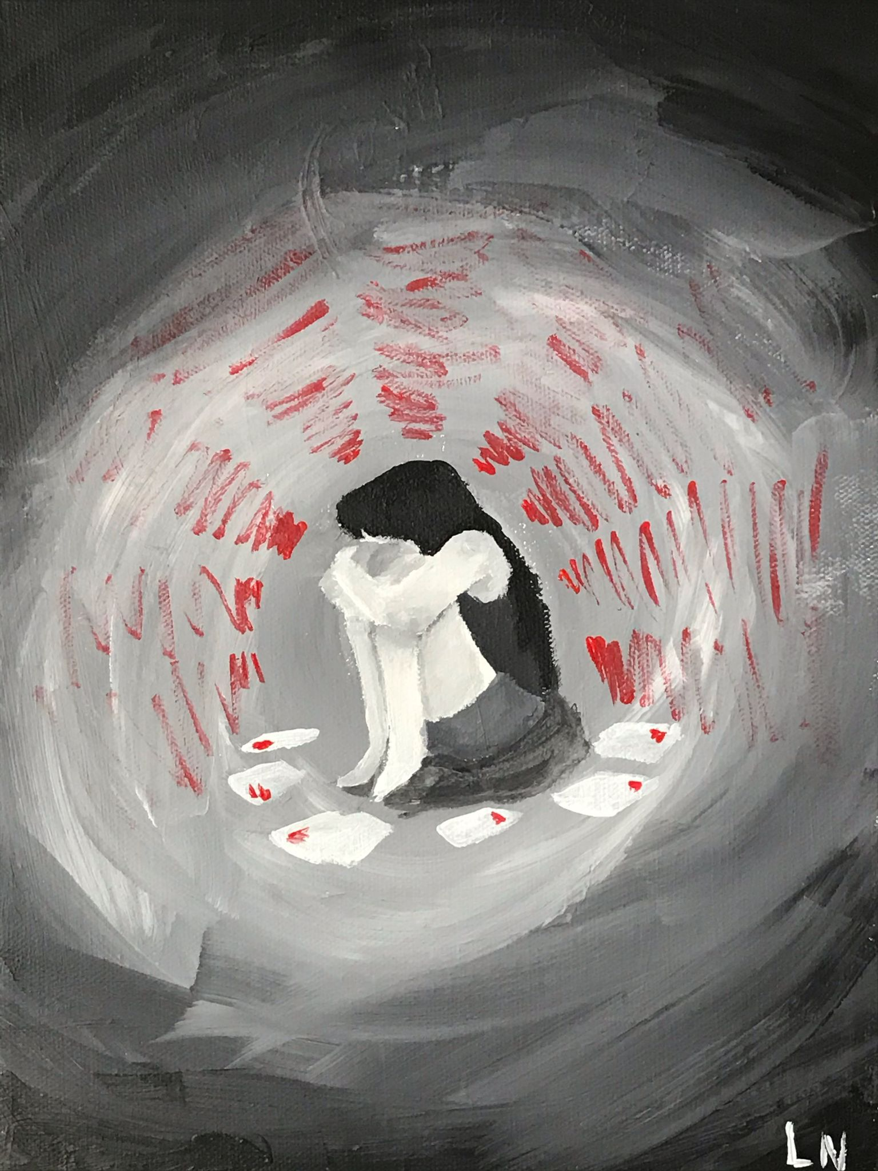
Student Artwork
Evangeline Nobbs

Slide 14
Student Artwork
Ellen Damore

Slide 15
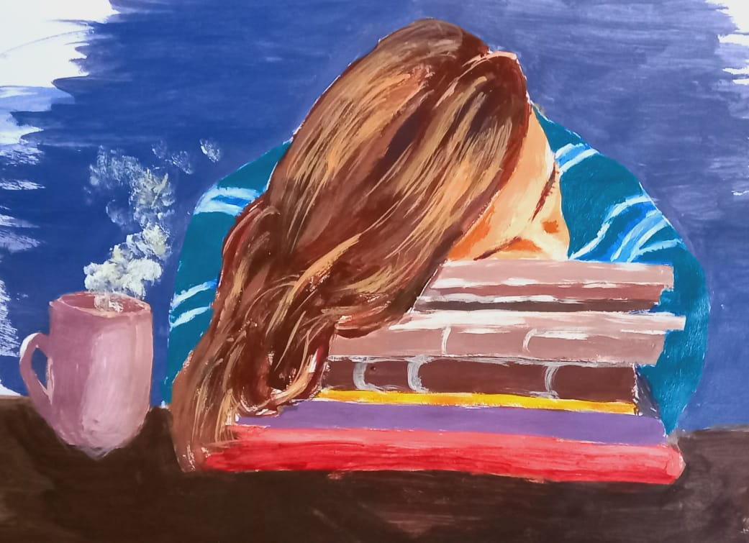
Student
Artwork
Jiayi Zeng

Slide 16
Student Release Form
aaaa
Release Form
Agreement to Contribute to Open Textbook
I, _______________________________, agree to participate in the refining of Blueprint for College and Career Success, an open textbook, in collaboration with my professor, Dave Dillon.
I understand that inclusion of my work in the final text is conditional upon my willingness to license my contributions under a CC-BY license.
I have read the Guide to Creative Commons Licenses (Links to an external site.) and understand that a CC-BY license allows others to share, use and adapt my work so long as they attribute me as the original author.
I understand that I have the right to request that my name and/or work be removed from the original text, or change the license on my contributions at any stage prior to publication.
Signed: _______________________________ Date: ____________________

Slide 17
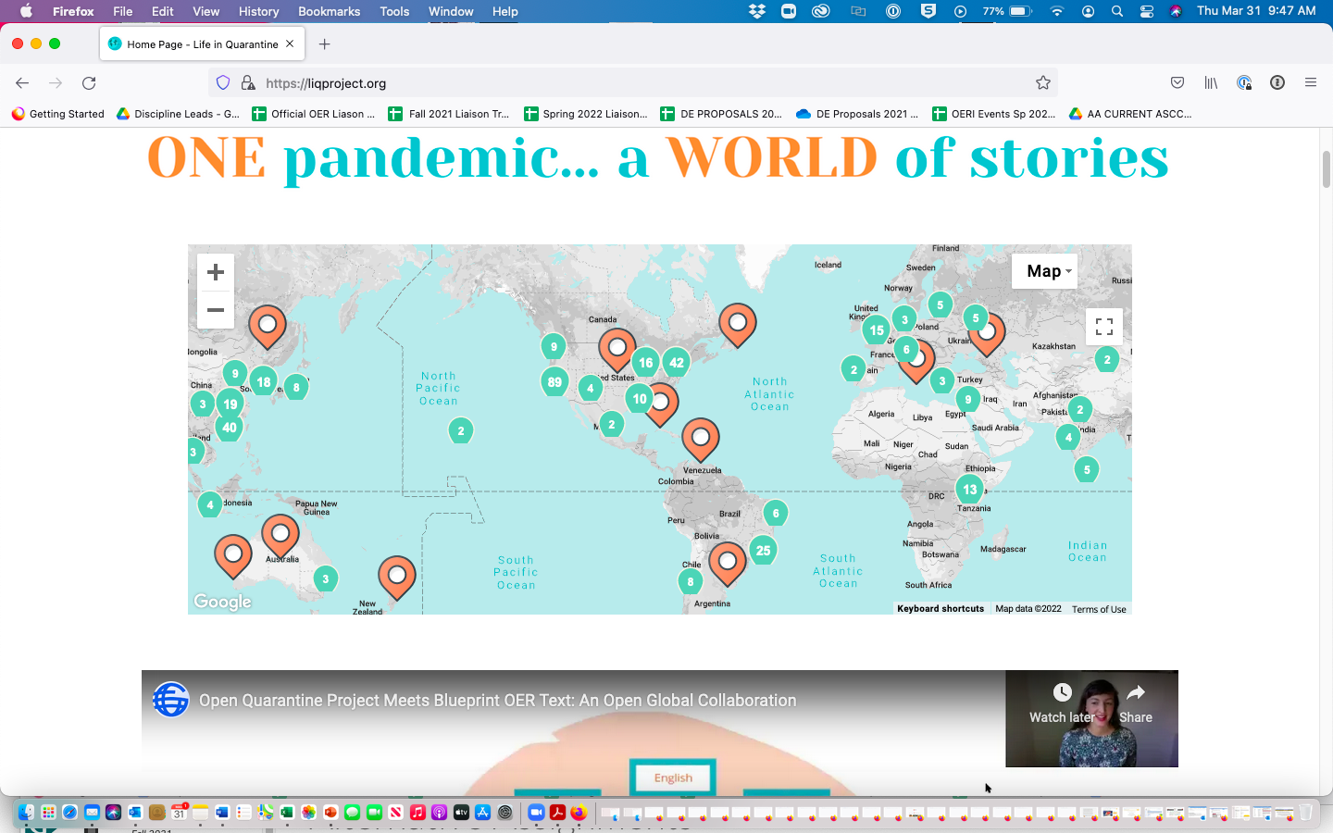
Life in Quarantine
https://liqproject.org/
aaaa

Slide 18
Inclusion, Diversity, Equity, and Anti-Racism - A Process for Reviewing and Improving Courses and Course Resources (Description)
The ASCCC OERI has developed a framework for reviewing and improving existing OER with respect to IDEA. The ASCCC OERI’s IDEA Framework may be applied not only to OER, but also to commercial and instructor-developed resources to determine if they are appropriate for our students. Join us for a review of the developed framework and a consideration of discipline-specific issues that warrant attention. Assist the OERI in identifying next steps in this evolving approach to improving course resources and student success. (tinyurl.com/OERI-IDEA)

Slide 19
Guiding Principles
Design and present resources always with students in mind and contribute to a learning environment that facilitates learning and growth.
Strive for meaningful inclusion of diverse populations to ensure that their perspectives and their experiences are reflected and valued.
Creating a classroom that supports diversity, equity, and inclusion is integral to teaching and an ongoing process.

Slide 20
ASCCC OERI IDEA
How can faculty address diversity, equity, inclusion, and anti-racism in the resources they use?
“Open” allows you to modify anything…Inclusion, Diversity, Equity, Anti-Racism Framework

Slide 21
5 Principles of Open Assignment Design
Develop students’ skills in alignment with the course - can you easily and succinctly articulate the objectives to your students?
Create a project that adds value to the world - provide a resource for others to use, inside and/or outside your class.
Produce something that is “openly available” - meaning students must be trained on CC licenses, understand the implications, and given the choice to opt out.
Provide support to students - scaffolding, tools to succeed.
Creativity builds (rather than repeats) - work builds on itself from semester to semester, changes each time.
-Open Pedagogy Approaches
Notes:
Sally

Slide 22
Open Pedagogy Examples
Robert Brown - San Bernardino Valley College - English 101 Composition
The HEART Project: public showcase - expression of students’ creativity of their own trauma surrounding race and ethnicity
Open-ended project based on self-expression in any format they chose (painting, drawing, music, poetry, short story, choreography, essay, speech, comic strip, audio interview, power point)
The HEART Gallery https://sbvcheart.wordpress.com/
Ruth Calcánas - Mt. San Antonio College - Sociology 101
Anti-Racist workbook for faculty, staff, and students in higher education (optional participation)
Reflection Qs for students to reflect on racism in US
Reflection Qs for faculty and staff to reflect on how racism impacts students and how they can support their students better
Permission to use assignments with or without names
Sharon Sampson - Grossmont College - Administration of Justice
Students created lesson plans for the course for 6 weeks
Some created them under CC licenses, some just shared with the class
Notes:
Sally https://www.cccoer.org/ofar/classroom-action/

Slide 23
Open Pedagogy Examples
Oliver Rosales - Bakersfield College – History of California
Creation of an interactive ArcGIS map administered through Survey 123
Students plot family histories and upload artifacts (objects, photos, etc.)
Showcased on google website, curated by instructor
Ana Garcia-Garcia – Monterey Peninsula College – Chem 2 & Geol 9
Students create their own open scientist slide with instructor guidance, someone they identify with
List accomplishments, why they chose them
Will share and use as examples with next class
Suzanne Iwanicki - Pasadena College - Bio 11
Students created openly licenced videos about the COVID-19 vaccine (15-60 seconds)
Implemented in all 21 sections in Spring 2021 (~600 students)
Trauma-informed pedagogy: COVID-related content warning, opt-out option, reflective spaces
Topic: I have received or plan to receive the vaccine OR I still have questions or concerns about the vaccine
Most students chose to openly license their videos, most chose CC BY-NC-ND
Notes:
Sally https://www.cccoer.org/ofar/classroom-action/

Slide 24
Resources
OE Global Thread
https://connect.oeglobal.org/t/suggested-resources-for-learning-about-open-pedagogy/1823

Slide 25
Resources
Regional Leaders of Open Education (RLOE): https://rloe.org/resources/. This page has a section for OE and Open Pedagogy.

Slide 26
Opportunity for Sharing Out
We invite you to share your experiences with open pedagogy? What have you applied/tried?

Slide 27
Discussion

Slide 28
Q & A
Photo by Pixabay from Pexels

Slide 29
Thank you!

