Slide 1
Accessibility Part 2
Suzanne Wakim; licensed CC BY 4.0

Slide 2
Part 2 of 2
Accessibility 1
Accessibility 2
Text considerations
links
headers
styles
lists
Colors
WAVE
Q and A
Video and audio
Images
alt text
captions
complex images
Tables
WAVE
Q and A

Slide 3
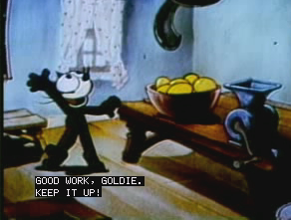
Captions & Transcript
Who uses them?
80% of people that use captions are not deaf!
How do people use them?
Quiet / loud environment
Second language learners
Learning challenges
Helps with focus
Challenging content
Supports learning
Many other reasons
Closed Caption Demonstration is in the public domain
Who uses Closed Captions by 3Play Media

Slide 4
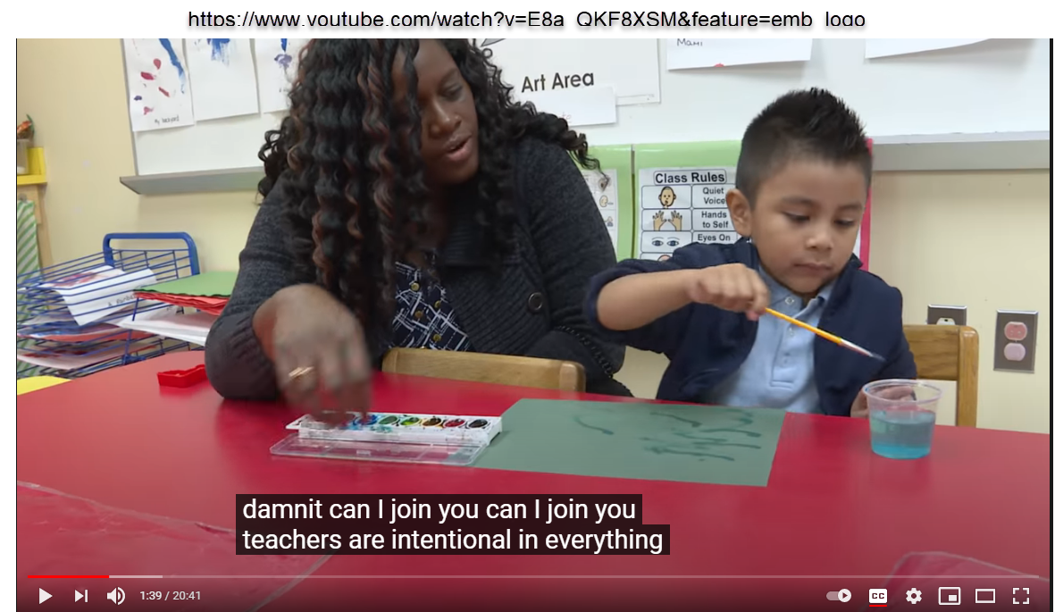
Autocaptions
Captions need to be accurate and have punctuation
damnit can I join you can I join you teachers are intentional in everything
Autocaptions are a good place to start - but then edit them

Slide 5
Video and Audio
Video
Include all important noises (bells, etc.)
Captions are not transcripts (use both if possible)
Interactive transcript have additional benefits
Transcripts for audio
Provide Context

Slide 6
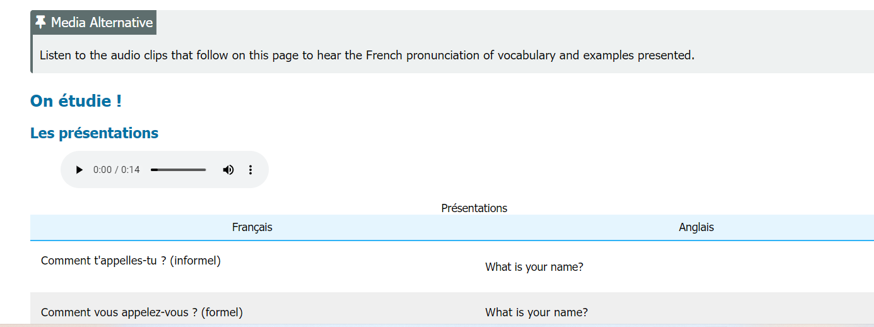
Video and Audio: Context
Notes:
This is an example from a French OER that has multiple audio files for most of the content on the page to help learners hear the French pronunciation. It was therefore advised that the authors put a media note on top to guide a learner usign screen reader what the audio files were about and that their alternative text was right below.
Link to page with audio: https://human.libretexts.org/Bookshelves/Languages/French/French_OER_1_(Carrasco_Zahedi_and_Parrish)/01%3A_Unite_1_-_Bonjour/1.03%3A_Comment_se_presenter

Slide 7
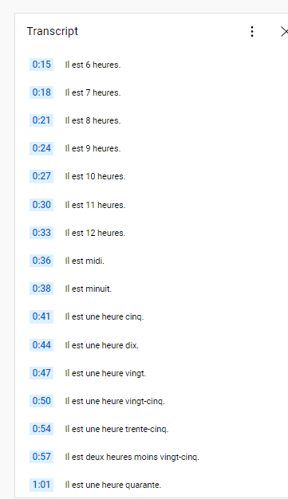
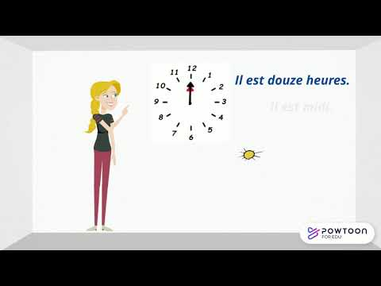
Video and Audio: Transcript
Notes:
Link the LT page with this video: https://human.libretexts.org/Bookshelves/Languages/French/French_OER_1_(Carrasco_Zahedi_and_Parrish)/02%3A_Unite_2_-_A_l'universite/2.04%3A_Quelle_heure_est-il

Slide 8
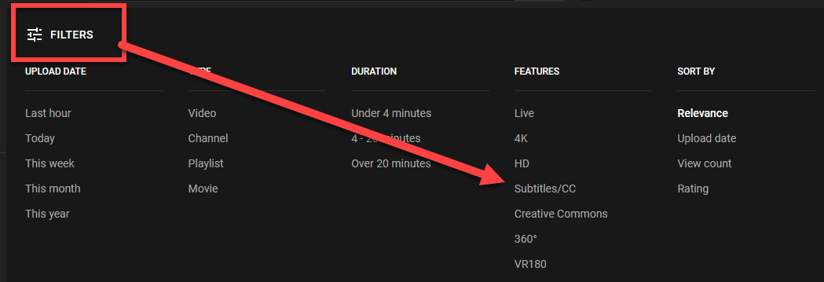
Finding captioned videos
Search for captioned videos
Check to make sure the captions are accurate

Slide 9
Images and Alt Text
Caption: UNESCO Global Open Educational Resources logo
Alt text: An open book with pages turning into raised hands; text reads Open Educational Resources.
Decorative?
Context matters!
not “image of…”
OER logo by Jonathasmello licensed CC BY 3.0
Notes:
Alt text begins with “image of” so don’t need to say that
A

Slide 10
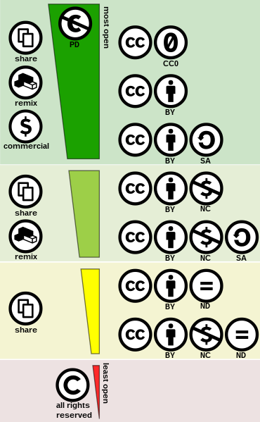
Complex Images
Alt text is limited to 140 characters
What might we put in the caption or body of the text?
CC license spectrum by Shaddim; licensed CC BY 4.0
Notes:
UDL - even students who can see can use help
Creative commons license spectrum

Slide 11
Accessibility Checkers
Wave Tool
wave.webaim.org
Notes:
We will practice in a bi

Slide 12
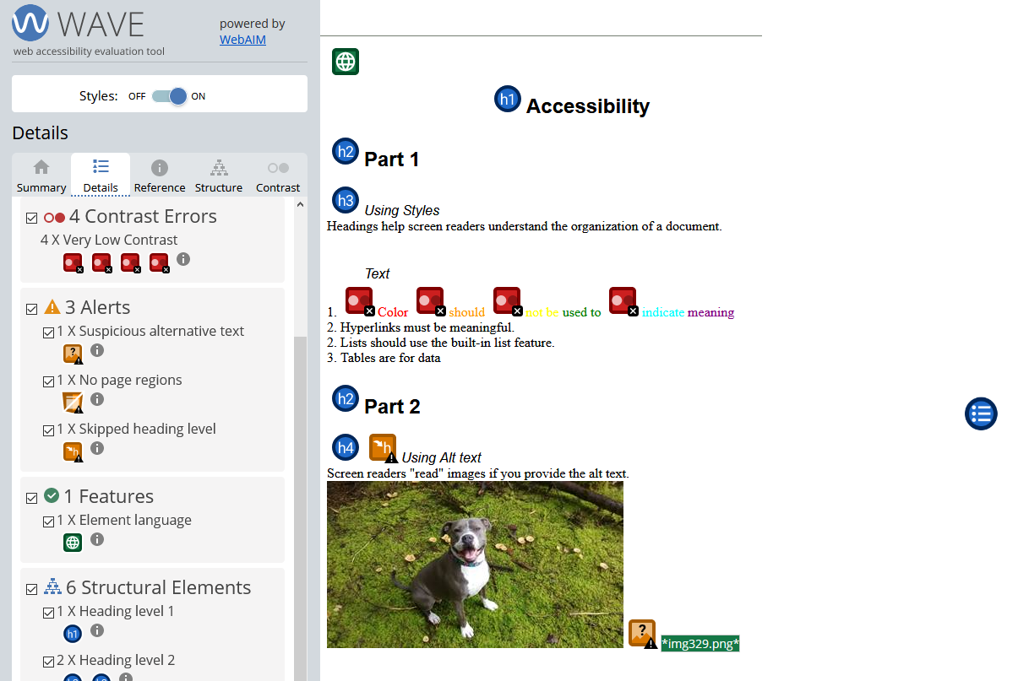
WAVE Results

Slide 13
WAVE Results - Images

Slide 14
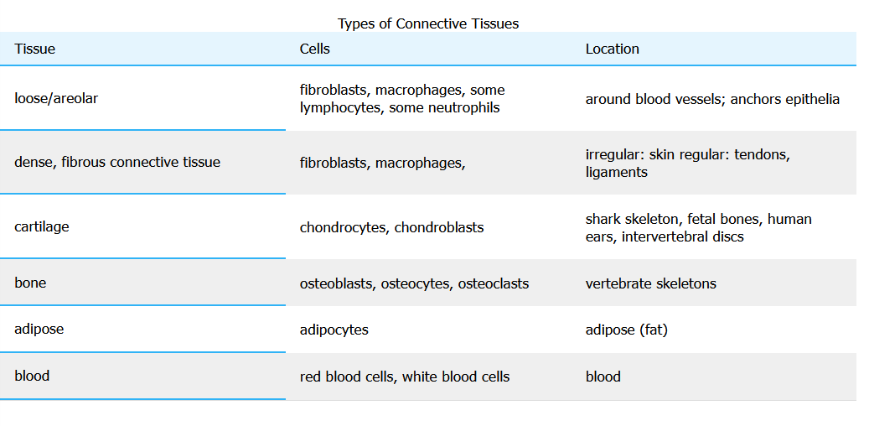
Tables
Tables are for data or organizing information not formatting
Need captions and headers
Notes:
Connective Tissue Table source

Slide 15
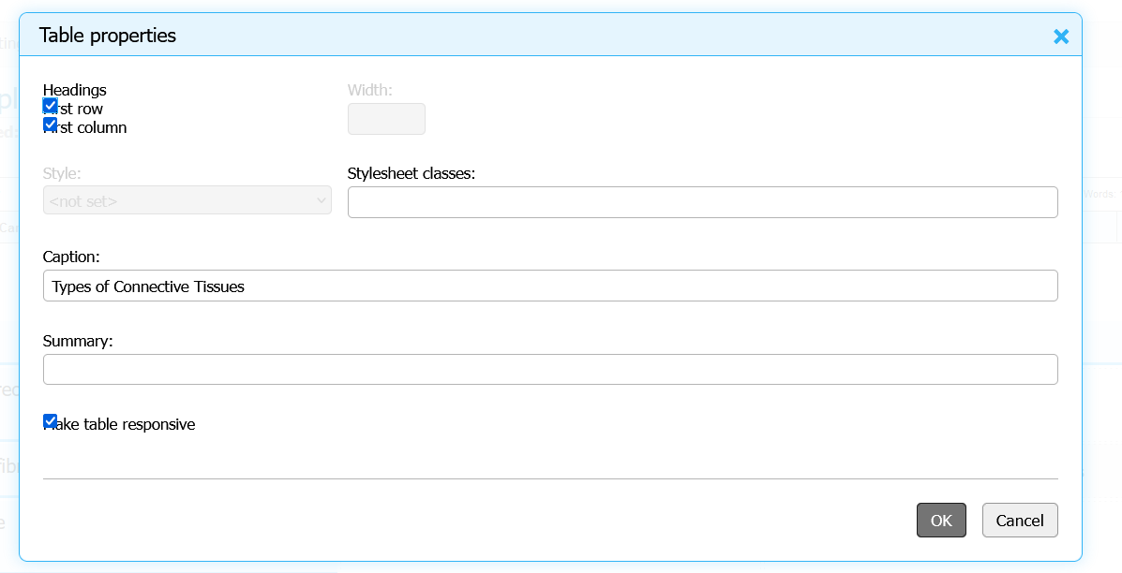
Table properties

Slide 16
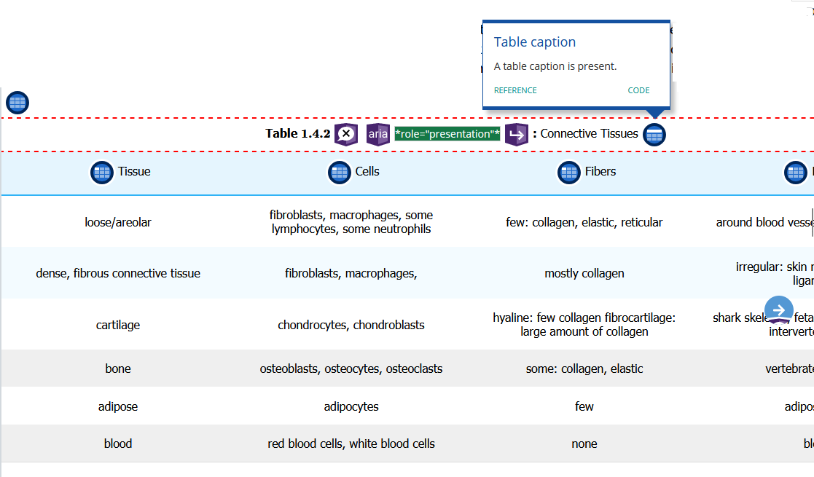
Data Table

Slide 17
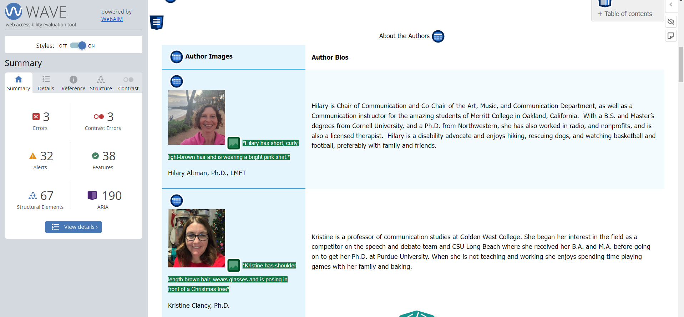
Table for Organizing Information
Notes:
Link to the page: https://socialsci.libretexts.org/Under_Construction/The_Courage_to_Communicate%3A_Understanding_Interpersonal_Communication_Draft_Version/00%3A_Front_Matter/05%3A_About_the_Authors

Slide 18
Layout Table

Slide 19
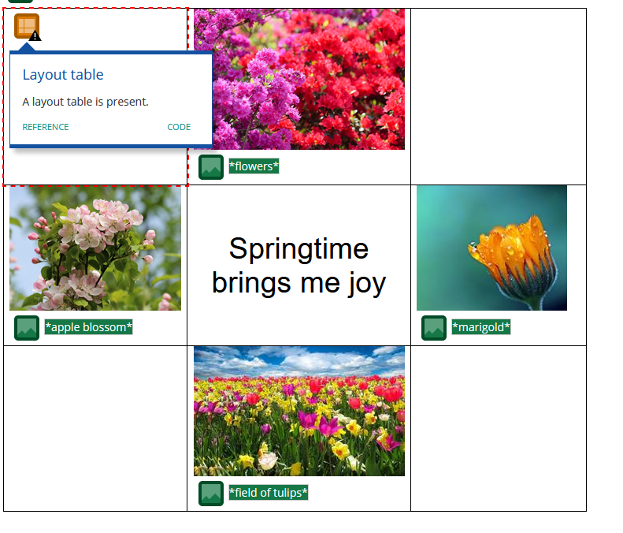
WAVE - Layout Table
Notes:
Attributions:
Ashikaga Flower Park by 雷太 licensed CC BY 2.0
Apple Tree Blossoms by George Chernilevsky; released into the public domain
Field of Tulips by Blende12 via Pixabay License
Marigold by Myriams photos via Pixabay License

Slide 20
Accessibility Checkers
Wave Tool
wave.webaim.org
Notes:
Have them go to Wave and test out a page. Maybe one of their pages if they have a book or their college homepage (or any other page)

Slide 21
Human Checked
Eyeglasses by StockSnap; pixabay license

Slide 22
Questions?
ASCCC OERI

