Slide 1
Reading, Writing, Research, and Reasoning:
an Advanced ESL Text
Gabriel Winer, Berkeley City College
Beth Wadell, Laney College
Marit ter Mate-Martinsen, Santa Barbara City College

Slide 2
Goals
Academic reading/writing with a language learner focus
Targeted 1 level below transfer-level English
Chapters organized around thematic content relevant to CCC ELs
Authentic readings from openly licensed texts
Examples of student writing at target level
Workbook-style activities to move from inductive learning to structured practice to more general application
Language structures presented in the context of expressing academic ideas: tools to make meaning

Slide 3
Contributors
ESL Faculty (+ 1 Librarian) from
Berkeley City College
City College of San Francisco
Imperial Valley College
Laney College
Porterville College
Santa Barbara City College

Slide 4
Process
Examined course outlines from our colleges and pulled out main objectives
Developed a values statement
Brainstormed chapters/organization
Reviewed other OER texts
Teams drafted chapters using templates on Google Docs
Peer reviewed
Editors revised content and moved to LibreTexts

Slide 5
Chapters and Themes
Critical Reading: undocumented immigrant rights
Organization and Cohesion: bias, stereotypes, and stereotype threat
Research: increasing teacher diversity
Integrating Evidence: maintaining heritage languages and bilingualism
Analyzing Arguments: reducing social and ecological harms of fast fashion
Clarity and Style: community efforts to address food deserts
Also includes Instructor Resources and Glossary

Slide 6
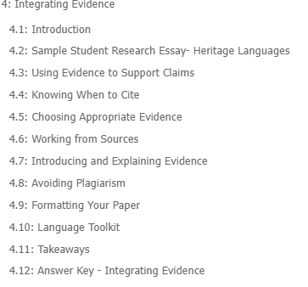
Features of each chapter
What will we learn?
Why is this important?
What theme will the chapter focus on?
Learning objectives

Slide 7
Features of each chapter
Sample student writing on the chapter theme that demonstrates concepts of the chapter.

Slide 8
Features of each chapter
Chapter content contains contextualized reading and writing examples and workbook activities.

Slide 9
Features of each chapter
Phrasebook for targeted element of academic writing:
words, sentence frames, etc. to help students use discrete elements in service of conveying meaning

Slide 10
Features of each chapter
Summary and questions for reflection

Slide 11
Features of each chapter
Answers to any “Try this!” exercises in the chapter

Slide 12
Workbook-style elements: Notice this!
Inductive learning through examining, identifying, evaluating, and/or comparing elements of an authentic text

Slide 13
Workbook-style elements: Try this!
Structured practice - sometimes includes answers on a separate linked page

Slide 14
Workbook-style elements: Apply this!
Encourages teachers and students to generalize the element or skill to their own writing in progress.

Slide 15
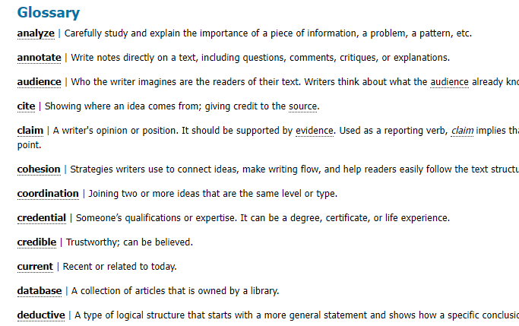
Glossary

Slide 16
Glossary
Hover over underlined words for the definition

Slide 17
Glossary
Hover over underlined words for the definition

Slide 18
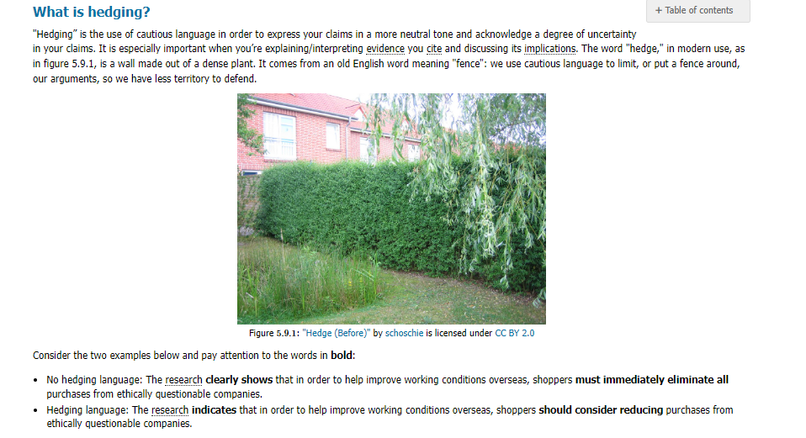
Highlight 1: Hedging (Gabe)
definitions/intro
examples

Slide 19
Highlight 1: Hedging (Gabe)
rationale
other notes

Slide 20
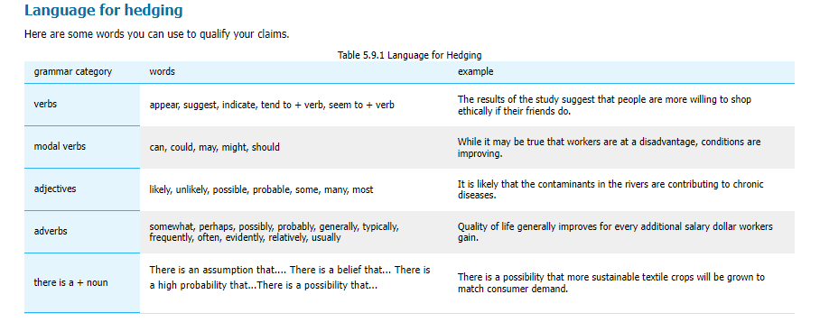
Highlight 1: Hedging (Gabe)
word bank with examples from the chapter theme

Slide 21
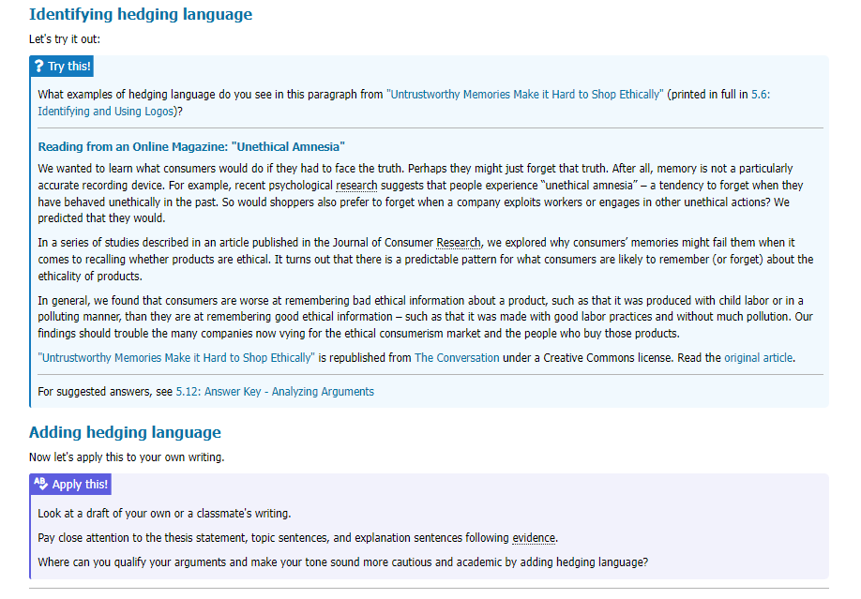
Highlight 1: Hedging (Gabe)
structured practice with linked answer key
suggestions for applying to own writing

Slide 22
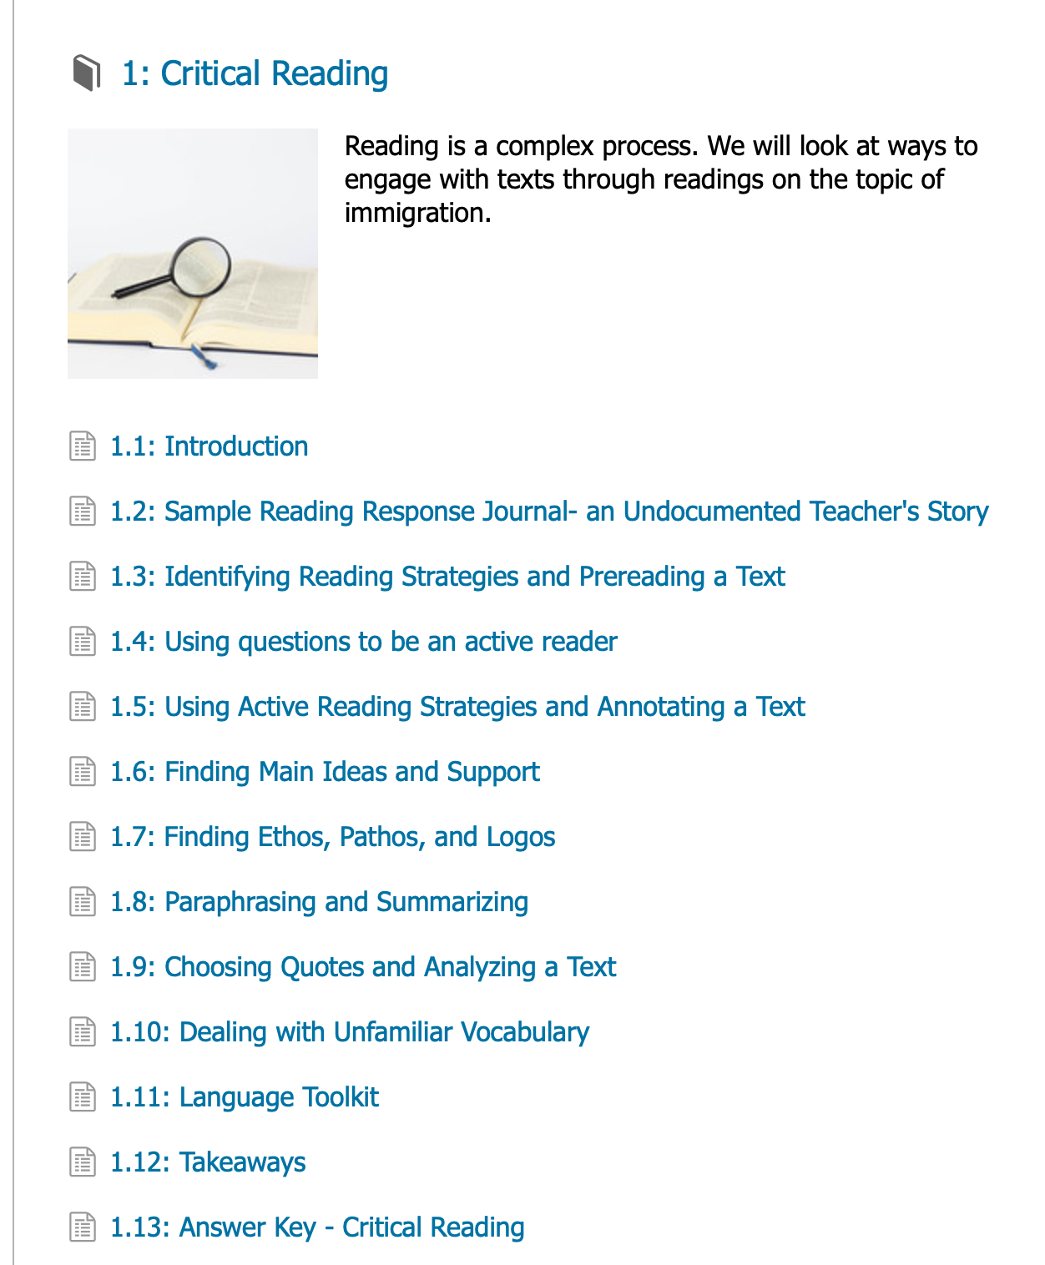
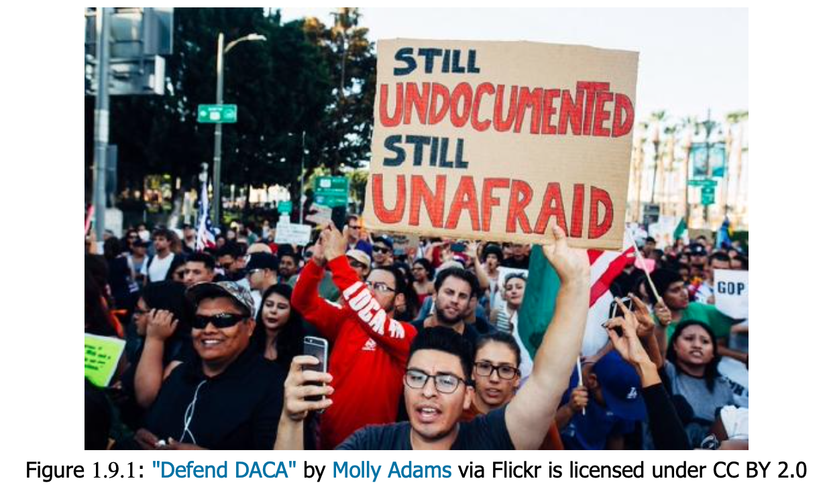
Highlight 2:
Critical Reading (Marit)

Slide 23
Use, share, and give us feedback!
Gabe: gwiner@peralta.edu
Beth: ewadell@peralta.edu

