Slide 1
New Data Element: XB12 Instructional Material Cost
Erin Larson, Specialist
Equitable Student Learning, Experience & Impact Office
Educational Services & Support Division
ASCCC OERI, June 2, 2022

Slide 2
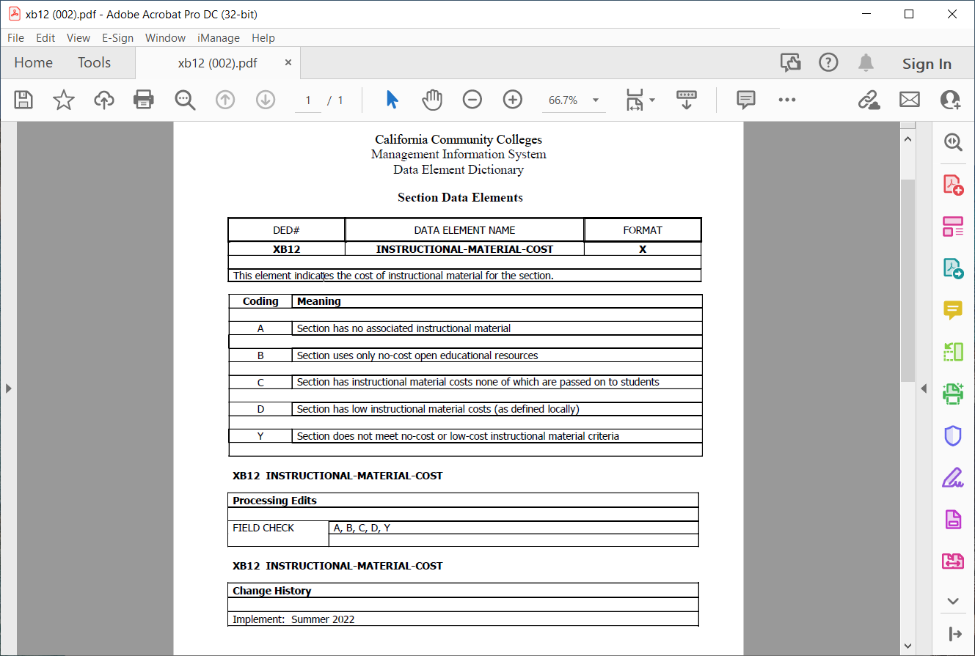
Data Element Dictionary

Slide 3
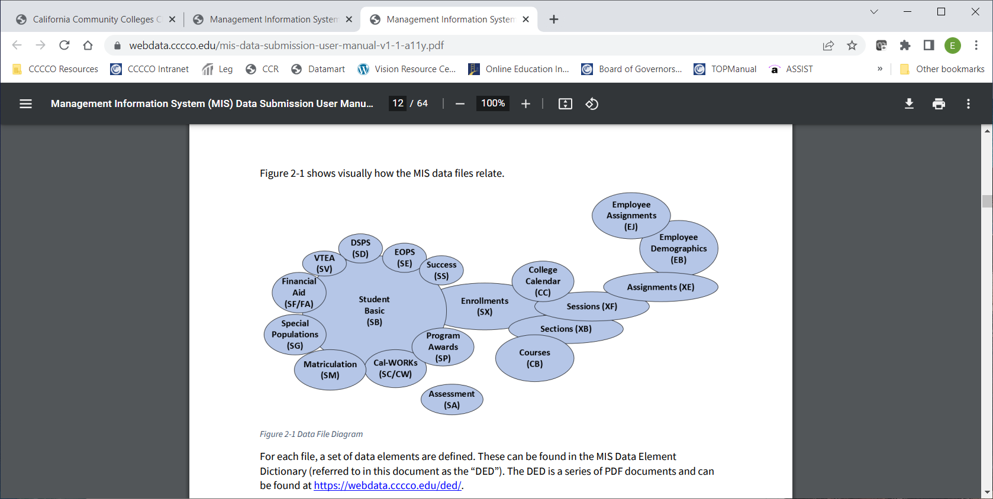
Relationship of MIS Data Files
Image from the MIS Data Submission User Manual
Notes:
Link to MIS User manual - https://webdata.cccco.edu/mis-data-submission-user-manual-v1-1-a11y.pdf

Slide 4
Why an Instructional Materials Data Element?
We do not have the data now
Tracks information the instructional materials by section
Gathers baseline information for the ZTC Program
Provides systemwide information in instructional materials
  Identify barriers to equitable access
  Establish baseline for future legislative program investments and budget advocacy
  Respond to legislative inquiries and reports

Slide 5
XB 12: Definition of Instructional Materials
  Any of the following:
  Textbooks (EDC 66406.7)
  Digital course materials (EDC 66406.9)
    Open educational resources
    Institutionally licensed campus library materials that all students enrolled in the course have access to use
    Other properly licensed and adopted materials
    Access codes to digital course materials
  Materials defined in the Disabled Student Services General Provisions section (EDC 67302.5(a)(4))
    AV work {Section 101 of Title 17 of the US Code) required for student’s success
DOES NOT
INCLUDE instructional supplies or equipment like uniforms, yoga mats for yoga class, paint brushes, calculators, etc.
Notes:
Textbooks as defined in the College Textbook Transparency Act Section 66406.7 - https://leginfo.legislature.ca.gov/faces/codes_displaySection.xhtml?lawCode=EDC&sectionNum=66406.7.
Digital course materials, Section 66406.9 - https://leginfo.legislature.ca.gov/faces/codes_displaySection.xhtml?lawCode=EDC&sectionNum=66406.9.
DSPS General Provisions, Section 67302.5(a)(4) - https://leginfo.legislature.ca.gov/faces/codes_displaySection.xhtml?lawCode=EDC&sectionNum=67302.5.
Definition of AV work in Section 101 of Title 17 of the US Code - https://www.govinfo.gov/content/pkg/USCODE-2011-title17/pdf/USCODE-2011-title17-chap1-sec101.pdf

Slide 6
XB 12: Instructional Material Cost - Coding Examples
Code
Example
A – Has no associated instructional material
B – Uses only no-cost open educational resources
C – Has instructional material cost, none of which are passed on to students
D – Has low instructional material costs (as defined locally)
Y – Does not meet no-cost or low-cost criteria
A – Never had a textbook
B – Digital course content that are widely available without a fee
C – Lending libraries, classroom sets, department provided
D – Per district policies, inclusive access
Y – Has textbook costs

Slide 7
Implementation
Timeline
Fall 2023
“Soft” implementation
Spring 2022
Development
Fall 2022
Required implementation
Spring 2023
Refinement and guidance
Summer 2022
Launch and guidance

Slide 8
Reminders
Guidance memo is coming
There’s time to implement and refine
Each institution should be aware of local policies related to low cost
Attention to the production and pricing of college textbooks is a legislative priority (EDC 66406)

Slide 9
elarson@cccco.edu

