Slide 1
Student Surveys: measuring the impact of ZTC and OER

Slide 2
Agenda
Introduction: OERI Student Impact Project
The survey tool: creation, distribution, pilot
Initial data: discoveries, insights, and predictions
Next steps

Slide 3
OERI Student Impact Project
Three goals:
collaboratively develop and administer a survey measuring impact of textbook costs and experience in ZTC/OER classes across ten pilot colleges
support the creation of campus-based videos highlighting student experiences with textbook costs and ZTC/OER classes
develop and share resources (webinars and a toolkit) to guide other CCC campuses to create similar projects

Slide 4
Survey development…
Collecting
Our target respondents
Distribution
Initial winter mini-pilot (~200)

Slide 5
Initial discoveries and insights

Slide 6
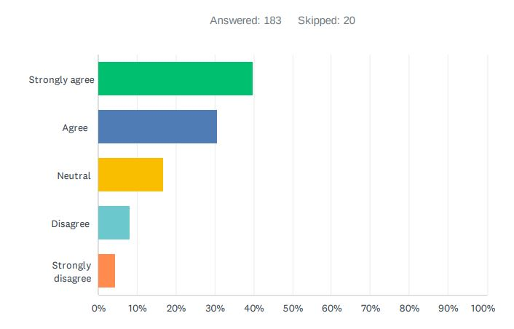
Have the cost of materials influenced students’ decisions to enroll in a class?

Slide 7
How do course materials costs influence student success?

Slide 8
If all classes used free course materials, how would students spend the savings?
“I would be able to pay all of my bills.”
“I would spend it on more of my education as most of the money to pay for my books come out of my college saving account.”
Meet basic needs
“For more school supplies-I really needed a keyboard attachment for my iPad but I chose to buy a $70 history book instead.”
Put toward tuition or additional courses
Buy instructional materials

Slide 9
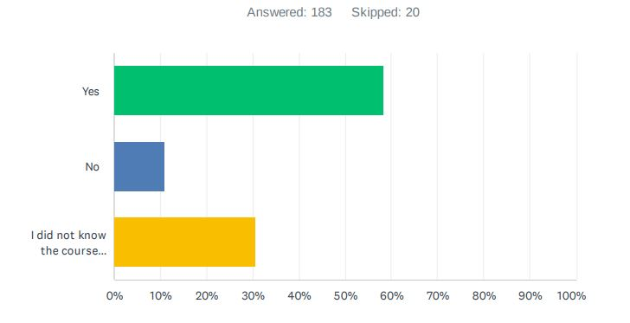
Did free course materials influence students’ decision to enroll in a course?

Slide 10
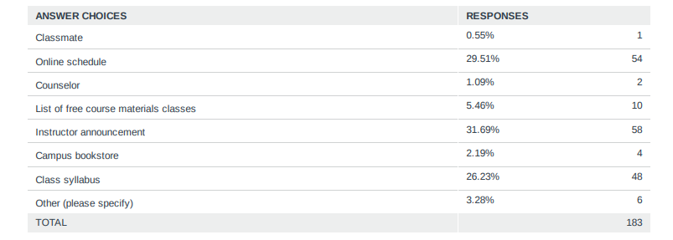
How do students find ZTC/OER classes?

Slide 11
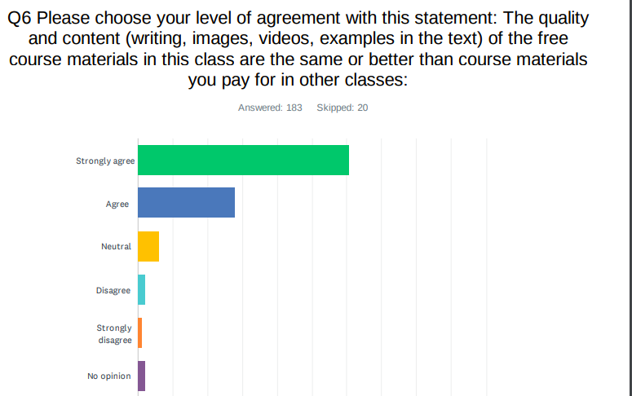
The quality of ZTC/OER materials are the same or better than traditional materials, according to students.

Slide 12
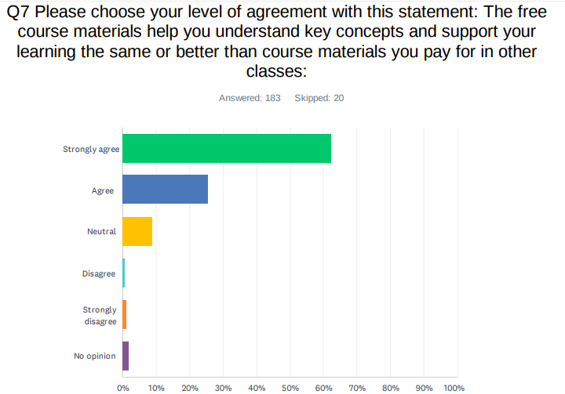
ZTC/OER helped students understand key concepts and learning in their classes

Slide 13
Students comment on how using free course materials impacted their learning experiences
“I thought it was very helpful to have the materials ready to go without having to wait for them to come in the mail or having to go to the bookstore.”
“I have purchased many expensive books that are door stops. The free materials were easy to use and interact with.”
Easy access
“I felt stress free. I didn’t have to worry about [purchasing] a material and [it] helped me relax about the course.”
Better or similar quality
Reduces stress

Slide 14
What’s Next?
Spring 2022: rolling out the student survey in a meaningful way across campus
Supporting each other in creating student interview videos highlighting their experience with OER/ZTC and textbook affordability
Leverage the results as documentation to support actionable items

Slide 15
Questions?

