Slide 1
Welcome!
On behalf of the ASCCC OERI, we are pleased to have you here for “ZTC Via OER – What do the data say?”
If you are not already muted, please mute yourself upon arrival. As this is set up as a meeting, we will be able to have an actual discussion – but we need all those who are not speaking to be muted.
You are also encouraged to use the “chat” feature.

Slide 2
ZTC Via OER – What do the data say?
Revised September 14, 2022.
This work is licensed under a Creative Commons Attribution 4.0 International License.
Attribute this slide deck as: “” "ZTC Via OER – What do the data say?" by ASCCC OERI is licensed under CC BY 4.0.

Slide 3
Webinar Description
OER is one way to alleviate textbook costs for students – but is it the best way? Other than the benefit of being free, are there data to demonstrate increased student success when ZTC is achieved by using OER? Colleagues from across the state will share their research findings with respect to this question.

Slide 4
Presenters
Julie Bruno, ASCCC OERI Communications Lead
Facilitator
Nicole Major and Jennifer Pakula
ZTC/OER Co-Chairs, Saddleback
Cynthia Sheaks
OER Liaison, Moorpark
Heather Dodge, ASCCC OERI Area B Regional Lead
Student Voices Data

Slide 5
Overview
Why OER?
Saddleback
Moorpark
Student Voices
Questions

Slide 6
Why OER? Free and…
OER are open
Modifiable at any time
Update, customize, ”remix”, etc.
OER can be employed alone with open pedagogy
Involve students in resource review and creation
But does that yield better outcomes?
And, if not, why not?

Slide 7
Implementation of OER in the CCCs
While we have seen the use of OER increase, are we leveraging the power of OER?
As OER use becomes more common, how do we encourage the changes in pedagogy that can be implemented when using resources that are open?
Should we view OER as merely a starting point?

Slide 8
Zero Textbook Cost Enrollments and Course Success by Ethnicity – Saddleback College
Jennifer Pakula and Nicole Major, Co-Chairs ZTC (Saddleback College)
Prepared by: Jared Lessard, Research Analyst

Slide 9
ZTC Credit Enrollments 2020 – 2021 and 2021 - 2022
Note: Close to 100% of non-credit sections are ZTC
Notes:
ZTC usage in high in non-credit sections. It is lower in credit sections; however, it has increased from 28% in 2020-21 to 33% in 2021-22 (and 40% in Fall 2022).

Slide 10
ZTC Credit Enrollments by Ethnicity (2021-22)
White – 34%
Latino – 33.5%
Asian – 31.8%
Black – 34.1%
Other - 31.8%
DSPS – 32.8%
Notes:
Students of all ethnicities appear to enroll in ZTC sections at similar rates. Students with disability also enroll at similar rates.

Slide 11
Course Success by ZTC Status
Notes:
Students in ZTC sections have 3% higher success rates. However, while success rates are higher for all groups, there does not appear to be an “equity bump” when it comes to the benefit of ZTC for course success (ZTC is associated with similarly higher course success rates across ethnicities and disability status.

Slide 12
Course Success by ZTC (non-MSE courses)
Notes:
MSE has by far the lowest success rate of any division, and relatively low rates of ZTC usage among faculty. Wanted to examine whether the perceived benefit of ZTC may be due to fewer ZTC sections in MSE. For non-MSE divisions, the students in ZTC sections only have a 1% higher success rates. Latino and black students have similar course success rates in ZTC and non-ZTC sections. Students with disability have marginally lower success rates in ZTC sections.

Slide 13
Course Success by ZTC (MSE)
Notes:
In MSE, students in ZTC sections have much higher success rates (6% higher overall) than students in non-ZTC sections. This is true of all ethnicities and for students with disability. Need to look further into this to determine if students in the courses are succeeding at higher rates, but suggests a large effect for MSE courses.

Slide 14
ZTC Sections by Division
Notes:
ZTC usage varies widely by Division. In Emeritus, Kinesiology, Fine Arts, Social and Behavioral Sciences, and Liberal Arts, at least 48% of sections are ZTC. (leaving out Online and Counseling, as they are much smaller). However, in Adult Ed, MSE, ATAS, Health, and Business, 20% or fewer of sections are ZTC.

Slide 15
Caveats and Conclusions
ZTC enrollments are increasing
Credit sections increased from 28% in 2020-21 to 33% in 2021-22
40% in Fall 2022
However, much lower in specific divisions (MSE, ATAS, Business, and Health)
67% of non-credit sections are ZTC
Course success rates are higher in ZTC courses
Particularly in MSE
Impact of higher textbook costs?
Currently low rates of ZTC use
ZTC does not seem to close equity gaps
But Latino students in ZTC have course success rates 2.5% higher, 5% in MSE
Notes:
As of now, there are 732 credit sections (40%) that are ZTC, and 211 non-credit sections (67%) that are ZTC. Overall, 943 sections (44%) are ZTC in Fall 2022.

Slide 16
ZTC Courses and Student Success – Moorpark College
With deepest gratitude to Lisa Chea, MS, Research Analyst
Office of Institutional Effectiveness, Grants, and Planning.

Slide 17
Research Questions
Do ZTC courses have higher success rates than non-ZTC courses?
Do students taking ZTC courses earn higher grades than students taking comparable, non-ZTC courses?
Does the effect that ZTC has on success rates differ by course delivery type, or by financial need?
Does the effect that ZTC has on course grades differ by course delivery type, or by financial need?

Slide 18
Methods – Data Collection and Analyses
Data Collection
Fall 2018
Spring 2019
Fall 2020
Spring 2021
Analyses
Chi-Square Test of Independence
T-Test
Multiple Regression
Logistic Regression
Notes:
The courses selected because they had sections that were both ZTC and non-ZTC for each term analyzed, for a matched comparison and pseudo-control group.

Slide 19
Method – Target Courses
American Government and Politics (POLS M03)
Child Health, Safety, and Nutrition (CD M23)
College Algebra for STEM (MATH M05)
English Composition (ENGL M01A)
Intermediate Algebra (MATH M03)
Intro to Psychology (PSY M01)
Introduction to Business (BUS M30)
Introduction to Mass Communication (FTMA M100)
Introduction to Sociology (SOC M01)
Physical Geology (GEOL M02)
Principles of Microeconomics (ECON M201)
Public Speaking (COMM M01)
US History Through Reconstruction (HIST M130)

Slide 20
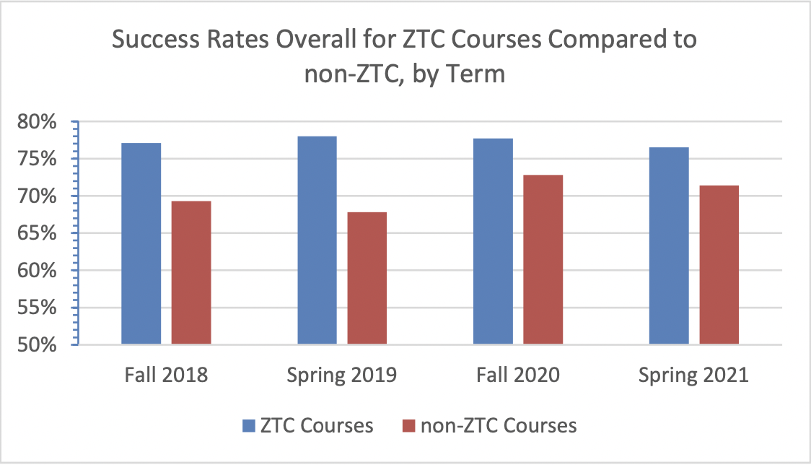
Results: Course Success Rates by Term
Statistically significant at p-value<.05

Slide 21
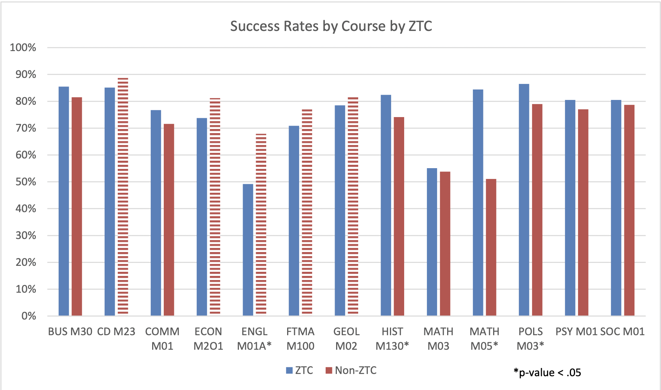
Results: Success Rates by Course

Slide 22
Results: Does ZTC Lead to Better Grades?
T-Test on Mean Course Grades
ZTC Course (n = 7504), Mean 3.09
Non-ZTC Course (n = 19888), Mean 2.79
P-value <.01

Slide 23
Unexpected Findings: Race and Financial Need
ZTC does not have a greater impact for students who are financially in need compared to those who are not in financial need.
Students who receive financial aid (Pell or BOG Waiver) or those who receive government assistance are less likely to be successful in a course.
ZTC does not have a greater impact on course success rates for some racial groups in comparison to white or Asian students.

Slide 24
“Numbers don’t lie, but they may not tell the whole story.”

Slide 25
Considerations
Probability of demonstrating success increases with n
Financial stability difficult to attain
Zero-cost textbooks part of the equation
PT students more likely to work
Financial obligations may cause stress
No distinction made between methods of achieving ZTC
Accurate designations a challenge
“When access is very low, experiments have a much higher likelihood of correctly rejecting the null hypothesis with smaller n… because there are more students in the sample that can be impacted by the intervention. However, as access increases, it pulls the probability of success down.”
(n = number of subjects)
Reference: Grimaldi PJ, Basu Mallick D, Waters AE, Baraniuk RG (2019) Do open educational resources improve student learning? Implications of the access hypothesis. PLoS ONE 14(3): e0212508. https://doi.org/10.1371/journal. pone.0212508

Slide 26
Additional Questions/Future Research
Do ZTC courses have better fill rates?
What is the estimated cost saving to students?
What is the Return on Investment of the ZTC program investment?
Does the effect that ZTC has on success rates differ by method of ZTC implementation?
OER?
ZTC?
Personalized/Customized Curation?
Is a student working? If so, how many hours each week?

Slide 27
Conclusions
Students taking ZTC courses are more likely to be successful than students taking non-ZTC courses.
ZTC improves course grades by, on average, .30 grade points.
ZTC’s effect depends on mode of course delivery.
Hybrid courses saw greatest gains
Still a consistent positive effect on online course success.
Part-time students see larger gains
Full-time course load has largest persistent positive effect on success rates and grades.

Slide 28
Additional Questions and Conclusions
Additional Questions
Do ZTC courses have better fill rates?
What is the estimated cost saving to students?
What is the Return on Investment of the ZTC program investment?
Does the effect that ZTC has on success rates differ by method of ZTC implementation?
OER?
ZTC?
Personalized/Customized Curation?
Is a student working? If so, how many hours each week?
Conclusions
Students taking ZTC courses are more likely to be successful than students taking non-ZTC courses.
ZTC improves course grades by, on average, .30 grade points.
ZTC’s effect depends on mode of course delivery.
Hybrid courses saw greatest gains
Still a consistent positive effect on online course success.
Part-time students see larger gains
Full-time course load has largest persistent positive effect on success rates & grades.

Slide 29
OERI Student Impact Project
Three goals:
collaboratively develop and administer a survey measuring impact of textbook costs and experience in ZTC/OER classes across ten pilot colleges
support the creation of campus-based videos highlighting student experiences with textbook costs and ZTC/OER classes
develop and share resources (webinars and a toolkit) to guide other CCC campuses to create similar projects

Slide 30
Student survey: initial discoveries and insights

Slide 31
Survey development…
Collaboration across ten colleges
Short/direct survey
Small pilot (December), large pilot (March-May)
1,730 student responses

Slide 32
Three big takeaways
(which may not be surprising)
✔ The high cost of textbooks disproportionately impacts students of color
✔ OER/ZTC courses need to be better advertised and students need to know HOW to find them
✔ Students find the quality of OER and ZTC materials to be the same or better than traditional materials

Slide 33
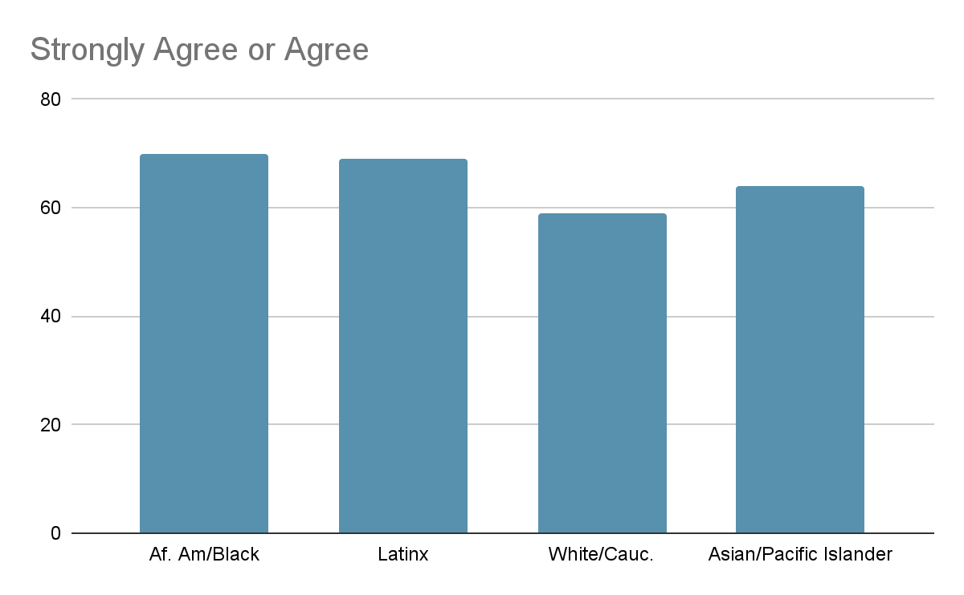
The cost of textbooks influences students’ decision to enroll in courses…

Slide 34
High textbook costs result in risky behaviors by students…
Financial strain/debt
Seeking unvetted sources online
Not purchasing material

Slide 35
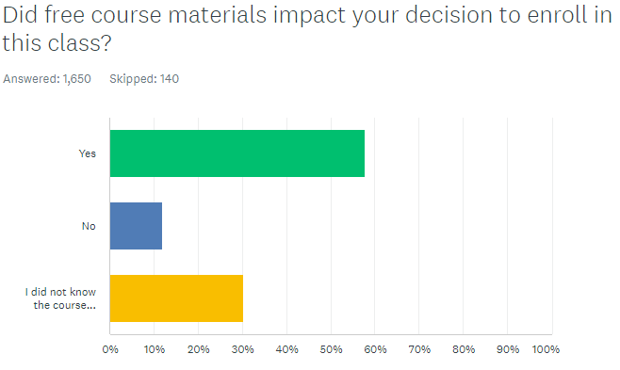
Students need to know how to find OER/ZTC classes…

Slide 36
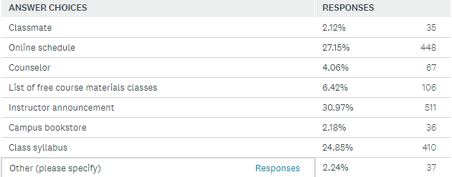
How do students find ZTC/OER classes?

Slide 37
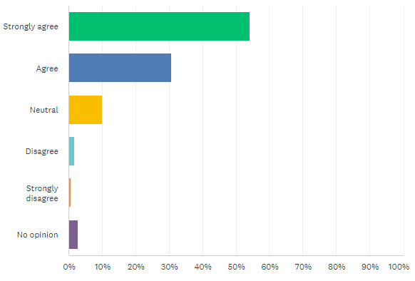
The quality of ZTC/OER materials are the same or better than traditional materials, according to students.

Slide 38
Students comment on how using free course materials impacted their learning experiences
Easy access - “I thought it was very helpful to have the materials ready to go without having to wait for them to come in the mail or having to go to the bookstore.”
Better or similar quality - “I have purchased many expensive books that are door stops. The free materials were easy to use and interact with.”
Reduces stress - “I felt stress free. I didn’t have to worry about [purchasing] a material and [it] helped me relax about the course.”

