Slide 1
Everything We Think We Know About the Zero Textbook Cost (ZTC) Program
October 7, 2022.
This work is licensed under a Creative Commons Attribution 4.0 International License.
Attribute this slide deck as: Everything We Think We Know About the Zero Textbook Cost (ZTC) Program by ASCCC OERI is licensed under CC BY 4.0.

Slide 2
Webinar Description
What do we know about the ZTC Program? What steps are being taken to maximize the involvement of all the CCCs – and to ensure we’re benefitting as many students as possible? How is the “sustainability” requirement being addressed – and how do you avoid “duplication”? This webinar will cover the ZTC Program basics and venture into the murky details. Join us to learn about the basics – and not-so-basics of the ZTC Program.

Slide 3
Overview
What do we know?
Recognizing the murky – what don’t we know?
What can we hope for?
What’s up with Phase 2?
Questions and Answers

Slide 4
What do we know?
Spending $115 million responsibly is a huge task
Getting it “right” is critical – the world is watching
Right?
  Impactful
  Sustainable

Slide 5
What we know – the facts…
Phase 1 - $20,000 to 115 degree-granting colleges
Completion of Phase 1 – Initial “certification” and submission of a “plan” provides college with Phase 3 funds
Phase 3 - $180,000 to implement the plan or a component of the Phase 1 plan

Slide 6
$20K + $180K = $200K
The CCCCO … shall distribute grants of up to two hundred thousand dollars ($200,000) to a community college district for each degree developed and implemented within the district that contributes to the overall elimination, or significant lowering, of textbook costs for students and aligns with the conditions for receipt of funds specified in subdivision (d).
While 78052 specifies “college district”, funds are going to colleges.

Slide 7
California Education Code 78052 (continued)
The chancellor’s office shall ensure that a grant does not result in the development or implementation of duplicate degrees for a subject matter to avoid duplication of effort and ensure the development and implementation of the greatest number of degrees for the benefit of the greatest number of students. The chancellor’s office may distribute the grants in phases, including a planning phase and an implementation phase.

Slide 8
CEC 78052 - subdivision (d) – what you need to do to get the money…
Develop and implement one or more of the following program pathways:
An existing (or new) associate degree or CTE certificate program, prioritizing existing associate degrees for transfer.
A new associate degree or CTE program must meet one of the following conditions:
(i) Has a high value in the regional market.
(ii) Meets an emerging regional business industry need.
(iii) Has high textbook costs.

Slide 9
78052 (d), 2-6
(2) In complying with paragraph (1), prioritize the development and implementation of a degree from an existing associate degree for transfer and, to the extent possible, prioritize the adaptation of existing OER through existing OER initiatives, or elsewhere, before creating new content.
(3) Develop degrees with consideration for sustainability after grant funding is exhausted, including how content is updated and presented.
(4) Ensure accessibility.
(5) Develop and implement a minimum of one degree for each grant received.
(6) Develop and implement a degree that other CCCs can use or adapt, and post each degree, and the contents of the degree in COOL4Ed

Slide 10
78052 (d), 7-10
(7) Ensure faculty shall have flexibility to update and customize degree content as necessary within the parameters of this program.
(8) Ensure that the degree developed and implemented is clearly identified in college catalogs and in class schedules.
(9) Provide the CO with all legislatively required information.
(10) Consult with the local academic senate of a college that would implement a degree.

Slide 11
78052 (d), 11-12
(11) (A) Use a multimember team approach, to develop and implement a degree pursuant to this section, that includes faculty, college administrators, and other content-focused staff, including, but not limited to, librarians, instructional designers, and technology experts, from the campus that would implement the degree, other CCCs, and interested campuses of the CSU and the UC.
(B) Grant recipients may use funds to obtain professional development and technical assistance to assist in the development of degrees.
(12) Strive to implement degrees within three academic years of receiving funding, or sooner, as determined by the CO.

Slide 12
The Murky…
How will duplication be avoided?
How will the broader goals be achieved?
How will maximal college/faculty/discipline participation be achieved?

Slide 13
What can we (or do we) hope for?
Centralized support
Modification of granting process
Collaboration encourages
Prohibition of approaches to ZTC that are not consistent with the legislation
Transparency
Maximal sustainable impact for students
Full faculty engagement

Slide 14

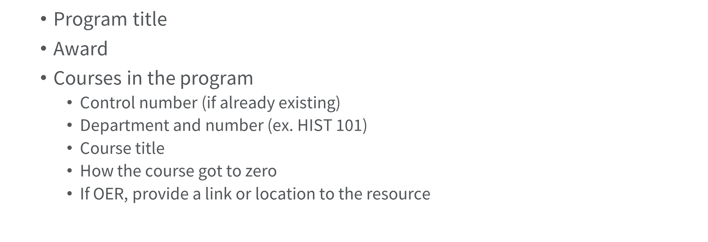


Slide 15

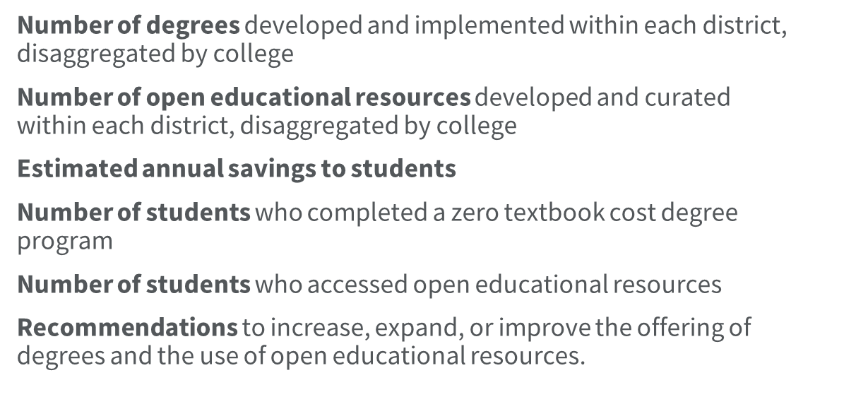
Program Goals
Reduce the overall cost of education
Decrease the time to completion for students

