Slide 1
Opportunities & Challenges
This Photo by Unknown Author is licensed under CC BY-NC-ND
Remixing and Revising History Textbooks

Slide 2
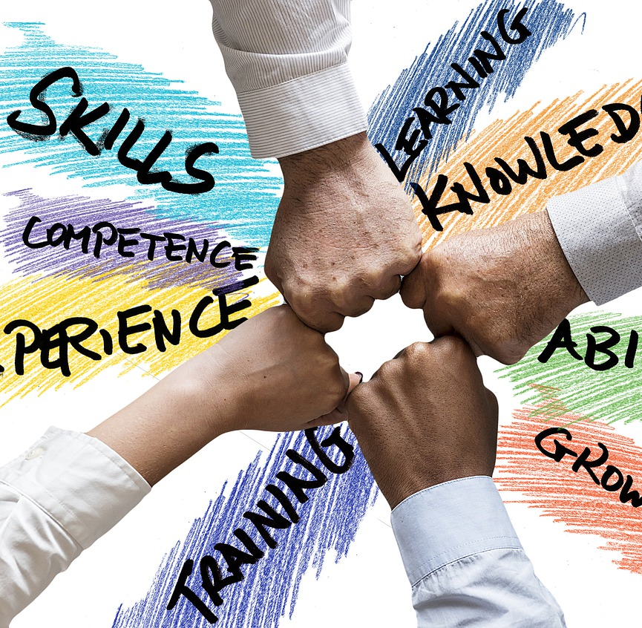
Panelists
Michele Brewster Mira Costa College
Dolores Davison Foothill College
Matthew Hacholski Fullerton College
August Samie Ohlone College
Lindsay Weiler Mount San Jacinto College
Anu Mande Fullerton College

Slide 3
Fantastic Opportunity!

Slide 4
Finding Faculty Collaborators
Time Constraints
Licensing
Content
Training

