Slide 1
Results of the Art & Art History OER Survey:
A Conversation
Please feel free to introduce yourself in the chat!
Join our Google Group
Thursday, May 11, 1:30-2:30pm
Cerise Myers, Art History Discipline Lead

Slide 2
Today
Survey history & goals
The instrument
The results
Why we aren’t using OERs
Which OERs we are using
What we need
Questions?

Slide 3
Survey History & Goals
2019 survey (before my time)
96 responses
Showed limited use of OERs, desire for better resources
Resources used were mostly online versions of older publisher texts, Khan Academy, Boundless/Lumen, and the Sachant OER

Slide 4
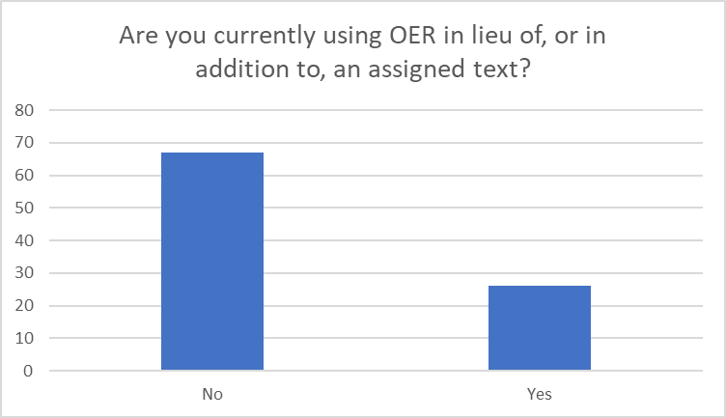
Survey History & Goals
Relatively little OER use at all

Slide 5
Survey History & Goals
2023 Survey Goals
Explore current usage and barriers to usage
Share existing resources
Identify areas of greatest need

Slide 6
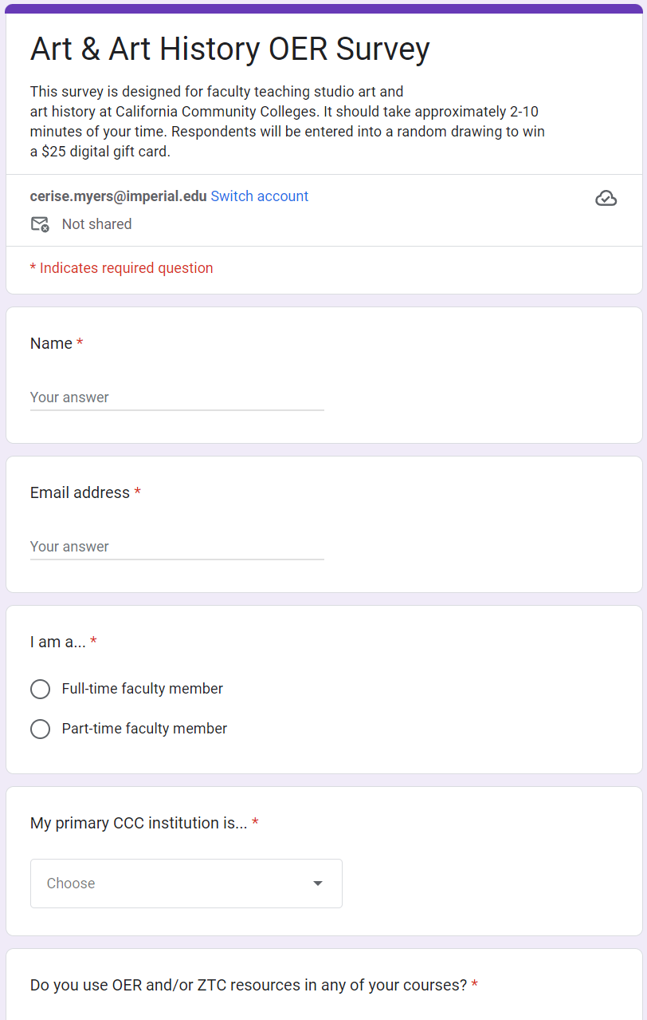
The Instrument
Demographic data
First forking question: OER/ZTC usage in any courses

Slide 7
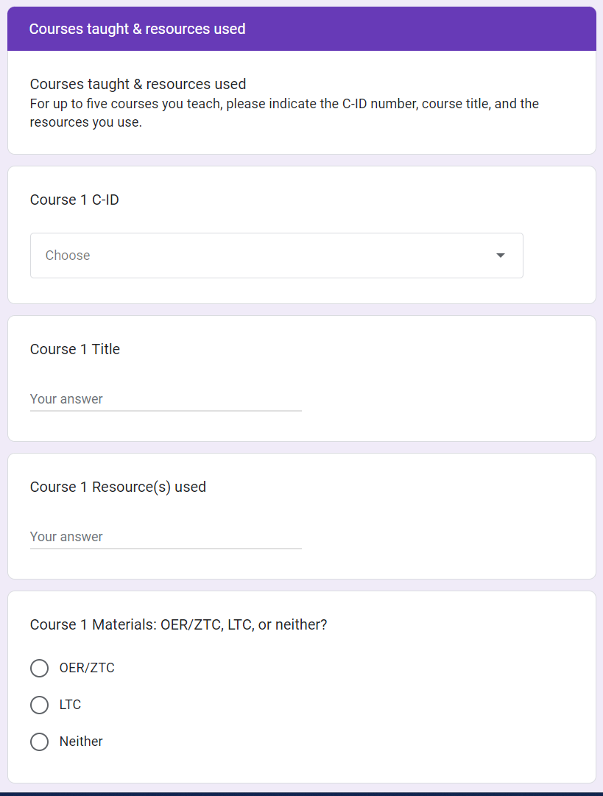
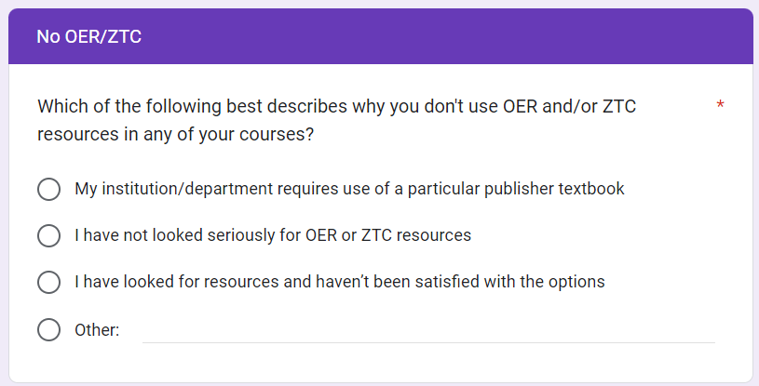
The Instrument
If no, the reason why
If yes, which resources (up to five courses)

Slide 8
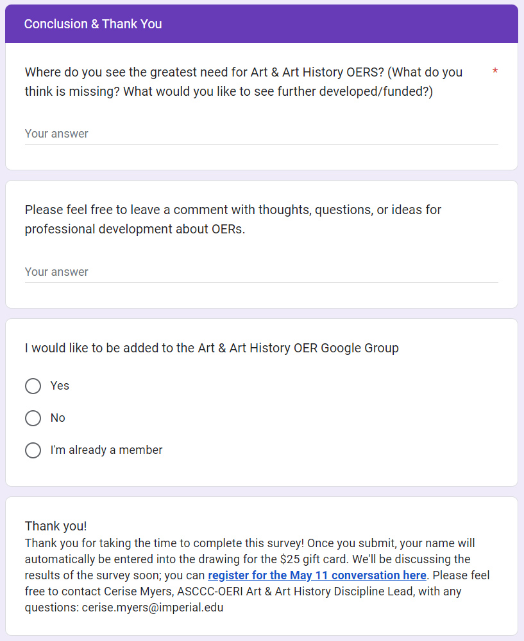
The Instrument
Conclusion: open-ended questions for both OER adopters and non-users

Slide 9
The Results: Demographics

Slide 10
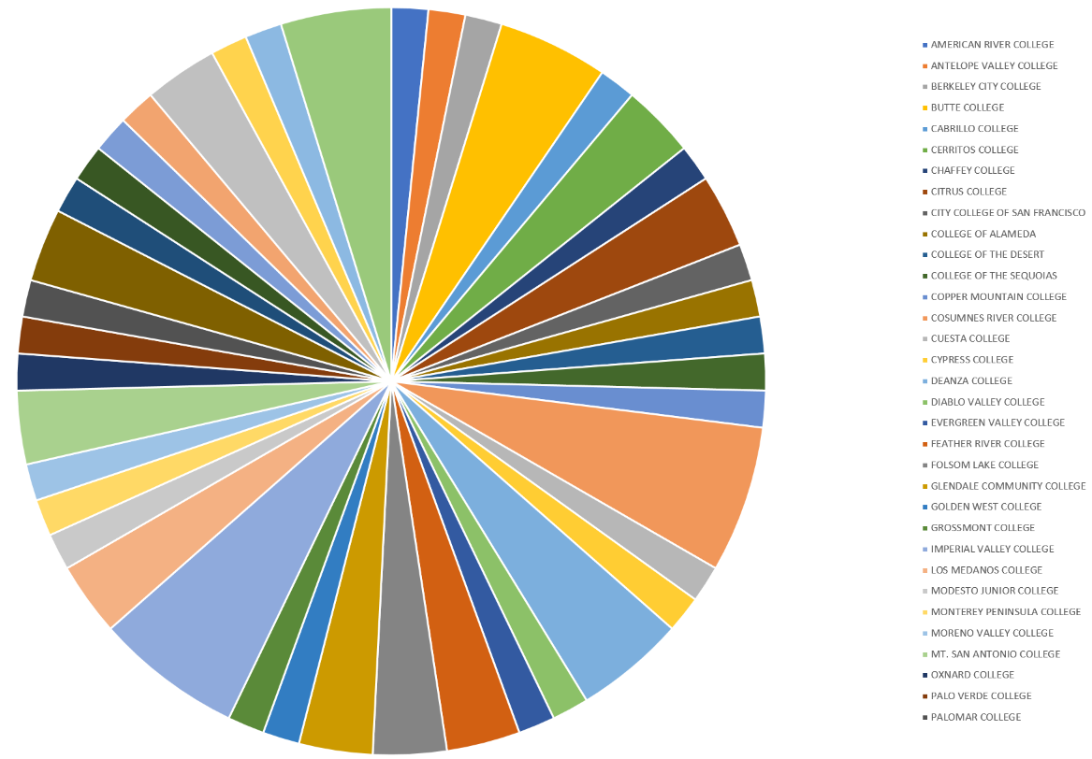
The Results: Demographics
Responses from 42 colleges/ districts

Slide 11
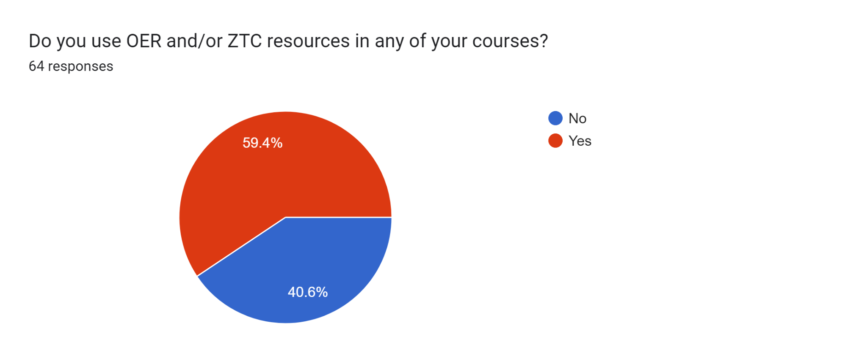
The Results: Usage

Slide 12
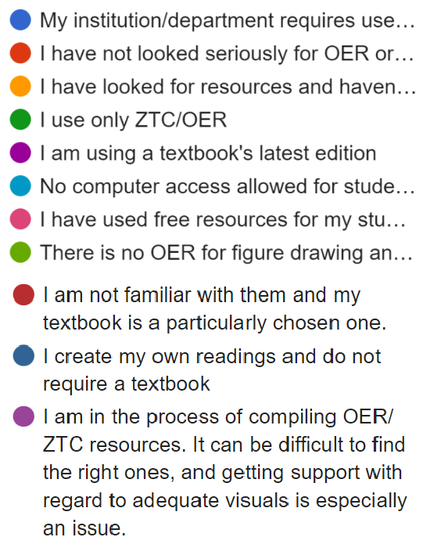
The Results: OER/ZTC Usage by Course

Slide 13
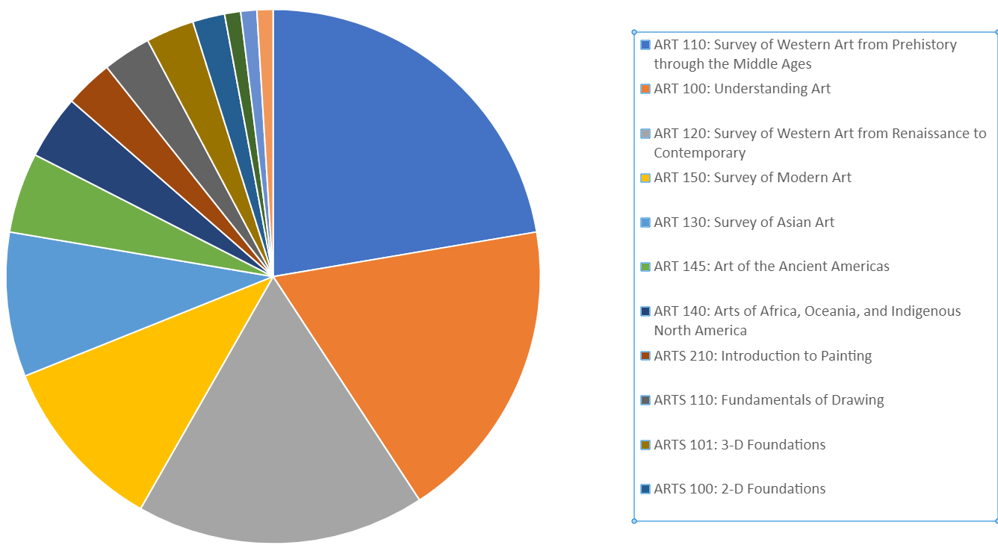
The Results: OER/ZTC Usage

Slide 14
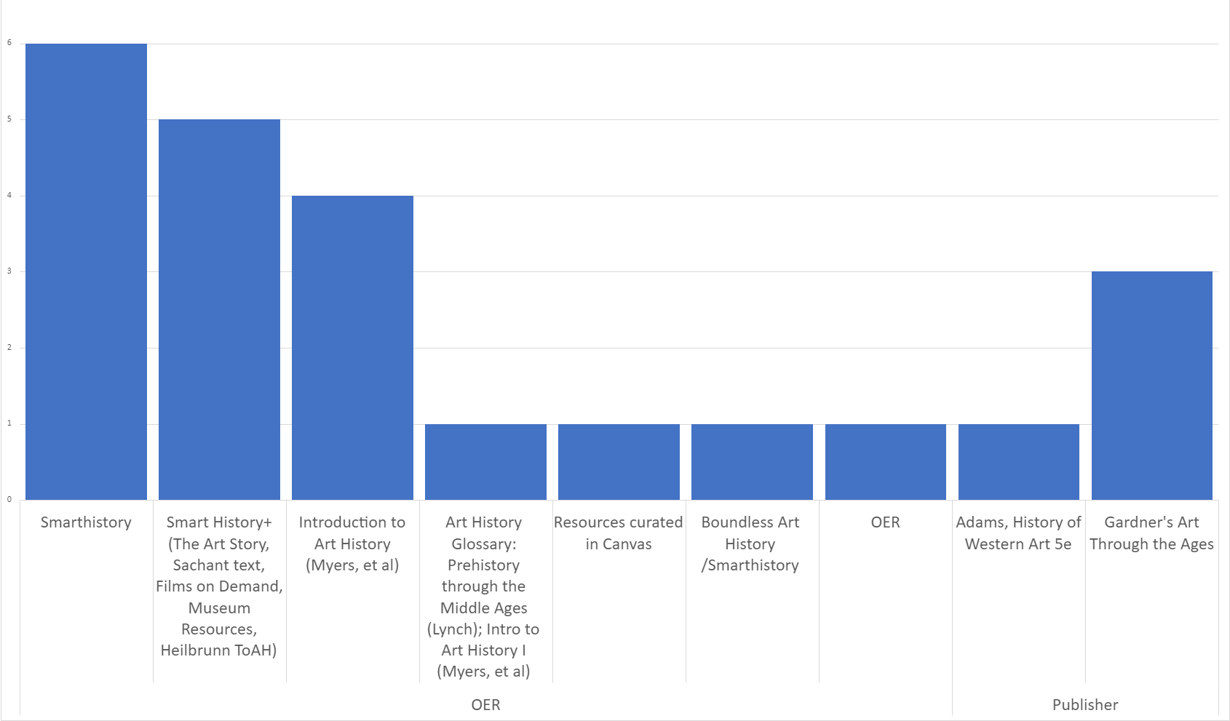
The Results: OER/ZTC Usage in ART 110
Note: I lightly consolidated/cleaned the data, but there’s still lots of overlap
ART 110 (Survey I) Resources used
Notes:
I had to do some manual clean-up of the data; hence SH & SH+

Slide 15
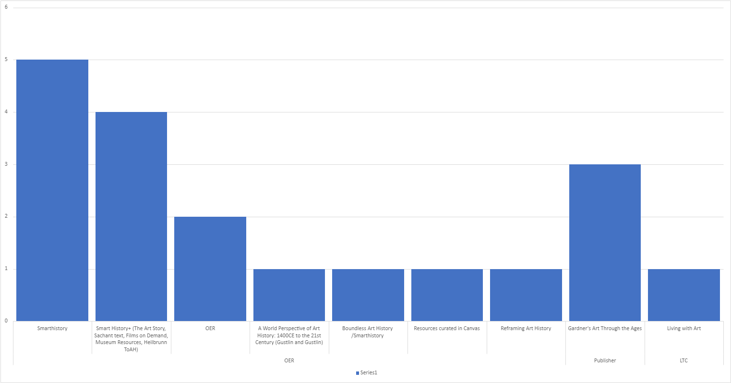
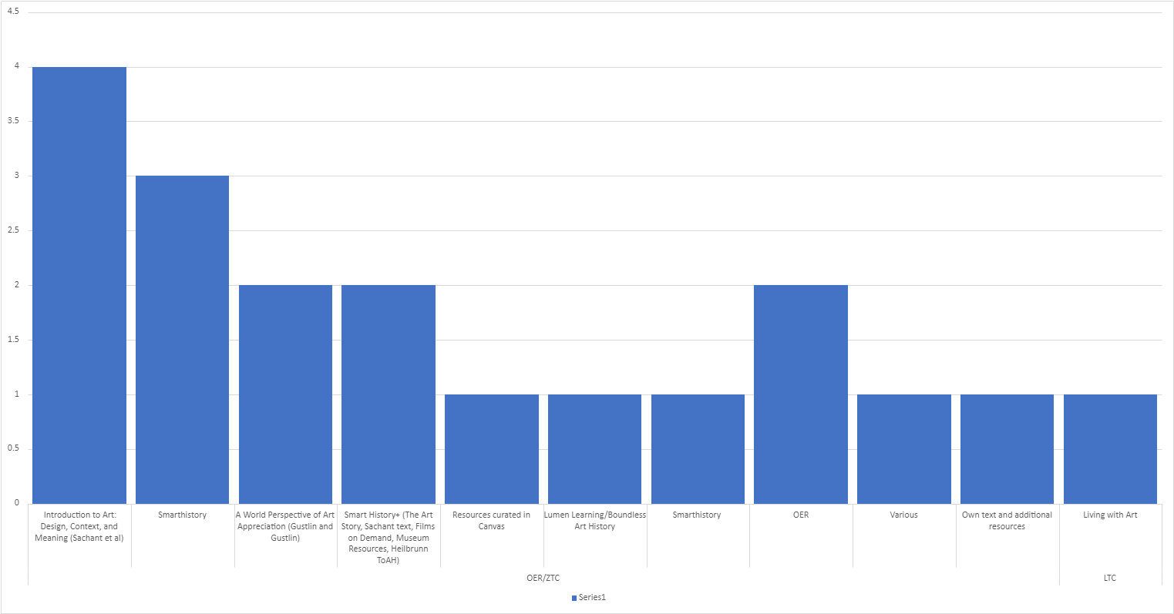
The Results: OER/ZTC Usage in ART 100 (Understanding Art)

Slide 16
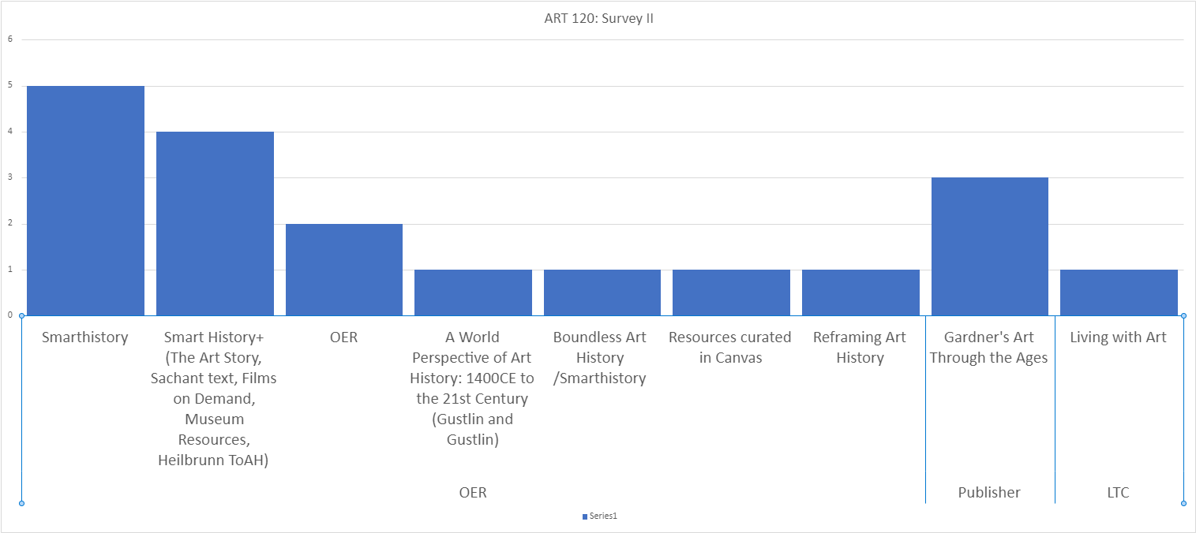
The Results: OER/ZTC Usage in ART 120 (Survey II)

Slide 17
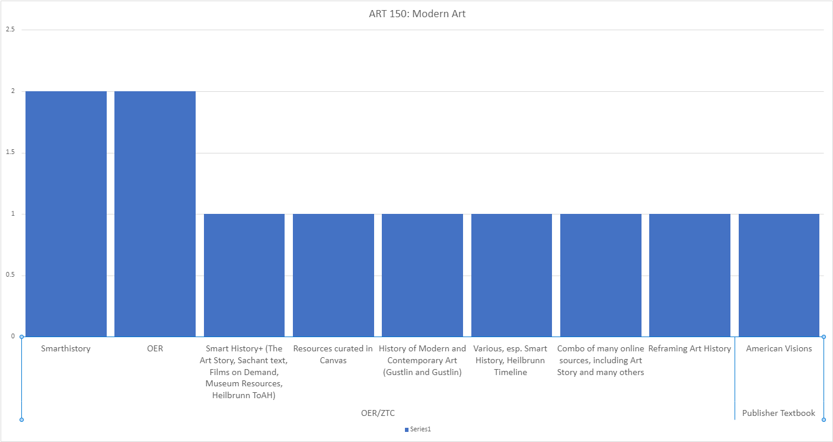
The Results: OER/ZTC Usage in ART 150 (Modern Art)

Slide 18
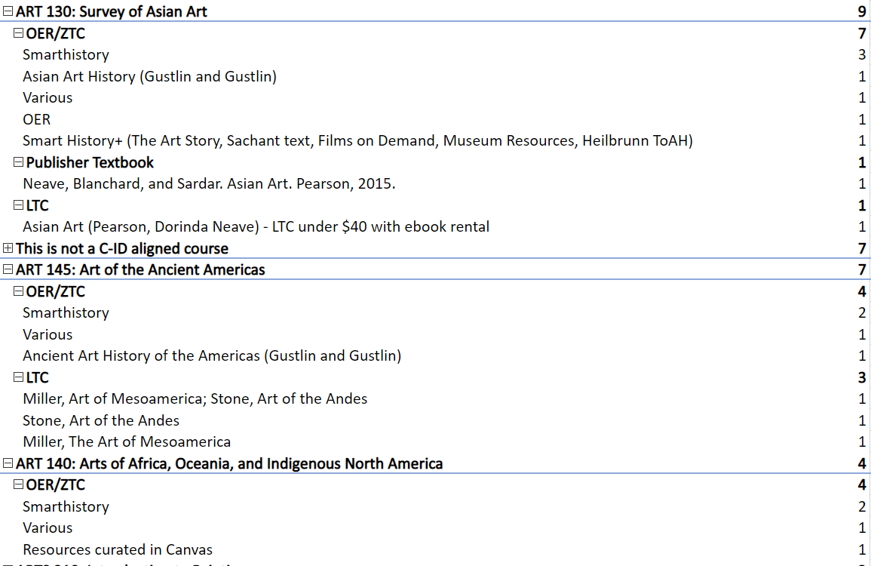
The Results: OER/ZTC Usage in Other AH Courses
Plus a few non-C-ID-aligned courses:
World Art and Visual Culture
American Art
History of Photography
History of Women and Gender in Art (Women, Art, & Society LTC

Slide 19
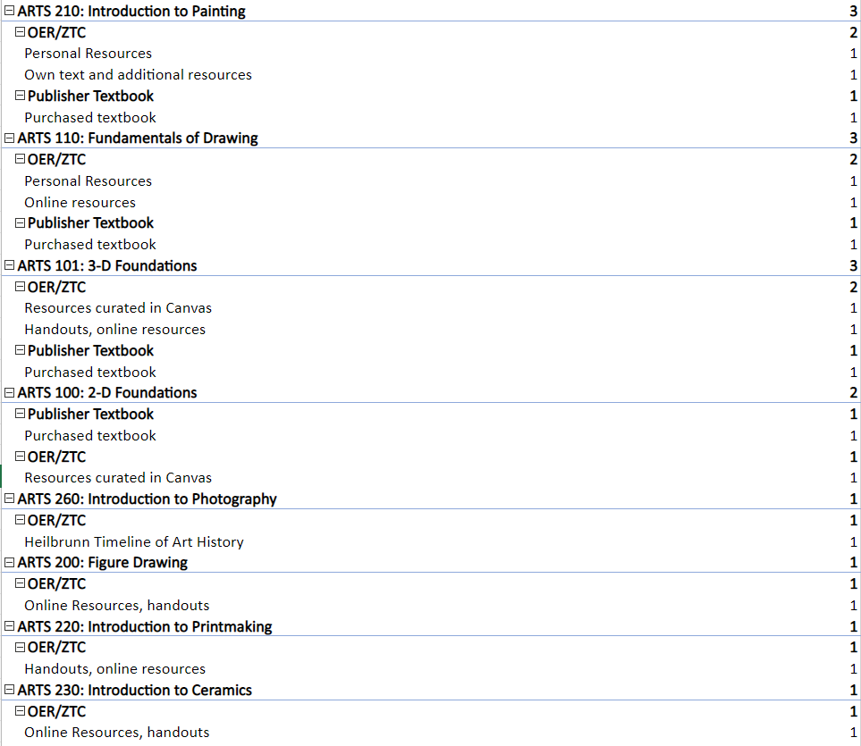
The Results: OER/ZTC Usage in Studio Art
Plus a few non-C-ID-aligned courses:
Color Theory
Drawing and Composition 1
(Resources Listed: Color Theory Course Pack and Drawing a Contemporary Approach, Chapter 8)

Slide 20
Takeaways
Art History has lots of solid resources available.
“We’re so lucky as a discipline to have Smarthistory.”
“Very little is missing, have eliminated text books for all my classes”

Slide 21
Takeaways
…and there’s room for improvement
“I don't use them because while a comparable cache of materials could be gathered, they would lack consistency of quality, in writing and reproduction.”
“It would be very helpful to have more well-organized OER sources for non-Western art history, and also history of photography, and if possible, to get funding and support for the development of test question banks and other ancillary and assessment resources for existing OERs.”

Slide 22
Suggestions
“Maybe a group of people would be interested in pursuing a grant to write these overview chapters? For AOA/140 for instance, we might only need money for four broad overview chapters: Intro, African, Oceanic, and Native North American and then faculty could choose from the wide assortment of existing Smarthistory articles to fill in the "chapter-like content" after a more comprehensive introduction. Same for Asian/130.”

Slide 23
Areas of Need
Global resources, especially for Africa, Asia, and the Americas
Studio arts resources, including Foundations and techniques
Funding for development and adoption

Slide 24
Questions/Discussion
Thoughts? Questions? Advice?
Remember to join our Google Group!
Please don’t hesitate to reach out:
Cerise Myers (cerise.myers@imperial.edu)

