Slide 1
Remixing Spanish OERs
in LibreTexts
and
Importing into Canvas
April 28, 2023

Slide 2
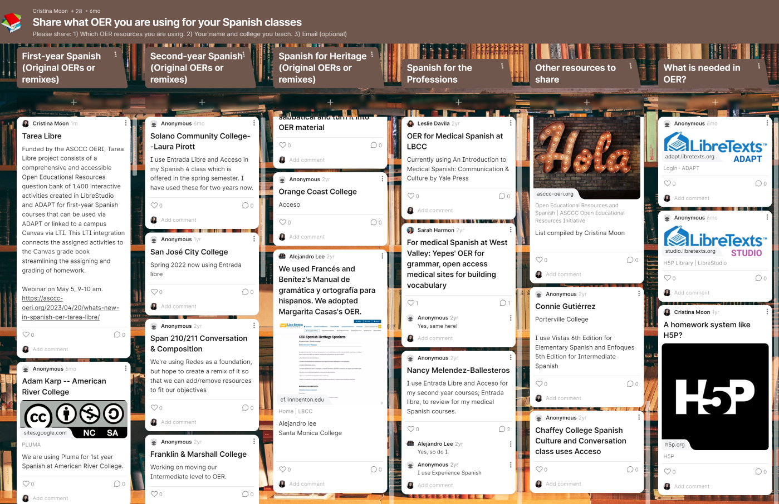
Notes:
Padlet: https://padlet.com/cmoon45/6aviwjzz3fwdilck
Please share what OER you are using.

Slide 3
Agenda
Search in Commons for OER
Find one OER and import into Canvas
Find two or more OERs and plan or map what you would combine
Navigate LibreTexts Remixer
Locate and play in your LibreTexts sandbox
Remix books, chapters, and pages
Save and publish

Slide 4
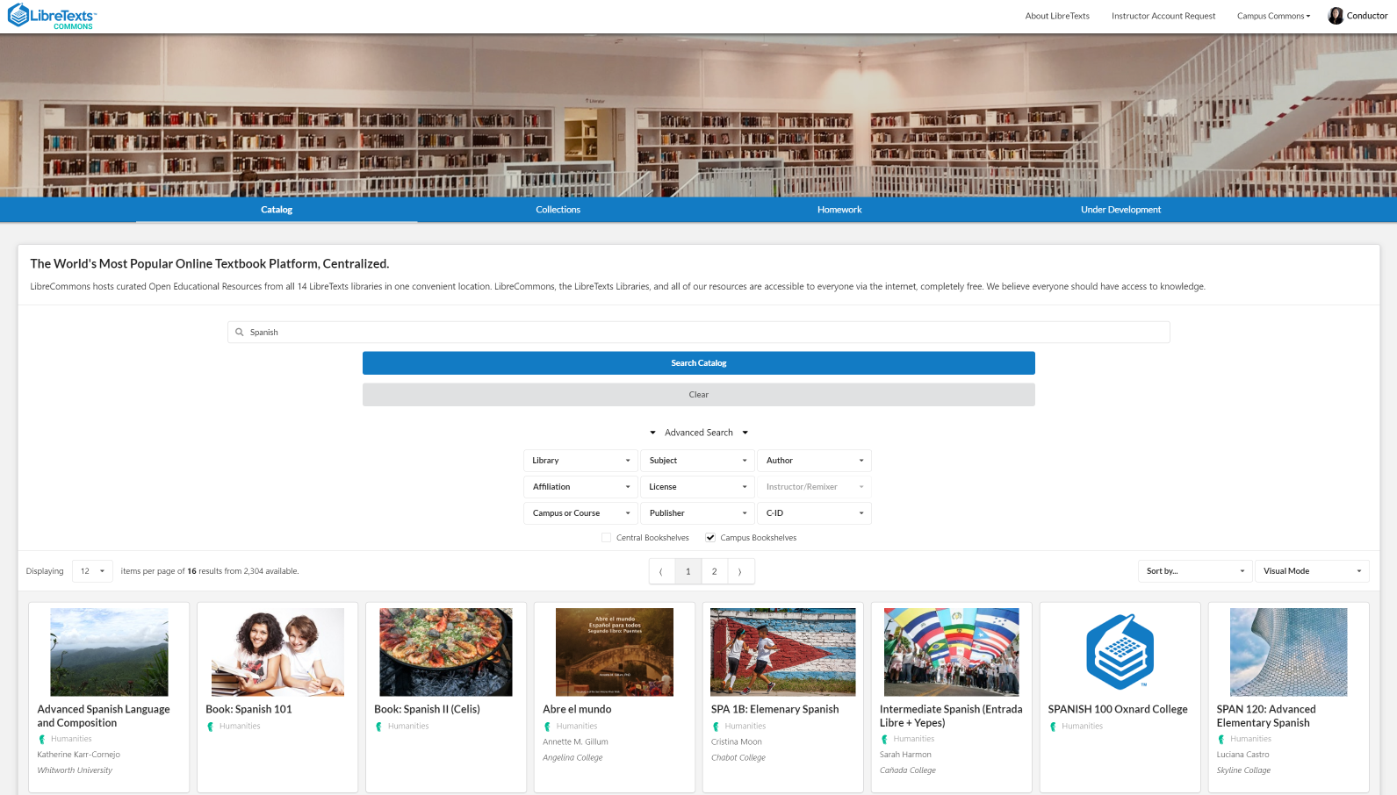
Search in LibreCommons
Notes:
https://commons.libretexts.org/

Slide 5
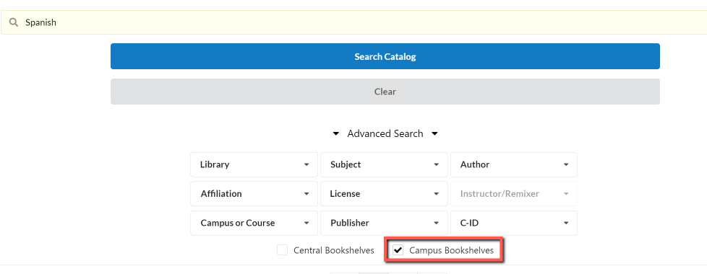
Search for remixes in LibreCommons
To find other remixes:
Go to Advanced Search
Campus Bookshelves
Search Spanish
Notes:
https://commons.libretexts.org/

Slide 6
Activity # 1: Search for OER
You can search in the:
Catalog
Collections
Homework
You can also do an “Advanced Search” in Campus Bookshelves for remixes from other colleges.
Activity:
Search for one or two OERs that you like.

Slide 7
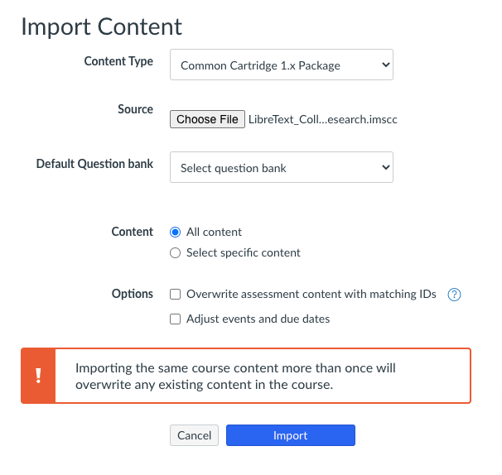
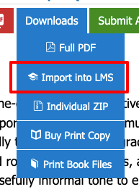
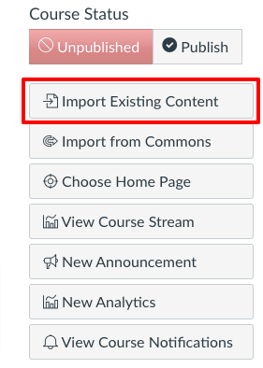
Activity # 2: Import OER into Canvas
Step 1: Click on one resource in the Commons and select Download LMS File.
Step 2: Navigate to a Canvas sandbox and click on Import Existing Content on the home page.
Step 3: Select Import Content Type > Common Cartridge 1.X Package and "all content." Then, click Import.
Step 4: Once the import is complete, click on Modules and locate your OER (remember that new modules appear at the bottom).
Step 3
Step 1
Step 2

Slide 8
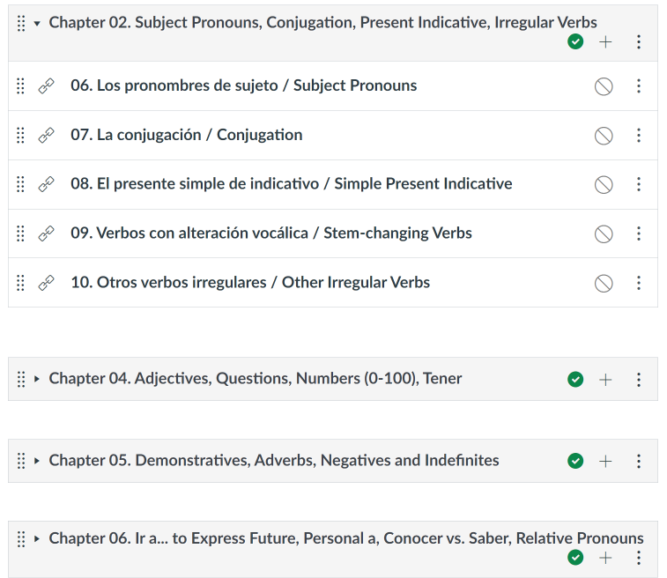
Activity # 3: Easy remix in Canvas
Once in Canvas, the chapters become modules and the pages become individual links. You can move/delete.

Slide 9
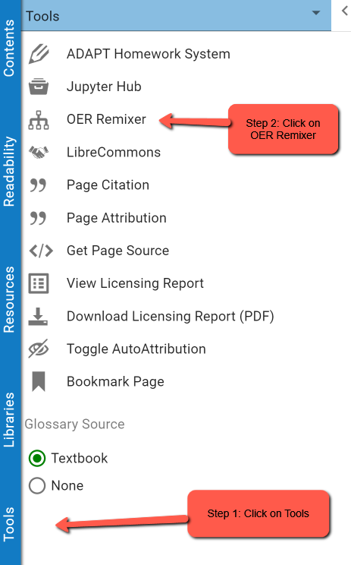
That was easy.
Now, do you want combine OERs?
Once you logged in to LibreTexts:
https://human.libretexts.org/
You can find the OER Remixer by clicking on “Tools” in the menu.
Notes:
https://human.libretexts.org/

Slide 10
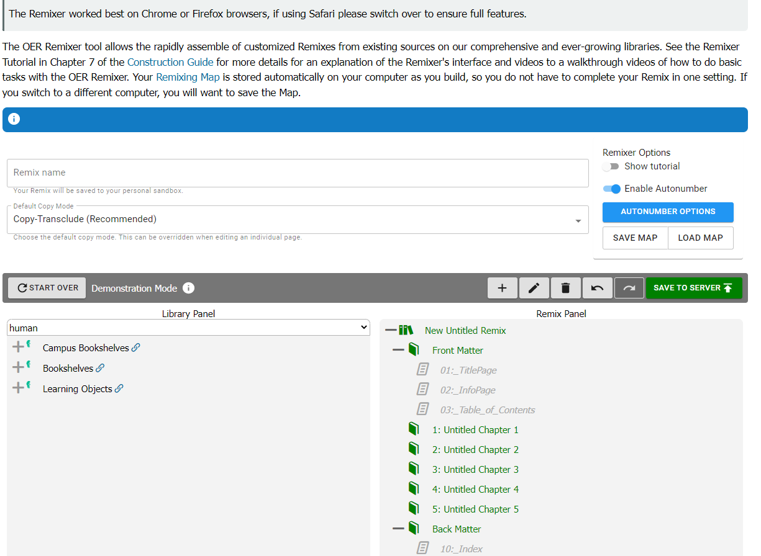
Activity # 4: Let’s Remix
After you name your “Remix”, the Library Panel (left panel) click on the + sign to open bookshelves and find the OER.
Then drag it to the Remix Panel (right panel).

Slide 11
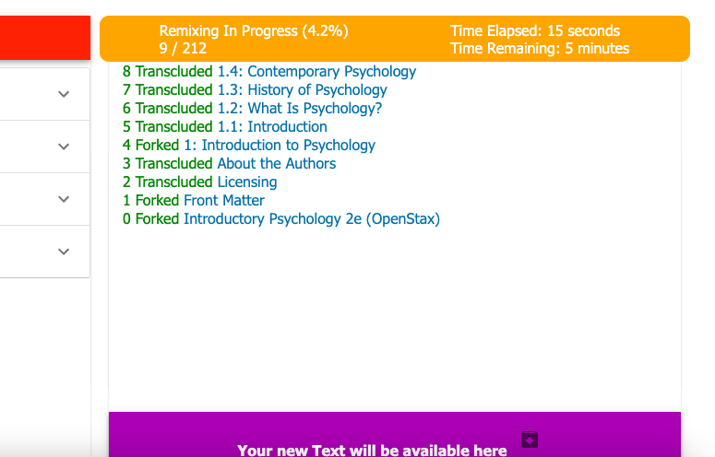
Now that you are happy with your remix …
Click on “Save to Server” and then “Save to Server” again at the bottom left of the page. You will then see the progress of your remix as it is finalized.
To see your remix: Click on “Your new text will be available here”.

Slide 12
Activity # 5: Customize by editing pages
Before you can edit the page you will need to “fork” it.
Click on “Edit” and now you should see the menu bar.

Slide 13
Final step: Publish
When you are ready to publish it for wider dissemination, please contact LibreTexts: info@libretexts.org
LibreTexts will run "bots" (web robots that automatically identify and address issues) over your remix to clean it up and check for accessibility.
Once these things are done, your new remix will be published and ready for dissemination.

Slide 14
Cristina’s Remixes
Spanish 1A: Beginning Spanish (Chabot College) and an example of content and activities breakdown by weekly modules, which is a remix of the following materials:
Chévere, volume 1, by Erica Brown, Alejandra Escudero, María Cristina Montoya, and Elizabeth Small, all of SUNY Oneonta;
¡Naveguemos juntos! by María Barrio de Mendoza, Karla Gutiérrez, Hsing Ho, Ching Ping D. Lin, and Anaid Stere Lugo and their project from the Academic Senate of the California Community Colleges (ASCCC), Open Educational Resources Initiative (OERI); and,
Libro Libre by Erin Huebener, Spokane Community College.
Spanish 1B: Elementary Spanish (Chabot College) and an example of content and activities breakdown by chapter module, which is a remix of the following materials:
Chévere, volume 2, by Erica Brown, Alejandra Escudero, María Cristina Montoya, and Elizabeth Small, all of SUNY Oneonta;
¡Naveguemos juntos! by María Barrio de Mendoza, Karla Gutiérrez, Hsing Ho, Ching Ping D. Lin, and Anaid Stere Lugo and their project from the Academic Senate of the California Community Colleges (ASCCC), Open Educational Resources Initiative (OERI); and,
Spanish Grammar Manual by Enrique Yepes of Bowdoin College, Colegiatura Colombiana, and Universidad Pontificia Bolivariana.

Slide 15
Ready for more OER?
What’s new in Spanish OER: Tarea Libre Friday, May 5, 2023 from 9:00 am – 10:00 am Register for What’s new in Spanish OER: Tarea Libre Join us to learn about the Tarea Libre project that consists of a comprehensive and accessible OER question bank of more than 1,300 interactive activities created in LibreStudio and ADAPT for first-year Spanish courses. The interactive activities may be used via ADAPT or linked to a campus Canvas via LTI integration, which connects the activities to the Canvas gradebook. Tarea Libre was funded as part of RFP IV and it is in the final review stages and should be ready for use by summer 2023. This LTI integration connects the activities to the Canvas gradebook.
Want to Learn About H5P/LibreStudio and ADAPT for Open Educational Resources (OER)? Friday, May 5, 2023 from 12:00 pm – 1:00 pm Register for Want to Learn about H5P/LibreStudio and ADAPT for OER? Creating interactive exercises to increase student engagement is useful, but what if you would like to require homework activities that rely on having scores on those activities in the course gradebook? In this webinar, we will introduce online homework systems that can facilitate the adoption of OER texts. Join us to discuss the benefits and limitations of each system.
Notes:
https://asccc-oeri.org/webinars-and-events/

Slide 16
Need more help with LibreTexts?
LibreTexts weekly office hours:
https://zoom.libretexts.org (Tuesdays at 9:00-10:00 Pacific time)
https://zoom.libretexts.org (Thursdays at 9:00-10:00 Pacific time)
LibreTexts 101 and Beyond Canvas
You can find it in Canvas Commons.
ASCCC OERI recorded webinars
LibreTexts I-Introduction to LibreTexts
LibreTexts II-Editing, Adding Images, and More
LibreTexts III-Developing a Book and the Remixer
If you have questions with accounts please email Jennifer Rogers at jrogers@libretexts.org

Slide 17
Want to join the OERI languages listserv?
We are hoping to do some work in various languages in the near future. With that in mind, new listservs for Arabic, Chinese, Italian, and Japanese have been created.
Please encourage your faculty in these disciplines - as well as ASL and Spanish - so add themselves to the listervs to ensure they are informed of any opportunities that emerge - https://www.asccc.org/sign-our-newsletters

Slide 18
Questions?
Cristina Moon
Spanish Faculty
OER/ZTC Coordinator at Chabot College
ASCCC OERI Spanish Lead, H5P/ADAPT Lead, and OERI Liaison
cmoon@chabotcollege.edu

Slide 19
Thanks
CREDITS: This presentation template was created by Slidesgo, and includes icons by Flaticon, and infographics & images by Freepik

