Slide 1
Tarea Libre: First-Year Spanish Homework Set Using ADAPT
Cristina Moon, Ph.D., Chabot College
Sarah Harmon, Ph.D., Cañada College
Alejandro Lee, Ph.D., Santa Monica College
Nancy Meléndez-Ballesteros, C.Phil., College of the Canyons and Mount Saint Mary’s University-Los Angeles
“Tarea Libre: First-Year Spanish Homework Set Using ADAPT” is licensed CC-BY 4.0 by Dr. Cristina Moon, Dr. Alejandro Lee, Dr. Sarah Harmon and Prof. Nancy Meléndez-Ballesteros.

Slide 2
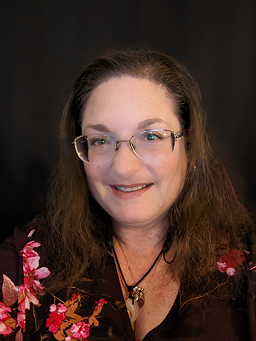
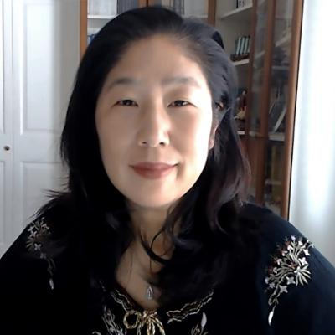
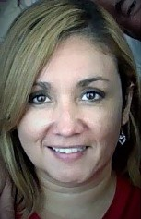
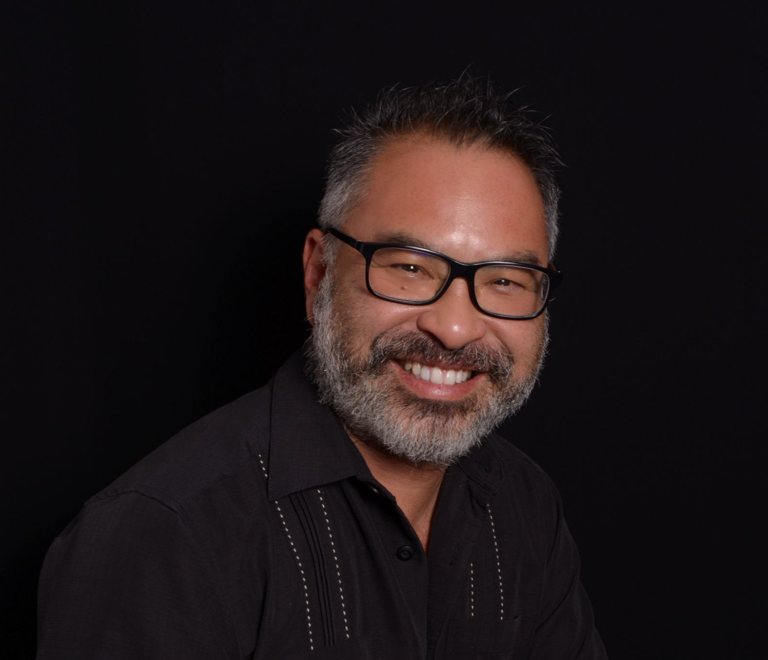
Tarea Libre Team
Sarah Harmon, Ph.D.
Cristina Moon, Ph.D.
Professor of Spanish OER Coordinator Chabot College
Adjunct Professor of Spanish and Linguistics OER/ZTC Coordinator Cañada College
Nancy Meléndez-Ballesteros, C.Phil.
Alejandro Lee, Ph.D., MLIS
Professor of Spanish Santa Monica College
Asst. Professor and Interim Chair, Mount Saint Mary’s University-LA Adjunct Professor, College of the Canyons
Notes:
CM

Slide 3
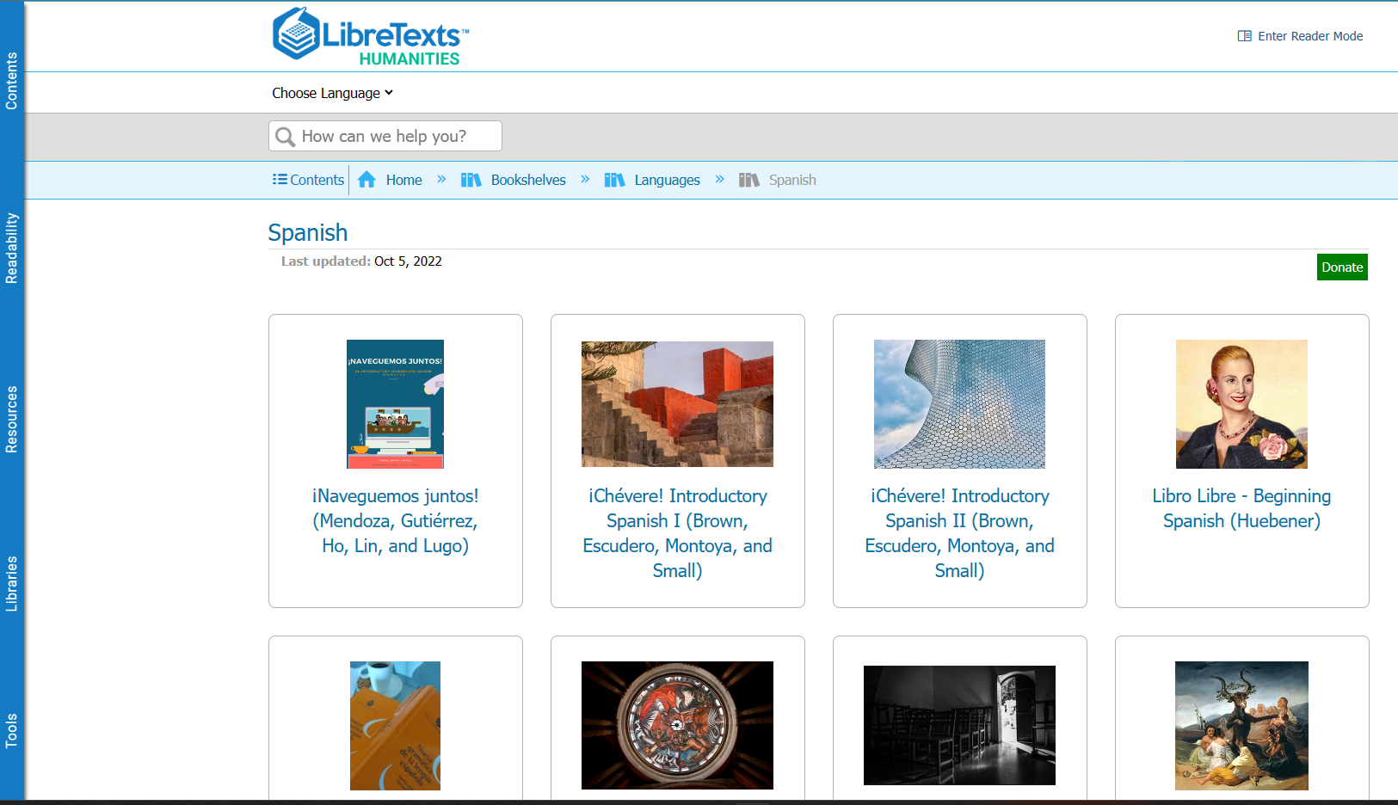
Filling the Gaps in Spanish OERs
There have been many projects for Spanish OER for first-year texts:
¡Chévere!: Part I and Part II
Beginning Spanish: Empecemos por aquí
Libro Libre
¡Naveguemos juntos!
Pluma
Missing gap: Homework sets in the OER realm
Entrada Libre for second year courses as a grammar manual
Frequently mentioned as a reason to not switch away from publisher materials
Notes:
CM

Slide 4
What is Tarea Libre?
Homework set for First-Year (collegiate) Spanish courses
Licensed as CC-BY-NC 4.0 (open license)
Written in accordance with California C-ID Transfer Model Curriculum for SPAN 100 and SPAN 110
Funding from Academic Senate for California Community Colleges (ASCCC) Open Educational Resources Initiative (OERI), RFP IV
Technical support from LibreTexts, particularly with new technologies
Written Summer 2022-Winter 2023
Media either self-created or openly-licensed
Notes:
CM

Slide 5
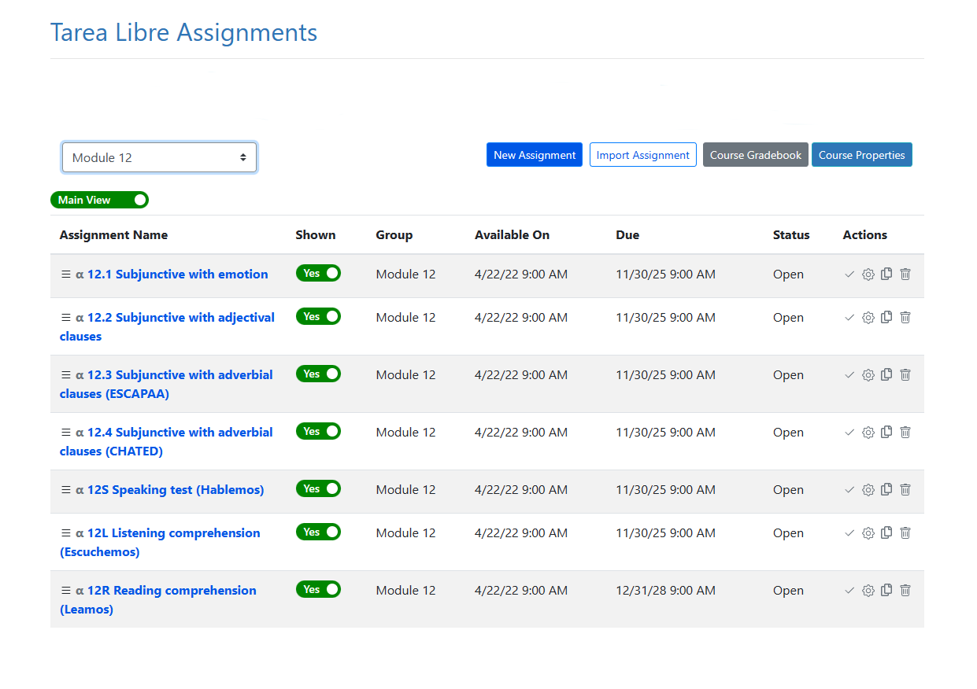
Tarea Libre Modules
1,400 activities
14 modules:
7 modules for 1st semester
7 modules for 2nd semester
4-5 sections per module with vocabulary and grammar
Notes:
CM

Slide 6
Overview of Grammar and Vocabulary Content
Tarea Libre covers 57 grammar topics typically taught in first-year Spanish courses. To increase adaptability and flexibility for instructors, the project has 7 modules for SPAN 100 and 7 modules for SPAN 110, based on California’s C-ID curriculum model. Each module is composed of 4 to 5 grammar topics and listening, speaking, and reading comprehension activities.
As found on most homework (workbook and lab activities), each grammar topic has a vocabulary page and 4 levels of mastering steps:
Paso Preliminar
Paso 1 "Empecemos"
Paso 2 "Continuemos"
Paso 3 "Practiquemos"
Paso 4 "Avancemos”
Notes:
CM

Slide 7
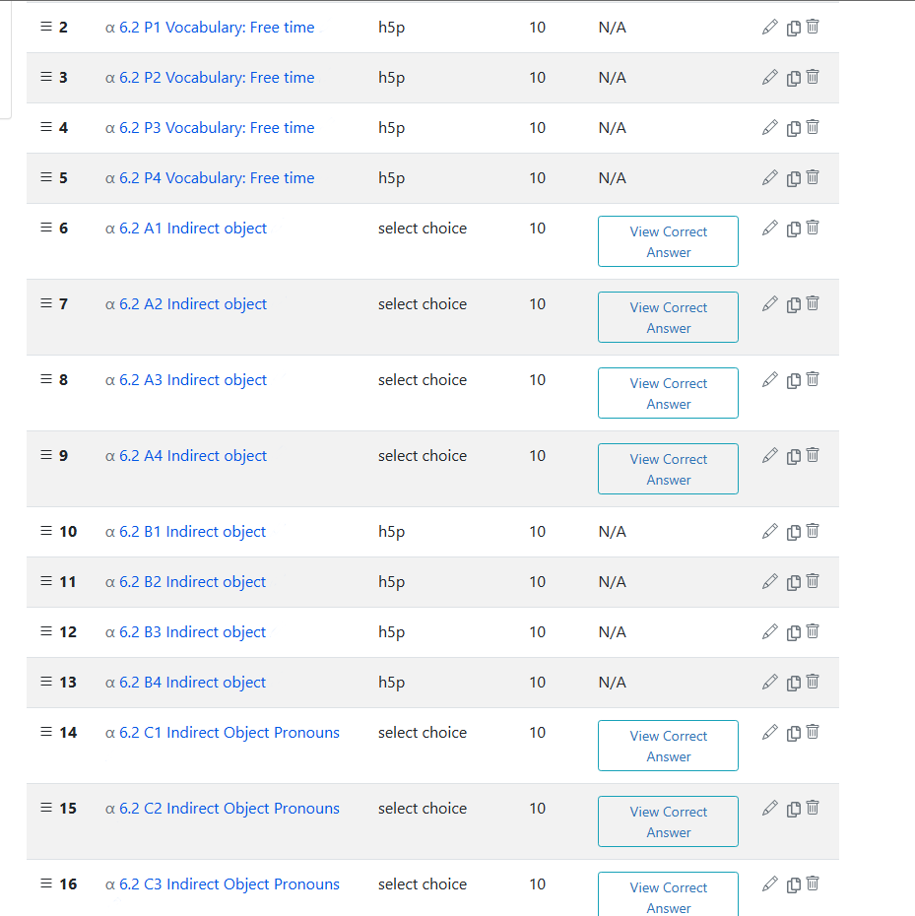
Module Contents
5 ‘pasos’ of vocabulary and grammar exercises per module and each “paso” with 4-8 activities.
P = Preliminar: Focus on vocabulary building; mostly multiple choice and select choice questions
A = Empecemos: Focus on recognition of grammatical concepts; mostly multiple choice and select choice questions
B = Continuemos: Focus on initial application of grammatical topics; mostly fill-in-the-blank in shorter contexts
C = Practiquemos: Focus on expanded application of grammatical topics; mostly fill-in-the-blank and select choice in longer paragraphs
D = Avancemos: Focus on expanded application of grammatical topics in dialogues; mostly fill-in-the-blanks
Notes:
CM

Slide 8
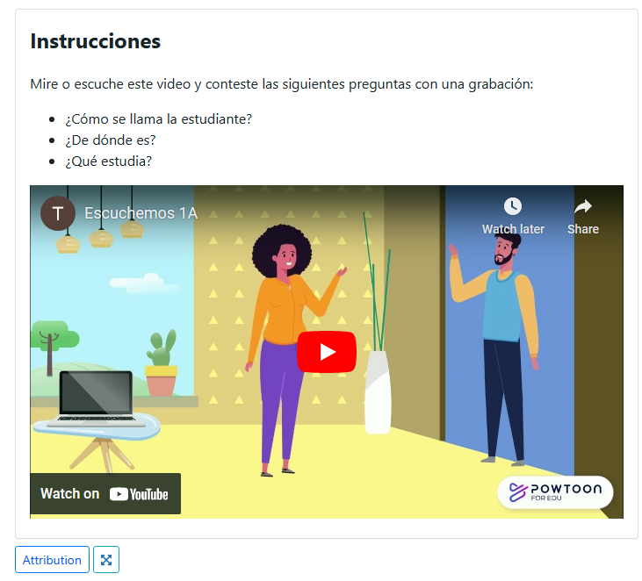
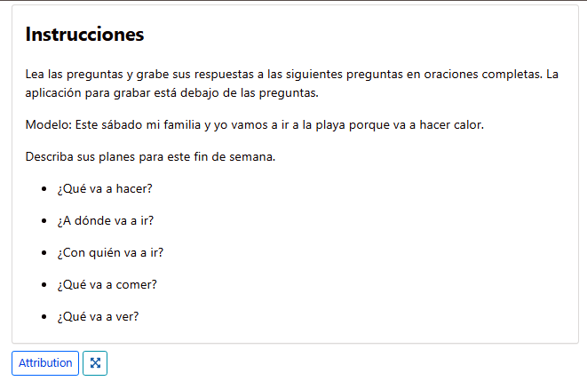
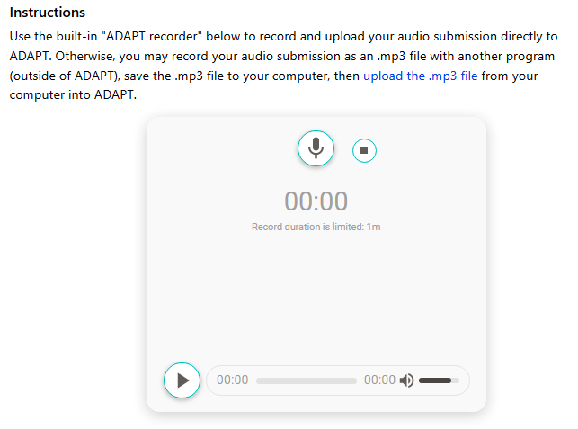
Summative Assessments
3 comprehensive assessments per module
Hablemos: Written prompts; students submit audio recording with answers (4 per module)
Escuchemos: Powtoon videos; students submit audio recording with answers (4 per module)
Leamos: Cultural and thematic reading with audio narration; students answer true/false comprehension questions (3-4 per module) (next slide)
Notes:
CM

Slide 9
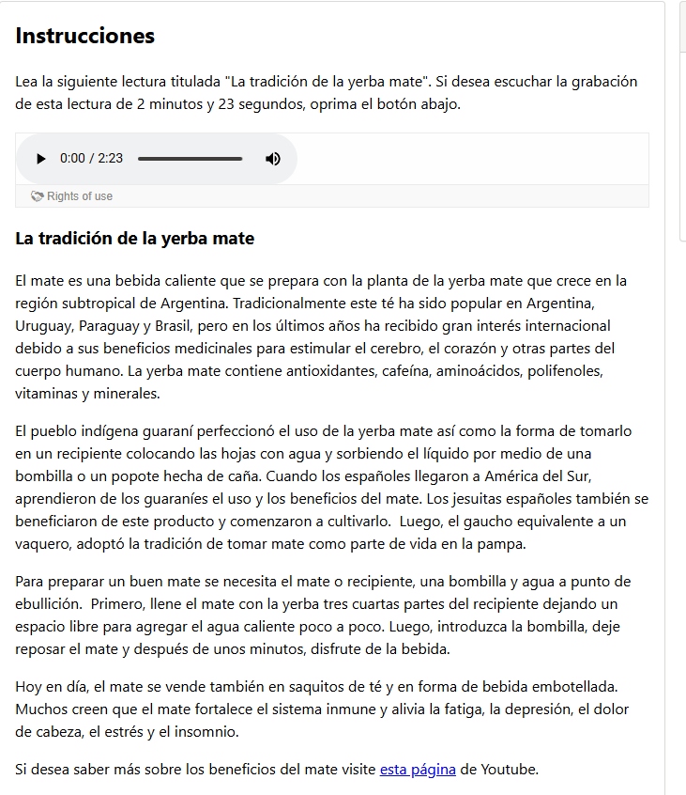
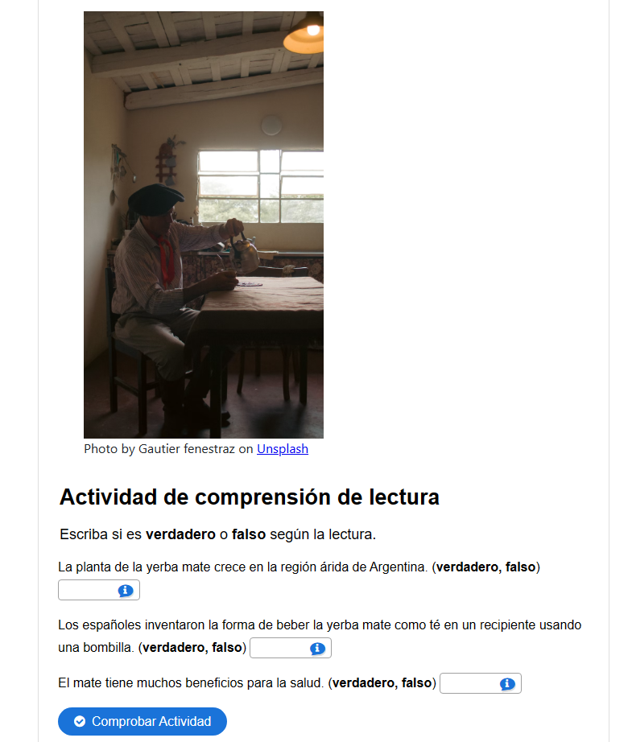
Overview of Reading Content
There are 47 cultural readings with narration and auto-graded comprehension questions were created on a variety of topics.
Notes:
AL

Slide 10
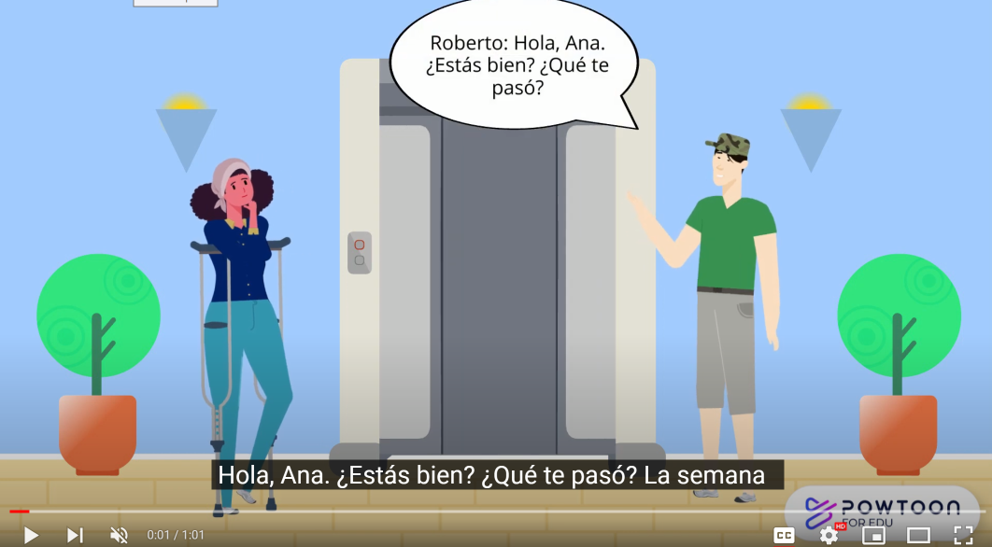
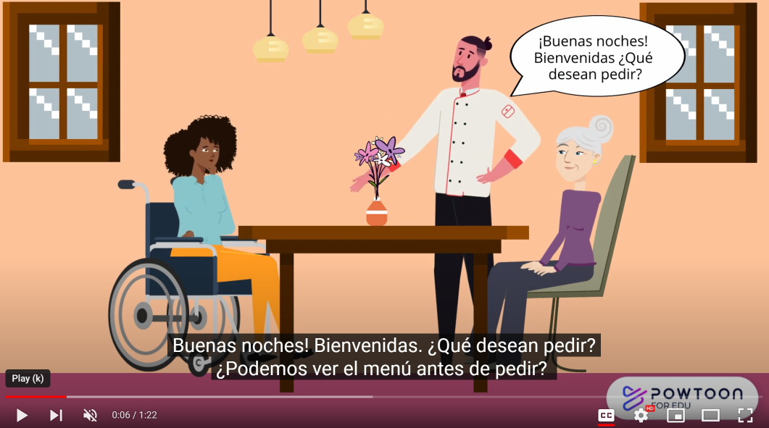
Inclusion, Diversity, Equity, Anti-Racism …and Accessibility
ASCCC OERI IDEA Framework
Culturally-responsive pedagogy
All assignments are meant to be accessible and have been reviewed by ASCCC OERI and LibreVerse accessibility specialists
Notes:
AL

Slide 11
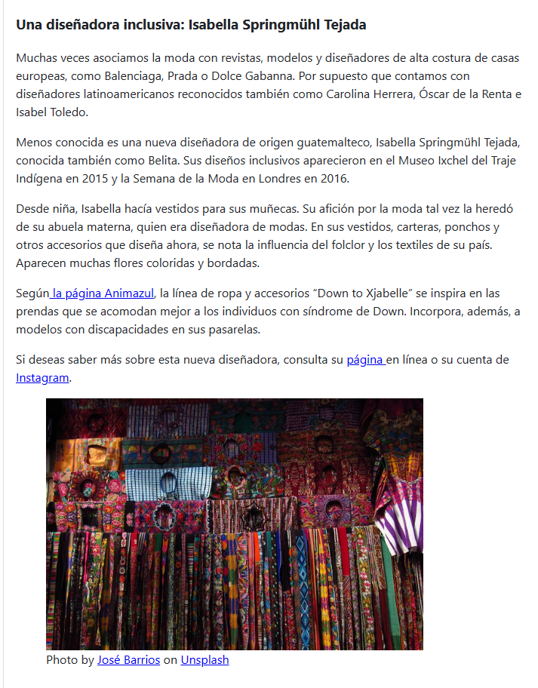
Incorporation of IDEA
People from around the Spanish-speaking world, including the Philippine Islands and Equatorial Guinea: Concha Buika, el silbo gomero, el español en las Islas Filipinas
People of African, Asian, Indigenous and mixed ethnic groups: Jorge Drexler, Perú Negro, los chifas peruanos, Guaraní, Taino
People from the LGBT+ community: Bienestar Clinic in Los Angeles, Gender-neutral names in exercises
People with disabilities: Isabelle Tejada Springmühl
Notes:
AL

Slide 12
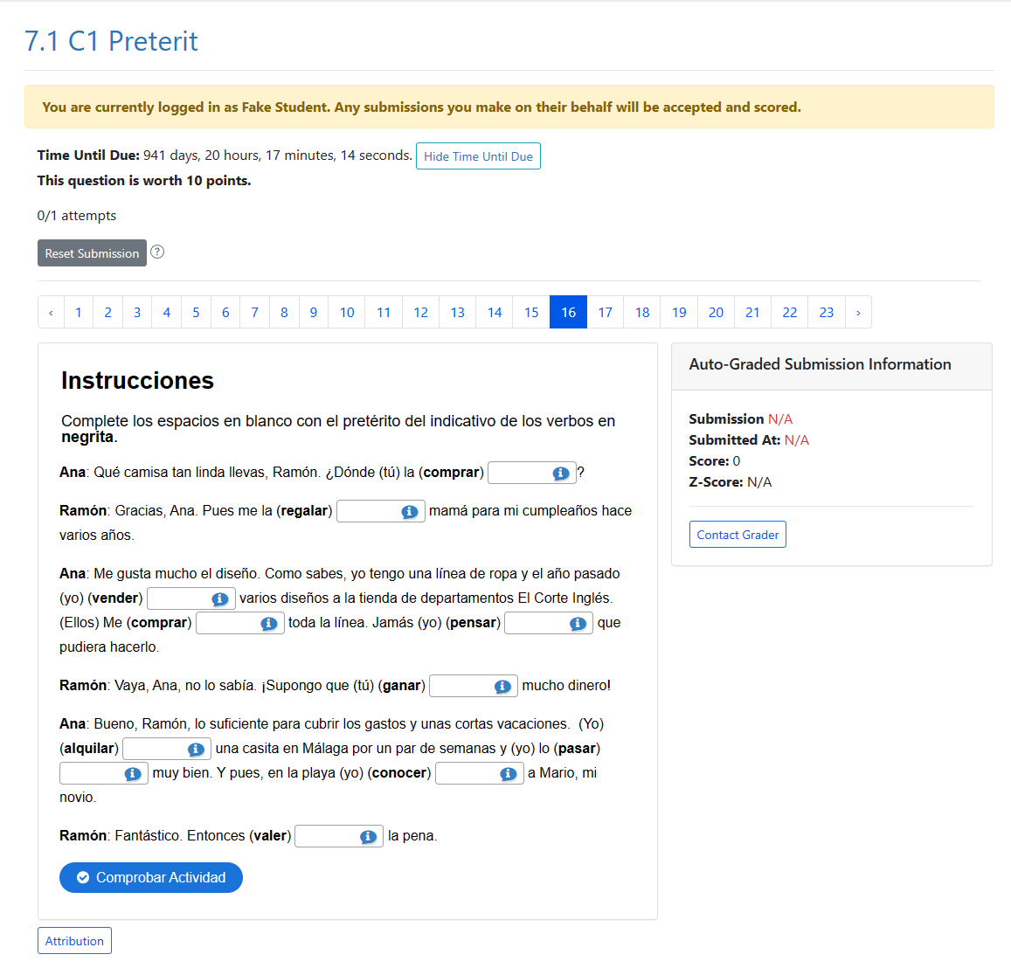
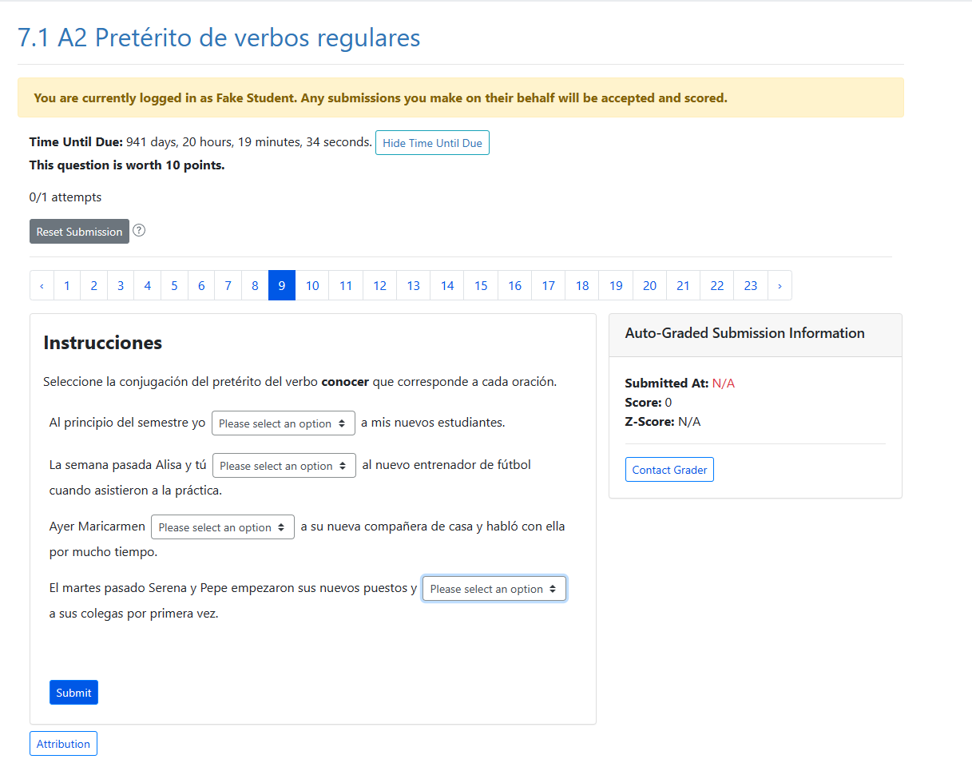
LibreStudio and ADAPT
LibreStudio for H5P-based questions (multiple choice, fill-in-the-blank) and audio recordings–imported into ADAPT
ADAPT native questions (select choice, matching, vocabulary presentations, readings)

Slide 13
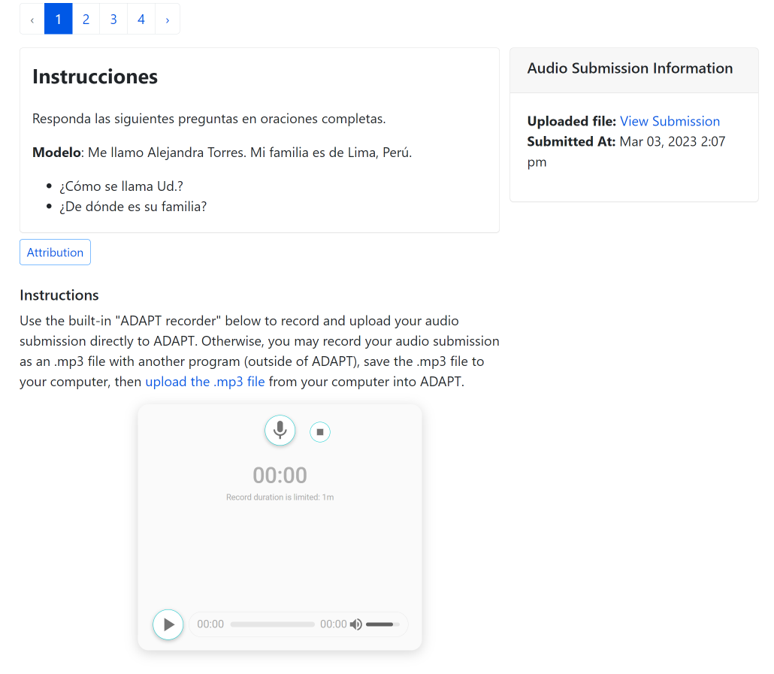
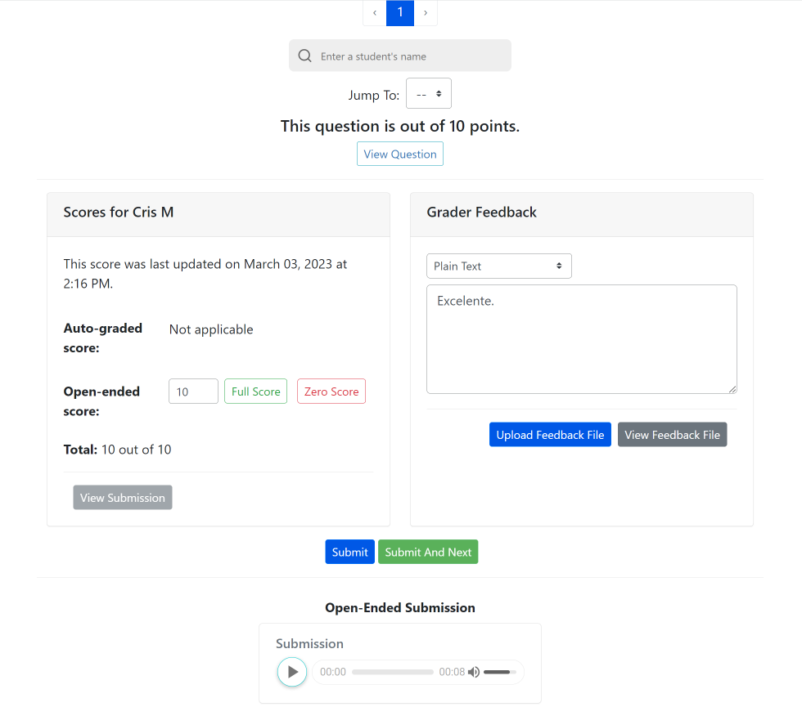
Audio Recording: Hablemos and Escuchemos
These are non auto-graded activities to assess oral and listening skills.
Students record their responses using the recorder tool in the ADAPT assignment.
Instructors listen, grade, and provide feedback all in the same page.

Slide 14
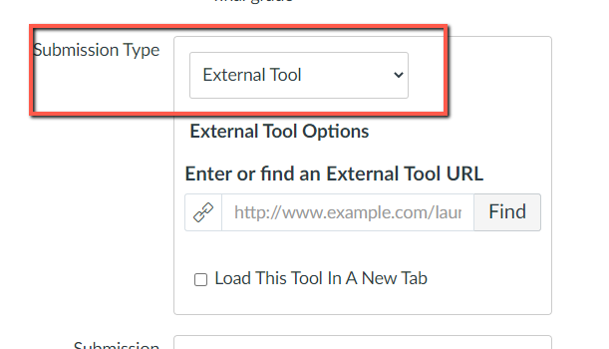
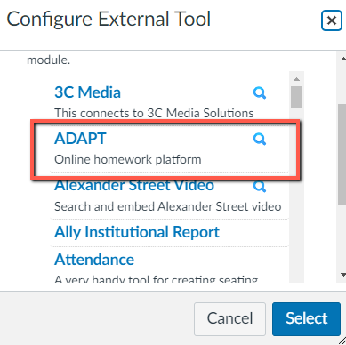
ADAPT Integration into LTI
LTI with deep integration into Canvas and Blackboard
Create assignments in ADAPT and connect in the LMS via External Tool
LTI integration seamlessly connects the assigned activities to the grade book streamlining the assigning and grading of homework.

Slide 15
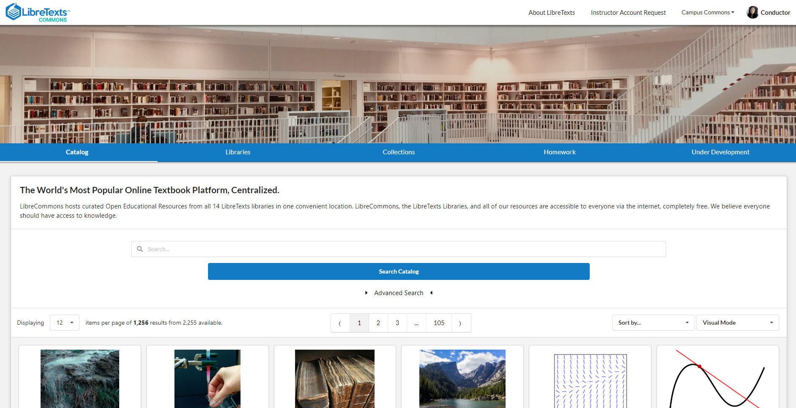
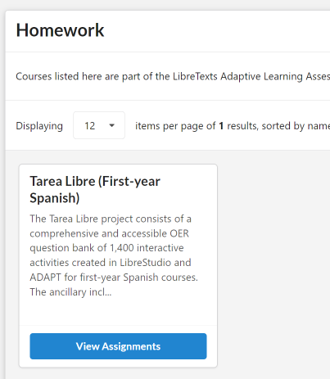
How to Preview Tarea Libre
To preview activities search for Tarea Libre in LibreCommons Homework
Ready for implementation for Summer/Fall 2023

Slide 16
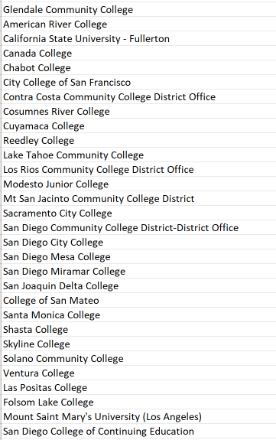
California Colleges with LTI
As of 5/5/23
30 California Colleges have completed the Canvas LTI with ADAPT

Slide 17
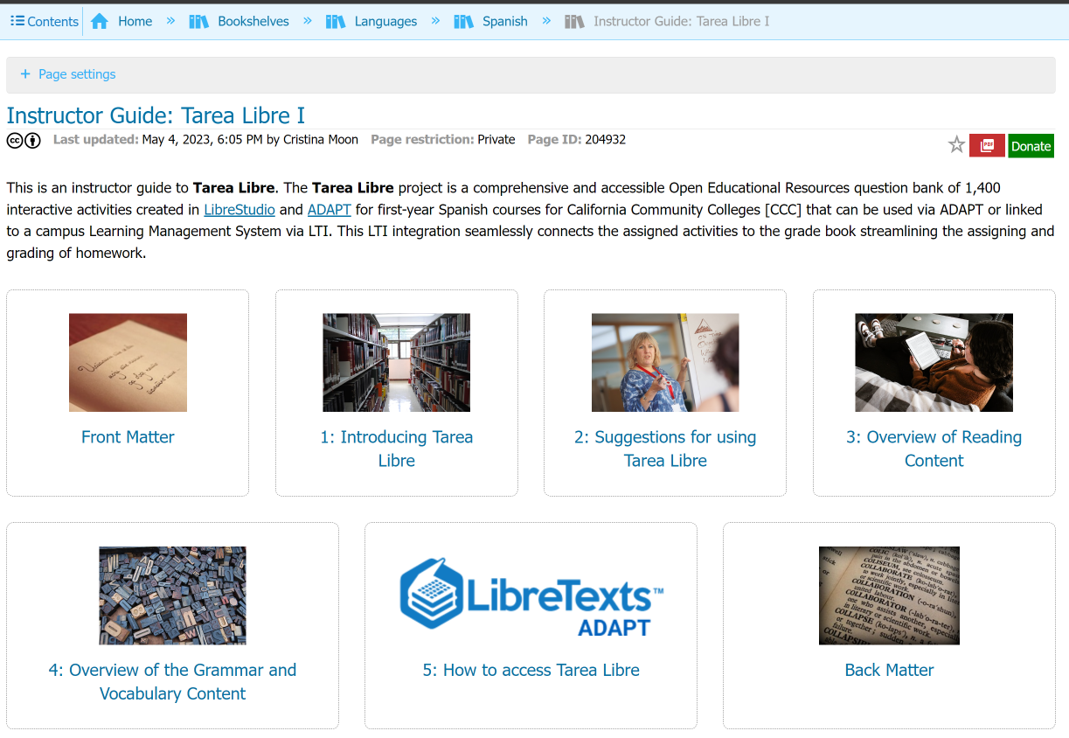
Instructor Guide to Tarea Libre
Start with the Tarea Libre Guide for Instructors in the Spanish Bookshelves in LibreTexts
Notes:
https://human.libretexts.org/Bookshelves/Languages/Spanish/Instructor_Guide%3A_Tarea_Libre_I

Slide 18
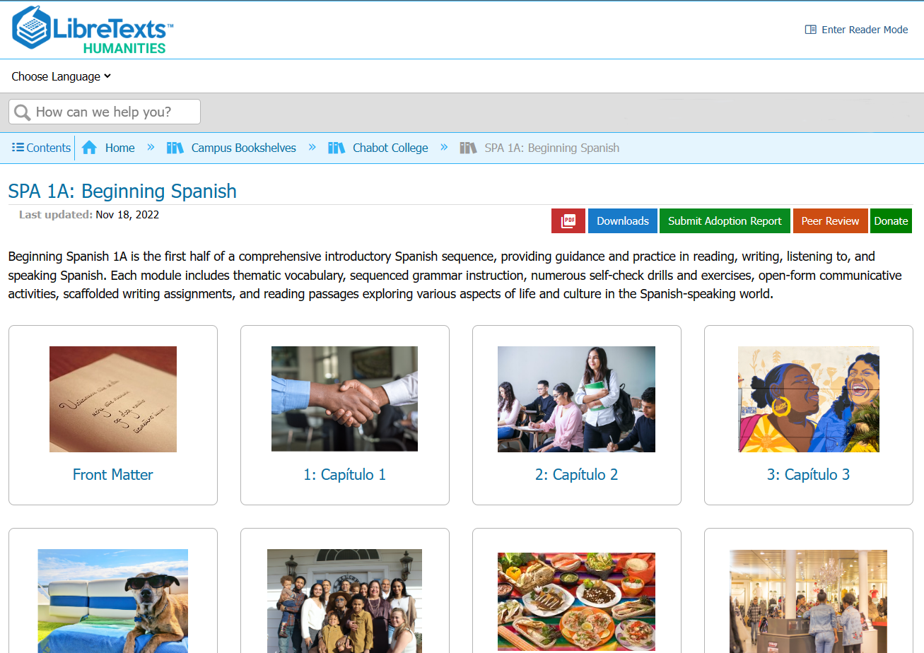
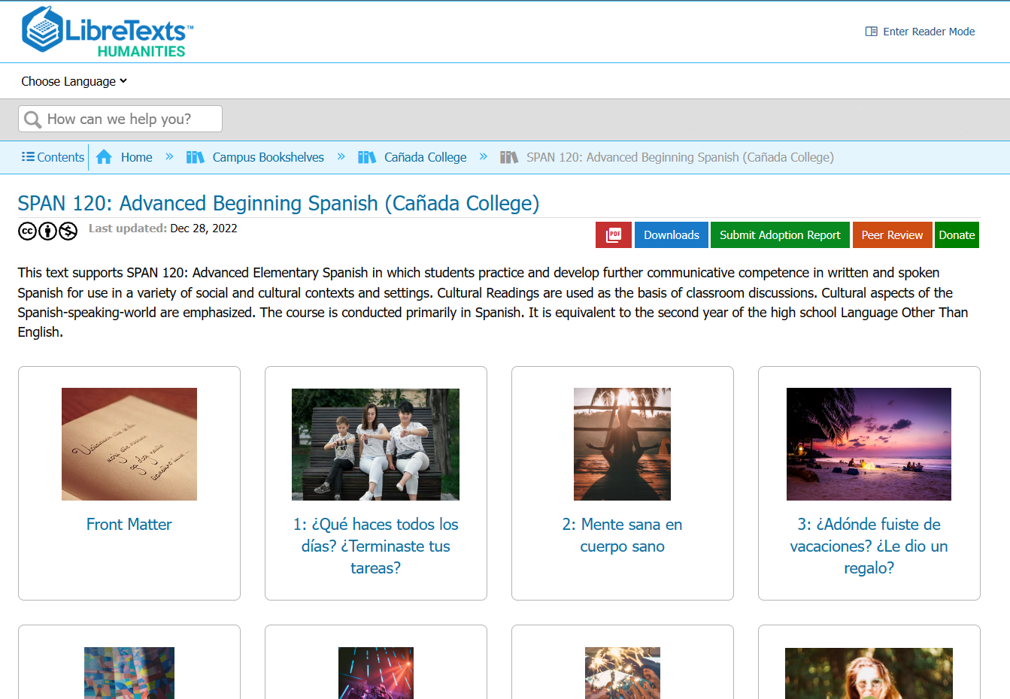
Textbook Remixes
For 1st semester: LibreTexts Humanities Library, Chabot College Campus Bookshelf: SPA 1A Beginning Spanish (remix) by Dr. Cristina Moon
For 2nd semester: LibreTexts Humanities Library, Cañada College Campus Bookshelf: SPAN 120 Advanced Beginning Spanish (remix) by Dr. Sarah Harmon

Slide 19
Let’s take a closer look at Tarea Libre

Slide 20
For more information
Cristina Moon Chabot College cmoon@chabotcollege.edu
Alejandro Lee Santa Monica College lee_alejandro@smc.edu
Sarah Harmon Cañada College harmons@smccd.edu
Nancy Meléndez-Ballesteros Mount Saint Mary’s University-LA nballesteros@msmu.edu

Slide 21
¡Gracias!

