Slide 1
Agenda Item 1.4
Board of Governors Instructional Material Affordability Resolution
Rebecca Ruan-O’Shaughnessy (Vice Chancellor, CCCCO)
Marco Martinez (Former VP of SSCCCC, Bakersfield College​)
James Glapa-Grossklag (Dean , College of the Canyons)
Michelle Pilati, PhD (ASCCC-OERI, Faculty Lead, Psychology, Rio Hondo College)
James Todd (Assistant Superintendent & Vice President of Student Services, Sierra College)
July 2023
Notes:
RRO’S

Slide 2
The Why
Inequitable Structure
Financial Load
Administrative Load
Psychological Load
“I always have an anxiety attack the first week of class because I know the process I have to go through to buy my books. I borrow money, work late to pick up extra hours to afford my books, try to buy used throughout the internet (most don't carry the version required by class), or obtain a short term high interest loan to afford the books.”
Compounding Friction Points
Notes:
MM

Slide 3
Instructional Material Affordability
ACT
ZTC Degree Grant Program Implementation
LEARN
CHANGE
Burden-Free Instructional Materials Taskforce Recommendations
BOG Resolution
Technical Assistance to Ensure Fidelity and Scale
XB 12
Readiness Assessment
Research and Evaluation
Notes:
RRO’S

Slide 4
ZTC Degree Grant Program – Key Dates
Planning Grant - $20K (every college)
July 2022
Fall 2026
557+ Programs Developed/ Implemented
March 2023
Implementation Grant - $180K (every college)
Launch Systemwide PD
Summer/Fall 2023
September 2023
Acceleration Grant (up to $200K per program)
115+ Programs Developed/ Implemented
Fall 2025
Notes:
JGG

Slide 5
ZTC Degree Grant Program -- Acceleration Grant
Program Plan Release
Aug. 15, 2023
Program Plan Submission
Sep. 15, 2023
Grant Award
Sep. 22, 2023
Progress Reports
Dec. 2024 & 2025
Final Report
Dec. 2026
Readiness Prompts
  Leadership
  Faculty Readiness
  Professional Development
  Student Services
  Institutional Research
Notes:
JGG

Slide 6
ZTC Degree Grant Program – Professional Development Plan
Facilitated Courses
Centralized TA Support
Community of Practice
Individual Coaching
Notes:
JGG

Slide 7
Evaluation and Continuous Improvement
XB-12
Readiness Assessment
Program Progress Reports
Program Evaluation
Coordinated Local Data
Notes:
JGG

Slide 8
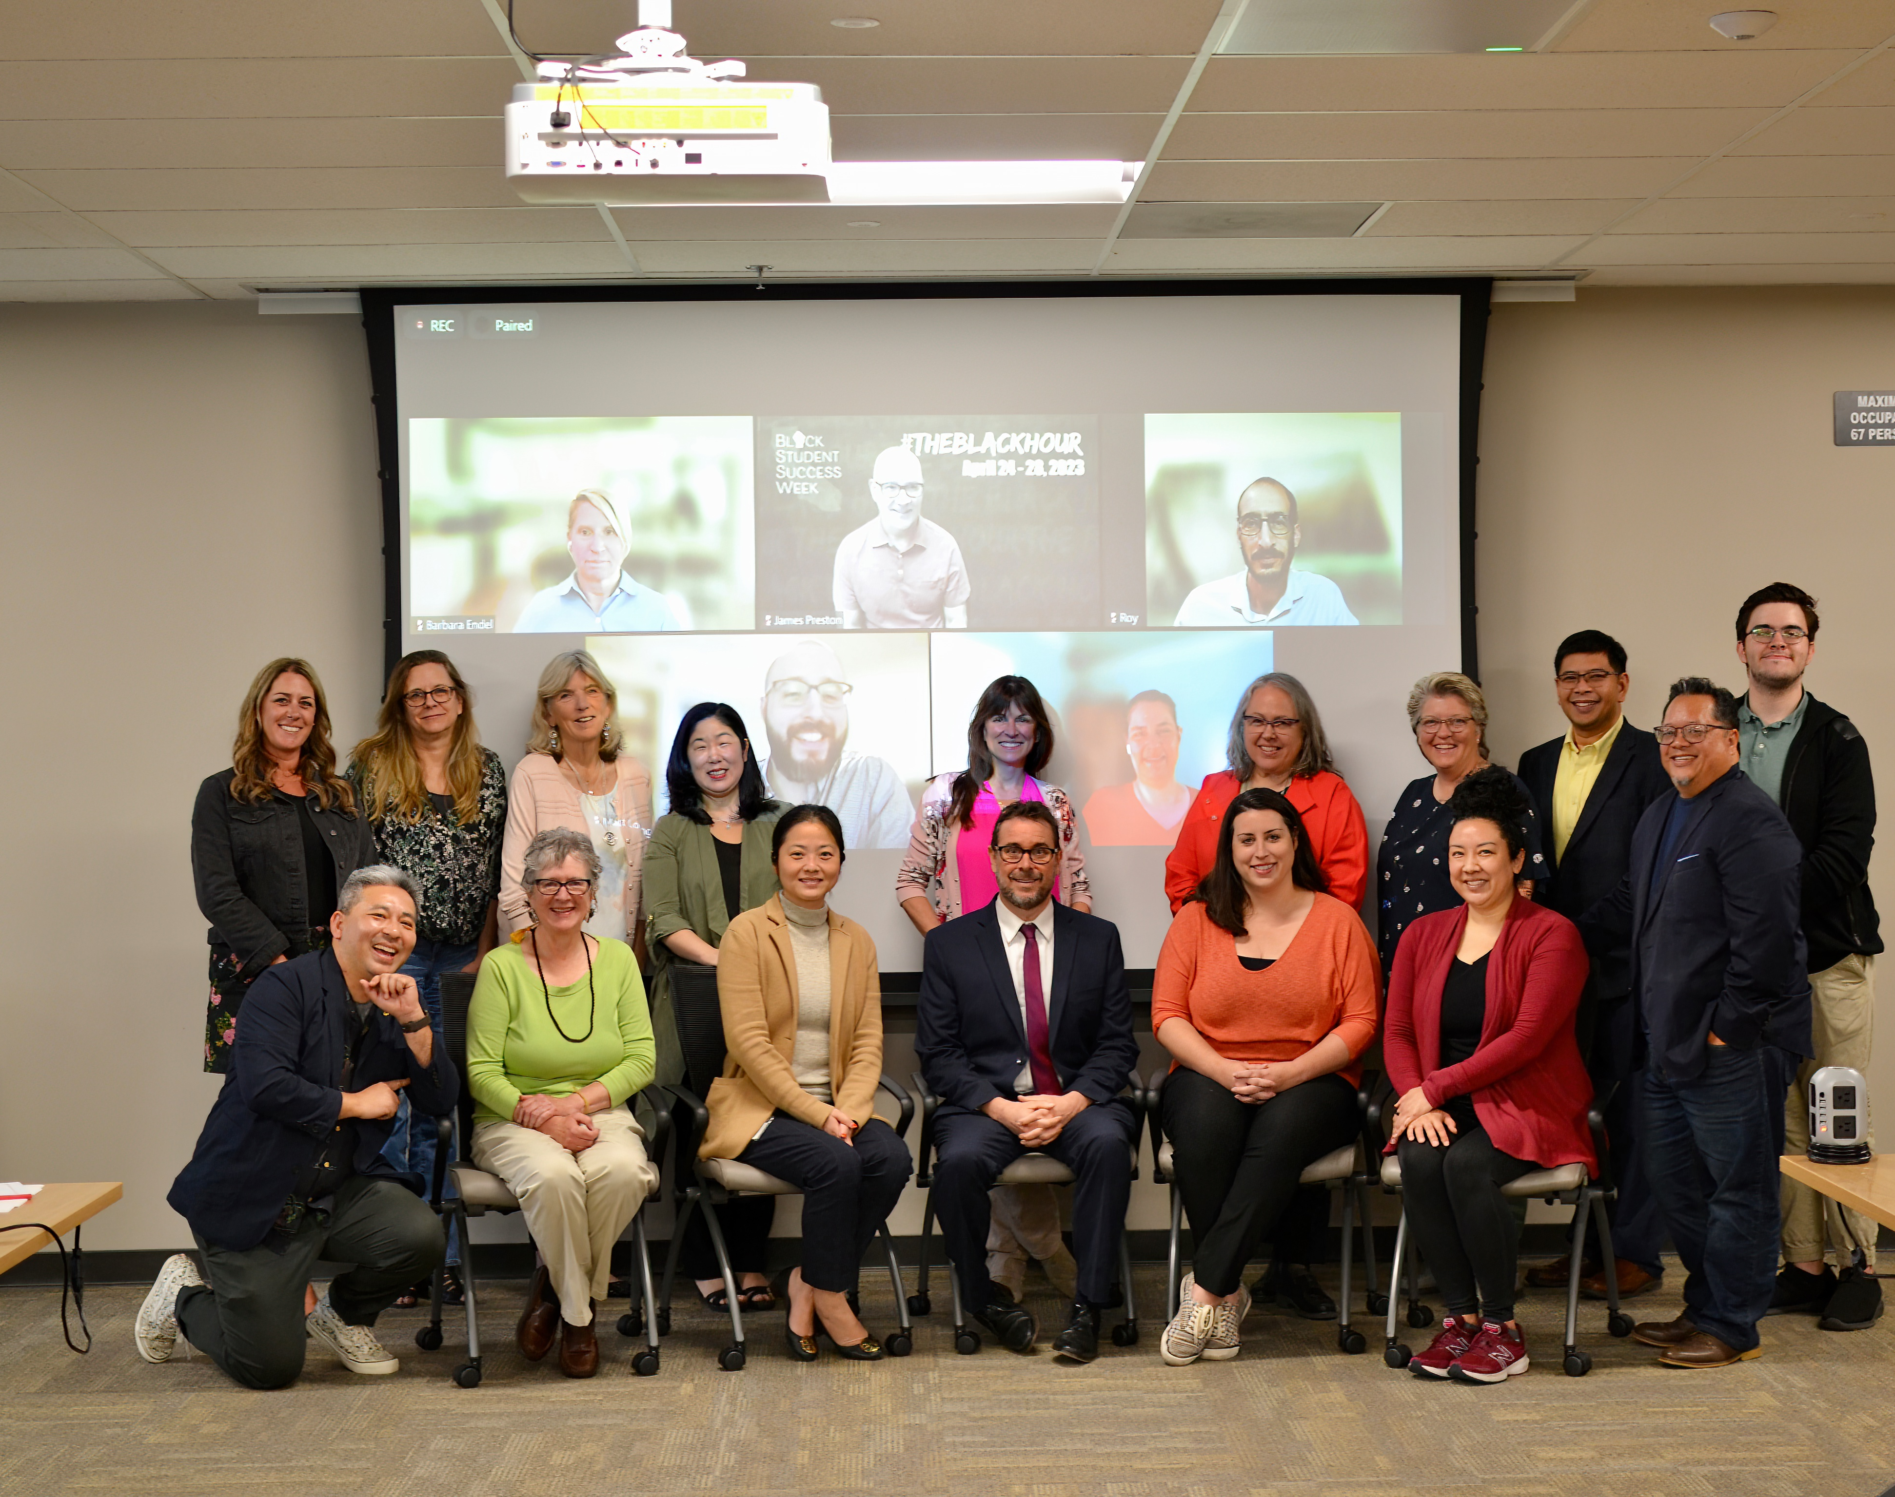
Burden-Free Instructional Materials Task Force
“It’s not just about how much a textbook costs or the expensive supplies needed for a healthcare program; it’s about teaching and learning and the accessibility of every program offered, so that students have what they need to learn and be successful before the class starts.”
-Taskforce member
Notes:
RRO’S

Slide 9
Task Force Charge
Assess the system’s existing infrastructure in place that guides instructional material choice
Provide recommendations and possible regulatory actions for system structural changes that will facilitate the creation of sustainable solutions that reduce instructional materials costs for students in the long term
Notes:
MP + JT

Slide 10
Task Force – Key Recommendations
System commitment & local goals
Scale OER and openly licensed materials by strengthening systemwide coordination and PD, enhanced by technology
Joint advocacy for additional ongoing investment
Data infrastructure to support continuous improvement
Regulation review to empower student choice, alleviate student burdens, and ensure funding flexibility
Expand system-level procurement
Notes:
MP + JT

Slide 11
BOG Resolution on Instructional Material Affordability
Prioritize reduction and elimination of instructional material costs & alleviate student burdens
Study implementation of task force recommendations
Provide recommendations to ensure sustainable no-cost textbook solutions for GE courses
Notes:
RRO’S

