Slide 1

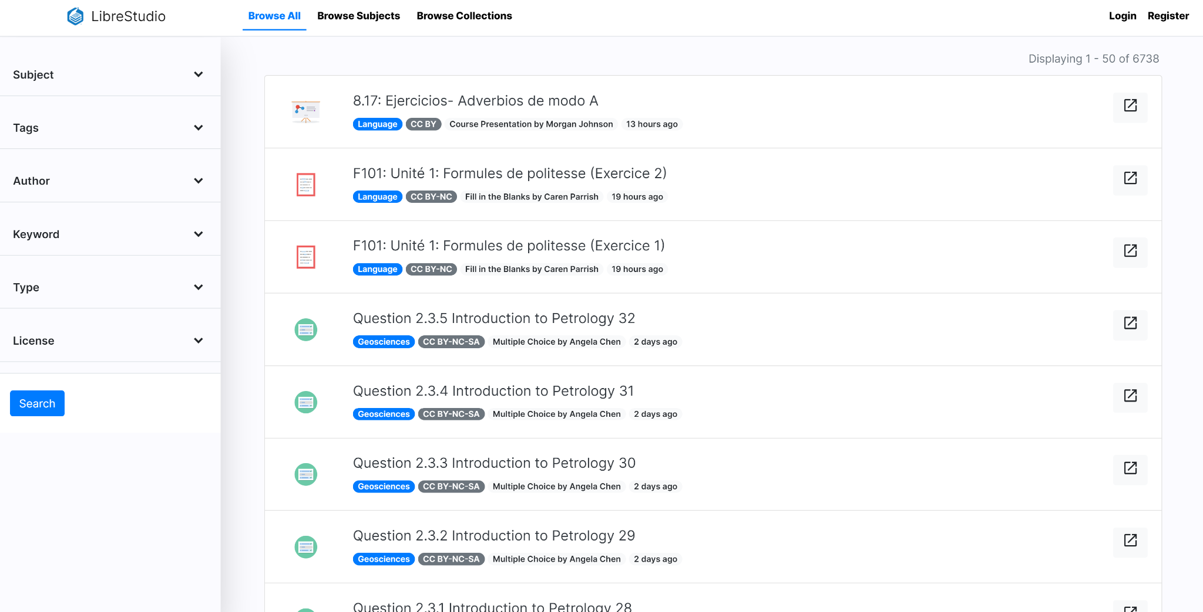

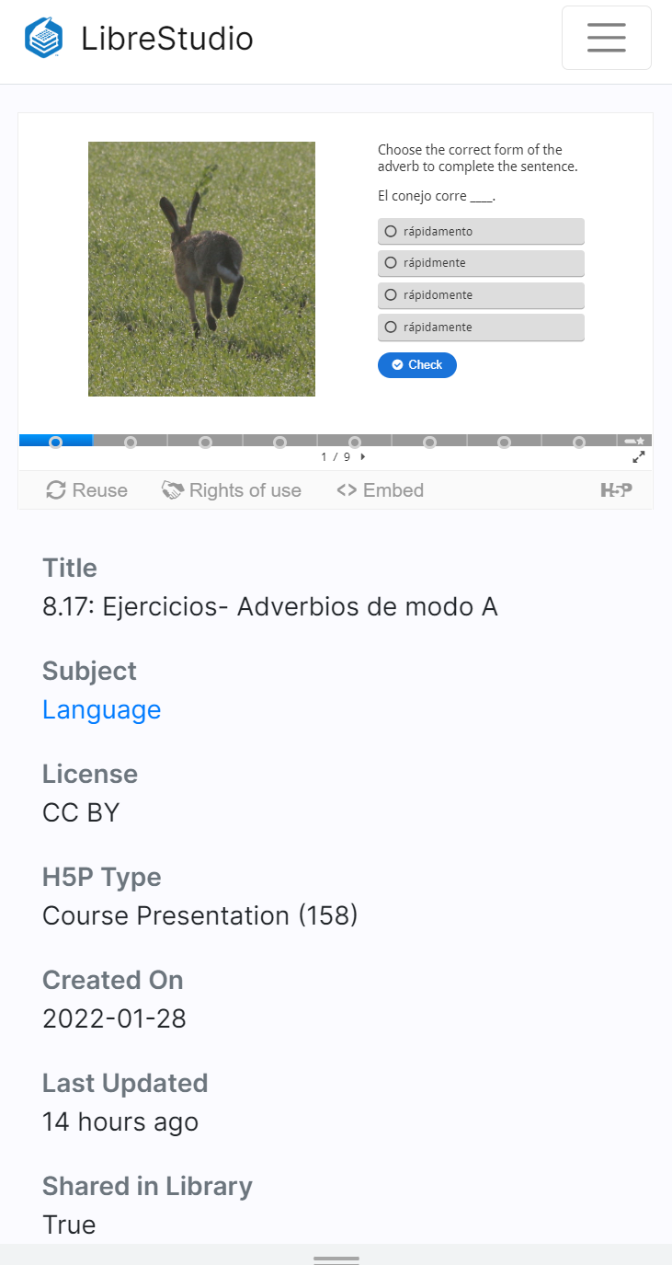
Interactive H5P with LibreStudio
Friday, August 11, 2:00-3:00 pm

Slide 2
H5P in Action
Embedded in a LibreTexts page:
Chemistry example: Hybrid orbitals
ESL example: Linking consonants to vowels
Spanish example: Entrada Libre

Slide 3
What is H5P?
H5P is a free and open-source content program that can let you create interactive videos, course presentations, branching scenarios and many more type of questions.
H5P is an abbreviation for HTML5 Package, and aims to make it easy for everyone to create, share and reuse interactive HTML5 content.
Create
Richer HTML5 Content in Existing Publishing Platforms
Share
Content Seamlessly Across Any H5P Capable Site
Reuse and modify
Content in Your Browser at Any Time
For more detailed information, visit:
h5p.org
h5p.com

Slide 4

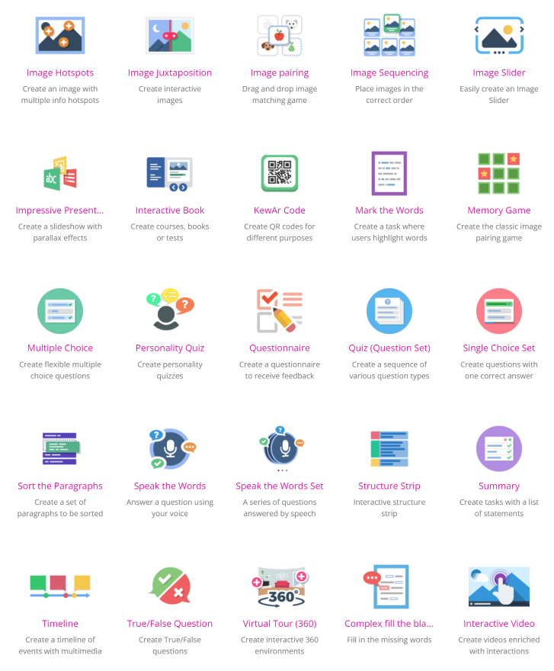
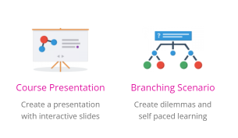
What can you create with H5P?
There are 50+ content types available on LibreStudio, you can learn more about each content type at h5p.org.

Slide 5
Other Considerations when Creating H5P
H5P is always changing, here are some things to consider when creating content:
New H5P Types: New H5P types are being added regularly.
Remix: You can find H5P to remix on Studio and elsewhere.
Accessibility: Some content types are more accessible than others.
LibreTexts Accessibility Report for H5P Activity Types.

Slide 6
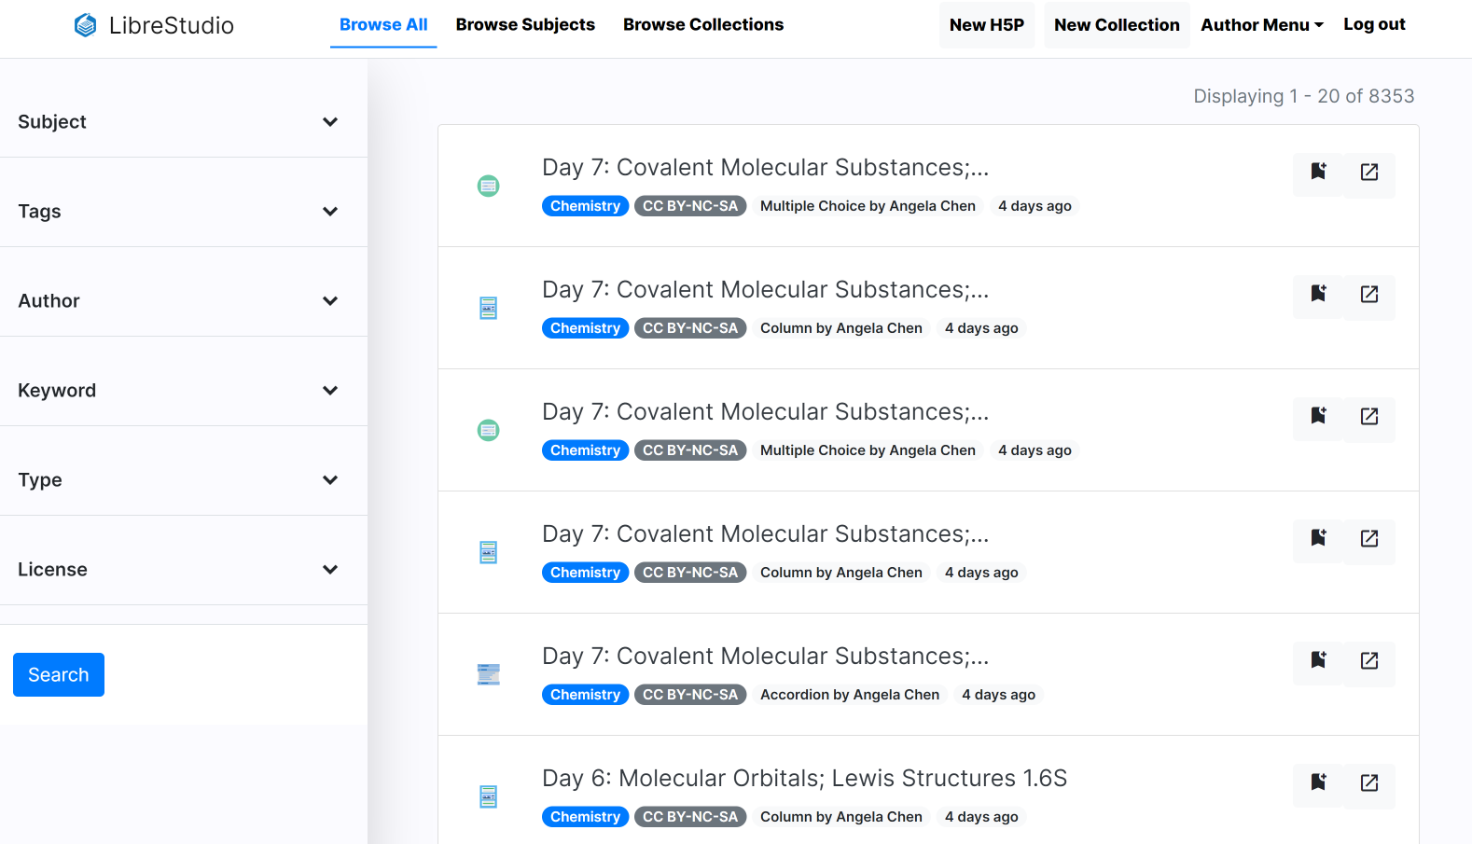
LibreStudio

Slide 7
LibreStudio
13,000 openly shared h5p and 750+ educators actively creating content.
Create, remix, and share h5p
Built using open source technologies
Available as an open source platform
Activities can be embedded into Canvas pages

Slide 8
Let’s get to work
Create a LibreStudio account
Explore H5P library and collections
Embed H5P activity in a Canvas page and LibreTexts page
Edit existing H5P activity
Create a fill-in the blanks, multiple choice, and sort the paragraph
Explore other types of H5P activities

Slide 9
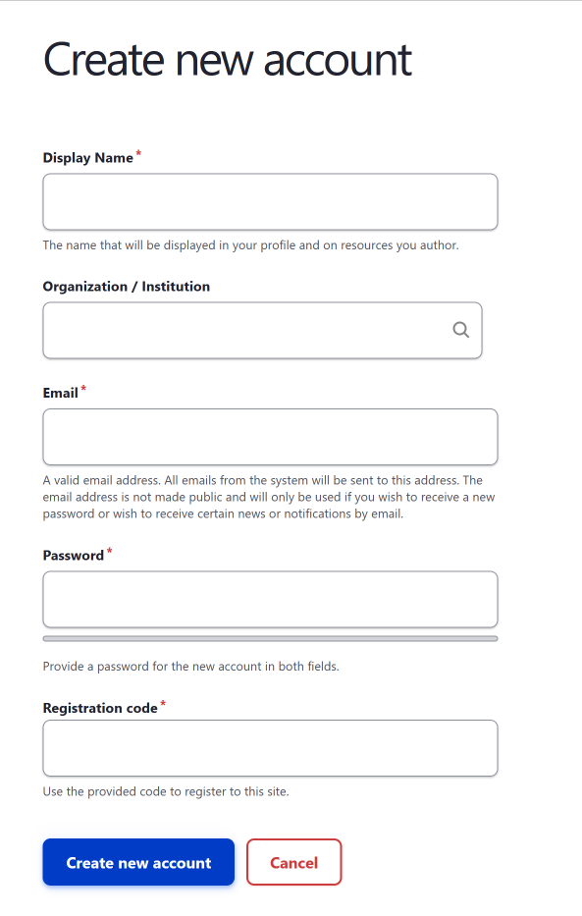
How to register for a free LibreStudio account
Register for account or simply follow along:
Go to studio.libretexts.org
Register
Enter registration code: ASCCC

Slide 10
Explore H5P library and collections
Goals:
Browse H5P library and collections.
Search by subject, type, etc.
Bookmark favorite H5P activities.

Slide 11
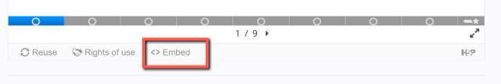
Embedding H5P in Canvas page
Goals:
Browse H5P library and collections.
Embed activity in Canvas page.
Steps:
Go to LibreStudio and find an H5P activity.
Find the embed code.
Open a Canvas page.
Click on HTML view.
Paste embed code.
studio.libretexts.org

Slide 12
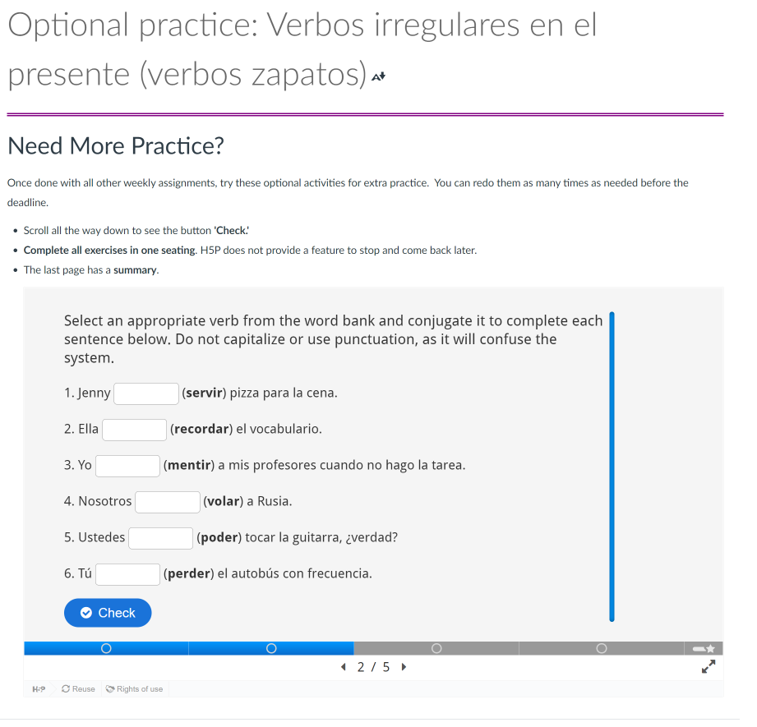
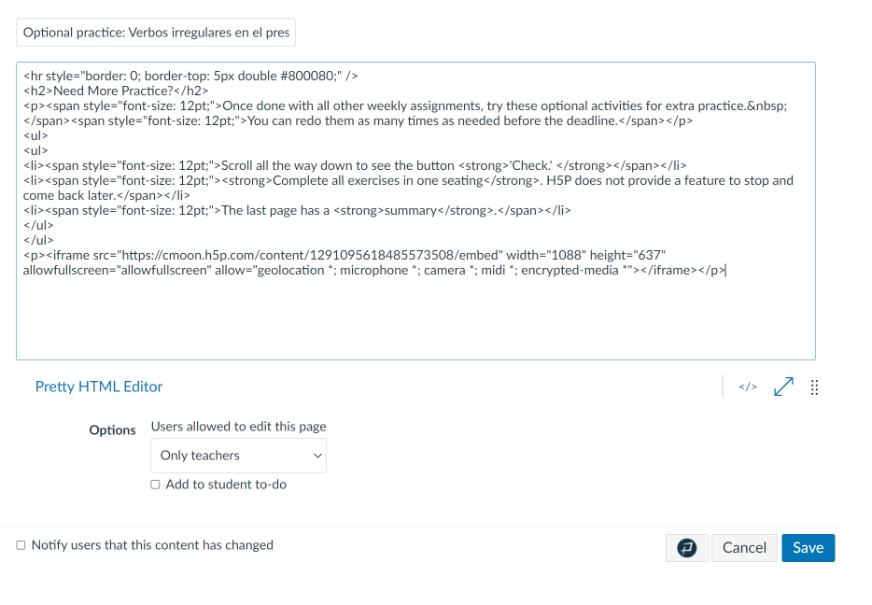
Example of embedded H5P in Canvas
Example of embedded H5P in Canvas
Notes:
Cristina

Slide 13
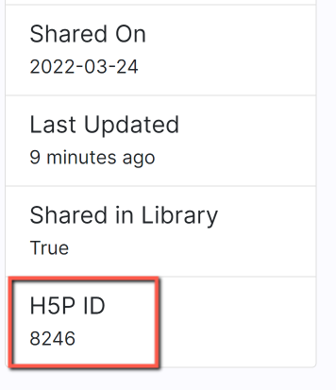
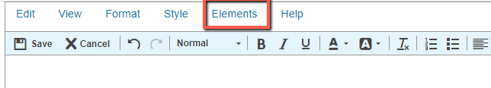
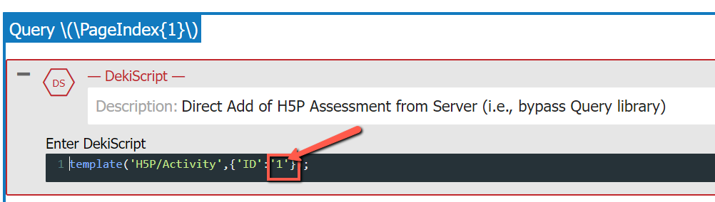
Example of embedded H5P in LibreTexts
Find the H5P ID
Find Elements in LibreTexts and then Templates
Select Template: Query H5P
Click on + to open and then replace 1 with the H5P ID and save
Notes:
Cristina

Slide 14
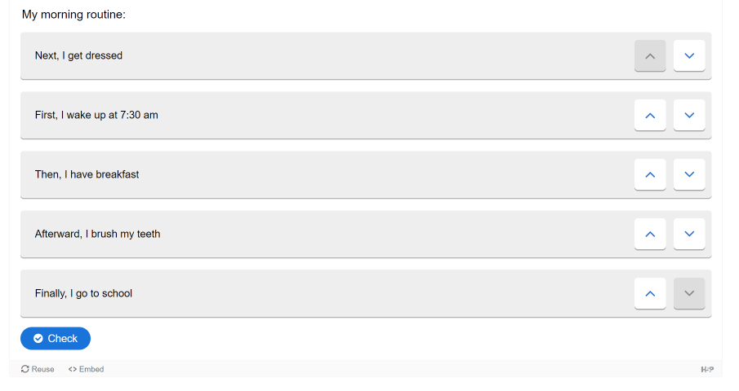
Exploring H5P activities
Examples:
Look at “memory game”
Look at “crossword puzzle”
Look at “sort the paragraph”
studio.libretexts.org

Slide 15
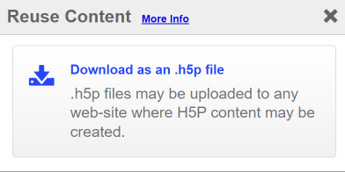
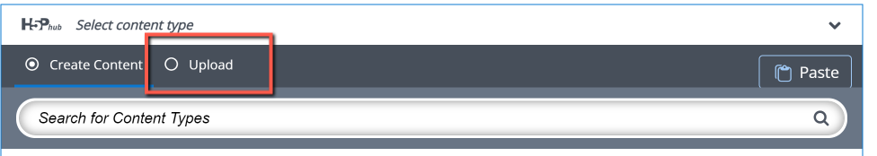
Editing an existing H5P activity
Goals:
Find an activity in LibreStudio
Reuse: Copy or download
Upload
Edit
Publish
studio.libretexts.org

Slide 16
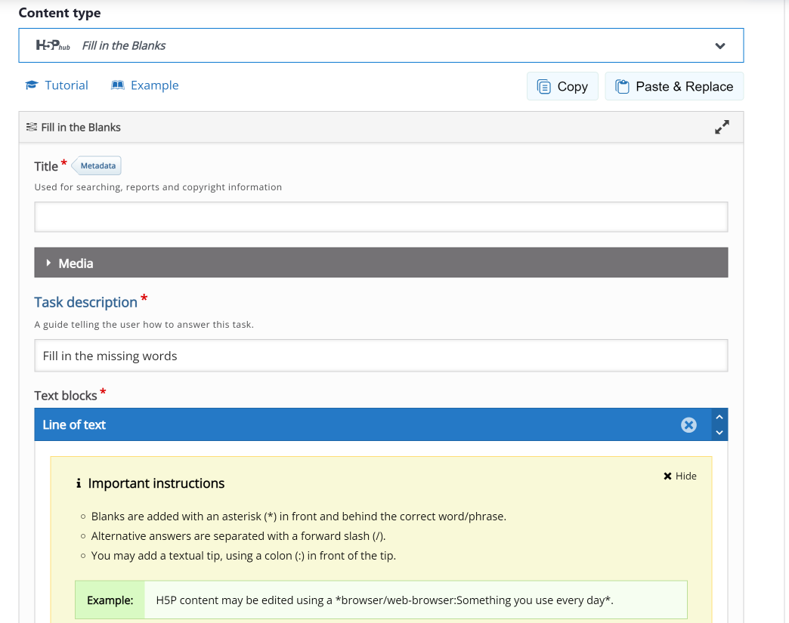
Creating a fill-in the blanks H5P activity
Goals:
Create a fill-in the blanks activity
Add metatext
Add tags
Embed activity in a Canvas page
studio.libretexts.org

Slide 17
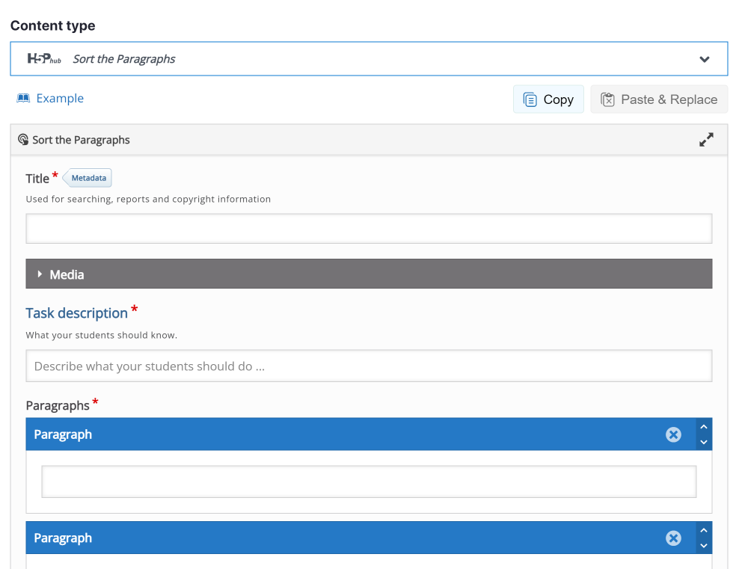
Creating a sort the paragraph H5P activity
Goals:
Create a sort the paragraph activity
Add metatext
Add tags
Embed activity in a Canvas page
studio.libretexts.org

Slide 18
Other H5P Repositories
There are numerous h5p places to find H5P to reuse:
H5P Studio at eCampusOntario
PressBooks Directory
H5P in Merlot

Slide 19
Using H5P for summative assessments
H5P Part II – Introduction to ADAPT
Friday, August 18, 2023 from 2:00 pm – 3:00 pm
Register for H5P Part II – Introduction to ADAPT
Following a brief recap of the skills developed in H5P Part I, we will build auto-graded activities in ADAPT as summative assessments that can be integrated into Canvas and create fill-in the blank, multiple choice, true or false, select choice, and matching ADAPT native questions. You will also learn how to add newly developed questions to an ADAPT assignment and how to use ADAPT in LibreTexts and, if locally available, within Canvas. Additional details regarding ADAPT integration into Canvas will be provided prior to the workshop.

Slide 20
Do you have more questions?
The OERI is pleased to offer a series of H5P office hours for the month of August These office hours will serve as a Q&A session where attendees bring in their H5P needs, requests, and questions. Attendees can also use this space to receive guidance and ask questions pertaining to H5P/ADAPT.
H5P Office Hours – August 11
Friday, August 11, 2023 from 3:00 pm – 4:00 pm
H5P Office Hours – August 18
Friday, August 18, 2023 from 3:00 pm – 4:00 pm

Slide 21
Questions?
Cristina Moon
Spanish Faculty
OER/ZTC Coordinator at Chabot College
ASCCC OERI Spanish Lead, H5P Lead, and OERI Liaison
cmoon@chabotcollege.edu

Slide 22
Fill-in the blanks example
Title: Verb “to be”
Task description: Instructions: Complete with the verb “to be” in the present.
Text blocks
I *am* a college student at Chabot College.
My friends *are* also students at Chabot.
We *are* all taking Spanish classes this semester.
*Are/are* you taking classes too?

Slide 23
Sort the paragraph example
Title: Números
Task description: Instructions: Put the following numbers in order from lowest to highest.
(Accessibility workaround instructions for sort the paragraph questions)
To use the keyboard to move a paragraph, select it by typing the Space or Enter key, then use the Up or Down arrow key to move the paragraph into position. Drop the paragraph by typing the Space or Enter key. To review correct and incorrect answers, users of screen reading software must read the paragraphs using forms mode.
Diez
Once
Doce
Trece
Catorce
Quince
Spanish example: https://studio.libretexts.org/h5p/8246

