Slide 1
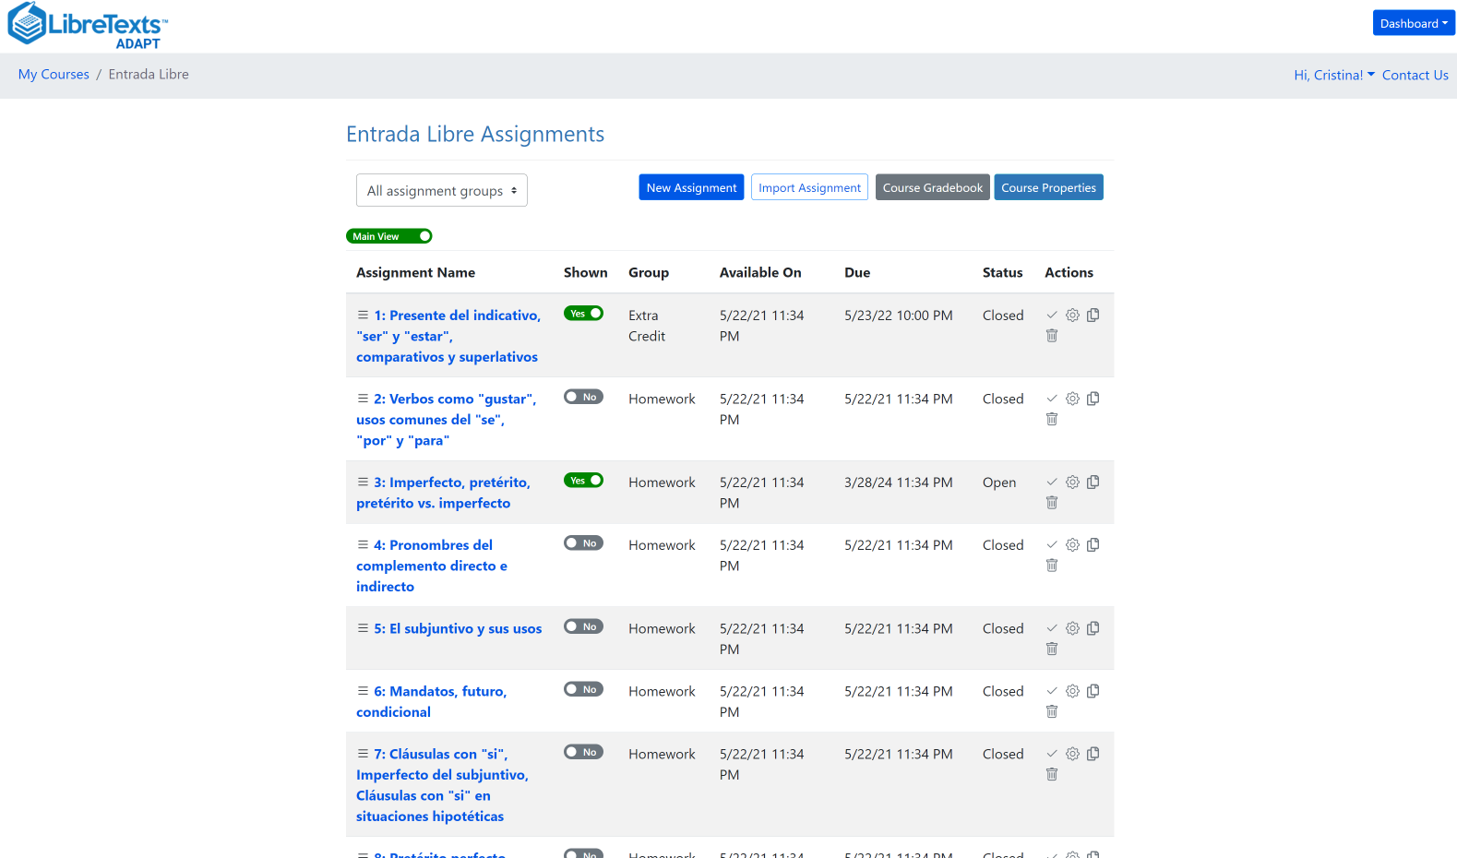
H5P Part II Introduction to ADAPT
Friday, August 18, 2023

Slide 2
Last Week’s Training on H5P
H5P Part I – Introduction to H5P and LibreTexts Studio
Friday, August 11, 2023 from 2:00 pm – 3:00 pm
Watch the “H5P Part I – Introduction to H5P and LibreTexts Studio” recording
Access the “H5P Part I – Introduction to H5P and LibreTexts Studio” presentation materials
H5P is a free and easy-to-use tool for creating interactive exercises. Following a showcase of existing H5P resources that are free, openly-licensed, and available for your use and customization, you’ll create your own H5P fill-in the blanks, multiple choice, true or false questions and sort the paragraphs activities. In addition, you will learn how to embed H5P resources in LibreTexts and Canvas as formative assessments. Note: To participate, attendees will need to create a LibreStudio account. How do you access LibreStudio?
Go to LibreStudio [ https://studio.libretexts.org/ ]
Then click on the register link [ https://studio.libretexts.org/user/register ] to set up an account and use the code ASCCC.

Slide 3
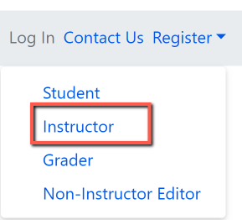
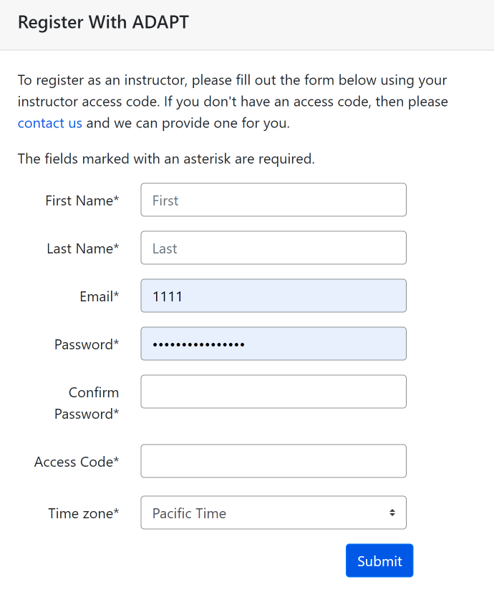
Create an instructor ADAPT account
Go to:
Login · ADAPT (libretexts.org)
Create an instructor account
Access code:
Click on “contact us” and complete the form. Once confirmed, you will receive an email with the access code which you will use to create the ADAPT account

Slide 4
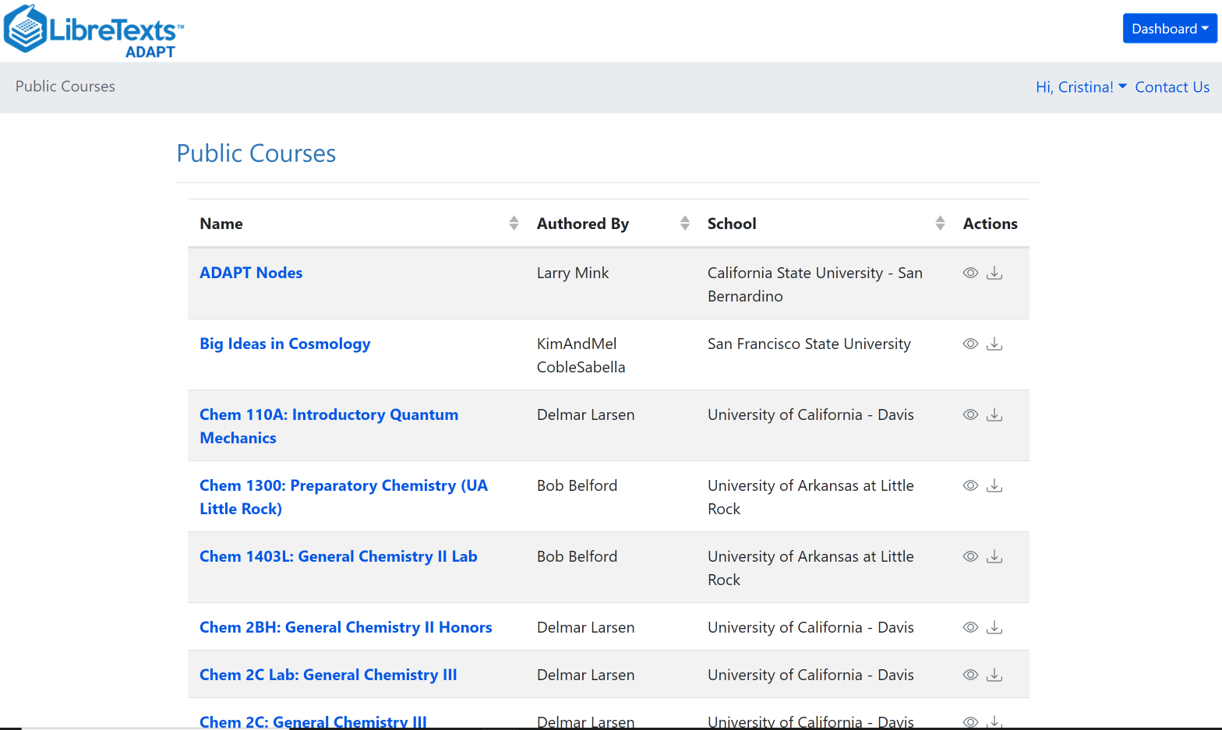
What is ADAPT?
ADAPT is a comprehensive online assessment/homework infrastructure that provides faculty the ability to include auto-graded and non-auto-graded activities from different platforms such as H5P, MyOpenMath, WeBWork, and it’s own native ADAPT questions.
ADAPT can be integrated into an LMS such as Canvas with full grade integration or it could be run independently.

Slide 5
ADAPT is Built for Multi-Modal Use - Technology
No single technology can handle all use cases. Our solution is to build ADAPT with multiple technologies capable of handling numerous use cases.
AutoGraded Questioning
Open-Ended Questioning
WebWork
IMathAS (MyOpenMath
& Ohm)
Rich Text
Plain Text
Native
(LMS QTI)
H5P
Audio
File
(PDF, Excel …)

Slide 6
ADAPT is Built for Multi-Modal Use – Application
Different Instructors have different pedagogies in their use of Homework.
In Class Personal Response System
Via ADAPT website
via phones
Via Textbook
Embed in Text
Via LMS
Campus LMS
Notes:
Icons: https://www.flaticon.com/free-icon/reading_948256?term=student&page=1&position=4&page=1&position=4&related_id=948256&origin=tag
https://www.flaticon.com/free-icon/open-book_171322?term=book&page=1&position=3
https://www.flaticon.com/free-icon/smartphone_1093286?term=iphone&page=1&position=12&page=1&position=12&related_id=1093286&origin=search
https://www.flaticon.com/free-icon/dashboard_2329083?term=learning%20managment&related_id=2329083

Slide 7
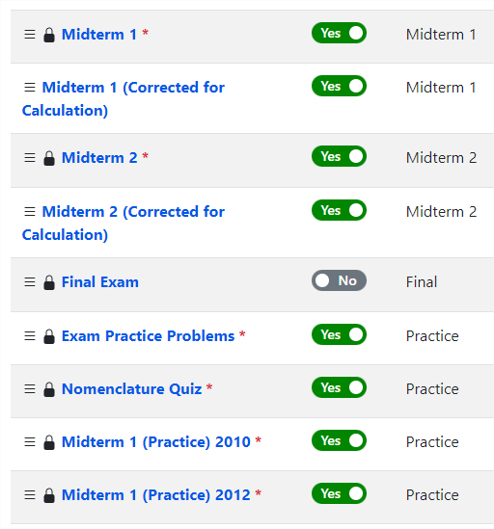
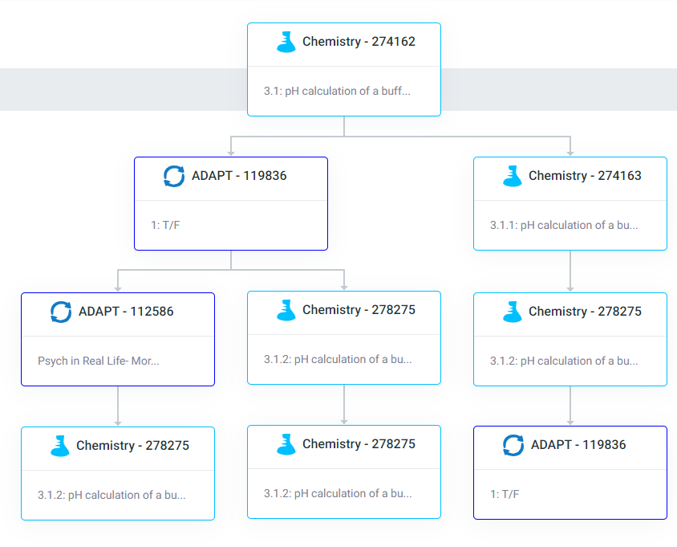
ADAPT is Built for Multi-Modal Use – Delivery
Students interact with problems via traditional Assignment/Question approach or via an adaptive Learning Tree approach that enables individualized assessment and learning.

Slide 8
Goals for this webinar
Find ADAPT questions, collections, and public courses.
Create an ADAPT course and set the Gradebook integration with Canvas.
Create an assignment and add existing questions.
Create new ADAPT native questions: multiple choice, select choice, etc.
Create a Canvas assignment and link ADAPT assignment in Canvas.

Slide 9
Let’s get to work
Find ADAPT
Questions
Collections
Public courses
Notes:
12:40

Slide 10
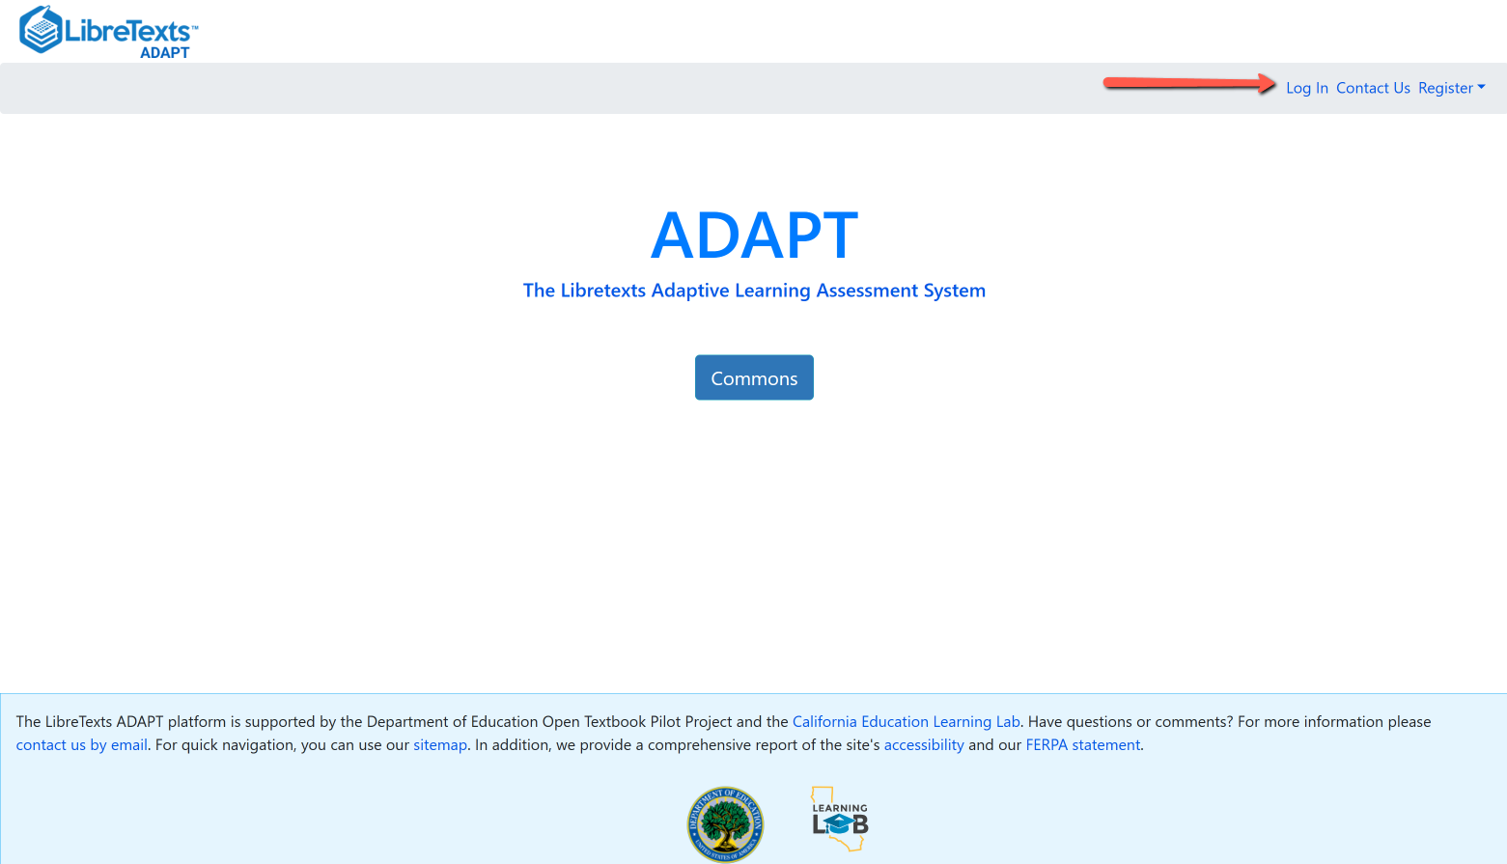
Login to your ADAPT account
Go to:
https://adapt.libretexts.org/login

Slide 11
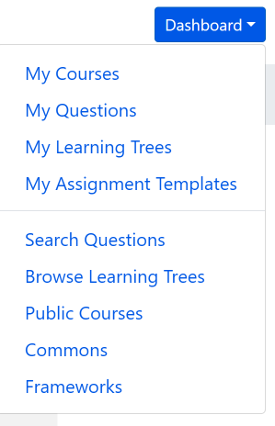
Search for ADAPT questions, collections, and
public courses
Questions: Search among 155,199 ADAPT questions.
Public Courses: Search among shared public courses.
Commons: Search from collections.

Slide 12
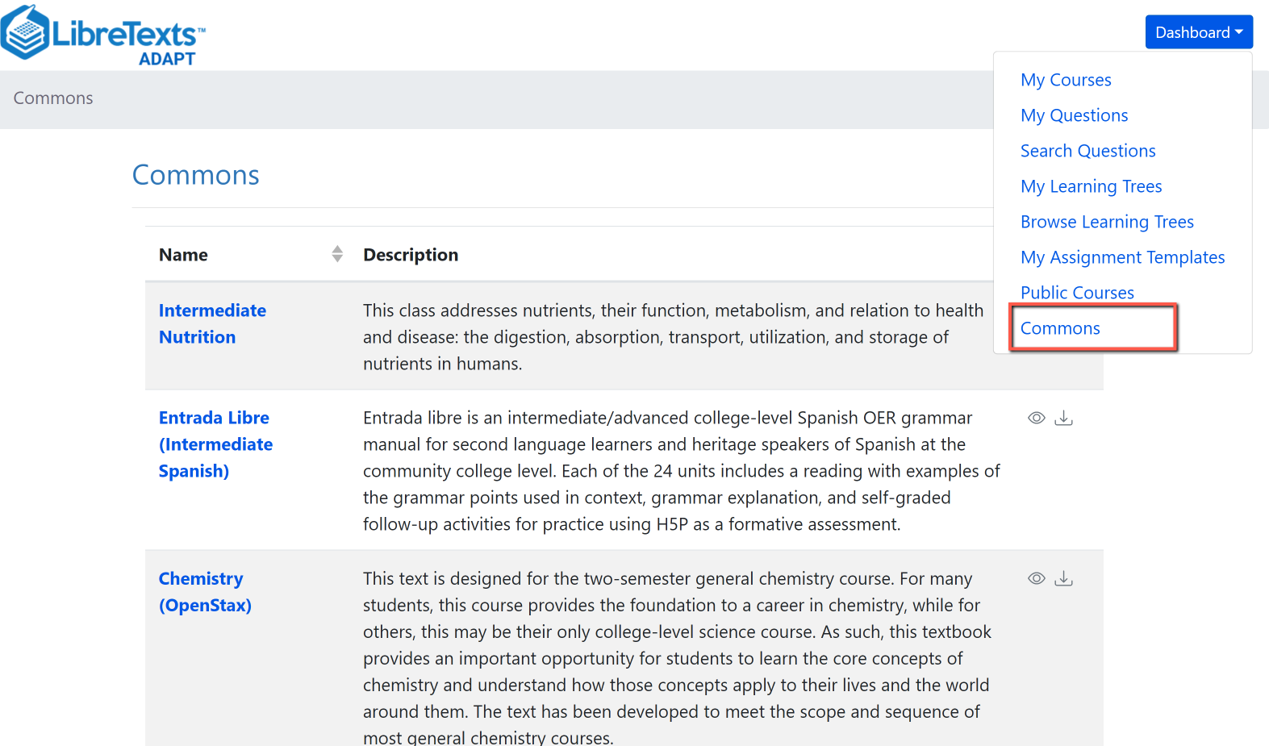
Search in Commons

Slide 13
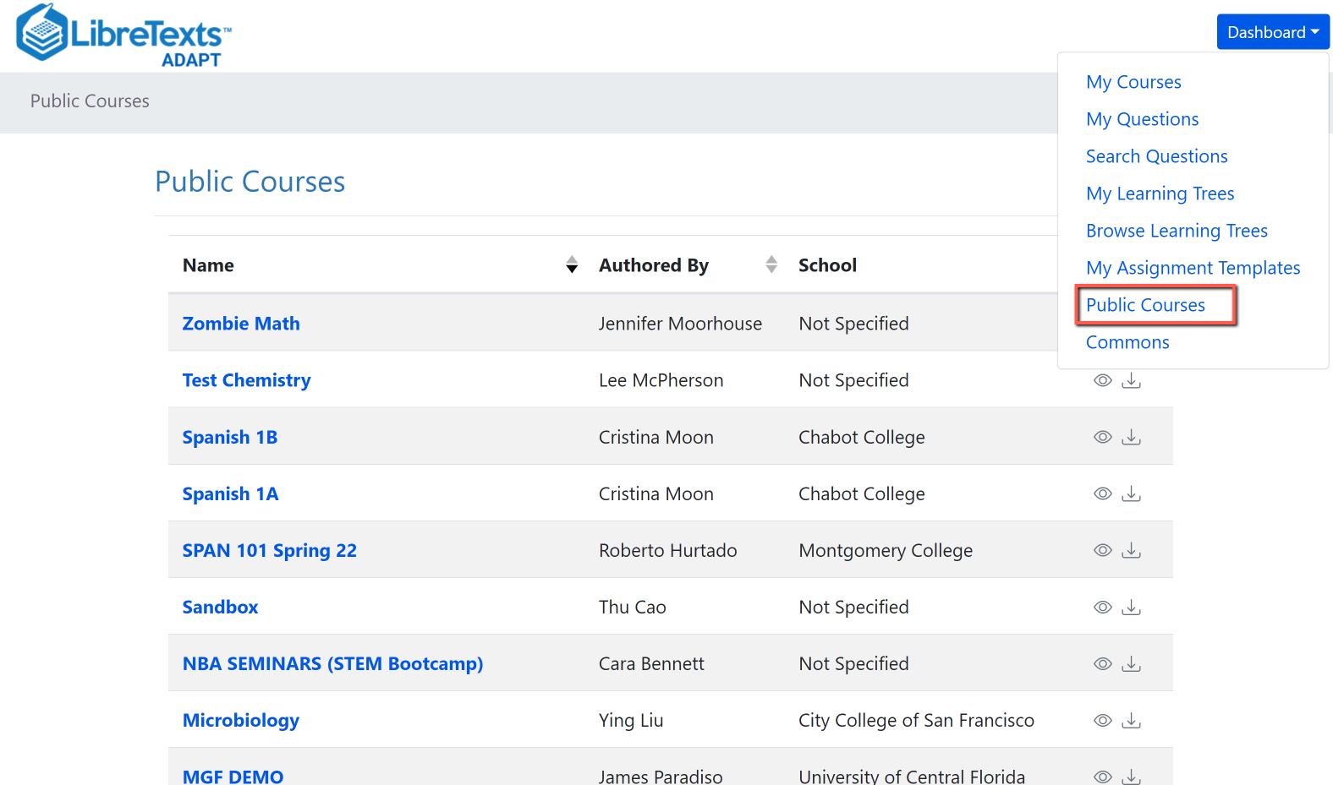
Search Public Courses

Slide 14
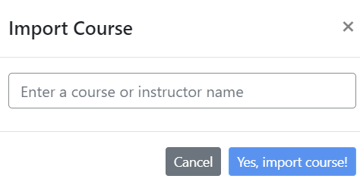
Import an existing course
You can look for public courses that other instructors have shared by going to “Public Courses”.
If you like what you see, you can import the course to your account:
Click on “Import course”
Search for course name or instructor name
Then, import.

Slide 15
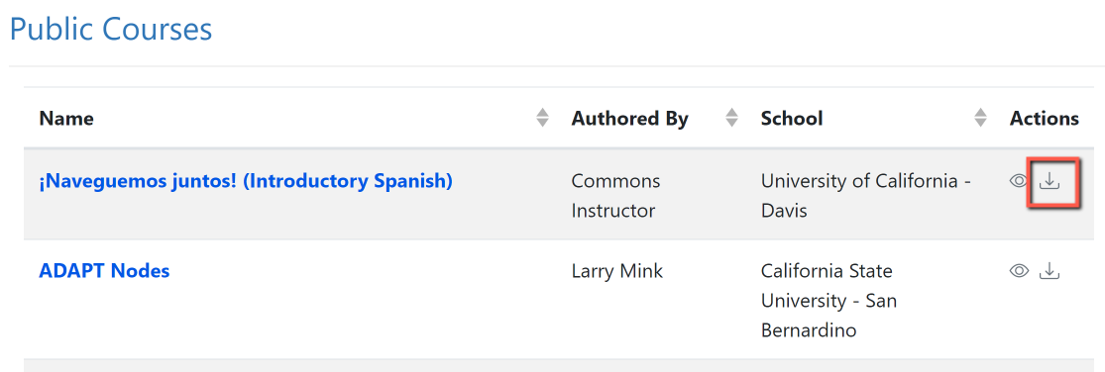
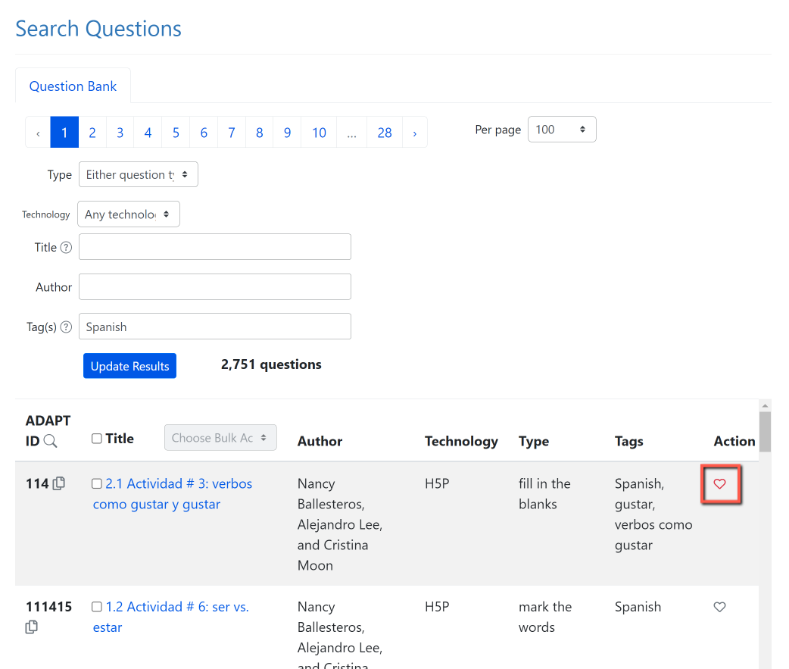
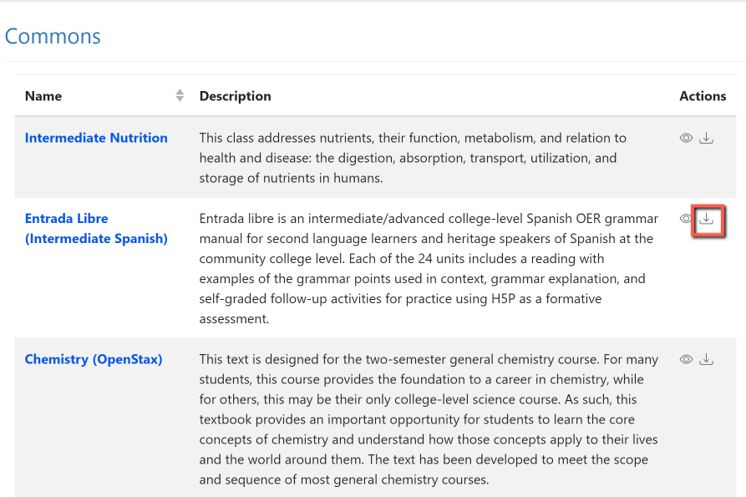
Activity # 1: Now, You Do It …
Search and import a Public Course or a collection from Commons
2. Search for questions and save to favorites.
Notes:
12:45

Slide 16
Let’s get to work
2. Create an ADAPT course and set the Gradebook integration in Canvas

Slide 17
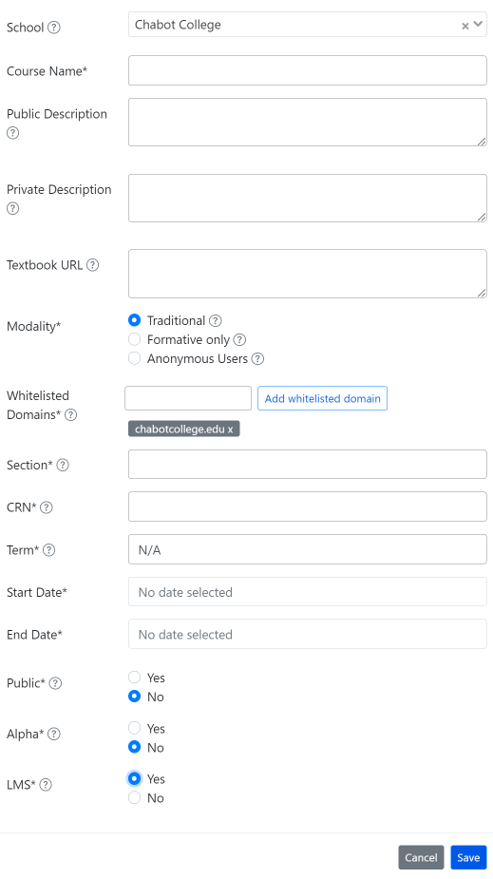
Create an ADAPT course and set the Gradebook integration with Canvas
Enter:
School: find your college if LTI was done
Course Name
Section/CRN
Term
Start/end date
Public: Yes >if you want to share your course with other instructors
LMS: select “Yes” for Canvas integration

Slide 18
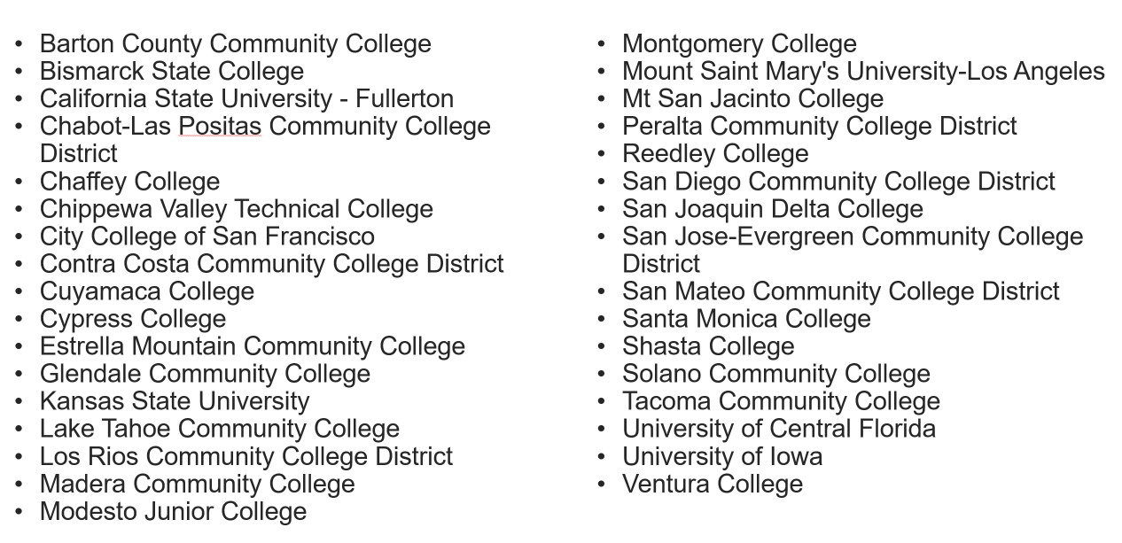
Colleges with Canvas ADAPT LTI (as of 7/31/23)

Slide 19
Let’s get to work
3. Create an assignment and add existing questions

Slide 20
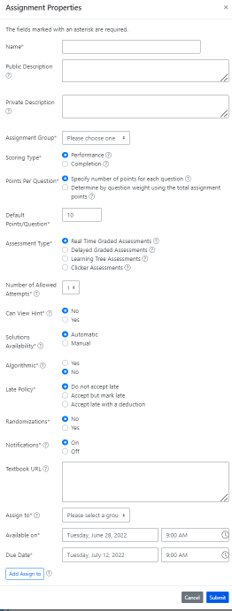
Create a new assignment
Enter:
Name of the assignment
Assignment group
Points (default is 10)
Assessment type
# of allowed attempts
Late policy
Assign to
Available on
Due date

Slide 21
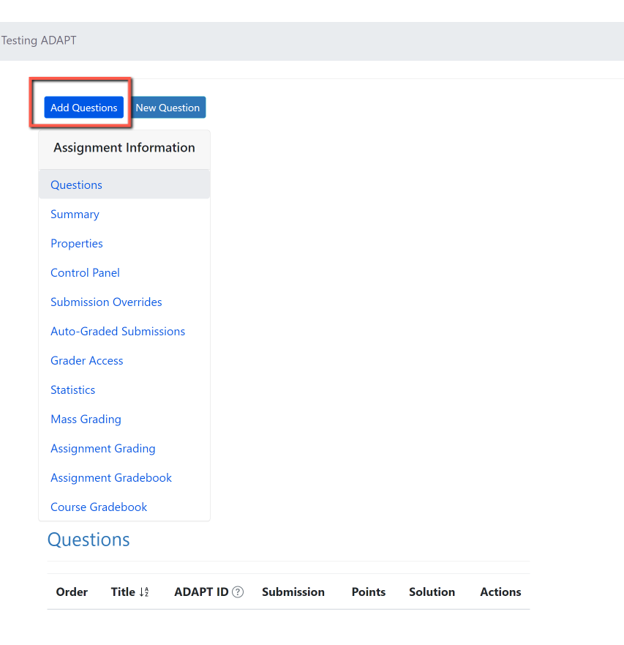
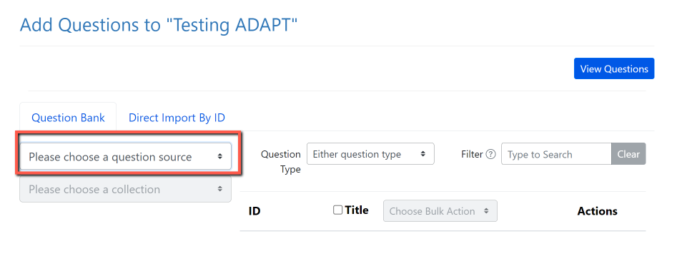
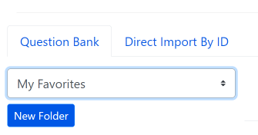
Activity # 2: Add Questions
Step 1: Add Questions
Step 2: Click on “Please choose a question source”
Step 3: Go to “My Favorites” and find the question you saved on activity # 1.
Notes:
12:55

Slide 22
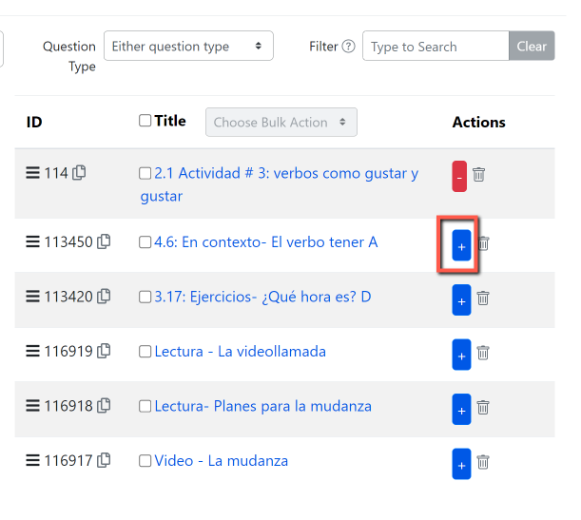
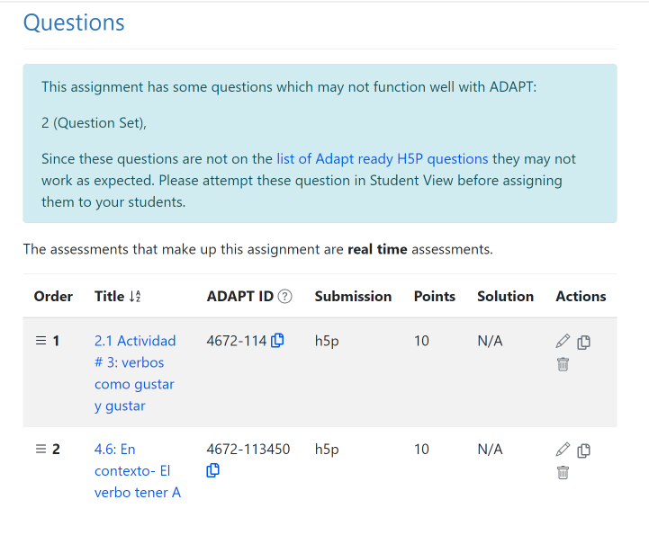
Step 4: Click on the + sign to add the activity to the assignment.

Slide 23
Let’s get to work
4. Create auto-graded ADAPT native questions:
Fill-in the blanks
Select choice
Matching

Slide 24
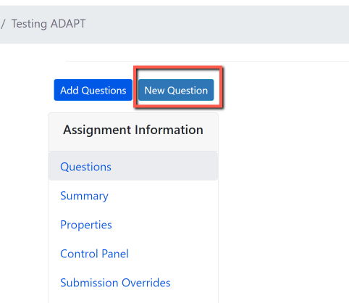
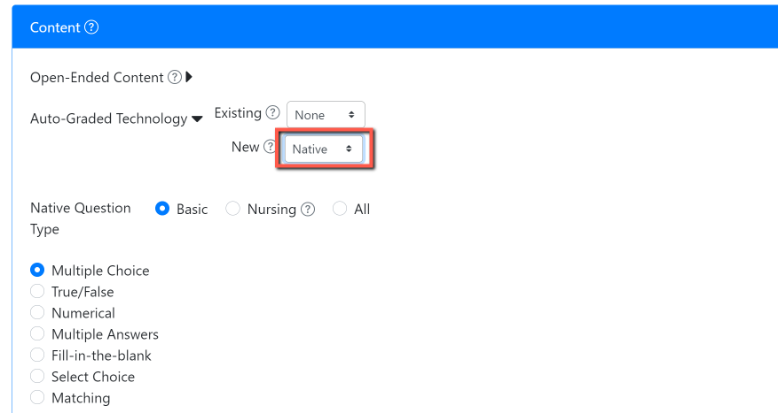
Activity # 3: Create a new auto-graded question in ADAPT
Step # 1: Click on New Question
Step # 2: Select “New” > “Native” question
Notes:
1:05

Slide 25
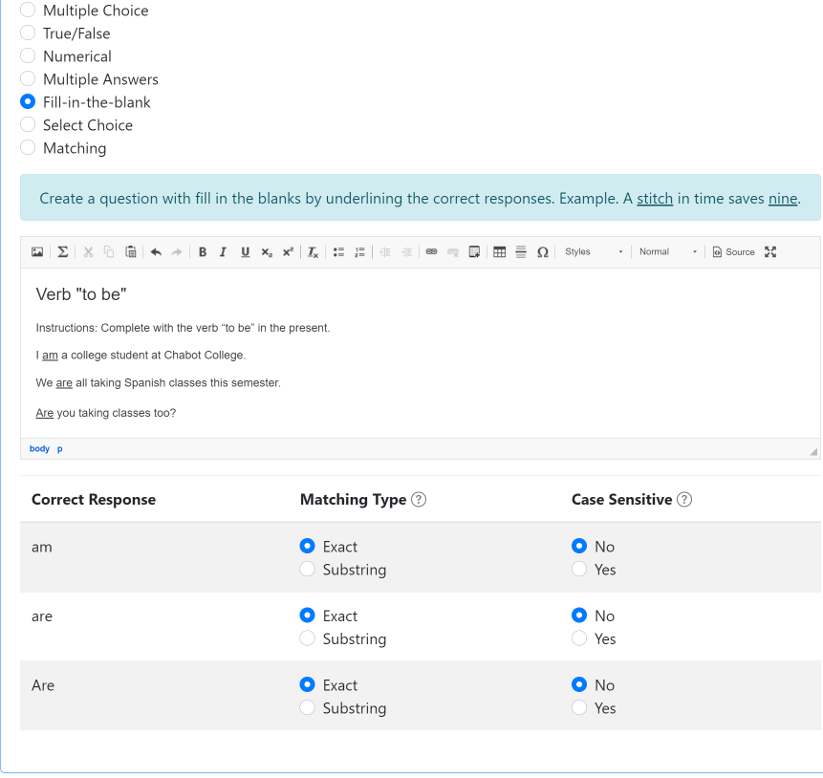
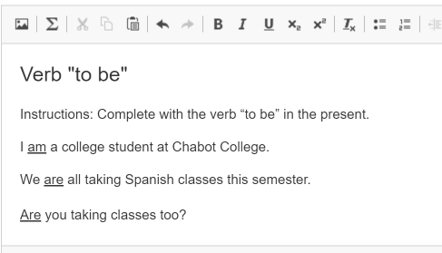
Create a fill-in the blanks activity
Create a question with fill-in-the blanks by underlining the correct responses.

Slide 26
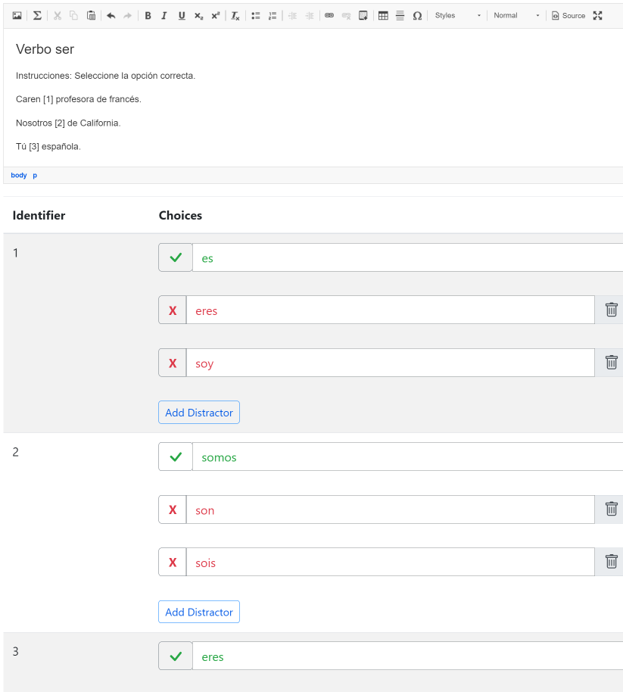
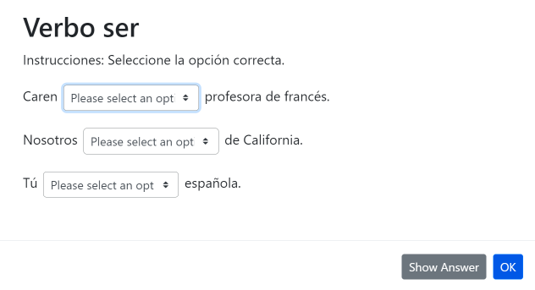
Create a select choice (drop-down) activity
Use brackets for answers. Example. The [planet] is the closest planet to the sun; there are [number-of-planets] planets. Then, add the choices below with your first choice being the correct response. Add distractors. Each student will receive a randomized ordering of the choices.

Slide 27
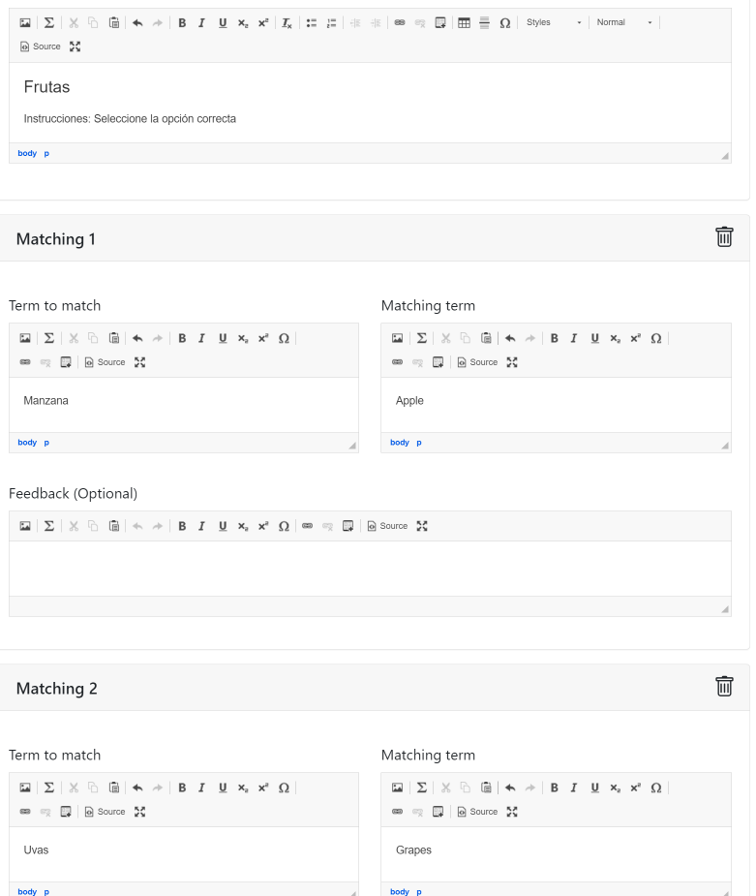
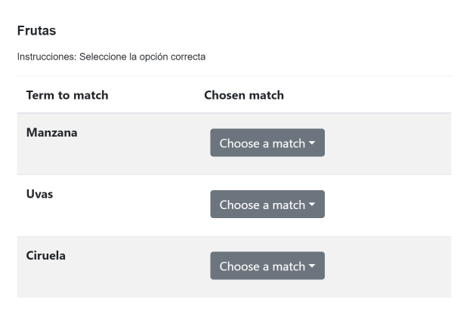
Create a matching
activity
Create a list of terms to match along with their matching terms. Matching terms can include media such as images. Optionally, add distractors which do not satisfy any of the matches.

Slide 28
Let’s get to work
5. Create a Canvas assignment and add ADAPT assignment in Canvas

Slide 29
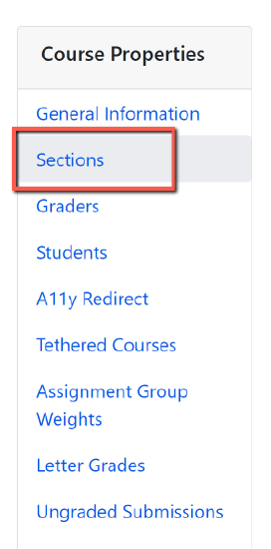
Accessing ADAPT directly
If LTI is not an option for your institution, you and your students can access ADAPT directly by creating an ADAPT account.
Students will need to create a student account.
The instructor will need to provide the Course Access Code. To find the code:
Go to the ADAPT course.
Click on Course Properties (the gear symbol).
Then, click on Sections.
You will find the Course Access Code here.

Slide 30
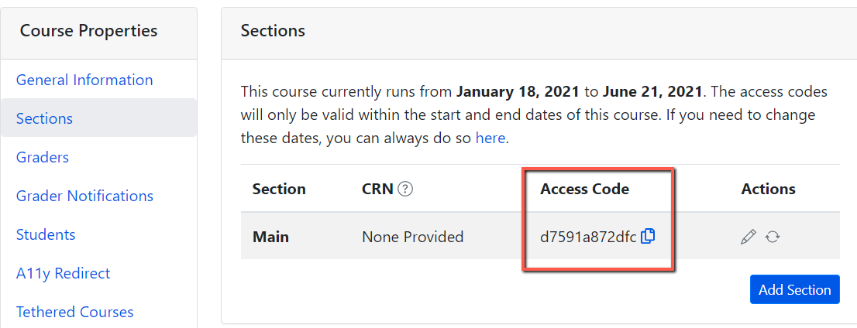
Important: ADAPT Access Code for Students
Go to your ADAPT course > course properties > sections > and get the “Access code”
Share this access code with your students. They will need to enter this code once when accessing ADAPT in Canvas.
Done.

Slide 31
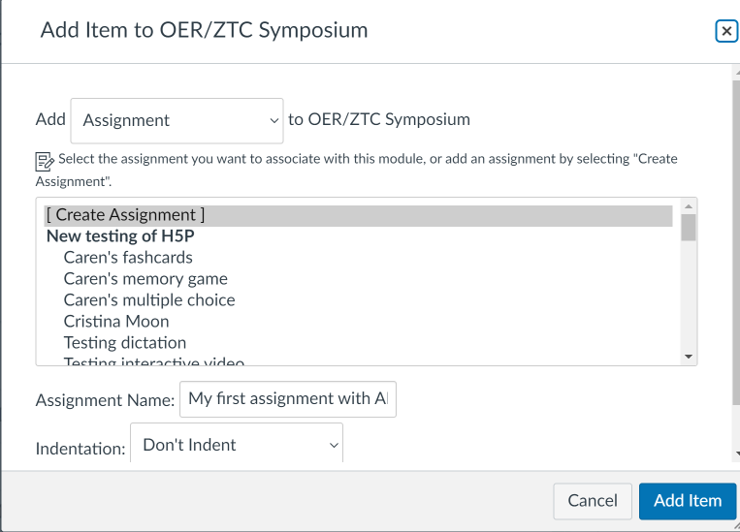
Activity # 4: How to link ADAPT in Canvas
Step # 1: Create an assignment in Canvas. Then edit.
Notes:
1:25

Slide 32
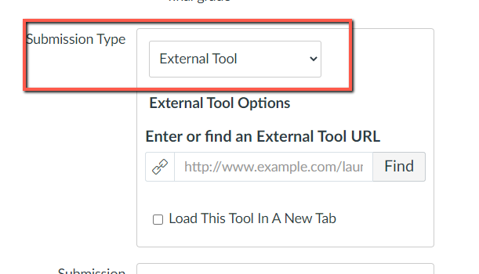
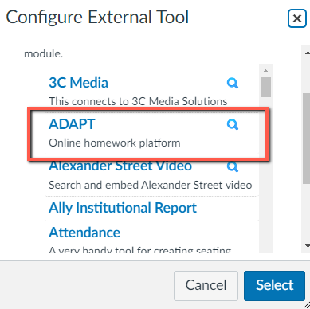
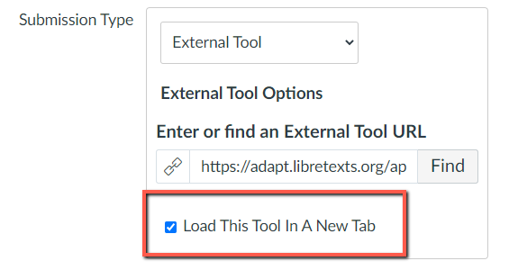
Select ADAPT in External Tool
Step # 2: Edit the assignment and choose “external tool” under submission type.
Step # 3: Click on “find” and look for ADAPT and “select”.
Step # 4: Click on “Load This Tool in A New Tab”

Slide 33
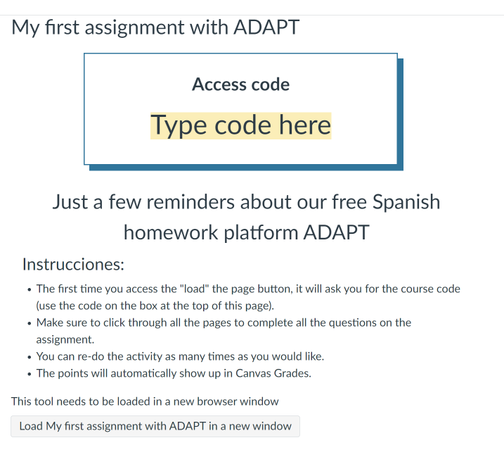
Example of an Assignment Description
This is an example of the description you can include on the assignment.
You should let the students know:
ADAPT Access code
Instructions about the assignment settings such as unlimited attempts.
Students need to click on “Load ….” to open the ADAPT assignment

Slide 34
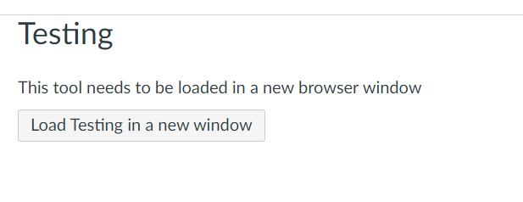
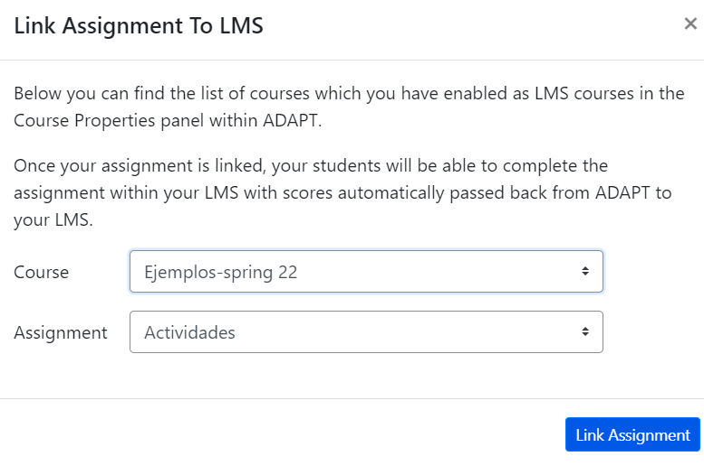
How to select the assignment in Canvas
In Canvas:
Click on “Load”
You will be able to see “Course” and “Assignment” you want to link to Canvas.
Click “Link Assignment”.
Done
This assignment is created and a column will appear in “Grades”.

Slide 35
Looking for more ADAPT resources?

Slide 36
ADAPT resources
Accessibility reports
ADAPT construction guide
Videos created by Prof. Robert Belford:
Bulk Uploading 5 questions from H5P to ADAPT
Adding 5 random questions from H5P to adapt assignment
LibreTexts weekly office hours:
https://zoom.libretexts.org (Tuesdays at 9:00-10:00 Pacific time)
https://zoom.libretexts.org (Thursdays at 9:00-10:00 Pacific time)

Slide 37
Questions?
Cristina Moon
Spanish Faculty
OER/ZTC Coordinator at Chabot College
ASCCC OERI Spanish Lead, H5P/ADAPT Lead, and OERI Liaison
cmoon@chabotcollege.edu

