Slide 1
Anti-Racism in Action
Applying the IDEA Framework
Tiffany Lanoix, IDEA Faculty Lead, Academic Senate for California Community Colleges
9/22/23

Slide 2
Agenda
IDEA Framework Training
IDEA Framework Background & Basics
Assessment Categories
Rubrics
Debrief
The goal is to provide an introduction to the IDEA Framework and how to use it as an assessment tool.

Slide 3
IDEA Framework Background
OERI
Expanding availability and adoption of high-quality OER materials
Freely available online
Support implementation efforts
Professional development, technical support, and technical resources

Slide 4
IDEA Framework
Purpose
Support faculty as they implement culturally responsive and anti-racist pedagogy
Provide a process and review framework to evaluate existing ASCCC OERI-supported materials
Inclusive, diverse, equitable, and anti-racist (IDEA)
Encourage consideration of how we know what we know and how education has been shaped by those in power
Dynamic with an iterative process for review and improvement

Slide 5
What do we mean by IDEA?
Inclusion, diversity, equity and anti-racism
Inclusion: Intentional efforts to ensure students feel welcome, included, respected, and valued
Diversity: Materials are representative of the varied experiences of our diverse student body
Equity: Address issues of access to and relevancy of course materials for historically marginalized groups
Anti-racism: Materials do not attempt to be color-blind or culturally neutral since doing so perpetuates racial and ethnic inequities and white supremacy
Notes:
include the varied experiences of students in a way that recognizes the value, legitimacy, and importance of those experiences
includes, but is not limited to, race and ethnicity, gender, class, ability, sexual orientation, country of origin and cultural affiliations
focused effort on reducing racial and ethnic inequities and dismantling white supremacy

Slide 6
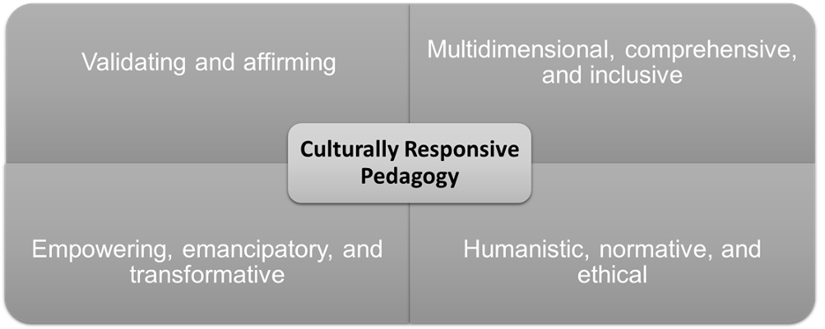

Slide 7
Personal Considerations
What should I keep in mind?
Aware of
Cultural assumptions & privileges
How do these shaped my view of the world and how I think?
Address with continuous training (implicit bias, CRP, etc.)

Slide 8
IDEA Framework Assessment Categories
1. Illustrations and Photos
Reflective of diverse populations and should not perpetuate stereotypes
Examine the number of images and illustrations and the individuals and populations represented
Analyze role, depiction, connotation, expressions of authority, and purpose of the people
Include images of people where the context does not relate to their identity
Notes:
Student can see people like themselves (representation matters)

Slide 9
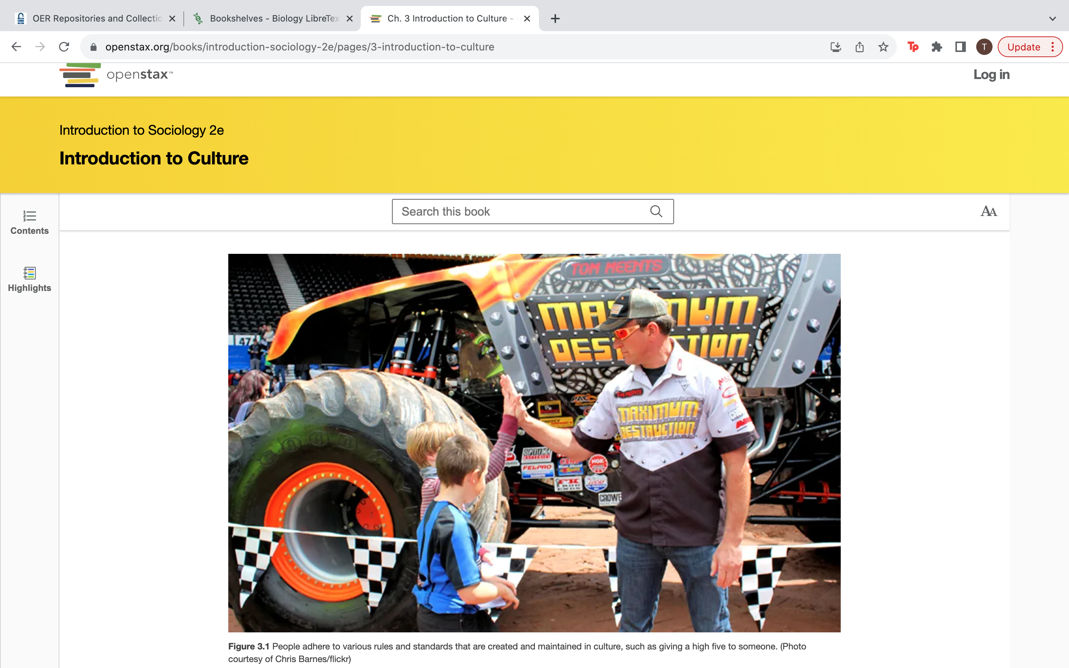

Slide 11
Notes:
https://human.libretexts.org/Bookshelves/Philosophy/Introduction_to_Philosophy_(OpenStax)/10%3A_Applied_Ethics

Slide 12
IDEA Framework Assessment Categories
2. Example Names
Names used for examples, exercises, and scenarios, and should represent various countries of origin, ethnicities, genders, and races and be properly portrayed

Slide 13
IDEA Framework Assessment Categories
3. Gender-Inclusive Language and Use of Pronouns
Use gender-neutral pronouns or language that intentionally dispels gender stereotypes
Reduce/eliminate the use of pronouns
Avoid making gender assumptions

Slide 14
Gender Neutral Exercise
Rewrite to reduce/eliminate the use of pronouns
Galileo’s use of the telescope was his most notable achievement in demonstrating the importance of observation. He discovered moons orbiting Jupiter and made other observations that were inconsistent with certain ancient ideas and religious dogma.
For this reason, and because of the manner in which he dealt with those in authority, Galileo was tried by the Inquisition and punished. He spent the final years of his life under a form of house arrest.
Because others before Galileo had also made discoveries by observing the nature of the universe, and because repeated observations verified those of Galileo, his work could not be suppressed or denied. After his death, his work was verified by others, and his ideas were eventually accepted by the church and scientific communities.
Notes:
https://phys.libretexts.org/Bookshelves/College_Physics/Book%3A_College_Physics_1e_(OpenStax)/04%3A_Dynamics-_Force_and_Newton's_Laws_of_Motion/4.00%3A_Prelude_to_Dynamics-_Newtons_Laws_of_Motion

Slide 15
IDEA Framework Assessment Categories
4. Diverse Authors, Researchers, and Studies
Reference discipline contributors—e.g., researchers, scholars, academics—with backgrounds like those of your students
Include photos/illustrations or description of BIPOC contributors
If the contributions are dominated by cis-hetero white men, openly recognize and discuss in the text
Avoid isolating diverse contributors to specific sections, e.g., “multicultural impacts on psychology.”

Slide 16
IDEA Framework Assessment Categories
5. Applications, Examples, and Problem Scenarios that Relate to Diverse Audiences
Include diverse and relatable examples for students and avoid stereotypes
Analyze terminology, contexts, and situations presented in problems and applications to ensure that they are comprehensible by all populations
Be mindful of assumptions about prior knowledge and experiences

Slide 17
Notes:
https://human.libretexts.org/Bookshelves/Philosophy/Introduction_to_Philosophy_(OpenStax)/12%3A_Contemporary_Philosophies_and_Social_Theories/12.04%3A_The_Frankfurt_School
Could this also be improved?

Slide 18
IDEA Framework Assessment Categories
6. Appropriate Terminology
Examine for derogatory, colloquial, inappropriate, or otherwise incorrect language
For historical uses, consider adding context, such as “a widely-used term at the time”
Strive to not use terminology that reduces a person to something that was done to them or a medical condition they are living with
Slave vs. enslaved; schizophrenic vs. person living with schizophrenia

Slide 19
IDEA Framework Assessment Categories
7. Keyword, Glossary, and Metadata Representation
Ensure that diverse topics and terms are appropriately represented in these sections
Add keywords that specifically highlight issues important to underrepresented groups

Slide 20
IDEA Framework Assessment Categories
8. Incorporating Diverse Perspectives on Issues, Events, and Concepts That Are Relevant to Underrepresented Groups
Diverse populations experience issues such as social problems, health, politics, business practices, and economic conditions that may differ from the mainstream
Include diverse perspectives when presenting controversies, arguments, and opinions for each topic or concept covered

Slide 21
How can we make this discussion more reflective of the experiences of diverse populations?
Notes:
https://socialsci.libretexts.org/Bookshelves/Economics/Principles_of_Macroeconomics_(LibreTexts)/02%3A_Confronting_Scarcity%3A_Choices_in_Production/2.2%3A_The_Production_Possibilities_Curve

Slide 22
Rubrics

Slide 23
Debrief
Reflection
Initial thoughts? What are the big takeaways for you?
What hesitations or concerns do you have about assessing OER materials using the IDEA Framework?
How can ASCCC provide support for your efforts? How can your institution support your efforts?

