Slide 1
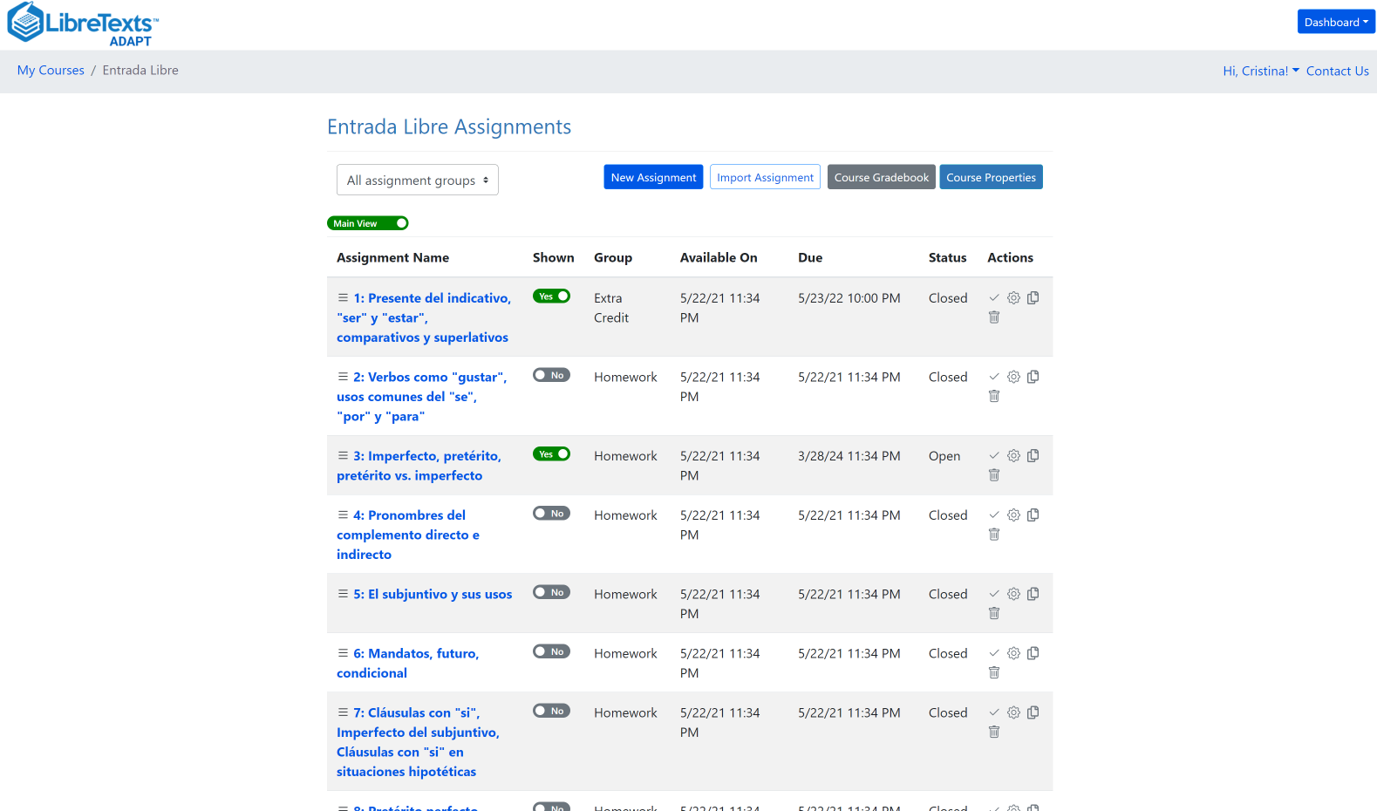
Integrating ADAPT to Canvas
Friday, September 8, 2023

Slide 2
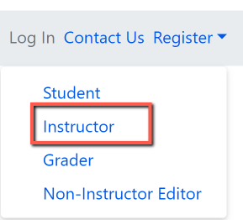
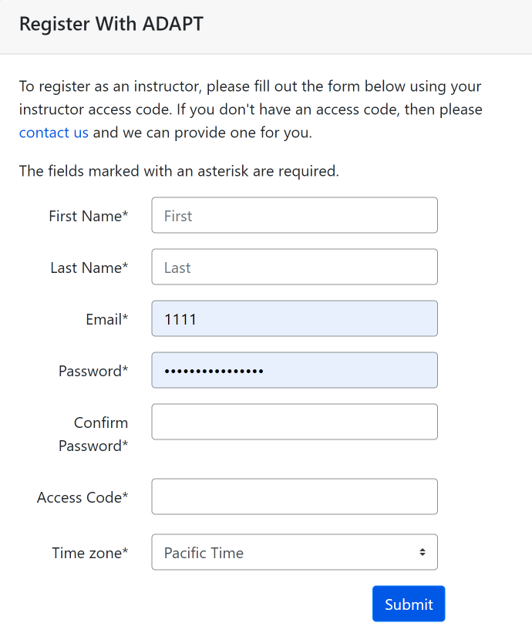
Create an instructor ADAPT account
Go to:
Login · ADAPT (libretexts.org)
Create an instructor account
Access code:
Click on “contact us” and complete the form. Once confirmed, you will receive an email with the access code which you will use to create the ADAPT account

Slide 3
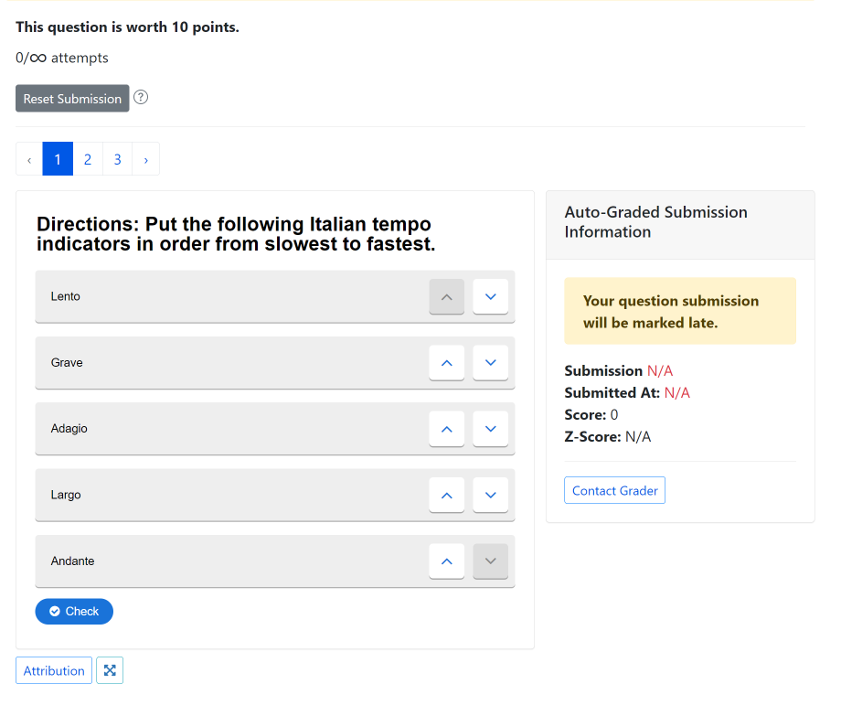
ADAPT in Action

Slide 4
Goals for this webinar
Find ADAPT questions, collections, and public courses.
Create an ADAPT course and set the Gradebook integration with Canvas.
Create an assignment and add existing questions.
Create new ADAPT native questions: multiple choice, select choice, etc.
Create a Canvas assignment and link ADAPT assignment in Canvas.

Slide 5
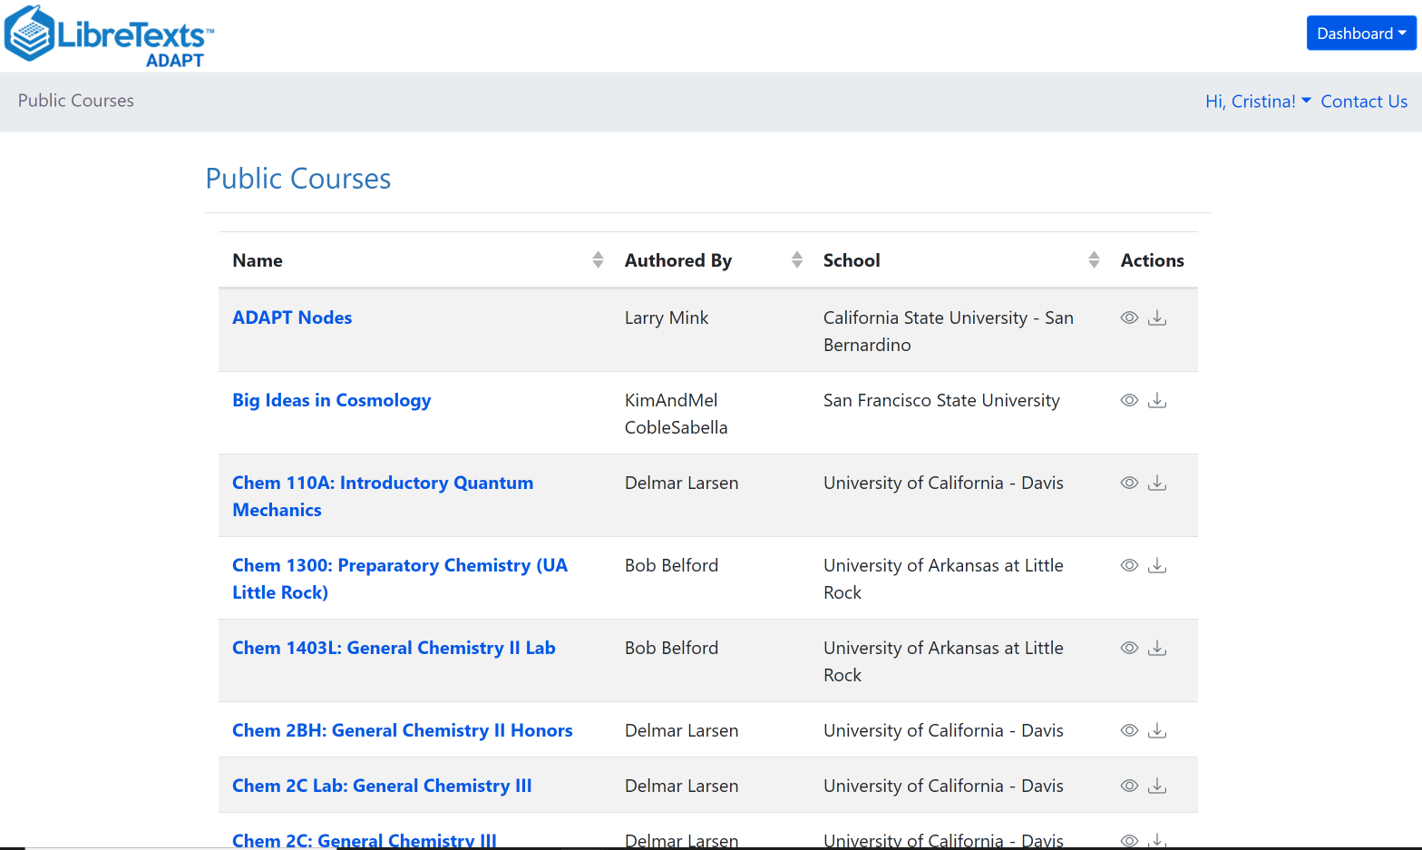
What is ADAPT?
ADAPT is a comprehensive online assessment/homework infrastructure that provides faculty the ability to include auto-graded and non-auto-graded activities from different platforms such as H5P, MyOpenMath, WeBWork, and it’s own native ADAPT questions.
ADAPT can be integrated into an LMS such as Canvas with full grade integration or it could be run independently.

Slide 6
Let’s get to work
Find ADAPT
Questions
Collections
Public courses
Notes:
12:40

Slide 7
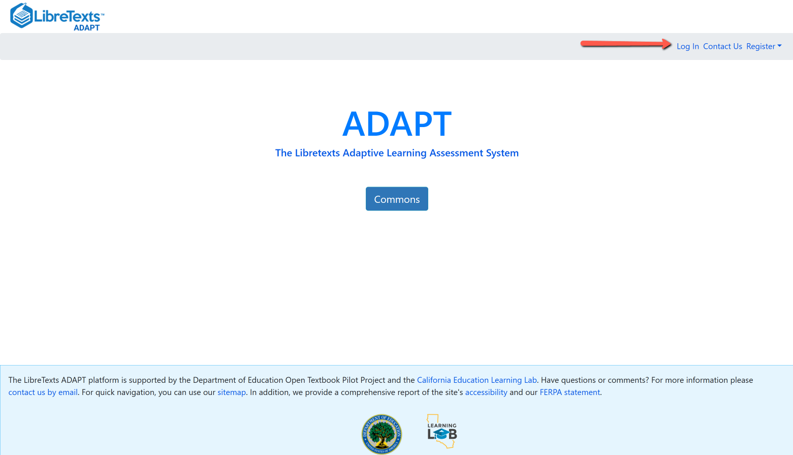
Login to your ADAPT account
Go to:
https://adapt.libretexts.org/login

Slide 8
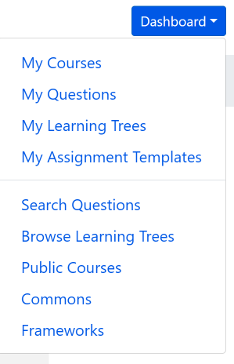
Search for ADAPT questions, collections, and
public courses
Questions: Search among 157,445 ADAPT questions.
Public Courses: Search among shared public courses.
Commons: Search from collections.

Slide 9
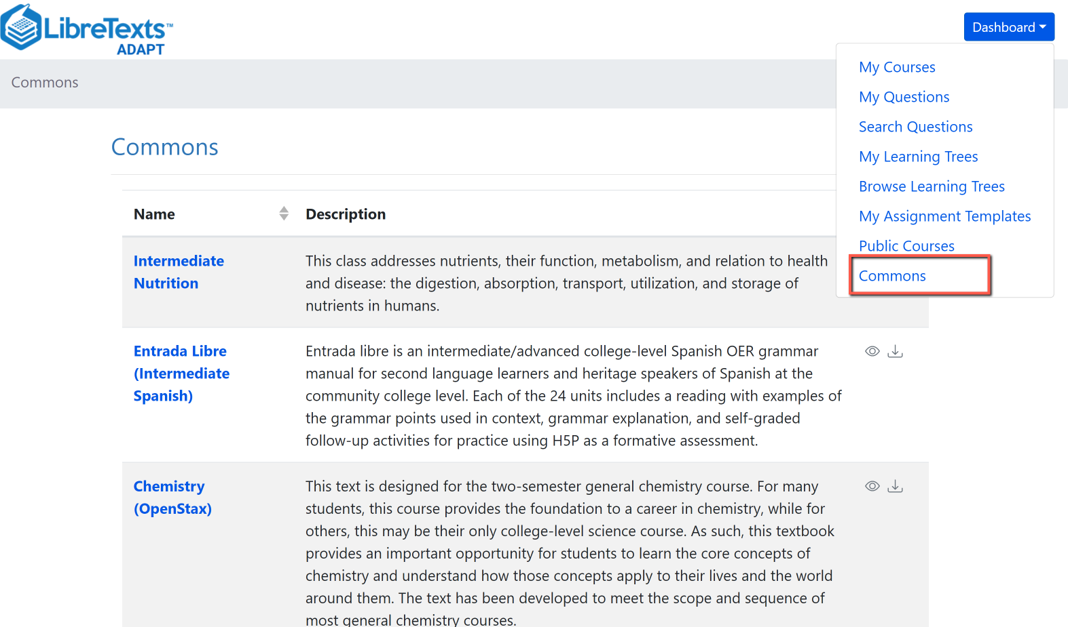
Search in Commons

Slide 10
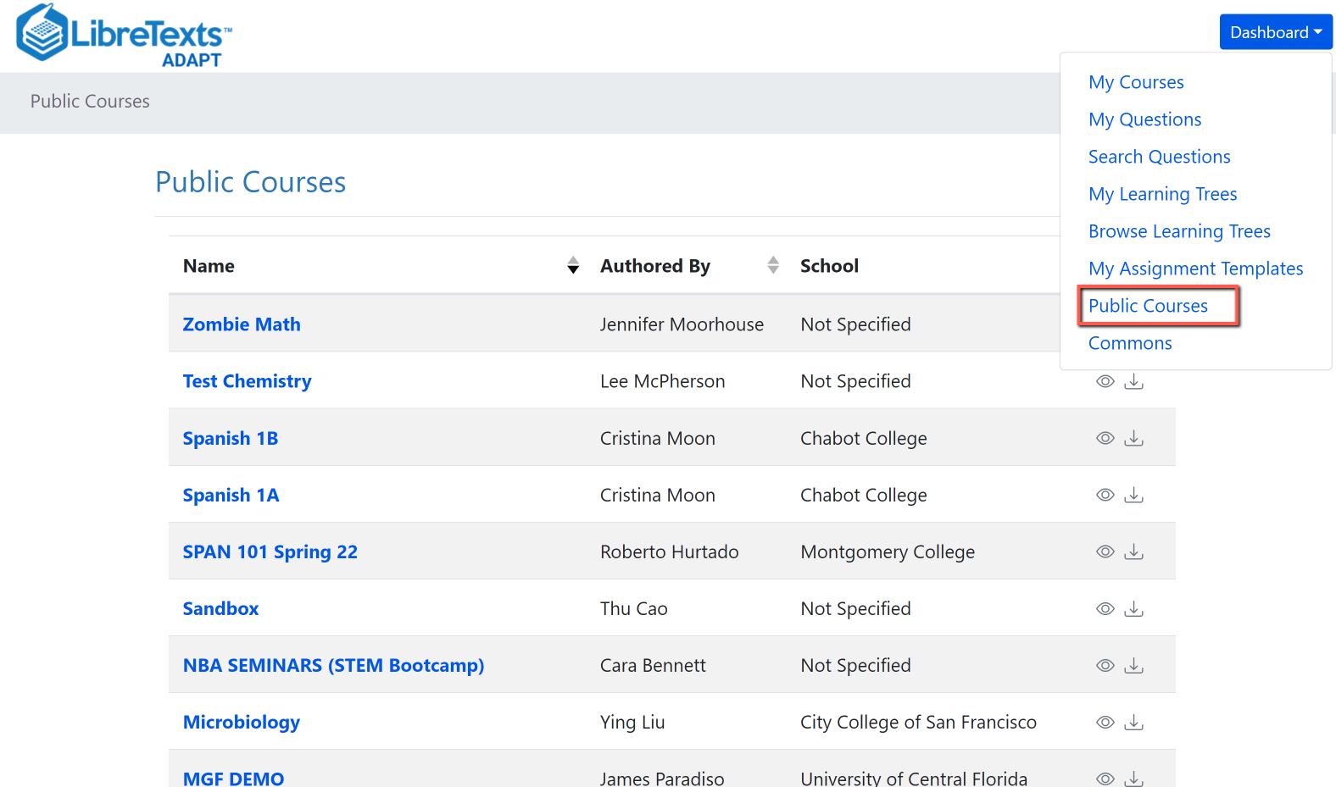
Search Public Courses

Slide 11
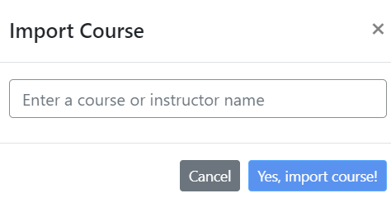
Import an existing course
You can look for public courses that other instructors have shared by going to “Public Courses”.
If you like what you see, you can import the course to your account:
Click on “Import course”
Search for course name or instructor name
Then, import.

Slide 12
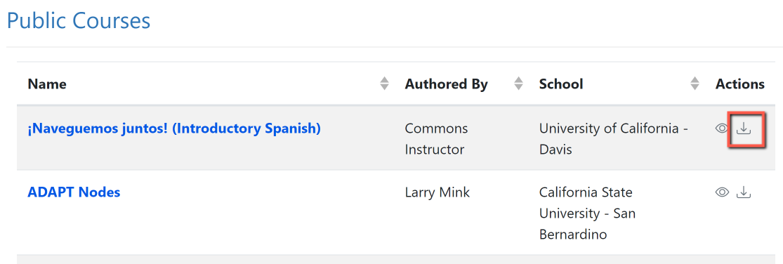
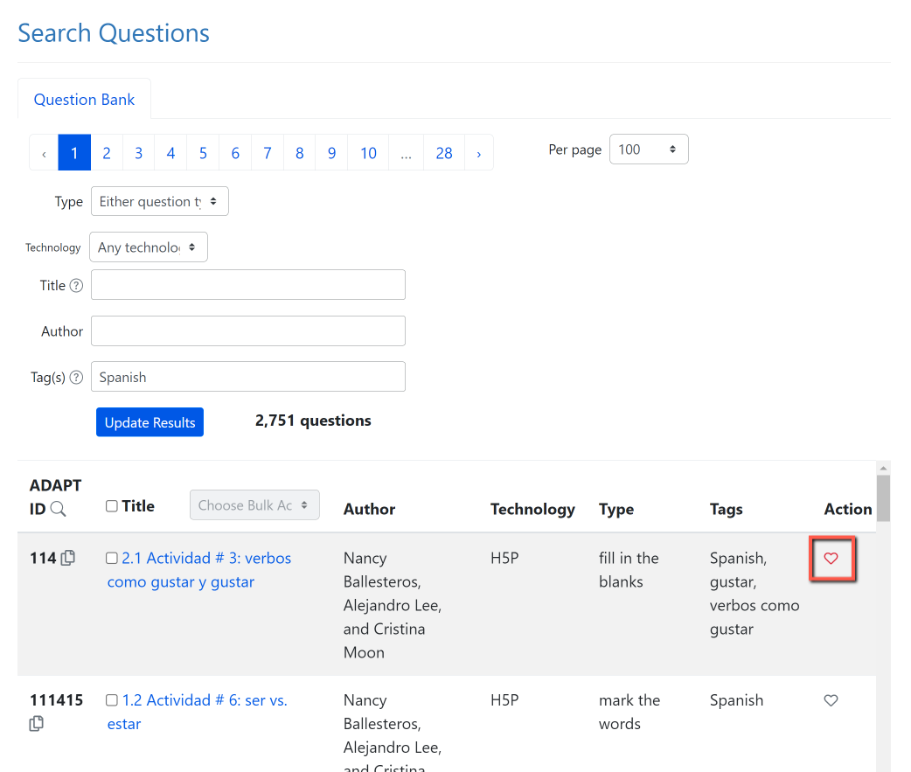
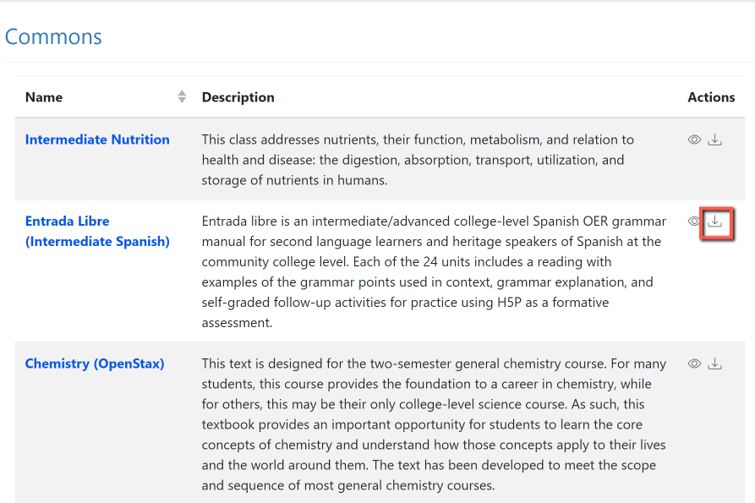
Activity # 1: Now, You Do It …
Search and import a Public Course or a collection from Commons
2. Search for questions and save to favorites.
Notes:
12:45

Slide 13
Let’s get to work
2. Create an ADAPT course and set the Gradebook integration in Canvas

Slide 14
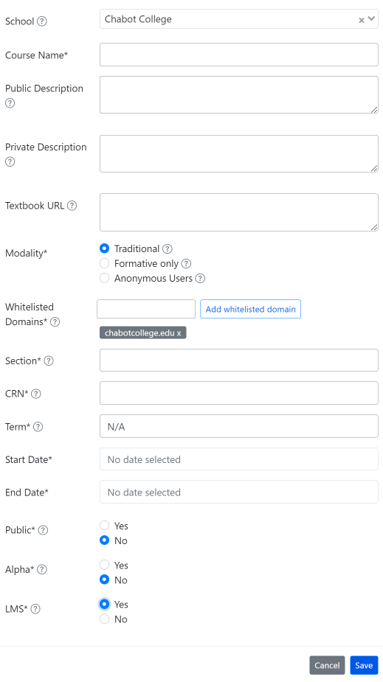
Create an ADAPT course and set the Gradebook integration with Canvas
Enter:
School: find your college if LTI was done
Course Name
Section/CRN
Term
Start/end date
Public: Yes >if you want to share your course with other instructors
LMS: select “Yes” for Canvas integration

Slide 15
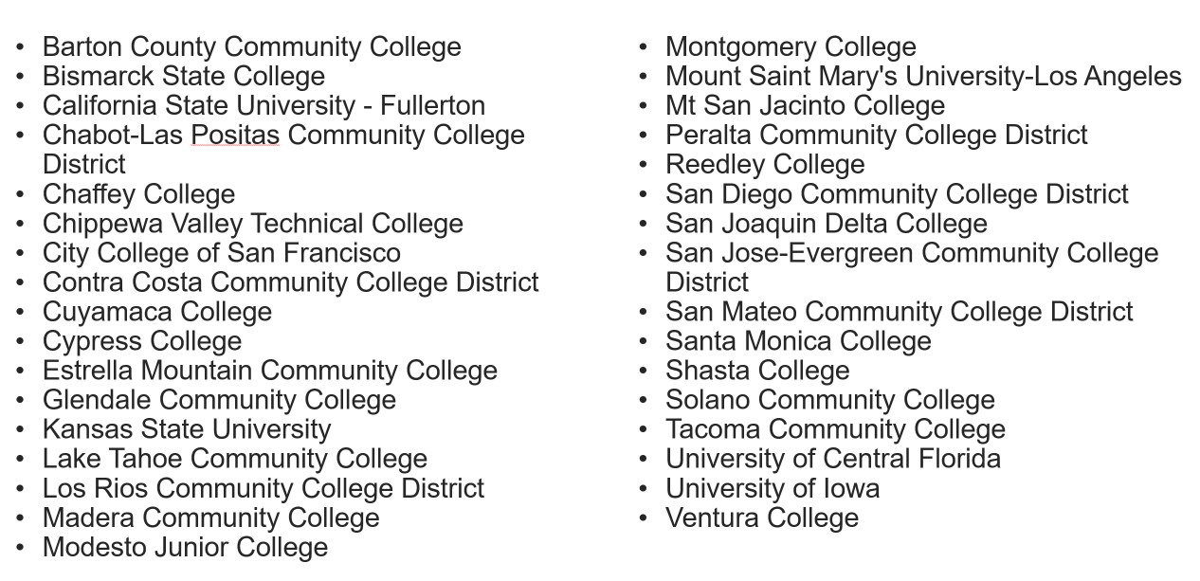
Colleges with Canvas ADAPT LTI (as of 7/31/23)
Updated list as of 9/7/23
Notes:
https://docs.google.com/spreadsheets/d/18dkMl8VCJBvAMKikA_D1XEdLbBz5klRWuVFX9lAWlKw/edit?usp=sharing

Slide 16
Let’s get to work
3. Create an assignment and add existing questions

Slide 17
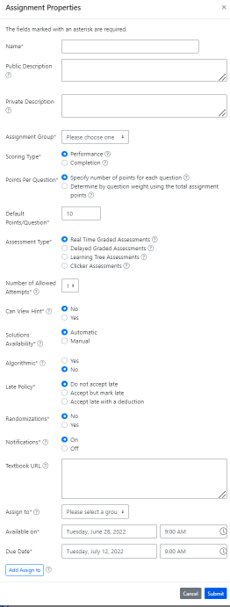
Create a new assignment
Enter:
Name of the assignment
Assignment group
Points (default is 10)
Assessment type
# of allowed attempts
Late policy
Assign to
Available on
Due date

Slide 18
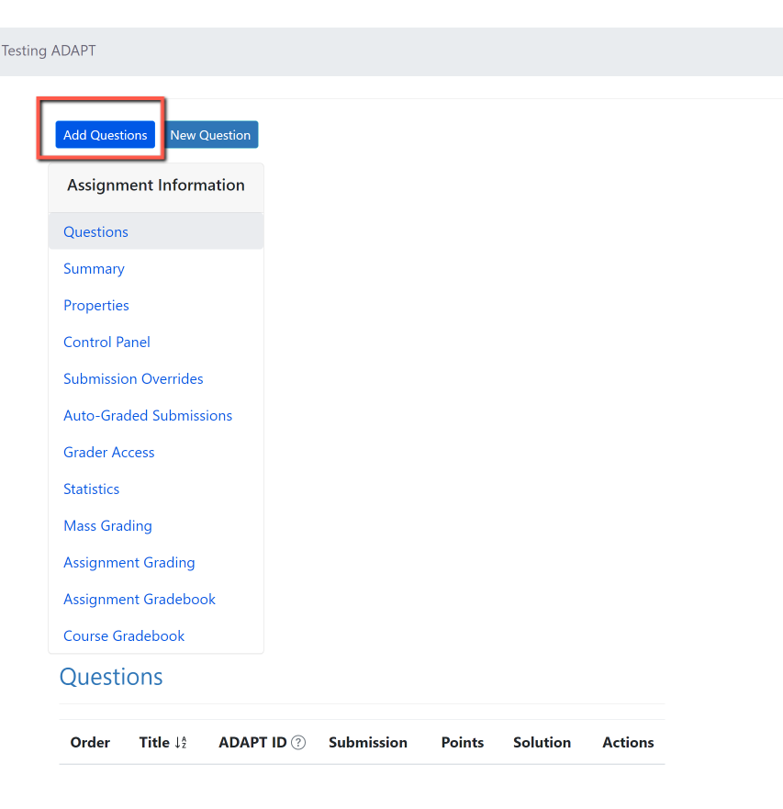
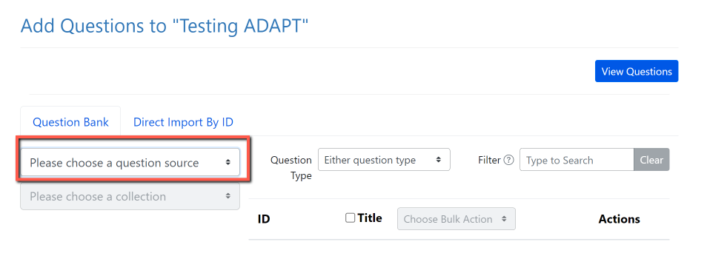
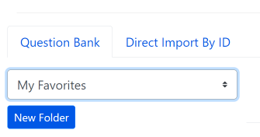
Activity # 2: Add Questions
Step 1: Add Questions
Step 2: Click on “Please choose a question source”
Step 3: Go to “My Favorites” and find the question you saved on activity # 1.
Notes:
12:55

Slide 19
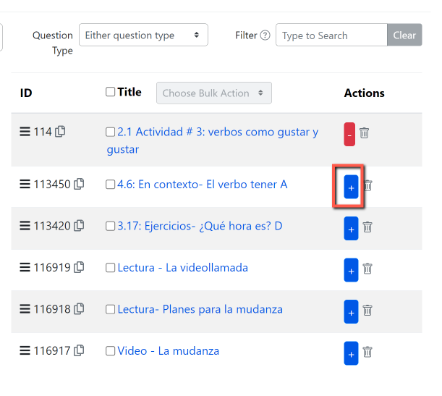
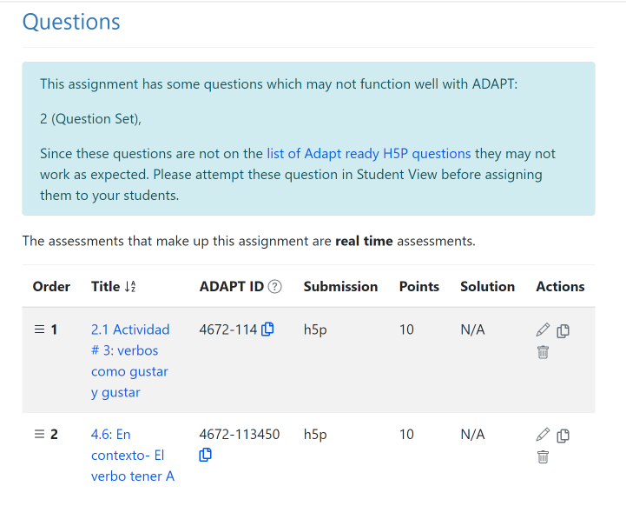
Step 4: Click on the + sign to add the activity to the assignment.

Slide 20
Let’s get to work
4. Create auto-graded ADAPT native questions:
Fill-in the blanks
Select choice
Matching

Slide 21
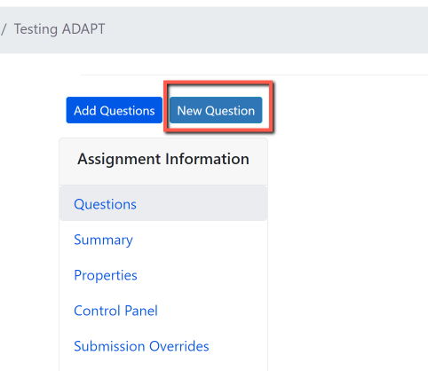
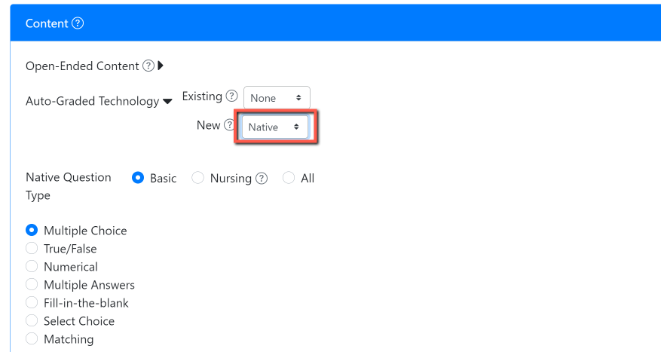
Activity # 3: Create a new auto-graded question in ADAPT
Step # 1: Click on New Question
Step # 2: Select “New” > “Native” question
Notes:
1:05

Slide 22
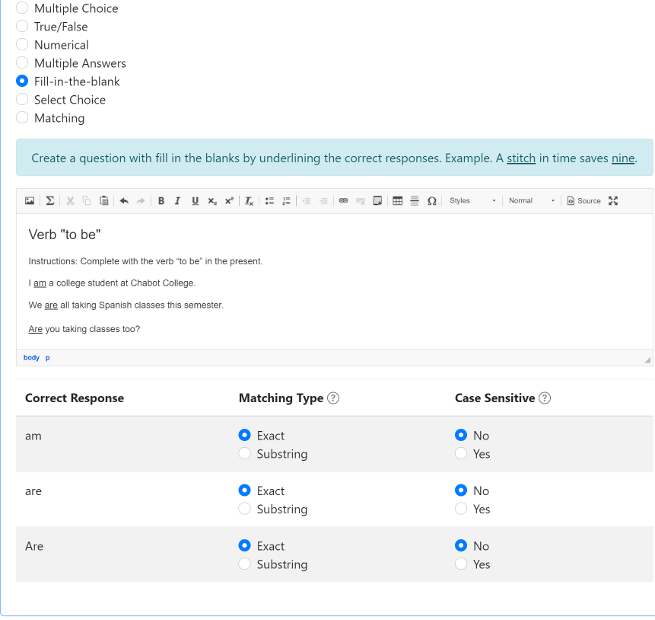
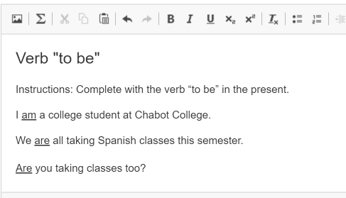
Create a fill-in the blanks activity
Create a question with fill-in-the blanks by underlining the correct responses.

Slide 23
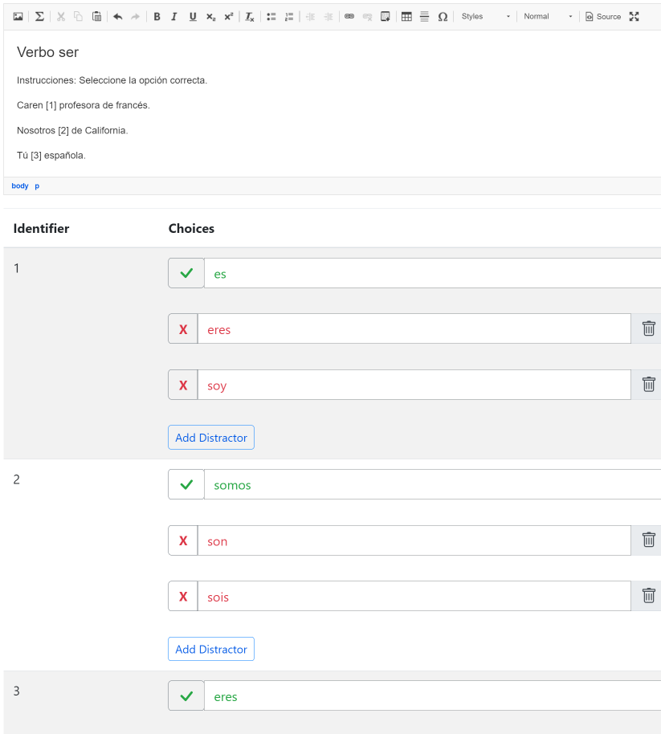
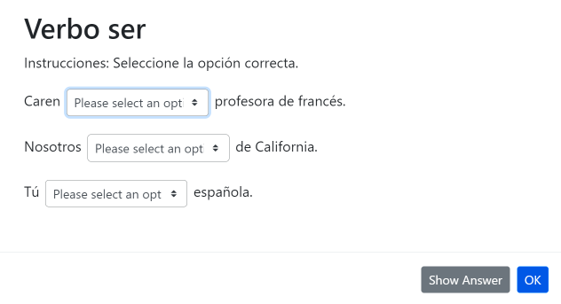
Create a select choice (drop-down) activity
Use brackets for answers. Example. The [planet] is the closest planet to the sun; there are [number-of-planets] planets. Then, add the choices below with your first choice being the correct response. Add distractors. Each student will receive a randomized ordering of the choices.

Slide 24
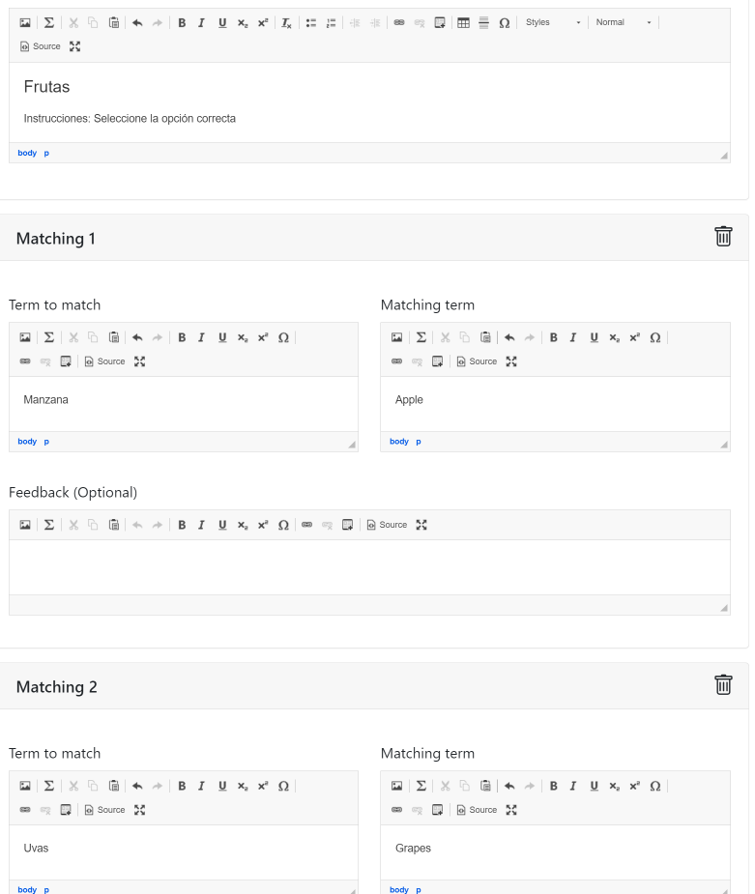
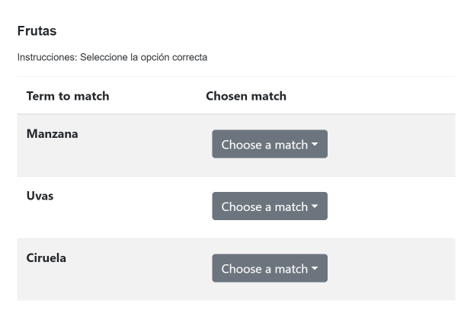
Create a matching
activity
Create a list of terms to match along with their matching terms. Matching terms can include media such as images. Optionally, add distractors which do not satisfy any of the matches.

Slide 25
Let’s get to work
5. Create a Canvas assignment and add ADAPT assignment in Canvas

Slide 26
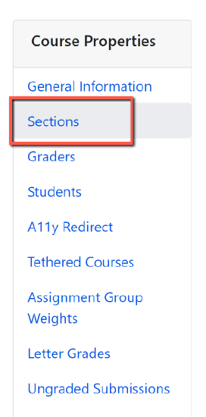
Accessing ADAPT directly
If LTI is not an option for your institution, you and your students can access ADAPT directly by creating an ADAPT account.
Students will need to create a student account.
The instructor will need to provide the Course Access Code. To find the code:
Go to the ADAPT course.
Click on Course Properties (the gear symbol).
Then, click on Sections.
You will find the Course Access Code here.

Slide 27
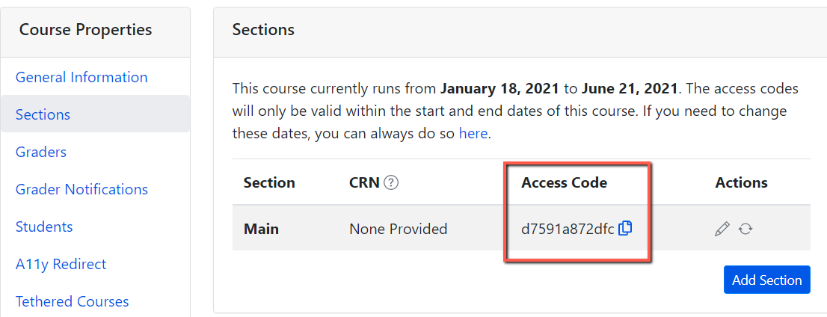
Important: ADAPT Access Code for Students
Go to your ADAPT course > course properties > sections > and get the “Access code”
Share this access code with your students. They will need to enter this code once when accessing ADAPT in Canvas.
Done.

Slide 28
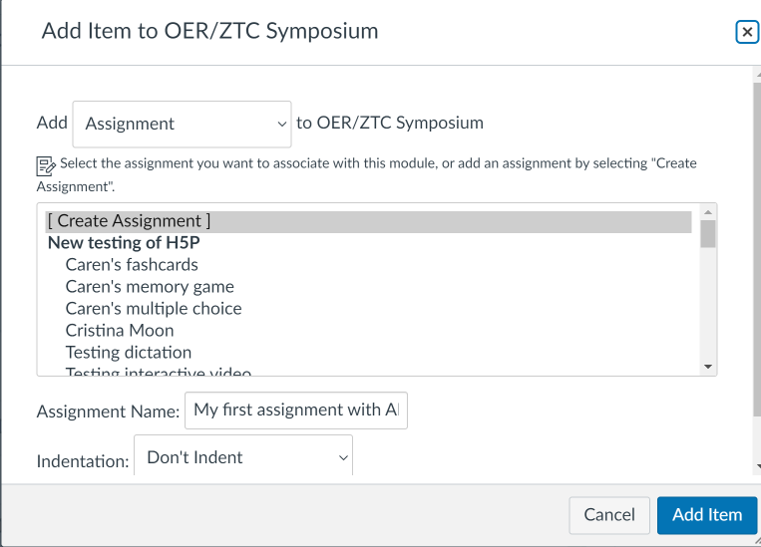
Activity # 4: How to link ADAPT in Canvas
Step # 1: Create an assignment in Canvas. Then edit.
Notes:
1:25

Slide 29
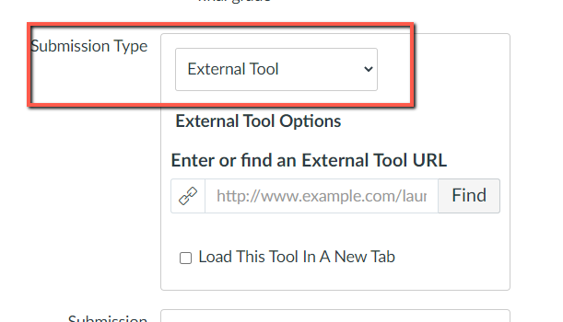
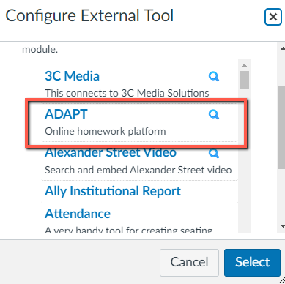
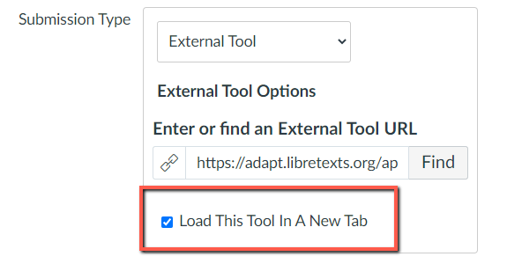
Select ADAPT in External Tool
Step # 2: Edit the assignment and choose “external tool” under submission type.
Step # 3: Click on “find” and look for ADAPT and “select”.
Step # 4: Click on “Load This Tool in A New Tab”

Slide 30
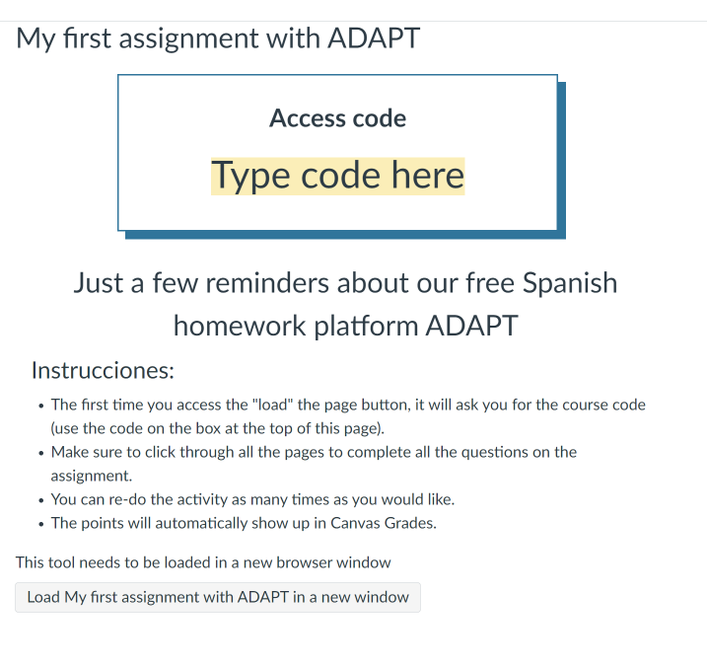
Example of an Assignment Description
This is an example of the description you can include on the assignment.
You should let the students know:
ADAPT Access code
Instructions about the assignment settings such as unlimited attempts.
Students need to click on “Load ….” to open the ADAPT assignment

Slide 31
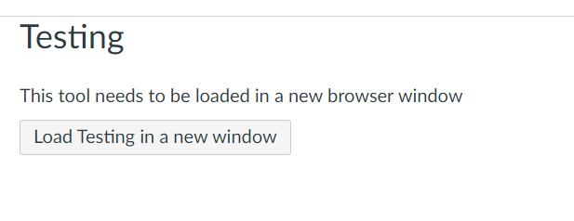
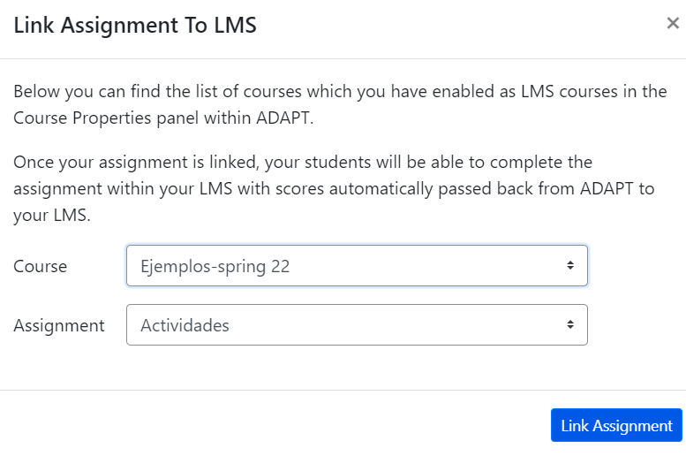
How to select the assignment in Canvas
In Canvas:
Click on “Load”
You will be able to see “Course” and “Assignment” you want to link to Canvas.
Click “Link Assignment”.
Done
This assignment is created and a column will appear in “Grades”.

Slide 32
Have Questions?
H5P/LibreStudio and ADAPT Office Hours
Friday, September 15, 2023 from 1:00 pm – 2:00 pm
Register for H5P/LibreStudio and ADAPT Office Hours

Slide 33
Looking for more ADAPT resources?

Slide 34
ADAPT resources
Accessibility reports
ADAPT construction guide
Videos created by Prof. Robert Belford:
Bulk Uploading 5 questions from H5P to ADAPT
Adding 5 random questions from H5P to adapt assignment
LibreTexts weekly office hours:
https://zoom.libretexts.org (Tuesdays at 9:00-10:00 Pacific time)
https://zoom.libretexts.org (Thursdays at 9:00-10:00 Pacific time)

Slide 35
More Questions?
Cristina Moon
Spanish Faculty
OER/ZTC Coordinator at Chabot College
ASCCC OERI Spanish Lead, H5P/ADAPT Lead, and OERI Liaison
cmoon@chabotcollege.edu

