Slide 1
Welcome!
On behalf of the ASCCC OERI, we are pleased to have you here with us for “The Zero Textbook Cost (ZTC) Program – Sustainability, Updating Content, and Duplication”
If you are not already muted, please mute yourself upon arrival.
Please use the “chat” feature to share your questions.

Slide 2
The Zero Textbook Cost (ZTC) Program – Sustainability, Updating Content, and Duplication
ASCCC OERI Friday Forum; Friday, September 15, 2023; 10:30 am – 11:30 am
This work is licensed under a Creative Commons Attribution 4.0 International License.

Slide 3
Description
California Education Code 78052 allocated to the California Community Colleges $115 million to “develop and implement zero-textbook-cost degrees and develop open educational resources.” It also introduced the further requirements including that districts…

Slide 4
That districts….
“[d]evelop degrees with consideration for sustainability after grant funding is exhausted, including how content is updated and presented,” and that “[t]he chancellor’s office shall ensure that a grant does not result in the development or implementation of duplicate degrees for a subject matter to avoid duplication of effort and ensure the development and implementation of the greatest number of degrees for the benefit of the greatest number of students.”

Slide 5
So…
In practical terms, what does this mean for your local ZTC efforts? Join us for a lively conversation about avoiding duplication and ensuring currency and sustainability in our ZTC Program efforts.
Photo by That's Her Business on Unsplash

Slide 6
Your Presenters
Shagun Kaur
Project Facilitator, ASCCC Open Educational Resources Initiative
Communication Studies, DeAnza College
Suzanne Wakim
Project Facilitator, ASCCC Open Educational Resources Initiative
Biology, Butte College

Slide 7
Overview
Language – Legislation Vs Reality
Sustainability
Duplication
Maximizing Benefits
Q and A

Slide 8
Language
We’re not “developing degrees” – most of our degrees were developed a long time ago. “Developing” is a component of the curriculum process.
“Implementing” a ZTC pathway means faculty have chosen course resources for individual course sections such that they are not passing costs for textbooks and supplemental resources on to students.

Slide 9
Sustainability
What does it mean for a ZTC course to be “sustainable”?
Photo by Edward Howell on Unsplash
Notes:
Ask audience… What does it mean?

Slide 10
How do you…
“[d]evelop degrees courses with consideration for sustainability after grant funding is exhausted, including how content is updated and presented”
What does this statement presume?
Only openly-licensed resources allow faculty to update resources as needed.
Notes:
How do you do it?

Slide 11
Is there an on-going cost to maintaining OER?
Photo by micheile henderson on Unsplash

Slide 12
How can updating be supported?
Centralized tracking of needed updates
Google doc/sheet
LibreTexts
COOL4Ed
Flex credit, sabbatical, units
Others?
Notes:
This slide focuses on approaches that don’t require money.

Slide 13
Funding Sources and Plans
OER/ZTC should be an identified priority.
Ask you administration about potential funding sources.
OER/ZTC should be integrated into all your plans – master, equity, guided pathways, program plans, etc.
While you are unlikely to find a dedicated funding stream, ensuring access to various sources of funding is a step toward sustainability.
Ensure your allies are everywhere. Don’t be forgotten.

Slide 14
Integrating OER and/or ZTC
SDCCD Strategic Plan – “Increase the use of “OER and zero textbook” classes to facilitate program access.”
RSCCD Strategic Plan - Objective 3D:
Increase support for Distance Education and Open Educational Resources (OER).
Number of faculty trained annually to teach online courses
Number of OER classes/degree pathways offered
De Anza Student Equity Plan –
OER coordinator
The Affordable Texts and Materials initiative, in partnership with the Bookstore and Library, …
The OER coordinator and OER team, with support from the college administration…
The initiative will also leverage state and regional resources to increase the number of courses using these materials

Slide 15
What about when you can’t get to zero with OER…
…modern literature…
…or printing is a must? (e.g., sheet music, lab manuals)
OER and ZTC should be integrated into all your plans.
Photo by Lucas Alexander on Unsplash

Slide 16
Related Considerations
XB12 – when modified to allow for more effective tracking of how resources got to zero – will enable colleges to track how both OER and college purchases (e.g., library resources, print cost) were used to achieve zero.
Such tracking can inform future investments.
Ed Code says that faculty should consider practices in selecting textbooks that will result in lower costs to students: “It is the intent of the Legislature to … encourage faculty to consider practices in selecting textbooks that will result in the lowest costs to students.”

Slide 17
Legislated Expectations
“[t]he chancellor’s office shall ensure that a grant does not result in:
the development or implementation of duplicate degrees for a subject matter to avoid duplication of effort and
ensure the development and implementation of the greatest number of degrees for the benefit of the greatest number of students.”
Notes:
The above is a quote from the legislation.

Slide 18
Why is duplication mentioned?
During the prior ZTC program, nothing was done to encourage or ensure sharing.
How do you encourage sharing?
Professional development is critical.
Sharing needs to happen in a transparent, accessible, and clearly defined place.

Slide 19
What happened before?
Despite working with a relatively small amount of money and employing a competitive process, no efforts appear to have been made to ensure colleges were not duplicating effort.
For example – at least 5 colleges were focusing on early childhood education (ECE) – but we don’t now have a wealth of ECE options.

Slide 20
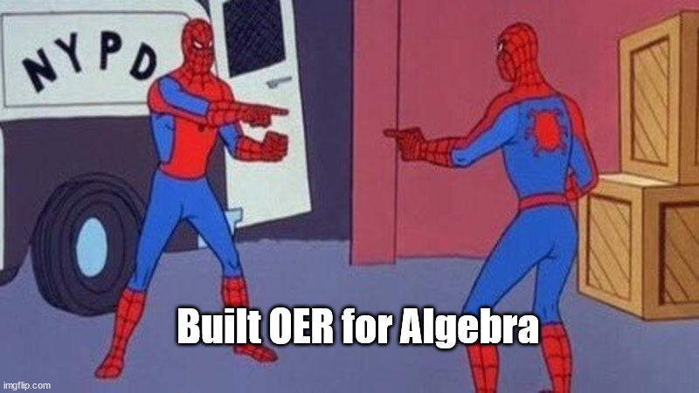
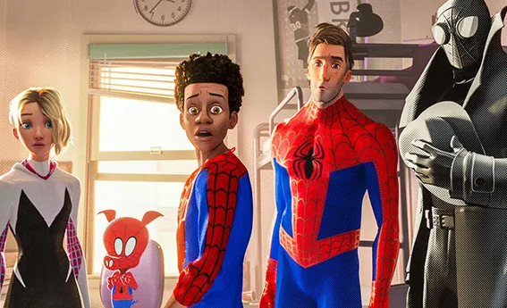
Ideally…
How should we define “duplication”?
And how could/should duplication be prevented?

Slide 21
Coordination and Collaboration
Everyone should be sharing how they are getting courses to zero – to avoid duplication of effort and “to ensure the development and implementation of the greatest number of degrees for the benefit of the greatest number of students.”
How do we make that happen?

Slide 22
How could we work together…
to address the elements of the legislation that have not been adequately addressed?
Photo by Alwi Alaydrus on Unsplash
Notes:
It’s not too late to right this sinking ship…

Slide 23
OERI – your partner in sustainability.
Connection
Curation
Training – licensing, accessibility, platform
Project management

Slide 24
Does duplication mean….
… we shouldn’t be working on the same degrees or CTE certificates?
… we should prioritize pathways that are unique to our colleges?
… we need to cyber-stalk one another as we identify the ZTC pathways we want to develop?

Slide 25
Don’t forget…
… the goal is to achieve the maximum benefit – for the greatest number of students.
What does that mean for you – and your college?
Maximizing benefit only happens when we leverage our existing statewide OER infrastructure, the OERI.

Slide 26
Photo by Alexander Grey on Unsplash

