Slide 1
The IDEA Framework Assessment Process
Tiffany Lanoix, IDEA Faculty Lead
Lara Braff, Regional Lead (Area D) and Liaison
Academic Senate for California Community Colleges-OERI
10/20/23

Slide 2
Agenda
IDEA Framework Training
IDEA Basics
IDEA Assessment
IDEA Assessment Experience
Debrief
The goal is to provide an overview of the IDEA Framework assessment process

Slide 3
IDEA Framework
Purpose
Support faculty as they implement culturally responsive and anti-racist pedagogy
Provide a process and review framework to evaluate new & existing ASCCC OERI-supported materials
Inclusive, diverse, equitable, and anti-racist (IDEA)
Self assessment & assessment through the ASCCC

Slide 4
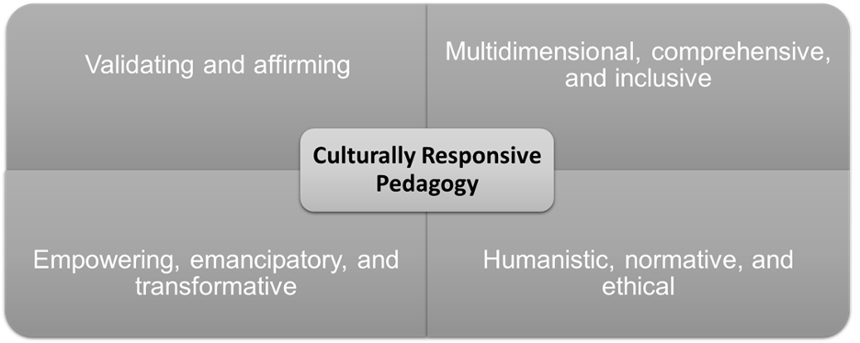

Slide 5
What do we mean by IDEA?
Inclusion, diversity, equity and anti-racism
Inclusion: Intentional efforts to ensure students feel welcome, included, respected, and valued
Diversity: Materials are representative of the varied experiences of our diverse student body
Equity: Address issues of access to and relevancy of course materials for historically marginalized groups
Anti-racism: Materials do not attempt to be color-blind or culturally neutral since doing so perpetuates racial and ethnic inequities and white supremacy
Notes:
include the varied experiences of students in a way that recognizes the value, legitimacy, and importance of those experiences
includes, but is not limited to, race and ethnicity, gender, class, ability, sexual orientation, country of origin and cultural affiliations
focused effort on reducing racial and ethnic inequities and dismantling white supremacy

Slide 6
IDEA Framework
Assessment Categories
Illustrations and Photos
Example Names
Gender Inclusive Language & Use of Pronouns
Diverse Authors, Researchers, & Studies
Applications, Examples and Problem Scenarios That Relate to Diverse Audiences
Appropriate Terminology
Keyword, Glossary, & Metadata Representation
Incorporating Diverse Perspectives on Issues, Events, & Concepts That Are Relevant to Underrepresented Groups

Slide 7
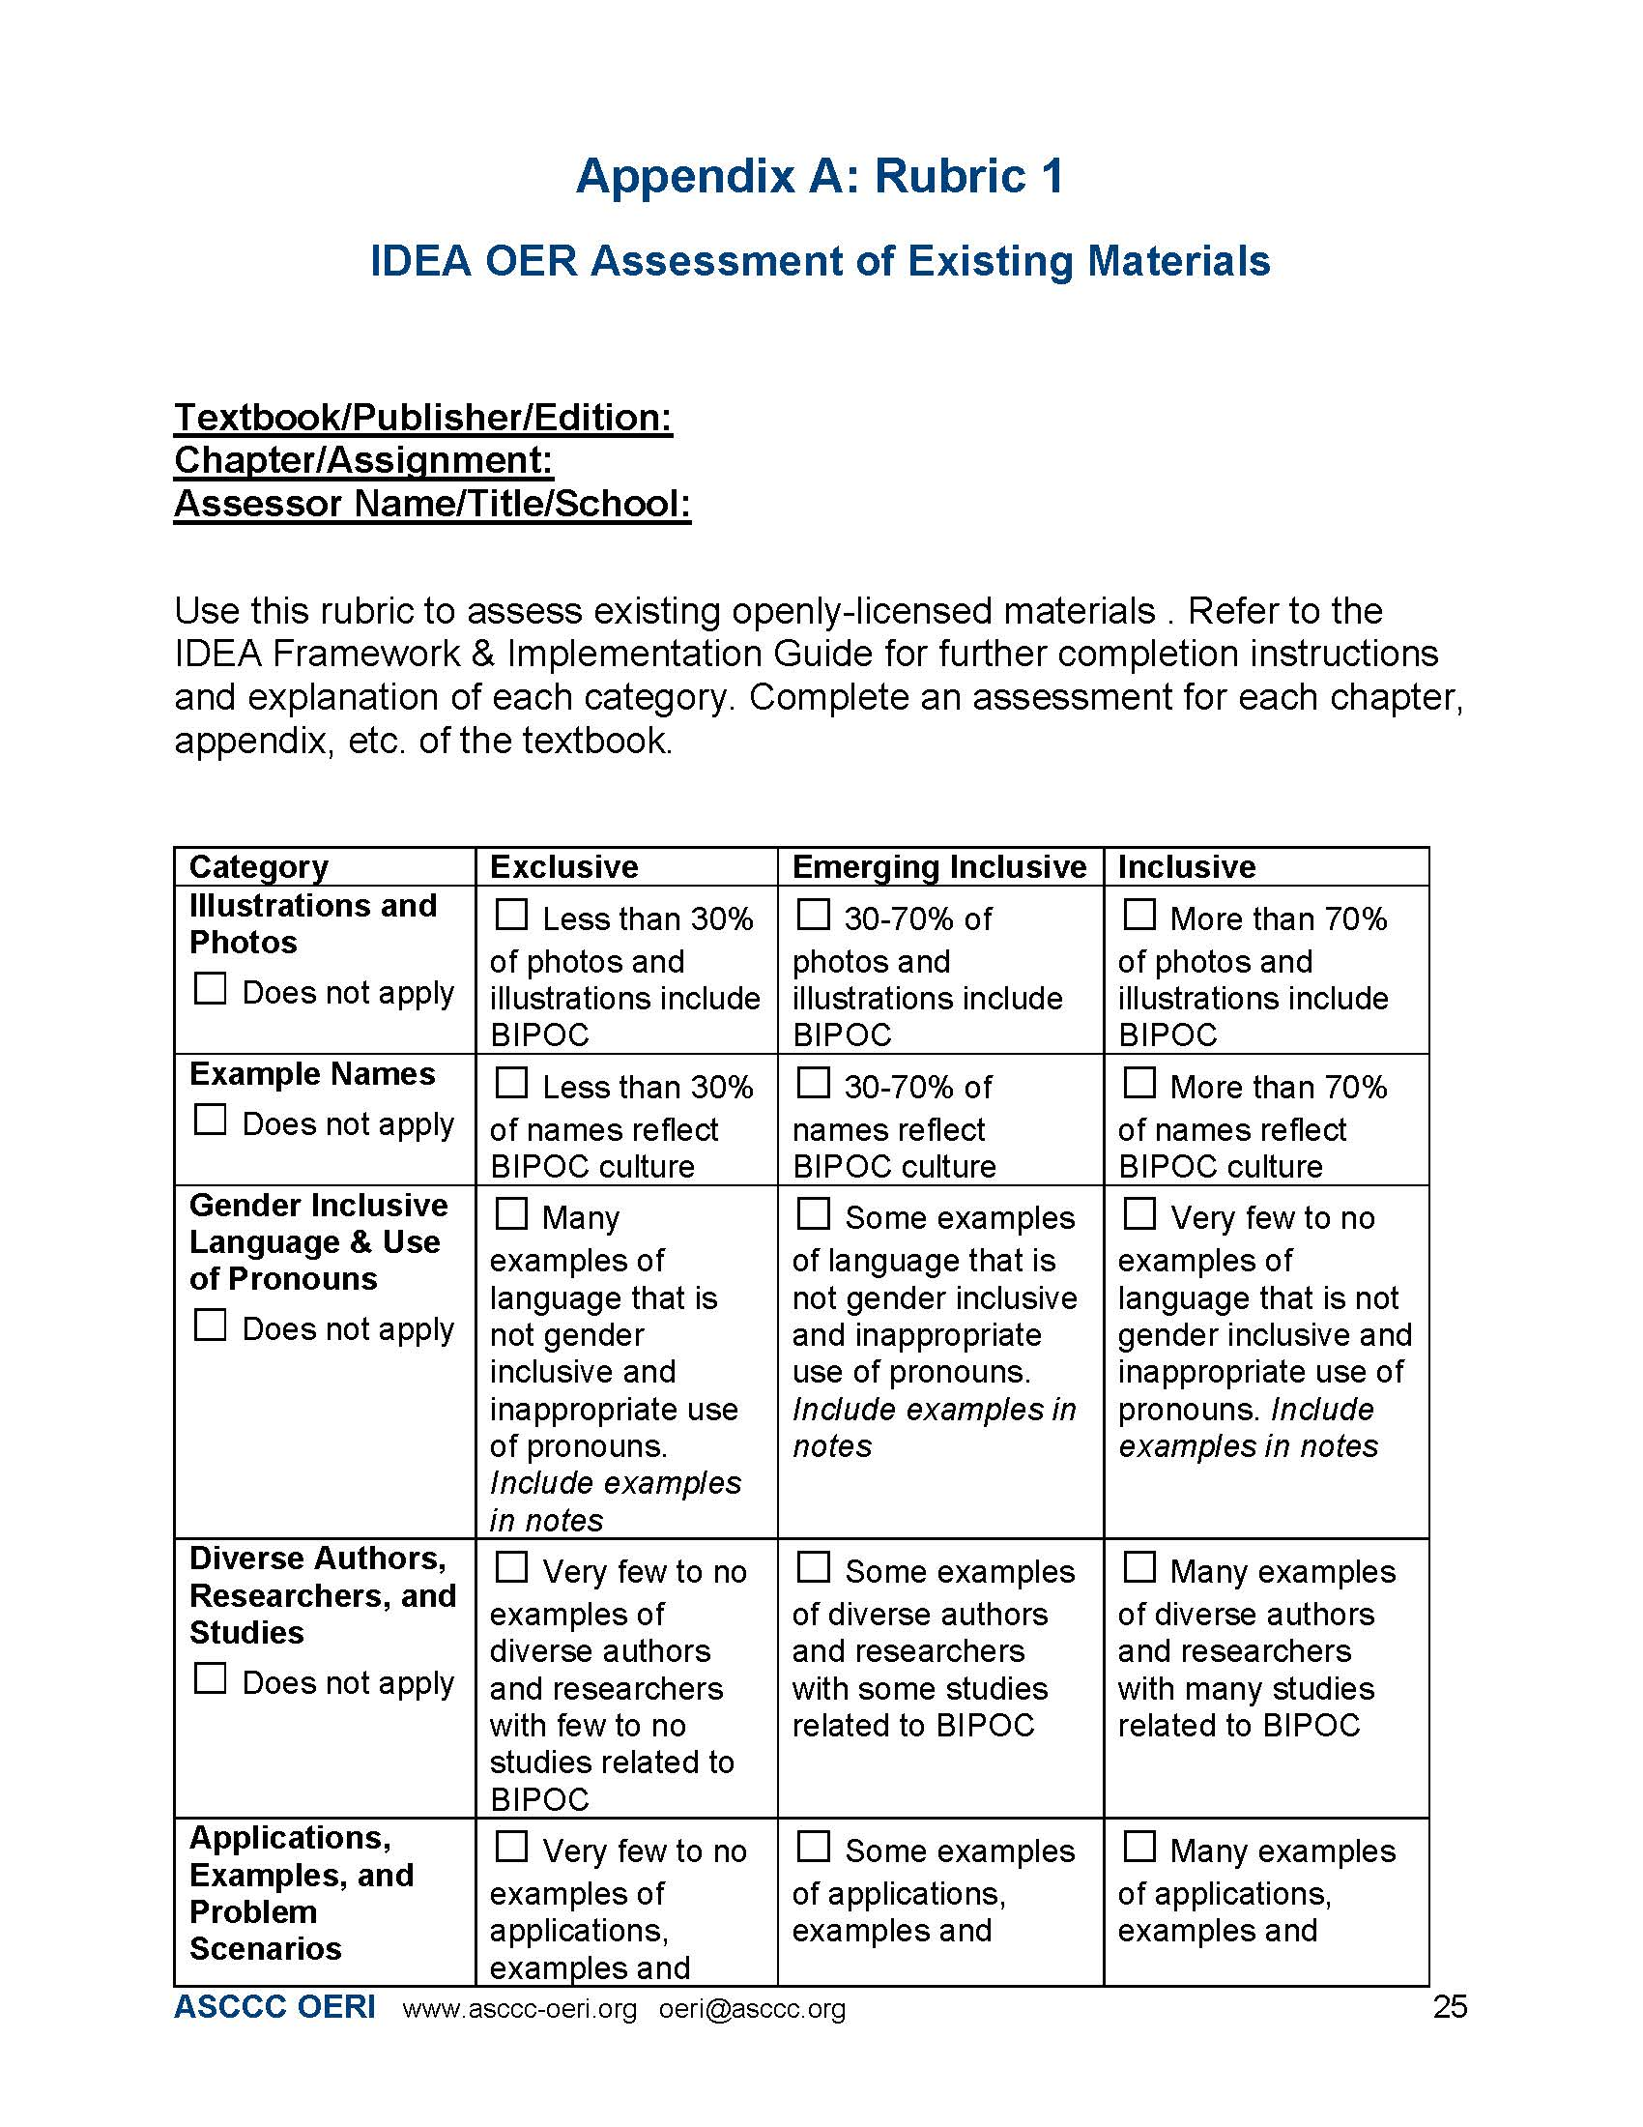
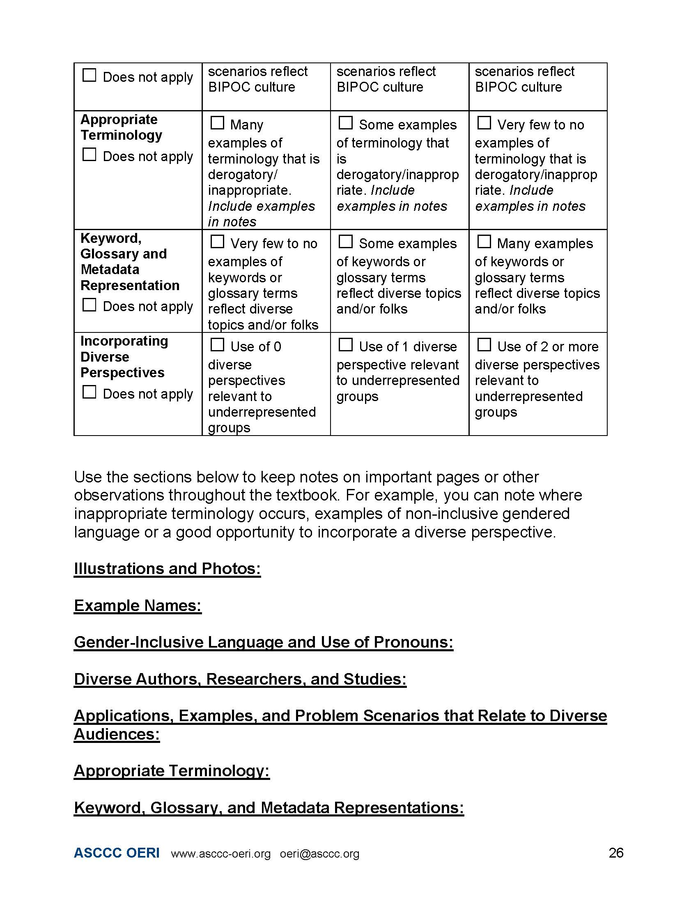
Assessed by chapter/assignment
What percentages make sense for you?
Qualitative and quantitative
Narrative

Slide 8
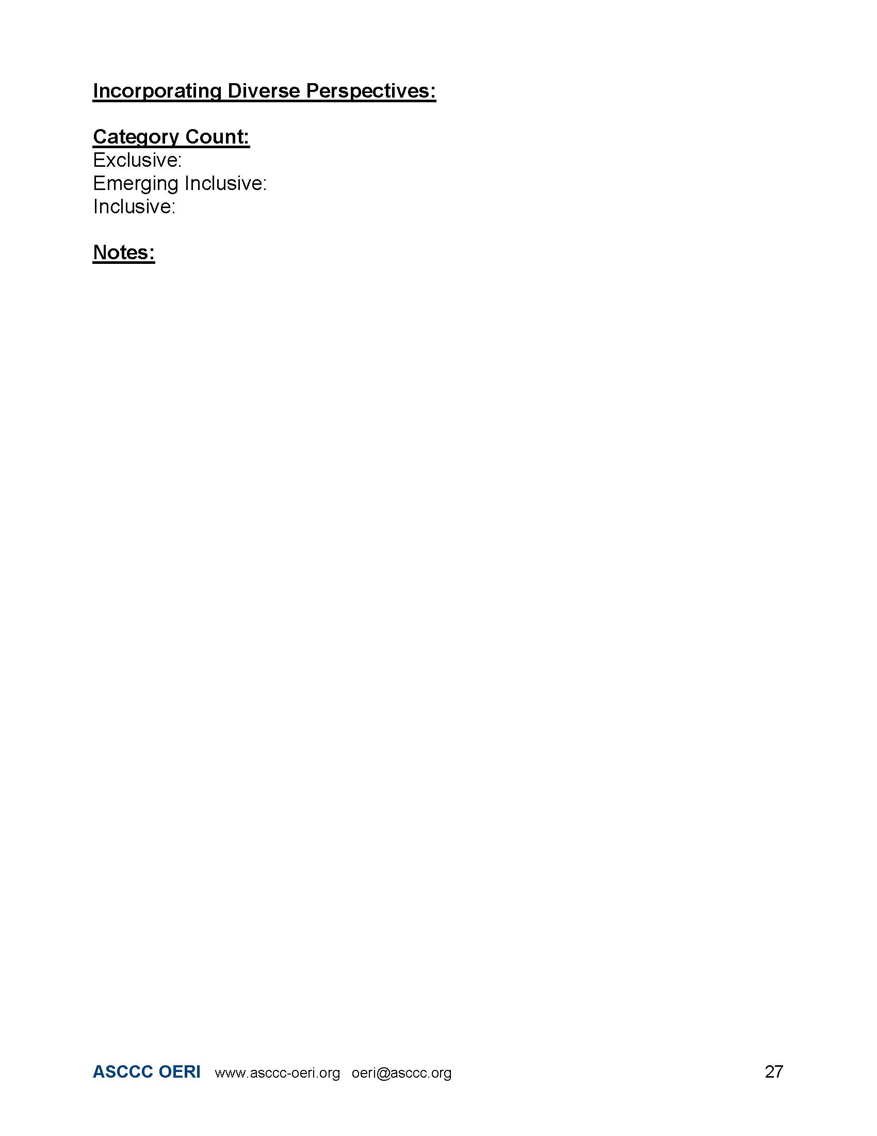

Slide 9
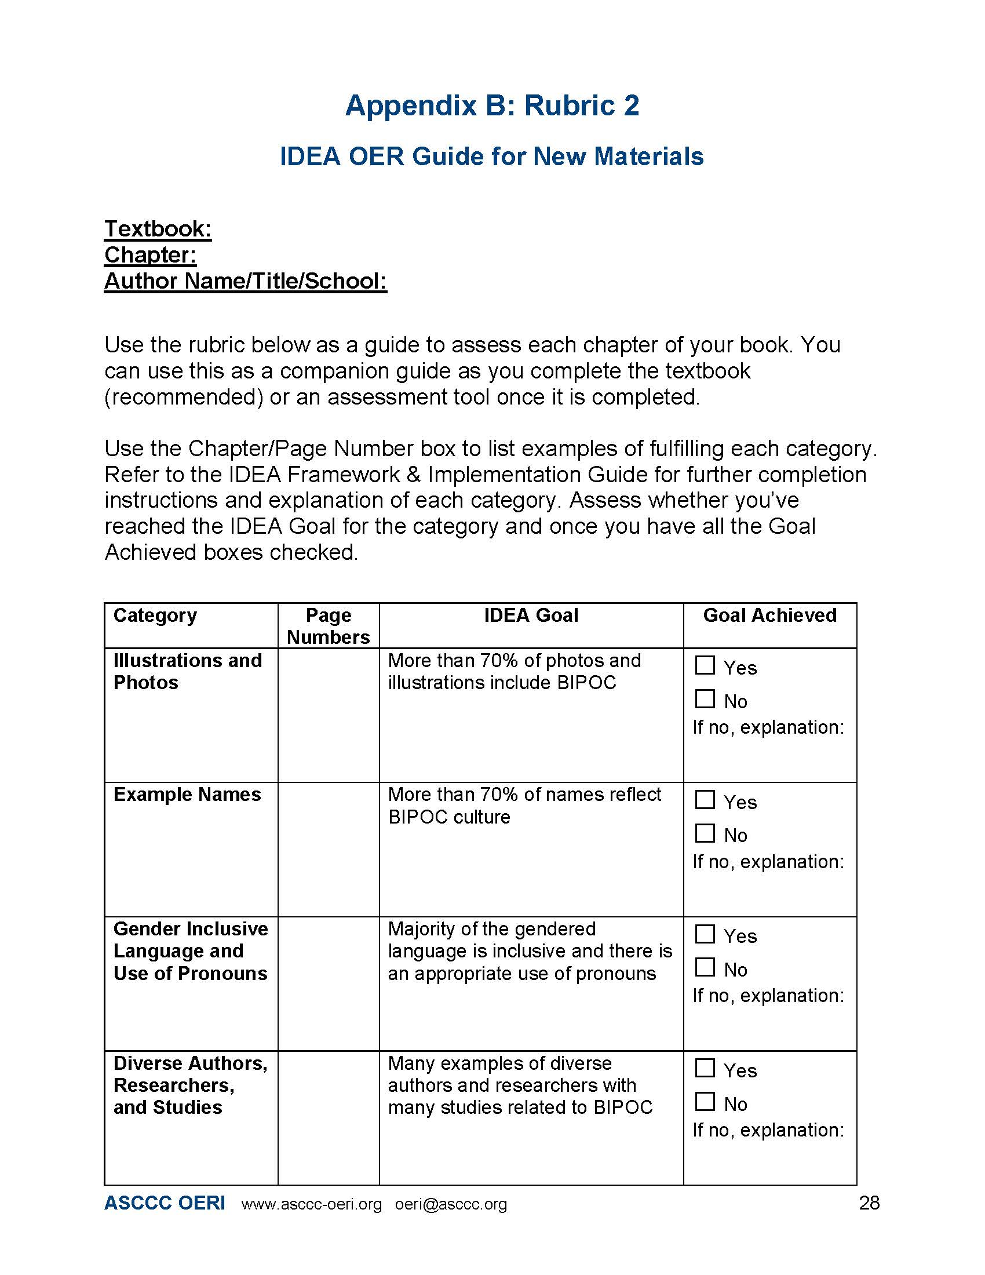
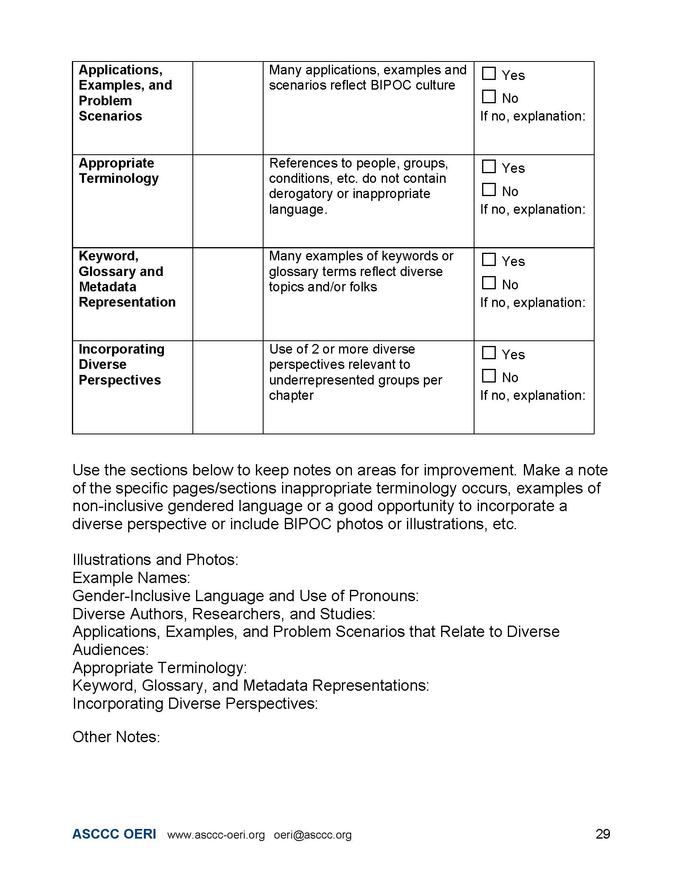

Slide 10
IDEA Framework Assessment Goals
Support faculty through the process of addressing IDEA
Provide faculty with constructive feedback
Provide faculty with necessary resources
IDEA Framework Guideline & Implementation Guide
Canvas site
Trainings
Office Hours

Slide 11
Debrief
Reflection
Initial thoughts? Questions? Feedback?
What hesitations or concerns do you have about submitting your materials for an IDEA Framework assessment? How can they be addressed?

