Slide 1
Getting Spanish to Zero Cost
An Openly Licensed Homework Option
Friday, October 20, 2023

Slide 2
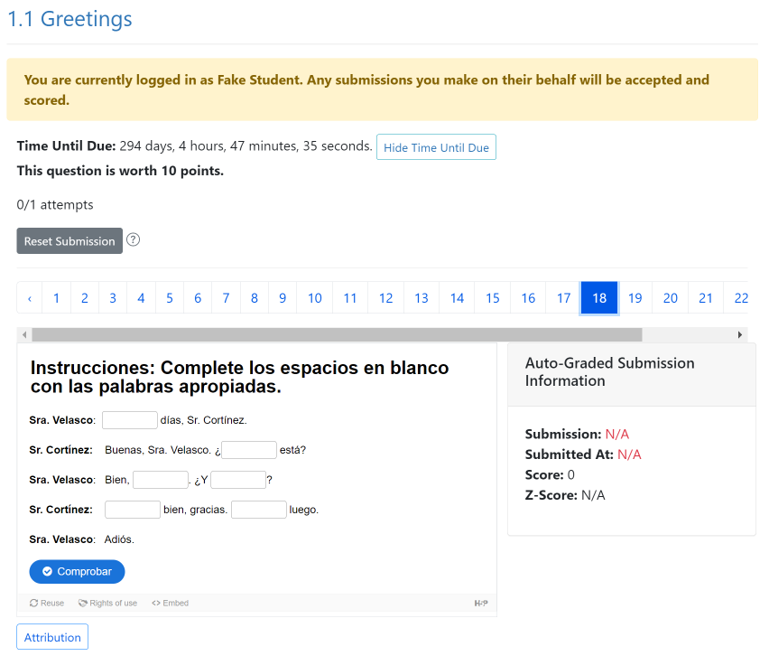
Agenda
Padlet
Spanish OER Resources
What is ADAPT
Spanish OER Homework Alternative
Let’s hear from our colleagues

Slide 3
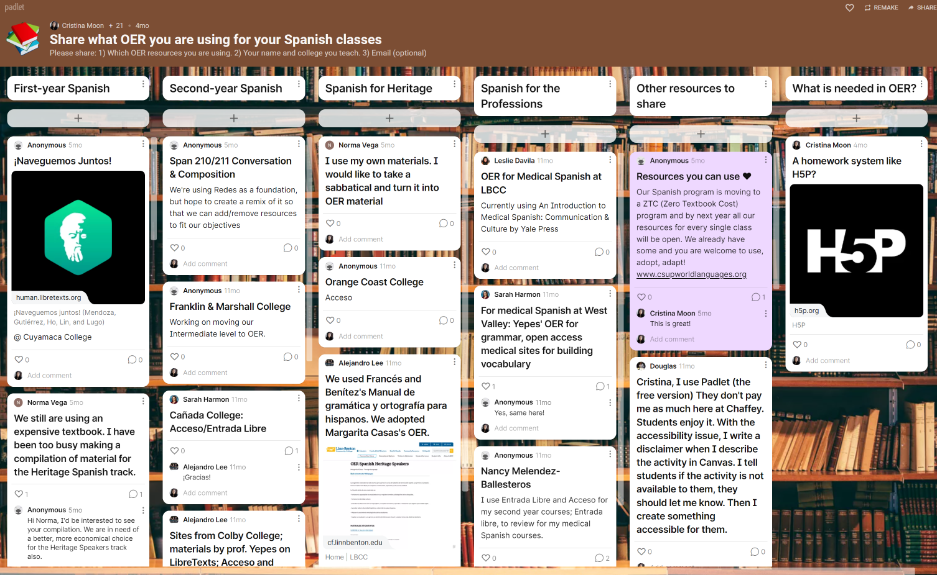
Notes:
Padlet: https://padlet.com/cmoon45/6aviwjzz3fwdilck
Please share what OER you are using.

Slide 4
Open Educational Resources and Spanish
Resources have been organized into the following categories:
First-year Spanish
Second-year Spanish
Spanish for Heritage Speakers Resources
Spanish Grammar/Linguistic Resources
Spanish Literature Resources
Spanish Video/Audio Resources
Proficiency Assessment Resources and Repositories
Spanish for the Professions

Slide 5
What about the homework?

Slide 6
Chabot College
Spanish 1
Textbook in LibreTexts
Spanish 1A: Beginning Spanish (Chabot College) and an example of content and activities breakdown by weekly modules, which is a remix of the following materials:
Chévere, volume 1, by Erica Brown, Alejandra Escudero, María Cristina Montoya, and Elizabeth Small, all of SUNY Oneonta;
¡Naveguemos juntos! by María Barrio de Mendoza, Karla Gutiérrez, Hsing Ho, Ching Ping D. Lin, and Anaid Stere Lugo and their project from the Academic Senate of the California Community Colleges (ASCCC), Open Educational Resources Initiative (OERI); and,
Libro Libre by Erin Huebener, Spokane Community College.
Homework in ADAPT (public courses)

Slide 7
Chabot College
Spanish 2
Textbook in LibreTexts
Spanish 1B: Elementary Spanish (Chabot College) and an example of content and activities breakdown by chapter module, which is a remix of the following materials:
Chévere, volume 2, by Erica Brown, Alejandra Escudero, María Cristina Montoya, and Elizabeth Small, all of SUNY Oneonta;
¡Naveguemos juntos! by María Barrio de Mendoza, Karla Gutiérrez, Hsing Ho, Ching Ping D. Lin, and Anaid Stere Lugo and their project from the Academic Senate of the California Community Colleges (ASCCC), Open Educational Resources Initiative (OERI); and,
Spanish Grammar Manual by Enrique Yepes of Bowdoin College, Colegiatura Colombiana, and Universidad Pontificia Bolivariana.
Homework in ADAPT (public courses)

Slide 8
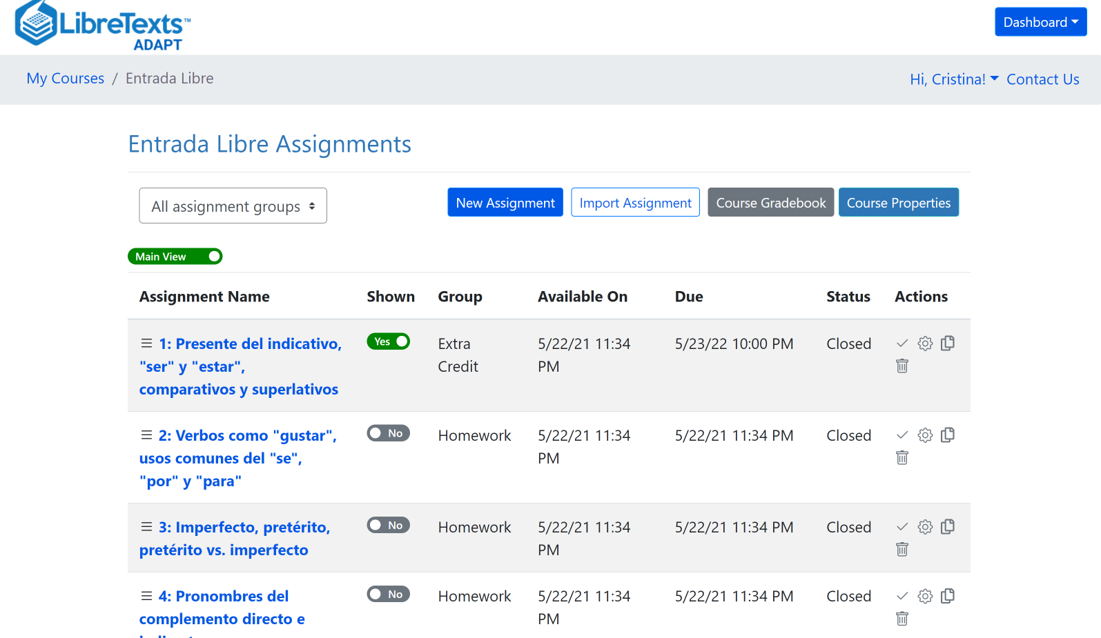
What is ADAPT?
ADAPT is a comprehensive online assessment/homework infrastructure that provides faculty the ability to include auto-graded and non-auto-graded activities from different platforms such as H5P, MyOpenMath, WeBWork, and it’s own native ADAPT questions.
ADAPT can be integrated into an LMS such as Canvas with full grade integration or it could be run independently.

Slide 9
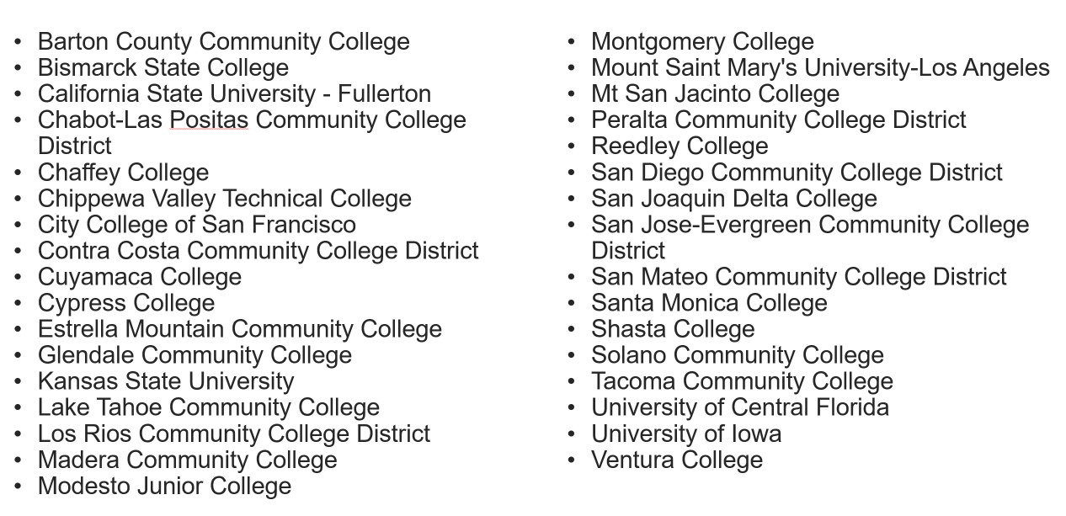
Colleges with Canvas ADAPT LTI (as of 7/31/23)
To link your campus Canvas to ADAPT:
Instructions for your Canvas Administrator.
Updated list as of 10/20/23
Notes:
https://docs.google.com/spreadsheets/d/18dkMl8VCJBvAMKikA_D1XEdLbBz5klRWuVFX9lAWlKw/edit?usp=sharing

Slide 10
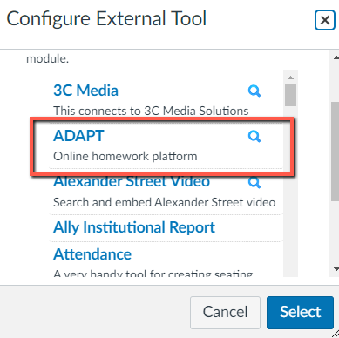
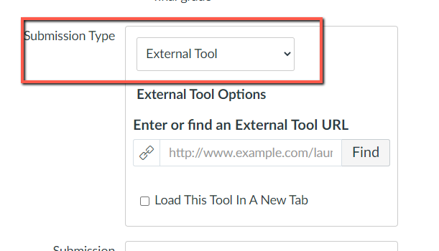
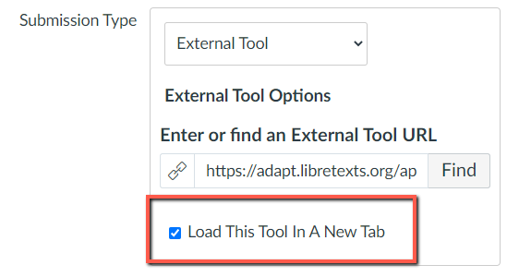
Select ADAPT in External Tool
Step # 1: New assignment and choose “external tool” under submission type.
Step # 2: Click on “find” and look for ADAPT and “select”.
Step # 3: Click on “Load This Tool in A New Tab”

Slide 11
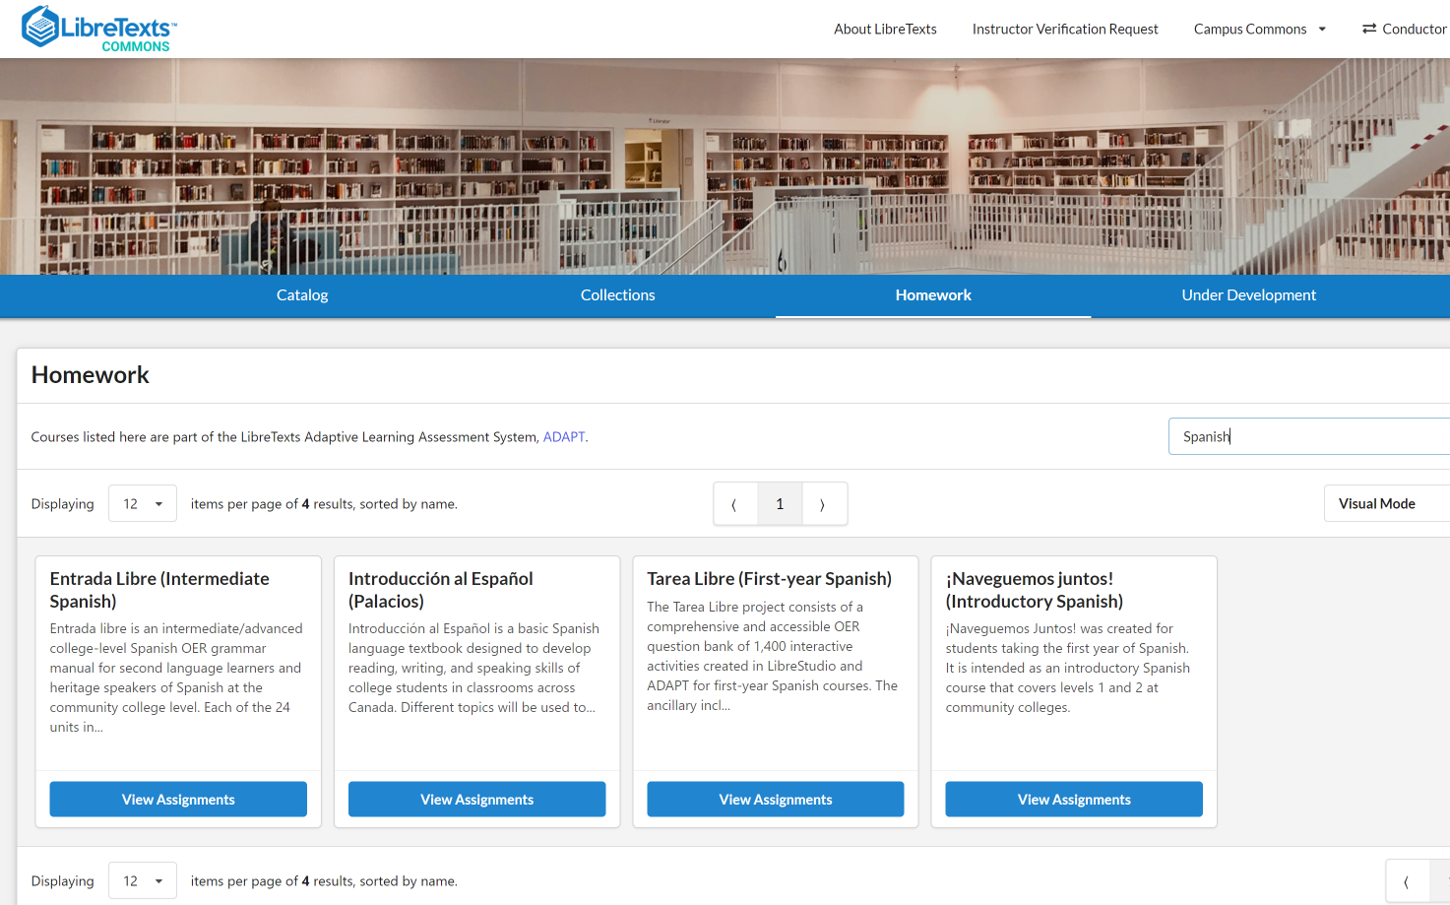
Let’s take a look at ADAPT
Preview Collections via LibreTexts Commons
Notes:
https://commons.libretexts.org/homework

Slide 12
Let’s hear from our colleagues

Slide 13
Reedley College
Madera College
Franchesca Amezola
Spanish and French Instructor
Dept. Chair, Communication and Languages
Lupe Vega
Spanish Professor
Languages Department
Lessons learned from moving to zero-textbook-cost:
Enrollment increased in all our Spanish 1 sections (online and F2F).
Waiting lists, especially in our online sections.
Students have expressed their gratitude for the zero-cost.
Materials available day-one of the semester.
Students have remained in the course.
Collaborative work across colleges.
Effective use of listening exercises, audio recordings, and cultural readings from TAREA LIBRE.

Slide 14
Lessons learned from ZTC, continued:
Transfer of grades from ADAPT to Canvas is seamless.
Tip: Ensure exercises selected are on the list of Adapt ready H5P questions.
From our experience, ALL scores from the TAREA LIBRE assignments were transferred to Canvas without an issue and seamlessly.
The ability to assess our students’ speaking skills is a highlight that TAREA LIBRE offers.
In all, the utilization of LibreTexts and ADAPT has brought positive changes to our language programs and we plan to continue their use for the benefit of our students.
If you have questions, you can contact us:
Franchesca Amezola: franchesca.amezola@reedleycollege.edu
Lupe Vega: lupe.vega@maderacollege.edu

Slide 15
What is Tarea Libre?
Authors: Cristina Moon (Chabot College), Alejandro Lee (Santa Monica College), Sarah Harmon (Cañada College), and Nancy Meléndez-Ballesteros (Mount Saint Mary’s University-LA).
Homework set for First-Year (collegiate) Spanish courses
Licensed as CC-BY-NC 4.0 (open license)
Written in accordance with California C-ID Transfer Model Curriculum for SPAN 100 and SPAN 110
Funding from Academic Senate for California Community Colleges (ASCCC) Open Educational Resources Initiative (OERI), RFP IV
Technical support from LibreTexts, particularly with new technologies
Written Summer 2022-Winter 2023
Media either self-created or openly-licensed
Notes:
CM

Slide 16
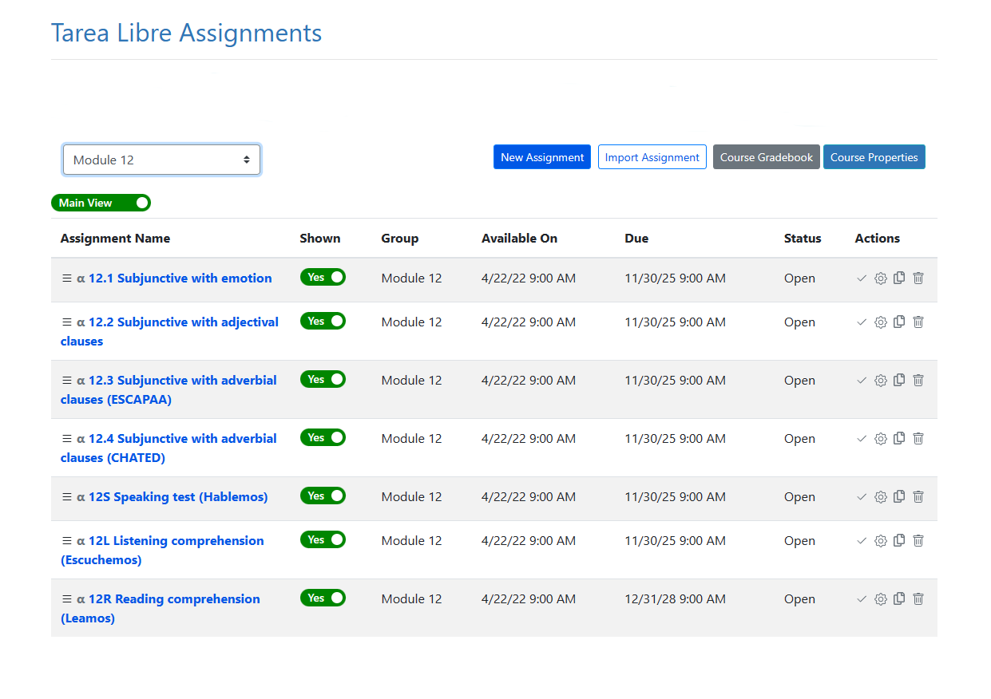
Tarea Libre Modules
1,400 activities
14 modules:
7 modules for 1st semester
7 modules for 2nd semester
4-5 sections per module with vocabulary and grammar
Notes:
CM

Slide 17
Overview of Grammar and Vocabulary Content
Tarea Libre covers 57 grammar topics typically taught in first-year Spanish courses. To increase adaptability and flexibility for instructors, the project has 7 modules for SPAN 100 and 7 modules for SPAN 110, based on California’s C-ID curriculum model. Each module is composed of 4 to 5 grammar topics and listening, speaking, and reading comprehension activities.
As found on most homework (workbook and lab activities), each grammar topic has a vocabulary page and 4 levels of mastering steps:
Paso Preliminar
Paso 1 "Empecemos"
Paso 2 "Continuemos"
Paso 3 "Practiquemos"
Paso 4 "Avancemos”
Notes:
CM

Slide 18
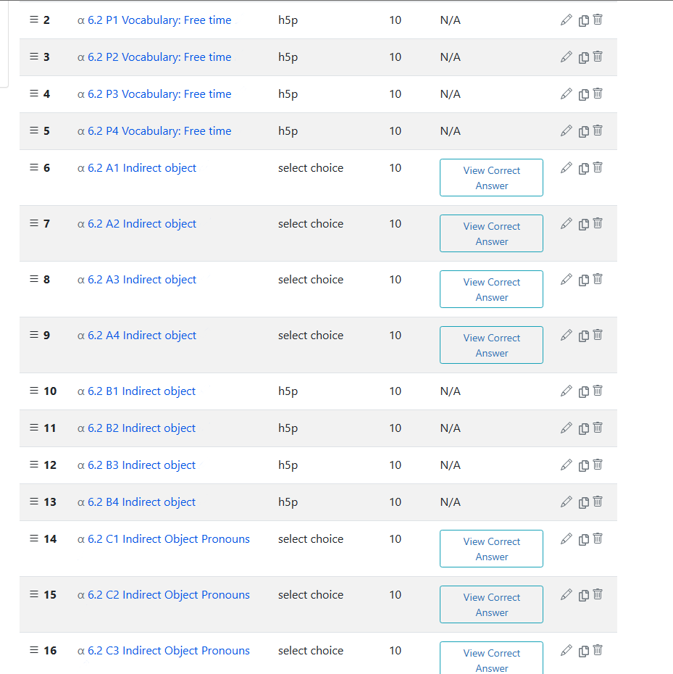
Module Contents
5 ‘pasos’ of vocabulary and grammar exercises per module and each “paso” with 4-8 activities.
P = Preliminar: Focus on vocabulary building; mostly multiple choice and select choice questions
A = Empecemos: Focus on recognition of grammatical concepts; mostly multiple choice and select choice questions
B = Continuemos: Focus on initial application of grammatical topics; mostly fill-in-the-blank in shorter contexts
C = Practiquemos: Focus on expanded application of grammatical topics; mostly fill-in-the-blank and select choice in longer paragraphs
D = Avancemos: Focus on expanded application of grammatical topics in dialogues; mostly fill-in-the-blanks
Notes:
CM

Slide 19
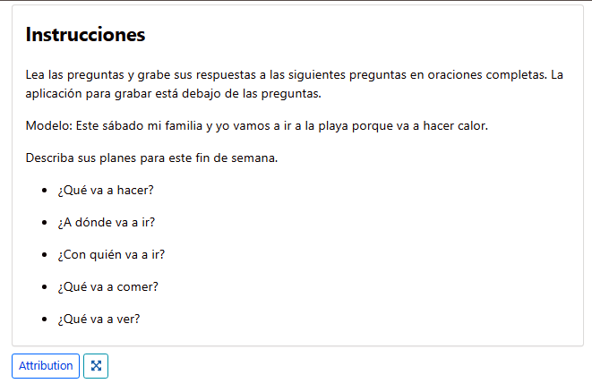
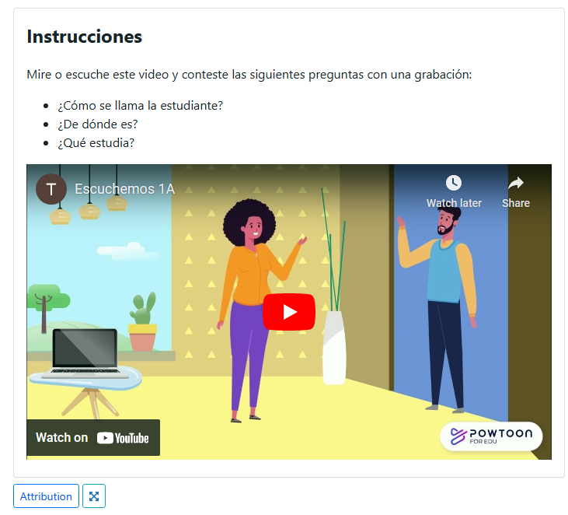
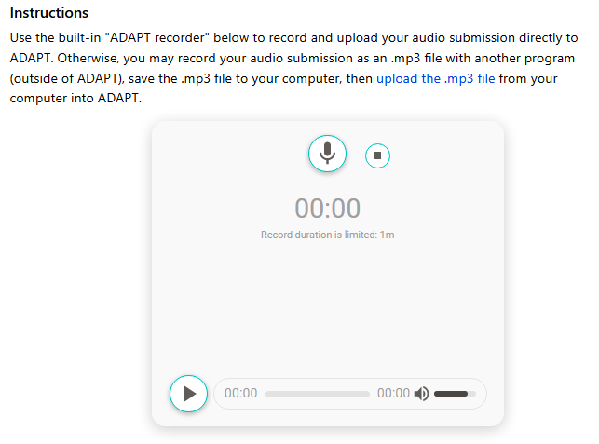
Summative Assessments
3 comprehensive assessments per module
Hablemos: Written prompts; students submit audio recording with answers (4 per module)
Escuchemos: Powtoon videos; students submit audio recording with answers (4 per module)
Leamos: Cultural and thematic reading with audio narration; students answer true/false comprehension questions (3-4 per module) (next slide)
Notes:
CM

Slide 20
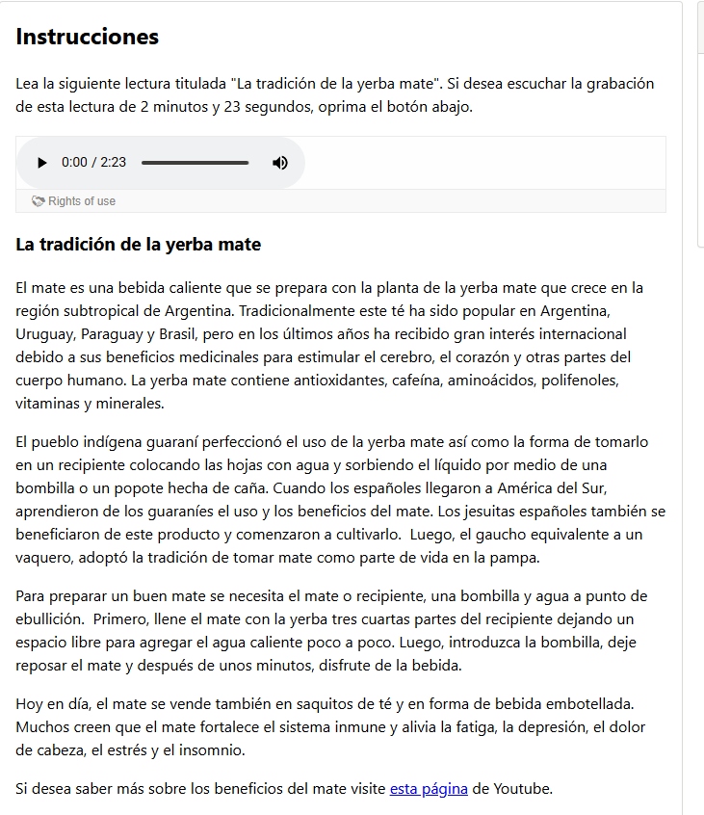
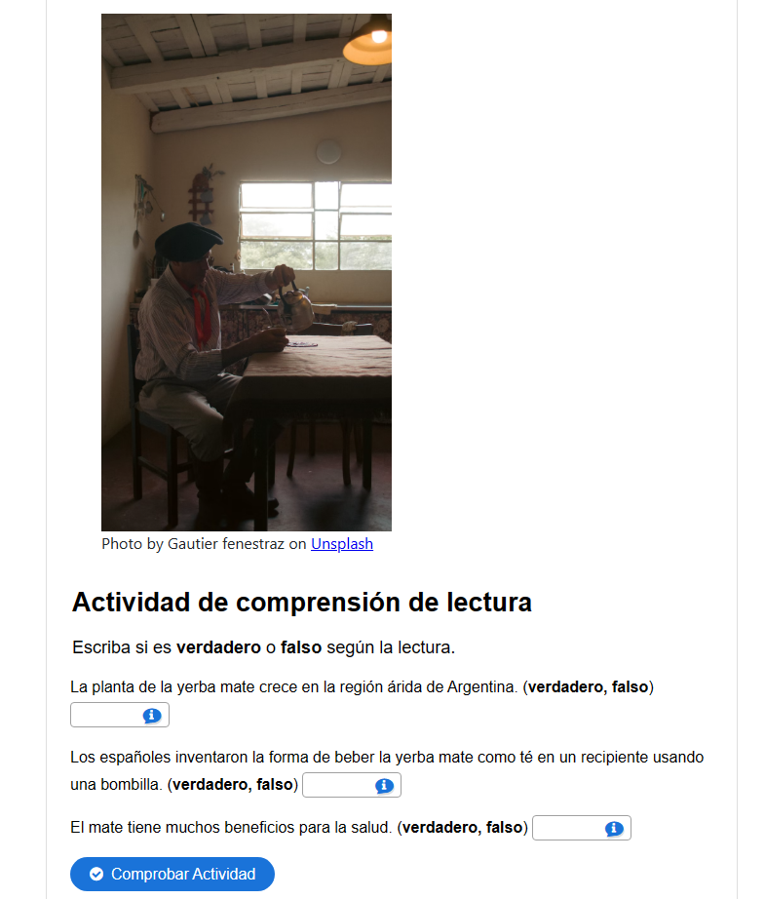
Overview of Reading Content
There are 47 cultural readings with narration and auto-graded comprehension questions were created on a variety of topics.
Notes:
AL

Slide 21
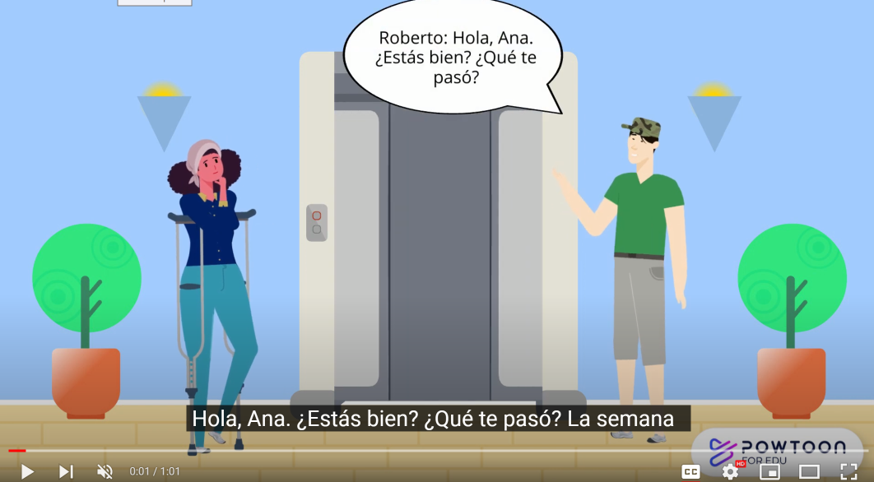
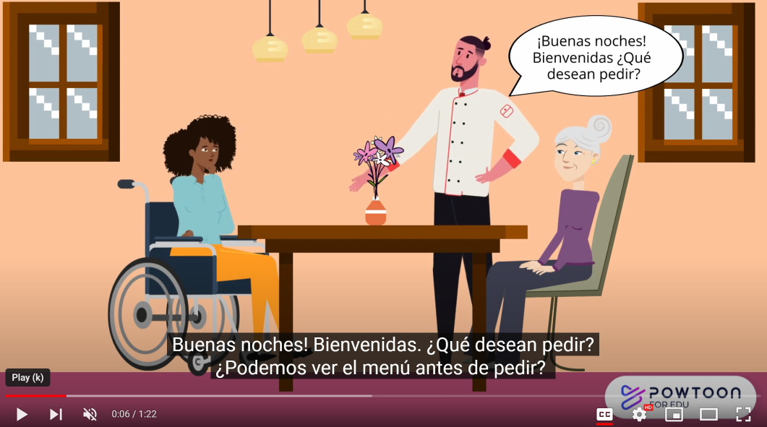
Inclusion, Diversity, Equity, Anti-Racism …and Accessibility
ASCCC OERI IDEA Framework
Culturally-responsive pedagogy
All assignments are meant to be accessible and have been reviewed by ASCCC OERI and LibreVerse accessibility specialists
Notes:
AL

Slide 22
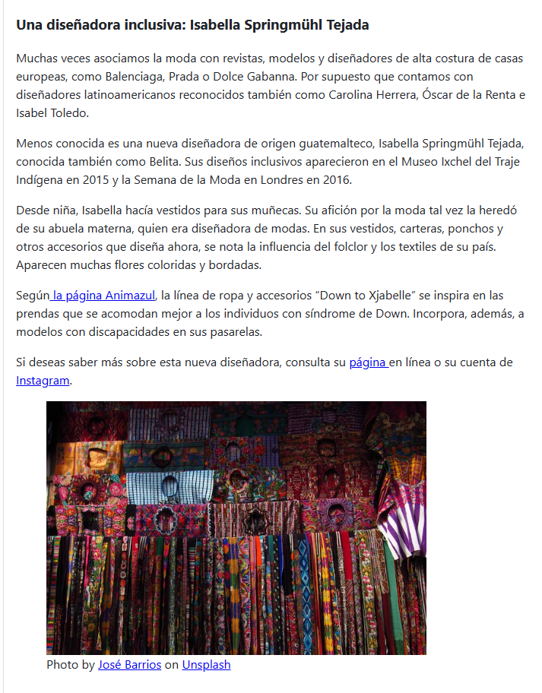
Incorporation of IDEA
People from around the Spanish-speaking world, including the Philippine Islands and Equatorial Guinea: Concha Buika, el silbo gomero, el español en las Islas Filipinas
People of African, Asian, Indigenous and mixed ethnic groups: Jorge Drexler, Perú Negro, los chifas peruanos, Guaraní, Taino
People from the LGBT+ community: Bienestar Clinic in Los Angeles, Gender-neutral names in exercises
People with disabilities: Isabelle Tejada Springmühl
Notes:
AL

Slide 23
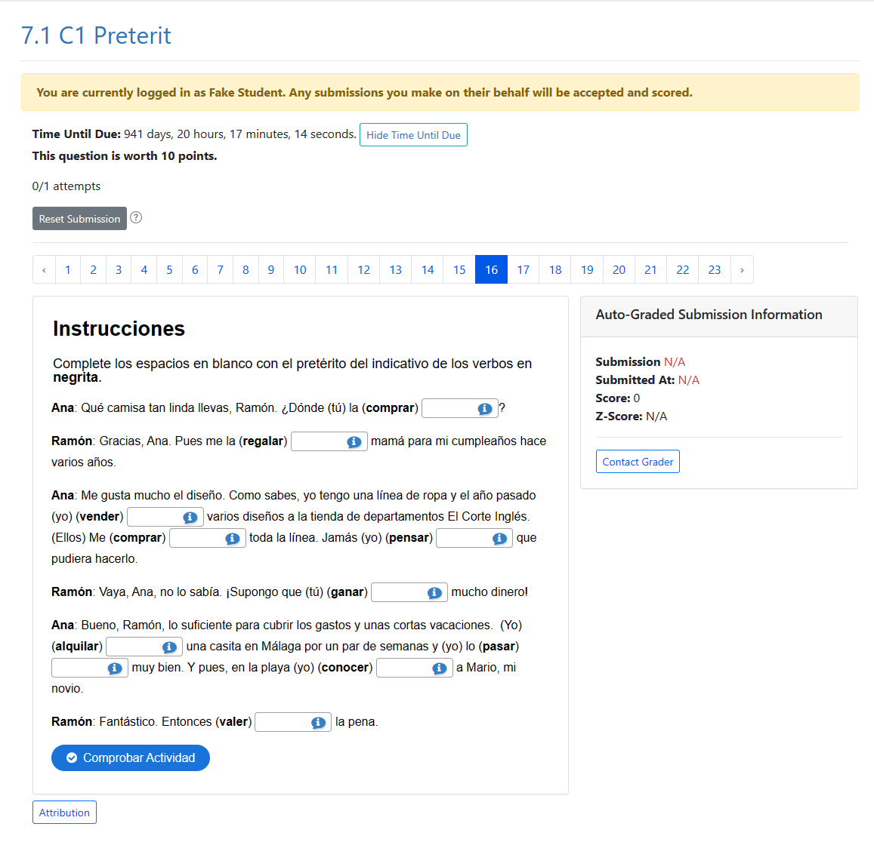
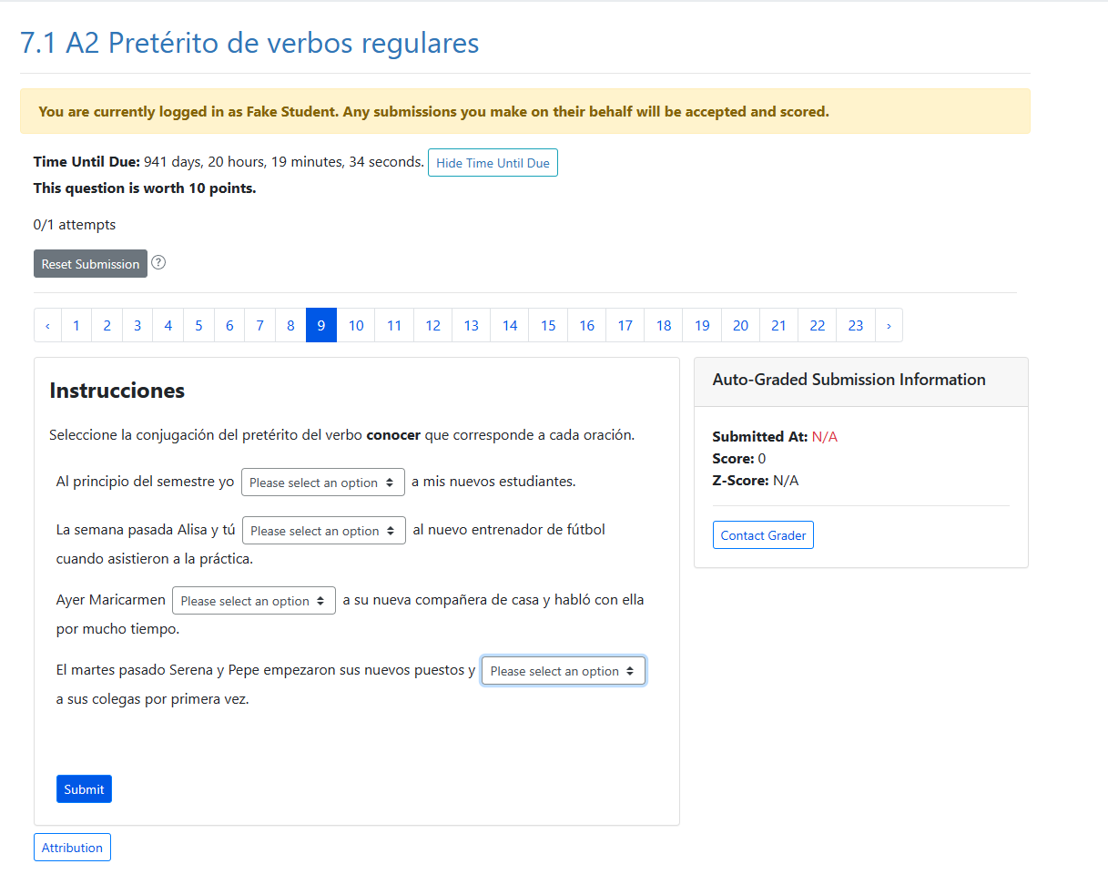
LibreStudio and ADAPT
LibreStudio for H5P-based questions (multiple choice, fill-in-the-blank) and audio recordings–imported into ADAPT
ADAPT native questions (select choice, matching, vocabulary presentations, readings)

Slide 24
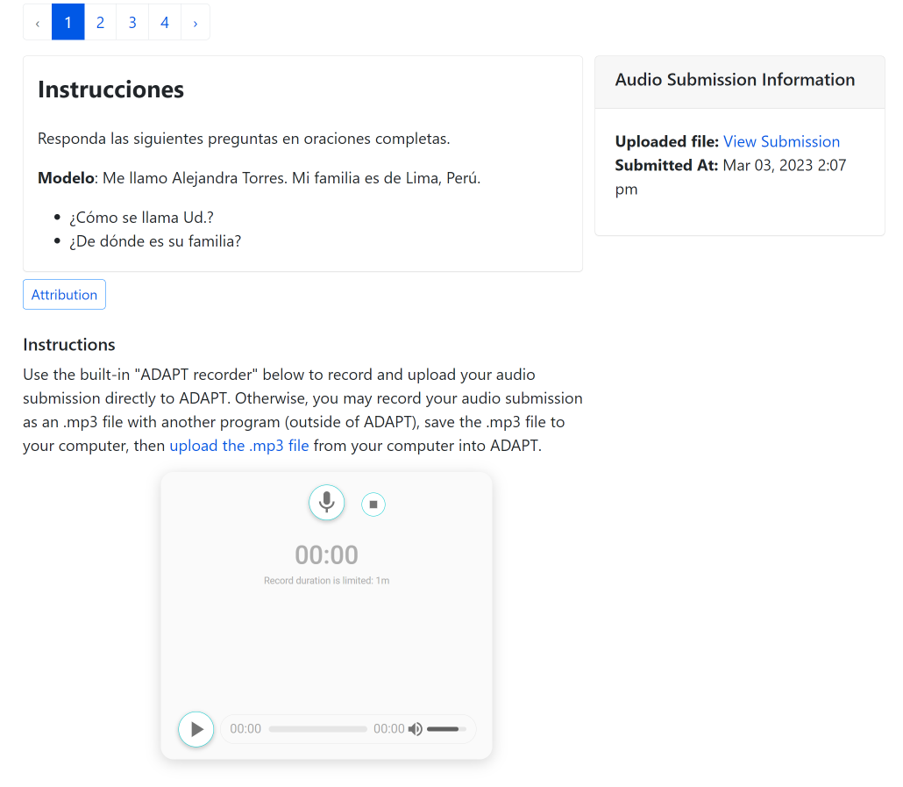
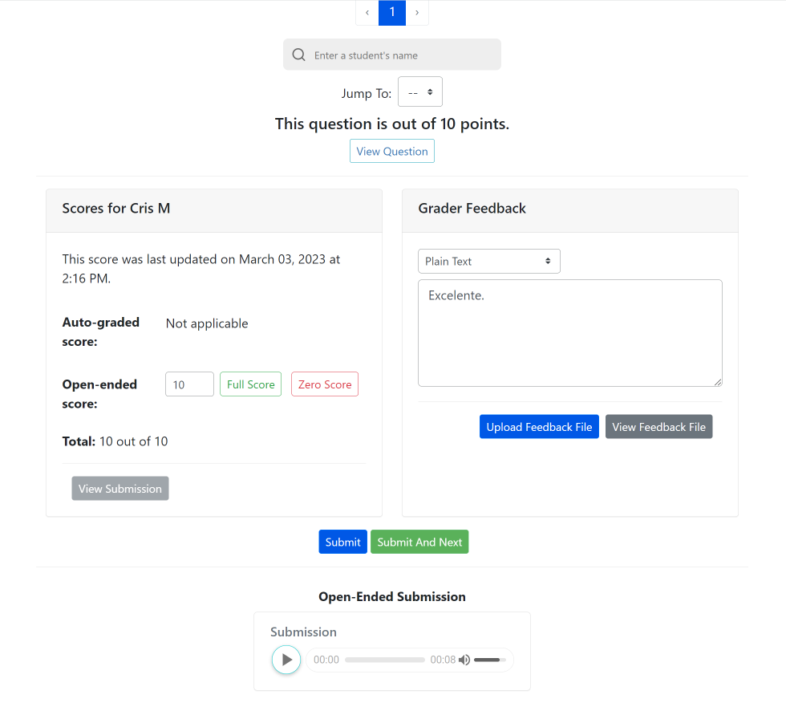
Audio Recording: Hablemos and Escuchemos
These are non auto-graded activities to assess oral and listening skills.
Students record their responses using the recorder tool in the ADAPT assignment.
Instructors listen, grade, and provide feedback all in the same page.

Slide 25
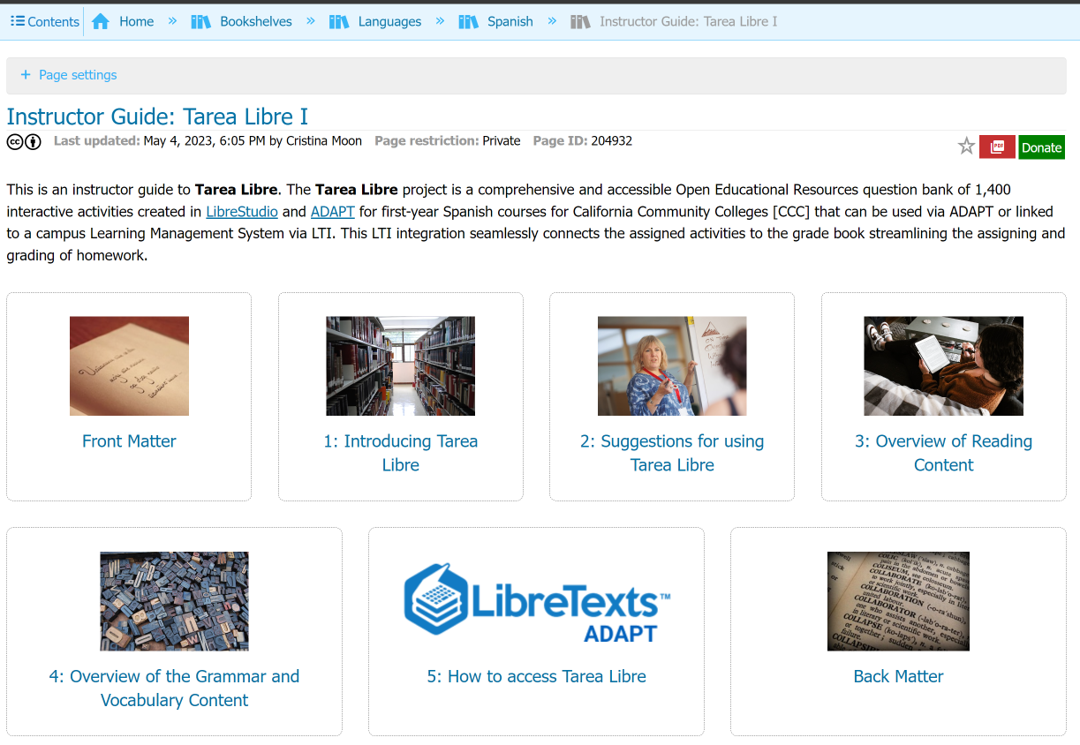
Instructor Guide to Tarea Libre
Start with the Tarea Libre Guide for Instructors in the Spanish Bookshelves in LibreTexts
Notes:
https://human.libretexts.org/Bookshelves/Languages/Spanish/Instructor_Guide%3A_Tarea_Libre_I

Slide 26
What’s next?
Spanish Open Educational Resources (OER) Hackathon: Let’s create a HW Collection
Friday, October 27, 2023 from 11:00 am – 12:30 pm
Register for the Spanish OER Hackathon
Do you want to help us create Spanish OER homework activities in ADAPT? During our OER Hackathon, we will create a collection of activities using LibreTexts ADAPT homework system. Come and join the fun and share the newly created resources with the world!
Notes:
Prep doc: https://docs.google.com/document/d/1YDuuXSj70gw4EZwvP__K8IygFnlQA0HWSXOdKScUjGs/edit?usp=sharing

Slide 27
ADAPT resources
Recorded webinar: Integrating ADAPT in Canvas (9/8/23)
ADAPT construction guide and Accessibility reports
If using H5P activities, make sure to look at the ADAPT ready questions list.
Ex: avoid course presentation, column, question set, etc.
LibreTexts weekly office hours:
https://zoom.libretexts.org (Tuesdays at 9:00-10:00 Pacific time)
https://zoom.libretexts.org (Thursdays at 9:00-10:00 Pacific time)

Slide 28
Questions?
Cristina Moon Ph.D.
Spanish Faculty and OER/ZTC Coordinator at Chabot College
ASCCC OERI Spanish and the H5P/ADAPT Lead
ASCCC OERI Liaison
cmoon@chabotcollege.edu

