Slide 1
ASCCC OERI Discipline Lead Webinar/Conversation
Different Types of Assessments in MyOpenMath
Emilie Hein, PhD & Polin Yadak, EdD
Physics Instructors
Skyline College

Slide 2
What is MyOpenMath
Getting started
LTI integration
Types of assessments with examples

Slide 3
What is MyOpenMath?
From https://www.myopenmath.com/info/classroom.php
“MyOpenMath is designed for mathematics, providing delivery of homework, quizzes, and tests with rich mathematical content. Students can receive immediate feedback on algorithmically generated questions with numerical or algebraic expression answers. And it can do so much more, providing a full course management system, including file posting, discussion forums, and a full gradebook, all designed with mathematics in mind.”
If it’s good for mathematics, it’s also great for other STEM disciplines!

Slide 4
Why use MyOpenMath?
It is free for you and your students to use!
LTI Integration - it can easily be integrated in your LMS
It is easy to share problems and courses with colleagues.
A large collection of course templates and problems is already available (depending on the discipline)
If you have already programmed problems in other platforms, it will be easy to do it in MOM
Well documented and supported: https://www.myopenmath.com/docs/docs.php
Additional support is available from the community

Slide 5
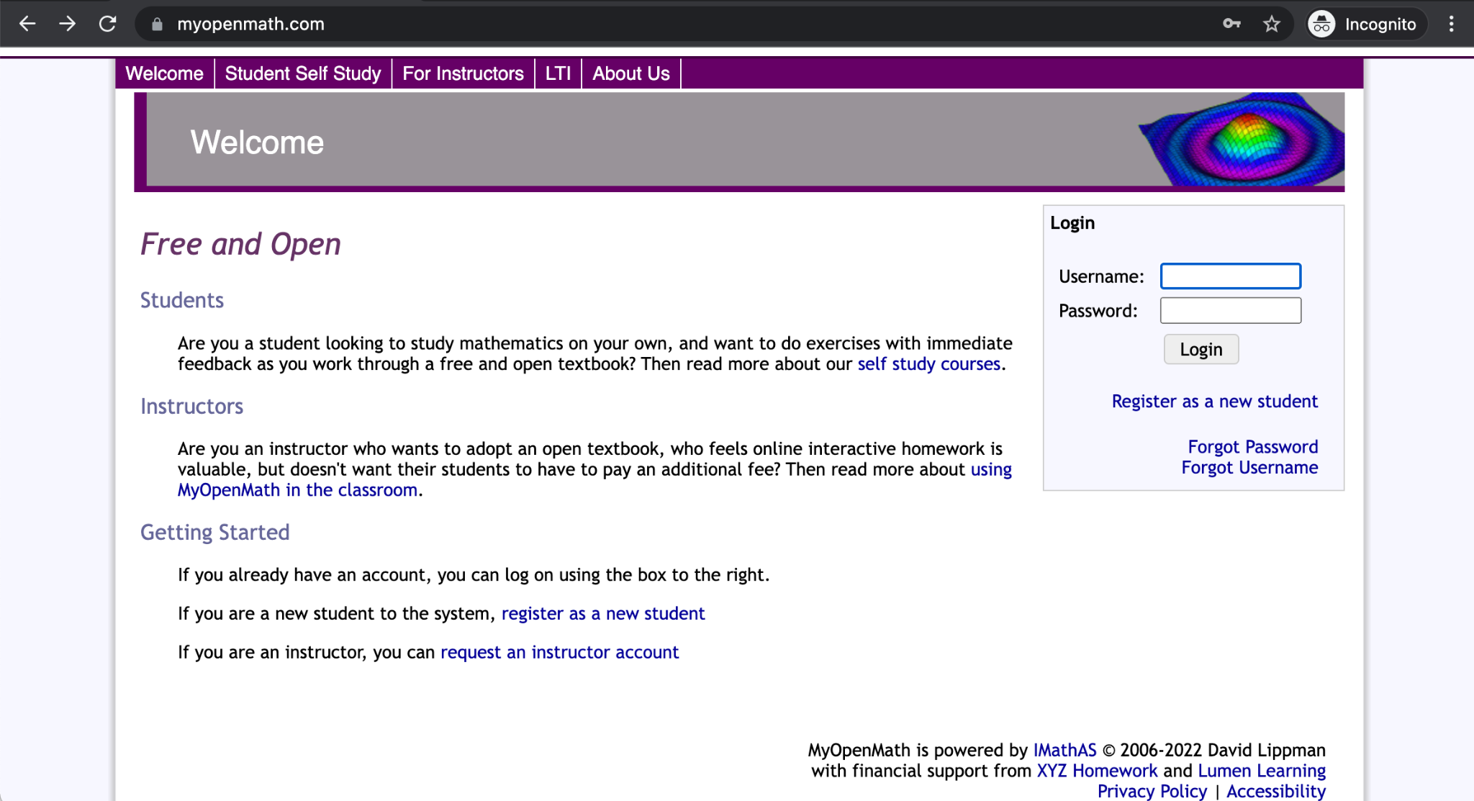
Getting started
If this is your first time using MyOpenMath, you will first need to request an account.
Go to https://www.myopenmath.com/
Request and Instructor account

Slide 6
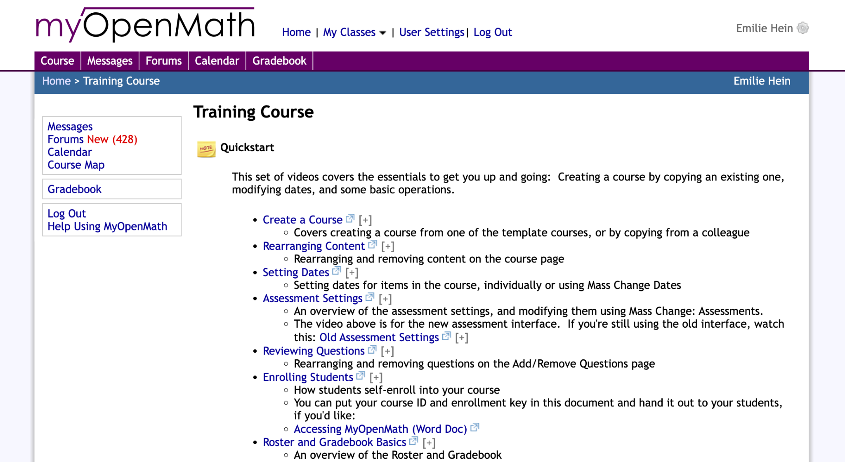
Training Course & Support Course
After logging in, you will land on the Home page.
You are automatically added to the Training and Support Courses.
Under “Courses you are taking”
Start there! Lots of resources and help from the MOM community

Slide 7
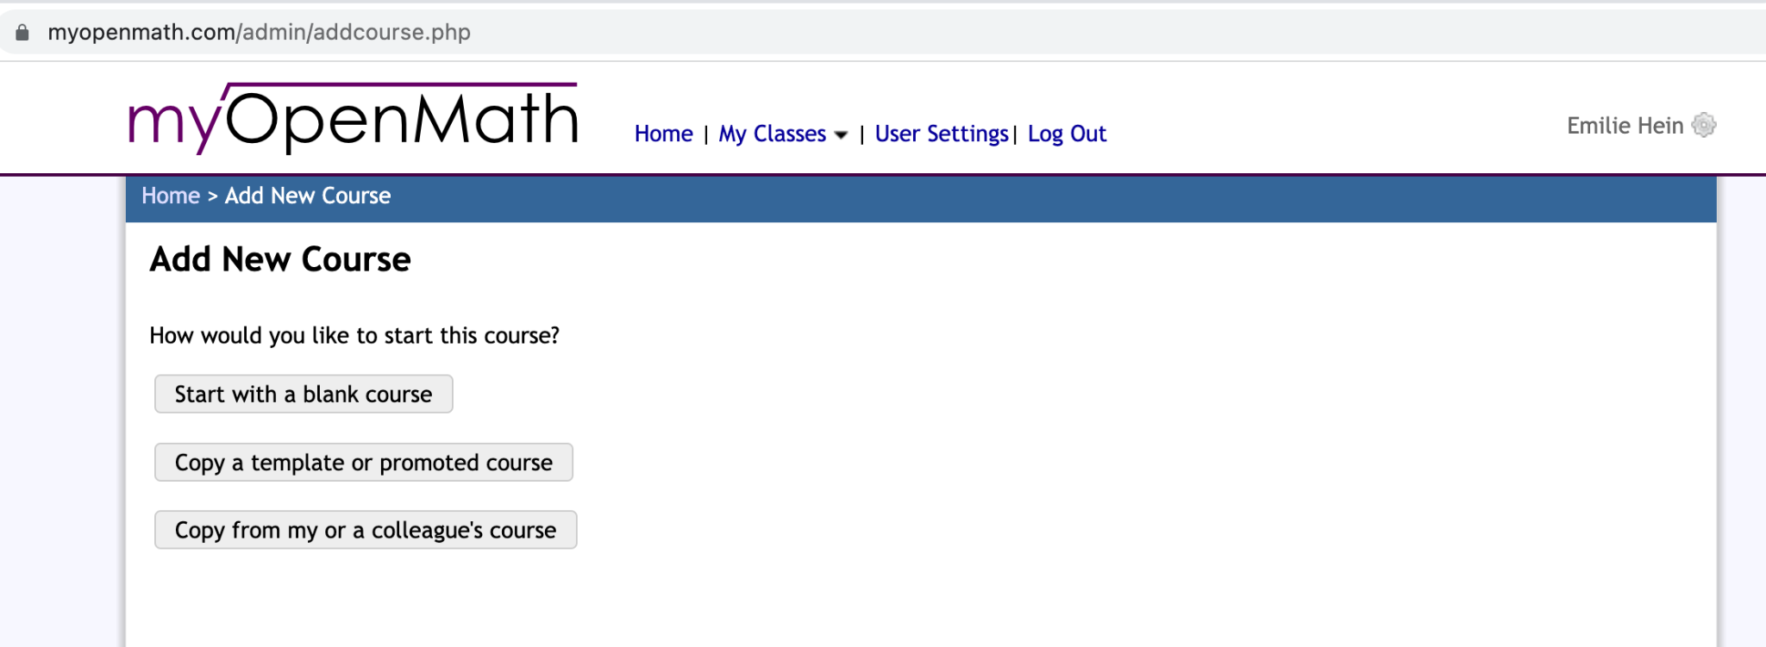
Explore existing content &
Create your own course
Select “Add New Course” from the Home page

Slide 8
Integrating MyOpenMath into your Canvas shell
In Canvas, go to Settings, then click the Apps tab
Click on View App Configurations, then the +App button
For Configuration type, select "By URL"
For Name, enter MyOpenMath, or whatever you'd like
For Consumer Key, enter: LTIkey_####_1, where #### is your Course ID
For Shared Secret enter the secret shown in your MyOpenMath Course Settings
For the Config URL, enter https://www.myopenmath.com/canvas.php
Click Submit

Slide 9
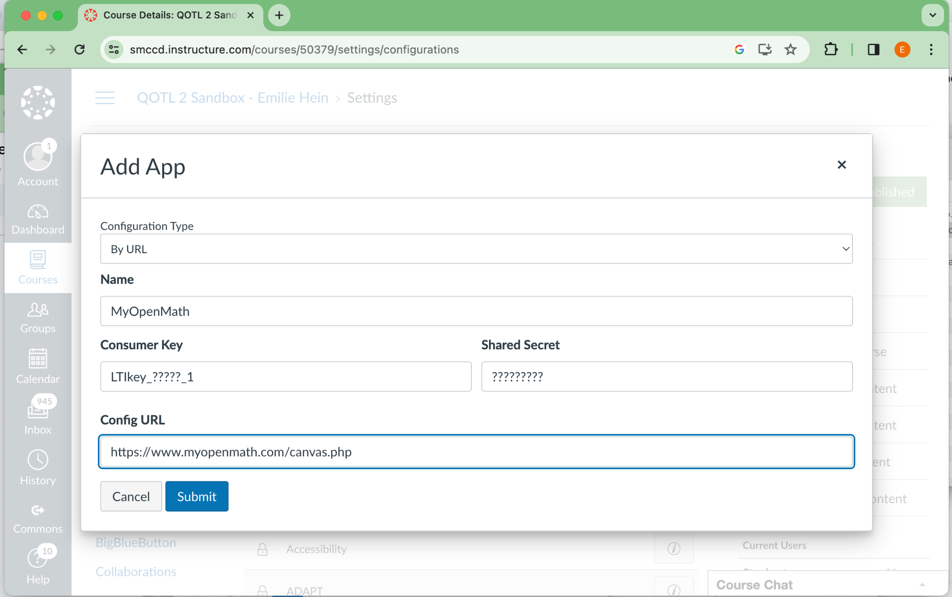
How to add key into MyOpenMath

Slide 10
How to create a link to an assignment in Canvas
Go to the Assignments page, and click +Assignment
Under Submission Type, select "External Tool"
Click on the "Find" button, then on the MyOpenMath tool (or whatever name you used when you created the tool)
If this is your first time using this key and secret, MyOpenMath will ask you, the teacher, to sign into your MyOpenMath account. This is necessary to establish a connection between your LMS account and your MyOpenMath account. You will not need to do this step again, and students will not be asked to sign in and will not need a MyOpenMath account.
If this is your first link from this course, MyOpenMath will ask you to select the MyOpenMath course you want to connect your LMS course with.
Select the assignment you want to link to, and click Make Placement.
Click the Select button
Finish setting up the assignment in Canvas
Assignments set up this way will receive grade return from MyOpenMath

Slide 11
Showing how to use the external tool in Canvas Shell to import MyOpenMath elements

Slide 12
LTI Integration
For additional help, you can visit
https://www.myopenmath.com/help.php?section=lti
https://docs.google.com/document/d/19rF5SwoYlNz58hll63ExPLuZb-4GqlMH/edit?usp=sharing&ouid=115502943412533578886&rtpof=true&sd=true

Slide 13
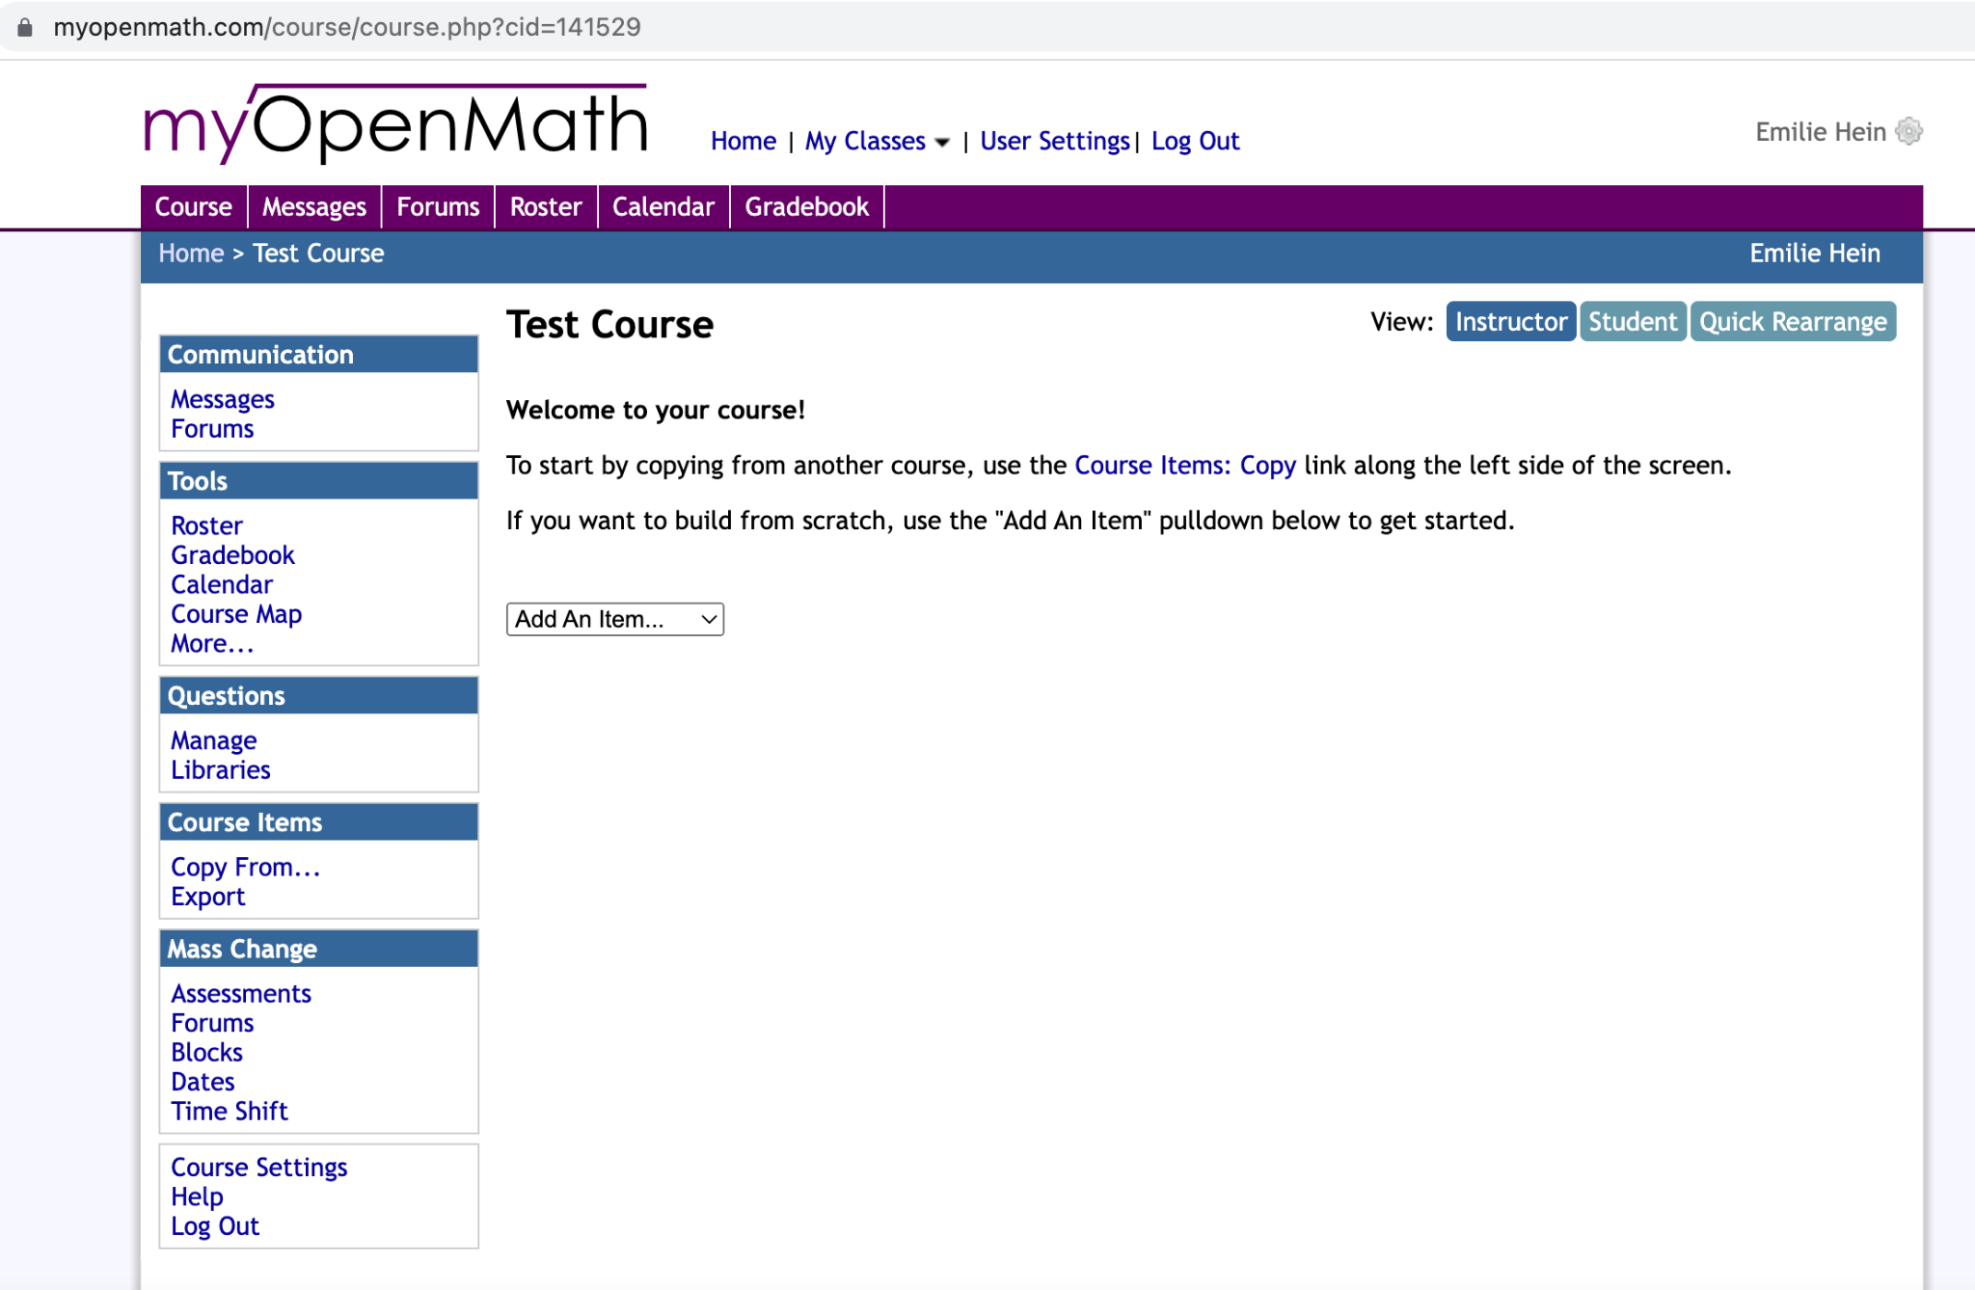
Exploring your new course

Slide 14
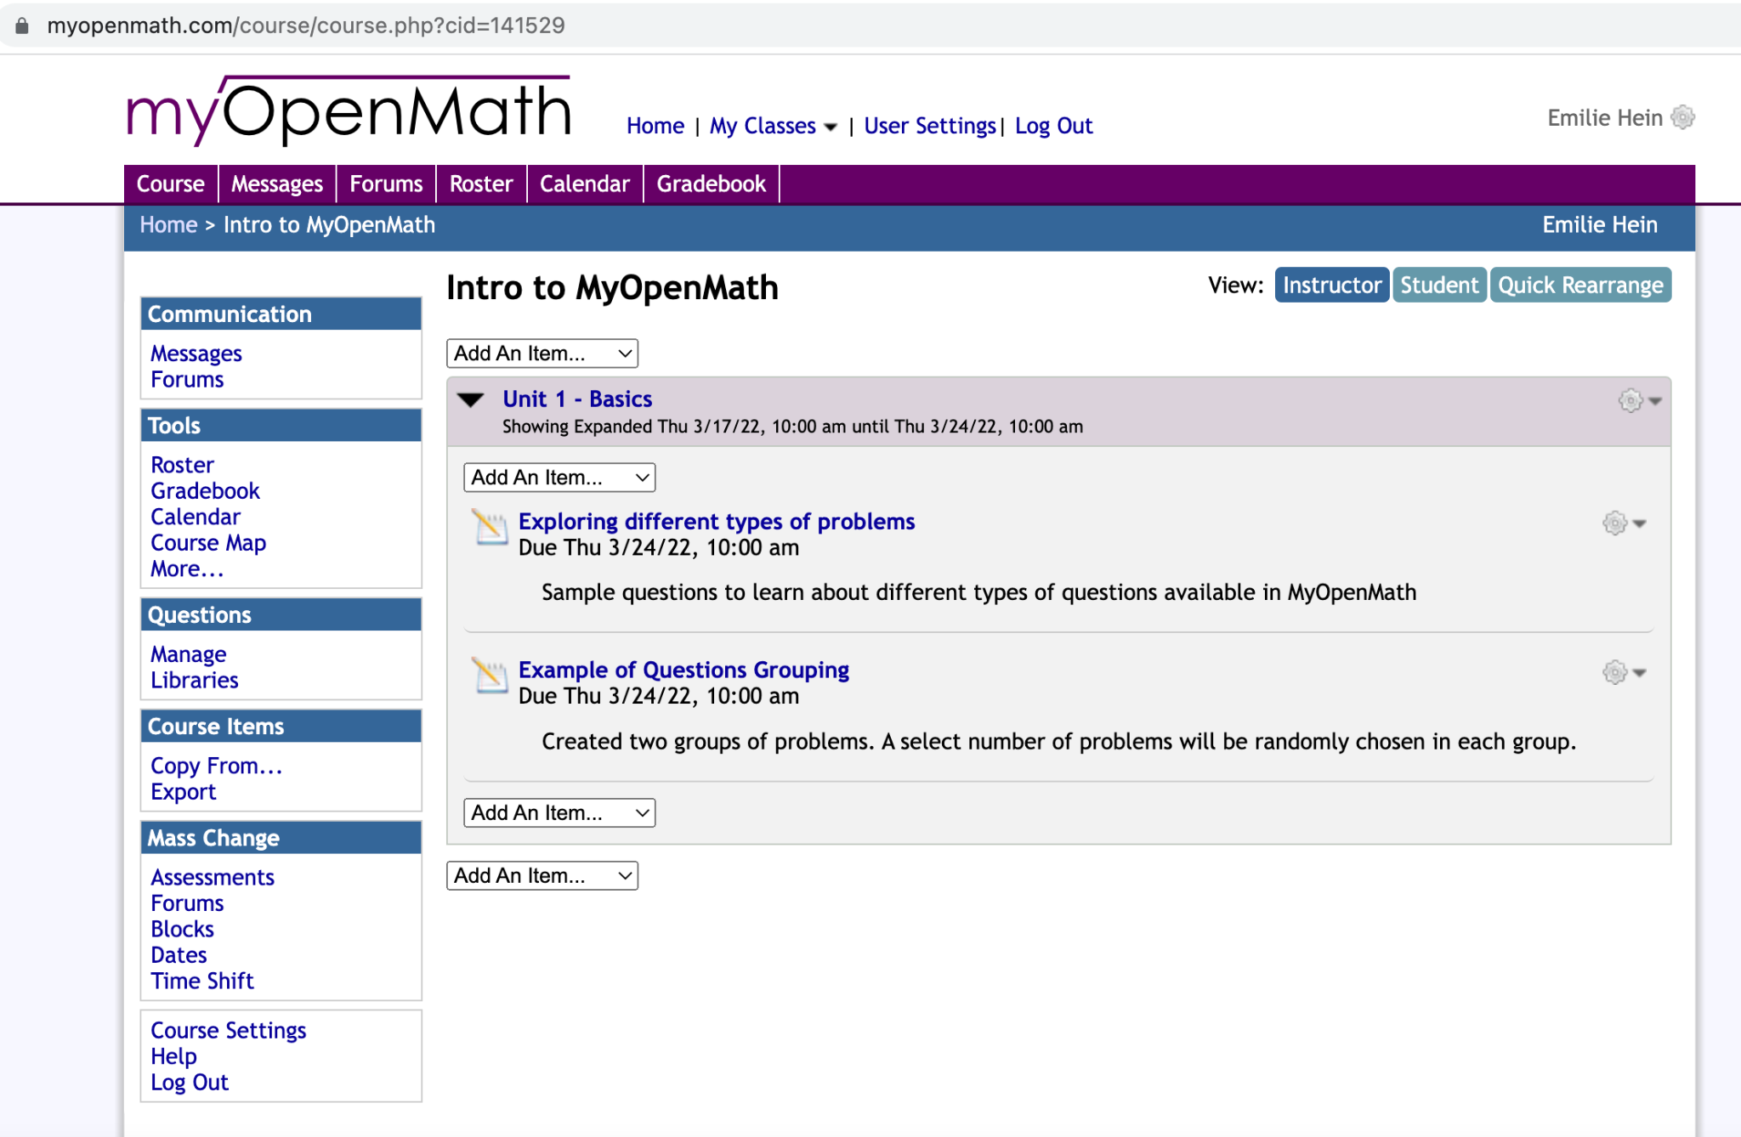
Let’s explore some examples…
Course ID: 141529
Course Name: Intro to MyOpenMath
Enrollment key: mom_intro

Slide 15
What now?
Explore existing content
Most users don’t need to learn how to code problems, they can use existing resources, as is.
If you don’t find what you are looking for
Ask the MOM community - a lot of people are developing content for various disciplines.
Ask the OER/ZTC community
https://asccc-oeri.org/
Talk to your colleagues, in your department and beyond. There may be funding available if you are interested in creating your own course templates
A lot of content for physics was developed thanks to ASCCC OERI grants
Get a team together or contact your ASCCC OERI Discipline lead
If you have any questions, please feel free to contact me - Emilie Hein heine@smccd.edu; Polin Yadak yadakp@smccd.edu

