Slide 1
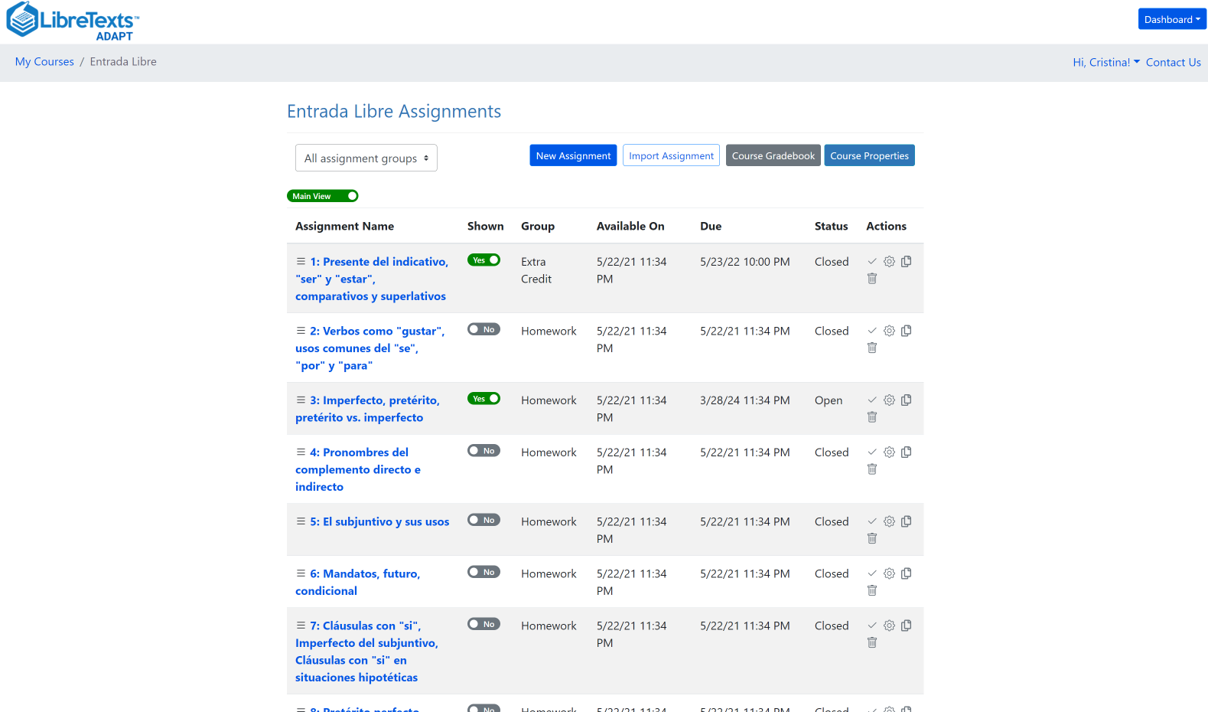
Spanish Hackathon
Cristina Moon
Friday, October 27, 2023

Slide 2
Your helpers at today’s hackathon
Alejandro Lee, Ph. D., MLIS
Spanish Faculty
Santa Monica College
Tarea Libre and Entrada Libre co-author
Caren Parrish, Ph. D.
French Faculty
Chabot College
French OER 1 and French OER 2 co-author

Slide 3
Goals for this Hackathon
Create a mini collection for second-year Spanish.
We will create new ADAPT native questions:
Multiple choice
Select choice
Matching
Fill in the blanks
Speaking test

Slide 4
Past Recorded Webinars on ADAPT
Getting Spanish to Zero – An Openly-Licensed Homework Option for Spanish | 2023/10/20
Integrating ADAPT in Canvas | 2023/09/08
H5P Part II – Introduction to ADAPT | 2023/08/18
H5P Part I – Introduction to H5P and LibreTexts Studio | 2023/08/11
Want to Learn About H5P/LibreStudio and ADAPT for Open Educational Resources (OER)? | 2023/05/05
What’s new in Spanish OER: Tarea Libre | 2023/05/05
Creating Summative Assessments with H5P and ADAPT | 2022/12/02
H5P Level III – Creating Summative Assessments with H5P in ADAPT | 2022/07/13
H5P Level II – Building Interactive Content in LibreStudio | 2022/07/11
H5P Level I – Introduction to H5P | 2022/06/27
Online Homework Solutions to Facilitate OER Adoption in Chemistry | 2022/05/13
Spanish, LibreTexts, and Adapt – Using OER to Customize Your Spanish Text and Integrate a Homework System | 2021/05/07

Slide 5
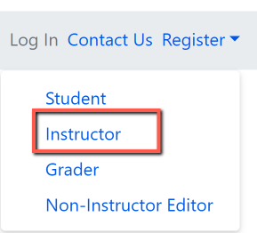
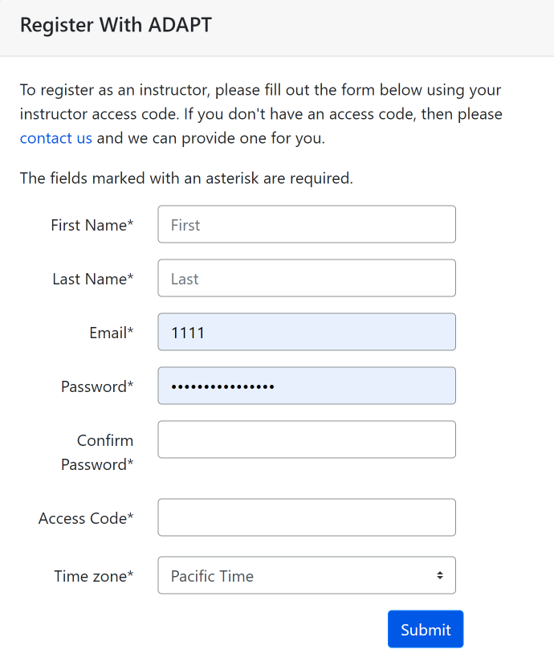
Create an instructor ADAPT account
Go to:
Login · ADAPT (libretexts.org)
Create an instructor account
Access code:
Click on “contact us” and complete the form. Once confirmed, you will receive an email with the access code which you will use to create the ADAPT account

Slide 6
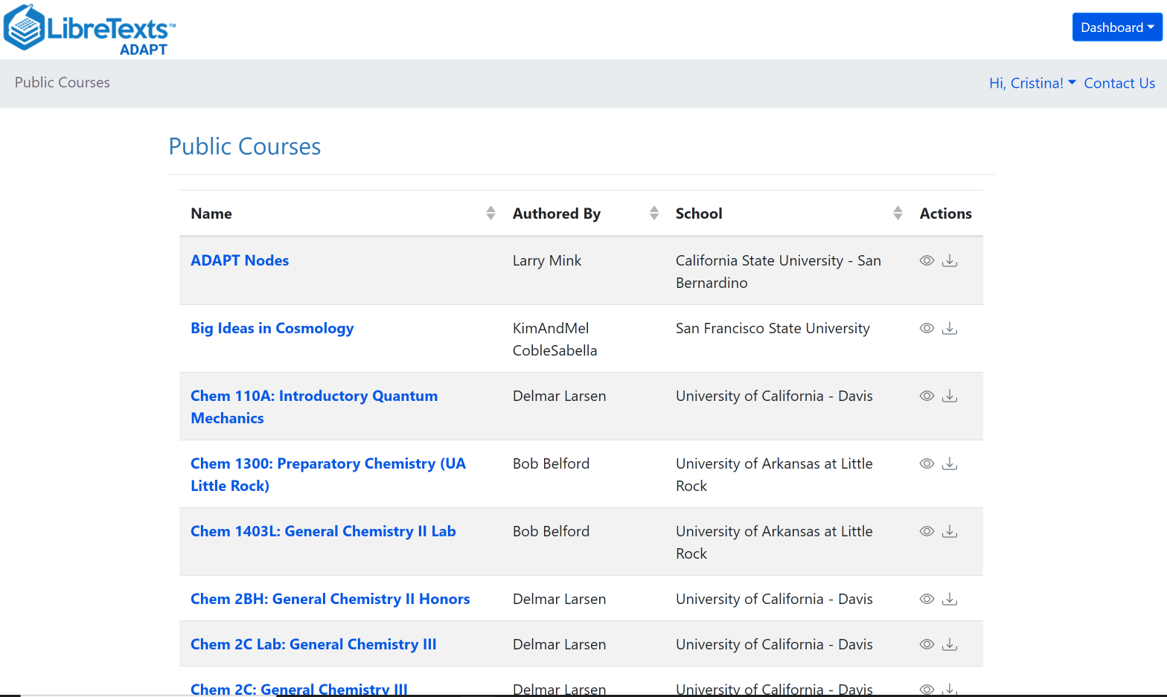
What is ADAPT?
ADAPT is a comprehensive online assessment/homework infrastructure that provides faculty the ability to include auto-graded and non-auto-graded activities from different platforms such as H5P, MyOpenMath, WeBWork, and it’s own native ADAPT questions.
ADAPT can be integrated into an LMS such as Canvas with full grade integration or it could be run independently.

Slide 7
Let’s get to work!
¡A trabajar!

Slide 8
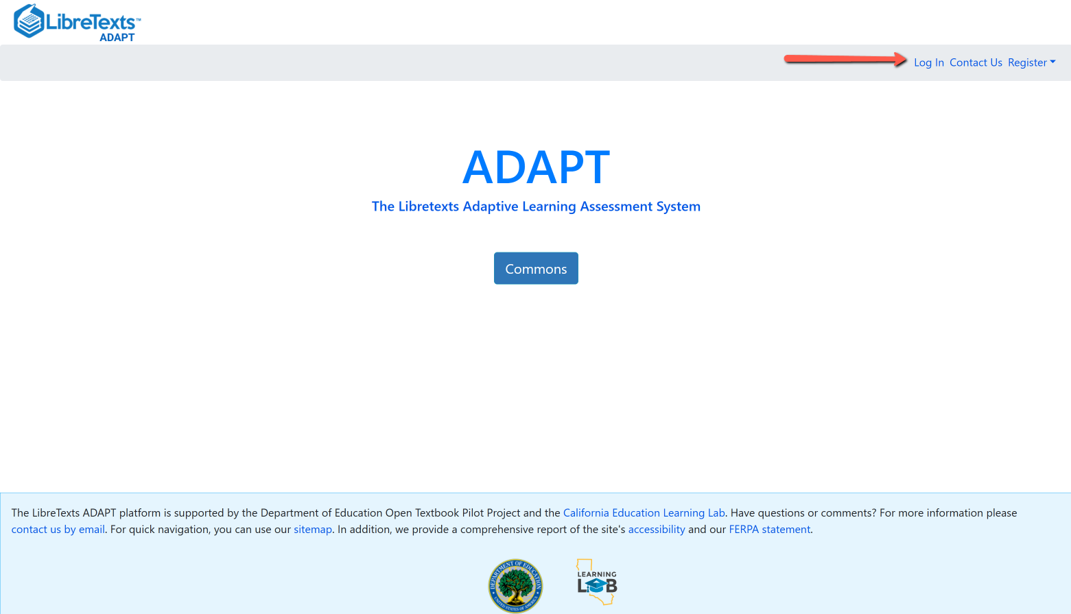
Login to ADAPT
Go to:
https://adapt.libretexts.org/login

Slide 9
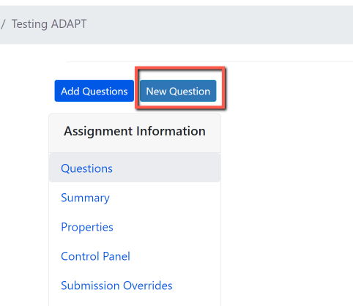
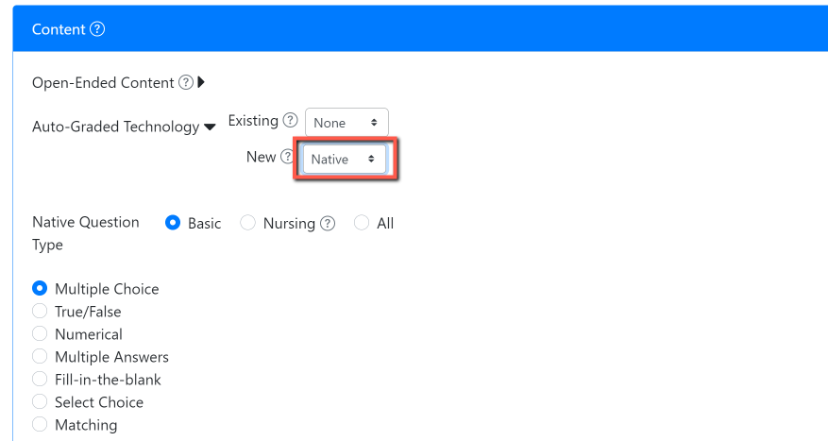
Activity # 1: Multiple Choice Question
Step # 1: Click on New Question
Step # 2: Select “New” > “Native” question
Notes:
1:05

Slide 10
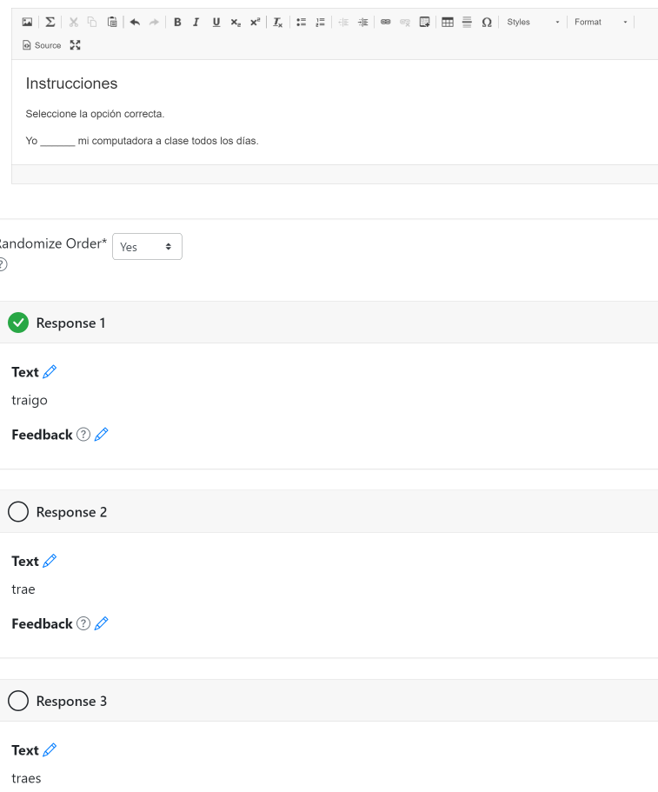
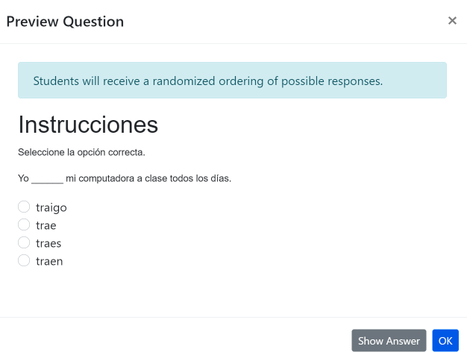
Write a question prompt and then create a selection of answers, choosing the correct answer from the list. Students will receive a shuffled ordering of the selection. Optionally provide feedback at the individual question level or general feedback for a correct response, an incorrect response, or any response.

Slide 11
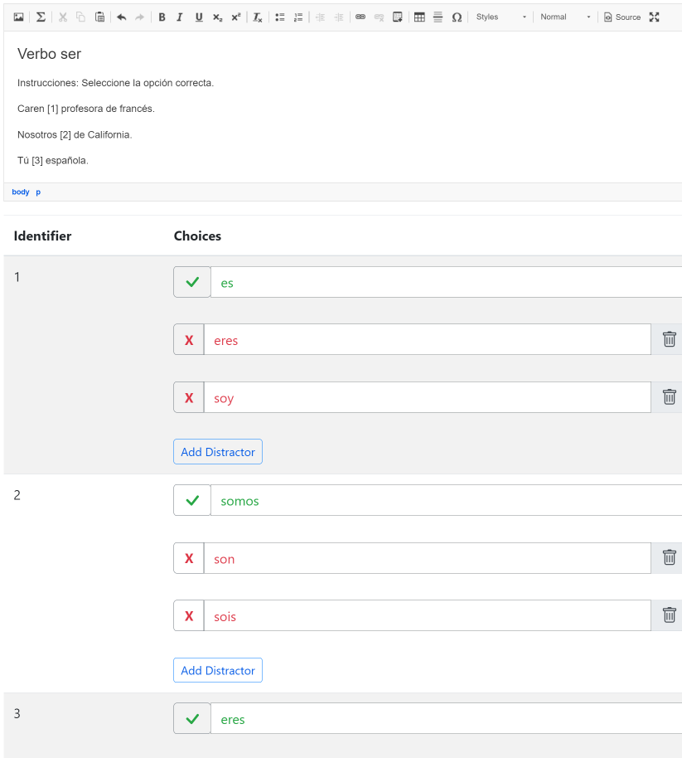
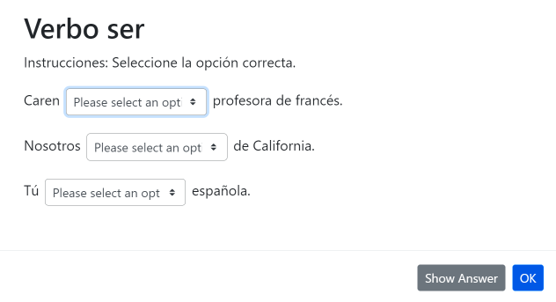
Activity # 2 Select Choice (drop-down) Question
Use brackets for answers. Example. The [planet] is the closest planet to the sun; there are [number-of-planets] planets. Then, add the choices below with your first choice being the correct response. Add distractors. Each student will receive a randomized ordering of the choices.

Slide 12
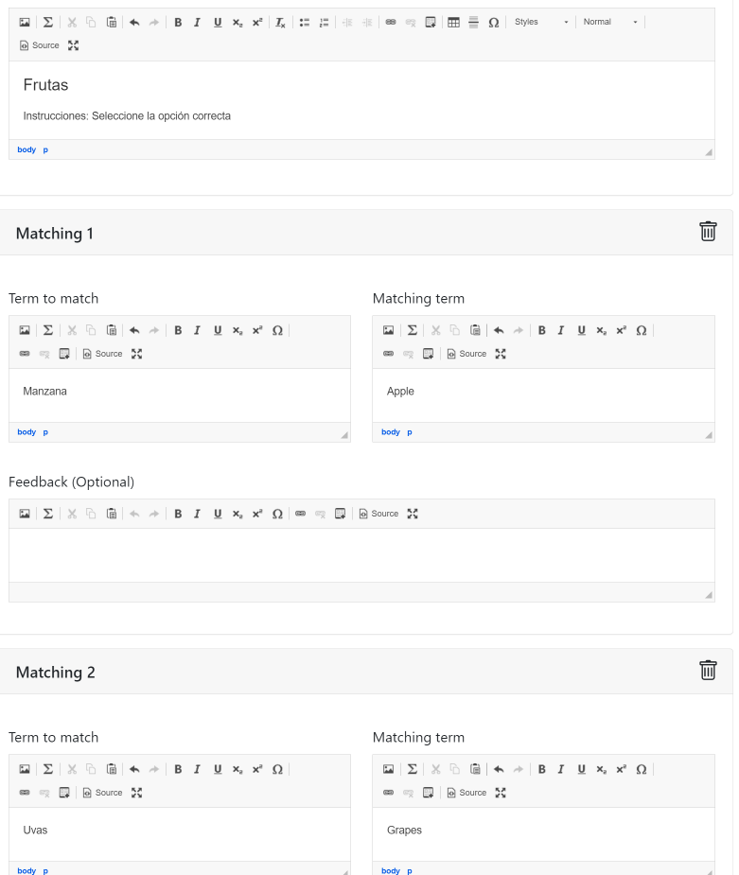
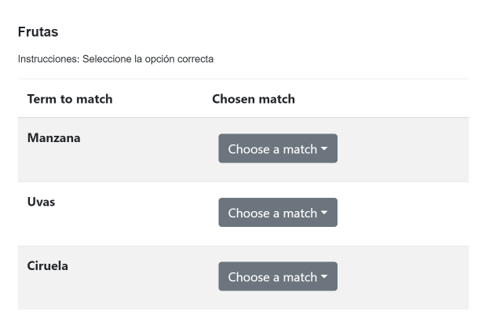
Activity # 3 Matching
Question
Create a list of terms to match along with their matching terms. Matching terms can include media such as images. Optionally, add distractors which do not satisfy any of the matches.

Slide 13
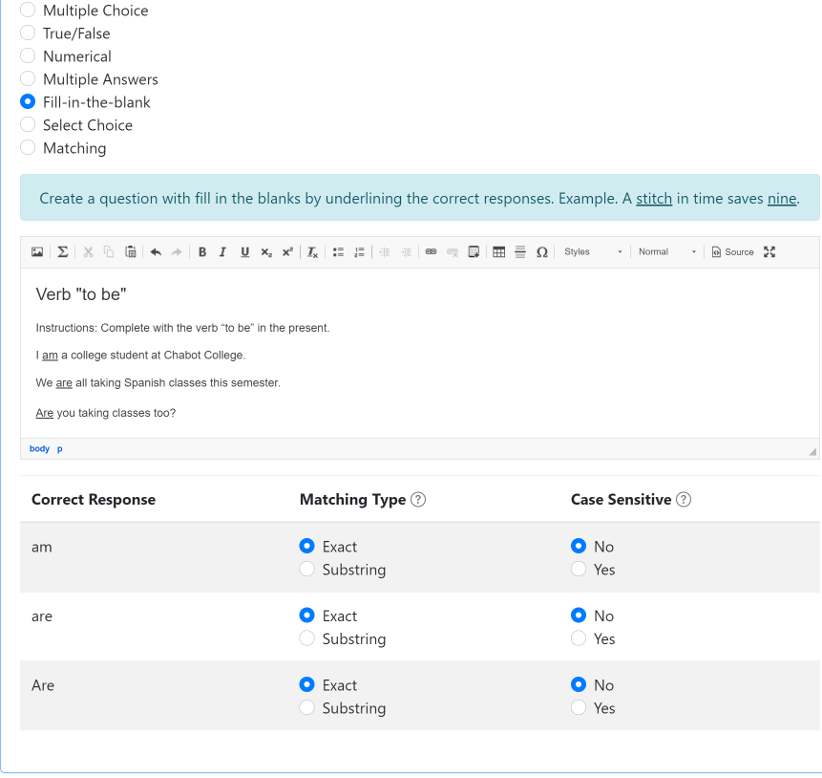
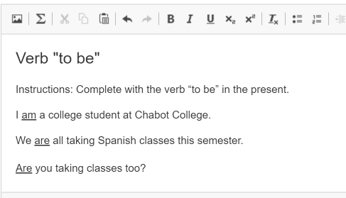
Activity # 4 Fill-in the blanks Question
Create a question with fill-in-the blanks by underlining the correct responses.

Slide 14
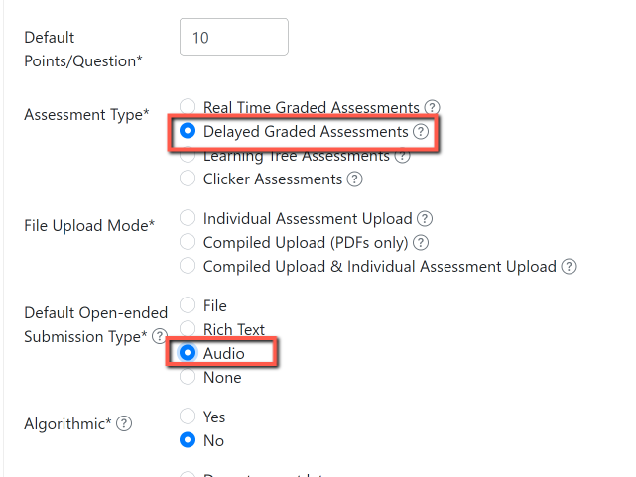
Activity # 5 Recording Question
Create a New Assignment
Under Assessment Type make sure to check “Delayed Graded Assessments”
For Submission type mark “Audio”

Slide 15
Do you want to edit an ADAPT question?

Slide 16
Step 1: Clone an activity to edit
After you add an activity to an assignment , clone it.
This will create a copy of the same activity which you will be able to edit.
Step 2: Change the name, edit, and now you have an edited version of the original (a clone).

Slide 17
Looking for more ADAPT resources?

Slide 18
ADAPT resources
Recorded webinar: Integrating ADAPT in Canvas (9/8/23)
ADAPT construction guide and Accessibility reports
If using H5P activities, make sure to look at the ADAPT ready questions list.
Ex: avoid course presentation, column, question set, etc.
LibreTexts weekly office hours:
https://zoom.libretexts.org (Tuesdays at 9:00-10:00 Pacific time)
https://zoom.libretexts.org (Thursdays at 9:00-10:00 Pacific time)

Slide 19
Questions?
Cristina Moon, Ph. D.
Spanish Faculty and OER/ZTC Coordinator at Chabot College
ASCCC OERI Spanish and the H5P/ADAPT Lead
ASCCC OERI Liaison
cmoon@chabotcollege.edu

