Slide 1








FINDING ECE OER ISN’T JUST MAGIC

Slide 2

Our Agenda for Today
  Resource Curation Sites
  Ancillaries
  Videos

Slide 3


OPEN EDUCATIONAL RESOURCES BY DISCIPLINE

Slide 4

Summary of Open Educational Resources in
Early Childhood Education

Slide 5




Early Childhood Education OER/ZTC Collaboration

Slide 6

Libretext
Early Childhood Education Bookshelf

Slide 7
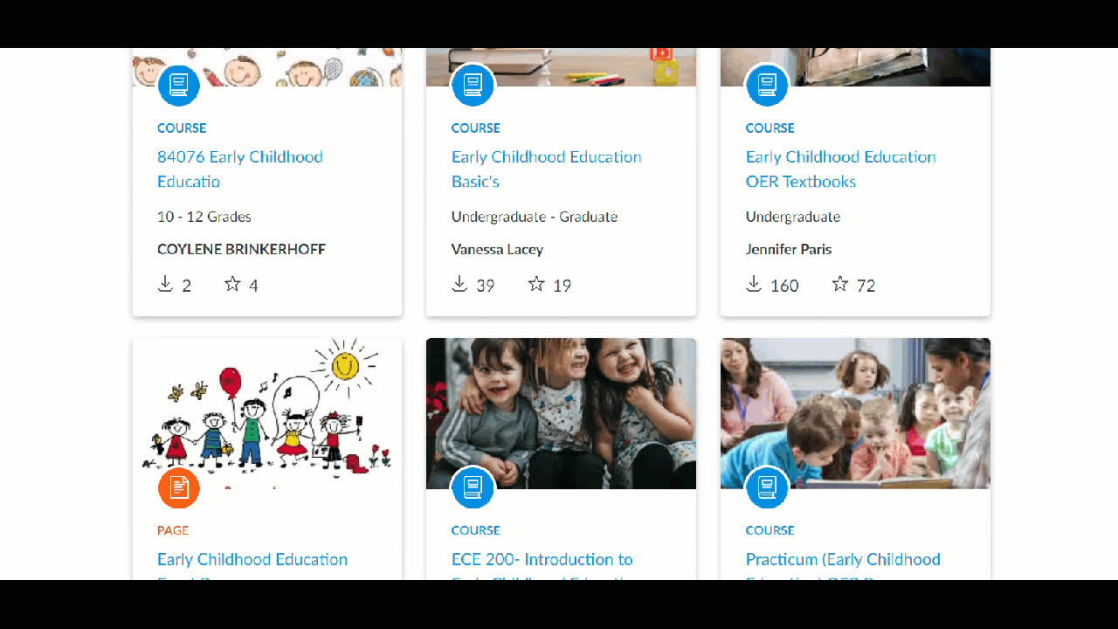


CANVAS COMMONS

Slide 8
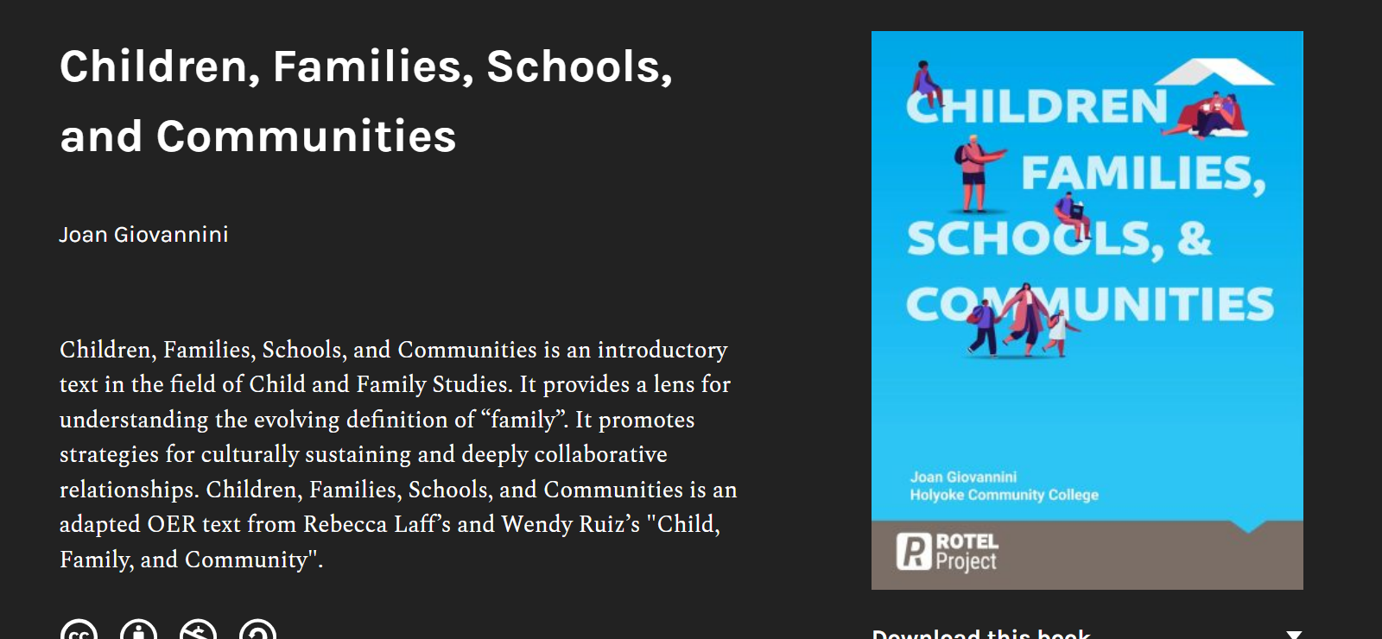
new resources
https://rotel.pressbooks.pub/children-families-schools-communities/

Slide 9

Methods of Teaching Early Literacy

Slide 10
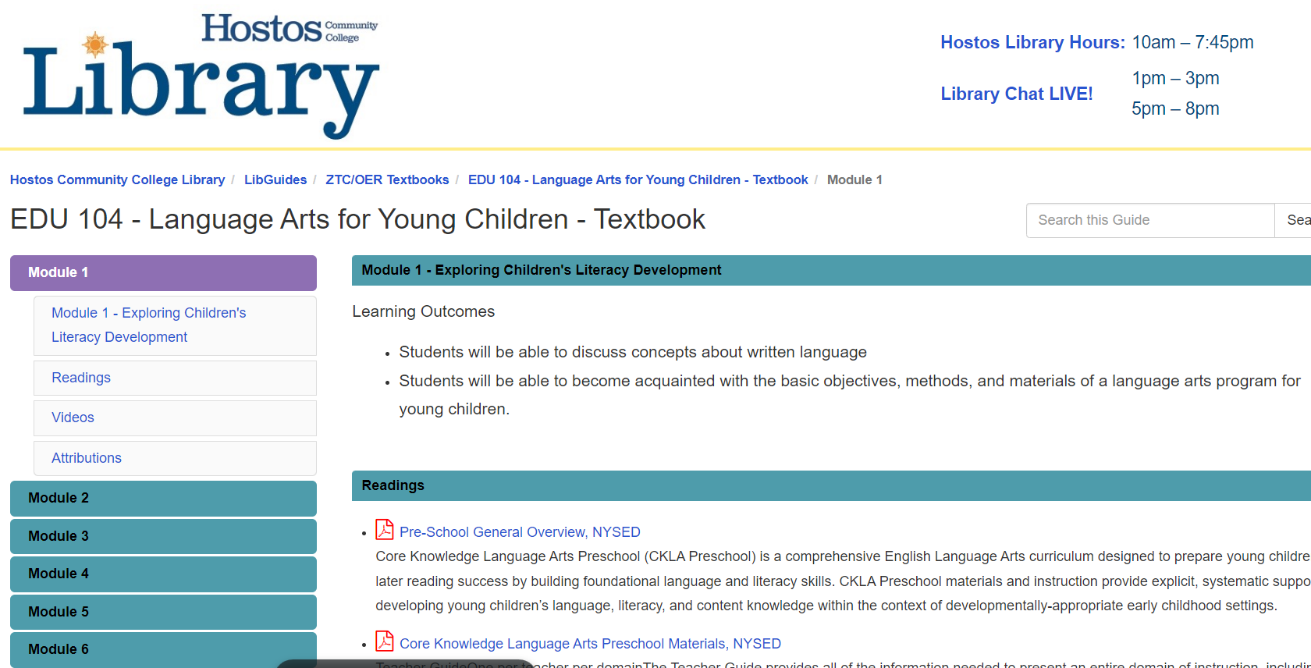
LANGUAGE ARTS FOR YOUNG CHILDREN - TEXTBOOK

Slide 11
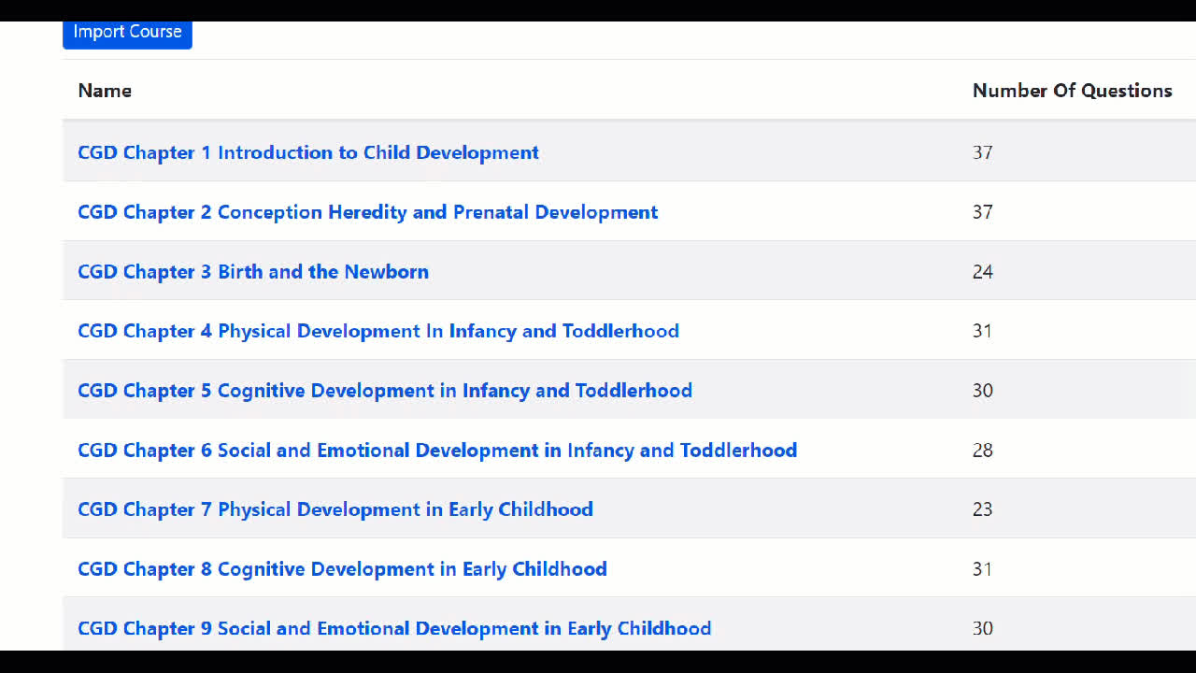
ADAPT

Slide 12
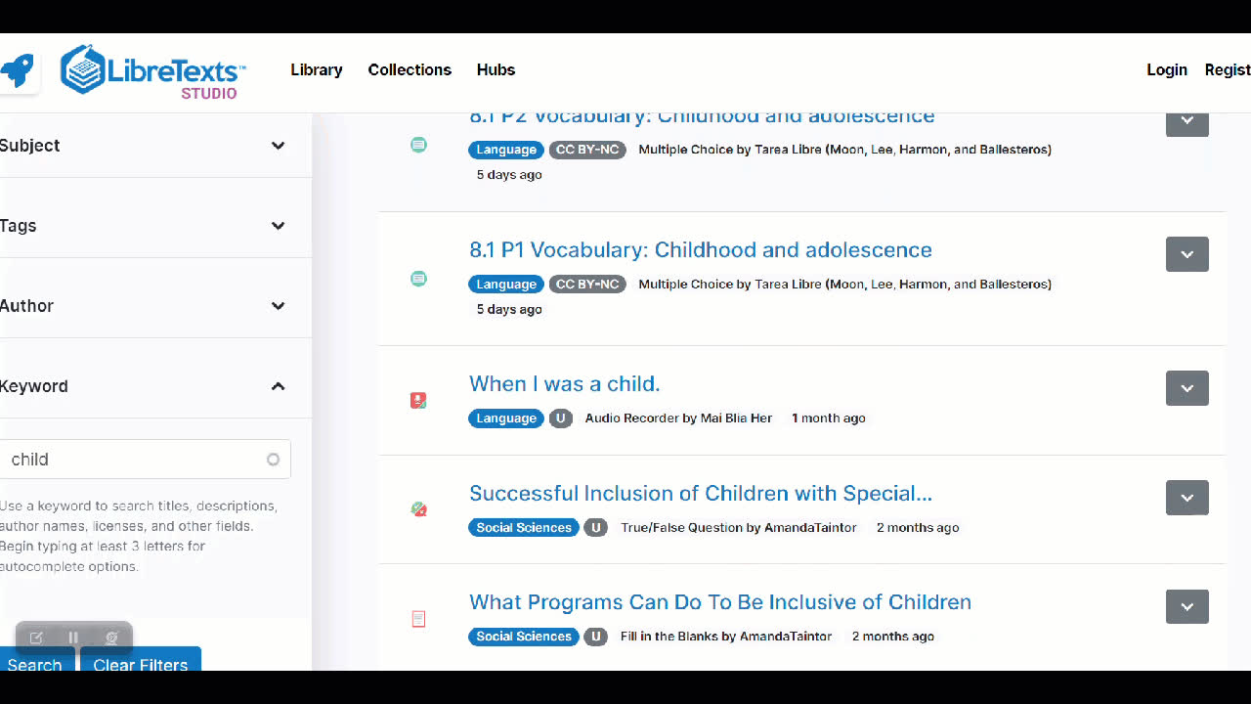
Libretext Studio

Slide 13
NOT OER BUT....

Slide 14
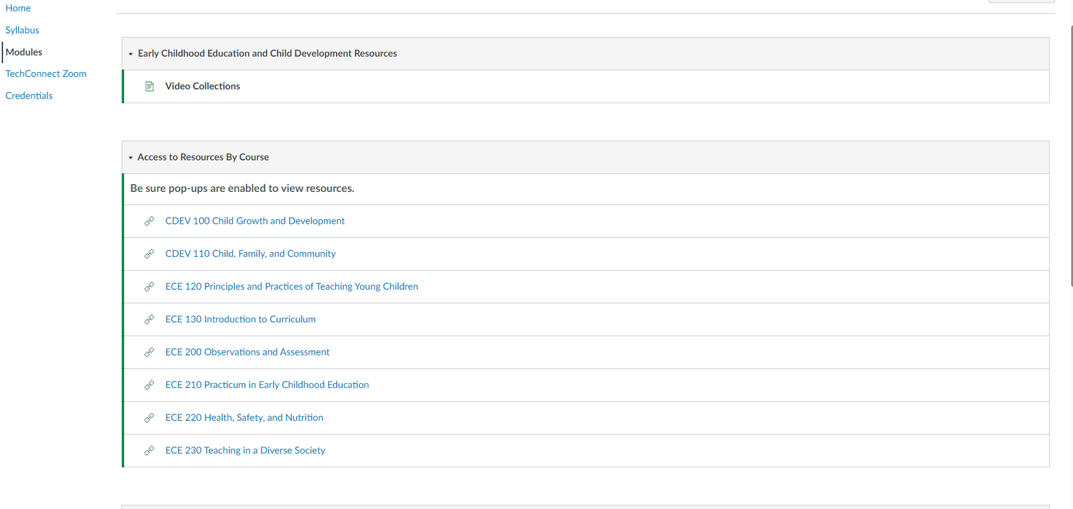
Videos
OERI Video Shells http://tinyurl.com/OERI-Video

Slide 15
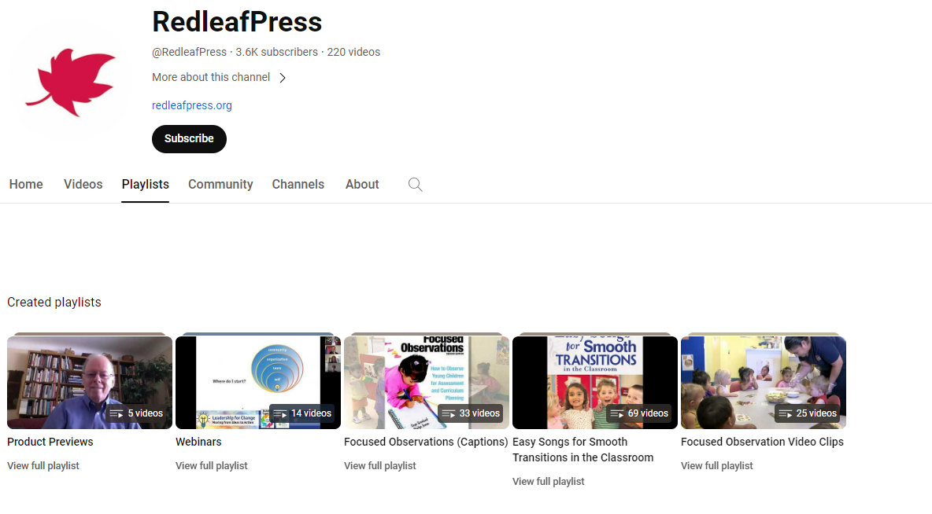
Other video sources
YouTube
Redleaf Press
CompSAT
CECE Early Childhood Videos at Eastern CT State U.
Search Terms
  Child Observation
  Playgroun Observation
  Early Childhood

Slide 16
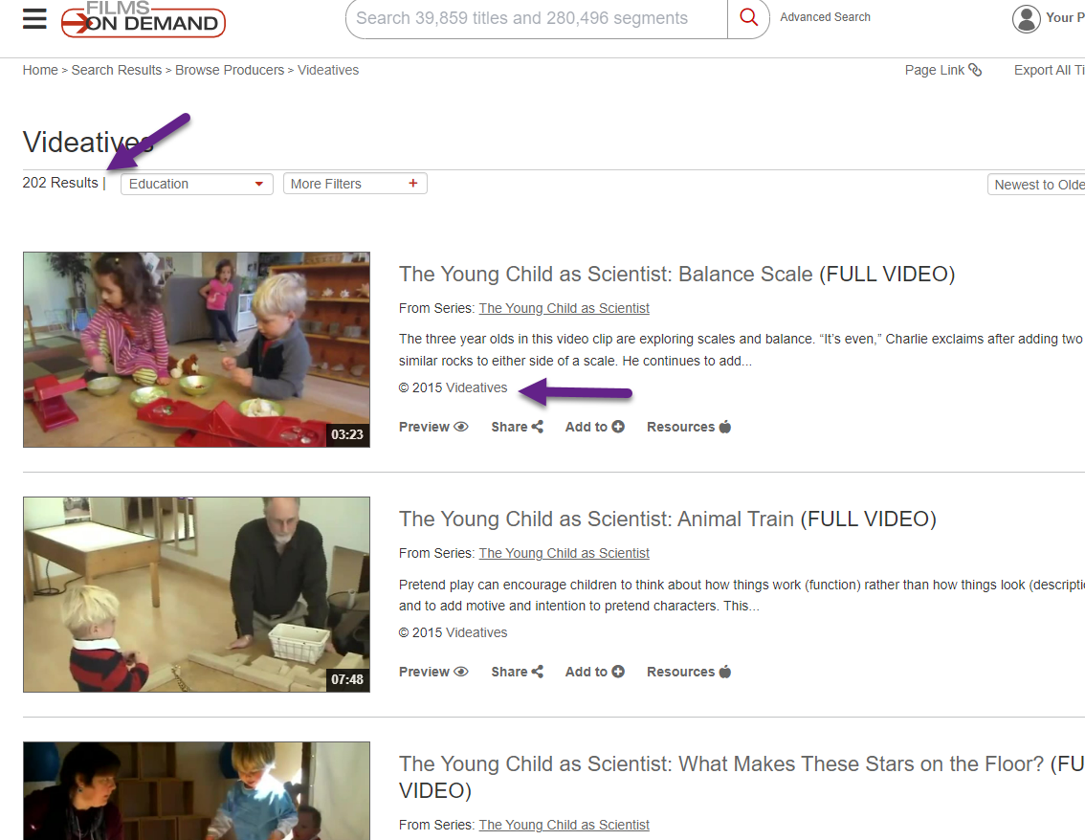
LIBRARY RESOURCES TO CHECK ON
Films on Demand
  Videatives
  Search terms:
    Observation
    Child
    Curriculum

Slide 17
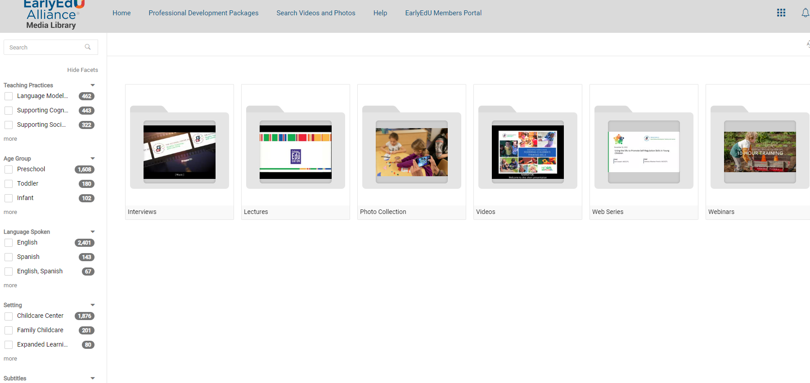
EarlyEdu Alliance
Media Library

