Slide 1
Welcome!
On behalf of the ASCCC OERI, we are pleased to have you here with us for “Examples of OER Development Processes”
If you are not already muted, please mute yourself upon arrival.
Please note that you are encouraged to use the Zoom “chat” feature for questions and comments.
You’re invited to introduce yourself in the chat. You might want to provide
Your name,
Your college(s),
Your discipline/role, and
Any OER that you have developed

Slide 2
Conversation: Examples of OER Development Processes
OERL Webinar; Monday, Dec. 4, 1:30 pm – 2:30 pm
This work is licensed under a Creative Commons Attribution 4.0 International License.

Slide 3
Description
Have you wondered what it's like to develop OER? It turns out that there are a LOT of different processes and experiences! Come listen to the experiences of a few different OER developers. We'll have plenty of time to answer your questions, too!

Slide 4
Host & Chat Monitor
Michelle Oja, ASCCC OERI Regional Lead for Area A
Psychology, Taft College
Lara Braff, ASCCC OERI Regional Lead for Area D
Anthropology, Grossmont College
Photo (photographyer unknown) on PXHere

Slide 5
Presenters
Presenter | Discipline | College
Mario Espinoza-Kulick | Ethnic Studies | Cuesta College & Porterville College
Patricia Foley | Chemistry & Engineering | College of the Canyons
Cristina Moon | Spanish | Chabot College
Ly-Huong Pham | Business & Workforce | Evergreen Valley College
Lara Braff | Anthropology | Grossmont College
Michelle Oja | Psychology | Taft College

Slide 6
Overview
Case Studies
Q & A
Resources
Pixabay

Slide 7
Ethnic Studies OER Projects and Resources
Introduction to Ethnic Studies (http://tinyurl.com/IESOER)
This textbook examines the development of Ethnic Studies as an academic discipline and provides relevant education centering narratives, philosophies, histories, and cultures of Black Indigenous People of Color, while countering eurocentrism and white supremacy. The content includes a comparative approach covering Africana/African American/Black Studies, Asian American and Pacific Islander Studies, Chicanx/Latinx Studies, and American Indian/Native American Studies.
New Directions in Chicanx and Latinx Studies (http://tinyurl.com/NDCLS)
A comprehensive, peer-reviewed introductory textbook written by scholars from the California Community Colleges and California State University. The content, spanning ten chapters, is guided by intersectional, transnational, and relational frameworks that build on current and emergent work in Chicanx and Latinx Studies.
Open Educational Resources and Ethnic Studies Discipline Guide (https://asccc-oeri.org/open-educational-resources-and-ethnic-studies/)
Includes resources for Ethnic Studies, African American Studies, Native American Studies, Asian American Studies, and Chicanx and Latinx Studies

Slide 8
CHEM 101 ADAPT Project
CANVAS
Why do we use online homework?
Extra practice
Just-in-time feedback
What we need
Auto-graded problems
Algorithmic problems
Evaluate significant figures
Meaningful feedback
Our Team
Tom Gisel (COC), Sheba Kuruvilla (MSJC), Schetema Nealy (Compton), Erin Brocker (VCC), Eshani Lee (Penn State), Tricia Foley (COC)

Slide 9
CHEM 101 ADAPT Project (cont.)
Successes
Equitable Framework for Classroom Assessment
Challenges
Technology transfer between ADAPT and MyOpenMath System
Element | Features
Macrostructure | Visual appearance Superficial structure
Readability | Sentence structure Wording or Syntax
Representations | Visual illustration Graphic organizer
Scaffolding | Content support/cues Contextualization
Some questions don’t transfer
Accessibility in both systems
Underlying coding challenging
Dr. Eshani Lee’s work

Slide 10
Cristina Moon
Chabot College
Spanish Faculty
OER Project | Entrada Libre RFP I (May 2019-January 2020) | Tarea Libre RFP IV (May 2022-February 2023)
The Project | 2nd year Spanish grammar manual. 8 chapters 24 grammar points H5P activities for each grammar page | 1st year Spanish HW bank. 14 modules 57 grammar points 1,400 H5P/ADAPT activities 47 cultural readings with recorded narration and auto-graded comprehension questions
The Team | Team of 3 Spanish instructors + 1 accessibility specialist | Team of 4 Spanish instructors (2 from NorCal + 2 from SoCal)
The Challenges | We had 3 months to write. Dealing with the copyright and accessibility issues with H5P. | Writing 1,400 activities! Dealing with accessibility issues.

Slide 11
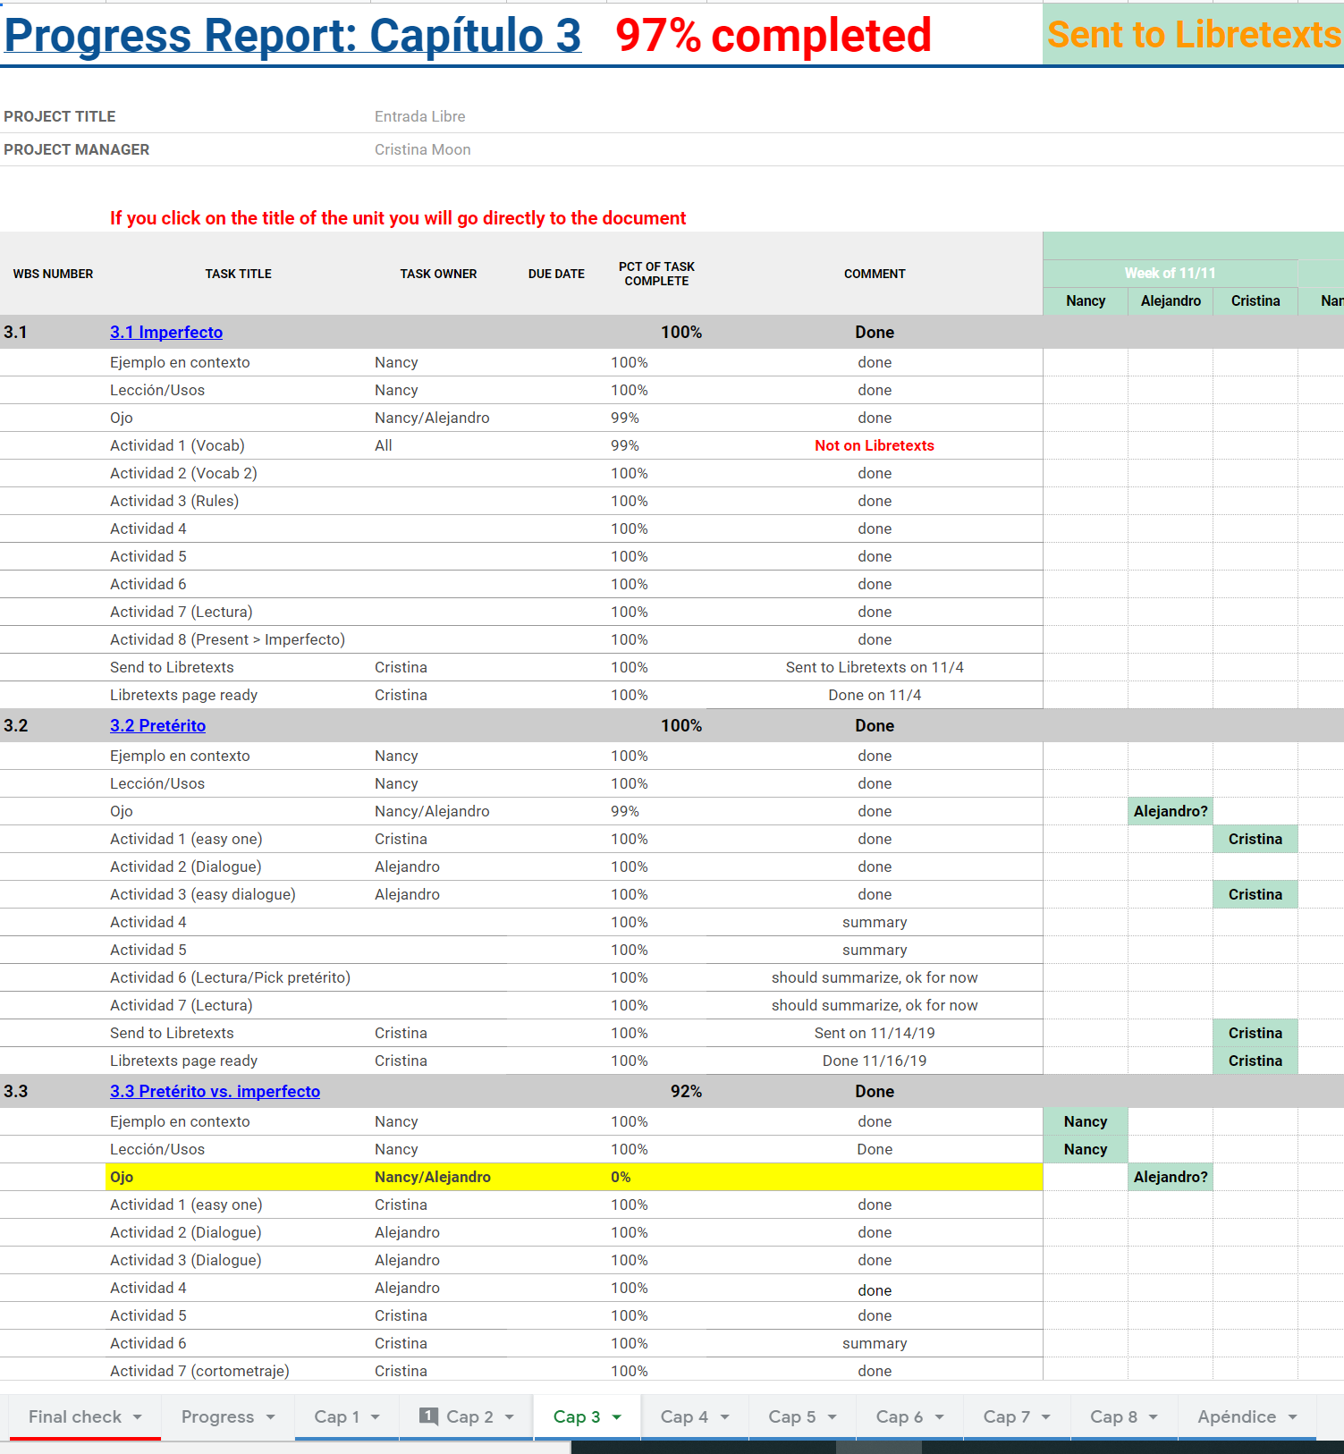
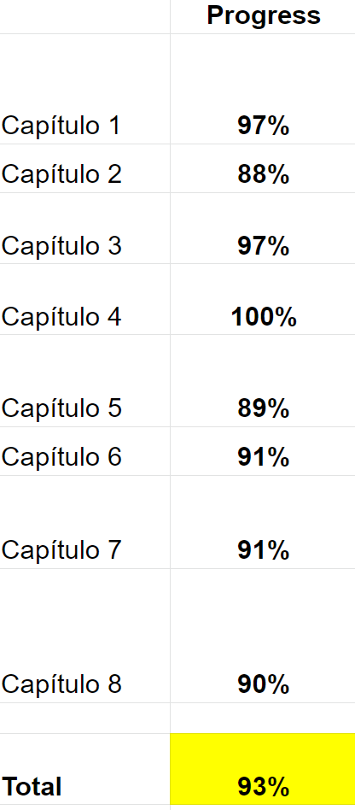
What worked for us?
Have clear deliverables and track the work.
Google docs to collaborate on content.
Google sheet to keep track of progress.
Regular: Weekly “meetings” either in Google or Zoom and daily text messages.

Slide 12
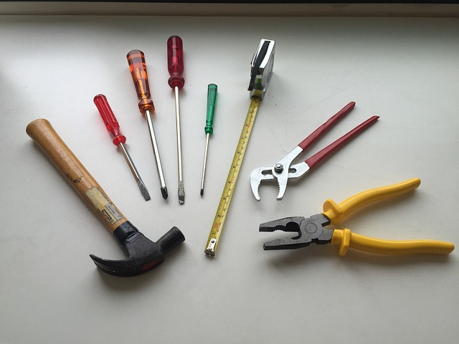
Ly-Huong Pham, Evergreen Valley College, B&W
 | Information Systems for Business (Revised 1st Edition, 2021) ASCCC RFPII | Information Systems for Business 2e (2023) EVC | Information System Lab Manual (2024), EVC, in progress
How much time did the project take?
How did you begin the project? What approach did you take?
Were other people involved? If so, how were they recruited and what did they do? | P | W | R, P
What were some successes and challenges? | P, P, P W, P | W, P

Slide 13
Ly Pham, Evergreen Valley College
Processes – Lessons Learned
Have different processes for different phases, different funding sources
•Time the roll out of only relevant processes, not all at once
•“Meet up hours” to work together in lieu of training/tracking each other
•Record mini walk-through videos from ‘just in time’ training
•Write a clear ‘job description,’ including when and how each member is compensated.
•Give Extra attention depending on the Team size and prior experience. Be prepared to step in and pick up extra tasks.
•Have a common place to store updates, documents, reviews,, project trackers (i.e., Canvas, Google Drive)
•Communicate with ALL stakeholders (Deans, faculty) throughout the project at different times/places (i.e. PDD, Division meetings)
Tracking progress is more than tracking deliverables
Writing an OER is more than writing a book

Slide 14
Dr. MO’s Resources
Private Resources- Email MO
Public Resources
Notes on coding equations
Accessibility resources & guides
APA Style resources
Notes on copyright and licensing
Notes on homework systems
Links and licensing info for images and videos
Notes on LibreTexts
Statistics resources
Textbooks and repositories (for behavioral statistics)
Resources showing benefits of OER
And notes from specific trainings and webinars!
Looking for OER that’s Already Created: https://tinyurl.com/MOsFindingOER
Learning OER Fundamentals: https://tinyurl.com/MOsOERfundamentals
Steps to creating OER: ttps://tinyurl.com/MOsOERsteps
Notes:
Looking for OER that’s Already Created: https://tinyurl.com/MOsFindingOER
Learning OER Fundamentals: https://tinyurl.com/MOsOERfundamentals
Steps to creating OER: ttps://tinyurl.com/MOsOERsteps

Slide 15
Explorations: Biological Anthropology
First and Second Editions
Our process
4 co-editors
41 authors/instructors (16 chapters; 3 appendices)

Slide 16
Resources: OER Discussed
Ethnic Studies:
Introduction to Ethnic Studies (http://tinyurl.com/IESOER)
New Directions in Chicanx and Latinx Studies (http://tinyurl.com/NDCLS)
Open Educational Resources and Ethnic Studies Discipline Guide (https://asccc-oeri.org/open-educational-resources-and-ethnic-studies/)
Chemistry - coming soon! (Spring 2024)
Spanish:
Entrada Libre RFP I (2020)
Tarea Libre RFP IV (2023)
Business:
Information Systems for Business (Revised 1st Edition, 2021) RFPII
Information Systems for Business 2e (2023) EVC
Information Systesm Lab Manual (2024), EVC, in progress
Anthropology: Explorations: An Open Invitation to Biological Anthropology
Behavioral statistics:
Search “PSYC 2200 LibreTexts”
Direct link
Notes:
Ethnic Studies:
Introduction to Ethnic Studies (http://tinyurl.com/IESOER)
New Directions in Chicanx and Latinx Studies (http://tinyurl.com/NDCLS)
Open Educational Resources and Ethnic Studies Discipline Guide (https://asccc-oeri.org/open-educational-resources-and-ethnic-studies/)
Chemistry - coming soon! (Spring 2024)
Spanish:
Entrada Libre RFP I (2020)
Tarea Libre RFP IV (2023)
Business:
Information Systems for Business (Revised 1st Edition, 2021) RFPII
Information Systems for Business 2e (2023) EVC
Anthropology: Explorations: An Open Invitation to Biological Anthropology
Behavioral statistics:https://stats.libretexts.org/Courses/Taft_College/PSYC_2200%3A_Elementary_Statistics_for_Behavioral_and_Social_Sciences_(Oja)

Slide 17
Resources: ASCCC OER-I
ASCCC OERI Website
Resources
Webinars and Events
Contacts:
oeri@asccc.org
Find everyone’s e-mail at: https://asccc-oeri.org/about-us/
Notes:
https://asccc-oeri.org/
oeri@asccc.org
https://asccc-oeri.org/about-us/

