Slide 1
Intro to OER for English
November 30, 2023
Anna Mills, Cañada College
ASCCC OERI English Discipline Lead
Slides (open for commenting): https://bit.ly/OEREnglish

Slide 2
Agenda
Why OER?
What’s available for English?
Working with an OER text: possibilities
Getting started adapting or authoring OER

Slide 3
Please say hello in the chat!
Name and college
Any topic you hope to cover today

Slide 4
Why OER?

Slide 5
Academic Senate for California Community Colleges Open Education Resources Initiative Michelle Pilati, Faculty Lead
OER Liaisons on every campus
OER Discipline Leads make resource lists and host webinars
Resources at ASCCC-OERI.org

Slide 6
What are Open Educational Resources?
Creative Commons defines OER as teaching, learning, and research materials that are either (a) in the public domain or (b) licensed in a manner that provides everyone with free and perpetual permission to engage in the 5R activities– retaining, remixing, revising, reusing and redistributing the resources.
-- Creative Commons

Slide 7
The 5R Permissions of OER
Make and own copies
Retain
Reuse
Use in a wide range of ways
Adapt, modify, and improve
Revise
Combine two or more
Remix
Share with others
Redistribute
The framework, freely available under a Creative Commons Attribution 4.0 license (CC BY), was designed by Lumen Learning as the 5Rs

Slide 8
Traditional Textbook
OER
Publishing company owns copyright and sells book for profit
Cannot copy, scan, or share without permission
One student = one copy
Cannot change (revise or edit) material
No one making a profit
Freely and instantly available online
Copy, scan, share, as much as needed
Edit, revise, modify (depending on the license)

Slide 9
Why Use OER, Especially Now?
Free - students need extra financial help right now
Instant, permanent access- no waiting for books to arrive, no expired access
Takes guessing game out of copyright and fair use
Can be integrated into Canvas
Can be printed as well

Slide 10
How Do You Know if Something is OER and Not Just Free?
Look for Creative Commons licenses:

Slide 11
OER lead to greater improvement in grades and retention for non-white and low-income students
POPULATION | CHANGE IN GRADE | CHANGE IN Drop, Fail, Withdraw
All Student | +8.6% | -2.68%
Non-Pell Eligible | +7.4% | -2%
Pell Eligible | +12.3% | -4.4%
Non-White | +13% | -5%
Part Time | +28% | -10%
Total students: 21,822
Source: AAC&U, University of Georgia The Impact of Open Educational Resources on Various Student Success Metrics, in International Journal of Teaching and Learning in Higher Education, 2018
This slide adapted from “OER Basics for the Less Familiar”, by Jennifer Paris of ASCCC OERI, licensed CC BY 4.0.

Slide 12
Increasingly, OER feature equitable representation and anti-racist principles

Slide 13
What’s available for English?

Slide 14
How do I quickly check for OER textbooks I might want to adopt?
Try the ASCCC-OERI English and Literature resource page

Slide 15
OER and English page on OERI Website

Slide 16
A list of textbooks organized by California course outline (C-ID)
College Composition
Argumentative Writing and Critical Thinking through Literature
Argumentative Writing and Critical Thinking
Style Guides
Readings and Anthologies
Introduction to Literature
Survey of American Literature 1 and 2
Survey of World Literature 1 and 2
Survey of Literature in English 1, 2, 3
Survey of British Literature 1 and 2
Children’s Literature
Introduction to Creative Writing

Slide 17
A few recommended texts for College Composition (ENGL 100)
EmpoWord: A Student-Centered Anthology & Handbook for College Writers
Let's Get Writing!
Successful College Composition
Writing Guide with Handbook (OpenStax)

Slide 18
More recommended texts for College Composition (ENGL 100)
About Writing
The Word on College Reading and Writing
Writing for Success
How Arguments Work: A Guide to Writing and Analyzing Texts in College (my book)

Slide 19
The OpenStax Writing Guide with Handbook focused on “cultural awareness as a core outcome” (OpenStax blog, 2/22)

Slide 20
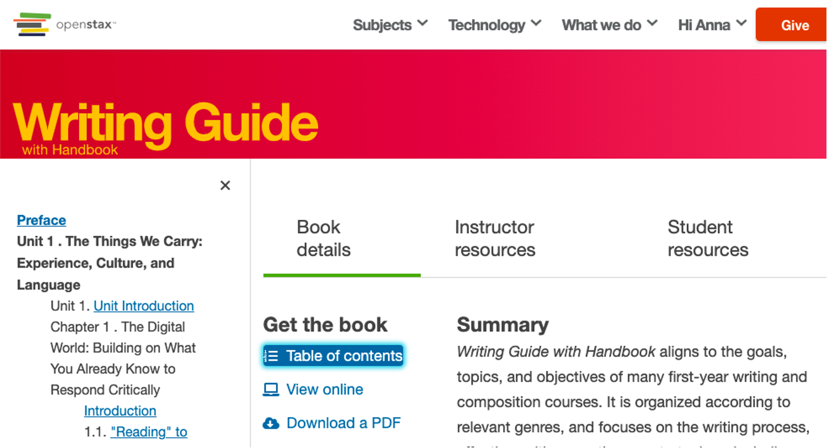
Writing Guide on OpenStax

Slide 21
But there are so many more...
The list includes some three dozen other OER textbooks relevant to C-ID English 100.
How do we assess quality efficiently?

Slide 22
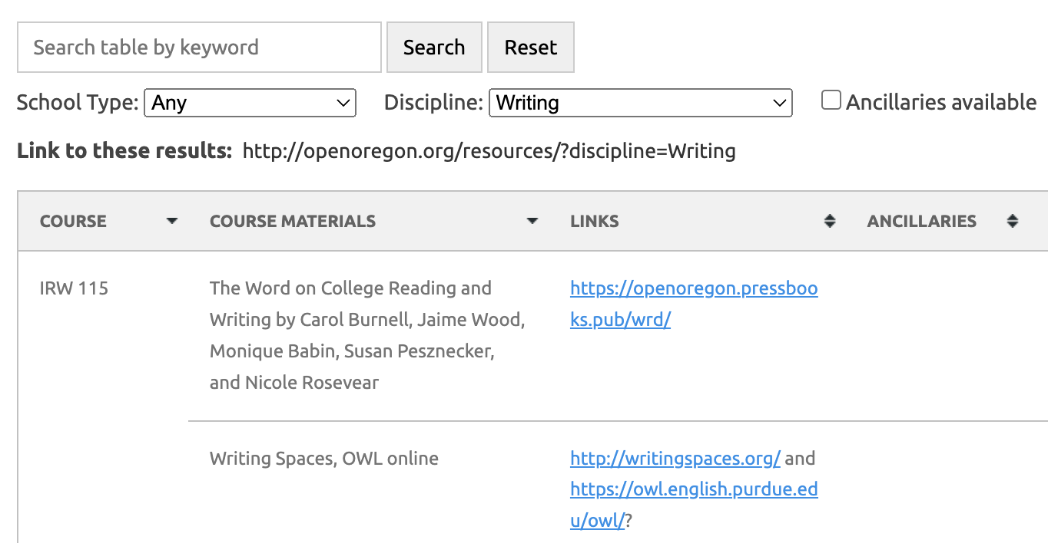
Look at which texts have been widely adopted
Open Oregon lists adoptions for writing courses across Oregon. Search on a particular title to see if it has been adopted in Oregon.

Slide 23
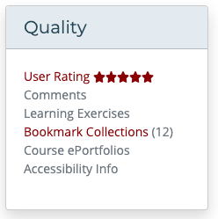
Look at instructor ratings
Open Textbook Library
MERLOT (also shows how many people have bookmarked a resource)
OER Commons
Cool4Ed

Slide 24
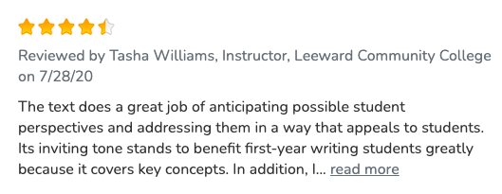
Open Textbook Library has the most substantive reviews

Slide 25
Argumentative Writing and Critical Thinking through Literature
OER Texts for C-ID English 110:
Writing and Critical Thinking Through Literature
Writing and Literature: Composition as Inquiry, Learning, Thinking, and Communication
Introduction to Literature (Lumen)
Literature for the Humanities (Lumen)
Composition and Literature: A Handbook and Reader (BC Campus Open Education)

Slide 26
Writing and Critical Thinking Through Literature on LibreTexts

Slide 27
A sample chapter with learning objectives

Slide 28
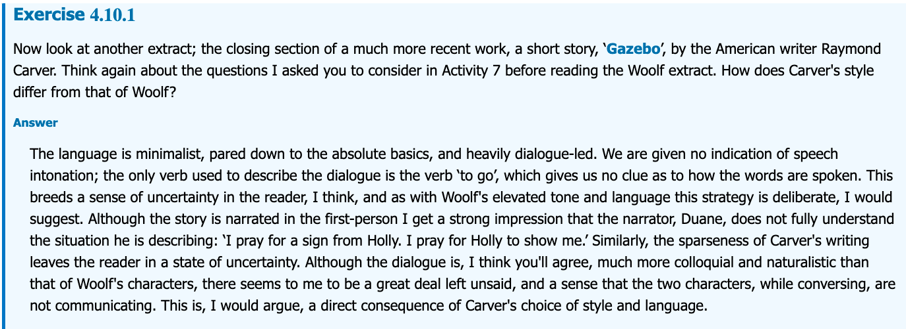
Exercises where students can click “answer” to see a sample response.

Slide 29
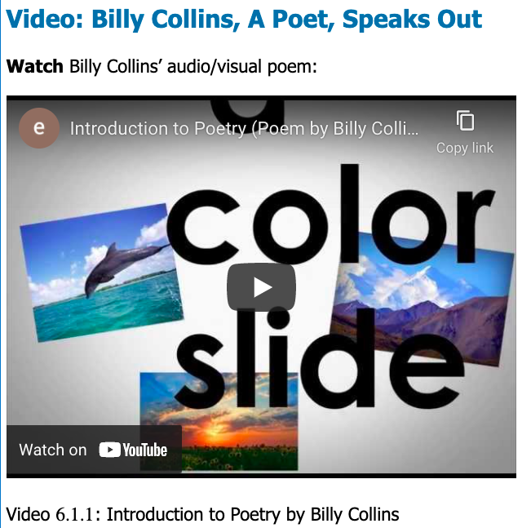
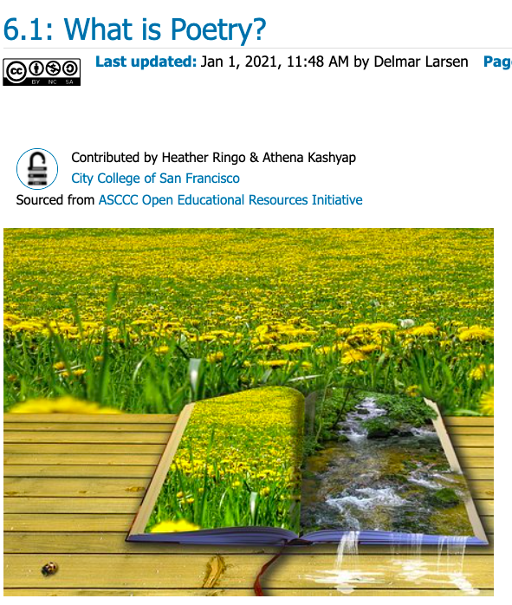
Embedded videos and beautiful images

Slide 30
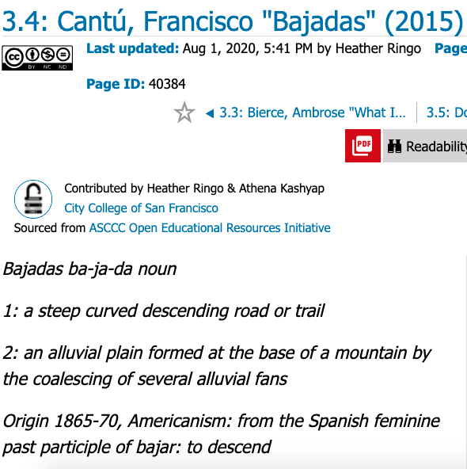
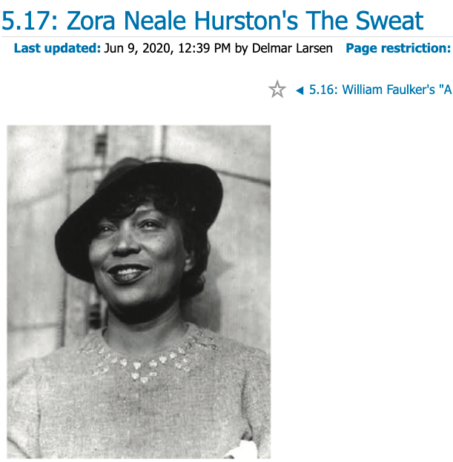
Some non-white authors

Slide 31
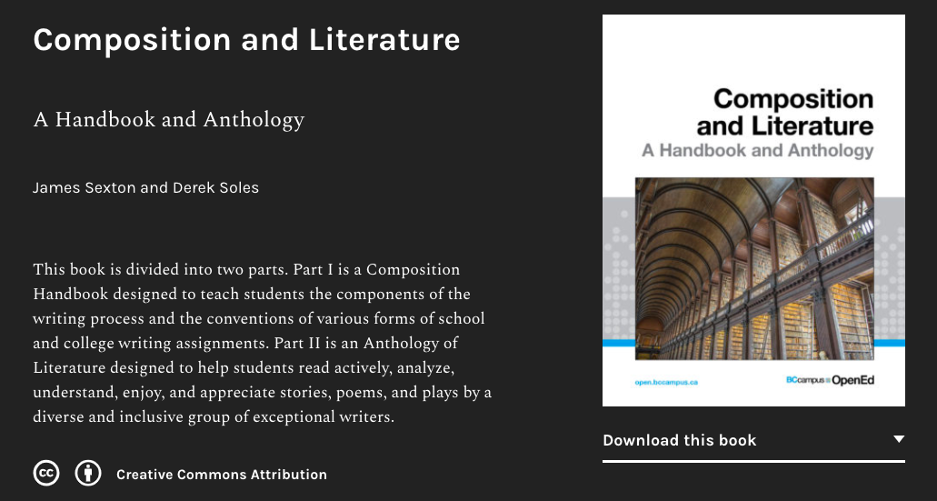
A literature anthology from BC Campus Open Education with discussion questions, essay assignments, and sample analyses

Slide 32
Literature and Creative Writing Electives
The ASCCC-OERI resource page lists textbooks and resources for each elective with a statewide course outline:
Introduction to Literature
Survey of American Literature 1 and 2
Survey of World Literature 1 and 2
Survey of Literature in English 1, 2, and 3
Survey of British Literature 1 and 2
Children’s Literature
Introduction to Creative Writing

Slide 33
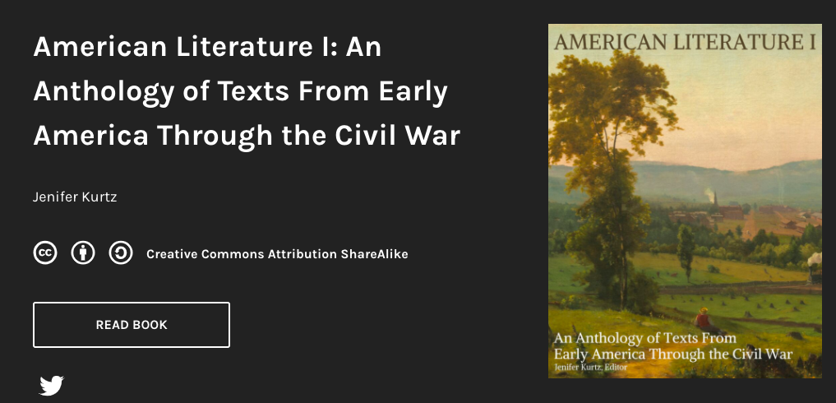
A few sample landing pages for literature textbooks:

Slide 34
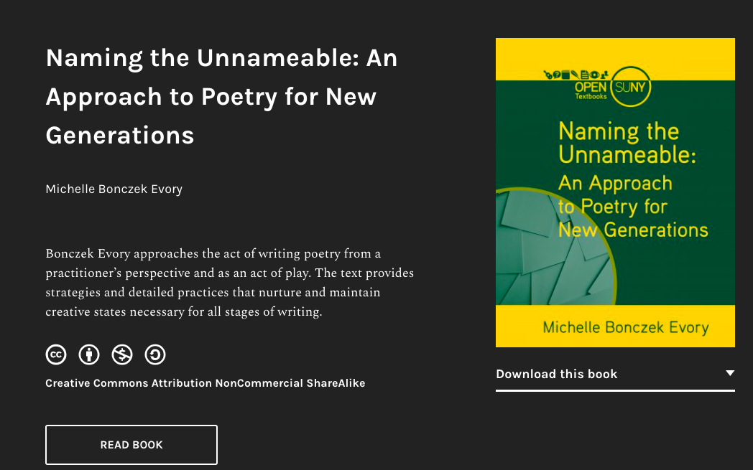
Naming the Unnameable book on Pressbooks

Slide 35
Cover for World Literature 1

Slide 36
Replace the Handbook? OER Style Guides (Free AND no ads)
Writing for Success
Guide to Writing (Lumen Learning)
Style for Students: A Writing Guide (Lumen Learning)
Excelsior OWL Grammar Essentials

Slide 37
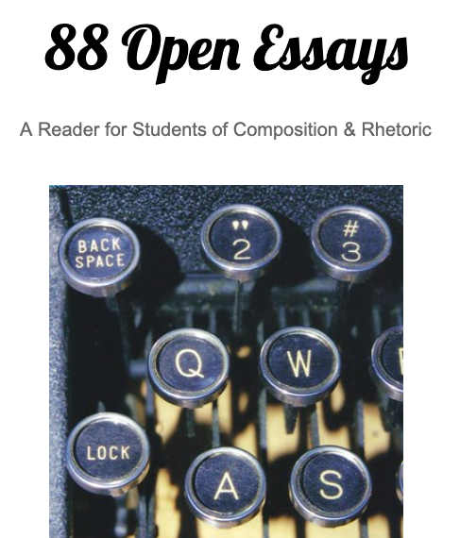
Open Readings
See the resource list for open-licensed contemporary work and public domain anthologies
One great open reader

Slide 38
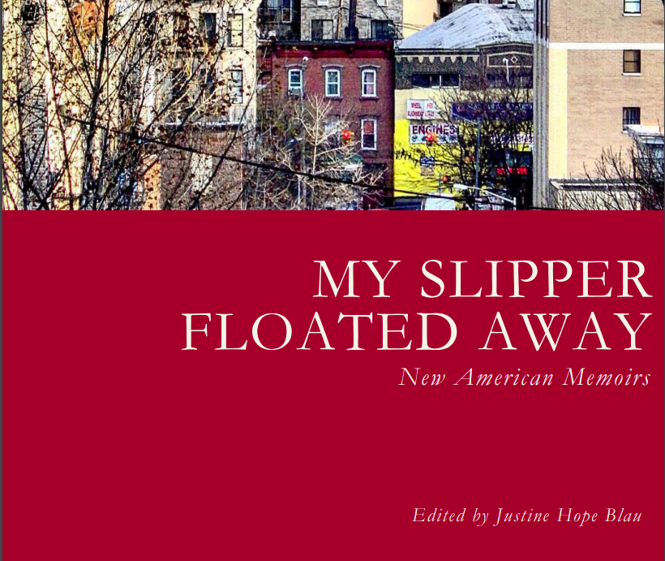
OER (increasingly) include diverse voices, like this new anthology from Lehman College in the Bronx.

Slide 39
An OER text on AI and writing
Writing and Artificial Intelligence: An Open Educational Resources (OER) Guide webinar recording
Writing and Artificial Intelligence OER guide by Joel Gladd and Liza Long (part of an Idaho OER text for English, Write What Matters)

Slide 40
Please post in the chat: Which OER texts have you used? Which do you recommend?

Slide 41
Working with an OER Text

Slide 42
What about printed copies?
LibreTexts books can be easily printed from LibreTexts.
A 171-page book with the cheapest binding and paper costs $10.13 plus shipping.
On Lulu, the OER textbook Writing in College: From Competence to Excellence costs $4.74 plus shipping.

Slide 43
How can I get to Zero Textbook Cost (ZTC)?
Often course outlines require a novel or nonfiction book in addition to a textbook
We can assign public domain books, but these won’t be contemporary
College libraries offer many eBooks, and librarians can often purchase specific titles at our request.

Slide 44
How can I get to Zero Textbook Cost (ZTC)? (Slide 2)
The library may be able to purchase an unlimited license or enough single user licenses for your class to read a specific book.
Some public libraries subscribe to services like Hoopla, which doesn’t limit how many people can borrow a given title at once.
Meet with a librarian to learn what the local practices for supporting ZTC courses are.

Slide 45
We and our students can access most books through Canvas
For an example, go to Canvas Commons, on the left of your Canvas nagivation
Search on "How Arguments Work"

Slide 46
Many texts include Canvas ancillaries
Assignments
Discussions
Quizzes

Slide 47
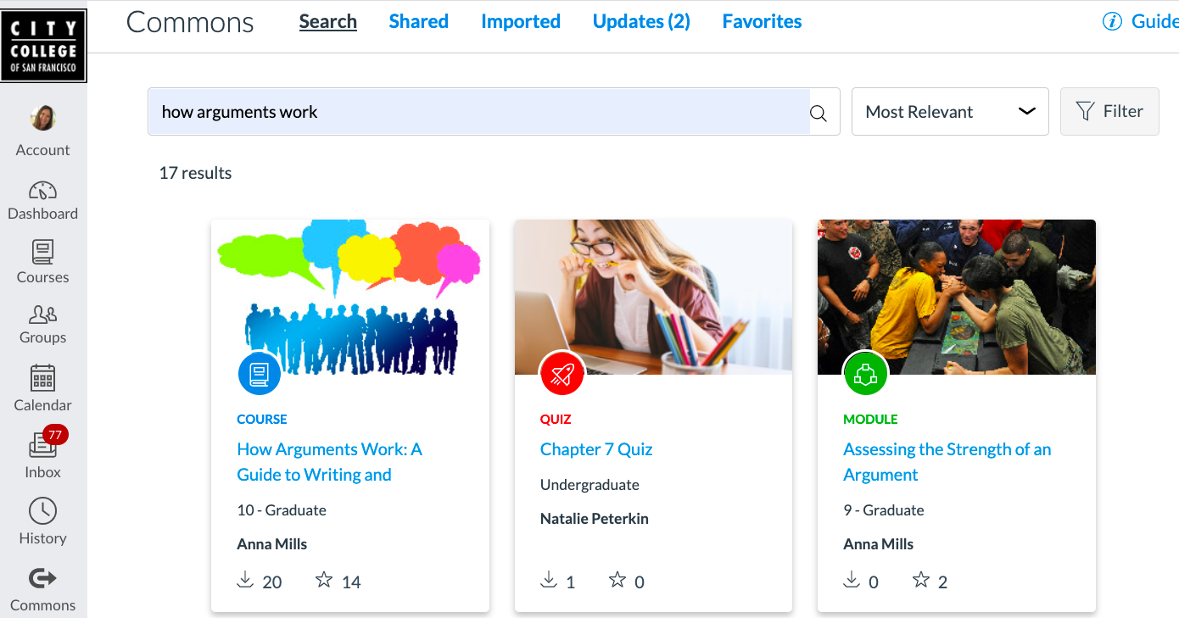
“How Arguments Work” Canvas course

Slide 48
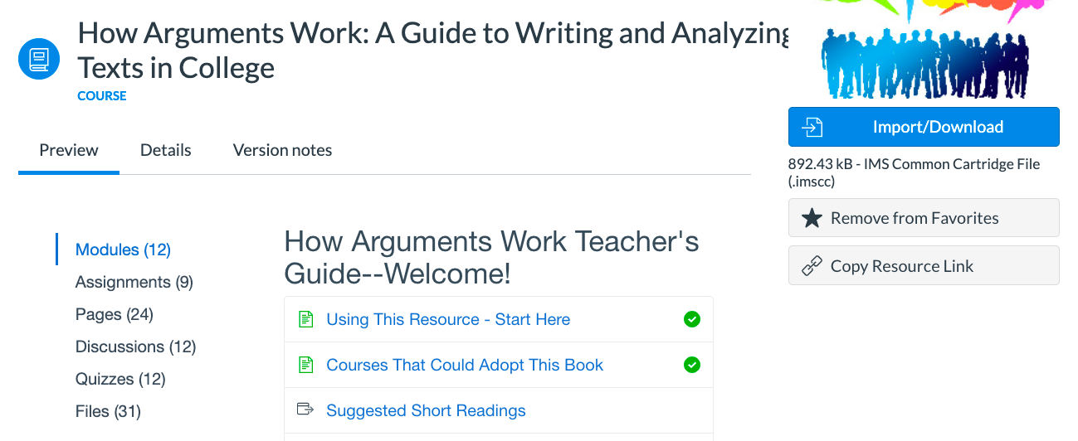
Import the book with ancillaries

Slide 49
How Arguments Work chapters with quizzes, sample essays and assignments appear as modules in your course

Slide 50
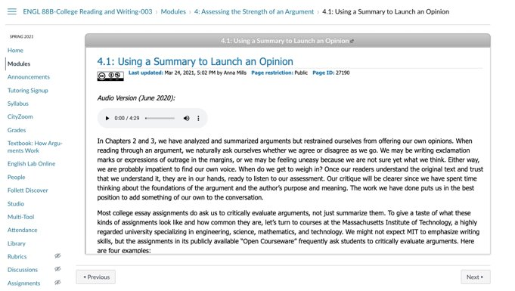
Assignments embedded into Canvas

Slide 51
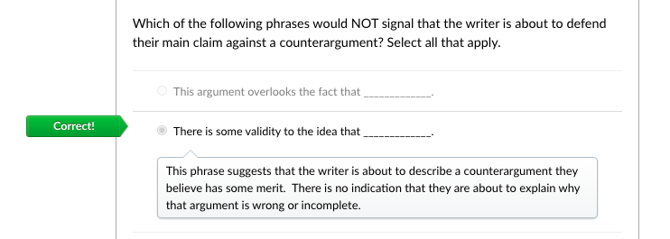
Chapter quizzes offer automated grading and feedback.

Slide 52
Benefits of Canvas Integration
When students click on assigned reading, they see the textbook page inside their course.
Reduces cognitive load for students
to have the textbook inside the LMS as part of the course rather than on a separate platform

Slide 53
OER also allows us to assign students to annotate the text together

Slide 54
What is social annotation?
Comment on a text
See others’ comments
Reply to others’ comments and questions
Much like commenting in Word or Google Docs
Works with other file formats (websites and PDF)
Integrate with a learning management system like Canvas
The two most common platforms are Hypothes.is and Perusall

Slide 55
Commercial textbooks mostly don’t allow social annotation
Commercial publishers control their texts on their own platforms
They don't offer their texts as PDFs or on the open web
Therefore, social annotation tools can't access them
Only a few publishers allow paid access through Perusall.

Slide 56
But OER work perfectly with social annotation
If a textbook is open, we can assign students not just to read but to comment and converse about each part of it
OER + social annotation means student encounters with the textbook are active, social, and fruitful!
Image by PIRO4D from Pixabay

Slide 57
How do I start adapting OER or creating my own?
If the text is in Google docs or Word, just copy it and start working (with attribution).
Otherwise, ask your OER liaison if your institution has a LibreTexts partnership w/support. Even if not, you can request a LibreTexts account and forge ahead...
If the text is hosted on OERCommons.org, you could edit it there.
If the text is in Pressbooks, see if your institution offers access to that platform.

Slide 58
Customizing and Remixing in LibreTexts
Request a LibreTexts account by emailing info@libretexts.org.
Access free training and resources.
Choose the chapters and pages from the books your want using the remixer.

Slide 59
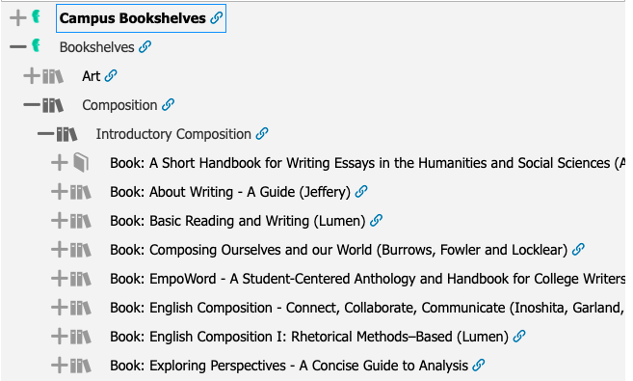
Choose the chapters or pages you want from one or more books, in the order you want

Slide 60
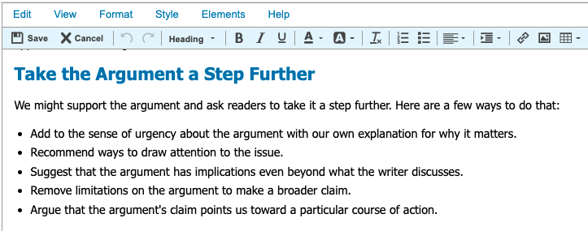
Check that the license allows (any CC license that doesn't say ND)
Edit away in LibreTexts

Slide 61
Join the English OER listserv
A place to ask for and recommend specific OER for college English
Share successes and challenges teaching with OER
Share strategies for advocating for OER in our departments
An informal community of practice
117 members as of 11/24/23
Join at https://groups.google.com/g/englishoer

Slide 62
Questions? Suggestions?
Anna Mills, Cañada College
ASCCC OERI English Discipline Lead
Slides: https://bit.ly/OEREnglish
millsanna@smccd.edu
This work is licensed under a Creative Commons Attribution-NonCommercial 4.0 International License.

