Slide 1
New Open Educational Resources (OER) Books and Resources in Ethnic Studies and Chicanx/Latinx Studies
Mario Alberto Viveros Espinoza-Kulick, MA, PhD
Ethnic Studies OERI Discipline Lead

Slide 2
Introductions
Please introduce yourself in the chat with the following:
Name
Pronouns
Affiliation(s)
Where you’re joining today’s conversation from
You are welcome to unmute yourself and share your introduction with the group

Slide 3
Webinar Description
In this webinar, we will hear about the two new OER textbooks in Ethnic Studies: Introduction to Ethnic Studies and New Directions in Chicanx and Latinx Studies. Participants will have the opportunity to preview content from both textbooks and learn how the structure and format of the LibreTexts platform can be utilized for course delivery in various modalities, including online, hybrid, and face-to-face as well as with incarcerated students.

Slide 4
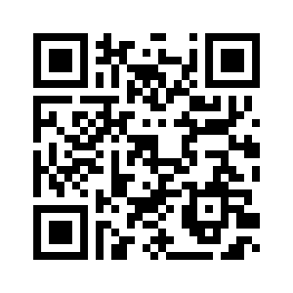
Survey
Please complete this short survey to share your best contact information to receive information about upcoming OER materials, as well as opportunities to collaborate with other faculty in your discipline on creating OER materials.
https://tinyurl.com/ESFacultyOER

Slide 5
What are Open Educational Resources?
Creative Commons defines OER as teaching, learning, and research materials that are either (a) in the public domain or (b) licensed in a manner that provides everyone with free and perpetual permission to engage in the 5R activities.
-- Creative Commons

Slide 6
The 5R Permissions of Open
Make and own copies
Retain
Use in a wide range of ways
Reuse
Adapt, modify, and improve
Revise
Combine two or more
Remix
Share with others
Redistribute
The framework, license (CC BY), was designed by Lumen Learning as the 5Rs

Slide 7
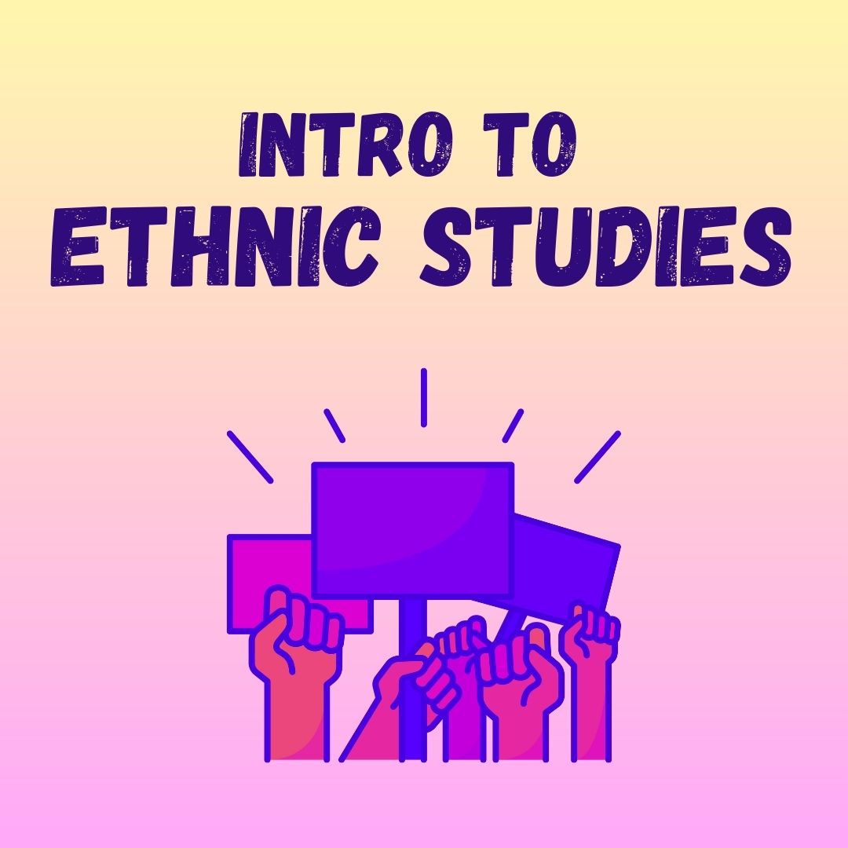
Introduction to Ethnic Studies
Authors:
Kay Fischer (Lead), Ethnic Studies, Chabot College,
Mario Alberto V. Espinoza-Kulick, Ethnic Studies, Cuesta College,
Ulysses Acevedo, Ethnic Studies, Foothill College,
Teresa Hodges, Ethnic Studies, Cuyamaca College,
Tamara Cheshire, Native American Studies, Folsom Lake College,
Melissa Leal, Ethnic Studies, Sierra College
https://tinyurl.com/IESOER

Slide 8
New Directions in Chicanx and Latinx Studies
Authors:
Amber Rose González (Co-Lead), Ethnic Studies, Fullerton College
Mario Alberto V. Espinoza-Kulick (Co-Lead), Ethnic Studies, Cuesta College,
Melissa Moreno, Ethnic Studies, Woodland Community College,
Lucha Arévalo, Ethnic, Gender, and Sexuality Studies, Rio Hondo College,
Eddy Francisco Alvarez Jr., Chicana and Chicano Studies, CSU Fullerton
https://tinyurl.com/NDCLS

Slide 9
OER Sources
Resources
ASCCC Open Educational Resources and Ethnic Studies
Ethnic Studies Bookshelf on LibreTexts

Slide 10
Future Directions for OER Sources
Forthcoming projects funded by ASCCC OERI RFP #5
OER Textbook and Ancillary Materials for Introduction to African American Studies: An Anthology of Essays on Radical Black Thought, Intellect, and Culture for the Ethnic Studies Student
Facilitating Active Learning with H5P/ADAPT Materials for New Directions in Chicanx and Latinx Studies
Key gaps for OER in Ethnic Studies
Asian American and Pacific Islander Studies
Native American and Indigenous Studies

Slide 11
Panel Discussion
Kay Fischer
Ulysses Acevedo
Dr. Tamara Cheshire

Slide 12
Discussion and Future Opportunities
Questions? Comments?
Reminder! Complete Survey https://tinyurl.com/ESFacultyOER
Stay tuned for more information about funding opportunities from ASCCC. Please sign up using the form if you are interested in collaborating with other faculty
“Forever Readers” by Josh MacPhee, JustSeeds
is licensed under CC BY-NC-ND 4.0

Slide 13
Mario Alberto Viveros Espinoza-Kulick, PhD
Ethnic Studies Department
Cuesta College mario_espinozakulick@cuesta.edu
@cuestaethnicstudies ASCCC Ethnic Studies Listserv
OER and Ethnic Studies Sources

