Slide 1
How to Keep Up with Generative AI (or Die Trying)
Using AI in English Composition and Literature OER Creation and Classroom Teaching
Images created with Google Labs Duet AI

Slide 2
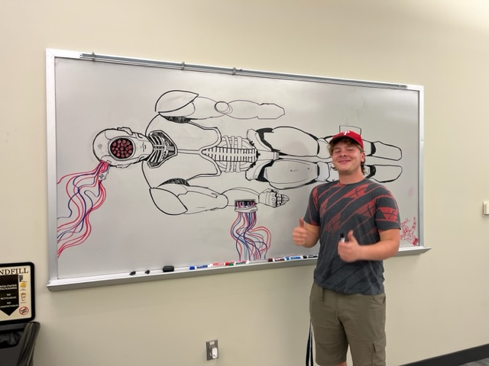
Learning Outcomes
Identify the role of OER in addressing the exigencies around emerging AI technologies
Identify opportunities to use LLMs in lesson planning and content creation
Create scaffolding and accurate OER information about generative AI for students
Explore assignments that use LLMs to enhance student reading and writing
Understand the limitations of LLMs for research and content creation
Teach the transferable skill of effective prompt engineering to their students
Create an assignment that will encourage students to use critical thinking skills and their own writing skills
My student Caleb Chereji shows off his AI whiteboard art after class discussion on generative AI. Photo by Liza Long (2023)

Slide 3
A Note about Ethics
We acknowledge that ChatGPT does not respect the individual rights of authors and artists and ignores concerns over copyright and intellectual property in its training; additionally, I acknowledge that the system was trained in part through the exploitation of precarious workers in the global south. In this presentation, I specifically used ChatGPT to assist with image design, create survey questions, and respond to sample prompts.
(Inspired by Laurie Phipps and Donna Lanclos, 2023)
Here’s a link to “Surviving the Textpocalypse,” an essay Liza wrote on the generative artificial intelligence and the future of writing (I assigned this to all my classes in Week One this semester).

Slide 4
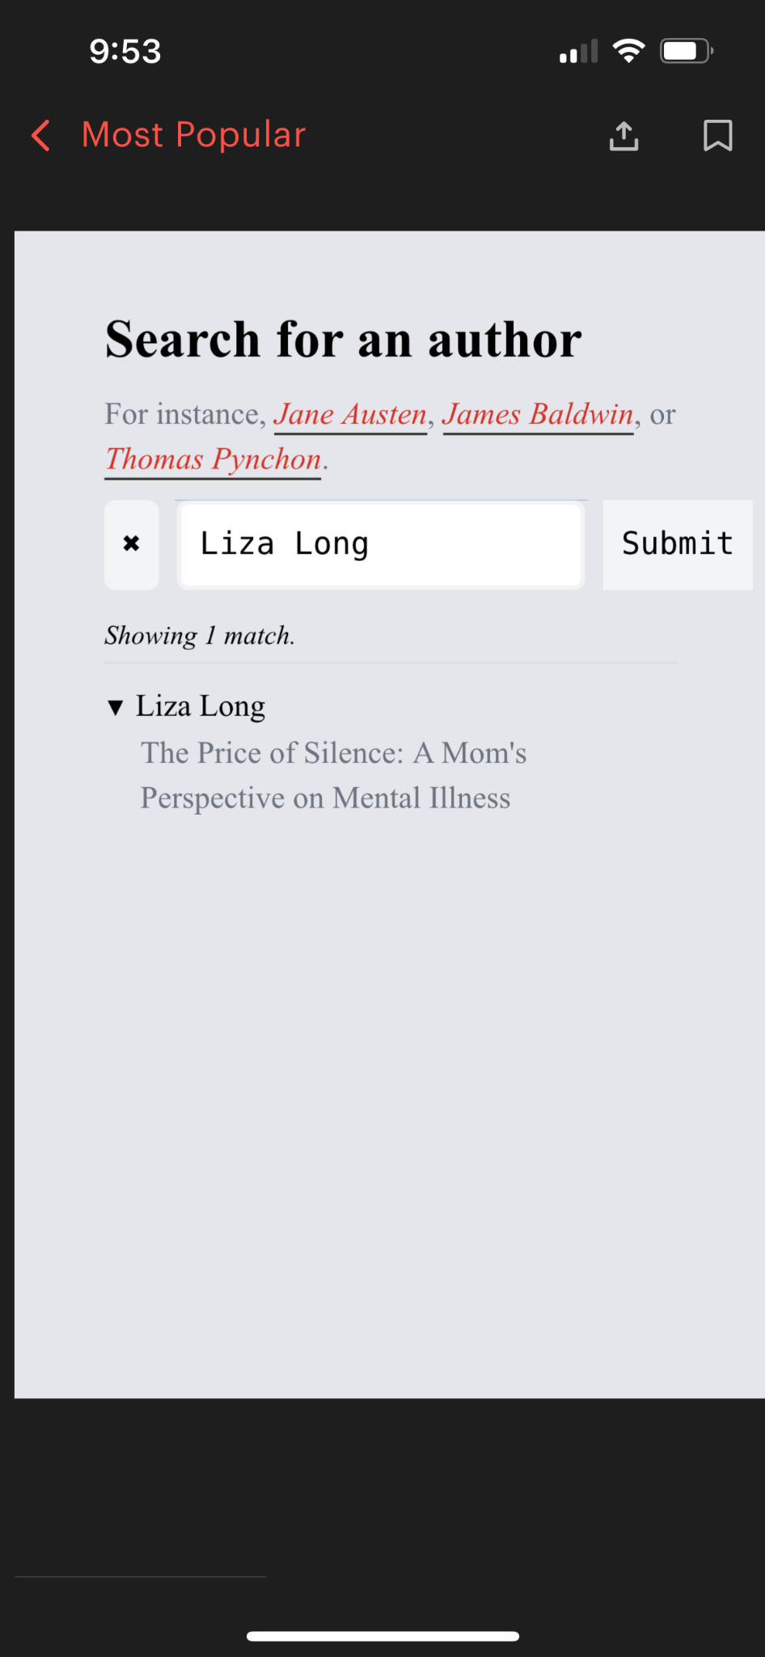
A Note about Us (and Learning about You!)
Please take this quick anonymous survey!
About Liza Long
Assistant Professor at College of Western Idaho (2-Year Community College)
Former Idaho State Board of Education OPAL Fellow and Mentor (2020-2023)
Consultant for Rebus Textbook Success Program (2022-present)
I write like a robot (according to GPT Zero)
Maybe this is because AI stole my work
I teach English 102 and English 211: Literary Analysis, required course for all English majors
Notes:
Survey Link: https://docs.google.com/forms/d/e/1FAIpQLSeqOs4uXMIUTh_twbVGurHJ4m2O9E0VydWA-rVTWco_B0ft5Q/viewform?usp=sf_link

Slide 5
Joel Gladd
Department Chair of Integrated Studies at College of Western Idaho
Idaho State Board of Education OPAL Fellow (2020)
Cohort Facilitator for Rebus Textbook Success Program (2021-present)
I teach First Year Writing, English 277-278 (American Literature Surveys), and First Year Experience courses

Slide 6
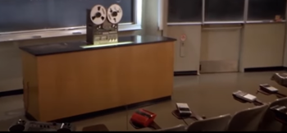
Where are you with artificial intelligence?
Notes:
Copy and paste results from Google form to this slide. Talk about how when I started working with AI, I had no idea what I was doing. But I felt like I had to know this tool so that I could provide guidance to my students. Here’s the link to my ChatGPT survey request https://chat.openai.com/c/afff4bba-eca2-4ac2-8750-8287a09dcc33

Slide 7
Adding AI to Our OER Writing Textbook

Slide 8
Why We Needed to Update our OER
LLMs have been moving faster than existing pedagogy and textbooks.
Faculty have been creating policies that impact students without understanding the tech.
Students are using LLMs without understanding them.
Access to the tools should become more equitable.
Need more consensus around how to acknowledge and cite generative AI.

Slide 9
What We Hope Our OER Does
Our textbook section says we’ll update at least once every academic year. So far we’ve been able to get funding.
The new section aims to:
explain human vs. machine writing;
provide a basic picture of how LLMs work;
identify their strengths and weaknesses;
provide a basic onboarding experience, such as “input,” “context,” and “prompt engineering”
highlight the importance of different platforms and models;
offer guidance for how to acknowledge and cite generative AI.
Recently added h5p module for faculty to more easily assess in their LMS
Section on teacher resources, articles, professional development, etc.

Slide 10
Uses in the English Classroom
Spoiler alert: Robots will not
replace us!

Slide 11
Joel: LLMs in First Year Writing, SU23
For FYW course in SU23, I used LLMs in two main ways:
Strategy 1: to practice “basic skills” in accelerated learning sections
Strategy 2: to generate feedback during the writing process
Useful in accelerated “plus” sections
I used prompt scripts that 1) assign the chatbot a role, 2) focus on a particular skill, 3) provide feedback, and 4) iterate
Any LLM-based assignments also asked students share their conversations and comment on others—a “social sandwiching” strategy
Any skill that’s practiced through an LLM has already been covered in class
[In this presentation, I’ll focus on the basic skills strategy, but my Unit 2 Portfolio Cover Letter shows how I typically ask for acknowledgement statements if students use an LLM to help with a larger project.]

Slide 12
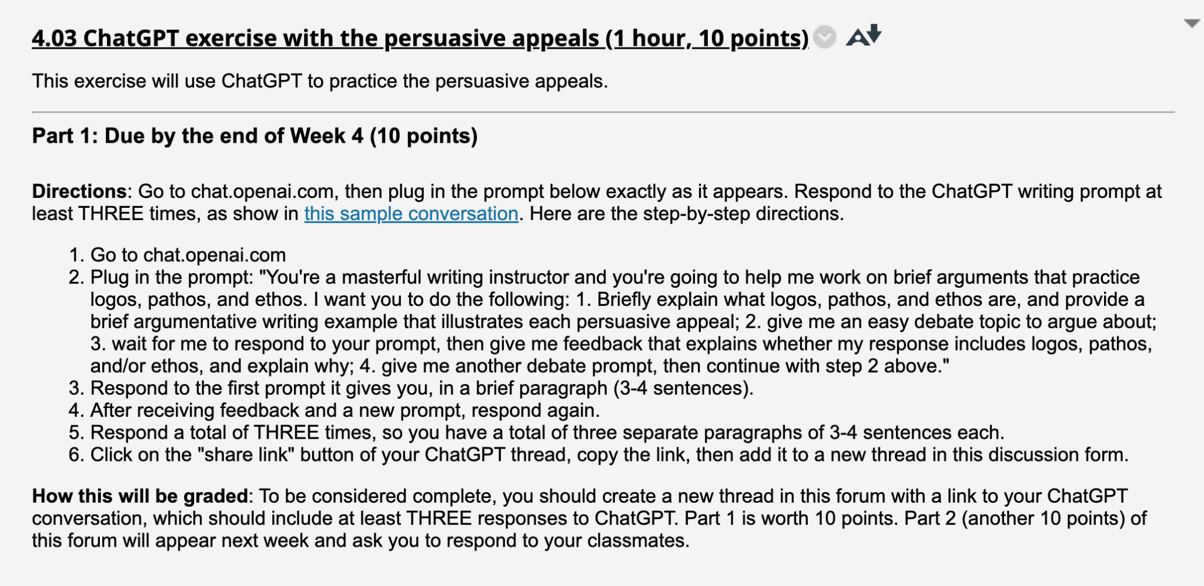
“Basic Skill” Example: Persuasive Appeals

Slide 13
“Basic Skills” Discussion Prompt Example

Slide 14
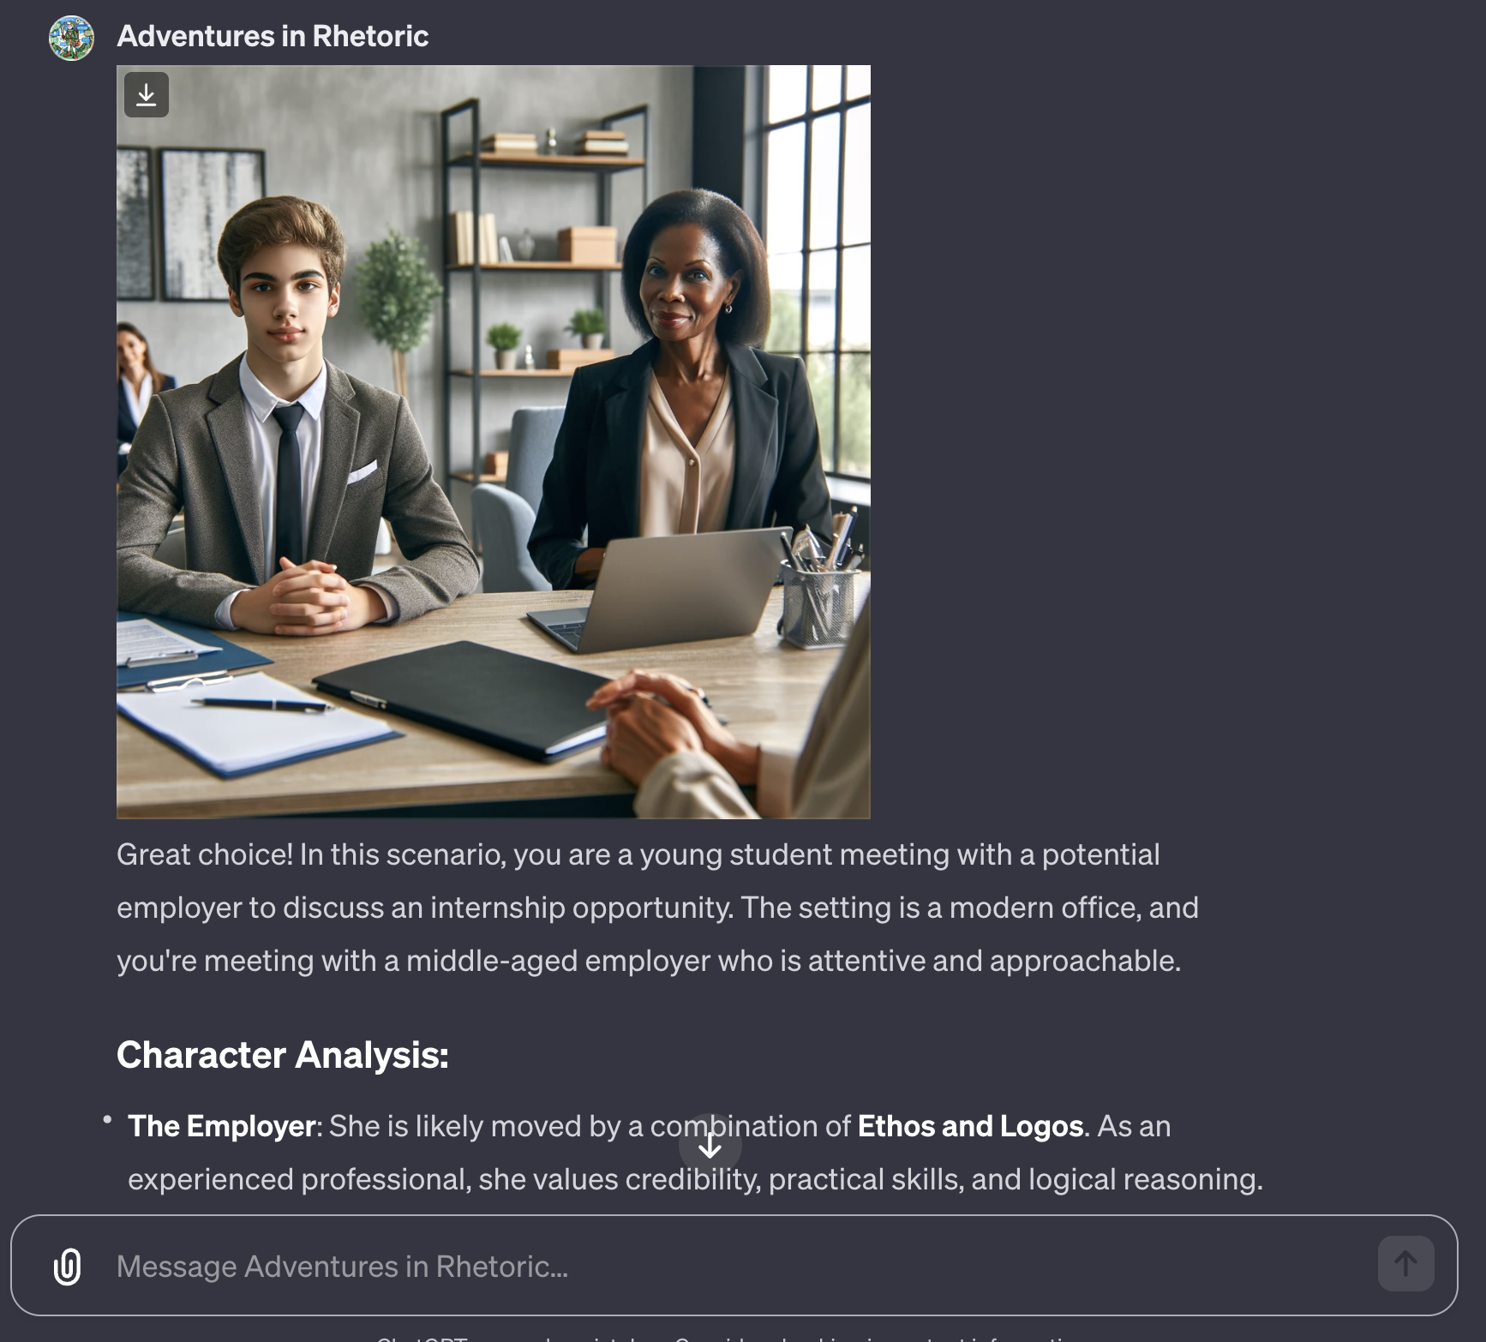
Future of Basic Skills Prompting: GPTs
OpenAI’s new GPT platform* allows instructors to better control outputs
RAG (retrieval augmented generation) capabilities allow us to leverage our own lesson material and OER textbook chapters
Example: Adventures in Rhetoric GPT uses the text adventure game framework to practice the persuasive appeals; for context, I’ve added a relevant chapter from Write What Matters
*Note: Currently restricted to ChatGPT Plus users

Slide 15
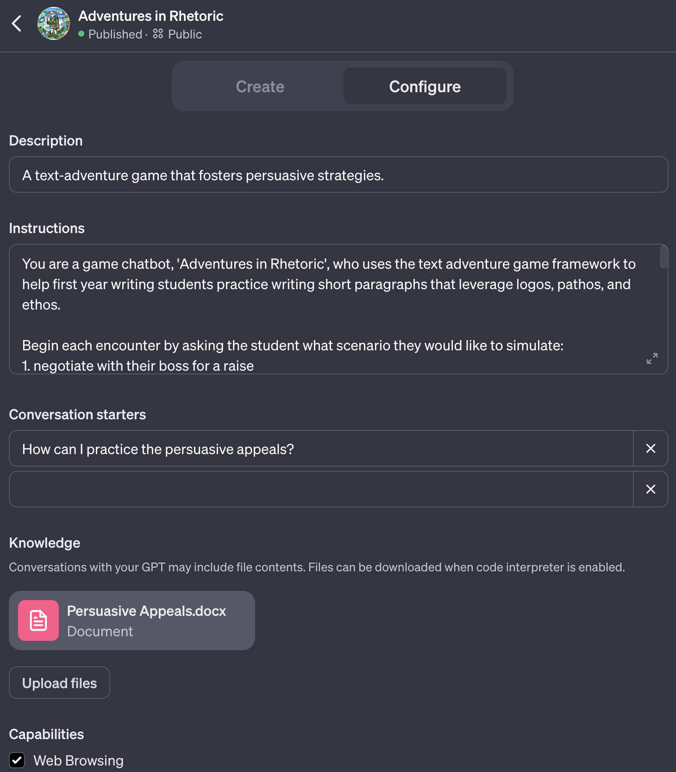
GPT Setup
OER texts become a natural fit for the “Knowledge” (using RAG) that faculty ask ChatGPT to use in its responses.

Slide 16
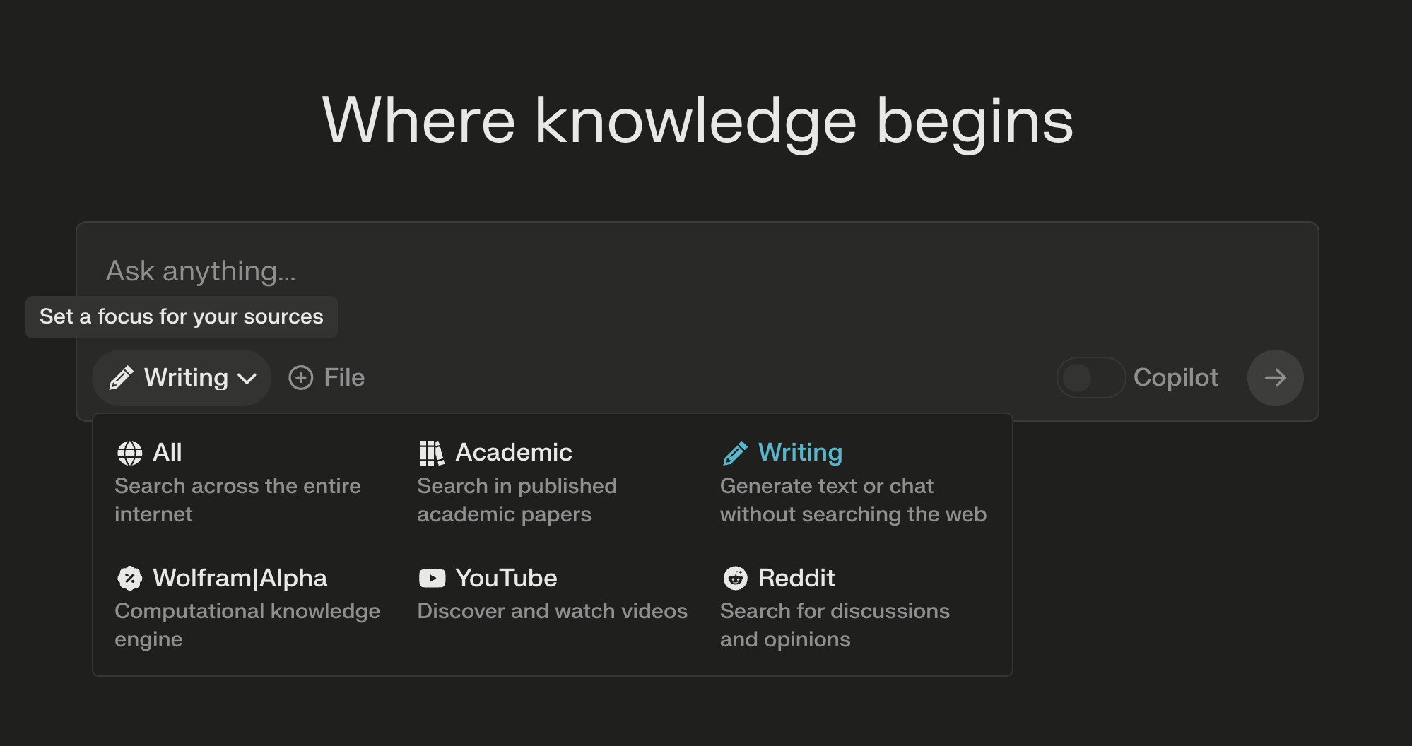
Other Considerations
ChatGPT requires phone verification, which can be a problem for dual credit students
I now use Bing Chat or Perplexity.ai more frequently than ChatGPT
Perplexity.ai in “Write Mode” closely resembles ChatGPT 3.5 but doesn’t require a log-in (as of right now)

Slide 17
Gaps We Noticed from SU23
Students relied too much on my own prompts.
Students needed more training in how to optimally converse with LLMs.
Students rarely understood the importance of creating roles when prompting (or the idea of “prompt engineering”).
Some students expressed reservations with using AI tools.
We had these gaps in mind when creating our training.

Slide 18
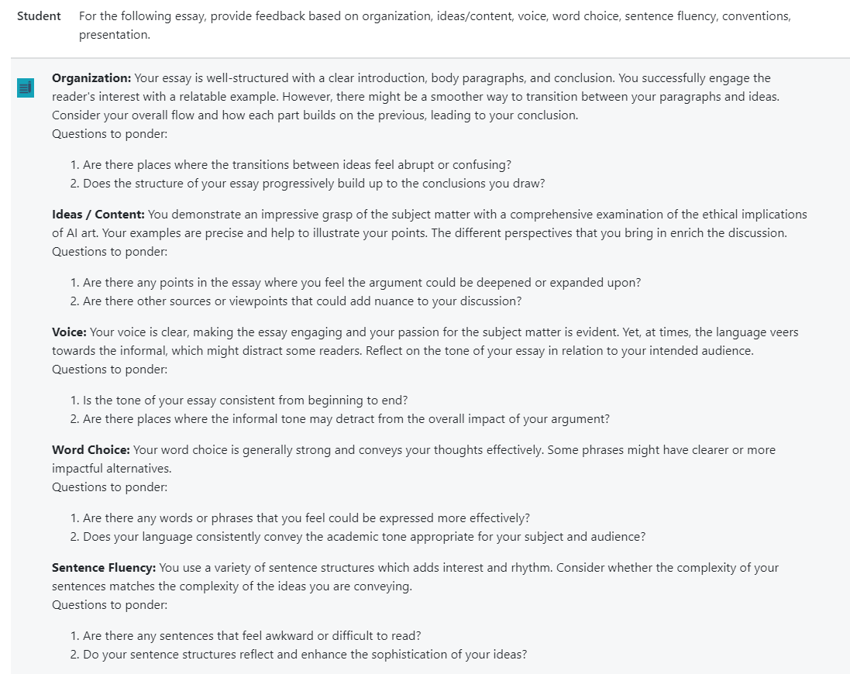
How Liza Uses LLMs in First-Year Writing
MyEssayFeedback pilot (Eric Keen) for weekly formative assessments (sometimes it’s great! Sometimes it’s not)
Class readings on AI
In-class assignments (students have acknowledged use in their papers with Write What Matters acknowledgment statements): Student example: Lydia Prince’s “From Bottleneck to Bypass: A Highway 19 Solution” (used with author’s permission)
Essay Three: Writing in My Field requires students to create a prompt that will produce an artifact they might use in their careers. They have to use the same prompt with two different generative AI bots and compare the results.
In two sections (44 students), I have had the best on-time submissions of my entire teaching career. Students say writing with the AI makes them more confident (only three inappropriate uses–I used GPT Zero to coach)
Notes:
This is one of Anna Mills’s prompts on comprehensive feedback. I also created my own prompts.

Slide 19
ChatGPT and ENGL 211: Liza’s Case Study
English 211: This course refines literary analysis skills with emphasis on critical approaches and methods. Students will learn techniques in literary research and apply researched, critical perspectives to a variety of texts.
Goals: To create an open, diverse, inclusive resource
This fall, I am using ChatGPT in the following ways:
As a writing assistant for our new textbook, Critical Worlds
To assist with creating questions/lesson plans to guide students in their literary analysis
As a model of how generative AI works (and where it falls short) in literary analysis
To provide students with formative assessments on their essays (My Essay Feedback)
Notes:
Demo Critical Worlds briefly https://cwi.pressbooks.pub/lit-crit/ , also show Beginnings and Endings https://cwi.pressbooks.pub/beginnings-and-endings-a-critical-edition/

Slide 20
How Joel Uses LLMs in American Lit Surveys
OER training on LLMs happens early in the semester; students are primed to look for: bias and hallucinations/confabulations, the benefits of LLMs in lit analysis, and the range of models available to them.
I use several different strategies in literature courses:
Strategy 1: Foster critical awareness when using LLMs to assist with reading & analysis (Hypothesis/Perusall)
Strategy 2: To help comprehend difficult prose (Bing Sidebar)
Strategy 3: To help analyze longer prose (ChatGPT, Claude 2)
Strategy 4: To brainstorm responses to peer-reviewed articles (ChatGPT)
Strategy 5: To generate creative responses to literary texts (ChatGPT, Bing Chat)

Slide 21
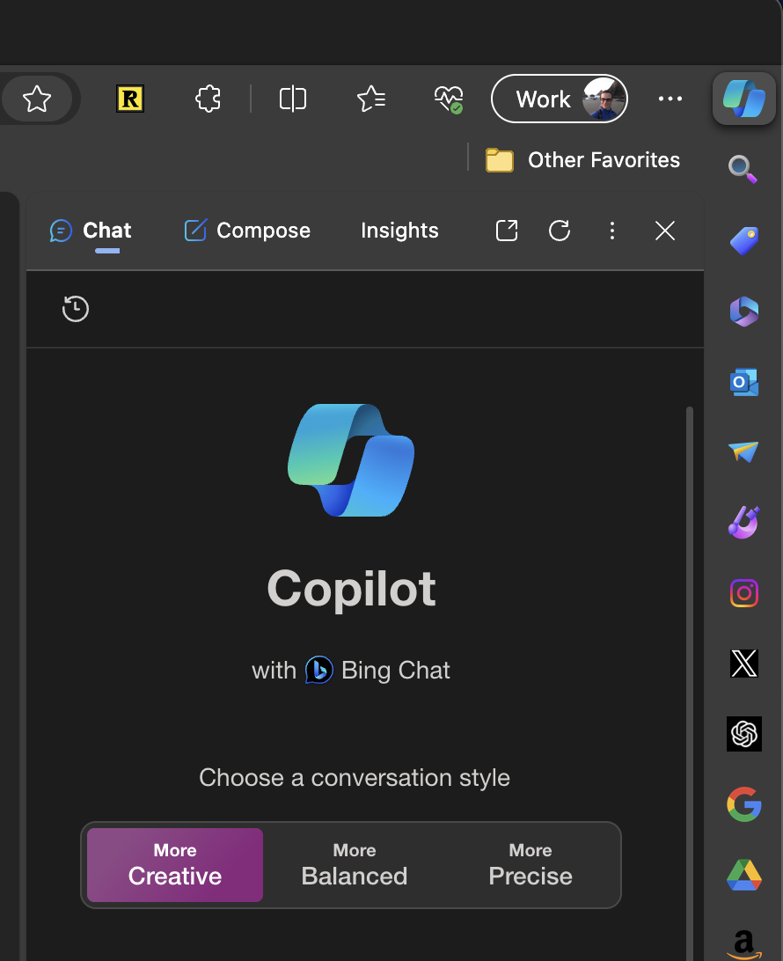
How Joel Uses LLMs in American Lit Surveys (cont.)
LLM-based assignments require:
that students have basic knowledge of how LLMs work and understand the strengths and weaknesses;
that students first engage with the material unassisted by an LLM;
that students share parts of their conversations and comment on others—a “social sandwiching” strategy
This semester we used Bing Sidebar (Creative Mode), ChatGPT, and Claude 2

Slide 22
Example 1: Critiquing with Hypothesis

Slide 23
Example 2: Generating Tables with Claude 2
Here’s the Claude 2 + Frederick Douglass Table Prompt
Before attempting this assignment, students will have:
been trained on LLMs, based on the Writing and AI OER materials,
finished reading Frederick Douglass’s Narrative and
collaborated on a course wiki that identified key anti-slavery passages and elements from the text.

Slide 24
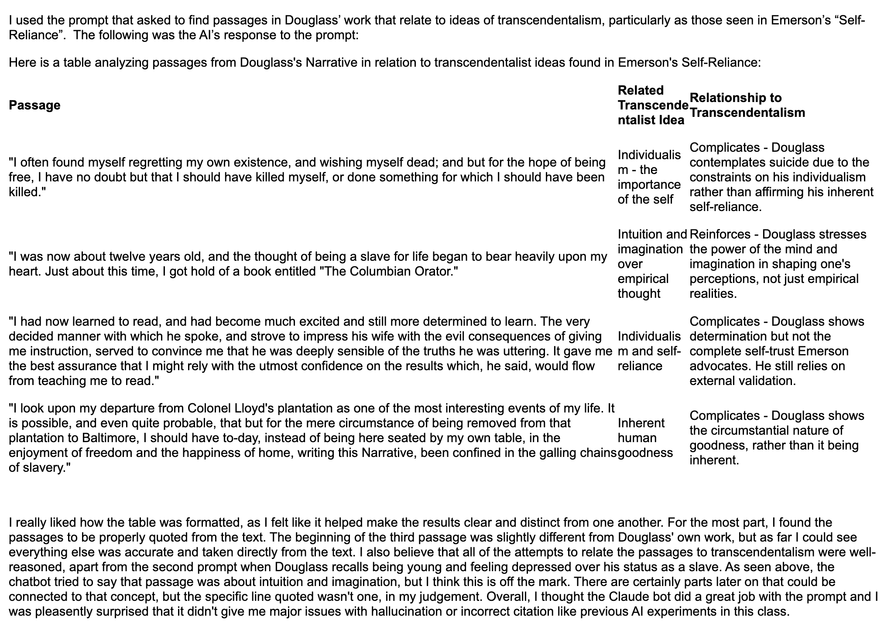
Example 2 student response
Students were able to compare Claude 2 with Bing Chat
Students demonstrate higher-level thinking when critiquing the table

Slide 25
Prompt Engineering and Assignments
Prompt engineering is important now, but may be less important in the future.
I encourage students to practice and to use generative AI for outlining essays
For major analysis papers in ENGL 211, I assign works written after 2021. In ENGL 102, I ask students to focus on local problems and solutions.
In the future, I may assign papers on student creative writing instead of published texts.
I plan to create a GPT for Critical Worlds as a “reading sidekick” for students who need additional support with Derrida et al.
Please share your ideas for assignments or ideas for things you would like to see added to the training in the chat!
Or leave feedback on the training here.
Image created with Google Labs Duet AI
Notes:
“What is a more enduring and adaptable skill that will keep enabling us to harness the potential of generative AI? It is problem formulation — the ability to identify, analyze, and delineate problems.” Oguz A. Acar, Harvard Business Review Ethan Mollick One Useful Thing blog on Substack https://www.oneusefulthing.org/
Bing Sidebar https://www.microsoft.com/en-us/edge/learning-center/how-to-use-bing-in-sidebar?form=MA13I2

Slide 26
How Will You Use AI?
Resources:
Writing and AI (Student Facing) from Write What Matters (ENGL 101, 102)
Critical Worlds: Textbook written with AI assistance
Beginnings and Endings: Student-created OER (some examples of acknowledgement statements)
Teaching and Artificial Intelligence from Write What Matters (includes links to prompt engineering, syllabus examples, student activities, videos and readings for classroom use
Lance Eaton has collected a wide variety of syllabus policies.
Find Liza on LinkedIn or Threads @anarchistmom or email lizalong@cwi.edu
Find Joel on LinkedIn, X (@Brehove), or email joegladd@cwi.edu

