Slide 1
Evaluating Open Educational Resources (OER) for Accessibility
Shagun Kaur and Suzanne Wakim; licensed CC BY 4.0
Notes:
Accessibility is not only a legal and ethical requirement, it is central to creating resources that are inclusive and support the education of all learners. In this webinar, we will provide an overview of the basic considerations for accessibility and tools for evaluating content.

Slide 2
Accessibility Commitments
We have done our best to make these slides as accessible as possible by:
Using a slide template that has been vetted as accessible
Including alt-text for all image
Sharing the presentation with you so that you can download it and customize the appearance on your own device as needed.

Slide 3
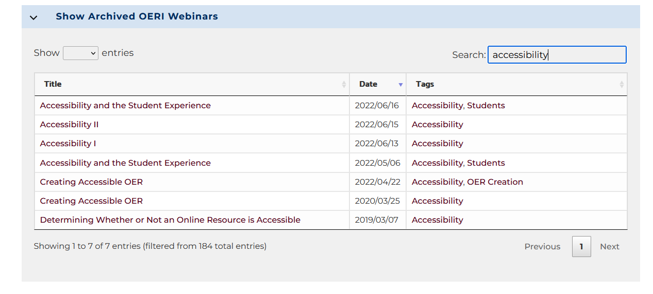
OERI Accessibility Resources
Checklists
OERI Accessibility Checklist Overview
OERI Accessibility Checklist
Webinars: Archived webinars can be searched by tags.
Notes:
We will use the checklist as our overall approach
Our focus is on evaluating rather than creating

Slide 4
Accessibility Checklist
Headings
Images
Text Styles and Design
Links
Lists
Tables
Media Elements
Notes:
List the top “7” things from our website
Will become the lens of how to look at things
ongoing - and more nuanced than we talk about
CAVEATS!!!

Slide 5
Accessibility Checkers
Platform-specific (examples: Canvas, LibreTexts, Microsoft, Adobe)
Campus tools (example: Pope Tech)
Plug-ins and other online tools (example: WAVE)

Slide 6
Human Checked
Eyeglasses by StockSnap; pixabay license

Slide 7
WAVE
WAVE - https://wave.webaim.org/
Works on any website
Has browser extensions for Chrome, Firefox and Edge
Good learning tool
Notes:
Hands on - pull up WAVE and paste URL into the address bar

Slide 8
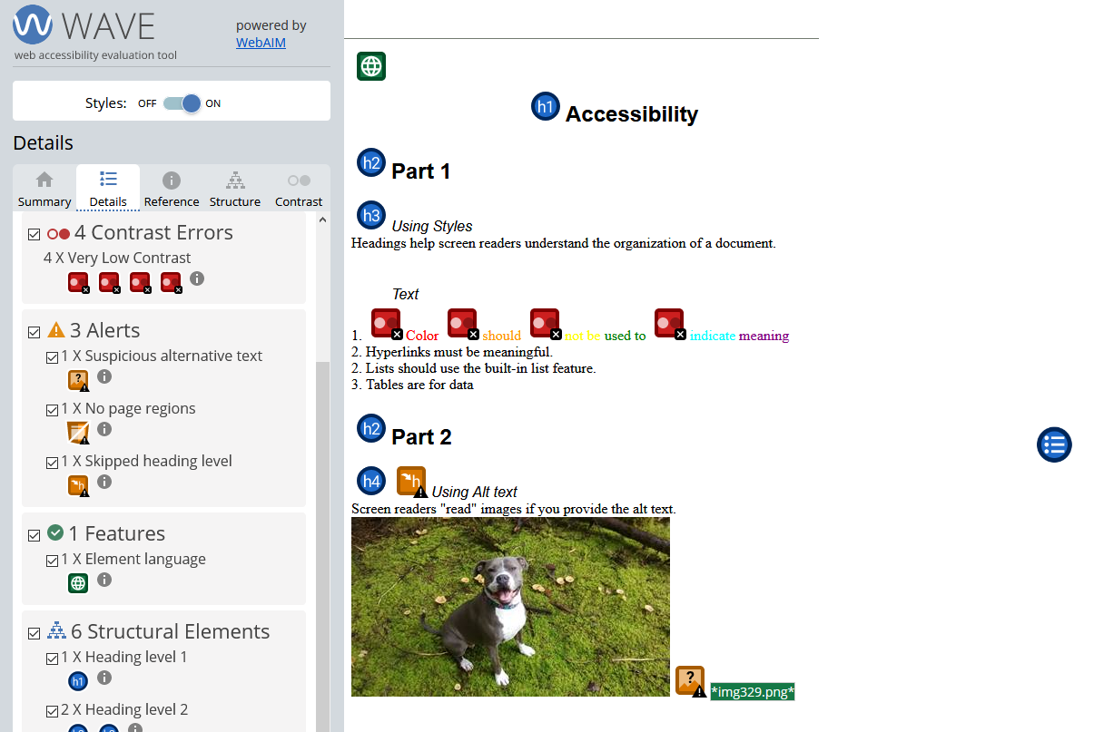
WAVE Results
Notes:
Can look overwhelming
Select each to learn more - this can be a great learning tool
We will break this down and look at specific elements

Slide 9
Headings
Headings
provide structure to a page.
Used by screen readers to navigate content.
Heading levels
H1 - page title - must have exactly one H1 on the page
H2 - main sections - should have at least one H2 on a page
H3 - subsections of each H2 - only if needed
H4 - subsections of each H3 - only if needed

Slide 10
WAVE Results – Correct Heading

Slide 11
WAVE Results – Missing Heading

Slide 12
WAVE Results – Skipped Heading

Slide 13
Images must have alt text
Alt text used by screen readers to describe the image
Alt text is different from the caption
Should not begin with “image of” or similar
Should not be the file name
Text in image should be identified
Should be short (less than ~120 characters)
Decorative tag is only for images with truly no function other than “eye candy”
Context matters

Slide 14
Simple Images
Caption: UNESCO Global Open Educational Resources logo (OER logo by Jonathasmello licensed CC BY 3.0)
What is a good alt text?
Notes:
Alt text option: An open book with pages turning into raised hands; text reads Open Educational Resource.

Slide 15
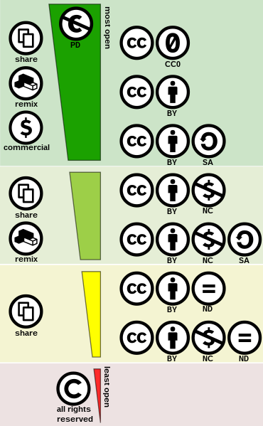
Complex Images
Caption: Level of openness (CC license spectrum by Shaddim; licensed CC BY 4.0)
What is a good alt text?
Notes:
Can either explain in caption or body of text. Alt text guides readers to where image is explained.

Slide 16
WAVE Results - Images
Notes:
WAVE can only do so much - you the human needs to determine if alt text is good

Slide 17
Text Styles and Color
Less is more
Adding visual flair adds cognitive load
A little goes a long way
Keep text formatting simple
Don’t use color as sole means of conveying meaning
Avoid bold, italics, underline and symbols (&)
Avoid fancy scripts

Slide 18
WAVE Results - Color

Slide 19
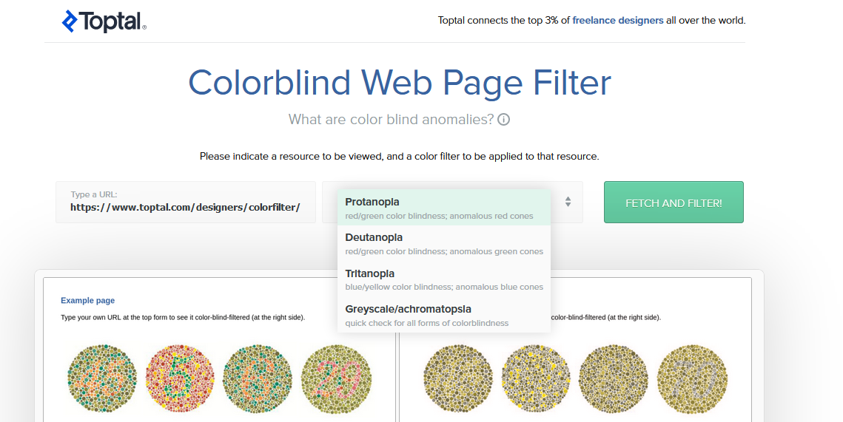
Toptal Colorblind Filter
Notes:
https://www.toptal.com/designers/colorfilter/

Slide 20
For cases where you can fix contrast issues
Three steps
Identify colors - Eye Dropper Chrome Extension
Check contrast - WebAIM Contrast Checker
Pick a better color

Slide 21
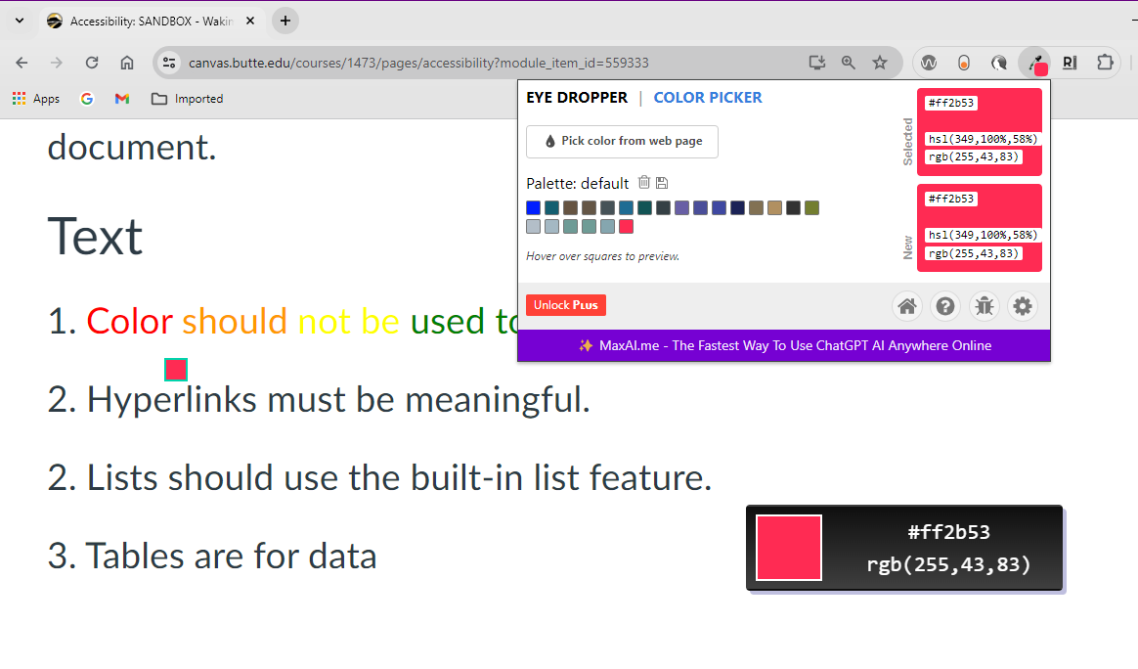
Identify Colors using Eye Dropper

Slide 22
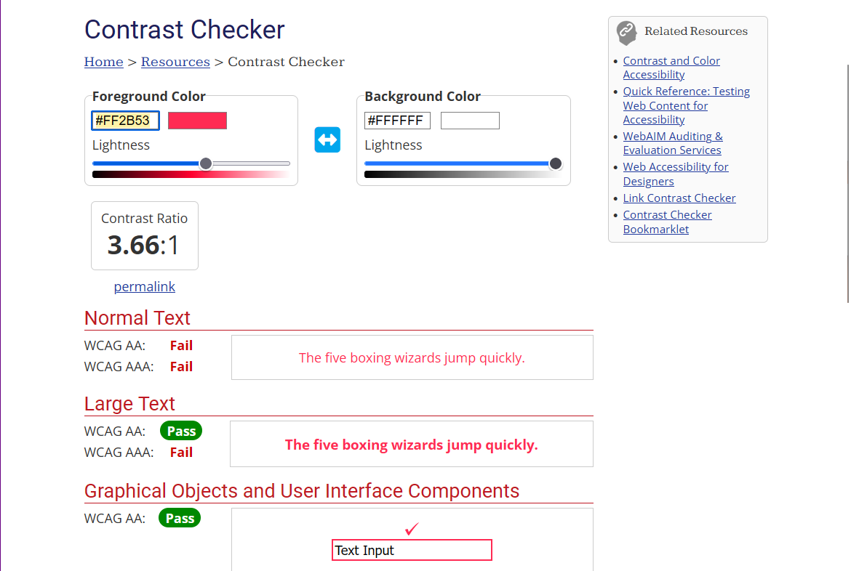
Check Contrast

Slide 23
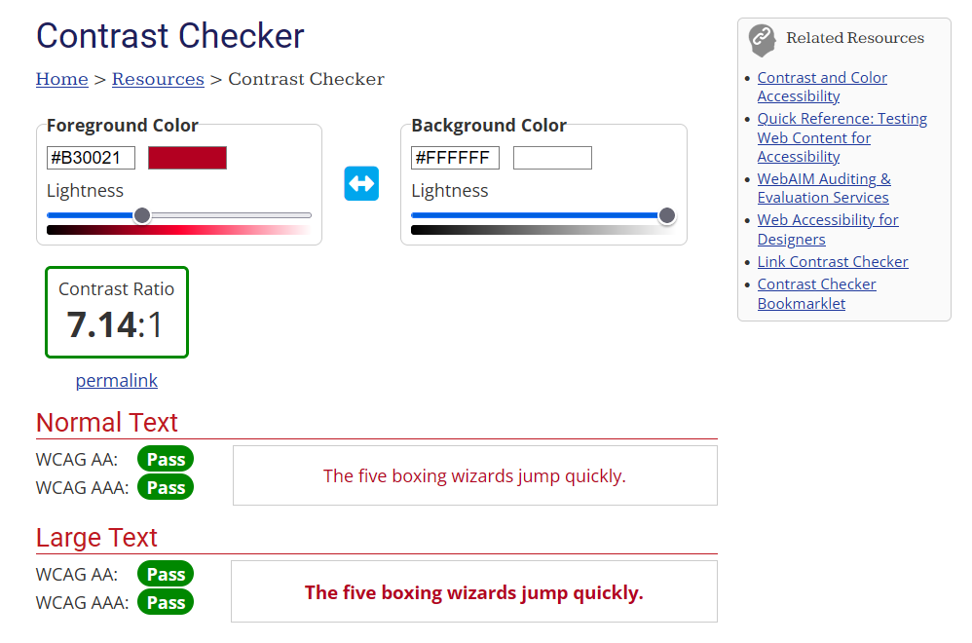
Find a color with better contrast

Slide 24
Links
Links should have meaningful text
Human Checked
Which is the best link?
For Accessibility Resources Click Here
For Accessibility Resources: https://ccconlineed.instructure.com/courses/6962/pages/accessibility?module_item_id=317319
For Accessibility Resources

Slide 25
Lists
Use the list feature rather than manually typing the numbers or symbols
Numbered lists are for sequential items
Example: steps in a process
Bulleted lists are for non-sequential items
Example: a list of ingredients

Slide 26
WAVE Results - Lists

Slide 27
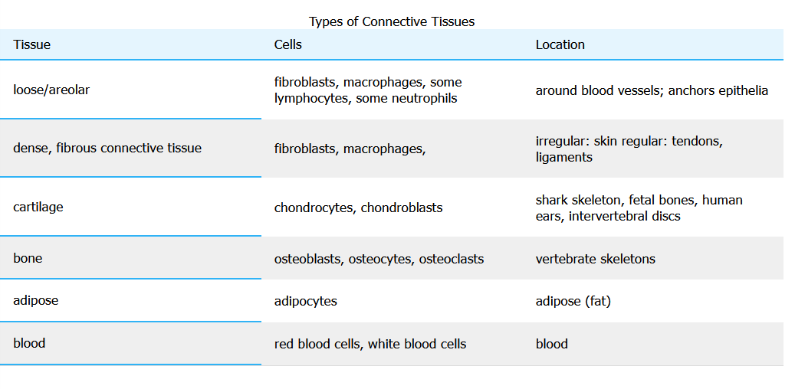
Tables
Tables are for data or organizing information not formatting
Need captions and headers
Notes:
Connective Tissue Table source

Slide 28
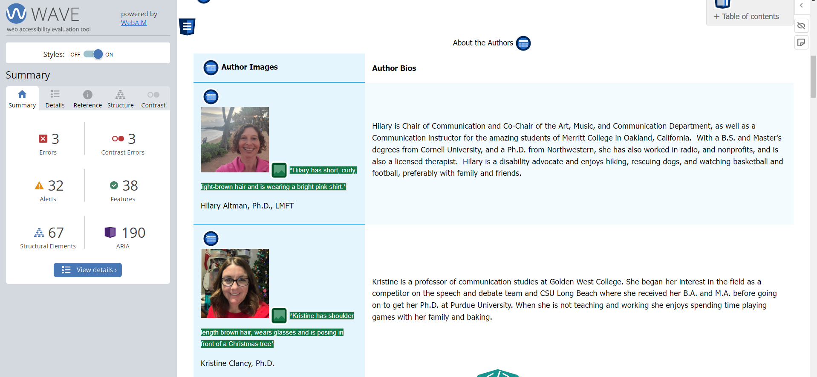
Table for Organizing Information
Notes:
Link to the page: https://socialsci.libretexts.org/Under_Construction/The_Courage_to_Communicate%3A_Understanding_Interpersonal_Communication_Draft_Version/00%3A_Front_Matter/05%3A_About_the_Authors

Slide 29
Table used for layout

Slide 30
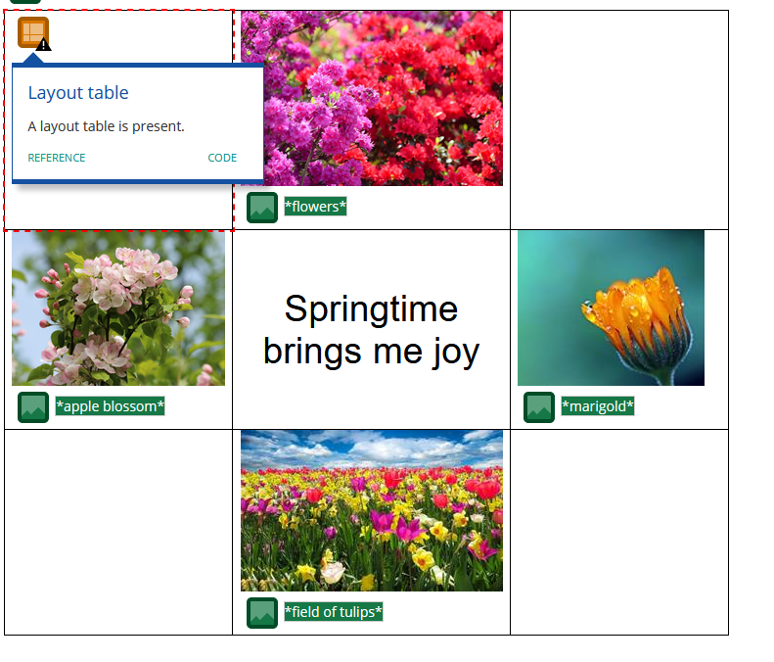
WAVE - Layout Table
Notes:
Attributions:
Ashikaga Flower Park by 雷太 licensed CC BY 2.0
Apple Tree Blossoms by George Chernilevsky; released into the public domain
Field of Tulips by Blende12 via Pixabay License
Marigold by Myriams photos via Pixabay License

Slide 31
Media Elements
Videos should have accurate captions
Autocaptions are not good enough yet
Audio should have transcript
Text should provide context for media elements

Slide 32
Captions
Captions should
be accurate
have punctuation
include all important noises (bells, etc.)
Captions are not transcripts (use both if possible)
Interactive transcript have additional benefits

Slide 33
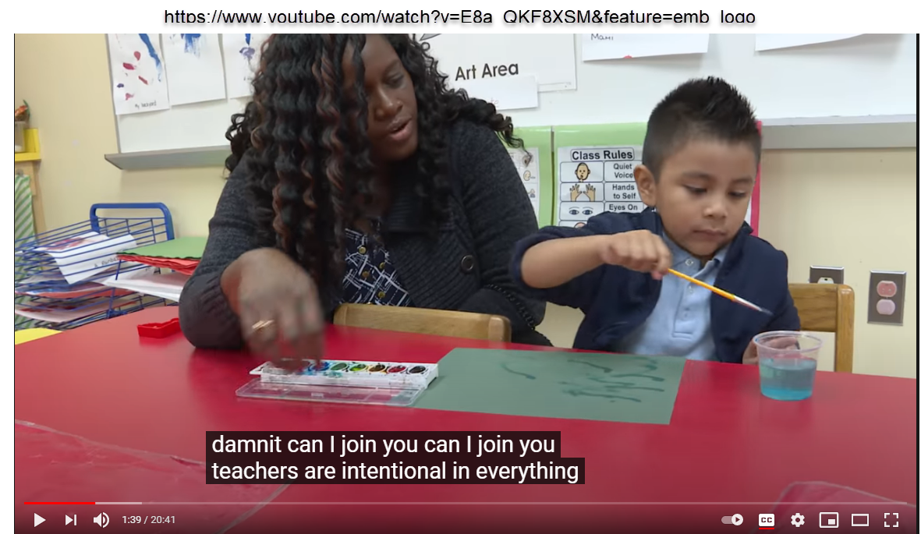
Autocaptions are not good enough
Autocaptions are a good place to start - but then edit them
Caption from screenshot: “damnit can I join you can I join you teachers are intentional in everything”

Slide 34
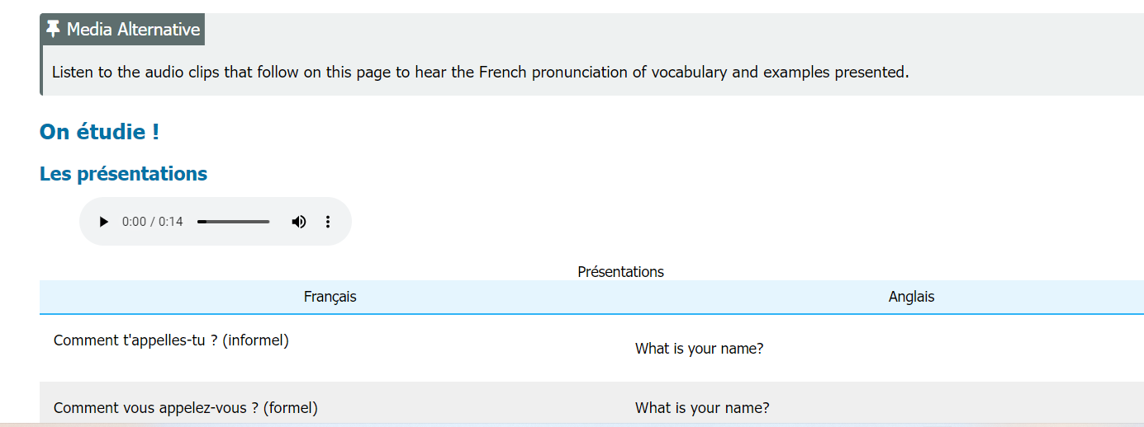
Video and Audio: Context
Notes:
This is an example from a French OER that has multiple audio files for most of the content on the page to help learners hear the French pronunciation. It was therefore advised that the authors put a media note on top to guide a learner usign screen reader what the audio files were about and that their alternative text was right below.
Link to page with audio: https://human.libretexts.org/Bookshelves/Languages/French/French_OER_1_(Carrasco_Zahedi_and_Parrish)/01%3A_Unite_1_-_Bonjour/1.03%3A_Comment_se_presenter

Slide 35
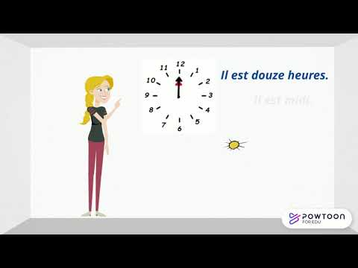
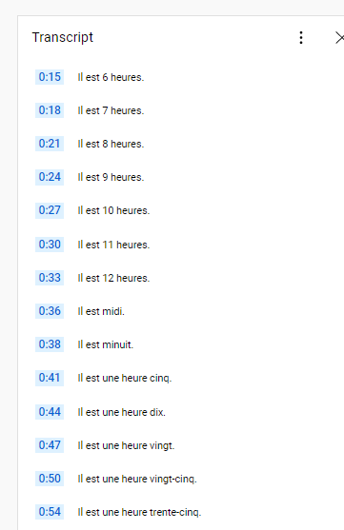
Video and Audio: Transcript
Notes:
Link the LT page with this video: https://human.libretexts.org/Bookshelves/Languages/French/French_OER_1_(Carrasco_Zahedi_and_Parrish)/02%3A_Unite_2_-_A_l'universite/2.04%3A_Quelle_heure_est-il

Slide 36
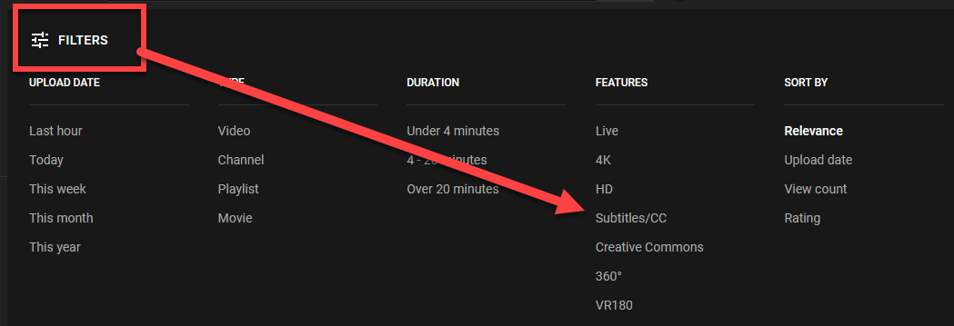
Finding captioned videos
Search for captioned videos
Check to make sure the captions are accurate

Slide 37
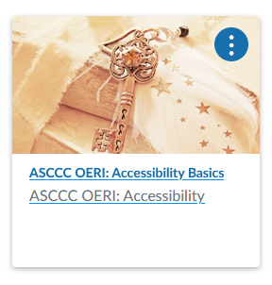
More details and how to create accessible content
Technical Aspects:
Headings and Styles
Alt text
Links
Lists
Tables
Notes:
https://ccconlineed.instructure.com/courses/7893

Slide 38
California Community College Accessibility Center
CCC Accessibility Center
https://cccaccessibility.org/
Self-paced classes and other trainings
Support for campuses
Places to ask questions
Much more!

Slide 39
Questions?
ASCCC OERI

