Slide 1
Searching for Open Educational Resources (OER)
Shagun Kaur and Suzanne Wakim
licensed CC BY 4.0; 2024

Slide 2
OER Basics Series
Date | Title
2/1 | Understanding Open Educational Resources (OER), Copyright, and Fair Use
2/8 | Introduction to Creative Commons Licensing
2/15 | Searching for Open Educational Resources (OER)
2/22 | Evaluating Open Educational Resources (OER) for Accessibility
2/29 | Open Educational Resources (OER) Curation and Advanced Licensing
Notes:
Cathy

Slide 3
Looking for Open Content
Organize
Consider your goals
Keep a record of your searches
Brainstorm
Identify search terms
Course level
Learning Outcomes
Search
Browse broadly - related subject areas
Think big!
Think small!
Searching by ArtsyBee via Pixabay License
Notes:
Think big! Look for complete open courses and textbooks.
Think small! Look for smaller chunks of content.
OER Treasure Hunt Worksheet

Slide 4
Complete Textbook Repositories
Notes:
Cathy

Slide 5
Open Textbook Library
Notes:
https://open.umn.edu/opentextbooks/

Slide 6
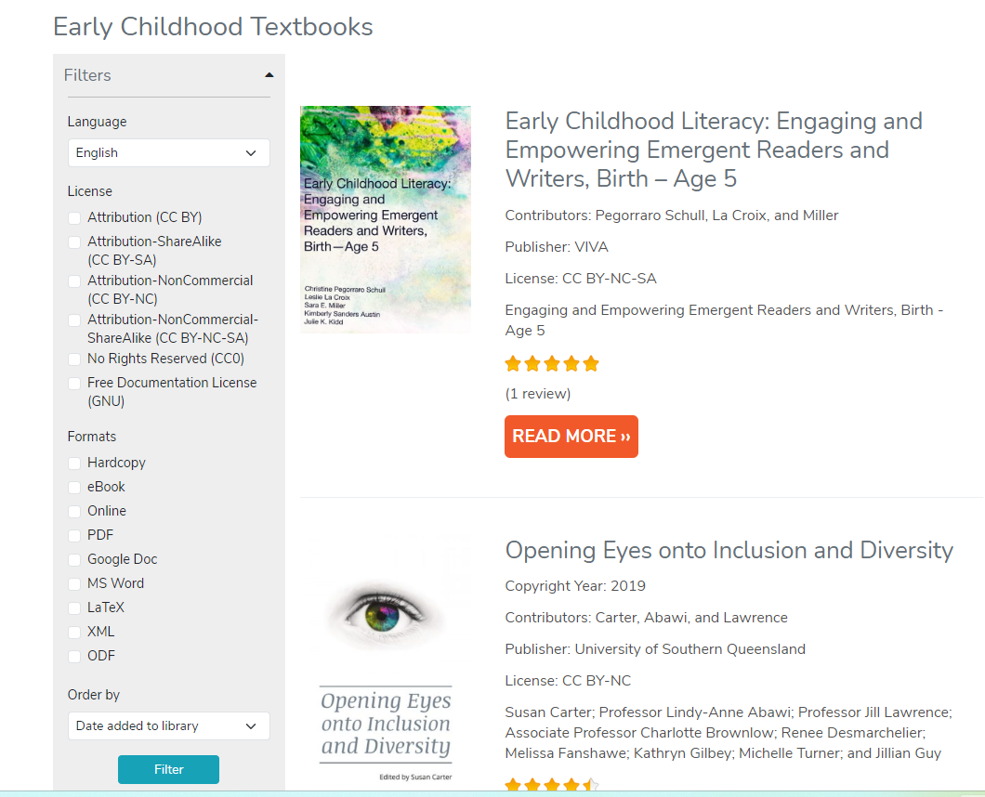
Open Textbook Library
Narrow down resources by:
License type or Formats
Language
Ancillary Materials
Reviews

Slide 7
Openstax
Professionally written and peer reviewed
Has ancillaries for instructors
Resources section for students
Notes:
Look at the Biology for AP book
https://openstax.org/

Slide 8
Looking at openstax
Notes:
11:40

Slide 9
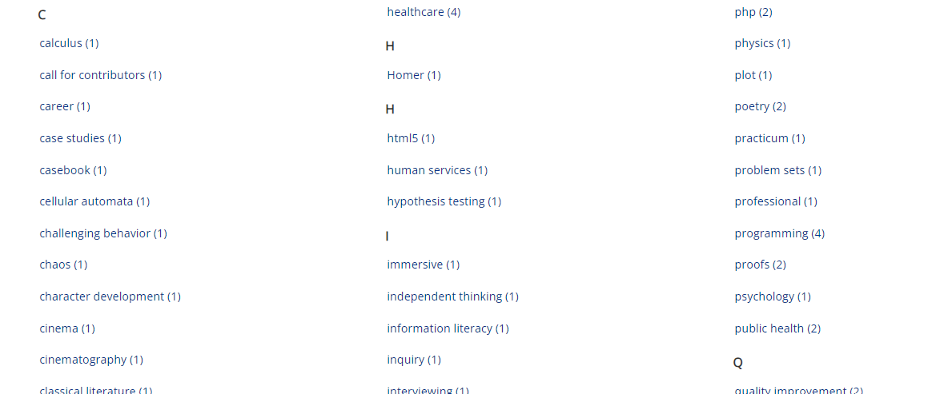
Looking at Milne Open Textbooks
Notes:
https://milneopentextbooks.org/

Slide 10
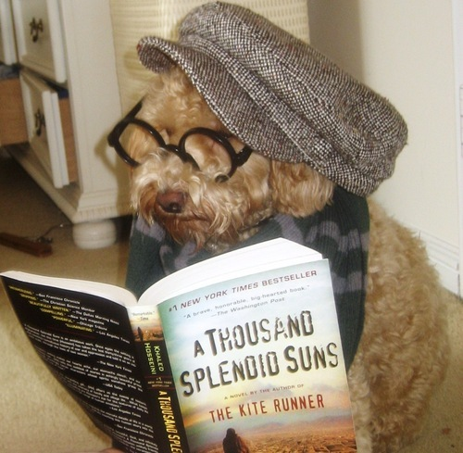
Pause for exploration or Q and A
Hipster Dog by Volkan berber is licensed CC BY-SA 4.0
Notes:
11:45-11:50

Slide 11
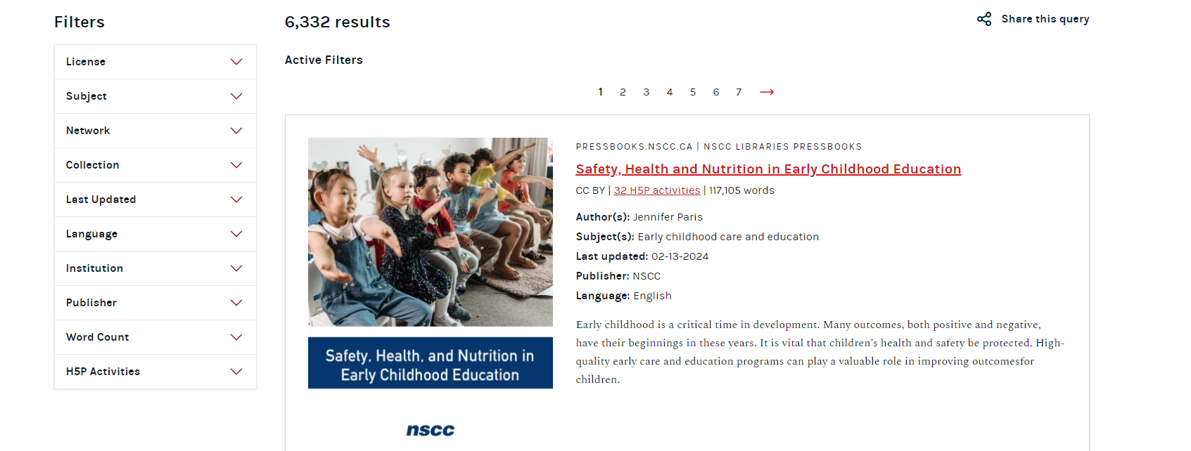
Other Textbooks sites
B.C. Open Collection
Oasis [Openly Available Sources Integrated Search] Genesco
PressBooks

Slide 12
Highly Curated

Slide 13
ASCCC OERI
Notes:
https://asccc-oeri.org/

Slide 14
Curated OER Collections

Slide 15
OER by Discipline

Slide 16
OER by TMC

Slide 17
OER by GE

Slide 18
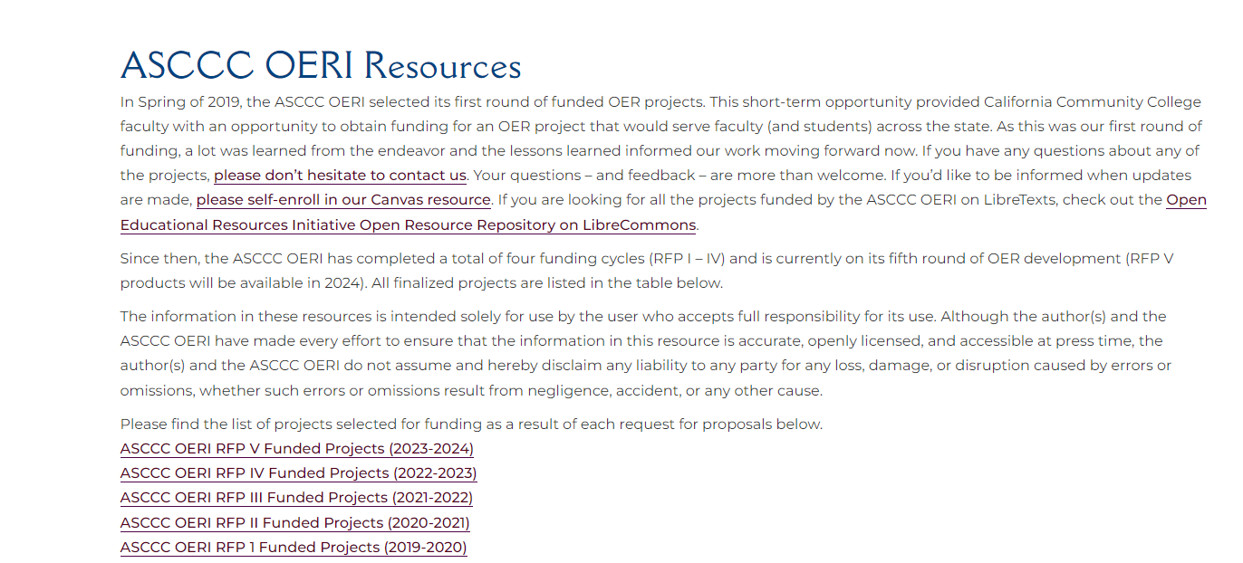
ASCCC OERI Resources

Slide 19
Pause for exploration or Q and A
Dog Intelligence by alicejamieson is licensed CC BY-NC-ND 2.0

Slide 20
Open Oregon
Aggregates proprietary and openly licensed materials by:
Course name
Course Materials
Institution
Instructor information
Notes:
http://openoregon.org/resources/

Slide 21
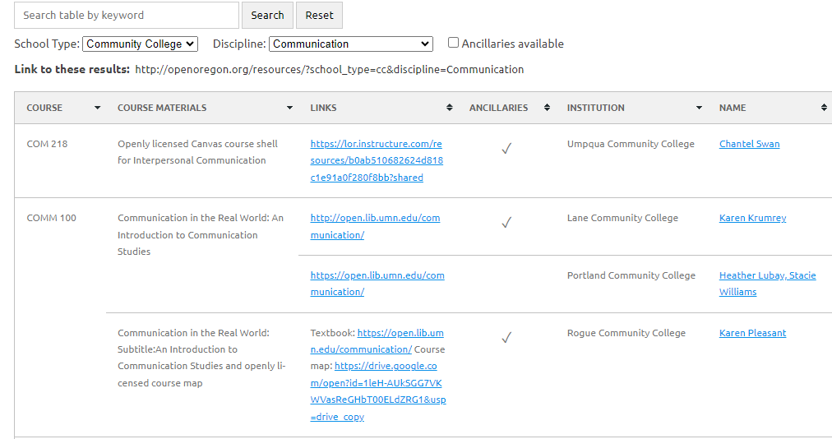
Looking at Open Oregon

Slide 22
Cool4Ed
California Open Online Library for Education aggregates searches across several collections.
Find Materials, look at faculty showcases

Slide 23
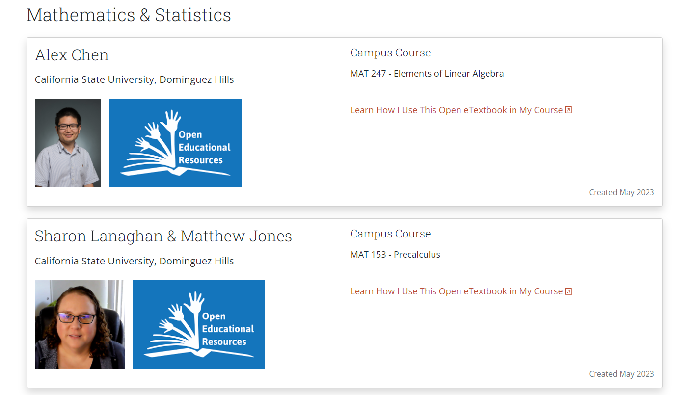
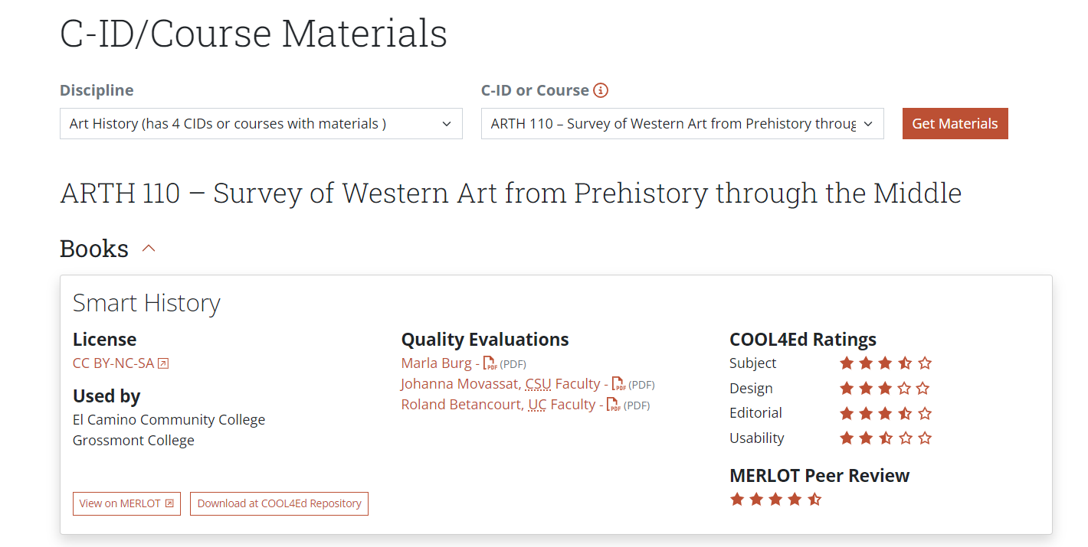
Looking at Cool4Ed

Slide 24
Pause for exploration or Q and A
Dog Reads Newspaper? by steve eng is licensed CC BY-SA 4.0

Slide 25
Large Collections

Slide 26
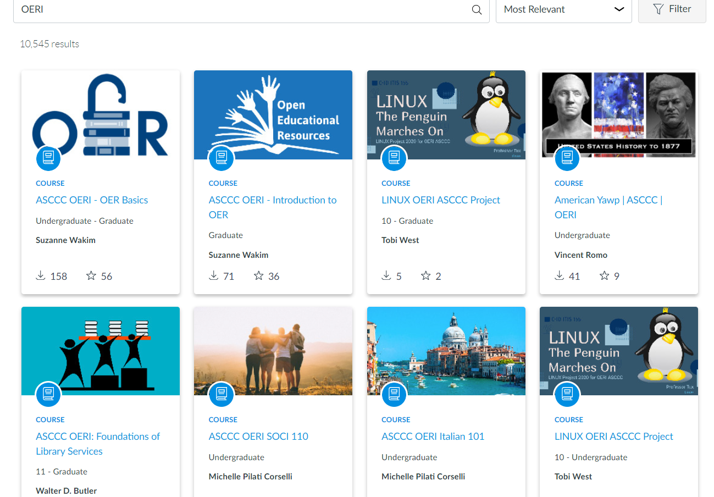
OERI in Canvas Commons
Notes:
https://lor.instructure.com/

Slide 27
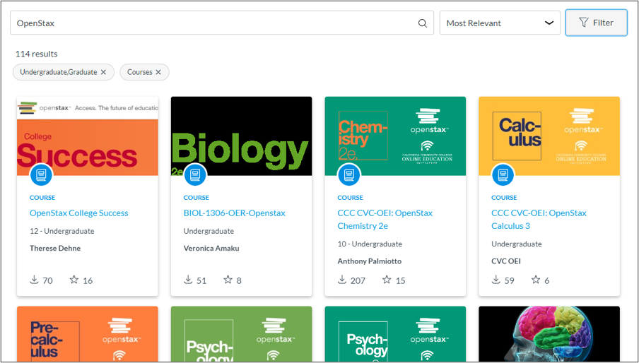
OpenStax is also in Canvas Commons

Slide 28
Pause for exploration or Q and A
Dog Wearing Eyeglasses by Sam Lion via Pexels license

Slide 29
OER Commons
Suggestion: Use limiters!
Also has building platform

Slide 30
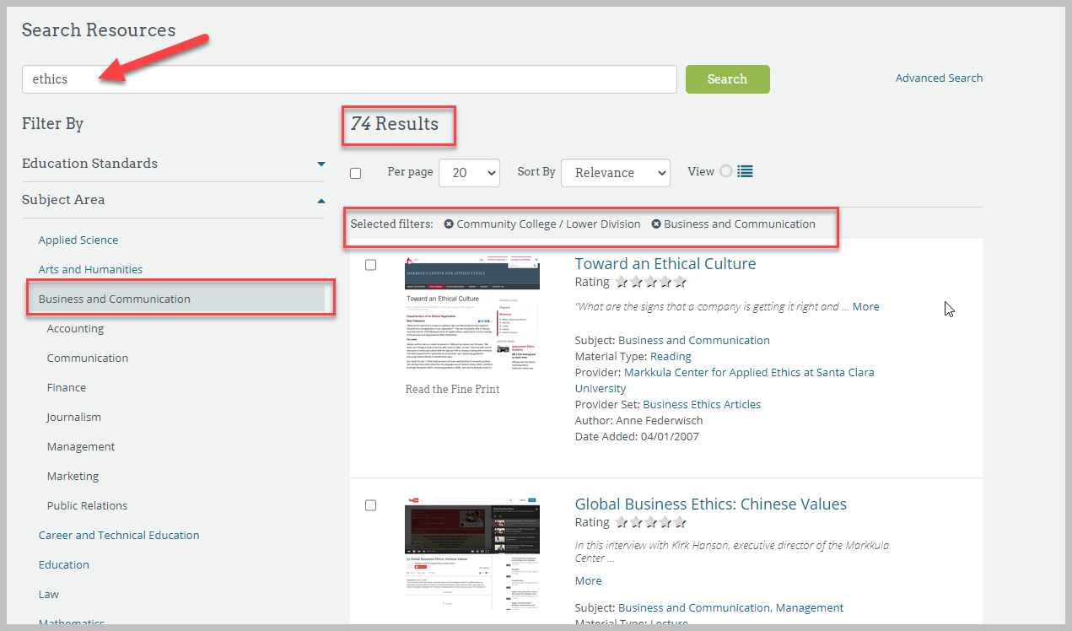
Looking at OER Commons

Slide 31
Skills Commons
Workforce Training Materials.
Expansion through Trade Adjustment Assistance for Community Colleges and Career Training (TAACCCT) grant
“View Showcases”
Notes:
Carolyn

Slide 32
Looking at Skills Commons

Slide 33
Mason OER Metafinder
Notes:
Instead, the OER Metafinder launches a real-time, simultaneous search across 22 different sources of open educational materials as you hit the Search button.
Step 1: Go to the Mason OER Metafinder.
Step 2: Type your search terms into the various search boxes.
Step 3: Include or exclude sources/platforms as necessary.
Step 4: Click Search.
Step 5: Use the Refine by options to limit and target results

Slide 34
Content Creators

Slide 35
LibreTexts
A repository of OER
Supports remixing, curating and authoring of OER.
Extensive features from textbooks, homework solution to learning platform.
Can “easily” remix various books together.
Editable and importable.
Notes:
Shagun
Spend time here!

Slide 36
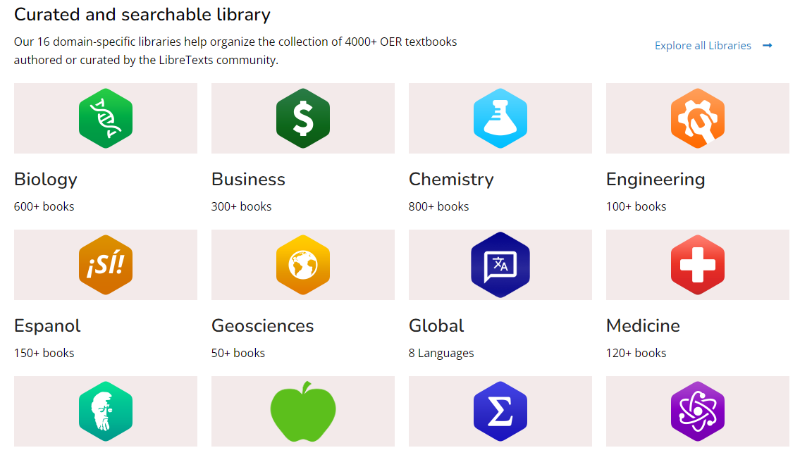
LibreTexts homepage

Slide 37
In the Libraries
Campus Bookshelves: Curated/Created books by college.
Bookshelves : Breaks down the discipline sin the Library.
Learning Objects: Public ancillaries. Conductor is better.

Slide 38
Campus Bookshelves

Slide 39
Bookshelves: Social Sciences

Slide 40
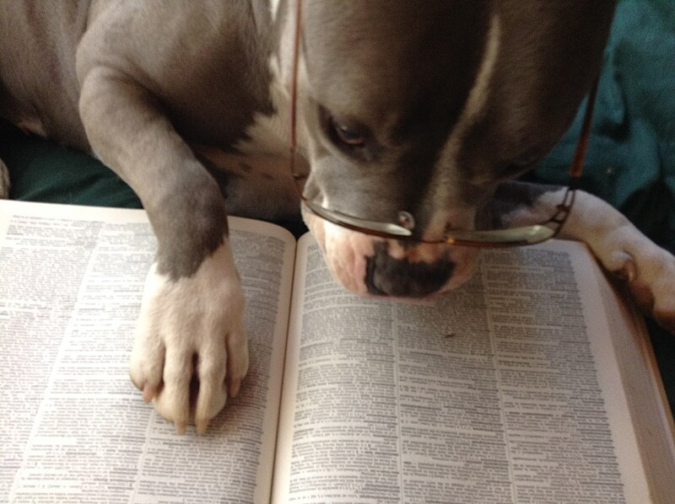
Pause for exploration or Q and A
Studious Puppy by WaSu-Bio is licensed CC-BY 4.0

Slide 41
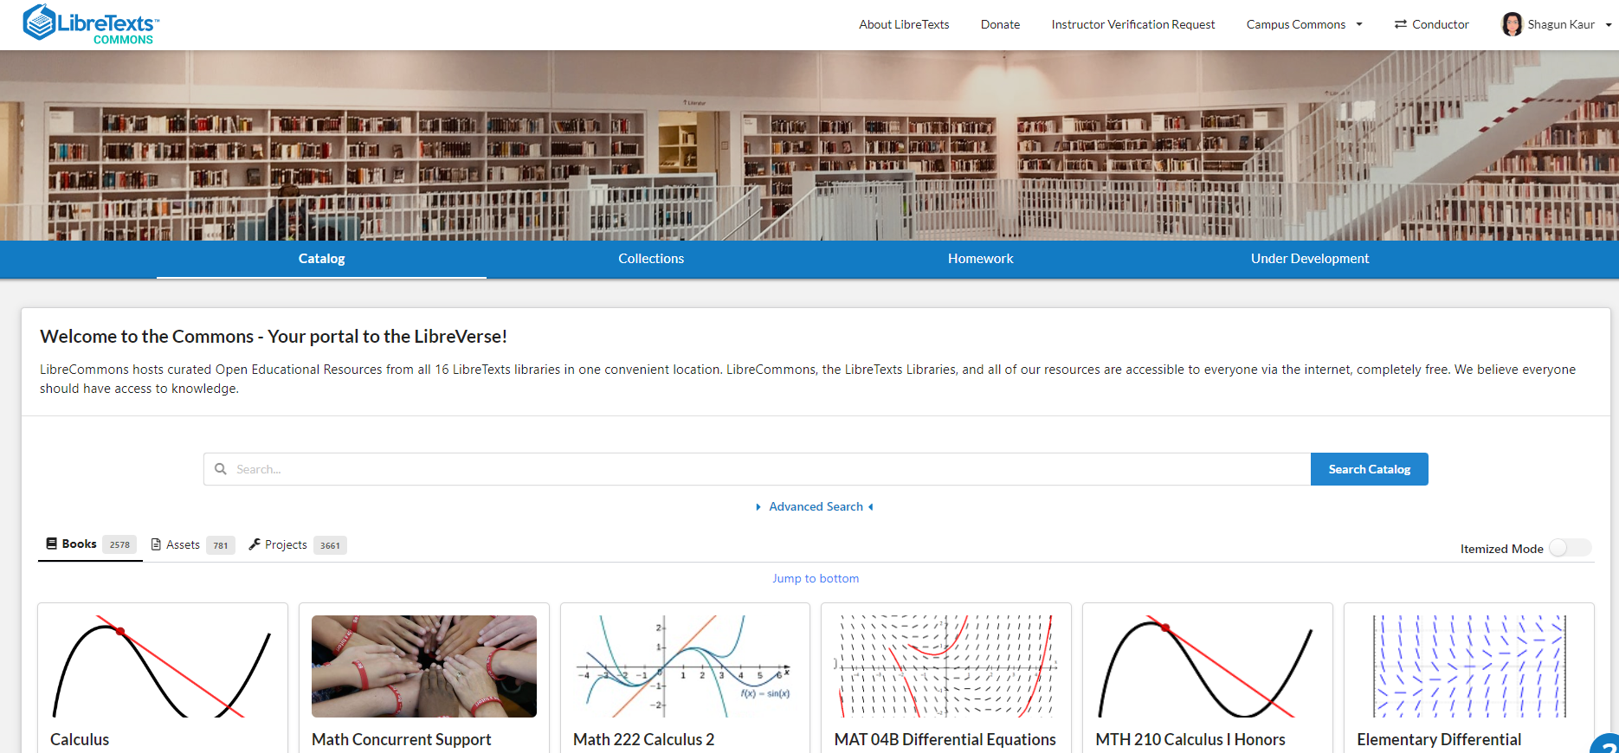
LibreTexts Commons
Notes:
https://commons.libretexts.org/

Slide 42
Finding small bits of things to add
Notes:
? switch ?

Slide 43
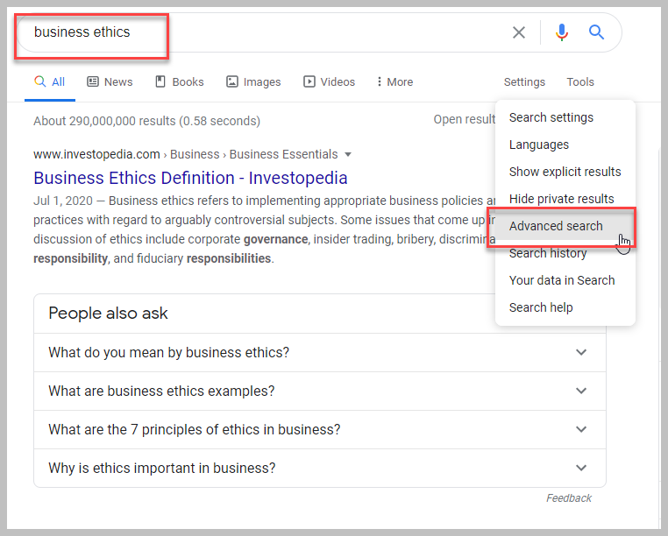
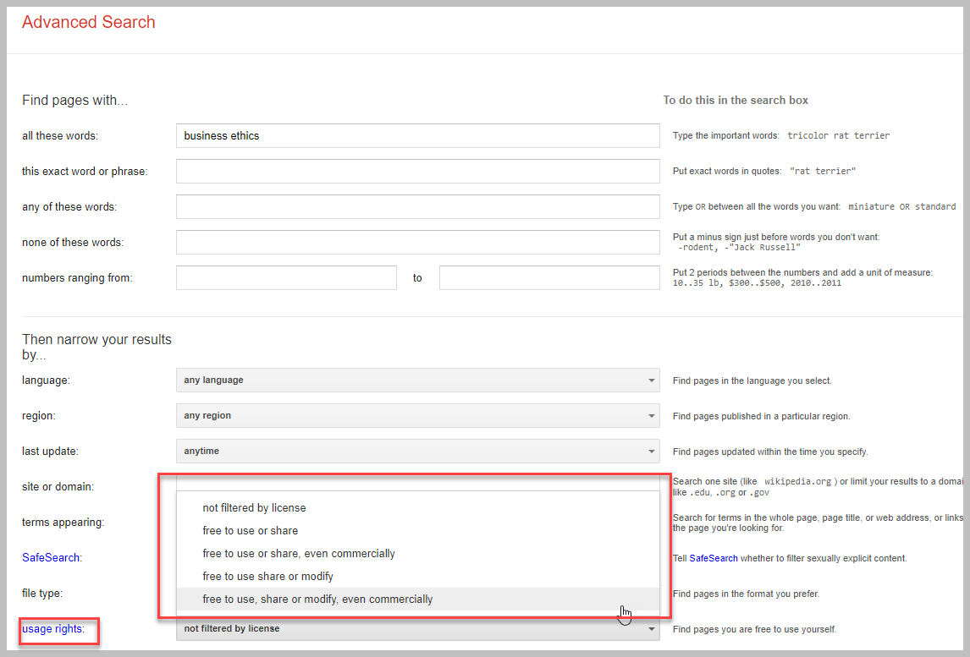
Looking at Advanced Google Search
Notes:
Advanced option is under “settings” or “tools”
Select “usage rights”
Add lots of limiters

Slide 44
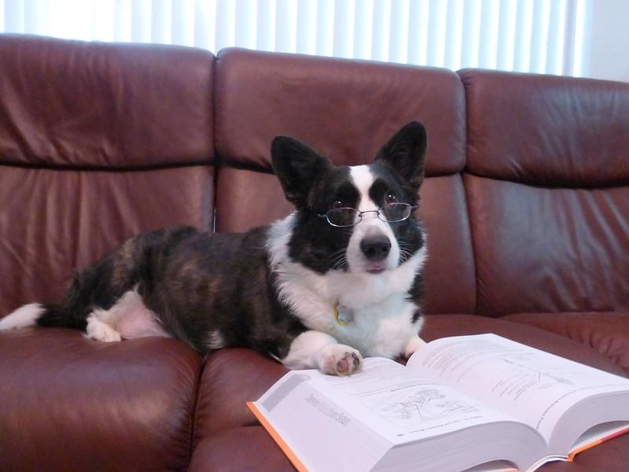
Pause for exploration or Q and A
The Book Dog by Jessica B. is licensed CC BY-NC-SA 2.0

Slide 45
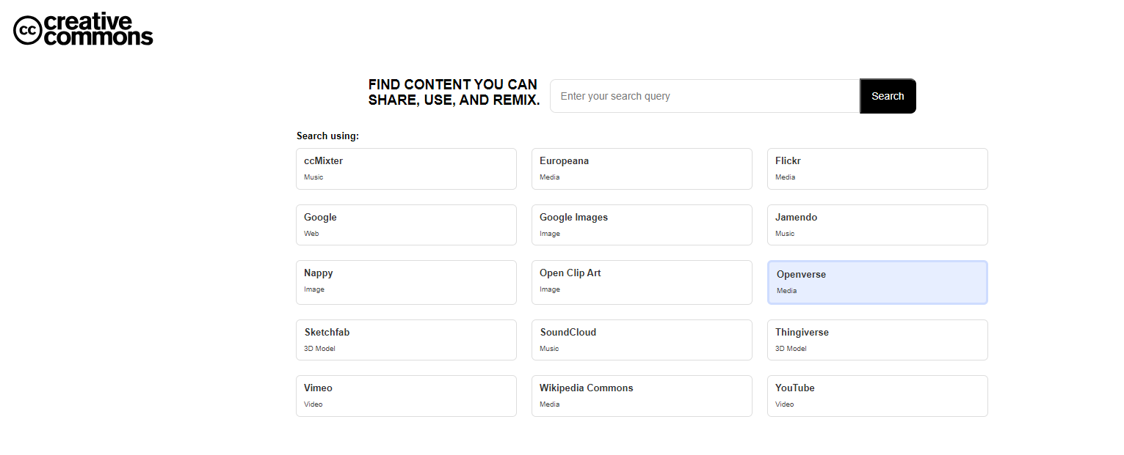
Creative Commons Search Portal
Notes:
https://search.creativecommons.org/

Slide 46
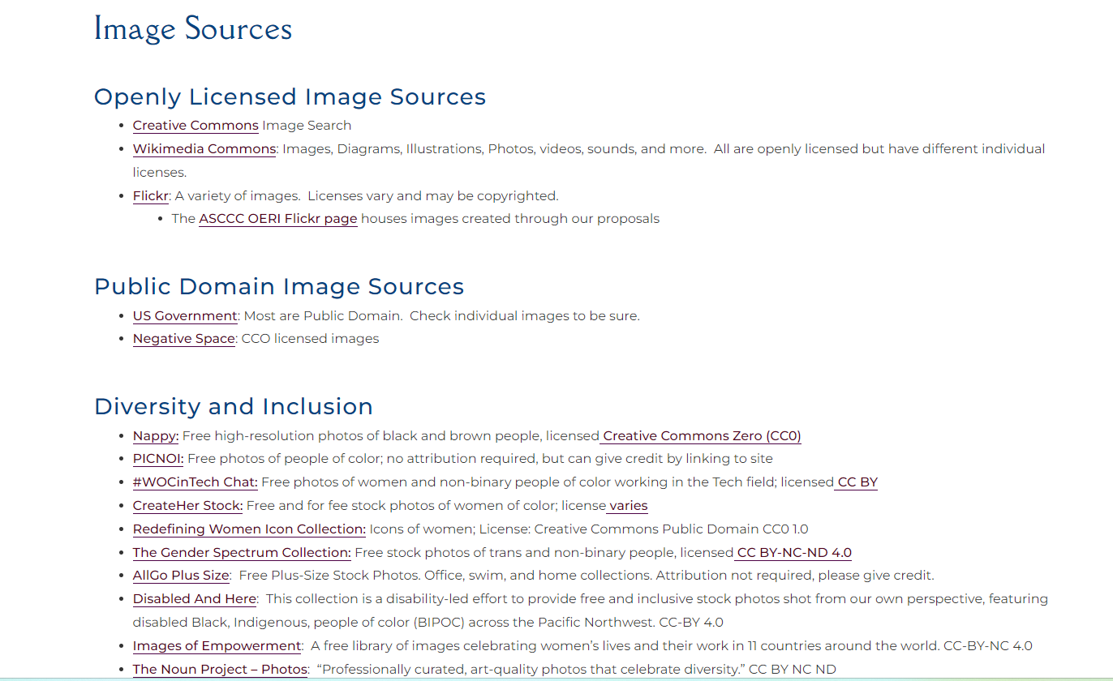
Images

