Slide 1
Understanding Open Educational Resources (OER), Copyright, and Fair Use
by Shagun Kaur and Suzanne Wakim licensed CC BY 4.0; 2024
adapted from Creative Commons, Copyright, and Fair Use – Why do we need OER? by Rachel Arteaga; CC BY 4.0
Notes:
Are you new to OER and interested in learning more? This webinar is an introduction to what OER is and the difference between “open" and "free" resources, copyright basics, and the concept of fair use.

Slide 2
Topics
Copyright
Fair Use (and its place in OER)
What is OER
Public Domain
California-specific: ZTC vs. OER
Attribution vs. Citation

Slide 3
What Is Copyright?
Exclusive set of rights for creators to copy, distribute, perform, adapt or use the work
Someone controls the copyright - creator, organization, employer
Copyright holder grants permission to use work
Copyright law is complicated in ways that cannot be quickly covered.

Slide 4
What Does Copyright Protect?
Copyright protects original and unique works in a tangible medium. For example:
Literary and artistic works
Translations, adaptations, arrangements
Collections of literary and artistic works
Applied art and industrial designs and models
Computer software

Slide 5
What Is NOT Covered by Copyright
Other forms of intellectual property are covered by Trademarks and Patents, others are not considered intellectual property. Examples of what’s not covered by copyright: ideas, facts, discoveries, recipes, procedures, processes, systems, methods of operation, concepts, principles

Slide 6
Additional Copyright Information
Copyright is automatic from the moment of creation
In the United States, copyright lasts the length of the author’s life plus 70 years (longer for copyrights held by corporations)
Copyright laws and length vary by country

Slide 7
Pop Quiz - True or False
Copyright protects the people who photocopy materials for classroom use
False
A teacher can copy up to 35% of a work for their students
False
You can upload a YouTube video explaining a core classroom concept on Canvas because it is for education
False
Giving credit to the source protects you from copyright infringement
False
You can use up to 30 seconds of a song and 10% of a picture without infringing copyright
Maybe
Notes:
Shagun and Suzanne
Copyright does not protect the people who photocopy materials for classroom use. Instead, it protects the creators of original works by giving them exclusive rights to reproduce, distribute, and display their works. The act of photocopying copyrighted materials without permission or proper licensing is generally considered a violation of copyright law.
Teachers can photocopy up to 1,000 words or 10% of a prose work for their students. This limit is in place to ensure that copyright laws are upheld and that the author's rights are respected. By photocopying only a small portion of the work, teachers can provide their students with relevant excerpts while still adhering to legal guidelines.
Linking out is a better option
Just giving credit isn’t enough to protect you against copyright. It’s still infringement if you use someone else’s work without their permission. To avoid copyright infringement, make sure you get permission from the copyright owner before you use their work!
Even using a tiny portion of a copyrighted work can be infringement (even if it’s just playing in the background)! That’s why so many videos get taken down from YouTube. Try to get permission from the copyright owner or use works in the public domain to be safe!
https://www.washburn.edu/statements-disclosures/copyright/faculty-staff/quizzes/index.html
All about CC licenses can be found in the CC book used for the certification course: https://certificates.creativecommons.org/cccertedu/chapter/1-what-is-creative-commons/

Slide 8
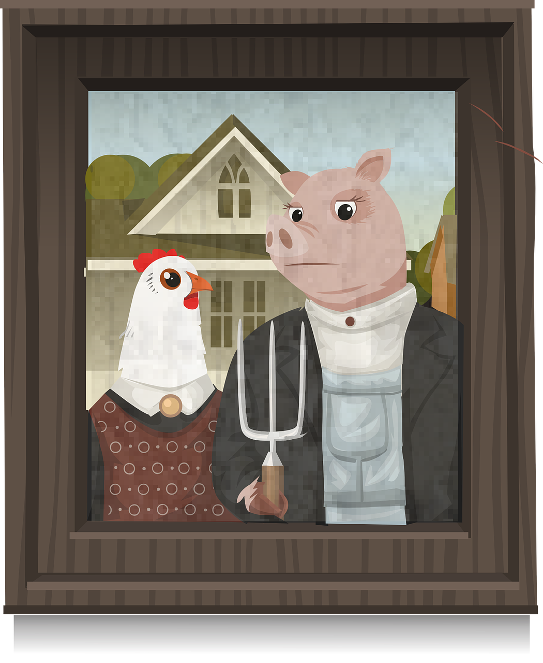
Exceptions or Limitations to Copyright
Criticism
Quoting Research
Parody
Access for the visually impaired
Other “fair” uses
Notes:
American Gothic Parody from Pixabay

Slide 9
What is Fair Use?
“Fair use is a legal doctrine that promotes freedom of expression by permitting the unlicensed use of copyright-protected works in certain circumstances. Section 107 of the Copyright Act provides the statutory framework for determining whether something is a fair use and identifies certain types of uses—such as criticism, comment, news reporting, teaching, scholarship, and research—as examples of activities that may qualify as fair use.”
More Information on Fair Use, Copyright.gov
Notes:
Some more resources on Copyright
UMN: Thinking Through Fair Use.​
Stanford University: Measuring Fair Use​
University of Washington: Guidelines for Fair Use in Education​
ALA Fair Use Evaluator

Slide 10
Fair use & OER - Examples
Fair Use ✔️
Not Fair Use ❌
Quoting research studies in the field
Screenshots showing students how to use tools
Short excerpts from different magazines showing differences in grammar
The 10% rule is a MYTH
A chapter from a textbook not used in the class
Short excerpts from National Geographic showing different kinds of maps
Notes:
For information on the TEACH act: https://guides.lib.utexas.edu/copyright/forms

Slide 11
Four Factors of Fair Use
Fair Use is a “framework” that must be looked at for each use. The four factors must be considered in totality and do not offer a definitive or legal answer.
Purpose and character of the use
Nature of the original work
Amount and substantiality of the portion used
Effect of the use on the potential market for or value of the source work

Slide 12
Fair Use Cautions
Legally complicated
Citing or acknowledging the source does not make your use fair
Case by case basis
Guidelines, not rules
Don’t rely on it to legally protect you
If you think your use is fair use a resource to help you decide
Notes:
See toolkit for links

Slide 13
Pause for Processing
Questions?

Slide 14
What are Open Educational Resources?
“OER are teaching, learning, and research resources that reside in the public domain or are released under an intellectual property license that permits their free use and repurposing by others”
-- Hewlett Foundation
Notes:
Carolyn

Slide 15
The 5R Permissions of OER
Retain - Make and own copies
Reuse - Use in a wide range of ways
Revise - Adapt, modify, improve
Remix - Combine with other sources
Redistribute - Share with others
The framework, freely available under a Creative Commons Attribution 4.0 license (CC BY), was designed by Lumen Learning as the 5Rs
Notes:
About the Licenses: https://creativecommons.org/share-your-work/cclicenses/

Slide 16
Creative Commons
Provides free, easy-to-use copyright licenses designed to make a simple and standardized way to give the public permission to share and use creative work.
Licenses work within existing copyright laws but are more “open” - they will tell you which, if any, of the 5R’s apply.
Notes:
Carolyn

Slide 17
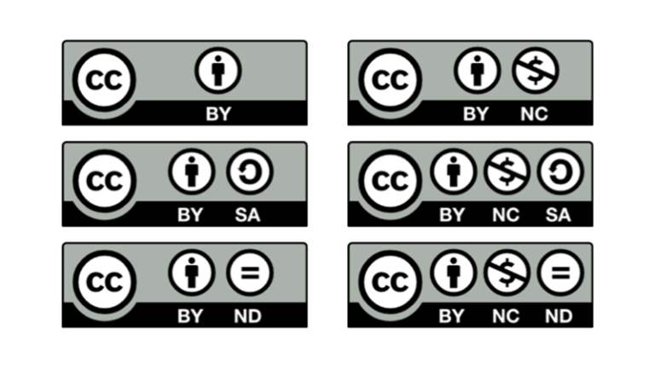
Creative Commons Licenses

Slide 18
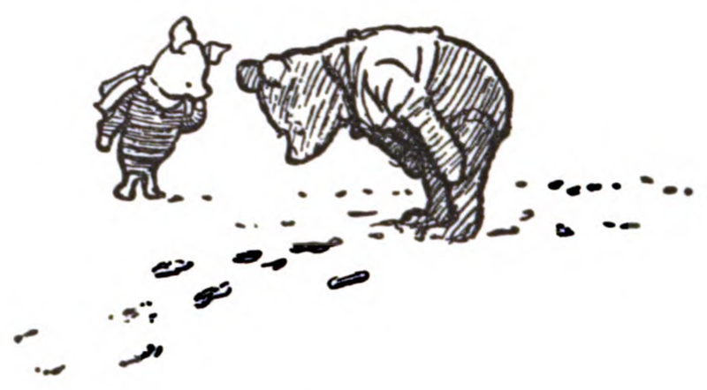
Public Domain
Not subject to copyright protections
Copyright has expired
Dedicated to the public domain (CC0)
Notes:
Winnie the Pooh image source
An comprehensive article on Public Domain: https://fairuse.stanford.edu/overview/public-domain/welcome/

Slide 19
California - ZTC v. OER
ZTC ✔️
Not ZTC ❌
Using library resources
Linking out to copyrighted online material
Photocopying pages of a textbook
Importing copyrighted online content into your Canvas shell

Slide 20
Pause for Processing Pt 2
Questions?

Slide 21
Attribution v. Citation
We are familiar with citing sources (MLA, APA, etc.)
Identify and cite any source you are using under fair use
Attribution is for creating OER and has a different purpose

Slide 22
T A S L
CC Blue Heart by Creative Commons Corportation; licenced under CC BY 4.0
Title: CC Blue Heart
Link to Location: https://commons.wikimedia.org/wiki/File:CC_blue_heart.png
Author: Creative Commons Corporation
Author Page: https://stateof.creativecommons.org/
License: CC BY 4.0
Link to license: https://creativecommons.org/licenses/by/4.0/deed.en

Slide 23
Questions?
ASCCC OERI or oeri@asccc.org

